Slide 1
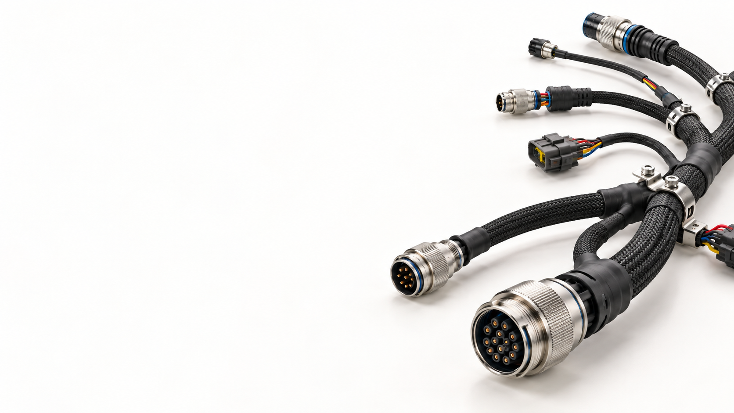
Harness
Design Platform
Connected harness engineering
across systems and projects
Investor presentation
Working product name October 2026
Notes:
Product evidence: current native Windows app, development build captured on 10 October 2026. Sources: README.md, CLAUDE.md, src/app/MainWindow.cpp, src/app/Editor.h, src/render/CanvasWidget.cpp, src/system/SystemDesign.cpp, src/app/BrickWizardDialog.cpp and src/app/View3DPane.h in C:/Work/AI/Edraw_desktop. Screenshots show example data and current implementation. They do not establish production maturity or certified compliance. The current executable is named Edraw. The deck uses the user-selected working title. Supporting backgrounds are AI-generated conceptual harness illustrations, not customer products or app-generated harnesses.

Slide 2
The investment proposition
A common harness design practice
across systems and projects
A working design core
Visible drawing confidence
System and project teams
System diagrams, schematics, mechanical harness authoring and 3D visualization already exist.
Saved validation status and project checks expose missing or outdated engineering evidence.
Hardware startups, defense suppliers and system builders need common wiring practices across projects.
Current stage: active product development. Commercial traction and production readiness remain to be demonstrated.
02
Notes:
Product evidence: current native Windows app, development build captured on 10 October 2026. Sources: README.md, CLAUDE.md, src/app/MainWindow.cpp, src/app/Editor.h, src/render/CanvasWidget.cpp, src/system/SystemDesign.cpp, src/app/BrickWizardDialog.cpp and src/app/View3DPane.h in C:/Work/AI/Edraw_desktop. Screenshots show example data and current implementation. They do not establish production maturity or certified compliance. User-proposed pricing and a five-role hiring plan inform the commercial slides. No customer or revenue traction was supplied. Supporting backgrounds are AI-generated conceptual harness illustrations, not customer products or app-generated harnesses.

Slide 3
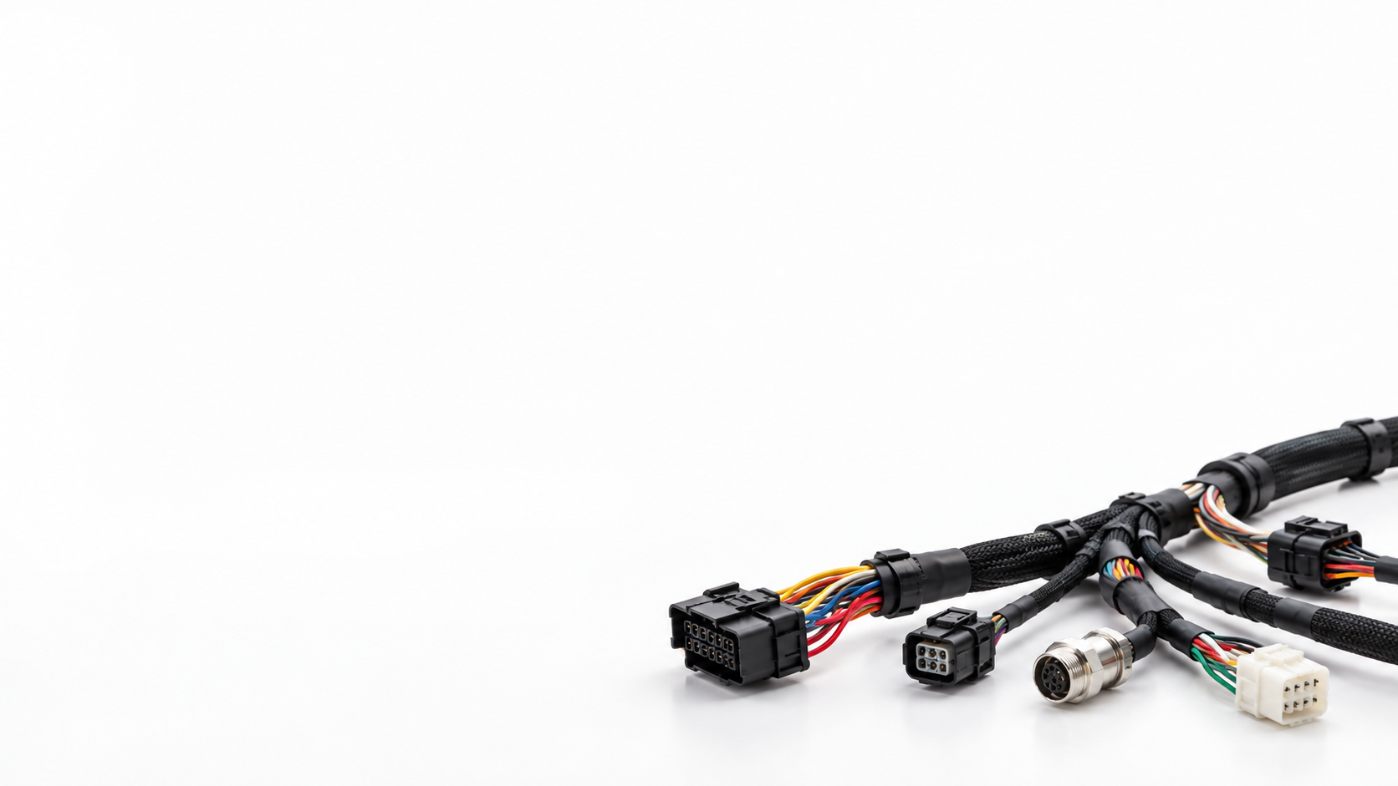
Who the platform serves
Every company that designs systems with harnesses
Customer group | Harness design need
Hardware startups / high tech | Device prototypes and repeatable wiring
Defense / aerospace suppliers | Interfaces and harnesses for complex systems
Hardware and system builders | Wiring for equipment, machines and devices
Project firms / integrators | Common designs across customer projects
Harness manufacturers | Buildable harness definitions
Qualifying buyers design hardware with harnesses, interfaces or cabinet wiring
03
Notes:
Primary positioning supplied by the project owner: small and midsize companies that build systems containing harnesses, especially firms running many projects. Harness suppliers are another customer segment. Industry examples are targeting hypotheses, not claimed customers. Primary context sources: https://www.zuken.com/en/solution/electrical-technologies/manufacturing-and-service-documentation/ and https://www.siemens.com/en-us/products/designcenter/cad-software/electronic-electrical-cad/wire-harness-design/ Supporting backgrounds are AI-generated conceptual harness illustrations, not customer products or app-generated harnesses.

Slide 4
Common harness engineering across projects
Reusable engineering assets become a company practice
Common definitions
Project-specific designs
Controlled evolution
Reuse connector data, drawing templates and engineering rules instead of rebuilding the same information.
Apply a common approach to each system while preserving the project drawing identity and revision.
Build a managed harness catalog and revision-impact review as the company ecosystem grows.
Common assets reduce repeated work and improve project consistency
Today: local design reuse. Roadmap: controlled common designs and revisions across projects.
04
Notes:
Product evidence: current native Windows app, development build captured on 10 October 2026. Sources: README.md, CLAUDE.md, src/app/MainWindow.cpp, src/app/Editor.h, src/render/CanvasWidget.cpp, src/system/SystemDesign.cpp, src/app/BrickWizardDialog.cpp and src/app/View3DPane.h in C:/Work/AI/Edraw_desktop. Screenshots show example data and current implementation. They do not establish production maturity or certified compliance. Current reuse tools include parts, templates, blocks and saved harness wizard designs. A managed corporate harness catalog, controlled variants, automatic project-wide change propagation and approvals are proposed, not existing live collaboration features. Supporting backgrounds are AI-generated conceptual harness illustrations, not customer products or app-generated harnesses.

Slide 5
The engineering problem
Repeated harness work grows
with every new project
Repeated data
Manual reconciliation
Unclear release state
Teams repeat connector data, harness layouts and drawing details across systems and projects.
Project drawings can disagree when teams copy information and revise it separately.
A check performed before an edit can look valid after the drawing has changed.
05
Notes:
Problem framing is a product hypothesis to validate through interviews. It is not a quantified customer survey or a claim that every harness organization uses disconnected tools. Supporting backgrounds are AI-generated conceptual harness illustrations, not customer products or app-generated harnesses.

Slide 6
The harness engineering ecosystem
Engineering stage | Current capability | Status
Project architecture | Nested units, ports, cables and drawings | Available
Schematic design | Connectors, conductors and schematic DRC | Available
Harness design | Wizard, dimensions, coverings and BOM | Available
3D engineering | 3D file import, route and length checks during design | Available
Data and checks | Parts, search and saved drawing checks | Available
Electrical CAB wiring | Cabinet components, terminals and wire routing | Proposed
Release management | Approvals, revision compare and PLM / ERP | Proposed
Available = implemented in the current development build. Proposed = future product work.
06
Notes:
Product evidence: current native Windows app, development build captured on 10 October 2026. Sources: README.md, CLAUDE.md, src/app/MainWindow.cpp, src/app/Editor.h, src/render/CanvasWidget.cpp, src/system/SystemDesign.cpp, src/app/BrickWizardDialog.cpp and src/app/View3DPane.h in C:/Work/AI/Edraw_desktop. Screenshots show example data and current implementation. They do not establish production maturity or certified compliance. Future modules follow docs/proposed-project-functions.md and the user’s ecosystem planning request. Separate modules currently share a desktop workspace, but this does not imply a fully synchronized single-model lifecycle. Supporting backgrounds are AI-generated conceptual harness illustrations, not customer products or app-generated harnesses.

Slide 7
Proposed Electrical CAB wiring module
Control cabinet wiring within the same project ecosystem
Design area | Proposed capabilities
Components and layout | Cabinet equipment, DIN rails and terminal strips
Wiring definitions | Wire numbers, terminals and from/to connections
Physical routes | Duct routes, wire lengths and segregation checks
Common project data | Reusable cabinet definitions and drawing details
Purpose: consistent harness and cabinet interfaces across complex systems
Proposed module. Detailed functionality, pricing and delivery milestones still need definition.
07
Notes:
User-requested proposal. CAB is interpreted as electrical cabinet / control-panel wiring. This is a planned module, not an implemented or demonstrated feature. Industry context: https://www.zuken.com/en/product/e3series/cabinet-layout-and-routing/ The competitor source supports the cabinet workflow category, not functionality of this app. Supporting backgrounds are AI-generated conceptual harness illustrations, not customer products or app-generated harnesses.

Slide 8
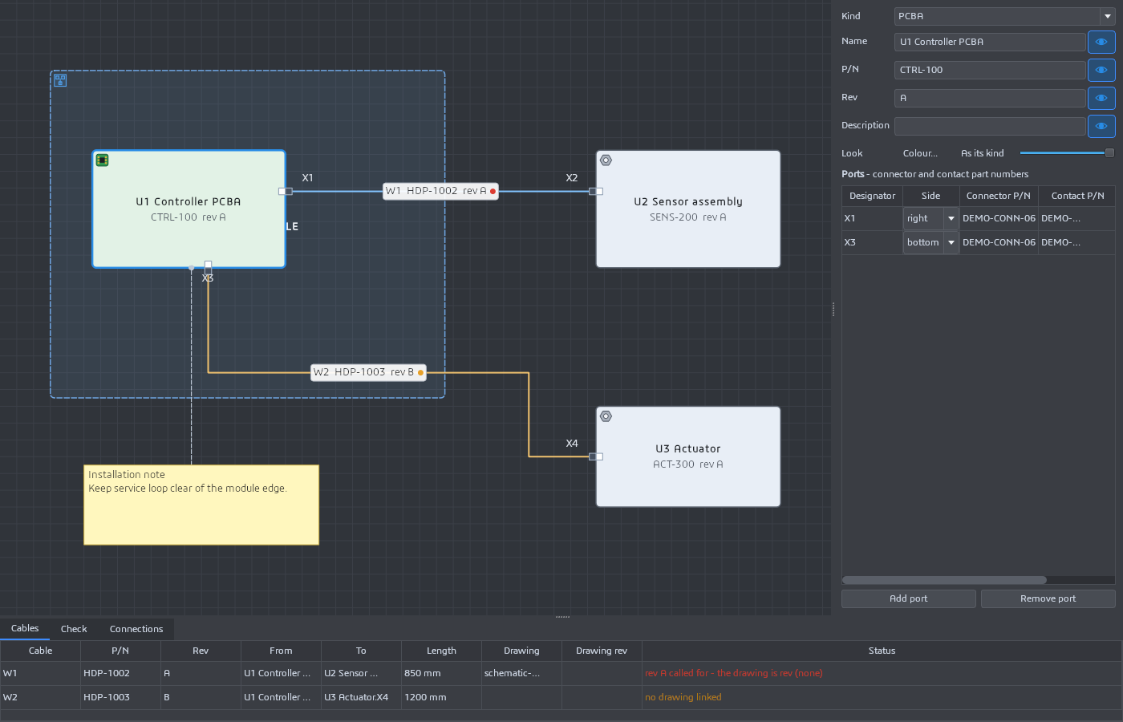
System design and project architecture
Nested units
and modules
Connector and contact data
live on each port.
Cables link to a drawing,
P/N and revision.
Notes attach to objects.
08
Notes:
Product evidence: current native Windows app, development build captured on 10 October 2026. Sources: README.md, CLAUDE.md, src/app/MainWindow.cpp, src/app/Editor.h, src/render/CanvasWidget.cpp, src/system/SystemDesign.cpp, src/app/BrickWizardDialog.cpp and src/app/View3DPane.h in C:/Work/AI/Edraw_desktop. Screenshots show example data and current implementation. They do not establish production maturity or certified compliance. Example data: a control module containing a controller PCBA, connected to a sensor and actuator. Cable identifiers, lengths and parts are illustrative. Supporting backgrounds are AI-generated conceptual harness illustrations, not customer products or app-generated harnesses.

Slide 9
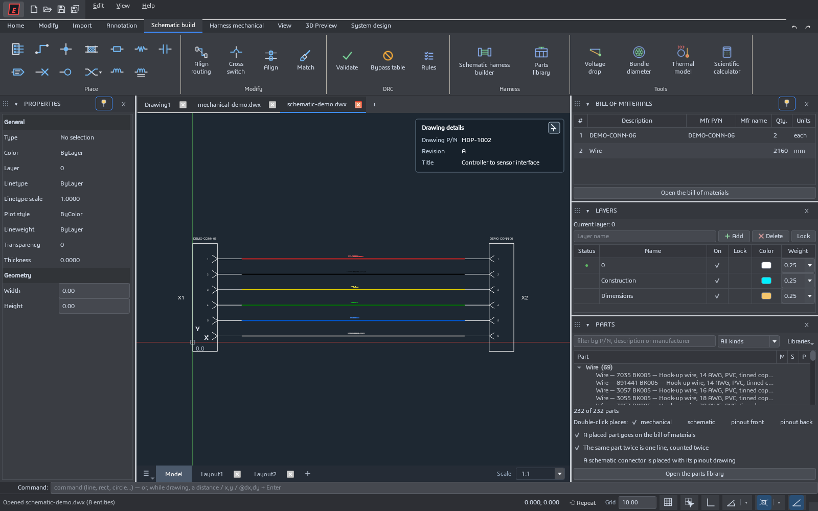
Electrical schematic design
Contact-level
connectivity
Connectors, named wires,
splices, shields and twists.
Align and adjust routes.
Find schematic issues
and jump to the object.
09
Notes:
Product evidence: current native Windows app, development build captured on 10 October 2026. Sources: README.md, CLAUDE.md, src/app/MainWindow.cpp, src/app/Editor.h, src/render/CanvasWidget.cpp, src/system/SystemDesign.cpp, src/app/BrickWizardDialog.cpp and src/app/View3DPane.h in C:/Work/AI/Edraw_desktop. Screenshots show example data and current implementation. They do not establish production maturity or certified compliance. The example uses two six-contact connectors and six named signals. The schematic passed the current rules during capture. This is a demonstration fixture, not an electrically certified design. Supporting backgrounds are AI-generated conceptual harness illustrations, not customer products or app-generated harnesses.

Slide 10
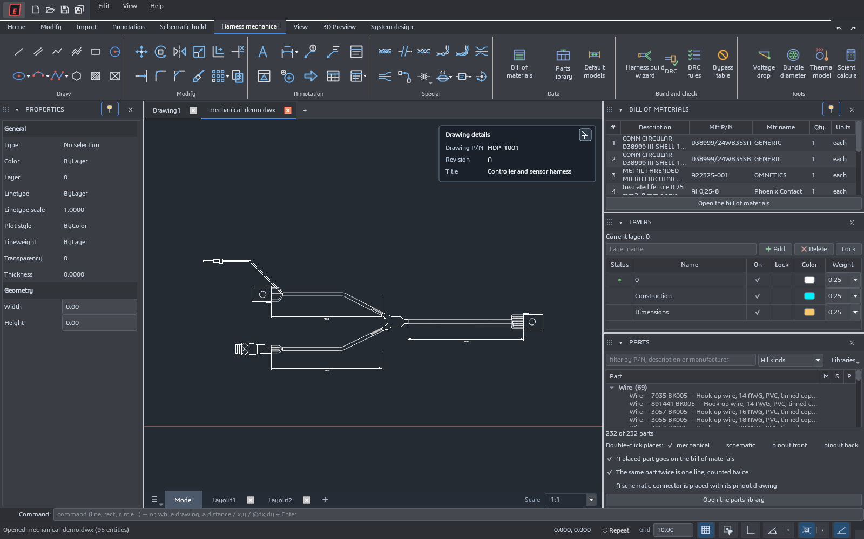
Mechanical harness authoring
Physical harness
engineering
Branches, fanouts and
protective coverings.
Dimensions and annotations.
Parts and quantities
in the BOM.
10
Notes:
Product evidence: current native Windows app, development build captured on 10 October 2026. Sources: README.md, CLAUDE.md, src/app/MainWindow.cpp, src/app/Editor.h, src/render/CanvasWidget.cpp, src/system/SystemDesign.cpp, src/app/BrickWizardDialog.cpp and src/app/View3DPane.h in C:/Work/AI/Edraw_desktop. Screenshots show example data and current implementation. They do not establish production maturity or certified compliance. The example is based on a local harness drawing fixture and has deliberately incomplete metadata. It is used to demonstrate drawing and validation features, not manufacturing readiness. Supporting backgrounds are AI-generated conceptual harness illustrations, not customer products or app-generated harnesses.

Slide 11
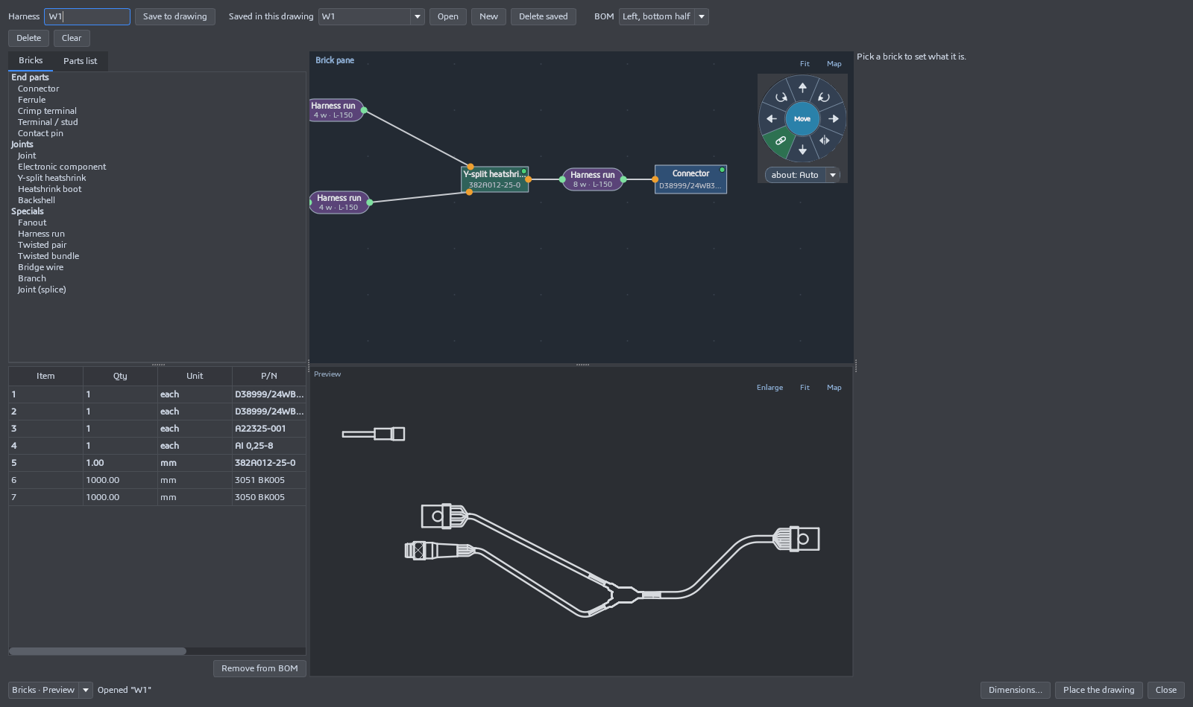
The harness build wizard
Engineers arrange connected parts and runs, inspect the live harness preview, and place the resulting drawing.
11
Notes:
Product evidence: current native Windows app, development build captured on 10 October 2026. Sources: README.md, CLAUDE.md, src/app/MainWindow.cpp, src/app/Editor.h, src/render/CanvasWidget.cpp, src/system/SystemDesign.cpp, src/app/BrickWizardDialog.cpp and src/app/View3DPane.h in C:/Work/AI/Edraw_desktop. Screenshots show example data and current implementation. They do not establish production maturity or certified compliance. The screenshot shows the actual brick-based harness wizard with a live drawing preview and BOM. It contains an unconnected ferrule, which the DRC screenshot later exposes. Supporting backgrounds are AI-generated conceptual harness illustrations, not customer products or app-generated harnesses.

Slide 12
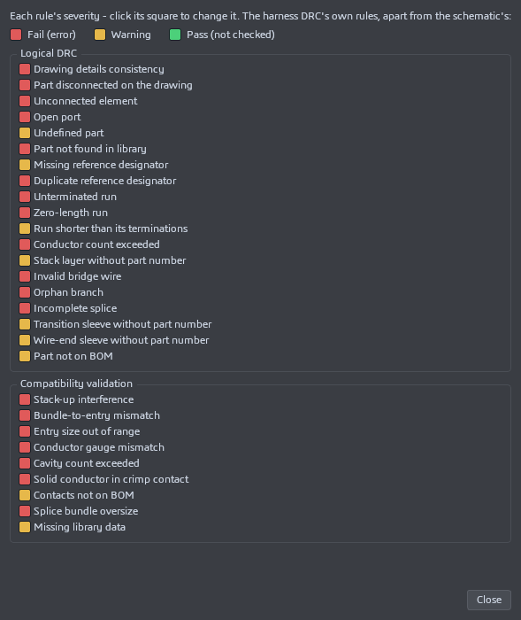
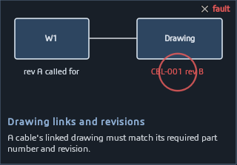
Design rules that explain the issue
Traffic lights and a legend
make rule severity visible
Animated examples explain the fault and its correction.
Findings link engineers back to the relevant drawing object.
Rules can be configured and findings bypassed. A disabled rule is distinct from a successful design check.
12
Notes:
Product evidence: current native Windows app, development build captured on 10 October 2026. Sources: README.md, CLAUDE.md, src/app/MainWindow.cpp, src/app/Editor.h, src/render/CanvasWidget.cpp, src/system/SystemDesign.cpp, src/app/BrickWizardDialog.cpp and src/app/View3DPane.h in C:/Work/AI/Edraw_desktop. Screenshots show example data and current implementation. They do not establish production maturity or certified compliance. Traffic-light colors in the rule configuration express severity or disabled status. Green "Pass (not checked)" in that dialog is not proof that the drawing passed. The animated explainer alternates between a fault and its correction. Screenshots show one animation frame. Supporting backgrounds are AI-generated conceptual harness illustrations, not customer products or app-generated harnesses.

Slide 13
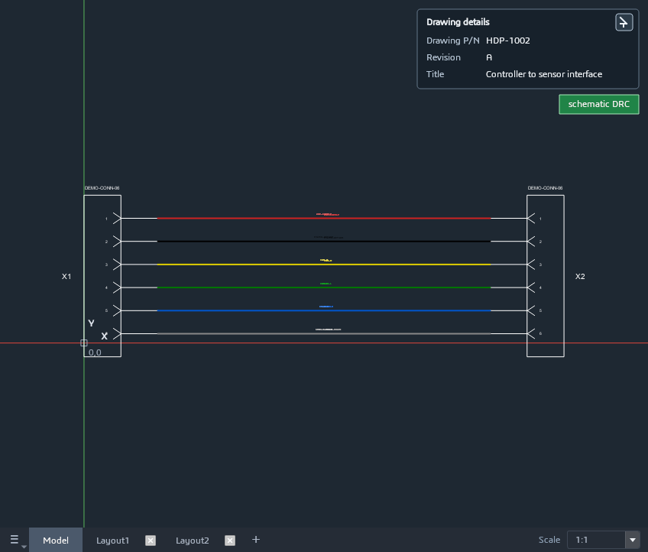
Validation status follows the drawing
A pass reflects
the current drawing
A green note records a
successful design check.
Any drawing edit clears it
and requires a new check.
Project checks inspect
saved validation evidence.
13
Notes:
Product evidence: current native Windows app, development build captured on 10 October 2026. Sources: README.md, CLAUDE.md, src/app/MainWindow.cpp, src/app/Editor.h, src/render/CanvasWidget.cpp, src/system/SystemDesign.cpp, src/app/BrickWizardDialog.cpp and src/app/View3DPane.h in C:/Work/AI/Edraw_desktop. Screenshots show example data and current implementation. They do not establish production maturity or certified compliance. src/model/Document.cpp stores content fingerprints for validation. src/model/Document.h clears stamps on dirty edits. Selection and view-only display actions do not count as drawing changes. This screenshot is the actual passed schematic fixture. Supporting backgrounds are AI-generated conceptual harness illustrations, not customer products or app-generated harnesses.

Slide 14
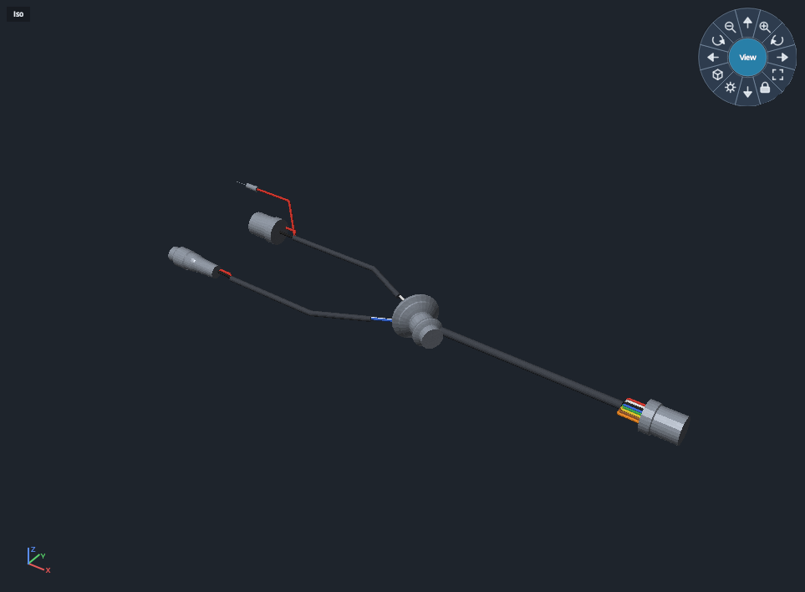
3D routing and length checks
Harness checks during
the design stage
Import 3D system files.
Check harness routing
and length in the
installation environment.
Reduce time spent on
physical trial fitting
and rework.
14
Notes:
Product evidence: current native Windows app, development build captured on 10 October 2026. Sources: README.md, CLAUDE.md, src/app/MainWindow.cpp, src/app/Editor.h, src/render/CanvasWidget.cpp, src/system/SystemDesign.cpp, src/app/BrickWizardDialog.cpp and src/app/View3DPane.h in C:/Work/AI/Edraw_desktop. Screenshots show example data and current implementation. They do not establish production maturity or certified compliance. The owner describes the 3D module as importing 3D files and checking harness routing and length in the installation environment during the design stage. The intended benefit is less time spent on physical trial fitting and rework. Time savings have not been measured. The screenshot shows a 3D rendering of the sample harness without an imported installation environment. Additional implemented APIs support STEP/STL/OBJ environment import, route nodes, branches, clips, length measurement and links back to the harness wizard. No claim of automated clearance verification, simulation accuracy or equivalence to a mature MCAD suite is made. Supporting backgrounds are AI-generated conceptual harness illustrations, not customer products or app-generated harnesses.

Slide 15
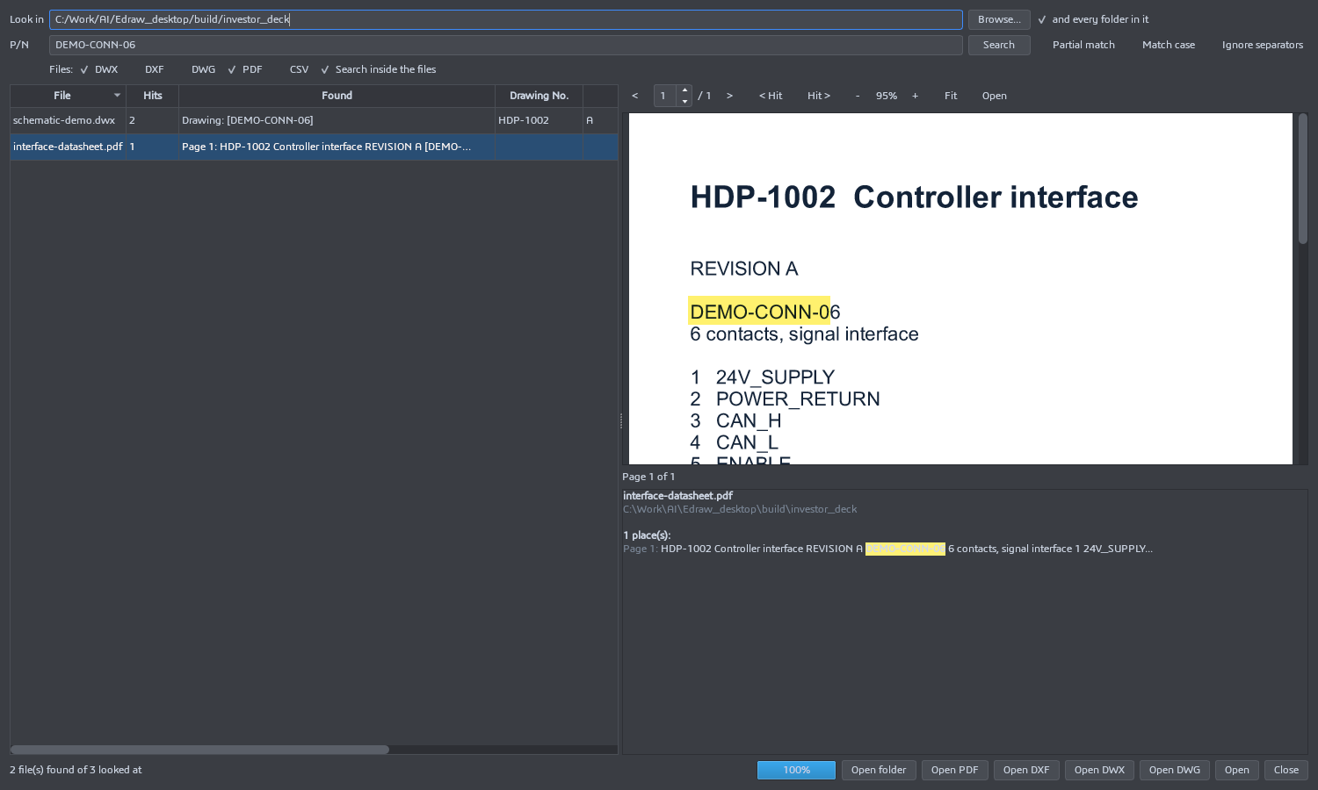
Engineering data and drawing discovery
Find part numbers
inside drawings
Search engineering files
with match controls.
View matching PDF pages
and highlighted results.
Reuse technical data
and library symbols.
15
Notes:
Product evidence: current native Windows app, development build captured on 10 October 2026. Sources: README.md, CLAUDE.md, src/app/MainWindow.cpp, src/app/Editor.h, src/render/CanvasWidget.cpp, src/system/SystemDesign.cpp, src/app/BrickWizardDialog.cpp and src/app/View3DPane.h in C:/Work/AI/Edraw_desktop. Screenshots show example data and current implementation. They do not establish production maturity or certified compliance. Actual DrawingFinderDialog capture shows a completed search and an embedded PDF viewer with a highlighted part number. The PDF was created as an illustrative demonstration datasheet. DWG content search depends on companion files/conversion support and is not presented as native unrestricted DWG parsing. Supporting backgrounds are AI-generated conceptual harness illustrations, not customer products or app-generated harnesses.

Slide 16
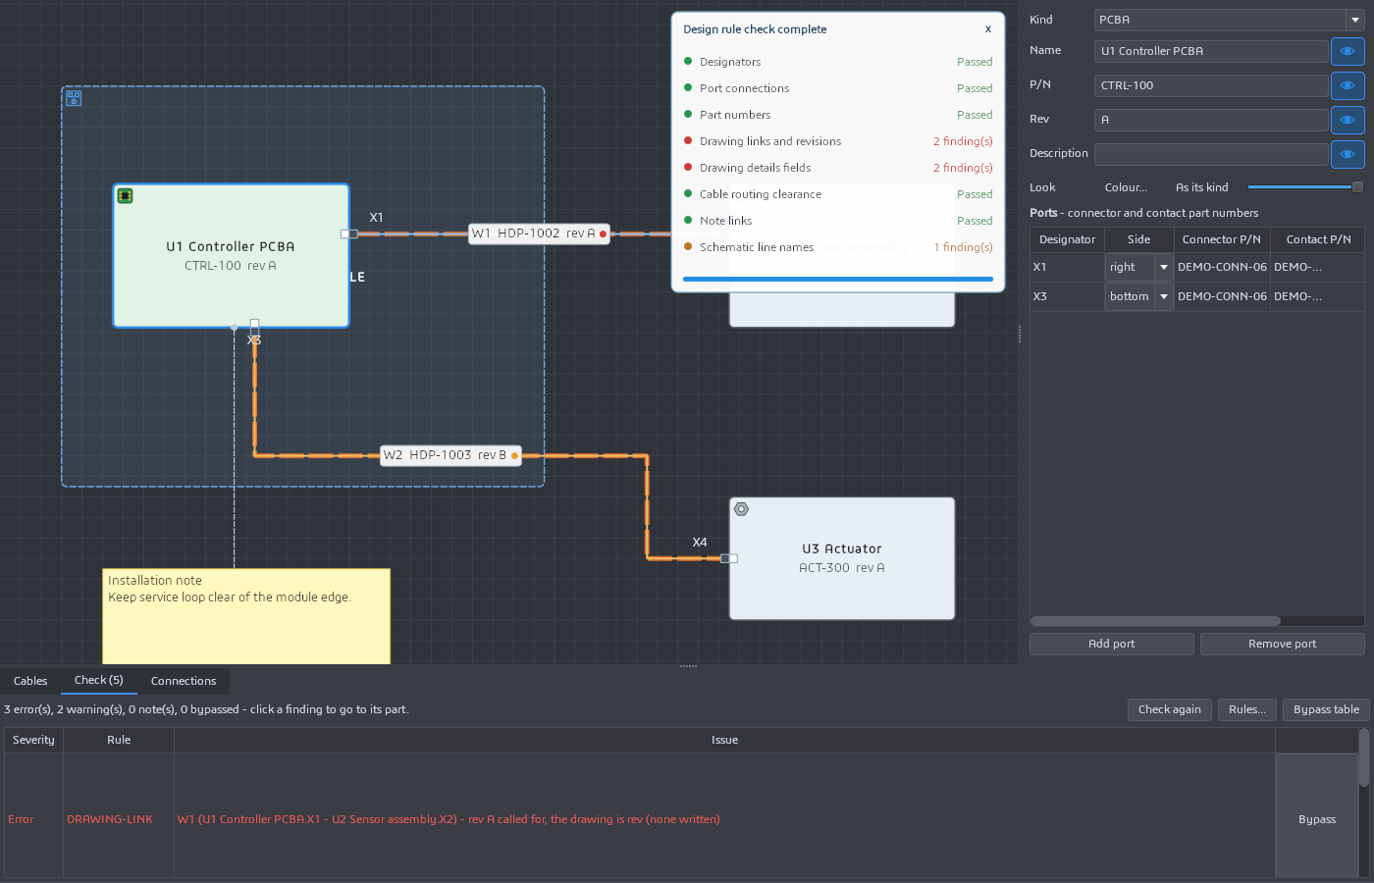
Project checks across linked drawings
Example: a controller,
a sensor and an actuator
Compare drawing data
with project expectations.
Review issues by
connection or drawing.
Click a finding to jump
to its location.
Demonstration includes intentionally missing or outdated data.
16
Notes:
Product evidence: current native Windows app, development build captured on 10 October 2026. Sources: README.md, CLAUDE.md, src/app/MainWindow.cpp, src/app/Editor.h, src/render/CanvasWidget.cpp, src/system/SystemDesign.cpp, src/app/BrickWizardDialog.cpp and src/app/View3DPane.h in C:/Work/AI/Edraw_desktop. Screenshots show example data and current implementation. They do not establish production maturity or certified compliance. The deliberately incomplete sample exposes an unlinked harness and missing current saved drawing evidence. It is not a screenshot of a fully released project. Current project checks compare metadata, ports and schematic line-name consistency. Contact-level interface definitions remain roadmap work. Supporting backgrounds are AI-generated conceptual harness illustrations, not customer products or app-generated harnesses.

Slide 17
Global harness software across hardware industries
$0.25B–$1.04B
Published global harness-software estimates for 2025
Buyers include hardware OEMs, aerospace/defense, machinery and system engineering teams.
USD millions
2025 publisher estimates differ. Both cover multiple buyer industries. These figures are not additive.
17
Notes:
Research rechecked 10 October 2026. 360iResearch via Research and Markets, Nov 2025: $245.71M in 2025, https://www.researchandmarkets.com/reports/6090408/electrical-wiring-harness-design-software LP Information via MarketResearch.com, published 5 June 2026: $1,039M in 2025, https://www.marketresearch.com/LP-Information-Inc-v4134/Global-Electrical-Wiring-Harness-Design-45255319/ Both discuss software demand across end-user industries. 360iResearch includes aerospace/defense, automotive, industrial machinery and railways. LP Information includes automobiles, machinery, aerospace and others. Differences in vendor coverage and methodologies are not reconciled by the public summaries. The displayed span is two publisher estimates, not a confidence interval, census or single consensus. Startup and high-tech hardware buyers are part of the target segment, not an additive hardware-sales market. Supporting backgrounds are AI-generated conceptual harness illustrations, not customer products or app-generated harnesses.

Slide 18
The broader electrical-design ecosystem
$9.81B
Estimated global ECAD ecosystem in 2025
Harness design is the starting scope. Cabinet wiring expands the roadmap into electrical system engineering.
USD billions
Broad ECAD context includes PCB tools and services beyond this app. It is not the current serviceable market.
18
Notes:
TechSci Research, Electrical Computer-Aided Design (ECAD) Market, January 2026. https://www.techsciresearch.com/report/electrical-computer-aided-design-ecad-market/25205.html Publisher estimates $9.81B in 2025 and forecasts $19.37B in 2031. Category includes software, services, support, training and maintenance. It includes electrical schematics and PCB layouts and multiple industrial sectors. This broader context is not the current product serviceable market or a pure harness/cabinet-software estimate. It overlaps with the harness category and must not be added to it. Supporting backgrounds are AI-generated conceptual harness illustrations, not customer products or app-generated harnesses.

Slide 19
Worldwide company landscape
Population | Published count | How to use it
Wire harness manufacturers | 1,363 companies | Focused prospecting proxy
Cable and harness manufacturers | 6,132 companies | Broader adjacent prospect pool
WHMA members | About 250 members | Industry access and pilot recruitment
Hardware startups, defense and high-tech device firms expand the buyer base beyond these directories.
These directories do not count every eligible hardware startup, device OEM or complex-system builder.
These overlapping industry counts describe one segment, not the complete software customer base.
19
Notes:
Sources: RevenueBase wire harness manufacturers page, data refreshed 19 September 2026: 1,363 companies. https://revenuebase.ai/companies/browse/wire-harness-manufacturers Broader cable and harness manufacturer category, refreshed 16 September 2026: 6,132 companies across 31 countries. https://revenuebase.ai/companies/browse/cable-and-harness-manufacturers WHMA history page states approximately 250 members. https://www.whma.org/about/history-whma Accessed 10 October 2026. Counts overlap and are not additive. Natural-language matching and association scope differ. These are prospecting proxies, not a census of independent design companies or confirmed buyers. Supporting backgrounds are AI-generated conceptual harness illustrations, not customer products or app-generated harnesses.

Slide 20
The main competitors
Product | Established strengths | Primary context
Siemens Capital | Electrical validation, harness and formboard design | Capital engineering ecosystem
Zuken E3.series | Synchronized cable/formboard data and DRC | Electrical design and manufacture
EPLAN Harness proD | 3D routes, 2D production drawings, MCAD links | Machine and vehicle cabling
SOLIDWORKS Electrical 3D | Schematic/3D integration and automatic wire routing | SOLIDWORKS mechanical workflows
Cadonix Arcadia | Cloud design, manufacturing reports and component data | Connected design and shop floor
RapidHarness | Harness/system design, DRC and cloud version control | Windows desktop with cloud data
Competitor capabilities come from vendor documentation. This is positioning, not a performance benchmark.
20
Notes:
Vendor descriptions from official sources, accessed 10 October 2026. Siemens: https://www.siemens.com/en-gb/products/capital/offerings/wiring-harness-designer-essentials/ Zuken: https://www.zuken.com/en/resource/datasheet-e3-series-formboard/ EPLAN: https://www.eplan.com/gb-en/products/eplan-harness-prod/ SOLIDWORKS: https://www.solidworks.com/product/solidworks-electrical-3d Cadonix: https://www.cadonix.com/home/ RapidHarness: https://rapidharness.com/features This comparison describes advertised strengths and product focus. It does not claim that missing features are absent or that the new app has measured performance superiority. Supporting backgrounds are AI-generated conceptual harness illustrations, not customer products or app-generated harnesses.

Slide 21
Where this app can win
Local project control
Visible validation state
Native Windows authoring and local DWX files suit teams with limited connectivity or local data requirements.
Canvas pass notes disappear after drawing changes. Project checks expose missing saved evidence.
Explained engineering rules
A lower paid entry price
Animated fault-and-fix previews and issue navigation help engineers understand what to correct.
Drawing starts at $70/month. RapidHarness Standard is $219/month individually. Capability scope differs.
Candidate strengths require pilot validation. Enterprise integration, collaboration and support remain competitor advantages.
21
Notes:
Product evidence: current native Windows app, development build captured on 10 October 2026. Sources: README.md, CLAUDE.md, src/app/MainWindow.cpp, src/app/Editor.h, src/render/CanvasWidget.cpp, src/system/SystemDesign.cpp, src/app/BrickWizardDialog.cpp and src/app/View3DPane.h in C:/Work/AI/Edraw_desktop. Screenshots show example data and current implementation. They do not establish production maturity or certified compliance. Positioning hypotheses. RapidHarness FAQ requires internet to sign in, open and save designs and uses cloud storage: https://rapidharness.com/support/faq Cadonix describes Arcadia as cloud based: https://www.cadonix.com/wp-content/uploads/2020/05/Arcadia-Harness.pdf Local workflow is a concrete contrast with these deployments, not proof that all competing products require cloud or cannot operate offline. Animation and invalidation are observable app features. Their competitive uniqueness and adoption impact are unmeasured. Price reference: https://rapidharness.com/pricing Supporting backgrounds are AI-generated conceptual harness illustrations, not customer products or app-generated harnesses.

Slide 22
Proposed subscription model
Tier | Capability bundle | USD / month | USD / year
Free | Evaluation access, limits to define | $0 | $0
Drawing | Harness drawing capabilities | $70 | $840
Engineering | Schematic and mechanical harness wizards | $100 | $1,200
Complete | 3D and system design capabilities | $150 | $1,800
Corporate terms
Multiple seats with volume and deployment terms to define during customer pilots.
Single-seat and corporate subscriptions. Prices are the proposed commercial plan, before any discounts or tax.
22
Notes:
Pricing supplied by the project owner on 10 October 2026. Tiers are presented as progressively broader capability bundles for the commercial plan. Cumulative entitlements, free-tier limits, corporate discounts and license terms still require definition. The current app does not demonstrate a billing implementation. Annualized figures equal monthly price × 12, with no annual discount. Corporate customers may buy several seats. No confirmed commercial traction was supplied. Supporting backgrounds are AI-generated conceptual harness illustrations, not customer products or app-generated harnesses.

Slide 23
Revenue when each company buys one seat
A one-seat customer contributes $840–$1,800 per year
Paying companies | Drawing $70/mo | Engineering $100/mo | Complete $150/mo
100 | $84,000 | $120,000 | $180,000
500 | $420,000 | $600,000 | $900,000
1,000 | $840,000 | $1,200,000 | $1,800,000
3,000 | $2,520,000 | $3,600,000 | $5,400,000
One company with one Engineering seat generates $100/month or $1,200/year
One paid seat per company. Illustrative annual revenue only, before costs, discounts, churn and tax.
23
Notes:
Owner-proposed prices: $70, $100, $150 per month. Each paying company buys one seat. Annual revenue = companies × monthly seat price × 12. These are illustrative subscription scenarios, not forecasts, signed contracts or profits. Free users produce zero modeled subscription revenue. No corporate discounts or churn are modeled. Supporting backgrounds are AI-generated conceptual harness illustrations, not customer products or app-generated harnesses.

Slide 24
One-seat and five-seat customer economics
Measure | One seat / company | Five seats / company
Monthly revenue / company | $100 | $500
Annual revenue / company | $1,200 | $6,000
Companies for 3,000 seats | 3,000 | 600
Annual revenue at 3,000 seats | $3,600,000 | $3,600,000
Base cash break-even: 841 Engineering seats, or 841 one-seat customers
Break-even assumes NIS 3.5/USD, 85% cash contribution and NIS 3M annual salary/rent cost.
24
Notes:
Illustrative Engineering tier at $100/seat/month. Annual subscriptions per customer equal $1,200 with one seat and $6,000 with five seats. Companies needed for 3,000 paid seats equal 3,000 with one seat/company or 600 with five seats/company. Subscription prices come from the owner. This is a seat-count comparison, not a customer acquisition forecast or profit claim. Supporting backgrounds are AI-generated conceptual harness illustrations, not customer products or app-generated harnesses.

Slide 25
Initial customers and route to market
First buyers
First engagement
Commercial proof
Hardware startups, defense and high-tech device builders, plus firms with many system projects. Harness suppliers are another segment.
Recruit 5–10 partners. Test common harness practices on several live projects, using real engineering drawings.
Measure time saved through reuse, consistency of project drawings, onboarding effort and willingness to pay.
Expansion path
Land a team on one project, then expand across its project portfolio with common parts, designs and engineering practices.
25
Notes:
Proposed market entry plan, not existing customer traction. Segment order should change after interviews and technical pilots. The suggested 5–10 design partners are recruitment targets. Supporting backgrounds are AI-generated conceptual harness illustrations, not customer products or app-generated harnesses.

Slide 26
Ecosystem roadmap
Stage | Product additions | Engineering value
Pilot readiness | Reliability, onboarding and representative drawings | Prove a dependable core workflow
Project intelligence | Shared harness catalog, revision compare and exceptions | Manage common designs across projects
Electrical CAB wiring | Components, terminals, cabinet layouts and wire routes | Extend design into control cabinets
Engineering release | Revision register, approval and drawing packages | Keep project release data consistent
Team ecosystem | Approvals, shared libraries and PLM/ERP integrations | Support controlled work across organizations
26
Notes:
Proposed roadmap. Base priorities: docs/proposed-project-functions.md. Electrical CAB wiring replaces the previously proposed manufacturing/test scope. CAB is treated as control cabinet wiring. Existing engineering calculations do not constitute hardware acceptance testing. Timing and delivery commitments are deliberately omitted. Supporting backgrounds are AI-generated conceptual harness illustrations, not customer products or app-generated harnesses.

Slide 27
The proposed five-person team
Role | Primary responsibility | 24-month salary
CEO / Product owner | Product direction, partnerships and company leadership | NIS 960,000
Backend software engineer | Data services, integrations and commercial infrastructure | NIS 960,000
Full stack engineer | Product interfaces and future team services | NIS 960,000
System software engineer | Native CAD engine, routing and engineering rules | NIS 960,000
Promotion and sales | Design-partner recruitment, pipeline and customer adoption | NIS 960,000
Five planned roles. Each budgeted at NIS 40,000 per month. The project owner will serve as CEO.
27
Notes:
User-supplied staffing plan: backend software engineer, promoter/sales, the user as CEO, full stack engineer and system software engineer. Each salary is approximately NIS 40,000/month for 24 months. Role responsibilities below are proposed. The five positions are planned capacity, not verified hires. Founder biography and employee names were not supplied. Supporting backgrounds are AI-generated conceptual harness illustrations, not customer products or app-generated harnesses.

Slide 28
NIS 6.0 million base funding requirement
24 months
NIS 250,000 per month
for the stated salary and office costs
Cost category | NIS / month | NIS / 24 months
Five salaries | 200,000 | 4,800,000
Office rent | 50,000 | 1,200,000
Base requirement | 250,000 | 6,000,000
Employer costs, equipment, marketing and contingency need explicit budget treatment.
Base budget supplied by the project owner. Funding terms and a fully loaded operating budget remain to be defined.
28
Notes:
User-supplied budget. Payroll: 5 people × NIS 40,000/month × 24 months = NIS 4,800,000. Office rent: NIS 1,200,000 for 24 months = NIS 50,000/month. Total stated base budget = NIS 6,000,000, equivalent to NIS 250,000/month. The user has not stated whether salaries include employer costs. No extra budget is supplied for equipment, promotion, software, cloud, insurance, legal/accounting or contingency. This is a base cost requirement, not a fully loaded financing forecast. No USD conversion or valuation is implied. Supporting backgrounds are AI-generated conceptual harness illustrations, not customer products or app-generated harnesses.

Slide 29
Investor cash-return assumptions
Model input | Illustrative assumption
Investment / investor ownership | NIS 6M / 20%
Paid-seat price / planning FX | $100/month / NIS 3.5 per USD
Annual salary and rent cost | NIS 3M
Cash contribution after variable costs | 85% of subscription revenue
Reserve from positive operating cash | 20% for taxes and reinvestment
Investor payments | Annual distributions from Year 3
Investor cash = positive operating cash × 80% × 20% ownership
Illustrative steady-state model. No acquisition ramp, dilution or agreed dividend policy is included.
29
Notes:
Illustrative model, not an agreed dividend policy or a forecast. Initial investment NIS 6M and ownership 20%. No investor distributions in Years 1–2. Stable paid seats from Year 3, no acquisition ramp modeled. Engineering seat price $100/month. Planning FX 3.5 NIS/USD is an assumption, not a current spot rate. Cash contribution 85% of subscription revenue after variable costs. Annual salary/rent cost NIS 3M derives from the owner budget. A 20% reserve from positive operating cash represents assumed tax/reinvestment needs and is not a statutory tax rate. Remaining cash distributes pro-rata annually. No dilution, additional financing, preference rights or transaction fees. Other costs may exceed these allowances. Supporting backgrounds are AI-generated conceptual harness illustrations, not customer products or app-generated harnesses.

Slide 30
When distributions return the NIS 6M investment
20% ownership and annual investor cash distributions
Paid seats from Year 3 | Annual company revenue | Annual investor cash | Full investment returned
1,500 | NIS 6.30M | NIS 0.377M | End of Year 18
3,000 | NIS 12.60M | NIS 1.234M | End of Year 7
5,000 | NIS 21.00M | NIS 2.376M | End of Year 5
For one-seat customers, 3,000 paid seats require 3,000 paying companies
Payments begin at the end of Year 3. Stable seats and the preceding cash assumptions determine payback.
30
Notes:
Inputs are on the preceding assumptions slide. Annual revenue in NIS = paid seats × $100 × 12 × 3.5. Annual investor cash = max(revenue × 85% − NIS 3M, 0) × 80% × 20%. Annual cash at 1,500 seats is NIS 376,800, 3,000 seats NIS 1,233,600, and 5,000 seats NIS 2,376,000. Annual payments begin at end of Year 3. Full payback year = 2 + ceil(NIS 6M / annual investor cash), so Years 18, 7 and 5. No return is modeled if annual operating cash is non-positive. Seat volumes are scenarios, not forecasts, and are stable from Year 3. No additional funding or dilution is modeled. Supporting backgrounds are AI-generated conceptual harness illustrations, not customer products or app-generated harnesses.

Slide 31
Investor payback through a company sale
At 20% ownership, a NIS 30M equity sale returns NIS 6M
Hypothetical sale | Exit equity value | Investor receives | Gross ROI
Year 3 | NIS 30M | NIS 6M | 0%
Year 5 | NIS 60M | NIS 12M | 100%
Year 7 | NIS 90M | NIS 18M | 200%
Investment cash returns when a qualifying company sale closes
Hypothetical sale dates and values. Separate exit-only cases, before dilution, preferences, taxes and fees.
31
Notes:
Separate exit-only model with no prior distributions. Initial NIS 6M investment at illustrative 20% ownership. Exit equity values and dates are hypothetical, not forecasts or revenue-derived valuations. Investor proceeds equal 20% of exit equity value. A sale at NIS 30M is the gross recovery threshold for NIS 6M. Scenarios: Year 3 / NIS 30M gives NIS 6M and 0% gross ROI; Year 5 / NIS 60M gives NIS 12M and 100%; Year 7 / NIS 90M gives NIS 18M and 200%. No dilution, preferences, fees, taxes or debt adjustment. Sale is of equity value, not enterprise value. Do not add these proceeds to the preceding distribution scenario unless a combined cash-flow model is explicitly built. Supporting backgrounds are AI-generated conceptual harness illustrations, not customer products or app-generated harnesses.

Slide 32
Investment priorities and proof milestones
Capital should fund evidence of a reliable,
paid engineering workflow
Product evidence
Commercial evidence
Ecosystem evidence
A repeatable demo on real partner designs, dependable file exchange and documented rule coverage.
Paid pilots, measured user value, pricing acceptance and a manageable onboarding/support burden.
A validated release-package workflow and one useful cabinet wiring or project-data integration.
Next step: a technical demonstration followed by design-partner pilots
32
Notes:
The base funding requirement and proposed salaries/rent come from the project owner. Milestones are proposals. Investor payback uses illustrative 20% ownership, with separate distribution and sale timelines. Terms are not agreed. No financial forecast, customer traction or founder biography was supplied. Product risks include incomplete metadata, format interoperability, validation coverage, performance at scale and commercialization. Standards-based certification and hardware acceptance evidence have not been established. Supporting backgrounds are AI-generated conceptual harness illustrations, not customer products or app-generated harnesses.

Slide 33
Market scope and estimate differences
Category / source | 2025 estimate | How the deck uses it
Harness software / 360iResearch | $245.71M | Cross-sector software estimate
Harness software / LP Information | $1,039M | Alternative publisher estimate
Broader ECAD / TechSci Research | $9.81B | Adjacent ecosystem including PCB/services
Hardware startups / defense / OEMs | No separate count asserted | Target buyers within engineering demand
These markets overlap. Qualify serviceable hardware accounts and paid-seat demand separately.
33
Notes:
Sources rechecked 10 October 2026: https://www.researchandmarkets.com/reports/6090408/electrical-wiring-harness-design-software https://www.marketresearch.com/LP-Information-Inc-v4134/Global-Electrical-Wiring-Harness-Design-45255319/ https://www.techsciresearch.com/report/electrical-computer-aided-design-ecad-market/25205.html Published harness estimates differ materially. Both cover end-user industries, not just harness manufacturers. Broad ECAD includes PCB and services beyond the app. Figures overlap and must not be summed. Hardware/device industry revenues are not software TAM. A measured serviceable market needs eligible accounts, paid-seat demand and segment research. Hardware startups and defense/high-tech system companies are target segments, not an additive market-size number. Supporting backgrounds are AI-generated conceptual harness illustrations, not customer products or app-generated harnesses.

Slide 34
Sources and product evidence
Evidence area | Source
Market recheck | 360iResearch, LP Information and TechSci Research
Company counts | RevenueBase manufacturer directories (Sep 2026) and WHMA
Electrical CAB proposal | Zuken E3.panel official cabinet-design workflow
Competitor capabilities | Official vendor product, FAQ and pricing pages
App capabilities and examples | Current app source and native UI captures (10 Oct 2026)
Investor return timing | Owner inputs and editable payback assumptions
Buyer focus and roadmap | Hardware/startup/defense buyers and Electrical CAB wiring
Detailed URLs and disclosures appear in the relevant slide notes.
34
Notes:
software: https://www.researchandmarkets.com/reports/6090408/electrical-wiring-harness-design-software
narrow: https://revenuebase.ai/companies/browse/wire-harness-manufacturers
broad: https://revenuebase.ai/companies/browse/cable-and-harness-manufacturers
whma: https://www.whma.org/about/history-whma
hardware: https://www.researchandmarkets.com/reports/5866799/wire-harness-global-market-opportunities
hardware2: https://www.custommarketinsights.com/report/wire-harness-market/
siemens: https://www.siemens.com/en-gb/products/capital/offerings/wiring-harness-designer-essentials/
zuken: https://www.zuken.com/en/resource/datasheet-e3-series-formboard/
eplan: https://www.eplan.com/gb-en/products/eplan-harness-prod/
solidworks: https://www.solidworks.com/product/solidworks-electrical-3d
cadonix: https://www.cadonix.com/home/
rapid: https://rapidharness.com/features
rapidfaq: https://rapidharness.com/support/faq
rapidprice: https://rapidharness.com/pricing
lpi: https://www.marketresearch.com/LP-Information-Inc-v4134/Global-Electrical-Wiring-Harness-Design-45255319/
ecad: https://www.techsciresearch.com/report/electrical-computer-aided-design-ecad-market/25205.html
cabinet: https://www.zuken.com/en/product/e3series/cabinet-layout-and-routing/
Local product evidence: current application source and captured native UI, 10 October 2026. Demo screenshots contain sample project data. Source notes on each relevant slide identify assumptions and scope. All external research accessed 10 October 2026. Supporting backgrounds are AI-generated conceptual harness illustrations, not customer products or app-generated harnesses.

