Slide 1
CAMPUSLOOP
Student to student
rentals on campus
Community Engagement Project · Current showcase demo
Rujal Sharma C-25 · Sudhanshu Pendalwar C-46
Shlok Mishra C-60 · Vansh Jain C-61
Second Year · AI and Data Science
Guide: Prof. Ifrah Sutar
Dr. D. Y. Patil Institute of Technology, Pimpri, Pune

Slide 2
CAMPUSLOOP / COMMUNITY ENGAGEMENT PROJECT
The project today
A working browser demo of a campus rental journey.
What students can try
How the demo works
Browse items, create a listing, request dates, review requests as an owner, confirm a return and rate a completed rental.
Four sample profiles and item data live in the browser. Changes persist locally with localStorage on the same device.
No live accounts, shared database, payments, deposits or escrow.
DYPIT Pimpri · AI and Data Science · 2026–2027
02

Slide 3
CAMPUSLOOP / COMMUNITY ENGAGEMENT PROJECT
The student problem
1
Useful equipment is often needed only briefly.
2
Buying each item raises the cost of coursework and activities.
3
Informal lending lacks a clear record of dates and owner decisions.
CampusLoop makes the steps of a short rental easy to see and demonstrate.
DYPIT Pimpri · AI and Data Science · 2026–2027
03

Slide 4
CAMPUSLOOP / COMMUNITY ENGAGEMENT PROJECT
Scope of the current demo
Implemented
Future product work
• Search, category filters and sorting
• Item details and listing creation
• Date requests and sharing terms
• Owner confirmation or decline
• Return confirmation and rating
• Browser-local saved state
• Authenticated student accounts
• Shared backend and database
• Verification and moderation
• Notifications and dispute support
• Payment model, only if needed
DYPIT Pimpri · AI and Data Science · 2026–2027
04

Slide 5
CAMPUSLOOP / COMMUNITY ENGAGEMENT PROJECT
One rental from start to finish
01
Discover
Search or filter sample items
02
Request
Choose dates and accept terms
03
Decide
Owner confirms or declines
04
Return
Borrower requests; owner confirms
05
Rate
Borrower rates the completed rental
DYPIT Pimpri · AI and Data Science · 2026–2027
05

Slide 6
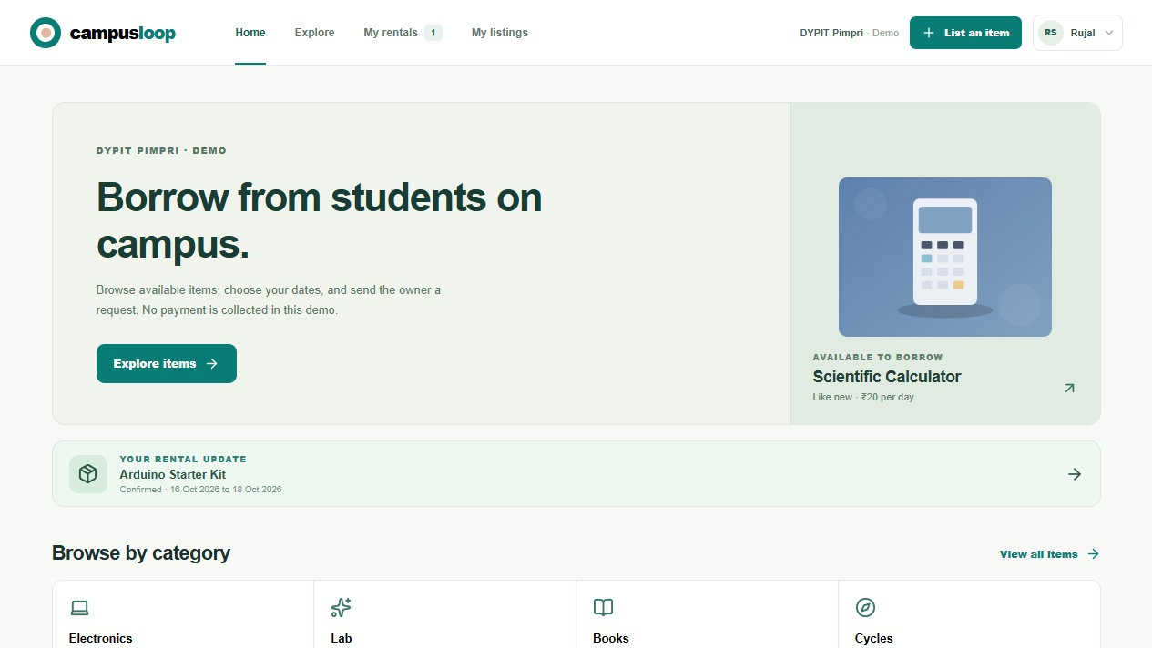
CAMPUSLOOP / COMMUNITY ENGAGEMENT PROJECT
Redesigned interface
Clear navigation
Home, Explore items, My rentals, My listings and Demo profile each have a direct destination.
Home screen of the current responsive React demo.
DYPIT Pimpri · AI and Data Science · 2026–2027
06

Slide 7
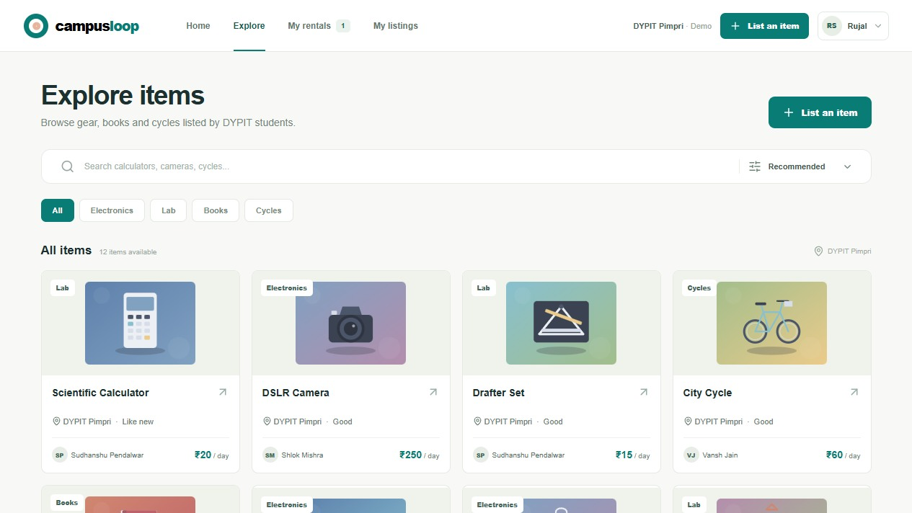
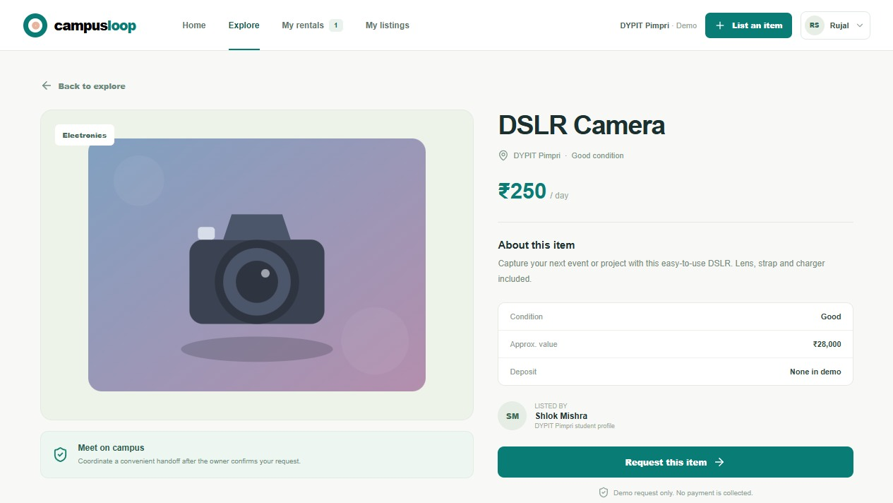
CAMPUSLOOP / COMMUNITY ENGAGEMENT PROJECT
Find and evaluate an item
Explore
Item details
Listings show category, condition, owner and daily rate. Details explain the handoff and demo deposit status.
DYPIT Pimpri · AI and Data Science · 2026–2027
07

Slide 8
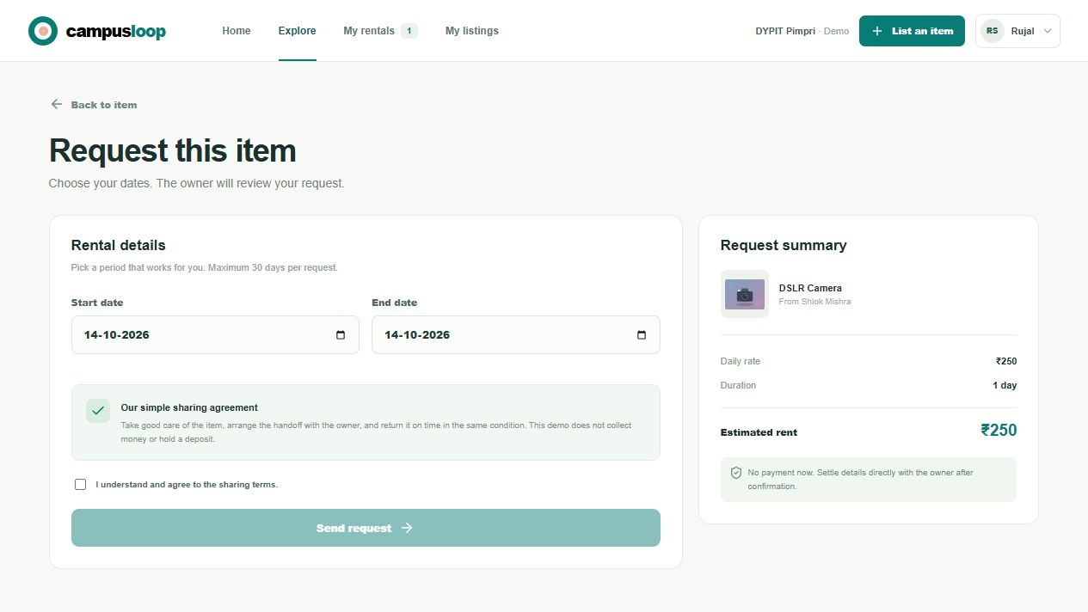
CAMPUSLOOP / COMMUNITY ENGAGEMENT PROJECT
Booking request and guardrails
The request form
Choose a date range and accept the sharing terms before sending. The summary shows estimated rent.
The demo blocks own-item requests, periods over 30 days and overlapping active requests.
No money is collected. Any real handoff would be arranged outside this prototype.
DYPIT Pimpri · AI and Data Science · 2026–2027
08

Slide 9
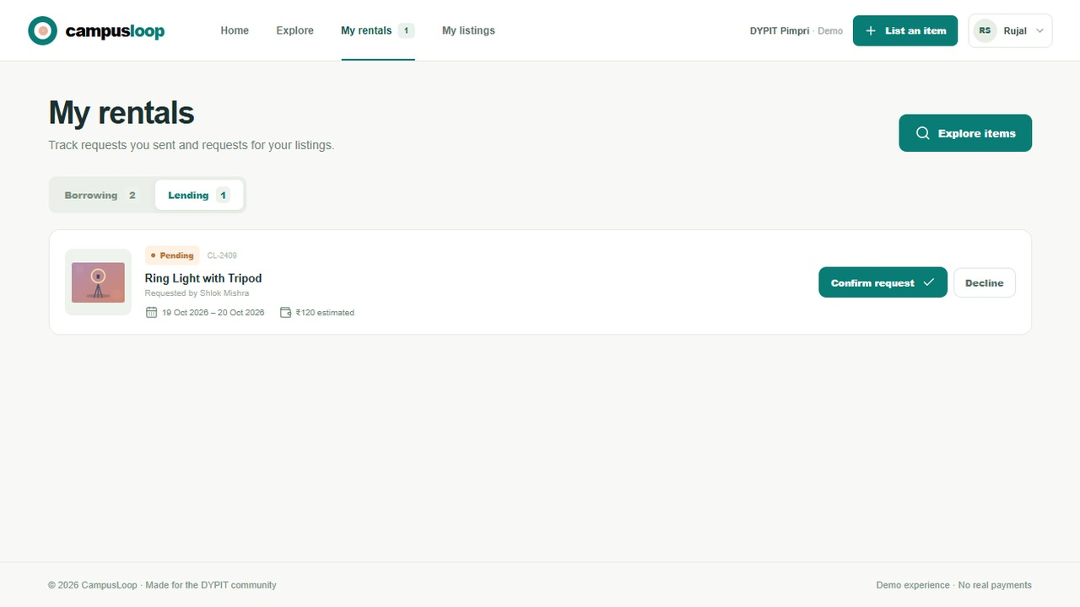
CAMPUSLOOP / COMMUNITY ENGAGEMENT PROJECT
Owner tools and rental state
Borrowing and lending views
Requests appear with a status. The owner can decide on a request and later confirm a return. Borrowers can follow their rental state.
DYPIT Pimpri · AI and Data Science · 2026–2027
09

Slide 10
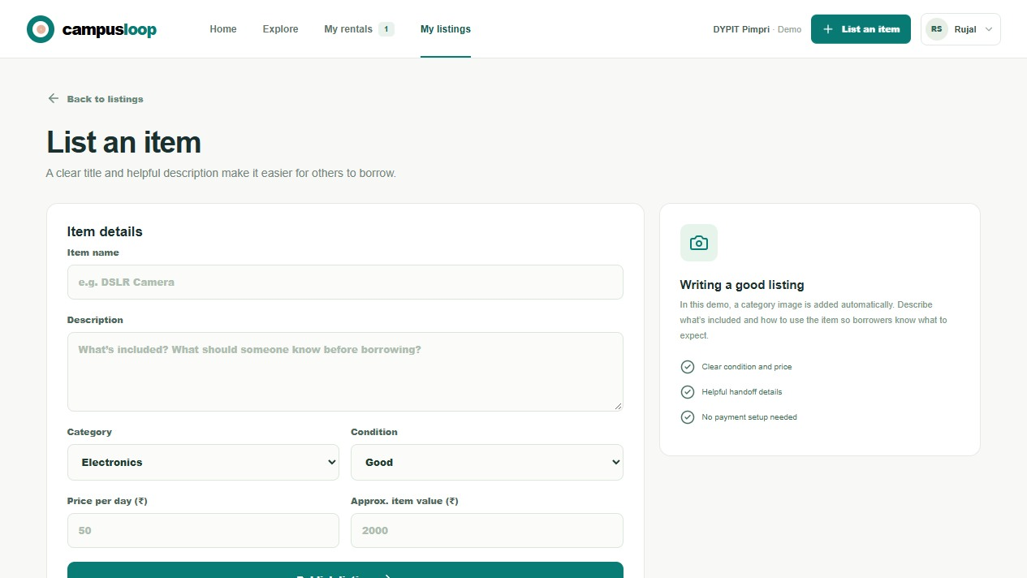
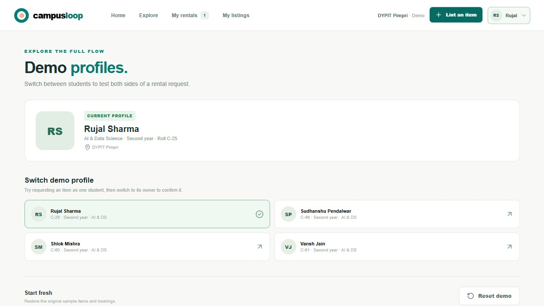
CAMPUSLOOP / COMMUNITY ENGAGEMENT PROJECT
Listings and sample profiles
Create a listing
Switch student profile
Rujal Sharma C-25, Sudhanshu Pendalwar C-46, Shlok Mishra C-60, Vansh Jain C-61. All are second year AI and Data Science sample profiles.
DYPIT Pimpri · AI and Data Science · 2026–2027
10

Slide 11
CAMPUSLOOP / COMMUNITY ENGAGEMENT PROJECT
How the demo is built
Interface
Logic
Data
Storage
React and Vite
Marketplace module
Sample catalog
localStorage
Responsive screens and forms
Validation, pricing, state changes
Starting listings and profiles
Persists in the current browser
There is no Express API, SQLite database, authentication system or payment service in the current project.
DYPIT Pimpri · AI and Data Science · 2026–2027
11

Slide 12
CAMPUSLOOP / COMMUNITY ENGAGEMENT PROJECT
What the prototype proves
Demonstrated
Still to validate
A complete borrower and owner interaction can be shown with understandable screens and sample state.
Real student demand, multi-device coordination, identity checks, safety processes and any payment model.
The project is ready for presentation as a demo, not for real transactions.
DYPIT Pimpri · AI and Data Science · 2026–2027
12

Slide 13
CAMPUSLOOP / COMMUNITY ENGAGEMENT PROJECT
Conclusion and next steps
CampusLoop now shows the full rental journey in a coherent, responsive demo.
1
Test the interface with students and collect feedback.
2
Add authenticated accounts and shared storage for real use.
3
Define moderation, handoff and payment policies with the campus.
Concept references: Botsman and Rogers (2010); Ellen MacArthur Foundation (2013); UN SDG 12. Implementation source: CampusLoop repository, October 2026.
DYPIT Pimpri · AI and Data Science · 2026–2027
13

