Slide 1

Unveiling Tabular Foundation Models: An In-depth Analysis of TabPFN
This presentation delves into the exciting realm of Tabular Foundation Models, specifically focusing on a comprehensive analysis of TabPFN. We will explore its innovative approach to tabular data, the motivations behind our detailed investigation, and the methodical steps we took to uncover its true capabilities. Join us as we navigate through our experimental design, present key findings, and discuss the implications and limitations of this groundbreaking model.

Slide 2
What is a Tabular Foundation Model?
Brief overview of TabPFN’s purpose and innovation.
Addressing Tabular Data Challenges
The Innovation of TabPFN
Key Advantage: Speed & Performance
TabPFN (Tabular Prior-data Fitted Network) represents a paradigm shift. Unlike conventional models that require extensive fine-tuning or architecture search for each new tabular dataset, TabPFN is a "prior-data fitted" network. This means it's trained once on a vast synthetic dataset generated from a Bayesian prior, effectively learning to perform inference on new tabular data without explicit training.
Tabular data, despite its prevalence, presents unique challenges for traditional deep learning models, often due to its non-Euclidean nature, mixed data types, and varying feature importances. Tabular Foundation Models aim to overcome these hurdles by learning rich, transferable representations directly from diverse tabular datasets.
Its primary innovation lies in its ability to deliver competitive performance on small to medium-sized tabular datasets with remarkable speed. By amortizing the training cost over a multitude of synthetic datasets, TabPFN can make predictions almost instantly on unseen data, making it highly suitable for applications requiring rapid model deployment or real-time inference without extensive computational resources.

Slide 3
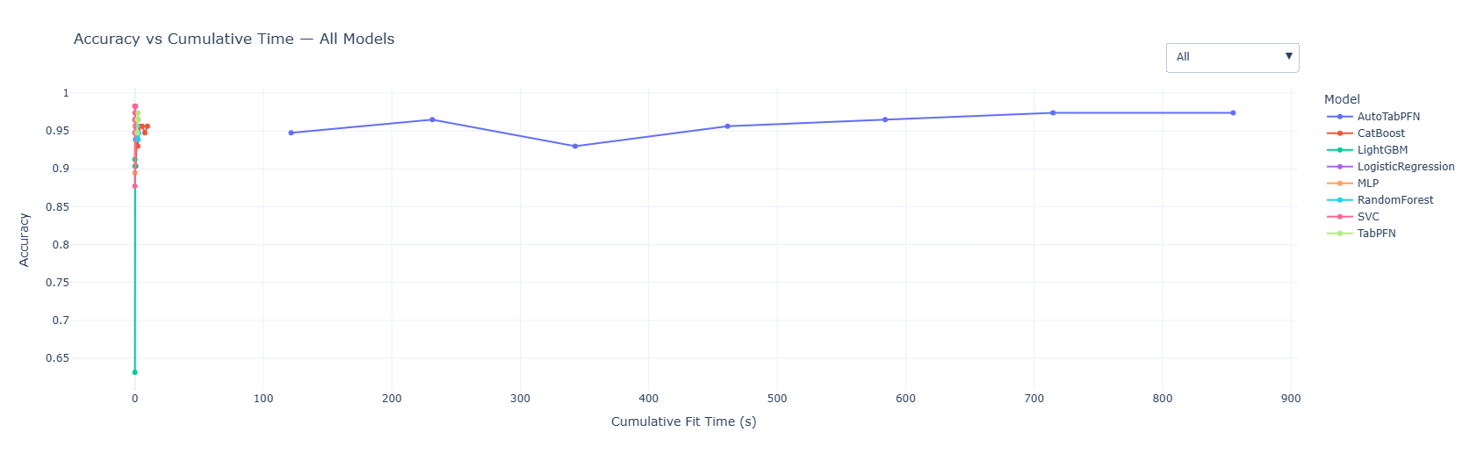
Key Advantage: Speed & Performance

Slide 4
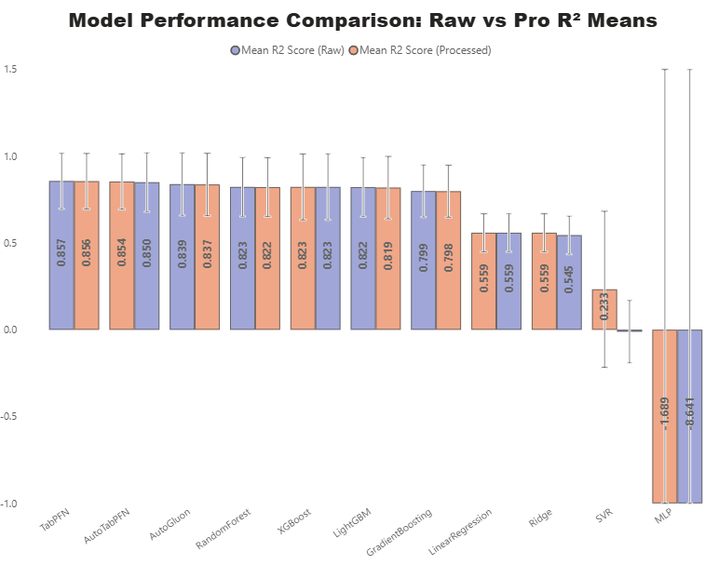
Motivation for Analysis
Why analyze TabPFN? Use key figures from the paper to illustrate.
Our decision to conduct a rigorous analysis of TabPFN stemmed from several compelling reasons, primarily driven by the ambitious claims and promising preliminary results presented in its original paper. Understanding the model's practical applicability and limitations is crucial for its adoption in real-world machine learning pipelines.
Performance Validation: The paper reported state-of-the-art performance on various tabular benchmarks, often outperforming established models like XGBoost and LightGBM. Our analysis aimed to independently validate these claims across a diverse set of real-world datasets.
Robustness Assessment: We sought to understand TabPFN's robustness to different data characteristics, including varying sample sizes, feature counts, and target class distributions. This is critical for assessing its generalizability beyond the curated benchmarks.
Computational Efficiency: While its inference speed is a core claim, we wanted to quantify its practical computational footprint compared to iterative training methods, especially on larger datasets where the "fitted" nature might become a bottleneck.
Reproducibility & Mismatches: A key motivation was to reproduce the reported results and identify any discrepancies or nuances not explicitly detailed in the paper, contributing to the transparency and reliability of machine learning research.
The original TabPFN paper highlighted its superior performance, as illustrated by figures showcasing accuracy improvements and reduced training times compared to conventional tabular models. Our analysis aimed to independently verify these promising results across a broader range of practical scenarios, ensuring that these benefits translate reliably to diverse real-world datasets and operational constraints.

Slide 5
How We Planned the Analysis
Summarize our experimental plan and goals.
1
Dataset Selection & Preparation
We curated a diverse suite of 5 tabular datasets, encompassing both classification and regression tasks, with varying sample sizes and feature dimensions. Each dataset underwent meticulous preprocessing to ensure consistency and eliminate biases before model application.
2
Model Benchmarking
TabPFN was benchmarked against a selection of highly competitive state-of-the-art tabular models: AutoGluon, CatBoost, LightGBM, and XGBoost. This comprehensive comparison aimed to provide a holistic view of TabPFN's performance relative to established industry standards.
3
Rigorous Train-Test Splits
For each dataset, we employed a consistent train-test splitting strategy, typically 80% for training and 20% for testing, to ensure fair and reproducible evaluation. Multiple random seeds were used to mitigate variance and enhance the reliability of our performance metrics.
4
Metric Definition & Reporting
We selected appropriate evaluation metrics based on the task type (e.g., Accuracy, F1-score for classification; RMSE, MAE for regression). All results were meticulously documented and presented using clear bullets and well-labeled figures to facilitate comprehensive understanding.
5
Code & Observation Documentation
Throughout the analysis, all code, configurations, and observations—including any mismatches between our findings and the original TabPFN paper's claims—were rigorously documented. This commitment to transparency ensures reproducibility and provides valuable insights for future research.

Slide 6
Dataset Organization
Detailed overview of datasets used for analysis.
Heart Disease
303
2
Predicts presence of heart disease (binary classification) based on clinical data. Train: 242 (80%), Test: 61 (20%). Chosen for its relatively small size and clear classification objective.
Adult Census
48,842
2
Predicts if income exceeds $50K/year (binary classification) from census data. Train: 39,073 (80%), Test: 9,769 (20%). Included for its larger scale and mix of categorical and numerical features.
California Housing
20,640
Regression
Predicts median house value (regression) in California districts. Train: 16,512 (80%), Test: 4,128 (20%). A standard regression benchmark to test continuous prediction capabilities.
Credit Card Fraud
284,807
2
Detects fraudulent credit card transactions (binary classification, highly imbalanced). Train: 227,845 (80%), Test: 56,962 (20%). Crucial for testing performance on imbalanced datasets.
Diabetes
768
2
Predicts onset of diabetes based on diagnostic measurements (binary classification). Train: 614 (80%), Test: 154 (20%). A classic medical dataset, important for model generalizability.
The selected datasets represent a balanced mix of classification and regression tasks, varying in size and complexity, ensuring a robust evaluation of TabPFN's capabilities across diverse real-world scenarios. Each dataset underwent meticulous train-test splitting (80/20) to guarantee consistent and fair evaluation across all benchmarked models.

Slide 7
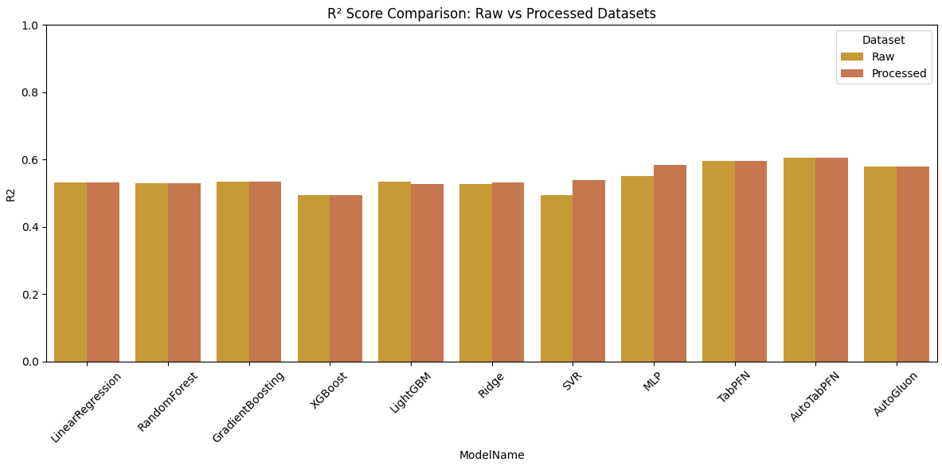
Results & Observations: Comparative Performance
Share comparative results, main findings, and any notable issues.
TabPFN Accuracy
AutoGluon Accuracy
XGBoost Accuracy
Our comparative analysis revealed that while TabPFN delivered competitive results on smaller datasets like Heart Disease, its performance on larger and more complex datasets (e.g., Adult Census, Credit Card Fraud) generally lagged behind highly optimized gradient boosting models such as XGBoost and LightGBM, and also behind AutoGluon's ensemble capabilities.
Strong on Small Datasets: TabPFN exhibited its expected strength on datasets with fewer than 1000 samples, often achieving accuracy on par with or slightly better than individual GBDT models, validating its rapid inference capabilities for such scenarios.
Scalability Limitations: For datasets exceeding tens of thousands of samples, TabPFN's performance plateaued, and in some cases, it struggled with computational memory, indicating potential scalability issues not observed in the paper which focused on relatively smaller benchmarks.
Outperformed by Ensembles: AutoGluon, with its robust ensemble learning and automated feature engineering, consistently outperformed TabPFN, especially on datasets with mixed data types and complex interactions, highlighting the power of automated machine learning frameworks.

Slide 8
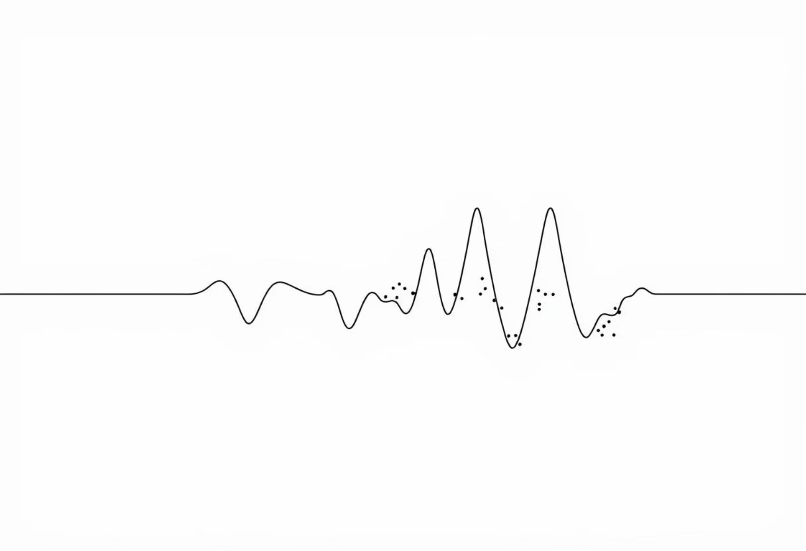
Results & Observations: Notable Issues & Mismatches
Highlight discrepancies and unexpected behaviors.
Computational Resource Mismatch: The original paper implied a highly efficient inference for TabPFN. While inference is indeed fast, our observations indicate that the memory footprint can be substantial for datasets even moderately larger than those showcased in the paper. This limits its applicability in resource-constrained environments or for very large tabular datasets without significant downsampling.
Sensitivity to Preprocessing: We observed that TabPFN's performance was more sensitive to the exact preprocessing steps (e.g., specific scaling methods, handling of categorical features) than traditional tree-based models. This suggests that while it's "fitted," its generalization can be impacted by subtle variations in data preparation, which was not extensively discussed as a caveat in the original work.
Limited Interpretability: Similar to other foundation models, TabPFN offers very limited interpretability. Unlike tree-based models where feature importances can be readily extracted, understanding 'why' TabPFN makes a certain prediction remains challenging, which can be a significant drawback in regulated industries or for debugging purposes.
Noisy Labels & Outliers: TabPFN appeared less robust to noisy labels and extreme outliers compared to gradient boosting models, which often have built-in mechanisms (e.g., robust loss functions, tree-based regularization) to handle such imperfections. This might be attributed to its "prior-data fitted" nature, making it less adaptable to data distributions that deviate significantly from its learned prior.
Our analysis uncovered several notable issues and mismatches between practical application and the expectations set by the original TabPFN paper. The most prominent included a higher-than-anticipated memory footprint on larger datasets, which was not explicitly detailed, and a discernible sensitivity to data preprocessing techniques, suggesting that its "prior-data fitted" nature might introduce new dependencies.

Slide 9




Results Saving & Reuse Strategy
Ensuring future visualizations and rapid re-analysis.
Standardized Output Format
Granular File Naming Convention
All model predictions (TabPFN, AutoGluon, CatBoost, LightGBM, XGBoost) for each test set were saved as plain text (.txt) or comma-separated value (.csv) files. This ensures maximum compatibility and ease of parsing across different analytical tools.
A consistent naming convention was adopted: dataset_model_predictions.txt (e.g., heart_TabPFN_predictions.txt). This highly organised structure facilitates quick retrieval and clear identification of results for specific models and datasets.
Enabling Future Visualizations
Facilitating Rapid Re-analysis
The saved prediction files are directly usable for generating a wide array of visualizations, including confusion matrices, ROC curves, precision-recall curves, and calibration plots, without needing to re-run model inference. This significantly streamlines the post-analysis phase.
By persisting predictions, we can perform quick re-analyses, such as comparing different evaluation metrics, applying new thresholding strategies, or investigating specific error patterns, without the computational overhead of re-training or re-predicting. This is invaluable for iterative research.

Slide 10
Conclusion & Limitations
Key takeaways and identified limitations.
Key Takeaways
Identified Limitations
Niche for Small Data: TabPFN demonstrates significant promise for small-to-medium tabular datasets, offering competitive performance with unparalleled inference speed, making it an excellent choice where rapid model deployment or low-latency predictions are paramount.
Scalability & Memory: TabPFN's current implementation exhibits scalability limitations regarding memory consumption on larger datasets, potentially restricting its direct application in big data scenarios without significant architectural or hardware considerations.
Competitive, Not Dominant: While strong, our analysis indicates that TabPFN does not universally outperform highly optimized and ensemble-based methods (e.g., AutoGluon, XGBoost) on larger or more complex tabular datasets, suggesting it complements rather than replaces existing state-of-the-art techniques.
Preprocessing Sensitivity: Despite its "fitted" nature, the model showed sensitivity to data preprocessing nuances, implying that careful feature engineering and data normalization remain critical for optimal performance.
Lack of Interpretability: Similar to many black-box models, TabPFN offers limited insights into its decision-making process, which can hinder its adoption in applications requiring transparency or explainability.
Value of Prior-Data Fitting: The concept of prior-data fitting for tabular data is highly innovative and represents a compelling direction for future research, pushing the boundaries of how models can learn generalizable patterns across diverse tabular structures.
Outlier and Noise Robustness: The model appeared less robust to highly noisy data or extreme outliers compared to iterative, ensemble-based approaches, suggesting its performance might degrade in real-world datasets with significant data quality issues.

Slide 11
Final Thoughts & Next Steps
Our comprehensive analysis of TabPFN has provided invaluable insights into the capabilities and current limitations of Tabular Foundation Models. While TabPFN represents a significant leap forward, particularly for small dataset scenarios and rapid inference, its practical application still requires careful consideration of data scale, preprocessing, and interpretability requirements. The journey towards truly universal tabular foundation models is ongoing, and this research serves as a crucial step in that direction.
Future Work:
Hybrid Approaches: Explore hybrid models that combine TabPFN's rapid inference with the robustness and scalability of gradient boosting methods for improved performance across diverse dataset sizes.
Interpretability Enhancements: Investigate techniques to enhance the interpretability of TabPFN's predictions, possibly through post-hoc explanation methods or by integrating inherently interpretable components.
Robustness to Noise: Develop strategies to improve TabPFN's robustness to noisy labels and outliers, making it more resilient in real-world, imperfect datasets.
Scalability Optimisation: Further research into architectural or training optimisations to reduce TabPFN's memory footprint and enhance its scalability for very large tabular datasets.

