Slide 1
From object detection to image captioning in retail environment
Bucciarelli Davide, Fino Alessandro, Pavone Cosimo

Slide 2
Goals
Object detection: improve inventory tracking and management.
Image classification and captioning: enhance customer experience and provide descriptive captions.
Content based image retrieval: recommend similar products according to customer request.

Slide 3
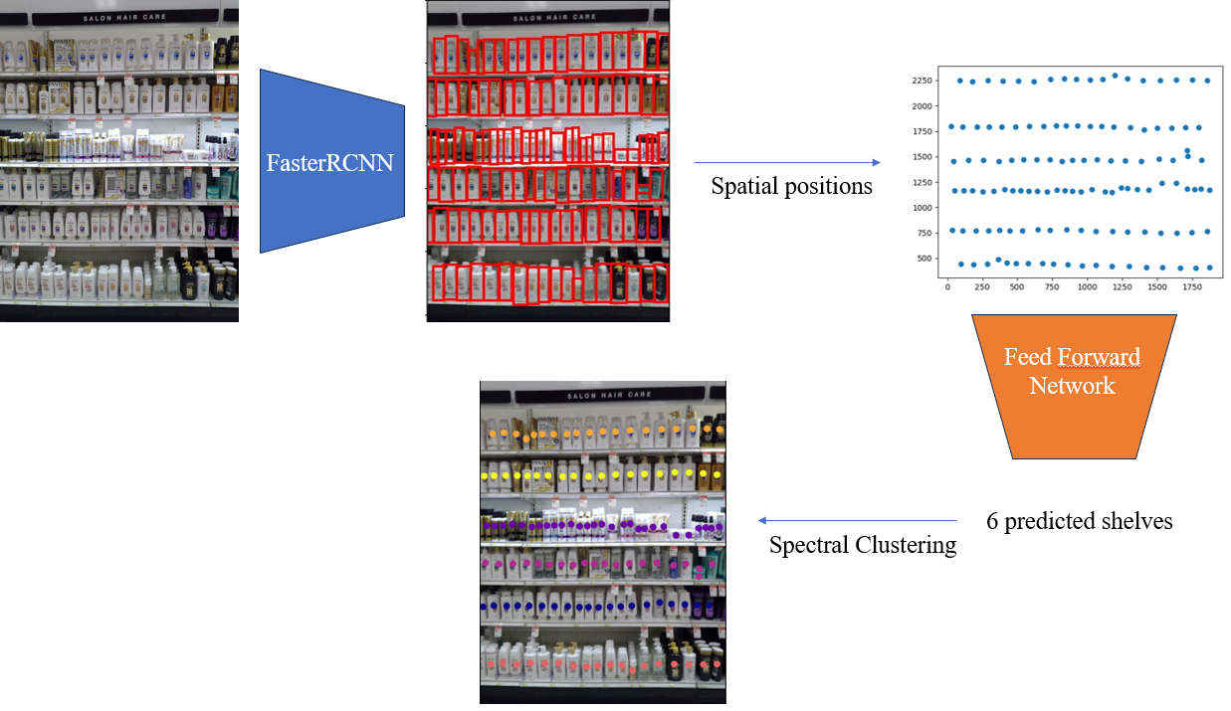
Object Detection

Slide 4
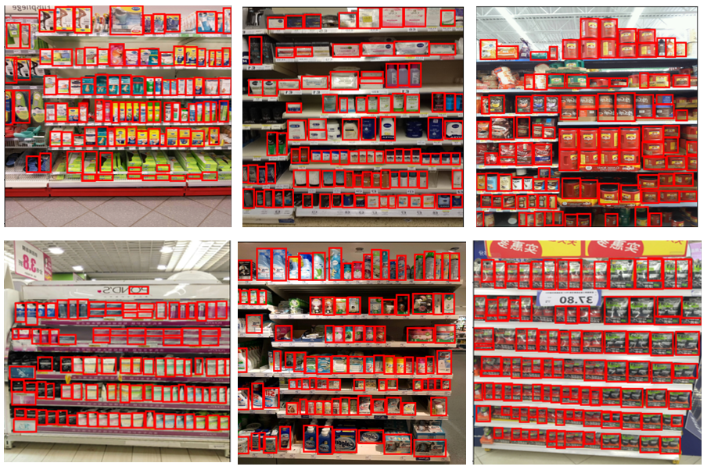
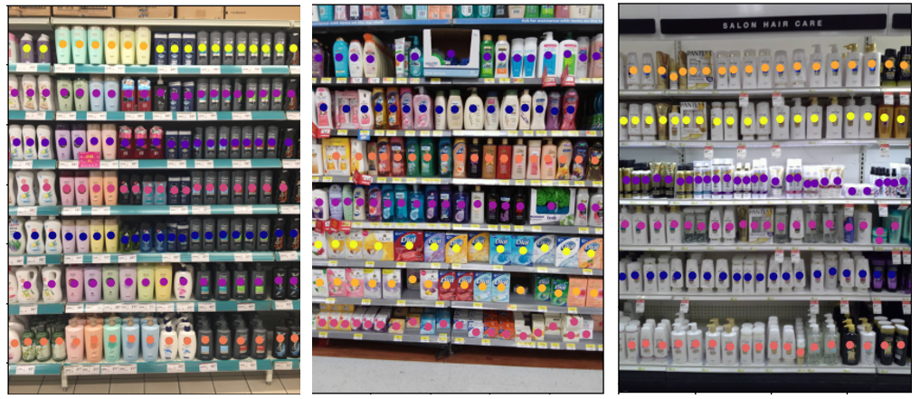
Object detection: results
For the object detection task we achieved Average precision = 0.59
For the shelf number prediction we achieved
Accuracy = 0.61 Mean Absolute error = 0.46

Slide 5
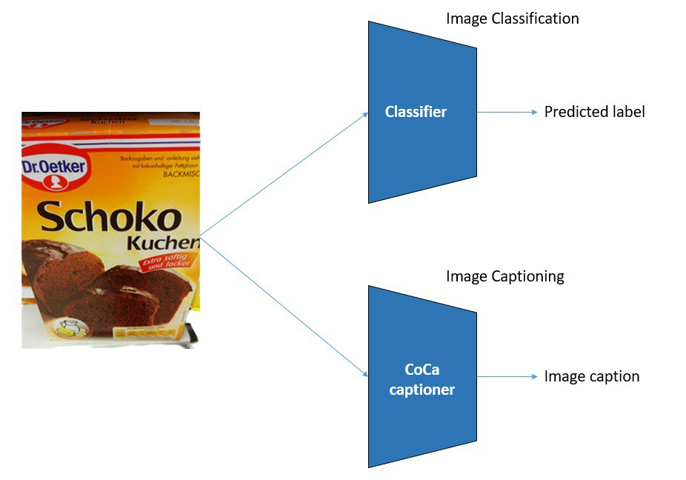
Classification-Captioning

Slide 6
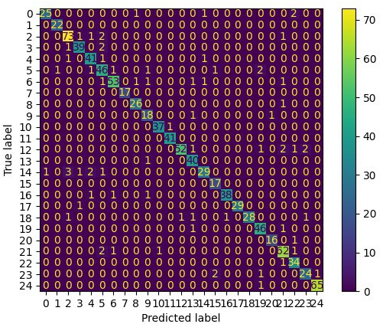
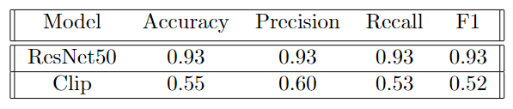
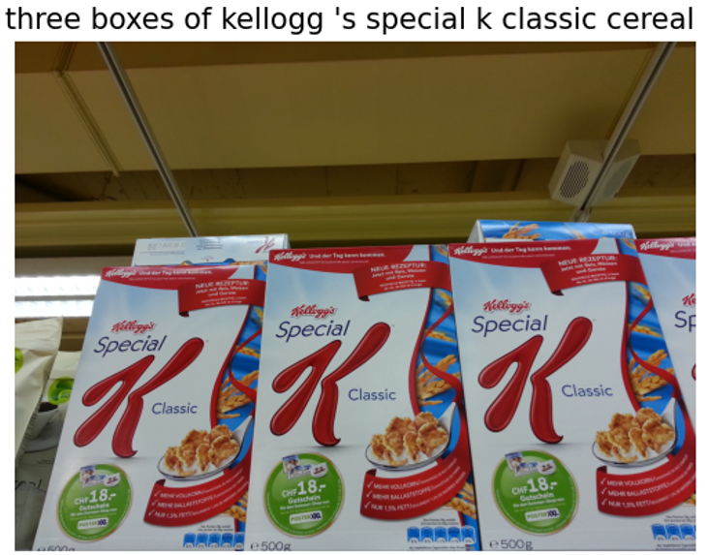
Classification and Captioning: results
For the classification task we achieved the following results:
For the captioning we achieved
CLIP-S = 0.30

Slide 7
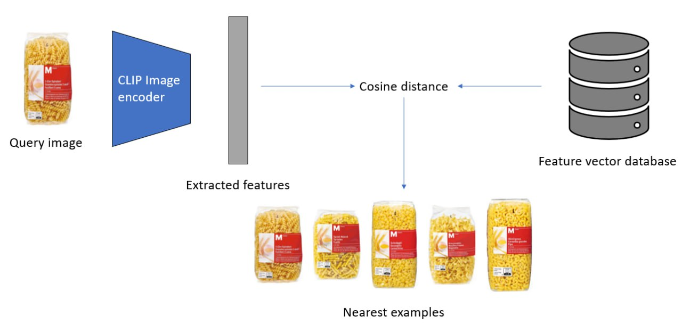
Retrieval

Slide 8
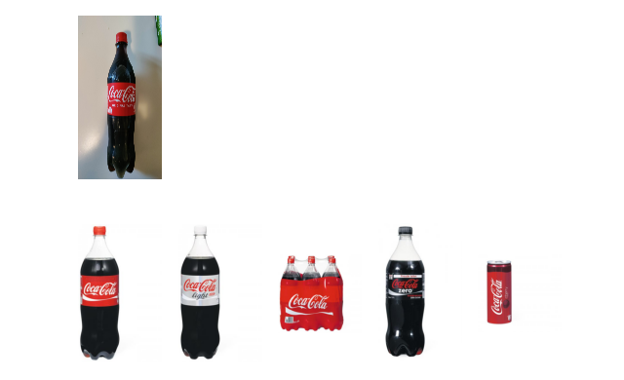
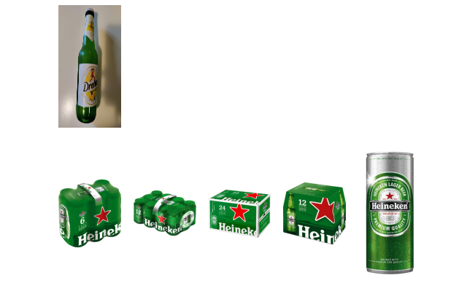
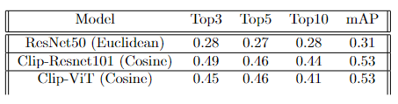
Retrieval: results
For the retrieval task we achieved the following results:

Slide 9
Future developments
Improve the shelf number predictor by using both visual and spatial features.
Zero-shot classification would improve by performing linear probing on our specific dataset.
It could be useful to develop towards real-time detection.

Slide 10
Thanks for your attention!

