Slide 1

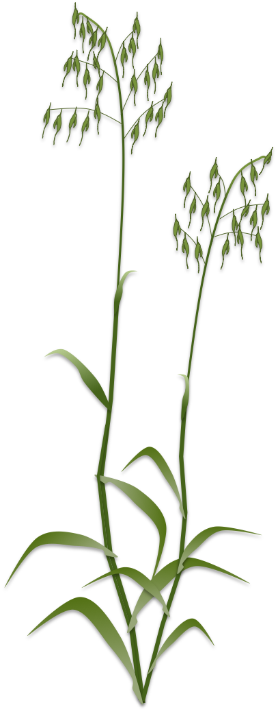

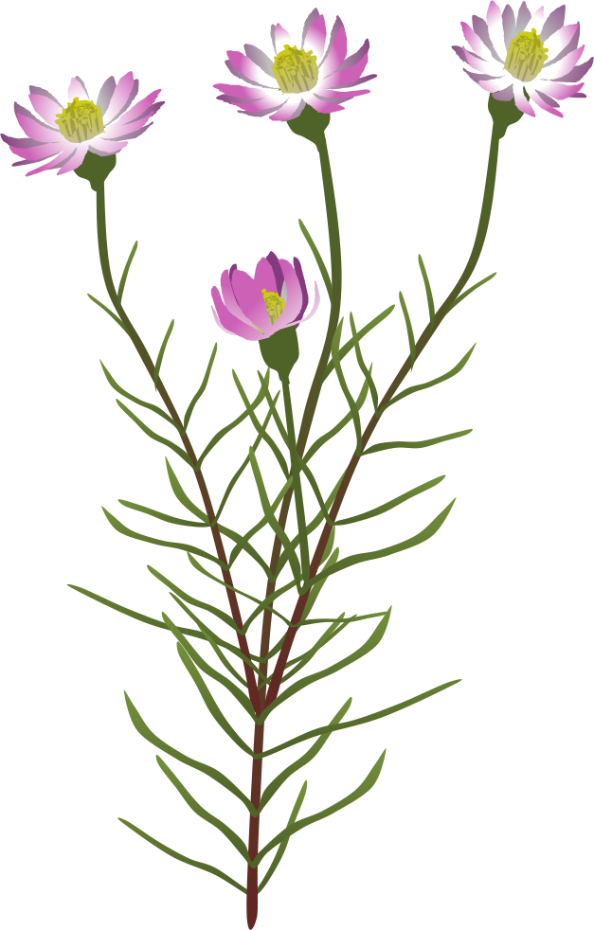


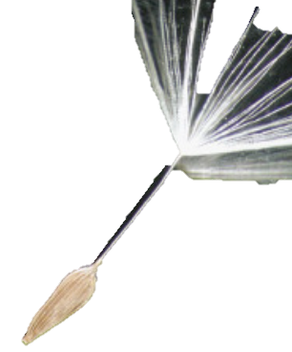

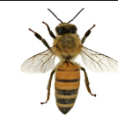


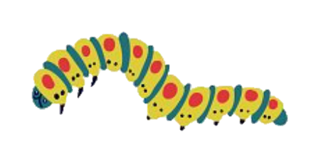
Intrinsic
fecundity
Intraspecific
Plant-plant
Generic effect
Species- specific
effect
Direct
interactions
Generic
effect
Fecundity
Plant-Fv
Species- specific
effect
Generic
effect
Plant-H
Species- specific
effect
Higher-order
interactions
Plant-plant-X

