Slide 1
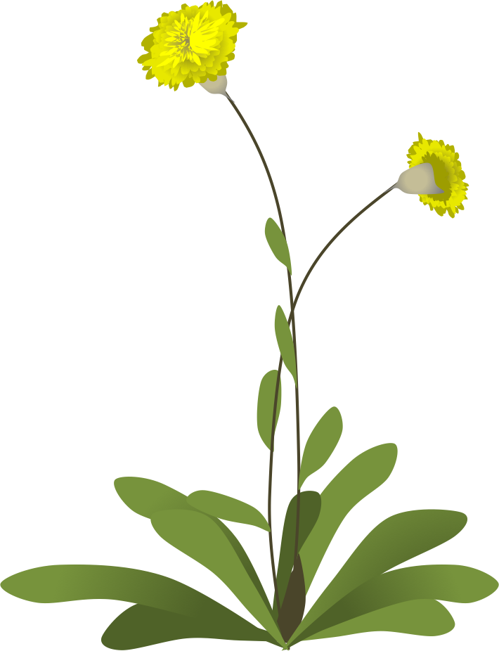
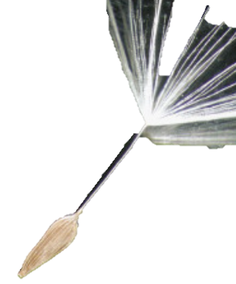

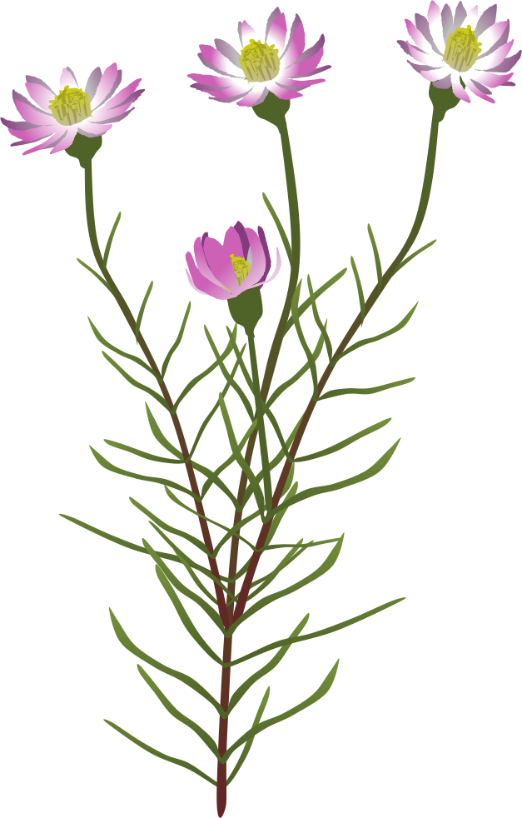
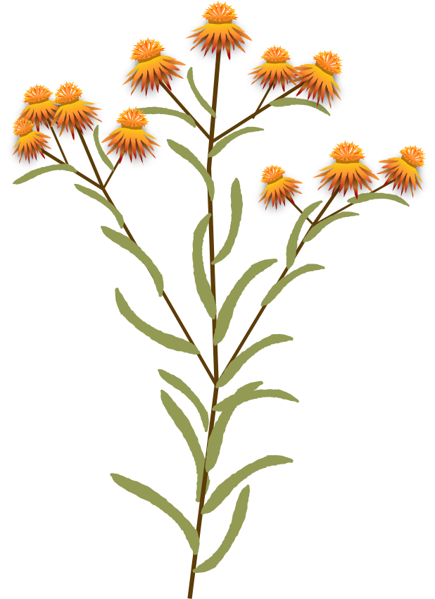
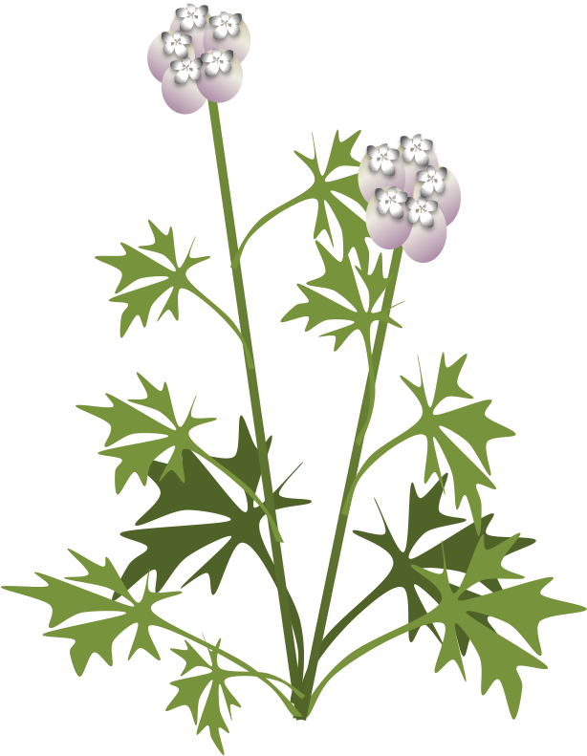



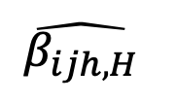


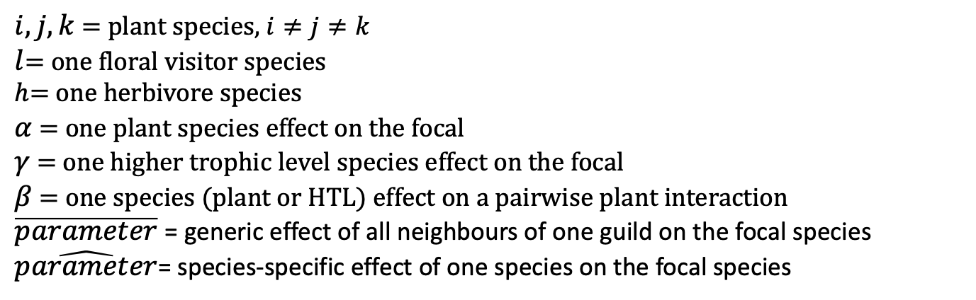
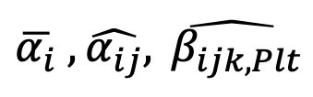
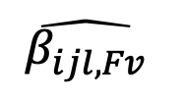

Intrinsic fecundity: $λ_{i}$
Self-regulation
Intraspecific interaction: $α_{ii}$
Fecundity $F_{i}$
Floral visitor
$$\overline{γ_{i,Fv}} , \hat{γ_{il}}$$
$$\hat{β_{ijl, Fv}}$$
Neighbour effect
Plant
$$\overline{α_{i}} , \hat{α_{ij}}, \hat{ β_{ijk,Plt}}$$
$i, j, k$ = plant species, $i≠j≠k$
$l$= one floral visitor species
$h$= one herbivore species
$α$ = one plant species effect on the focal
$γ$ = one higher trophic level species effect on the focal
$β$ = one species (plant or HTL) effect on a pairwise plant interaction
$\overline{parameter}$ = generic effect of all neighbours of one guild on the focal species
$\hat{parameter}$= species-specific effect of one species on the focal species
$$\hat{β_{ijh,H}}$$
Herbivore
$$\overline{γ_{i,H}} , \hat{γ_{ih}}$$

Slide 2
Negative (-)
Positive (+)

Slide 3
Positive (+)
Negative (-)

