Slide 1
The balance between individual model complexity and the evaluation of species persistence
How prevalent is complexity through time ?

Slide 2







Data story
Place
9 plots including 36 subplots of 1 m² along a gradient of salinity and humidity
Time
2015 to 2021
Actors
25 annual plant
44 species of herbivore
66 species of pollinator
32 species of pollinator/ herbivore : beetles
7.5 cm
17
Notes:
Abundance or density?

Slide 3
Grouping factors, to reduce complexity
25 annual plants
Forb or Grass -- 2 groups
Family classification - 13
Species level – 25
Herbivores, pollinators
Guild level - 11
Family level - 63
Species level - 142

Slide 4
Plan
Sparsity approach
6 scenarios/models for each year
Evaluate the best one based on RMSE or alternative
Determine the level of complexity selected relative to the full potential complexity

Slide 5



Beverton-Holt model
$$Seed=\frac{intrinsic growth rate}{1+pairwise interactions+ higherorder interactions }$$
$$﻿$$
﻿
$$F_{i,t+1}= \frac{λ_{i}}{1+\sum_{j=1}^{S}{α_{i,j}N_{j,t}+ \sum_{k=1}^{S}{\sum_{j=1}^{S}{β_{i,j,k}N_{j,t}N_{k,t}}}}}$$
﻿
F_{i} $\sim Poisson$
$λ_{i} \sim norm$al
$$α_{ij} \sim normal$$
$$γ_{ik} \sim normal$$
$$β_{ijk}\sim normal$$
+ regularized horseshoe priors

Slide 6
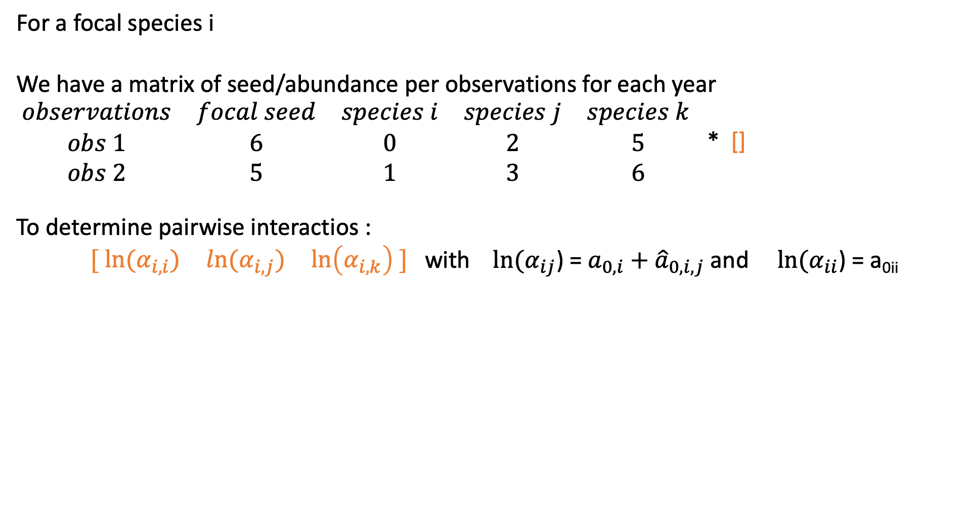
Behind the model
For a focal species i
We have a matrix of seed/abundance per observations for each year
$\begin{matrix}observations & focal seed & species i & species j & species k \\ obs 1 & 6 & 0 & 2 & 5 \\ obs 2 & 5 & 1 & 3 & 6\end{matrix}$ * []
To determine pairwise interactios :
$\begin{matrix}[ ln⁡(α_{i,i}) & ln⁡(α_{i,j}) & \ln\left(α_{i,k}\right) ] \end{matrix}$ with ${ln⁡(α}_{ij}$) = ${a_{0,i}+\hat{a}}_{0,i,j}$ and ${ln⁡(α}_{ii}$) = a_{0ii}

Slide 7
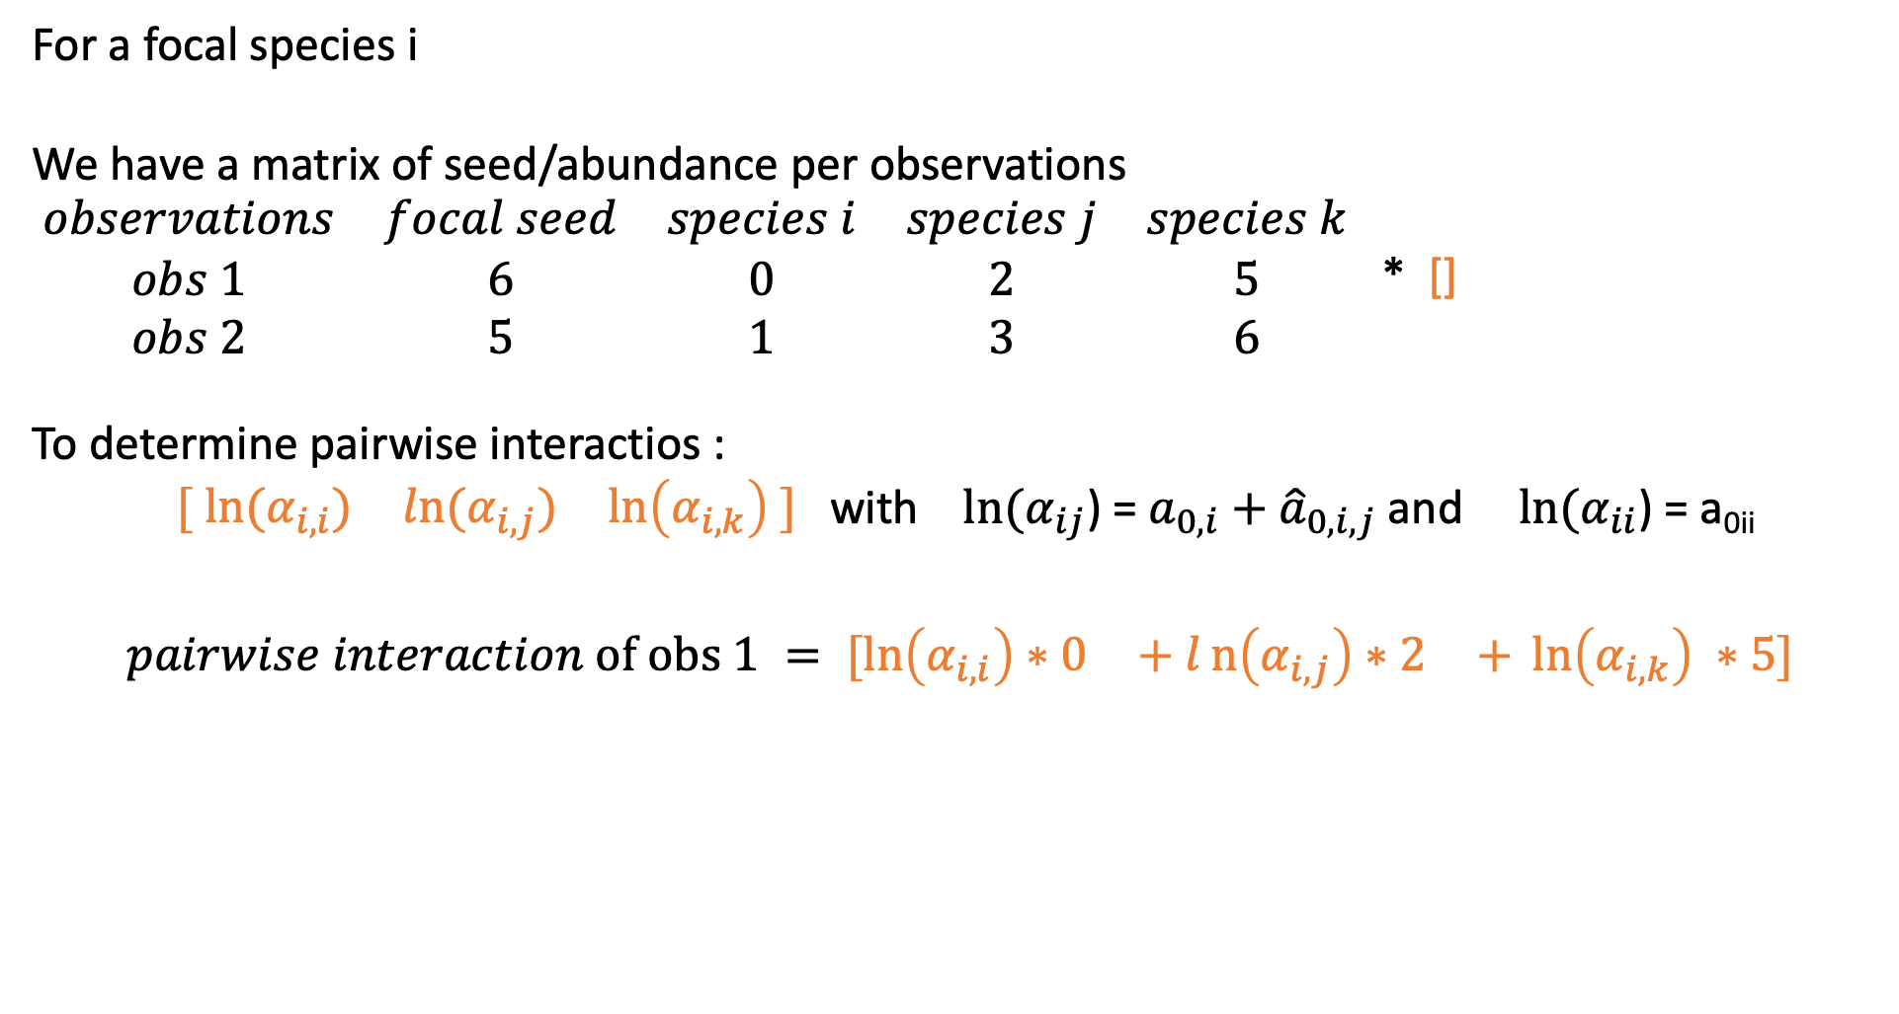
Behind the model
For a focal species i
We have a matrix of seed/abundance per observations
$\begin{matrix}observations & focal seed & species i & species j & species k \\ obs 1 & 6 & 0 & 2 & 5 \\ obs 2 & 5 & 1 & 3 & 6\end{matrix}$ * []
To determine pairwise interactios :
$\begin{matrix}[ ln⁡(α_{i,i}) & ln⁡(α_{i,j}) & \ln\left(α_{i,k}\right) ] \end{matrix}$ with ${ln⁡(α}_{ij}$) = ${a_{0,i}+\hat{a}}_{0,i,j}$ and ${ln⁡(α}_{ii}$) = a_{0ii}
$$\begin{matrix}pairwise interaction of obs 1 = [\ln\left(α_{i,i}\right)∗0 & + ln\left(α_{i,j}\right)∗2 & + \ln\left(α_{i,k}\right) ∗5] \end{matrix}$$

Slide 8
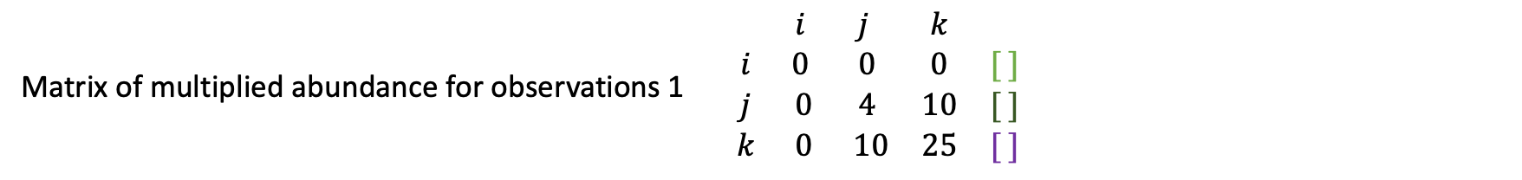
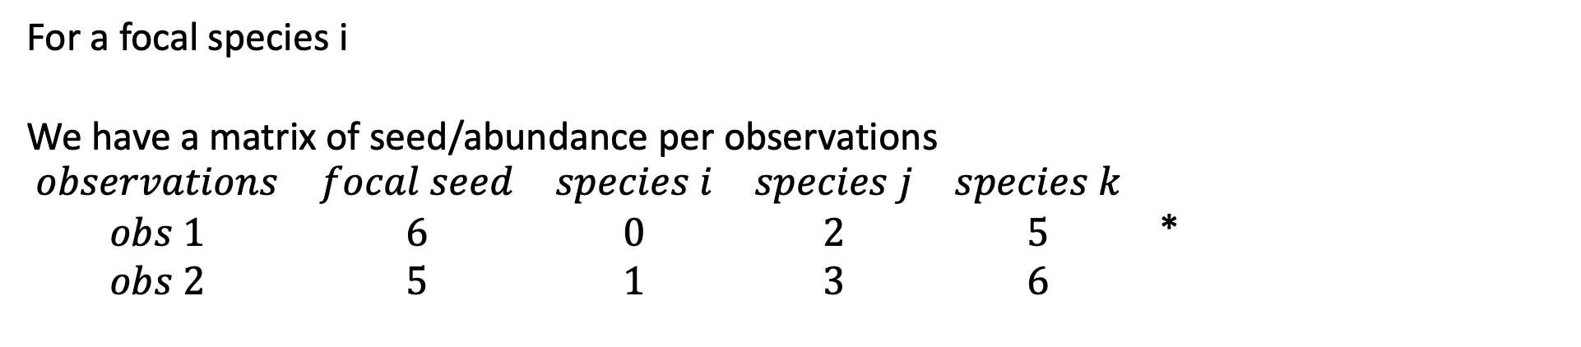
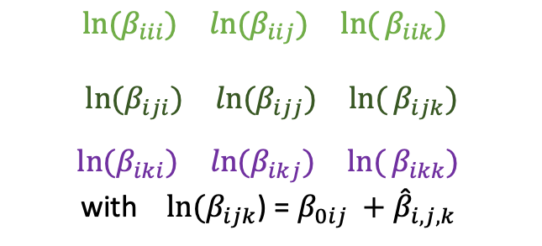
How to add HOIs ?
For a focal species i
We have a matrix of seed/abundance per observations
$\begin{matrix}observations & focal seed & species i & species j & species k \\ obs 1 & 6 & 0 & 2 & 5 \\ obs 2 & 5 & 1 & 3 & 6\end{matrix}$ *
Matrix of multiplied abundance for observations 1 $\begin{matrix} & i & j & k & \\ i & 0 & 0 & 0 & [ ] \\ j & 0 & 4 & 10 & [ ] \\ k & 0 & 10 & 25 & [ ]\end{matrix}$
$$\begin{matrix}ln⁡(β_{iii}) & ln⁡(β_{iij}) & ln({β_{iik})} \end{matrix}$$
$$\begin{matrix} ln⁡(β_{iji}) & ln⁡(β_{ijj}) & ln({β_{ijk})}\end{matrix}$$
$$\begin{matrix} ln⁡(β_{iki}) & ln⁡(β_{ikj}) & ln({β_{ikk})} \end{matrix}$$
with ${ln⁡(β}_{ijk}$) = ${β_{0ij} +\hat{β}}_{i,j,k}$

Slide 9
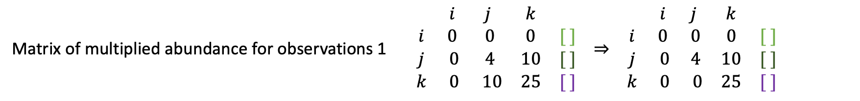
How to add HOIs ?
For a focal species i
We have a matrix of seed/abundance per observations
$\begin{matrix}observations & focal seed & species i & species j & species k \\ obs 1 & 6 & 0 & 2 & 5 \\ obs 2 & 5 & 1 & 3 & 6\end{matrix}$ *
Matrix of multiplied abundance for observations 1 $\begin{matrix} & i & j & k & \\ i & 0 & 0 & 0 & [ ] \\ j & 0 & 4 & 10 & [ ] \\ k & 0 & 10 & 25 & [ ]\end{matrix} ⇒ \begin{matrix} & i & j & k & \\ i & 0 & 0 & 0 & [ ] \\ j & 0 & 4 & 10 & [ ] \\ k & 0 & 0 & 25 & [ ]\end{matrix}$
$$\begin{matrix}ln⁡(β_{iii}) & ln⁡(β_{iij}) & ln({β_{iik})} \end{matrix}$$
$$\begin{matrix} ln⁡(β_{iji}) & ln⁡(β_{ijj}) & ln({β_{ijk})}\end{matrix}$$
$$\begin{matrix} ln⁡(β_{iki}) & ln⁡(β_{ikj}) & ln({β_{ikk})} \end{matrix}$$
with ${ln⁡(β}_{ijk}$) = ${β_{0ij} +\hat{β}}_{i,j,k}$

Slide 10
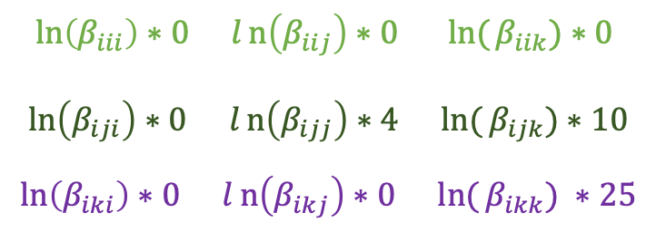
How to add HOIs ?
For a focal species i
We have a matrix of seed/abundance per observations
$\begin{matrix}observations & focal seed & species i & species j & species k \\ obs 1 & 6 & 0 & 2 & 5 \\ obs 2 & 5 & 1 & 3 & 6\end{matrix}$ *
Matrix of multiplied abundance for observations 1 $\begin{matrix} & i & j & k & \\ i & 0 & 0 & 0 & [ ] \\ j & 0 & 4 & 10 & [ ] \\ k & 0 & 10 & 25 & [ ]\end{matrix} ⇒ \begin{matrix} & i & j & k & \\ i & 0 & 0 & 0 & [ ] \\ j & 0 & 4 & 10 & [ ] \\ k & 0 & 0 & 25 & [ ]\end{matrix}$
$$\begin{matrix}ln⁡(β_{iii}) & ln⁡(β_{iij}) & ln({β_{iik})} \end{matrix}$$
$$\begin{matrix} ln⁡(β_{iji}) & ln⁡(β_{ijj}) & ln({β_{ijk})}\end{matrix}$$
$$\begin{matrix} ln⁡(β_{iki}) & ln⁡(β_{ikj}) & ln({β_{ikk})} \end{matrix}$$
with ${ln⁡(β}_{ijk}$) = ${β_{0ij} +\hat{β}}_{i,j,k}$
$$\begin{matrix}\ln\left(β_{iii}\right)∗0 & ln\left(β_{iij}\right)∗0 & ln({β_{iik})∗0} \end{matrix}$$
$$\begin{matrix}\ln\left(β_{iji}\right)∗0 & ln\left(β_{ijj}\right)∗4 & ln({β_{ijk})∗10}\end{matrix}$$
$$\begin{matrix}\ln\left(β_{iki}\right)∗0 & ln\left(β_{ikj}\right)∗0 & ln({β_{ikk})} ∗25\end{matrix}$$
HOIs of plants for focal i, obs 1 =>
Each row is summed to its corresponding $α_{i,X}$

Slide 11
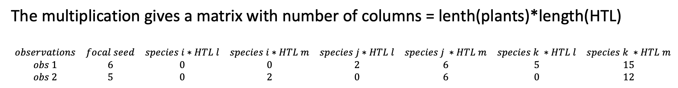
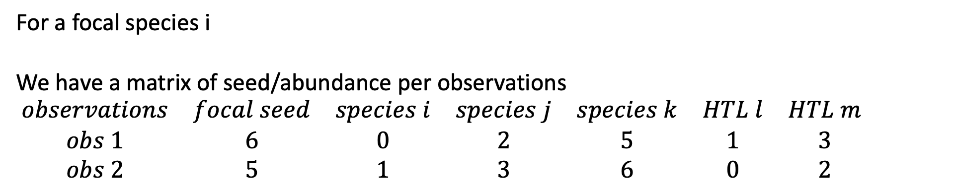
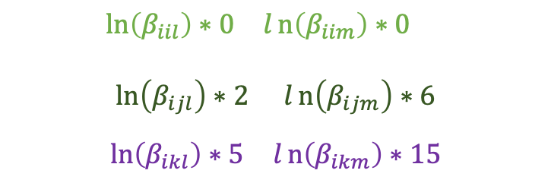
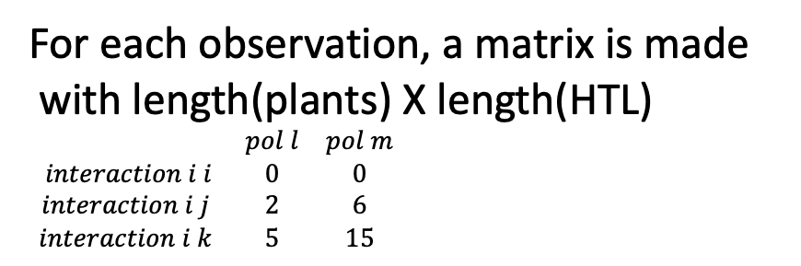
How to add HOIs for higher trophic level ?
For a focal species i
We have a matrix of seed/abundance per observations
$\begin{matrix}observations & focal seed & species i & species j & species k & HTL l & HTL m \\ obs 1 & 6 & 0 & 2 & 5 & 1 & 3 \\ obs 2 & 5 & 1 & 3 & 6 & 0 & 2\end{matrix}$
*
The multiplication gives a matrix with number of columns = lenth(plants)*length(HTL)
$\begin{matrix}observations & focal seed & species i∗HTL l & species i∗HTL m & species j∗HTL l & species j ∗HTL m & species k ∗HTL l & species k ∗HTL m \\ obs 1 & 6 & 0 & 0 & 2 & 6 & 5 & 15 \\ obs 2 & 5 & 0 & 2 & 0 & 6 & 0 & 12\end{matrix}$
For each observation, a matrix is made
with length(plants) X length(HTL)
$\begin{matrix} & pol l & pol m \\ interaction i i & 0 & 0 \\ interaction i j & 2 & 6 \\ interaction i k & 5 & 15\end{matrix}$
$$\begin{matrix}\ln\left(β_{iil}\right)∗0 & ln\left(β_{iim}\right)∗0 & \end{matrix}$$
$$\begin{matrix}\ln\left(β_{ijl}\right)∗2 & ln\left(β_{ijm}\right)∗6\end{matrix}$$
$$\begin{matrix}\ln\left(β_{ikl}\right)∗5 & ln\left(β_{ikm}\right)∗15\end{matrix}$$
HOIs of HTL for focal i, obs 1 =>

Slide 12
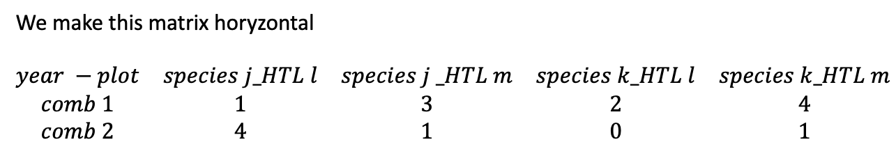
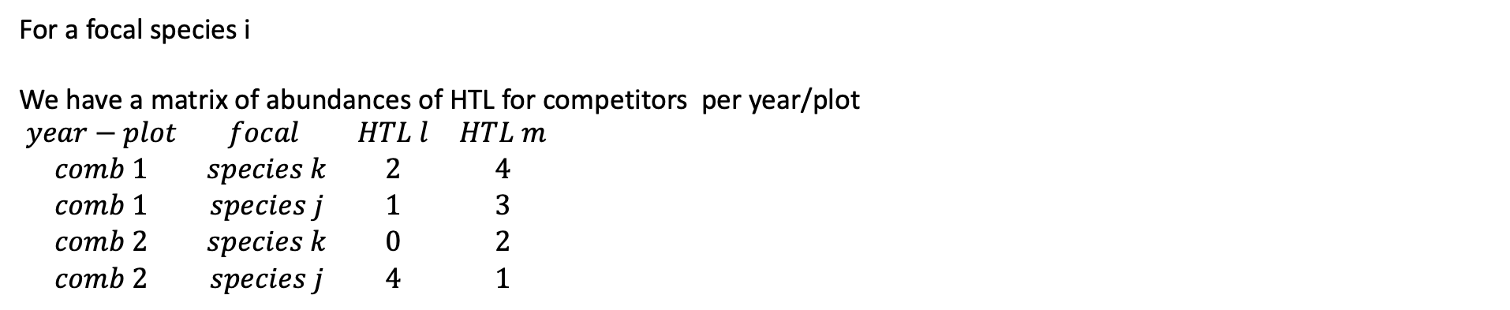
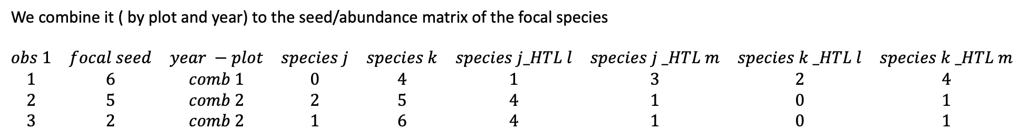
How to add HOIs for higher trophic level ?
For a focal species i
We have a matrix of abundances of HTL for competitors per year/plot
$\begin{matrix}year−plot & focal & HTL l & HTL m \\ comb 1 & species k & 2 & 4 \\ comb 1 & species j & 1 & 3 \\ comb 2 & species k & 0 & 2 \\ comb 2 & species j & 4 & 1\end{matrix}$
We make this matrix horyzontal
$\begin{matrix}year −plot & species j_HTL l & species j _HTL m & species k_HTL l & species k_HTL m \\ comb 1 & 1 & 3 & 2 & 4 \\ comb 2 & 4 & 1 & 0 & 1\end{matrix}$
We combine it ( by plot and year) to the seed/abundance matrix of the focal species
$\begin{matrix}obs 1 & focal seed & year −plot & species j & species k & species j_HTL l & species j _HTL m & species k _HTL l & species k _HTL m \\ 1 & 6 & comb 1 & 0 & 4 & 1 & 3 & 2 & 4 \\ 2 & 5 & comb 2 & 2 & 5 & 4 & 1 & 0 & 1 \\ 3 & 2 & comb 2 & 1 & 6 & 4 & 1 & 0 & 1\end{matrix}$
*

Slide 13
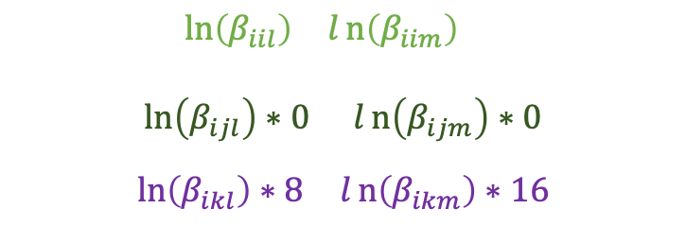
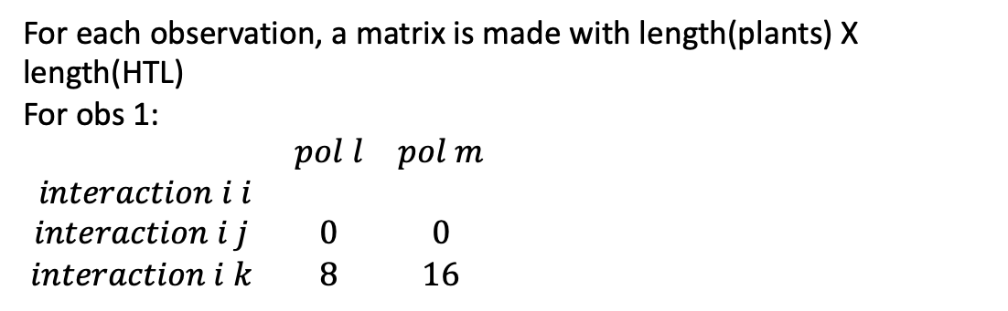
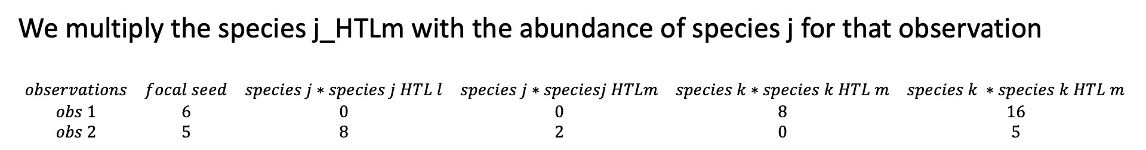
How to add HOIs for higher trophic level ?
We multiply the species j_HTLm with the abundance of species j for that observation
$\begin{matrix}observations & focal seed & species j∗species j HTL l & species j∗speciesj HTLm & species k∗species k HTL m & species k ∗species k HTL m \\ obs 1 & 6 & 0 & 0 & 8 & 16 \\ obs 2 & 5 & 8 & 2 & 0 & 5\end{matrix}$
For each observation, a matrix is made with length(plants) X length(HTL)
For obs 1:
$\begin{matrix} & pol l & pol m \\ interaction i i & & \\ interaction i j & 0 & 0 \\ interaction i k & 8 & 16\end{matrix}$
$$\begin{matrix}\ln\left(β_{iil}\right) & ln\left(β_{iim}\right) & \end{matrix}$$
$$\begin{matrix}\ln\left(β_{ijl}\right)∗0 & ln\left(β_{ijm}\right)∗0\end{matrix}$$
$$\begin{matrix}\ln\left(β_{ikl}\right)∗8 & ln\left(β_{ikm}\right)∗16\end{matrix}$$
HOIs of HTL for focal i, obs 1 =>

Slide 14
How to add HOIs for higher trophic level ?

Slide 15
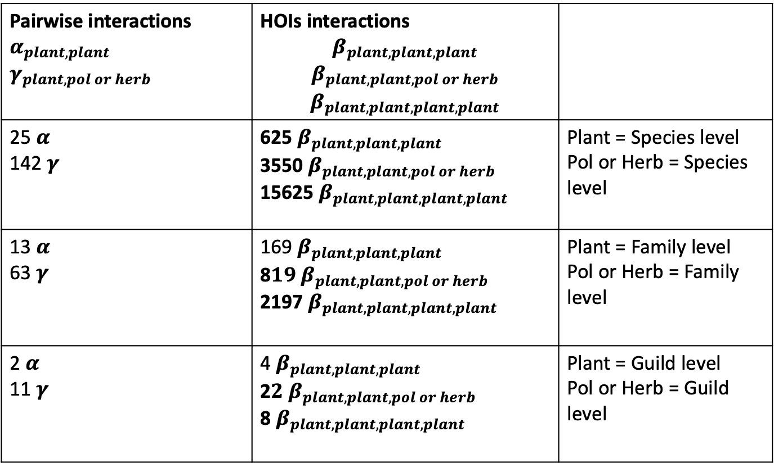
Plan
Sparsity approach
Pairwise interactions $α_{plant,plant}$ $$γ_{plant,pol or herb}$$ | HOIs interactions $$β_{plant,plant,plant}$$ $$β_{plant,plant,pol or herb}$$ $$β_{plant,plant,plant,plant}$$
25 $α$ 142 $γ$ | 625 $β_{plant,plant,plant}$ 3550$β_{plant,plant,pol or herb}$ 15625${ β}_{plant,plant,plant,plant}$ | Plant = Species level Pol or Herb = Species level
13 $α$ 63 $γ$ | 169 $β_{plant,plant,plant}$ 8$19 β_{plant,plant,pol or herb}$ 2197${ β}_{plant,plant,plant,plant}$ | Plant = Family level Pol or Herb = Family level
2 $α$ 11 $γ$ | 4 $β_{plant,plant,plant}$ 2$2 β_{plant,plant,pol or herb}$ 8${ β}_{plant,plant,plant,plant}$ | Plant = Guild level Pol or Herb = Guild level
Focal plant (species level) at year i
~

Slide 16
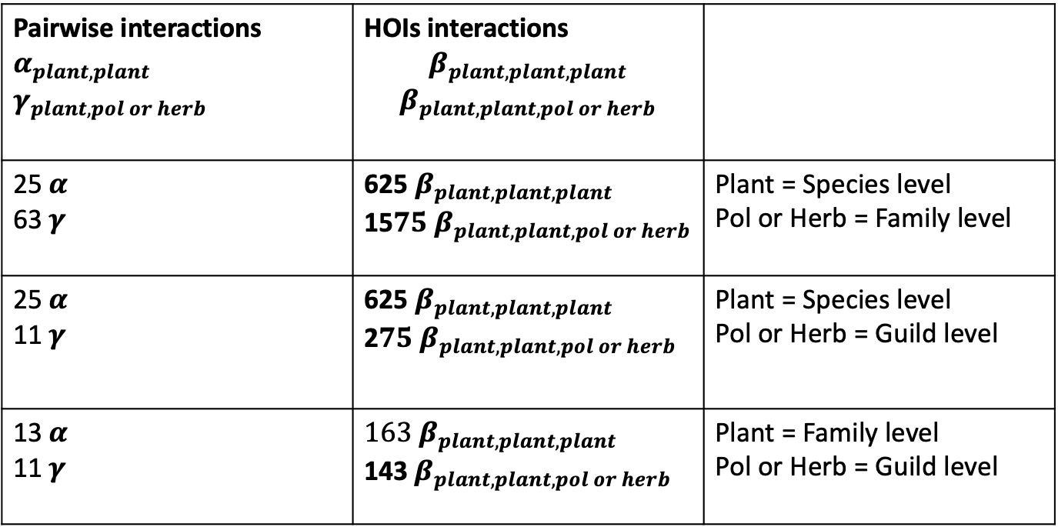
Plan
Gama and Beta always same level of complexity
Complexity of plant > complexity of pol or herb
Pairwise interactions $α_{plant,plant}$ $$γ_{plant,pol or herb}$$ | HOIs interactions $$β_{plant,plant,plant}$$ $$β_{plant,plant,pol or herb}$$
25 $α$ 63 $γ$ | 625 $β_{plant,plant,plant}$ 15$75 β_{plant,plant,pol or herb}$ | Plant = Species level Pol or Herb = Family level
25 $α$ 11 $γ$ | 625 $β_{plant,plant,plant}$ 2$75 β_{plant,plant,pol or herb}$ | Plant = Species level Pol or Herb = Guild level
13 $α$ 11 $γ$ | $163 β_{plant,plant,plant}$ 143$β_{plant,plant,pol or herb}$ | Plant = Family level Pol or Herb = Guild level
Focal plant (species level) at year i
~

Slide 17
Challenges
Computer power
How to select the best model ? RMSE (Martyn & al, 2021)
Standardise way to compute max/min of complexity for the selected model based on every years specific data available
How to use that model to push it further
Extract coefficient
Structural stability approach
NFD
Shoemaker & Hallett, 2019

