Slide 1


Slide 2

Goal of today’s meeting
Brainstorm ideas for summary figures
Methods to link species interactions with abundance across time and climate

Slide 3
Objectives of Chapt 3
Show that species interactions change across neighbours’ density (chapt2) and across time
Link species interactions to higher-level patterns, such as abundance over time and climate variables
Predict abundances over time from species interactions in different climatic scenarios

Slide 4
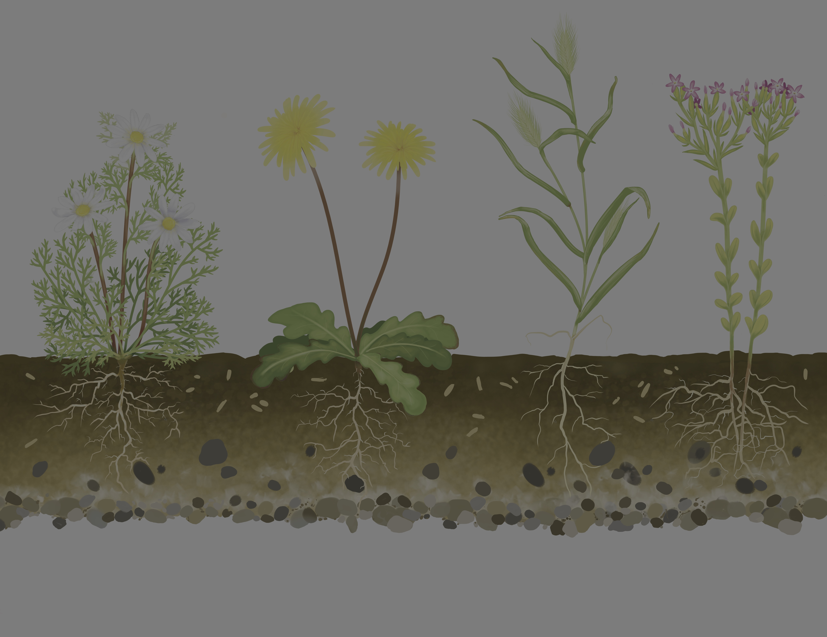
Where, what, when, who?
Spain Grassland
Plant–plant community
Time: 2015 – 2021
Data: fecundity data related to neighbours' condition
~ 10 consistent families of annual plants
~ 10 focal species

Slide 5
Output from species interactions’ estimations

Slide 6
Time series of Caracoles, Spain
LEMA

Slide 7
Intrinsic fitness across time

Slide 8
Species interaction across time

Slide 9
Environmental change across time

