Slide 1
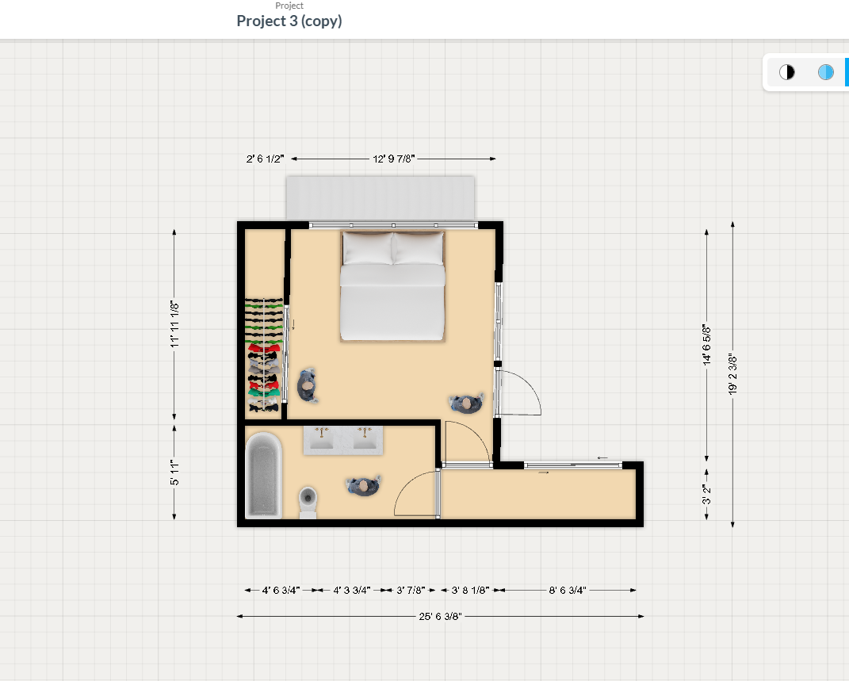
First floor
South East corner of current house
Panama Ave

Slide 2
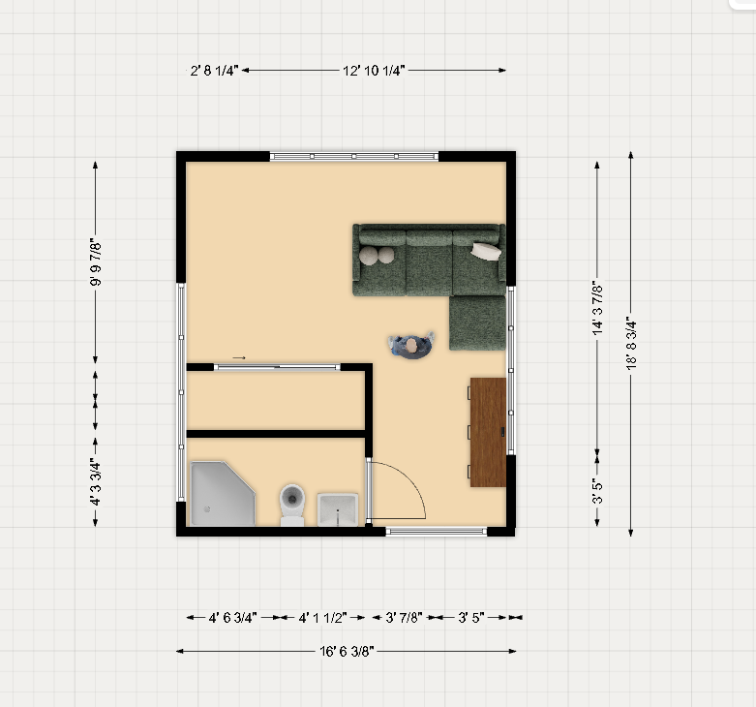
Second Story

