Slide 1
Accelerated Failure Time - Xgboost

Slide 2
Motivation
Alternative to Cox Proportional Hazard Model.
Capturing Non-Linear Pattern.
Doesn’t require base line to be calculated

Slide 3
Accelerated Failure Time - Xgboost
Parametric Survival Models + Tree Based Models.
Flexibility of choosing different distributions – Normal, Logistic and Extreme.
Supports left, right and interval censoring data.
Additional Hyperparameters – Sigma, Distribution, Starting Baseline

Slide 4
Data
Neuroblastoma data sets – Tumor Patient Data at the Institute Curie having gene profile.
Each data set has the following files, with the sequenceID column used to link them, and the following columns:
profiles: raw/noisy sequence data in which to look for changepoints.
position: position on chromosome (x axis in plot of sequence data)
signal: noisy data (y axis on plot of sequence data)
Outputs: interval of log(penalty) values that achieves min label errors, i.e. all log(penalty) values in (min.log.lambda, max.log.lambda) result in changepoint models with min label errors.
33 disease types.
Interval Censored Data
Link - https://github.com/tdhock/neuroblastoma-data/tree/master/data

Slide 5
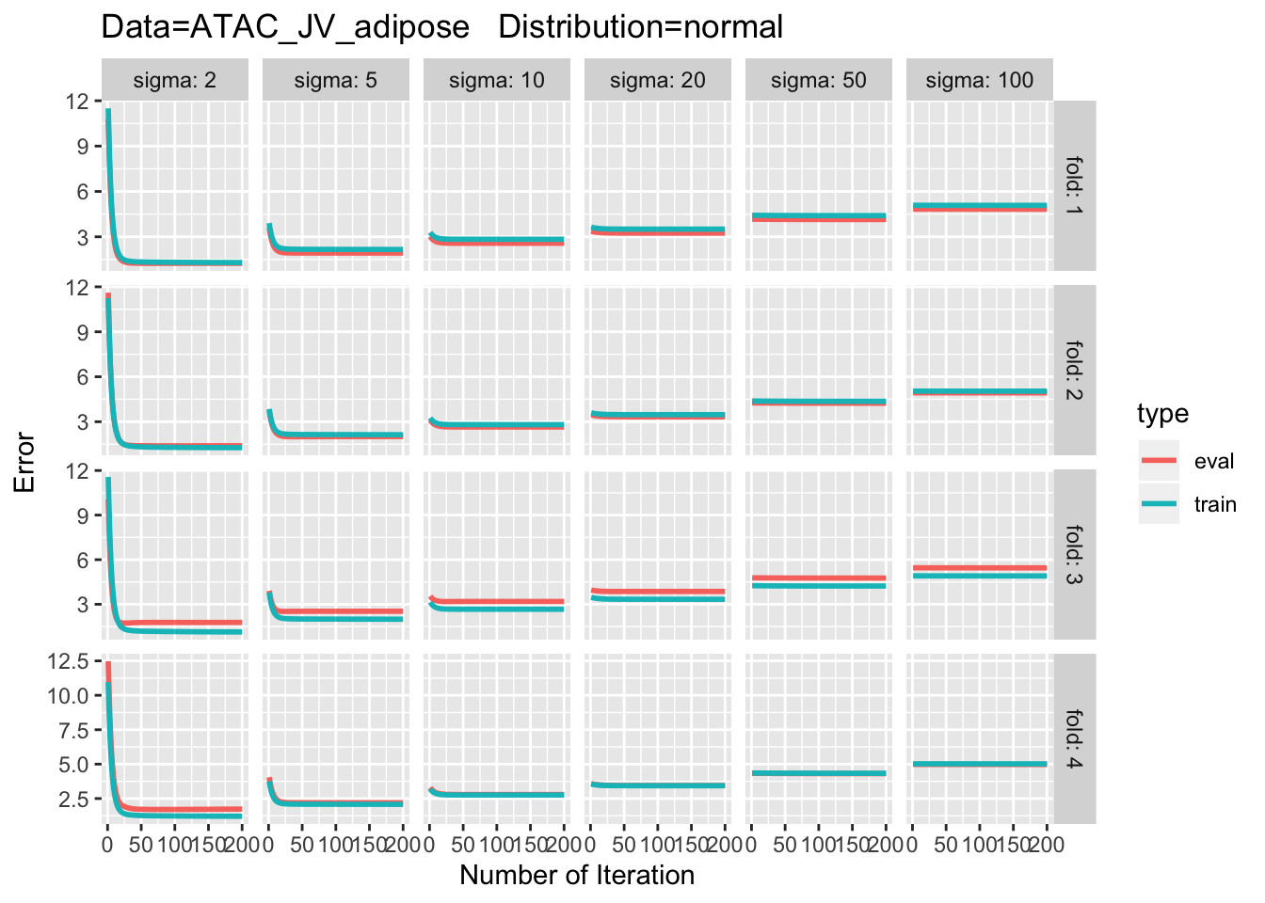
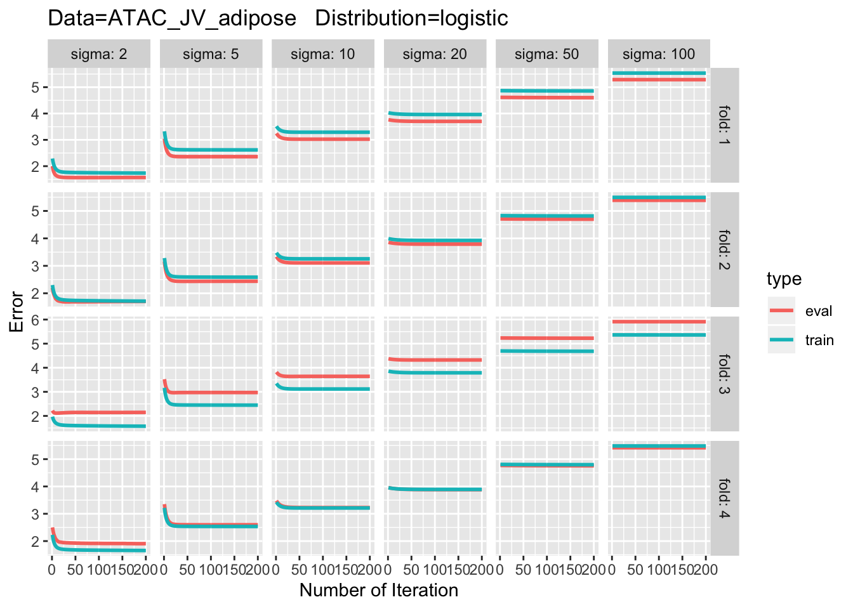
Results

Slide 6
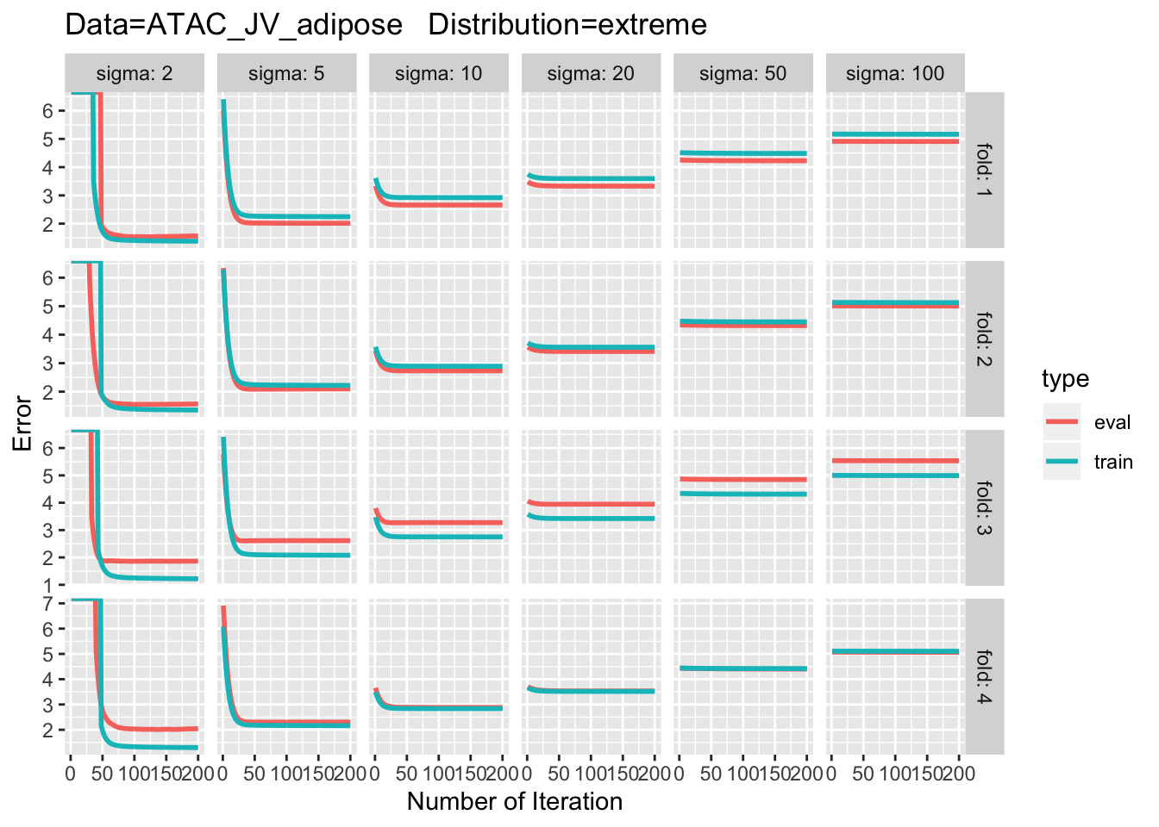
Results

Slide 7
Comparing Results
Survival Regression
Penalty Regression – Max Margin Interval Regression.
Transform Boosted Model – Choosing best variables in boosting

Slide 8
References
Transform Boosting Model - https://link.springer.com/content/pdf/10.1007%2Fs11222-019-09870-4.pdf
Interval Penalty Learning - http://proceedings.mlr.press/v28/hocking13.html
Survival Interval Regression - https://stats.idre.ucla.edu/r/dae/interval-regression/

