Slide 1
Blockchain framework for commodities and goods Distribution
A brief presentation
Riley Wall

Slide 2
Contents
Supply chains overview
Why use blockchains
Project implementation
Benefits/Lessons learned
Conclusions

Slide 3
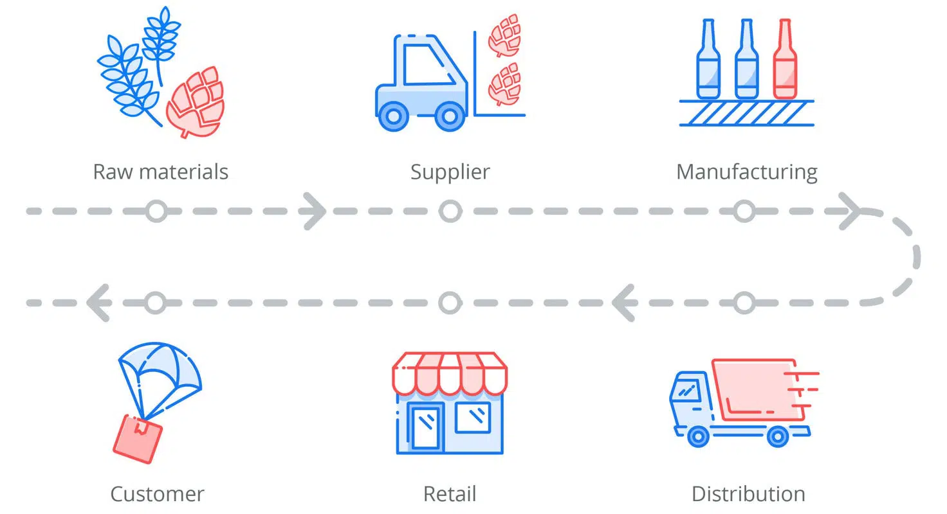
How supply chains work (Broadly and very quickly)
Raw materials are sent to manufacturers
Producers and manufactures produce goods and commodities for consumers.
Stores sell these goods to consumers
[2] Supply chain management explained: methods in modern business. Accessed: Dec. 4, 2021. [Online]. Available: https://www.unleashedsoftware.com/supply-chain-management-guide

Slide 4
Promising Blockchain features
Immutable:
Past transactions can’t be altered or forged.
Transparent:
Increases confidence in users.
Non-centralized:
No party control the means in which they communicate.
[4] Dujak, D., & Sajter, D. (2019). Blockchain applications in supply chain. In SMART supply network (pp. 21-46). Springer, Cham.
[5] Azzi, R., Chamoun, R. K., & Sokhn, M. (2019). The power of a blockchain-based supply chain. Computers & industrial engineering, 135, 582-592.

Slide 5
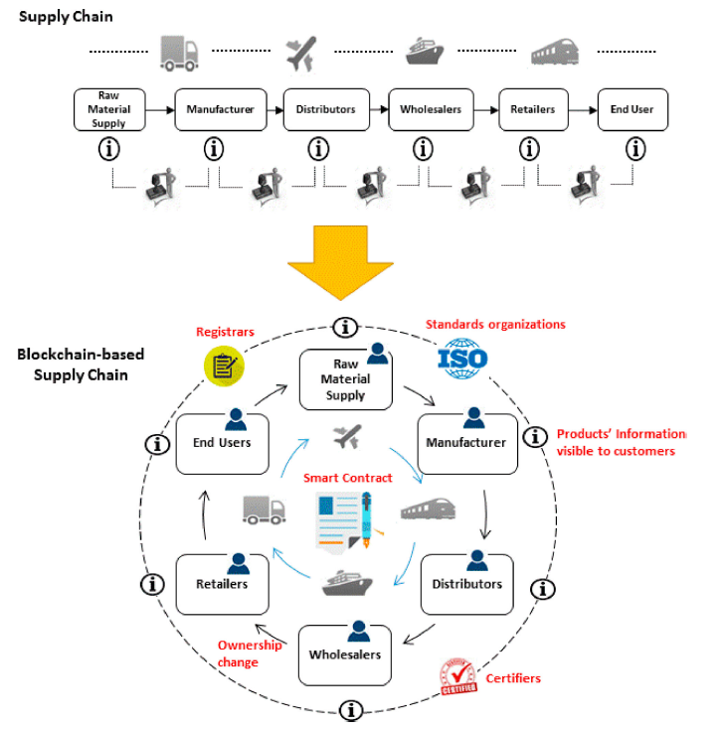
Blockchain-Based Supply chain
The design principles behind block-chain make them well suited to supply chain systems
Non-centralized, immutable, transparent
Helps to reduce complexity in communications
Helps to reduce intermediary steps
[1] Saberi, S., Kouhizadeh, M., Sarkis, J., & Shen, L. (2019). Blockchain technology and its relationships to sustainable supply chain management. International Journal of Production Research, 57(7), 2117-2135. (Fig 2)

Slide 6
How it works
Network participants deposit their tokens.
Can be done via payment channel, or through an exchange as a side-chain
Participants then use their deposited token to purchase goods from other participants.
Likewise, participants also sell their goods to other interested parties.
Finally, network participants withdraw their balance to their main wallet.

Slide 7
Project Implementation
Early into project development, I had decided to implement the functionality on the Ethereum blockchain (locally) using solidity smart contracts.
The contract handles the intermediary transactions between the participants. That is:
Depositing of tokens, storing of exchange receipts (Transaction data stored as a “bill”)
This choice had some larger technical implications, as we will see.

Slide 8
Project Implementation
Ideally, the platform would be implemented on a sidechain, or across multiple sidechains in order to avoid clogging the Ethereum main chain with the transactions of an entire supply chain infrastructure.
Unfortunately, I was unable to realize this in time to correct it. The implementation in my project remains on the Ethereum blockchain.
Additionally, my implementation does not include a complete payment exchange process for depositing and withdrawing of tokens.
As this project was never intended to see real-world commercial use, I believe not implementing a functioning payment channel was acceptable within the scope of this project.

Slide 9
Benefits
The functionality of solidity made implementing much of the control logic a simple task.
Different types of goods can deploy separate exchanges to facilitate better supply chain efficiency and reduce communication overhead for any individual exchange.
Brings all the advantages present with blockchain applications which happen to be features we value in trading. [Trust, reliability, decentralized, ect.]

Slide 10
Drawbacks Encountered
As mentioned, the decision to implement the system on Ethereum using Solidity smart contracts was made early in the development process and led to some technical issues as development dragged on.
The main issue encountered was with the implementation of the side chain. As Solidity can run on several Ethereum based blockchains, selecting a more suitable/established blockchain network would lend itself to a more open exchange where many various tokens could be redeemed.

Slide 11
Further development
Future supply-chain/resource exchange applications should consider deploying on more connected Ethereum sidechains/cross chains such as Polkadot.
This would allow for more token types to be supported much easier
Additionally, changes could be made to the transaction/block structure to make it more efficient.

Slide 12
Conclusions
Decentralized exchanges allow for more efficient and lest costly supply chain operation
Blockchains are a technology with many properties which are advantageous to trading platforms
Platforms built to operate on sidechains would offer greater payment flexibility and reduce load on larger blockchain networks.

Slide 13
Thank you
References
[1] Saberi, S., Kouhizadeh, M., Sarkis, J., & Shen, L. (2019). Blockchain technology and its relationships to sustainable supply chain management. International Journal of Production Research, 57(7), 2117-2135.
[2] Supply chain management explained: methods in modern business. Accessed: Dec. 4, 2021. [Online]. Available: https://www.unleashedsoftware.com/supply-chain-management-guide
[3] Esmaeilian, B., Sarkis, J., Lewis, K., & Behdad, S. (2020). Blockchain for the future of sustainable supply chain management in Industry 4.0. Resources, Conservation and Recycling, 163, 105064. [4] Dujak, D., & Sajter, D. (2019). Blockchain applications in supply chain. In SMART supply network (pp. 21-46). Springer, Cham.
[5] Azzi, R., Chamoun, R. K., & Sokhn, M. (2019). The power of a blockchain-based supply chain. Computers & industrial engineering, 135, 582-592.
*while not all of these may be explicitly referenced on each slide, general ideas on the suitability of blockchain for supply chain management common to these resources were critical in both the initial methodology as well as the demand for such an application.

