Slide 1

Machine Learning, Artificial Intelligence and Deep Learning for the Data Professional
Buck Woody – Microsoft
Applied Data Scientist

Slide 2

Data Science

Slide 3
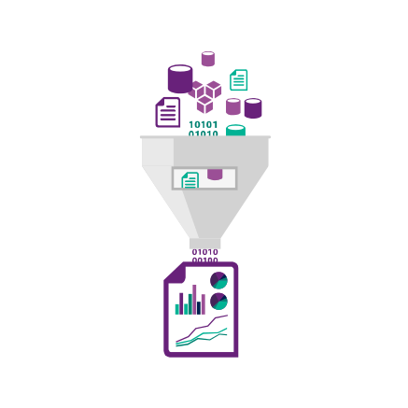

Data Science Described
Data Analysis
  Create, Read, Update Delete
  Programming and Control
  Reporting
  Business Intelligence
  Statistics and Data Mining
  Story Telling
Scientific Process
  Define the Question
  (Create Hypothesis)
  Create a Repeatable Test
  Publish Results
Artificial Intelligence
  Machine Learning
  Deep Learning
http://aka.ms/tdsp

Slide 4
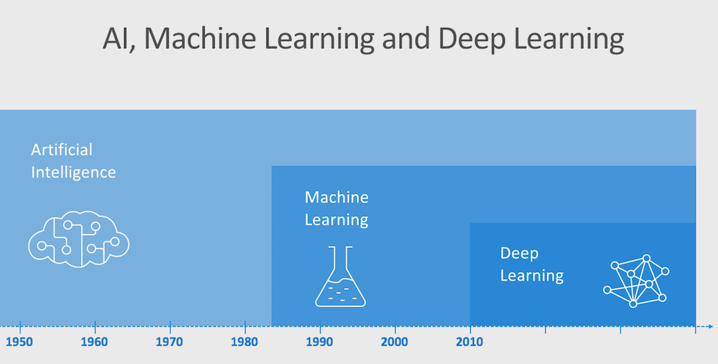
Progression
Notes:
AI: Distinguished by input systems, any mathematical technique that mimics human behavior
ML: Using combinations of mathematical formulae to act over data, improving a prediction or classification from that data
DL: Using specialized layers of algorithms to train a model through the layers to create a prediction or classification
As an example, a machine learning workflow starts with relevant features being manually extracted from images. The features are then used to create a model that categorizes the objects in the image. With a deep learning workflow, relevant features are automatically extracted from images. In addition, deep learning performs “end-to-end learning” – where a network is given raw data and a task to perform, such as classification, and it learns how to do this automatically.
Another key difference is deep learning algorithms scale with data, whereas shallow learning converges. Shallow learning refers to machine learning methods that plateau at a certain level of performance when you add more examples and training data to the network.
A key advantage of deep learning networks is that they often continue to improve as the size of your data increases.

Slide 5
Artificial Intelligence

Slide 6
Artificial Intelligence
“Human intelligence can be so precisely described that a machine can be made to simulate it."
Dartmouth Summer Research Project on Artificial Intelligence, 1956
Development
Symbolic
Statistical
Inference
Information Theory
Logic
Fuzzy Systems
Simulation
Hidden Markov Models
Expert Systems
Normative Bayesian Decision Theory
Evolutionary Computing

Slide 7






Artificial Intelligence Uses and Implementation Families
Vision
Speech
Language
Knowledge
Search
Labs
Video Indexer
Speaker Recognition
Text Analytics
QnA Maker
Bing Entity Search
Project Gesture
Computer Vision
Bing Speech
Bing Spell Check
Azure Search
Bing Autosuggest
Project Local Insights
Face
Custom Speech
Translator Text
Bing Search
Project Academic Knowledge
Emotion
Translator Speech
Language Understanding (LUIS)
Web Search
Project Entity Linking
Content Moderator
Unified Speech
Custom Vision
Image Search
Project Knowledge
Exploration
Custom Vision
Speech to Text
w. Custom Speech
News Search
Project Event Tracking
Text to Speech
w. Custom Voice
Video Search
Project Answer Search
Speech Translation
w. Custom Translator
Bing Statistics add-in
Project URL Preview
Bing Visual Search
Project Anomaly Finder
Bing Custom Search
Project Conversation Learner
Project Personality Chat
Notes:
https://azure.microsoft.com/en-us/services/cognitive-services/directory/vision/
Example Code: https://docs.microsoft.com/en-us/azure/cognitive-services/Computer-vision/QuickStarts/python-analyze
Vision: Image-processing algorithms to smartly identify, caption and moderate your pictures
Computer vision: Distill actionable information from images
Content Moderator: Automatically moderate potentially offensive images, text and videos
Customer Vision Service: Train a web service to recognize specific content in images
Face: Identify human faces and emotions in images
Video indexer: Easily extract insights from your videos to enrich your applications
Speech: Convert spoken audio into text, use voice for verification, or add speaker recognition to your app
Bing Speech: Convert speech to text and text to speech
Speaker Recognition: Use speech to identify and authenticate individual speakers
Custom Speech Service: Overcome speech recognition barriers like speaking style, background noise, and vocabulary
Translator Speech: Easily conduct real-time speech translation on your app
Language: Enable your apps to process natural language with pre-built scripts, evaluate sentiment and learn how to recognize what users want
Bing Spell Check: Add spell checking functionality to your app
Language Understanding (LUIS): Add language understanding intelligence to your apps with minimal effort
Linguistic Analysis: Easily parse complex text with language analysis
Text Analytics: Easily evaluate sentiment, language, and key phrases to understand what users want
Translator Text: Easily conduct machine translation for 60+ languages
Knowledge: Map complex information and data in order to solve tasks such as intelligent recommendations and semantic search
Knowledge Exploration Service: Enable interactive search experiences over structured data via natural language inputs
Entity Linking Service: Power your app's data links with named entity recognition and disambiguation
Academic Knowledge: Tap into the wealth of academic content in the Microsoft Academic Graph using the Academic Knowledge API
QnA Maker: Distill information into an easy-to-navigate FAQ for bot services
Customer Decision Service: Create custom experiences with adaptive, contextual decision-making
Search: Add Bing Search APIs to your apps and harness the ability to comb billions of webpages, images, videos, and news with a single API call
Bing Autosuggest: Give your app intelligent autosuggest options for searches
Bing News Search: Search for news and get comprehensive results
Bing Web Search: Get enhanced search details from billions of web documents
Bing Entity Search: Enrich your experiences by identifying and augmenting entity information from the web
Bing Image Search: Search for images and get comprehensive results
Bing Video Search: Search for videos and get comprehensive results
Bing Custom Search: Create tailored site search or vertical search experiences for topics you care about
Labs: Cognitive Services Labs are early preview limited availability leading innovation APIs and SDKs that allow developers to start experimenting with Microsoft’s latest and greatest Cognitive Services.
Project Prague: SDK to incorporate gesture-based controls into your apps. Quickly define and implement customized hand gestures, creating a more natural user experience. Limited private preview availability at launch.
Project Cuzco: API to help developers find events associated with Wikipedia entities. Begin with a Wikipedia entity, and receive a list of related events organized by time.
Project Johannesburg: API to calculate route logistics for with deeper location intelligence to account for specific enterprise requirements. IE: weight, height length, hazardous materials, etc.
Project Nanjing: API to calculate isochrones - time and distance-based recommendations for enterprise route optimization.
Project Abu Dhabi: API to create distance matrices, enabling you to calculate a histogram of travel times, and serve as stepping stone for enterprise route optimization.
Project Wollongong: API to help ‘score’ the attractiveness of a location, based on how many of a particular amenity are within a specific distance. Ex: restaurants, parks, transit stops.
With Cognitive Services, developers can easily add intelligent features – such as emotion and sentiment detection, vision and speech recognition, knowledge, search and language understanding – into their applications. The collection will continuously improve, adding new APIs and updating existing ones.
Cognitive Services includes:
<click>
Vision: From faces to feelings, allow apps to understand images and video
<click>
Speech: Hear and speak to users by filtering noise, identifying speakers, and understanding intent
<click>
Language: Process text and learn how to recognize what users want
<click>
Knowledge: Tap into rich knowledge amassed from the web, academia, or your own data
<click>
Search: Access billions of web pages, images, videos, and news with the power of Bing APIs
Why choose these APIs? They work, and it’s easy.
<click>
Easy: The APIs are easy to implement because of the simple REST calls. There’s a common way to implement, and you can get started with all of them for free simply by going to one place, one website, www.microsoft.com/cognitive.
Flexible: We’ve got a breadth of intelligence and knowledge APIs so developers will be able to find what intelligence feature they need. And, importantly, they all work on whatever language, framework, or platform developers choose. So, developers can integrate into their apps—iOS, Android, Windows—using their own tools they know and love.
Tested: Tap into an ever-growing collection of powerful AI algorithms developed by experts. Developers can trust the quality and expertise build into each API by experts in their field from Microsoft’s Research organization, Bing, and Azure machine learning and these capabilities are used across many Microsoft first party products such as Cortana, Bing and Skype.
Transition: When it comes to real-world applications for Cognitive Services, the sky is the limit! Let’s look at some examples.
<click>

Slide 8
Learning Resource
https://aischool.microsoft.com/

Slide 9
Machine Learning

Slide 10

Machine Learning
The Formal Definition:
“A computer program is said to learn from experience E with respect to some class of tasks T and performance measure P if its performance at tasks in T, as measured by P, improves with experience E.”

Slide 11





Machine Learning Simplified
Model - If:
Open top = TRUE
Closed bottom = TRUE
Holds liquid = TRUE
Hand-sized = TRUE
…
Then
CUP = TRUE
Features
Label
Image | OpenTop | ClosedBottom | HoldsLiquid | Hand-Sized | IsCup
 | TRUE | TRUE | TRUE | TRUE | TRUE
 | TRUE | TRUE | TRUE | TRUE | TRUE
 | TRUE | TRUE | TRUE | TRUE | TRUE
 | FALSE | FALSE | FALSE | FALSE | FALSE
Score :
CUP = TRUE
CERTAINTY = 90%

Slide 12
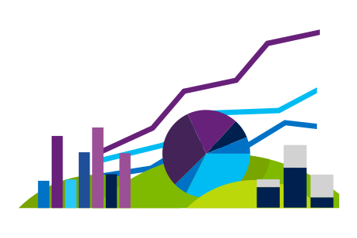
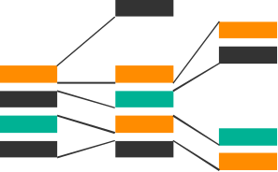










Machine Learning Uses and Algorithm Families
Which group
(Clustering,
Recommender)
How much/many
(Regression)
Which category
(Classification)
Which action
(Reinforcement Learning)
Is it odd
(Anomaly)

Slide 13
Languages and Libraries
Language | Libraries
R | Standard Libraries and Packages, E1071, rpart, randomForest, caret, kernlab, glmnet, ROCR, gbm, party, arules, tree, klaR, Rweka, ipred, lars, earth, CORElearn, mboost
Python | TensorFlow, Scikit-Learn, Numpy, Keras, PyTorch, LightGBM, Eli5, SciPy, Theano, Pandas
Platform-Specific (Spark, Hadoop, etc.) | MLLib, PySpark, SparkR, … (Spark), Etc.
SQL (data selection and preparation) | N/A
Java (primarily data preparation) | ADAMS, Deeplearning4j, ELKI, JavaML, JSAT, Mahout, MALLET, Massive Online Analysis, RapidMiner, Weka.

Slide 14
Example Code
# a) linear algorithms
set.seed(7)
fit.lda <- train(Species~., data=dataset, method="lda", metric=metric, trControl=control)
# b) nonlinear algorithms
# CART
set.seed(7)
fit.cart <- train(Species~., data=dataset, method="rpart", metric=metric, trControl=control)
# kNN
set.seed(7)
fit.knn <- train(Species~., data=dataset, method="knn", metric=metric, trControl=control)
# c) advanced algorithms
# SVM
set.seed(7)
fit.svm <- train(Species~., data=dataset, method="svmRadial", metric=metric, trControl=control)
# Random Forest
set.seed(7)
fit.rf <- train(Species~., data=dataset, method="rf", metric=metric, trControl=control)
Source: https://machinelearningmastery.com/machine-learning-in-r-step-by-step/
Notes:
https://studio.azureml.net/Home/ViewWorkspaceCached/b9548ddf771d4324acf445c4b705df8d#Workspaces/Experiments/Experiment/b9548ddf771d4324acf445c4b705df8d.f-id.0c2bb13534f34495966dc43d80b4394c/ViewExperiment

Slide 15
Learning Resource
https://www.edx.org/course/data-science-essentials

Slide 16
Deep Learning

Slide 17



Complex Predictions and Classifications

Slide 18
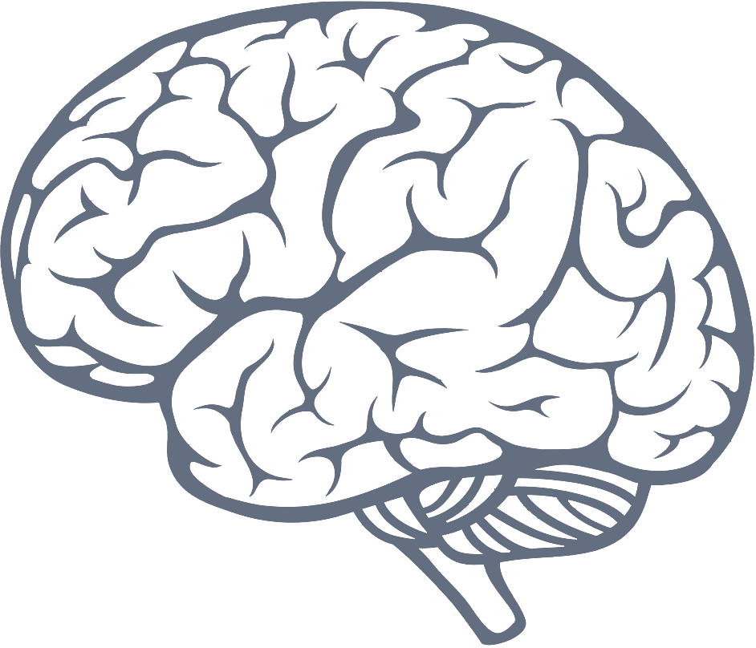
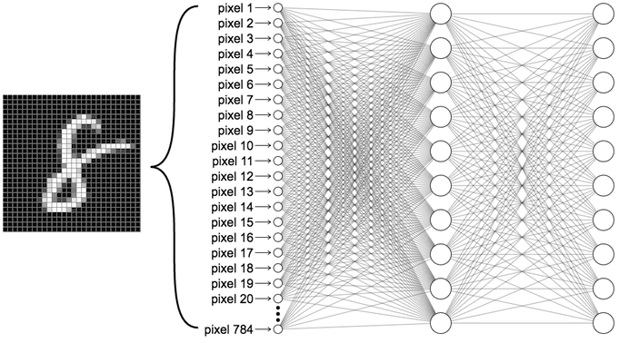
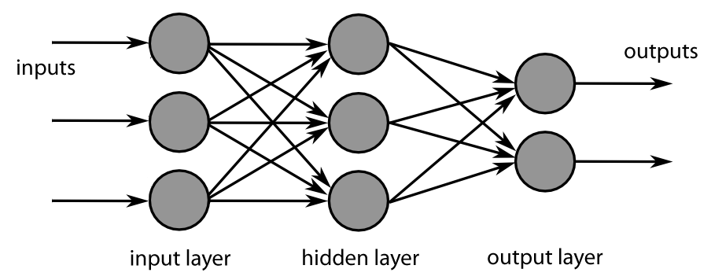
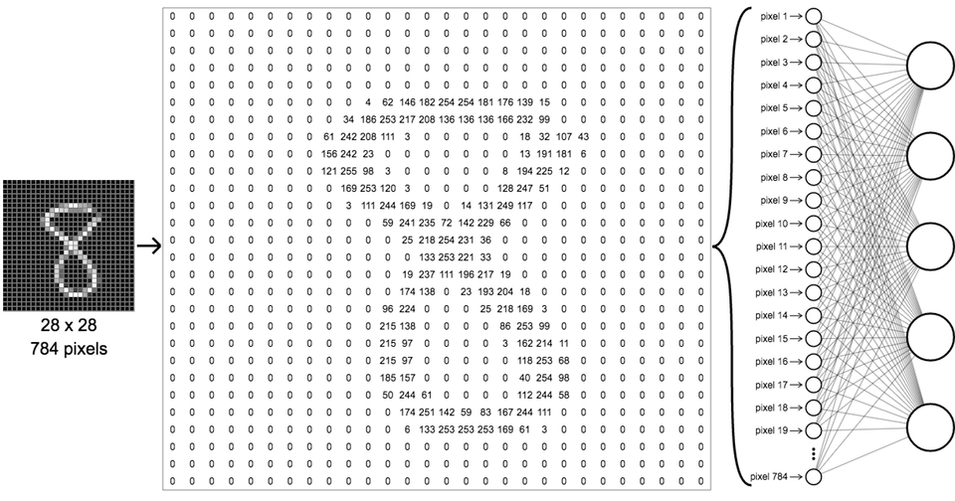
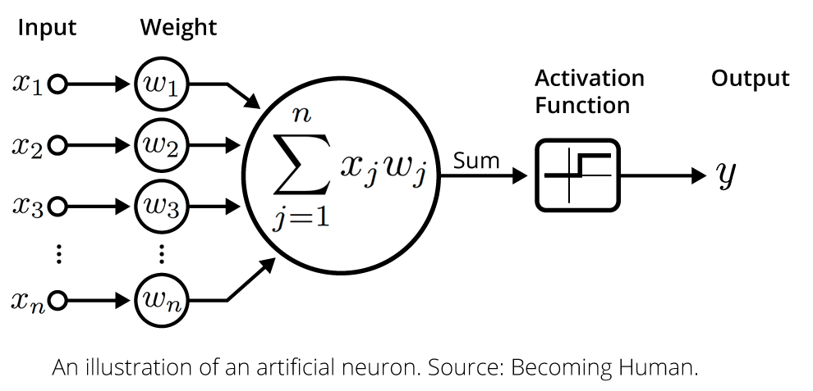
Understanding Deep Learning
Learning through layers
Notes:
https://elitedatascience.com/keras-tutorial-deep-learning-in-python
https://aitold.me/
Deep learning, a subset of machine learning, is a part of a broader family of machine learning methods based on learning data representations, as opposed to task-specific algorithms. Learning can be supervised, semi-supervised or unsupervised. Most modern deep learning models are based on an artificial neural network, although they can also include propositional formulas or latent variables organized layer-wise in deep generative models such as the nodes in deep belief networks and deep Boltzmann machines.
DL uses a hierarchical level of artificial neural networks to carry out the process of machine learning. The artificial neural networks are built like the human brain, with neuron nodes connected together like a web. While traditional programs build analysis with data in a linear way, the hierarchical function of deep learning systems enables machines to process data with a nonlinear approach. The ”Deep” in Deep Learning refers to the number of layers where the data is transformed.
The first layer of the neural network processes a raw data input. In the case of fraud detection, the amount of a bank transaction is accepted and acted on and passed to the next layer as output. The next layer takes the second layer’s information and includes raw data like geographic location and makes the machine’s pattern even better. This continues across all levels of the neuron network.

Slide 19
Learning Resource
https://www.youtube.com/watch?v=r0Ogt-q956I
Notes:
https://www.youtube.com/watch?v=QSaZGT4-6EY
https://www.mathworks.com/discovery/deep-learning.html
https://www.datasciencecentral.com/profiles/blogs/the-mathematics-of-data-science-understanding-the-foundations-of

Slide 20
Platforms and Tools

Slide 21
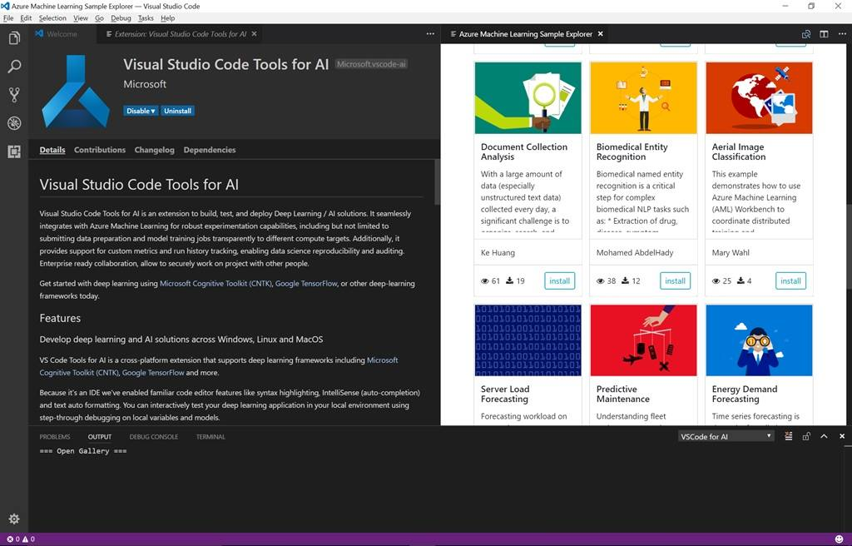
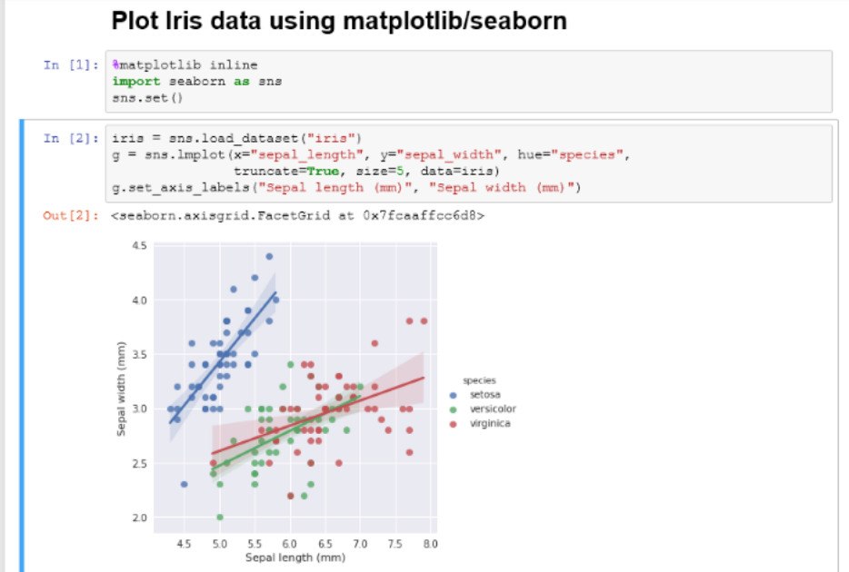
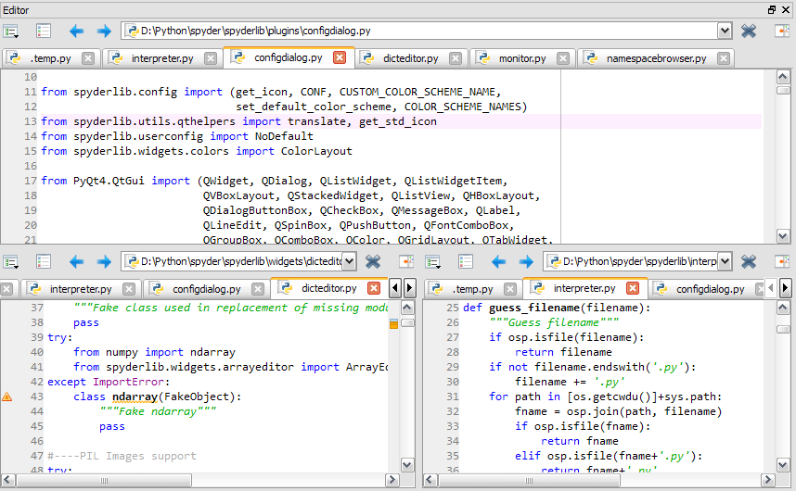
Development Tools: Jupyter, VS Code, Azure Data Studio, Visual Studio, and 3rd Party,
SDK’s and R/Python Packages
(Available on the Azure Data Science Virtual Machine)
http://LearnAI-DataScienceVM
Notes:
Data Science Blog - https://buckwoody.wordpress.com/

Slide 22






Platforms - ML/AI/DL on Azure
Sophisticated pretrained models
To accelerate solution development with easy to use pretrained models
…
Vision
Speech
Language
Search
Cognitive Services
Popular frameworks
Build sophisticated deep learning solutions
Pytorch
TensorFlow
Keras
Onnx
Productive services
Empower your development teams
Azure
Databricks
Azure
Machine Learning
Machine Learning
VMs
Powerful infrastructure
Accelerate time to value
CPU
GPU
FPGA
Notes:
Azure Machine Learning services
Machine learning at big data scale
Container based AI deployment from cloud to edge
Rapid, scale out, collaborative experimentation
AI powered data wrangling
Spark, Docker, Cognitive Toolkit, TensorFlow, Caffe, and more
Azure Databricks
Bring teams together in an interactive workspace. From data gathering to model creation, use Databricks Notebooks to unify the process and instantly deploy to production. Launch your new Spark environment with a single click. Integrate effortlessly with a wide variety of data stores and services such as Azure SQL Data Warehouse, Azure Cosmos DB, Azure Data Lake Store, Azure Blob storage, Azure Event Hubs, Azure IoT Hub, and Azure Data Factory. Add advanced artificial intelligence (AI) capabilities instantly and share your insights through rich integration with Power BI.
Other Ignite Sessions -

Slide 23
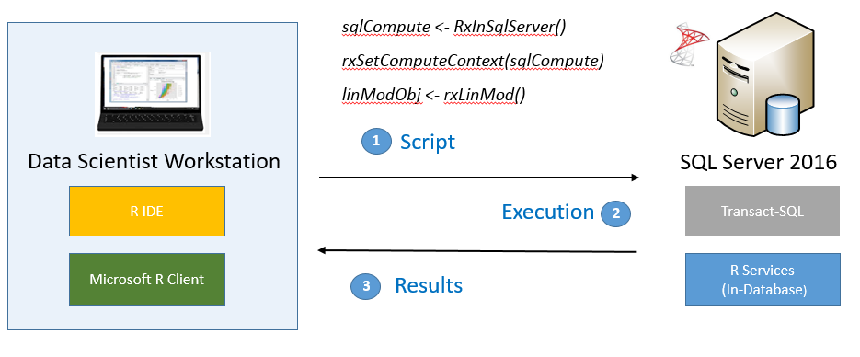
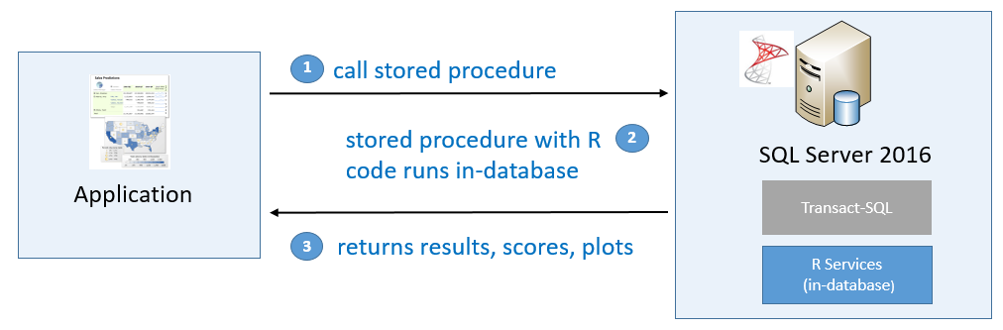
Platforms – SQL Server
Support for major languages
T-SQL for data work
SSIS for Data Engineering
Ground to Cloud
Complete Ecostructure
Training and Deployment target
Uses the Machine Learning Extensibility Framework

Slide 24



Hybrid Modeling and Deployments
Deploy and manage models on internal systems or intelligent cloud and edge
Train & deploy
Train & deploy
Track models in production
Capture model telemetry
Retrain models automatically
Deploy
Notes:
We are the only company that offers ability to deploy and manage models whether in the cloud, on-premises or even the edge.
This is extremely valuable in disconnected scenarios where predictions have to be made on the edge w/o connectivity to the cloud.
With IoT deployments becoming more widespread, we are well positioned to help our customers innovate with AI wherever they want.
So, you should be excited with our Machine Learning portfolio.

Slide 25

Resources
SQL Server Workshops
http://aka.ms/sqlworkshops
(look for SQL Server Machine Learning)

