Slide 1
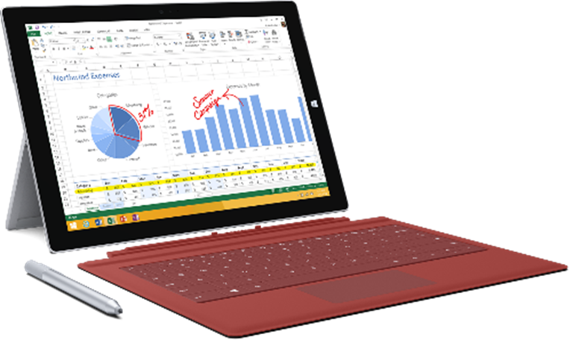

SQL Server 2019 Big Data Clusters
Architecture Workshop
Wi-Fi Event Code:
On the back-bottom of your badge
Notes:
Welcome the Students
Get them started on the course location

Slide 2

aka.ms/sqlworkshops
The Big Data Landscape
Module 01
SQL Server 2019 BDC Components
Module 02
Planning, Install and Configuration
Module 03
Operationalization
Module 04
Management and Monitoring
Module 05
Security
Module 06
Notes:
Explain the Modules
Point to the github, orient
Success factors:
RTFM
Take notes
Everything in the VM
Do the Work
Work with your neighbor
We stay together when we are supposed to – will pose the question, must answer honestly

Slide 3















SQL Server 2019
Solving Modern Data Challenges
ciphertext
Polybase++
Query
SQL
101001010110
Secure Enclaves
Intelligent
Query Processing
Learn
Memory grant
Enclave
In-Memory Databases
plaintext
Cosmos DB
Data Classification
Run query
Built-in Machine Learning and Extensibility
High Availability
R
Modern Platforms with Compatibility
Accelerated Database Recovery
Notes:
5 mins
This is animated in this sequence
Data Virtualization with Polybase and Big Data Clusters
Intelligent Query Processing and In-Memory databases
Security enhancements with Always encrypted with enclaves
New HA capabilities such enhancements for AGs, built-in HA support from k8s and OpenShift, and Accelerated Database Recovery
Extensibility now with Java
Modern platforms choices with compatibility – Backup a db on any of these and restore to any of these

Slide 4
Module 01
The Big Data Landscape
sqlworkshops/sqlserver2019bigdataclusters/SQL2019BDC/01 - The Big Data Landscape
Notes:
(Module Slide)
Check that everyone is at this location

Slide 5


Data Growth
Computing and Storage advances impact data collection abilities
sqlworkshops/sqlserver2019bigdataclusters/SQL2019BDC/01 - The Big Data Landscape
Computing and Storage technologies allow greater data collection points
They also allow longer historical data storage, and as time goes on become part of that storage lineage
Large Retailers are a classic example of data proliferation and leverage
Notes:
Interesting use of Big Data at Walmart: https://www.dezyre.com/article/how-big-data-analysis-helped-increase-walmarts-sales-turnover/109
451 Research recently published its H1 2019 Voice of the Enterprise: Data & Analytics, which is designed to provide a broad, integrated view of enterprise data processing and analytics strategy and initiatives, business drivers, underlying technology, and the nature, pace and direction of adoption. It is based on a survey of approximately 600 IT end-user decision-makers conducted in early 2019. Below we’ve highlighted 451’s perspective and summarized overarching findings as well as workload-specific findings.
451’s Take
The data platforms landscape is in the midst of a seismic shift, driven by accelerated public and private cloud adoption.
Transactional workloads show the greatest propensity for change. It isn’t simply a matter of emerging workloads (such as those involving hybrid operational and analytic processing or data science) driving change – although that is happening. There is also a significant shift away from established vendors, deployment locations, licensing, data models and scaling architecture for the workloads that represent ‘home turf’ for incumbent vendors.
The most data-driven companies are ahead of the competition and pulling further away. The companies most driven by data are taking active steps through the adoption of new technologies and organizational approaches, and have a significant advantage over the least data-driven companies in terms of enjoying successful projects and gaining a competitive advantage.
Summary of Key Findings
A growing majority – 91% – say at least some of their strategic decisions are driven by data.
Eighty percent of respondents say data will be increasingly important to their organization 12 months from now, and 95% say that it will be as important or more.
The most data-driven companies have been significantly more successful with data and analytics projects to date (91%), compared with less than 60% of those that are least data-driven.
Improved operational efficiency is the primary benefit enterprises are seeing from data and analytics workloads, as 55% of respondents note.
There is a significant split between the attitudes of companies in North America and EMEA. Nineteen percent of North American respondents are Data Drivers, compared with 10% of those in EMEA.
The highest interest in emerging analytics interface technologies is for real-time alerts driven by automated anomaly detection. This is seen as more beneficial than natural language text and speech interfaces.
Summary of Workload-Specific Findings
451 expects to see the greatest swing to a new data platform vendor with hybrid operational and analytic processing (HOAP) workloads; 29% of respondents indicate that they expect to be using a new vendor for HOAP two years from now.
Data science and discovery is also expected to drive traction for new data platform vendors (28%) and shows the greatest adoption of cloud-based data platforms (75%) two years from now. Non-transactional workloads are more likely than transactional workloads to be migrated to the cloud in the next 2 years.
HOAP workloads are expected to see the greatest adoption of open source databases (47%) and the greatest adoption of non-relational data models (36%).
The greatest adoption of scale-out architecture two years from now will be for non-transactional workloads, although the greatest shift to non-relational data models will be for transactional workloads.
Business intelligence reports and dashboard workloads are expected to see the most volatility, with the greatest swing to open source, as well as to non-relational data models and cloud.
The database workload least likely to see a change of database vendor in the next two years is ad hoc and self-service analytics, although it will see a significant move to the cloud.

Slide 6
Use-Cases
Every Industry classification benefits from Big Data, Retail and Finance leads the way
sqlworkshops/sqlserver2019bigdataclusters/SQL2019BDC/01 - The Big Data Landscape
Industry Sector | Primary Use-Cases
Retail | Demand prediction
 | In-store analytics
 | Supply chain optimization
 | Customer retention
 | Cost/Revenue analytics
 | HR analytics
 | Inventory control
Finance | Cyberattack Prevention
 | Fraud detection
 | Customer segmentation
 | Market analysis
 | Risk analysis
 | Blockchain
 | Customer retention
Healthcare | Fiscal control analytics
 | Disease Prevention prediction and classification
 | Clinical Trials optimization
 | Patient load analysis
 | Episode analytics
Public Sector | Revenue prediction
 | Education effectiveness analysis
 | Transportation analysis and prediction
 | Energy demand and supply prediction and control
 | Defense readiness predictions and threat analysis
Manufacturing | Predictive Maintenance (PdM)
 | Anomaly Detection
 | Pattern analysis
Agriculture | Food Safety analysis
 | Crop forecasting
 | Market forecasting
 | Pipeline Optimization
Notes:
Hortonworks study: https://hortonworks.com/solutions/

Slide 7
Activity
Define Your Use-Case
sqlworkshops/sqlserver2019bigdataclusters/SQL2019BDC/01 - The Big Data Landscape
Notes:
Open this page: https://github.com/microsoft/sqlworkshops/blob/master/sqlserver2019bigdataclusters/SQL2019BDC/01%20-%20The%20Big%20Data%20Landscape.md
Walk the scenario
Move down to: Activity: Define Your Use-Case

Slide 8
Scale-Out Processing
sqlworkshops/sqlserver2019bigdataclusters/SQL2019BDC/01 - The Big Data Landscape
Operating Systems
Containers and Controllers
Distributed Data Storage
Command and Control
Data Ingestion and Processing
Notes:
Move through OS Section

Slide 9
Activity
Work with Linux Commands
sqlworkshops/sqlserver2019bigdataclusters/SQL2019BDC/01 - The Big Data Landscape
Notes:
1. Move to this location: Activity: Work with Linux Commands

Slide 10
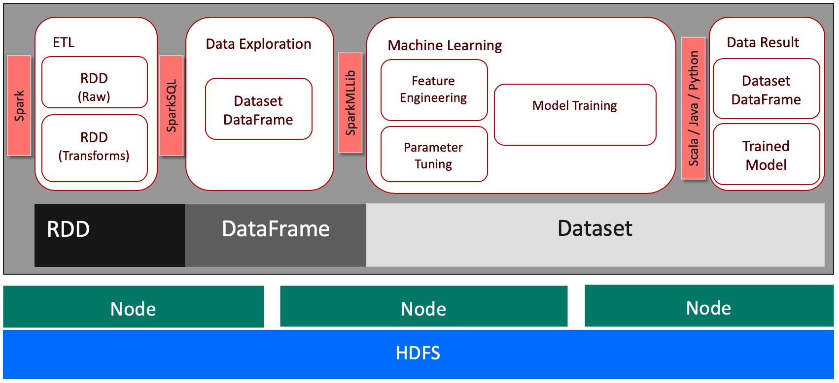
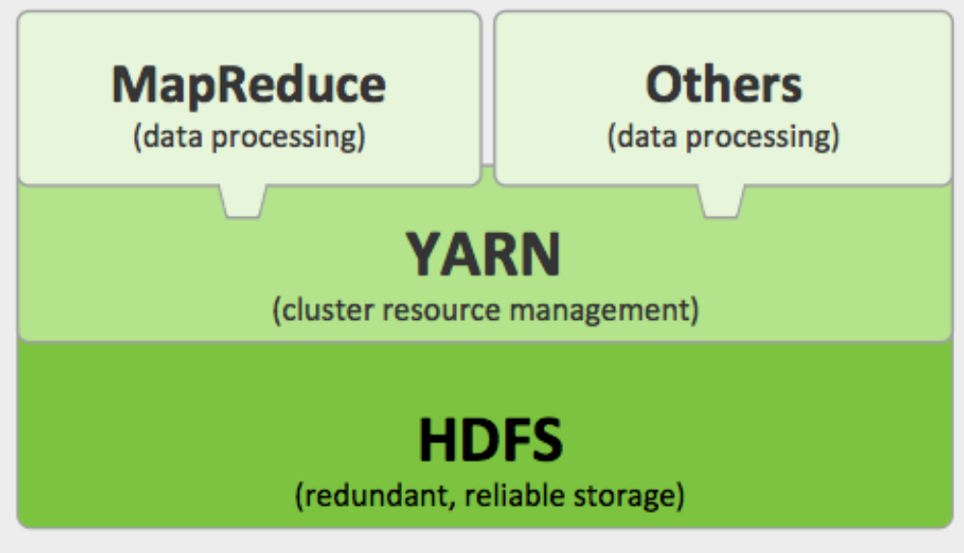
Scaled Processing and Scaled Storage
The foundations of scale
sqlworkshops/sqlserver2019bigdataclusters/SQL2019BDC/01 - The Big Data Landscape
Hadoop
Spark
Notes:
Scale-out Data Processing Discussion - https://docs.microsoft.com/en-us/previous-versions/sql/sql-server-guides/hh393529(v=sql.110)
Move down and through Big Data – Distributed Data Storage
Explain HDFS and Spark

Slide 11
Activity
Review HDFS Tutorial
sqlworkshops/sqlserver2019bigdataclusters/SQL2019BDC/01 - The Big Data Landscape
Notes:
1. Move to: Activity: Review HDFS Tutorial

Slide 12



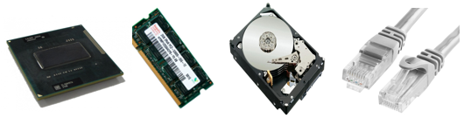
Virtualization
Hardware Abstraction
sqlworkshops/sqlserver2019bigdataclusters/SQL2019BDC/01 - The Big Data Landscape
Physical Computer
Virtual Hard Disk
Virtual Hard Disk
Virtual Hard Disk
Building on hardware, you can create a complete “PC” on top of a Hypervisor layer, which abstracts out the hardware. You still own the Operating System and up
This allows for scale by ring-fencing OS-level dependencies
Python
Python
Python
Binaries
Binaries
Binaries
Code
Code
Code
Hypervisor
Operating System
Notes:
Remind of location: There is big data, there is a reason for big data, and there is a way to process big data at scale.
Now we need a place to do the processing and storage.
Level-set with Hypervisors
Deeper discussion on Hypervisors: https://www.usenix.org/system/files/login/articles/105498-Revelle.pdf

Slide 13

Containers
Abstracting the OS, Allowing complete portability
sqlworkshops/sqlserver2019bigdataclusters/SQL2019BDC/01 - The Big Data Landscape
Physical Computer
Containers go one level further than the Hypervisor, and focusing on binaries and applications
Storage and networking are a consideration
Scale is achieved through multiple containers
Container
Container
Container
Python
Python
Binaries
Binaries
Binaries
Code
Code
Code
Container Runtime
Operating System
Notes:
Explain Containers
Docker for the Virtualization Admin - https://goto.docker.com/docker-for-the-virtualization-admin.html

Slide 14
sqlworkshops/sqlserver2019bigdataclusters/SQL2019BDC/01 - The Big Data Landscape
Container Orchestration
Containers at Scale
Node
Cluster Orchestration
Master
Container(s) live in Pods
Pod(s) are abstractions within Nodes
Node(s) are PC’s or VM’s
Cluster(s) are groups of Nodes
Storage is by means of Volume(s) mounted through a Claim
Node
Node
Orchestration
Shim
IP-Proxy
Node
Pod
Pod
Pod
Node
Node
Node
Notes:
Explain Kubernetes
Online tutorials: https://kubernetes.io/docs/tutorials/

Slide 15
Activity
Familiarize Yourself with Container Orchestration using minikube
sqlworkshops/sqlserver2019bigdataclusters/SQL2019BDC/01 - The Big Data Landscape
Notes:
Explain that we are using AKS, but K8’s can be installed in many locations.
Move to: Activity: Familiarize Yourself with Container Orchestration using minikube
Point out For Further Study links – have class open each one to review
First Break

Slide 16
Module 02
SQL Server BDC Components
sqlworkshops/sqlserver2019bigdataclusters/SQL2019BDC/02 - SQL Server BDC
Notes:
(Module Slide) – Move to https://github.com/microsoft/sqlworkshops/blob/master/sqlserver2019bigdataclusters/SQL2019BDC/02%20-%20SQL%20Server%20BDC%20Components.md

Slide 17
Activity – Set Up Class Environment
Open the Following Link:
Follow the instructions (save info to a Notepad entry)
Connect to the JumpVM using name/credentials
(Everything we do from here on out will be on the VM)
Double-click the text file on the main page
Wait here…
Notes:
Follow along with the class on the screen
Ensure everyone is in the same place

Slide 18
The same abstraction layer with SQL Server on Linux
sqlworkshops/sqlserver2019bigdataclusters/SQL2019BDC/02 - SQL Server BDC
System resource &
latency sensitive code paths
All other systems
RDBMS
IS
AS
RS
SQL Platform Abstraction Layer
(SQLPAL)
SQL Platform Abstraction Layer
(SQLPAL)
Win32-like APIs
SQL OS API
Windows Host Ext.
Linux Host Extension
SQL OS v2
Windows
Linux
Host extension mapping to OS system calls
(IO, Memory, CPU scheduling)
Choice across OS and containers
Notes:
Remind them of where we are:
Big Data
Processing BD at Scale
Scaling through Containers
Controlling through Orhestration
Explain PAL

Slide 19



sqlworkshops/sqlserver2019bigdataclusters/SQL2019BDC/02 - SQL Server BDC
SQL Server 2019 and Big Data OLTP, Data Virtualization, Data Mart and Big Data
Control
BDC
Cluster Orchestration
Master
SQL Data Pool
SQL Server
SQL Server
App Pool
SQL Server
Master
Compute Pool
ML Server
SQL Server
Job (SSIS)
Controller
Storage Pool
(Web Apps)
SQL Server
Spark
(Shared Services)
HDFS
HDFS
Notes:
Explain BDC Uses in github page
Walk through BDC Elements
Carefully explain each Pod/Service – track through github
BDC Reference: https://docs.microsoft.com/en-us/sql/big-data-cluster/big-data-cluster-overview?view=sqlallproducts-allversions

Slide 20
Activity
Explore BDC Components in Kubernetes - AKS
sqlworkshops/sqlserver2019bigdataclusters/SQL2019BDC/02 - SQL Server BDC
Notes:
Show this in Buck’s Browser

Slide 21
Module 03
Planning, Install and Configuration
sqlworkshops/sqlserver2019bigdataclusters/SQL2019BDC/03 - Planning, Installation and Configuration
Notes:
(Module Slide) – Move to https://github.com/microsoft/sqlworkshops/blob/master/sqlserver2019bigdataclusters/SQL2019BDC/03%20-%20Planning,%20Installation%20and%20Configuration.md

Slide 22
Open this link, follow along with the instructor:
https://aka.ms/ignite-PRE06
Code: IGNITE5207
Notes:
Access Installation
Github Pull
Open ADS – allow to finish, Update Now, then wait
For first connection, find the SQL Server Master Instance Front-End IP address
Name is sa
Password is MySQLBigData2019
Explore ADS
Explore Dashboard

Slide 23
Sizing Considerations
sqlworkshops/sqlserver2019bigdataclusters/SQL2019BDC/03 - Planning, Installation and Configuration
Data virtualization
Managed SQL Server, Spark, and data lake
OLTP
Admin portal and management services
Integrated AD-based security
Analytics
T-SQL
Apps
REST API containers for models
SQL Server External Tables
SQL Server
Spark
SQL Server
ML Services
Spark &
Spark ML
Compute pools and data pools
Scalable, shared storage (HDFS)
Open database connectivity
NoSQL
Relational databases
HDFS
External data sources
HDFS
Performance is at “slowest component”
Memory and Fast Storage are important
Standard SQL Server Considerations, plus offloading
Notes:
Primary factors are the same as in Kubernetes, SQL Server, Spark, and HDFS.
Everything must be planned
Memory and Storage are the keys to performance
https://docs.microsoft.com/en-us/sql/big-data-cluster/concept-data-persistence?view=sql-server-ver15

Slide 24
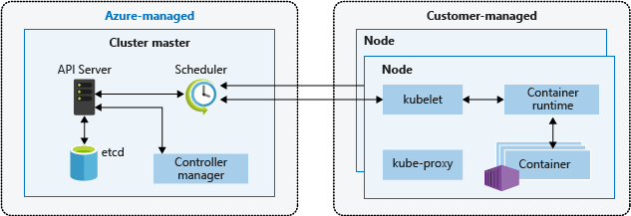
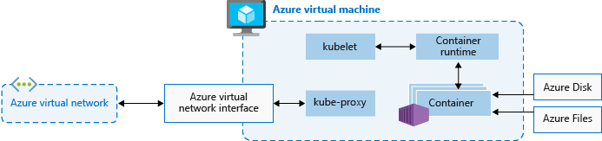
Big Data Clusters in Azure Kubernetes Service (AKS)
sqlworkshops/sqlserver2019bigdataclusters/SQL2019BDC/03 - Planning, Installation and Configuration
Notes:
Explain AKS

Slide 25
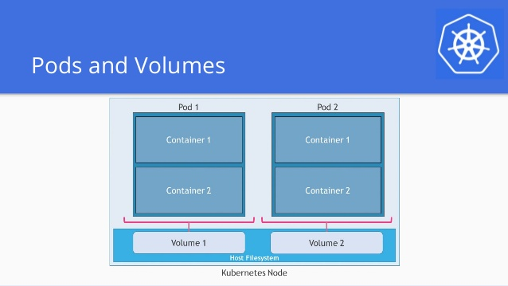
Big Data Clusters on Premises
sqlworkshops/sqlserver2019bigdataclusters/SQL2019BDC/03 - Planning, Installation and Configuration
Notes:
Explain deployment options such as KubeADM, KubeSpray, Ranger, and OpenShift

Slide 26
Activity
Explore Installation
Deployment guidance - SQL Server big data clusters
sqlworkshops/sqlserver2019bigdataclusters/SQL2019BDC/03 - Planning, Installation and Configuration
Notes:
Search the text above
Open link – Walk page
Explain config list – optional, show
Open the link for Deployment configuration file reference for a config file
2nd Break

Slide 27
Module 04
Operationalization
sqlworkshops/sqlserver2019bigdataclusters/SQL2019BDC/04 - Operationalization
Notes:
(Module Slide) – Navigate to https://github.com/microsoft/sqlworkshops/blob/master/sqlserver2019bigdataclusters/SQL2019BDC/04%20-%20Operationalization.md
Review Scenario, explain this is the solution for the questions raised at the beginning of class, and that we will show all “hero” scenarios for BDC in this one solution.

Slide 28
sqlworkshops/sqlserver2019bigdataclusters/SQL2019BDC/04 - Operationalization
Data Ingestion and Query
Data at Scale
Data Ops
External Data
Spark Job
External Mount
Pipeline System (ADF, etc.)
HDFS
SQL Data Pool
SQL Server
SQL Server
HDFS
SQL Server
SQL Server
Master
SQL Server
Spark
Compute Pool
Storage Pool
BDC
Notes:
Explain options for data loads, and that we will do manual loads using endpoints – not often done, but useful
Reference: https://docs.microsoft.com/en-us/sql/relational-databases/polybase/polybase-queries?view=sqlallproducts-allversions

Slide 29
Activity
Initial Data Load and Query
C:\MyDocuments
\sqlworkshops
\sqlserver2019bigdataclusters
\SQL2019BDC
\notebooks
sqlworkshops/sqlserver2019bigdataclusters/SQL2019BDC/04 - Operationalization
Notes:
Switch to VM
Open CMD, right-click and run as Administrator (For Data Load)
File Open
My Documents, sqlworkshops…
00
Use New
Allow to finish – Look at Tasks
In CMD Prompt: AZ LOGIN (paper for info)
Open Portal.microsoft.com – navigate to your subscription per the paper
Find the resource group and cluster name
In CMD: az aks get-credentials --resource-group=ODL-sql-bdc-109780 --name akssqlbdc109780
In CMD: kubectl get svc –nakssqlbdc109780
In ADS: Replace with parameters in cells, when it starts, edit the other cells
Show HDFS files in Pool
Copy and paste each cell – edit to include proper IP Addresses

Slide 30
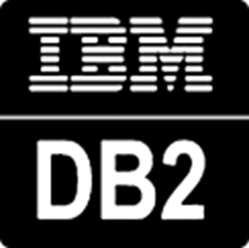



What is SQL Server Polybase?
sqlworkshops/sqlserver2019bigdataclusters/SQL2019BDC/04 - Operationalization
“It’s all about
Data Virtualization”
Distributed compute engine integrated with SQL Server
Query data where it lives using T-SQL
Distributed, scalable query performance
Manual/deploy with SQL Server
Auto deploy/optimize with Big Data Clusters
Analytics
T-SQL
Apps
SQL Server
PolyBase external tables
ODBC
NoSQL
Relational databases
Big data
Excel
Cosmos DB
HDFS
Intelligence over all data
Notes:
1. Explain Polybase and how it can solve problems

Slide 31
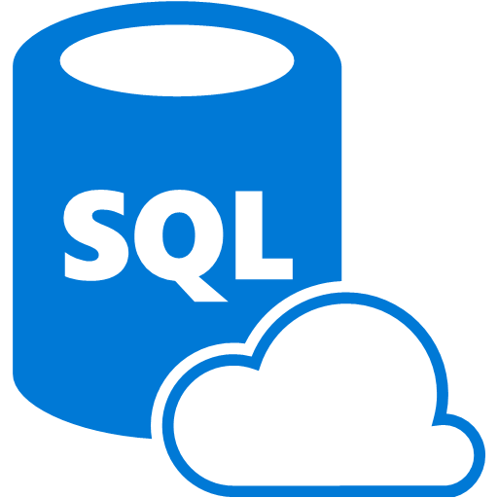





Data Virtualization Example
sqlworkshops/sqlserver2019bigdataclusters/SQL2019BDC/04 - Operationalization
Modern StockItems
Legacy Suppliers
Mobile
App Orders
WWI
SQL Server
2019
SQL
WideWorldimporters
Customers from Acquisition
Accounts Receivable
Order Reviews
Notes:
This is a great example for a company that has existing data sources but doesn’t want to or cannot move the data. This diagram can be demonstrated with a demo video or using the github examples at https://github.com/microsoft/sqlworkshops/tree/master/ModernizeYourDatabases2019/ModernizeSQL2019/Module%208%20Activity%20-%20Data%20Virtualization

Slide 32



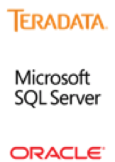
sqlworkshops/sqlserver2019bigdataclusters/SQL2019BDC/04 - Operationalization
SQL Server 2019 and Big Data
Data Virtualization Detail
SQL Server
Master
PolyBase Connector
DMS (Executor)
Scale-Out
PolyBase
PDW (Orchestrator)
DMS (Executor – Performs Operations)
PolyBase Connector
DMS (Executor)
NoSQL
Data Source
(Format)
External Table
PolyBase Connector
RDBMS
Notes:
Reference: https://docs.microsoft.com/en-us/sql/relational-databases/polybase/polybase-queries?view=sqlallproducts-allversions

Slide 33
Activity
PolyBase Query
sqlworkshops/sqlserver2019bigdataclusters/SQL2019BDC/04 - Operationalization
Notes:
In ADS: Open Notebook 01, run cells
In ADS: Open Notebook 02, run cells

Slide 34

sqlworkshops/sqlserver2019bigdataclusters/SQL2019BDC/04 - Operationalization
SQL Server 2019 and Big Data
Data Mart Details
SQL Server
Master
PolyBase Connector
HDFS
Compute Pool
PolyBase Connector
Cosmos DB
PolyBase Connector
RDBMS
SQL Server Data Pool
Notes:
Feedback: why the external data sources here?

Slide 35
Activity
Load to Data Pool
sqlworkshops/sqlserver2019bigdataclusters/SQL2019BDC/04 - Operationalization
Notes:
In ADS – Open 03, run

Slide 36
The Team Data Science Process aka.ms/tdsp
sqlworkshops/sqlserver2019bigdataclusters/SQL2019BDC/04 - Operationalization
Cross Industry Standard Process for Data Mining
Consume
Deploying
Train Models
Evaluating
Create Models
Modeling
Generate Features
Data Preparation
Explore and Visualize
Data Understanding
Planning, Environment, Ingest
Business Understanding
Notes:
This process largely follows the CRISP-DM model: http://www.sv-europe.com/crisp-dm-methodology/
It also references the Cortana Intelligence process: https://azure.microsoft.com/en-us/documentation/articles/data-science-process-overview/
A complete process diagram is here: https://azure.microsoft.com/en-us/documentation/learning-paths/cortana-analytics-process/
Some walkthrough’s of the various services: https://azure.microsoft.com/en-us/documentation/articles/data-science-process-walkthroughs/
Data Science Blog: https://buckwoody.wordpress.com/

Slide 37

sqlworkshops/sqlserver2019bigdataclusters/SQL2019BDC/04 - Operationalization
SQL Server 2019 and Machine Learning
Training, Scoring and Model Tracking options
BDC
App Pool
SQL Server
Master
ML Server
Storage Pool
(Web Apps)
Spark
HDFS
Notes:
Explain points for training/testing/deployment
BDC Reference: https://docs.microsoft.com/en-us/sql/big-data-cluster/big-data-cluster-overview?view=sqlallproducts-allversions

Slide 38
Activity
Spark Jobs and ML Query
sqlworkshops/sqlserver2019bigdataclusters/SQL2019BDC/04 - Operationalization
Notes:
Open 04, Change Kernel to PySpark, Run

Slide 39
Module 05
Management and Monitoring
sqlworkshops/sqlserver2019bigdataclusters/SQL2019BDC/05 - Management and Monitoring
Notes:
(Module Slide) – Move to https://github.com/microsoft/sqlworkshops/blob/master/sqlserver2019bigdataclusters/SQL2019BDC/05%20-%20Management%20and%20Monitoring.md

Slide 40
sqlworkshops/sqlserver2019bigdataclusters/SQL2019BDC/05 - Management and Monitoring
Managing the Big Data Cluster
Tools and Process Flow
kubectl
Azure Data Studio
Grafana Interface
Kibana Interface
azdata
Cluster Orchestration
Master
Management Proxy
Controller
Kibana
Grafana
Operator
Elastic Search
InfluxDB
Config Store
Control Watchdog
Telegraf
CollectD
Fluentbit
Telegraf
CollectD
Fluentbit
Deployment, Configuration, Upgrade, HA
Monitoring and Metrics
Notes:
Walk Slide
BDC Reference: https://docs.microsoft.com/en-us/sql/big-data-cluster/big-data-cluster-overview?view=sqlallproducts-allversions

Slide 41



sqlworkshops/sqlserver2019bigdataclusters/SQL2019BDC/05 - Management and Monitoring
Cluster High-Availability Detail
Using Cluster HA and SQL Server Availability Groups
Controller
Listener
(Readable Secondary)
Operator
Cluster Orchestration
Master
SQL Server
SQL Server
SQL Server
AG
Primary
Secondary
Secondary
(Becomes Primary)
Replication Controller
HA Supervisor
HA Supervisor
HA Supervisor
Listener
(Primary)
Cluster HA
SQL Server HA
Notes:
Walk Slide

Slide 42
Activity
Manage and Monitor with ADS, SSMS, Grafana and Kibana
sqlworkshops/sqlserver2019bigdataclusters/SQL2019BDC/05 - Management and Monitoring
Notes:
Open ADS

Slide 43
Module 06
Security
Notes:
(Module Slide)

Slide 44



sqlworkshops/sqlserver2019bigdataclusters/SQL2019BDC/05 - Management and Monitoring
Cluster Security
Access, Authentication, Authorization
SQL Server
(Master Instance)
Management Proxy
Cluster Orchestration
Master
Knox
Kibana
Grafana
Livy
ACLS
YARN
Controller
HDFS
Spark
Notes:
BDC Reference: https://docs.microsoft.com/en-us/sql/big-data-cluster/big-data-cluster-overview?view=sqlallproducts-allversions

Slide 45
Activity
Security Review
sqlworkshops/sqlserver2019bigdataclusters/SQL2019BDC/05 - Management and Monitoring
Notes:
https://docs.microsoft.com/en-us/sql/big-data-cluster/concept-security?view=sql-server-ver15

Slide 46
Let’s Do This
Notes:
https://docs.microsoft.com/en-us/sql/big-data-cluster/concept-security?view=sql-server-ver15

Slide 47
Resources
Official documentation – aka.ms/bdc
In-depth training - aka.ms/sqlworkshops
Code Examples – aka.ms/BDC-samples

