Slide 1
Developing a Privacy Canvas Model
Final Year Project For Computer Science 2019
Maurice Buckley
Dr Dave Lewis
3/4/19

Slide 2
Background
The recent introduction of the General Data Protection Regulation has brought with it a profound change on how businesses collect and process data.
Privacy and Data Protection now fundamental part of every business.
Low level of knowledge
Few suitable tools available

Slide 3
The Privacy Canvas
For early innovators
GDPR first step
Used alongside the Business Model Canvas
Demonstrates privacy by design

Slide 4
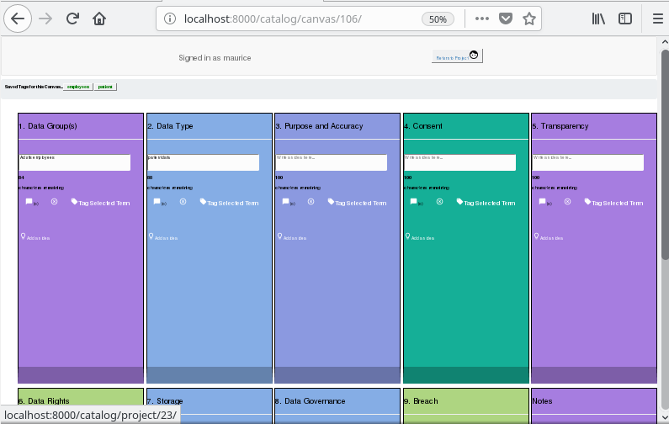
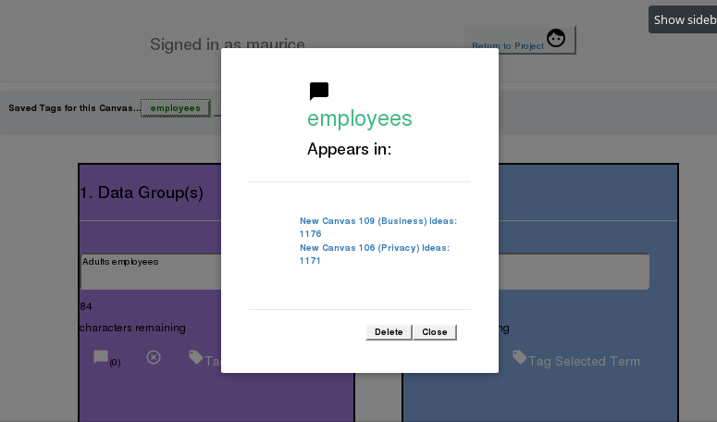
Implementation
Canvas Model
Encapsulates GDPR principles
Virtual Privacy Canvas
Brainstorming tool

Slide 5
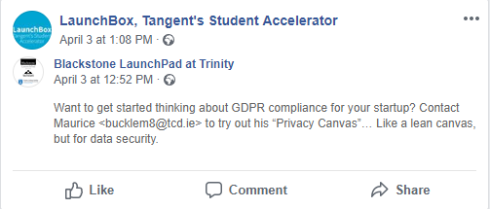
Evaluation
Research study
Strict Participant criteria
Test and answer survey
83/100 SUS score (68 average)
71% agreed it helped identify privacy and data protection concerns not previously thought about

Slide 6
Thank You

