Slide 1






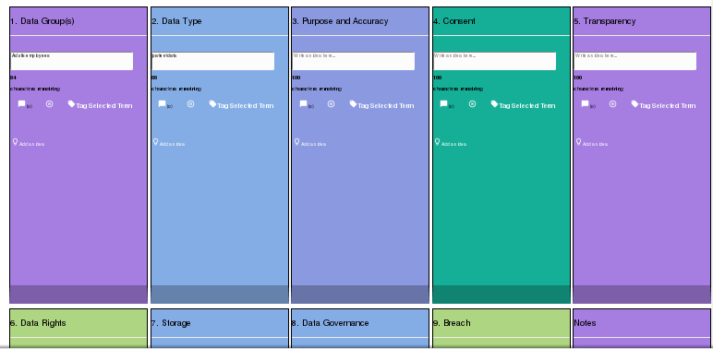
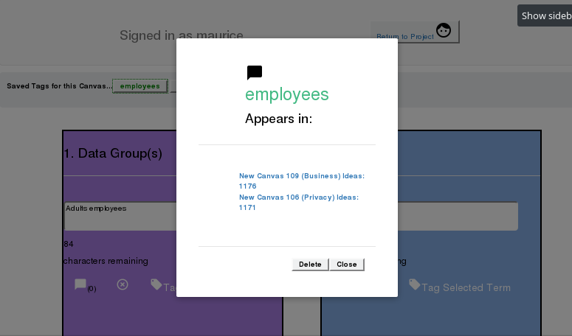



Developing a Privacy Canvas Model
Student name: Maurice Buckley Supervisor: Dr Dave Lewis
What is the Privacy Canvas?
Implementation
A GDPR tool suitable for early innovators
Based on the canvas model
Used alongside a Business Model Canvas
Demonstrates Privacy by Design
GDPR first step
Based on canvas model like the Business Model Canvas and the Ethics Canvas
Introduces key GDPR principles informally
Helpful brainstorming tool, does not test users
Opens discussion on GDPR, privacy and data protection
Virtual Implementation:
  Stores created canvases
  Create multiple canvases
  Tag keywords between canvases
  Easily iterate and switch between canvases
Motivation
The recent introduction of the General Data Protection Regulation has brought with it a profound change on how businesses collect and process data.
Privacy and Data Protection now fundamental part of every business.
Low level of knowledge
Few suitable tools available
Evaluation
The Privacy Canvas was evaluated by conducting a research study where participants who matched the criteria would test and give feedback on the canvas.
Participants must have completed a Business Model Canvas as a prerequisite and are developing or have developed an application which stores personal data. Users Completed a Privacy Canvas and answered a survey after. Survey was 15 questions, with the first 10 being a System Usability Scale (SUS).
85.7% said they would use it frequently
71% agreed it help identify privacy and data protection concerns not previously thought about
83/100 SUS Score (68 = average for SUS)
Existing Technologies
Tools not suitable to early innovation stage
Mainly compliance checkers and tests
Few learning tools for people with low GDPR knowledge
Example: Data Protection Impact Assessment (DPIA)
Mandatory under law for organisations holding high risk data. Very complex and not suitable for new business. Privacy Canvas could be a precursor to a DPIA
Conclusion
Successful proof of concept of a Privacy Canvas
Strong feedback from people who work with startups
Gap in market for tools like the Privacy Canvas
Suitable first step towards GDPR and compliance
Effective demonstration of Privacy by Design.
Integrated Computer Science

