Slide 1
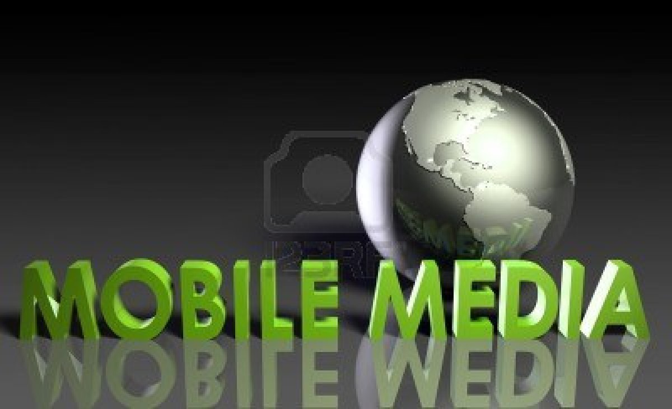

Mobile Multimedia Services
Студентка : Хуен Нго
Ф.н:44643,спец.:Информатика ,курс:4
Проект по Съвременни комуникации

Slide 2
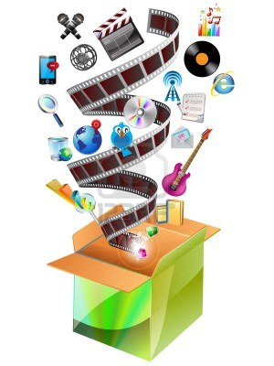
Contents
What is Multimedia ?
Mobile Multimedia
Mobile Messaging Overview

Slide 3

What is MULTIMEDIA?
DEFINITION OF Multimedia
elements of multimedia
Benefits of multimedia

Slide 4
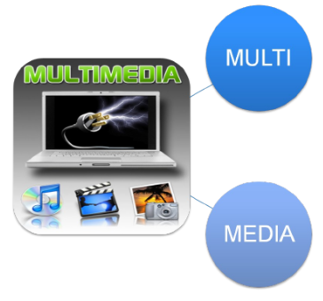
Definition of Multimedia
Many or more than one
Medium of Communication

Slide 5


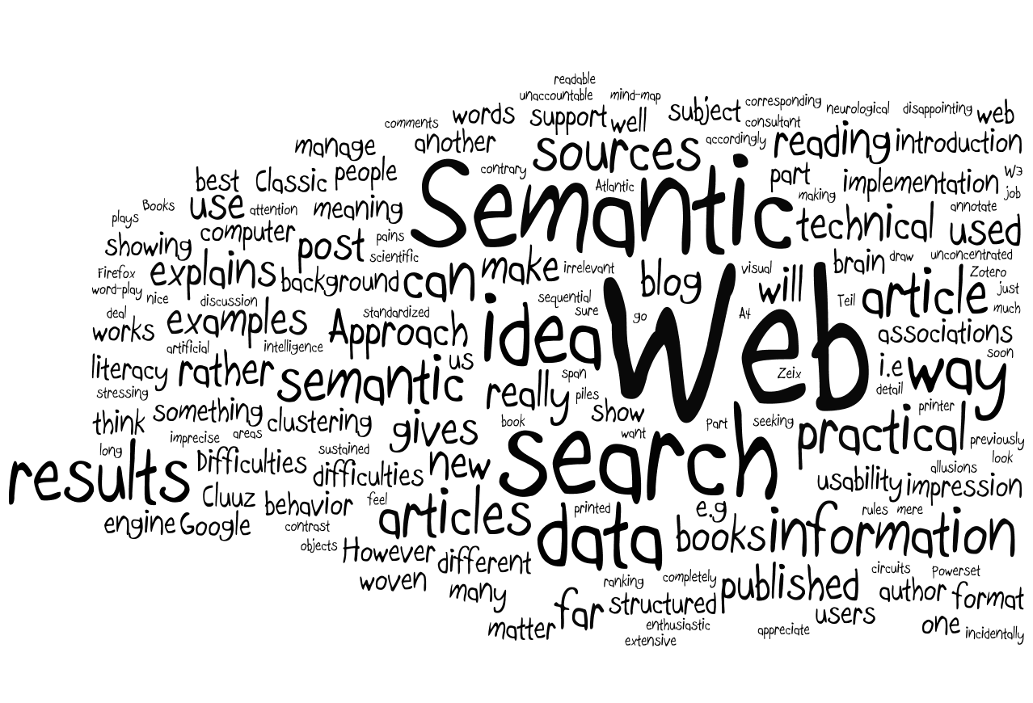


Elements of Multimedia
Animation
Audio
Graphics
Text
Video

Slide 6
Advantages
Effect of text presentations.
Improves the quality of presentation and retains the attention of audience.
It can be used for educational as well as entertainment purpose .
Notes:
1.Мултимедия засилва ефекта на текстови презентации.
2. Подобрява качеството на представяне и задържа вниманието на публиката.
3. Може да се използва за образователни , така както и за забавлителни цели.

Slide 7
Multimedia in mobile devices
Computers,smartphones,mobile devices.
MMS (Multimedia Messages Services)
Email addressing

Slide 8
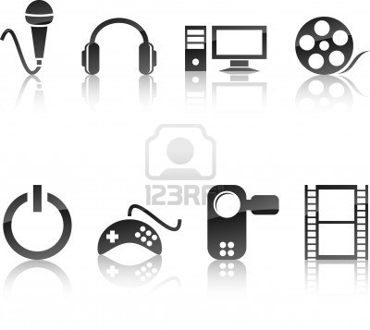
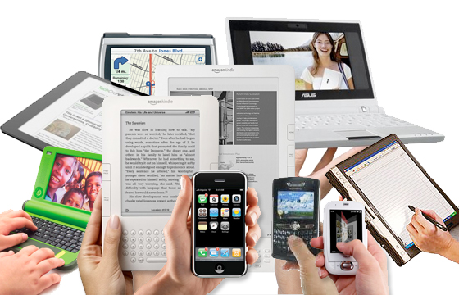


Definition of Mobile Multimedia
Mobile multimedia refers to various types of content that are either accessed via portable devices or created using them.
Text, picture, and video messaging services

Slide 9


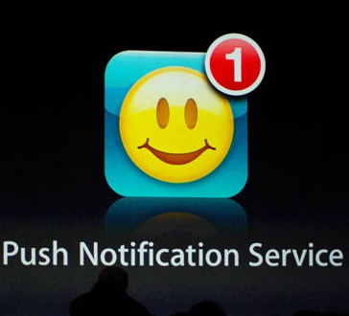
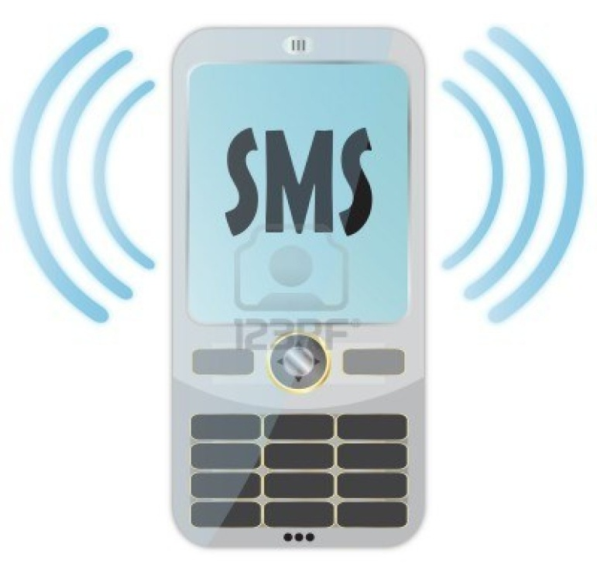
Mobile Messaging Overview
SMS
MMS
Push notifications

Slide 10
SMS services
Chats
Voting
Reality TV

