Slide 1

駿懋銀行
Lloyds Bank plc

Slide 2
駿懋銀行 英國專注於國內業務的最大銀行
發行機構簡介
駿懋銀行公開有限公司(Lloyds Bank plc，以下簡稱LB)成立歷史可追溯至1765年，致力為英國客戶提供活期賬戶、儲蓄、貸款和信用卡等全面的金融產品及服務。該行是勞埃德銀行集團(Lloyds Banking Group plc，以下簡稱LBG)旗下的圍欄銀行(Ring-Fenced Bank)-即核心零售銀行服務與集團其他業務風險分開。
其母公司-勞埃德銀行集團總部位於倫敦，為英國領先的金融服務集團，按總資產排名位居英國第3大銀行、綜合排名英國第6名企業(Forbes Global 2000)。服務通過多個知名品牌提供，包含駿懋銀行(Lloyds Bank)、蘇格蘭銀行(Bank of Scotland)、哈利法克斯(Halifax；英國最大的抵押貸款銀行)，以及蘇格蘭遺孀(Scottish Widows；英國前三大的養老金供應商)，並通過多種分銷渠道，包括英國最大的分行網絡和數位銀行，提供零售、商業銀行、保險等廣泛的銀行及金融服務，專注於個人及商業客戶。該集團在倫敦及紐約證券交易所皆有掛牌上市，且為富時100指數成份股之一。
特色/亮點
勞埃德銀行集團在英格蘭和威爾士設有眾多分支機搆，被公認為英國「四大銀行」 之一 。
勞埃德集團於2025推出了首個大規模生成式人工智慧產品，在Evident AI 2025全球指數中總排名中上升12位至第15位，成為英國第二佳銀行。
#3
英國銀行總資產排名
(歐洲銀行總資產排名第11位)
(S&P Global 2025)
#3
英國銀行客戶數排名
(Statista 2025)
業務結構
#6
FY2025
淨營收
184億英鎊
駿懋銀行
138億英鎊
英國企業排名
(Forbes Global 2000 2025)
資料來源：官網、年報、新聞整理、capital.com、 S&P Global、Statista、Forbes Global 2000、 Evident insights
Notes:
官網1
https://www.lloydsbankinggroup.com/who-we-are/our-heritage/lloyds-bank.html
官網3
https://www.lloydsbankinggroup.com/who-we-are/our-brands/lloyds-bank.html
官網4
https://www.lloydsbankinggroup.com/who-we-are/group-overview/ring-fencing.html
官網5
https://www.lloydsbankinggroup.com/who-we-are/group-overview.html
官網6
https://www.lloydsbankinggroup.com/who-we-are/our-brands.html
銀行年報
https://www.capitaliq.spglobal.com/apisv3/spg-webplatform-core/docviewer?mid=255954528&KeyProductLinkType=2
集團年報
https://www.lloydsbankinggroup.com/assets/pdfs/investors/financial-performance/lloyds-banking-group-plc/2025/q4/2025-lbg-annual-report.pdf
Press1
https://uk.finance.yahoo.com/news/cheapest-mortgage-interest-rates-bank-england-hsbc-natwest-barclays-nationwide-060037729.html
Press2
https://www.scottishwidows.co.uk/about-us/media-centre/press-releases/pensions-growth-boosted-by-digital-engagement.html
capital.com
https://capital.com/zh-hant/learn/market-guides/trade-Lloyds
S&P Global 2025
https://www.capitaliq.spglobal.com/apisv3/spg-webplatform-core/news/article?id=88404022&KeyProductLinkType=14&utm_campaign=top_news_2&utm_medium=top_news&utm_source=news_home
Statista
https://www.statista.com/statistics/940560/number-of-customers-at-select-banks-in-the-united-kingdom/
Evident AI global index
https://evidentinsights.com/bankingbrief/heres-the-2025-evident-ai-index/
Forbes Global 2000
https://www.forbes.com/lists/global2000-united-kingdom/
Since 1765, Lloyds Bank has been serving the people, businesses and communities of Britain.(官網1)
自1765年以來，LB致力於服務英國的民眾、企業和社區。(官網1)
We offer a comprehensive range of financial products and services shaped to suit individual needs, from current accounts, savings, mortgages, loans and credit cards, to private banking and wealth management services. (官網3)
致力為英國客戶提供活期賬戶、儲蓄、貸款和信用卡等全面的金融產品及服務。(官網3)
A ring-fenced sub-group Comprising the majority of our Lloyds Bank, Bank of Scotland and Halifax banking activities including current accounts, savings and deposits.
該行是勞埃德銀行集團(Lloyds Banking Group plc，以下簡稱LBG)旗下的圍欄銀行(官網4)
The rules mean large UK banks must separate personal banking services, such as current and savings accounts, from risks in other parts of the business such as complex wholesale and investment banking.
即核心零售銀行服務與集團其他業務風險分開。(官網4)
Lloyds Banking Group is a leading UK-based financial services group. (官網5)
其母公司-勞埃德銀行集團總部位於倫敦(集團年報)，為英國領先的金融服務集團。(官網5)
The Lloyds Bank Group’s main business activities are retail and commercial banking and it operates primarily in the UK. Services are provided through a number of well recognised brands including Lloyds Bank, Halifax and Bank of Scotland and through a range of distribution channels, including the largest branch network and digital bank in the UK. (銀行年報)
勞合社銀行集團的主要業務活動是零售和商業銀行業務，並且主要在英國運營。服務通過多個知名品牌提供，包括駿懋銀行、蘇格蘭銀行和哈利法克斯銀行，並通過多種分銷渠道，包括英國最大的分行網絡和數位銀行。(銀行年報)
Halifax, the UK’s largest mortgage lender(press1)
英國最大的抵押貸款銀行(press1)
Scottish Widows is now the UK’s second biggest defined contribution workplace provider, and a top three individual annuities provider. (press2)
蘇格蘭寡婦公司現已成為英國第二大養老金供應商，也是前三大個人年金供應商之一。(press2)
We provide a wide range of banking and financial services, focused primarily on retail and commercial customers. (官網5)
提供零售、商業銀行、保險(網頁中的圖)等廣泛的銀行及金融服務，專注於個人及商業客戶。(官網5)
該集團在倫敦及紐約證券交易所皆有掛牌上市，且為富時100指數成份股之一(capital.com)
勞埃德銀行集團在英格蘭和威爾士設有眾多分支機搆，被公認為英國「四大銀行」(Big Four) 之一 。(capital.com)
Lloyds (#15) jumped up 12 spots, beating out NatWest (#16) and Barclays (#23) to be the second-best in the U.K. behind HSBC (#8). The bank rolled its first large-scale Gen AI product out this year and has the sixth-most AI use cases with outcomes of the 50 banks we track.
勞埃德（#15）上升了12個名次，超越了NatWest（#16）和Barclays（#23），成為英國第二佳銀行，僅次於HSBC（#8）。該銀行今年推出了首個大規模生成式人工智慧產品，並且在追蹤的50家銀行中，擁有第六多的人工智慧應用案例及結果。(Evident AI global index)
英國銀行總資產排名(S&P Global 2025)
英國銀行客戶數排名(Statista 2025)
英國企業排名 (Forbes Global 2000)

Slide 3
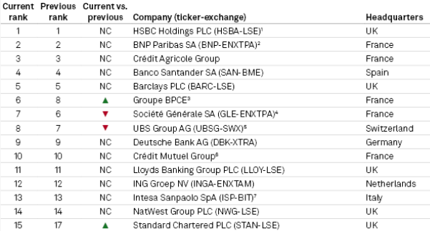

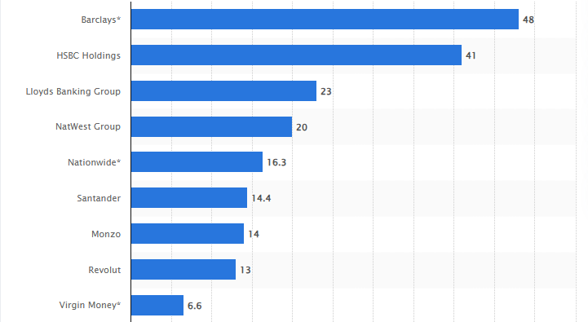
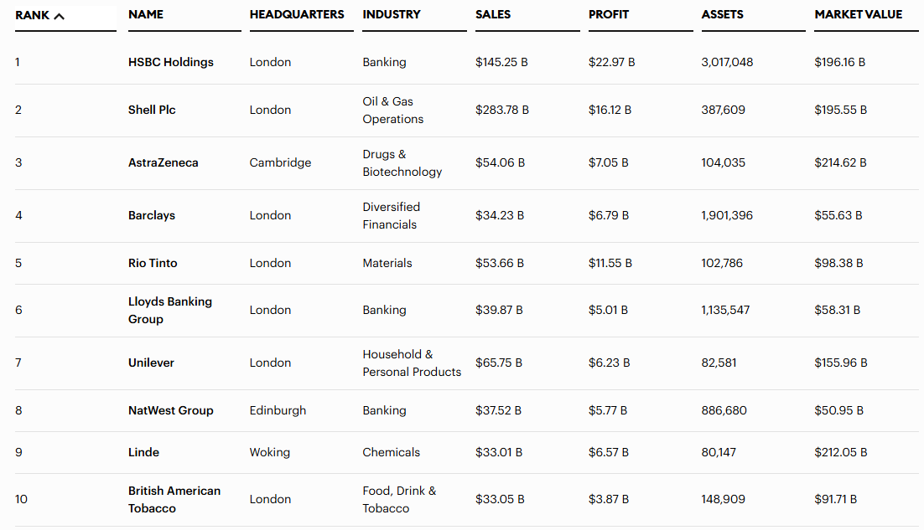
英國「四大銀行」 之一
按資產，勞埃德銀行集團為歐洲第11大行、英國第三大行
按服務客戶數，勞埃德銀行集團位居英國第三大行
Top 50 European banks by total assets
Leading banks in the UK in 2025, by number of customers
(百萬客戶)
2025年《Forbes Global 2000》
英國銀行綜合排名第6位
2025年《 Evident AI index 》
全球總排名第15位，為英國第二佳銀行
COMPANY | RANK
JPMorganChase | 1 | -
Capital One | 2 | -
Royal Bank of Canada | 3 | -
CommBank | 4 | ↑1
Morgan Stanley | 5 | ↑5
Wells Fargo | 6 | ↓2
UBS | 7 | ↓1
HSBC | 8 | ↓1
Goldman Sachs | 9 | ↑2
Bank of America | 10 | ↑5
COMPANY | RANK
BNP Paribas | 11 | ↑1
Citigroup | 12 | ↓4
TD Bank | 13 | ↓4
BBVA | 14 | ↓1
Lloyds Banking Group | 15 | ↑12
NatWest | 16 | ↑2
BNY | 17 | ↓3
DBS | 18 | ↓2
Bank of Montreal | 19 | ↑5
ING | 20 | ↓3
資料來源：S&P Global、Statista、Forbes Global 2000、 Evident insights
Notes:
S&P Global 2025
https://www.capitaliq.spglobal.com/apisv3/spg-webplatform-core/news/article?id=88404022&KeyProductLinkType=14&utm_campaign=top_news_2&utm_medium=top_news&utm_source=news_home
Statista
https://www.statista.com/statistics/940560/number-of-customers-at-select-banks-in-the-united-kingdom/
Forbes Global 2000
https://www.forbes.com/lists/global2000-united-kingdom/
Evident insights
https://evidentinsights.com/ai-index/
英國銀行總資產排名(S&P Global 2025)
英國銀行客戶數排名(Statista 2025)
英國企業排名 (Forbes Global 2000)

Slide 4
核心業務穩健，營收、獲利持續創高
年度財務
FY25淨營收年增8%至184.3億英鎊，係受惠1)利息收益資產的平均水平提高及利差擴大，帶動淨利息收入年增6%；2)零售業務中英國汽車金融表現改善，主要來自車隊增長和平均車輛租賃價值提高，以及淨費用和佣金收入增加。
普通股可分配淨利年增%至38.6億美元，在零售業務方面，2025年的損失反映了強勁的業務表現以及校準和模型改進的收益，並且包括債務出售。在商業銀行業務方面，上半年因少數個案導致的較高損失，被第一階段和第二階段模型校準的釋放所抵消，這些校準反映了良好的信貸表現並降低了全年利率。
除稅前利潤(列帳基準)
百萬英鎊 |  | 截至12月31日止年度
 |  | 2025年 |  |  | 2024年
列帳基準
收入 |  |  | 18,429 |  | 17,071
營業支出 |  |  | (12,165) |  | (11,927)
預期信貸損失及其他信貸減值準備變動 |  |  | (792) |  | (456)
除稅前利潤 |  |  | 5,472 |  | 4,688
稅項支出 |  |  | (1,616) |  | (1,202)
除稅後利潤 |  |  | 3,856 |  | 3,486
資料來源：：年報、台新證券整理
註：可比淨營收於官方財報乃指「法定營業收入」排除重組及其他項目後的「基本營業收入」
Notes:
年報
Total income for 2025 was £18,429 million, an increase of 8% (2024: £17,071 million). Within this, net interest income of £13,363 million was up
6% on the prior year (2024: £12,592 million), driven by higher average interest-earning assets and a higher margin. Other income of
£5,066 million was 13% higher (2024: £4,479 million), reflecting improved performance in UK Motor Finance within Retail from fleet growth
and higher average vehicle rental values, as well as higher net fee and commission income. Other income in the prior year was impacted by a
write off relating to changes in commission arrangements with Scottish Widows.
The impairment charge was £792 million compared to a £456 million charge in 2024, which benefitted from a large credit from improvements in the Group’s economic outlook. In Retail, the charge for 2025 reflected both strong performance alongside the benefits from calibrations and model refinements and a debt sale. In Commercial Banking, higher charges in the first half of the year driven by a small number of individual cases were more than offset by releases from Stage 1 and Stage 2 model calibrations capturing strong credit performance and reducing interest rates throughout the year.

Slide 5
渣打前景俏，穆迪調整評等至「正向」
信用評等 | 穆迪 | 標普 | 惠譽
優先無擔保 債信評等 | A1 | A+ | A+
評等展望 | 穩定 | 穩定 | 穩定
展望發佈日 | 2025/5/20 | 2025/12/23 | 2025/11/13
標普觀點 標普於報告中指出，駿懋大型的客戶貸款組合以住宅抵押貸款為主，但也包括信用卡等風險較高的部分。隨著英國資產質量正常化，資產可能出現逾期和違約的情況。即便如此，穩健的承保、抵押貸款組合中較低的貸款價值比（LTV）以及強韌的消費者資產負債表應該能支撐 LB 的整體資產質量。 穆迪觀點 穆迪的評等基於低違約損失率以及來自英國政府的支援可能性在高級解困損失(Advanced LGF)分析中分別調高一個等級。 穆迪表示，駿懋銀行a3的基準信用評估(BCA)，反映了其強健的資產質量、穩定的零售資金來源和充裕的流動性，以及盈利前景受到戰略性收入和成本措施的支持。穆迪認為LB的資本充足，但也隨著LBG的資本分配計劃而下降。 惠譽觀點 評等反映勞埃德銀行集團強健的資產質量，不良貸款比率保持低於2%，並受到利率下降的支持。 惠譽表示盈利能力穩定強勁，並且與英國及歐洲的同業相比表現良好。收入多元化及對非利息收入業務的策略性投資，也應有助於支持盈利能力。
資本水位持穩
註：駿懋CET1 ratio的最低監管要求為10.6%
淨債務槓桿為負值
意味流動資金大於債務，展現良好的流動性
資料來源：彭博、信評機構
Notes:
Moodys
file://naszsc/JBQ/%E9%87%91%E8%9E%8D%E6%A9%9F%E6%A7%8B%E9%83%A8/@%E7%99%BC%E8%A1%8C%E6%A9%9F%E6%A7%8B%E7%B0%A1%E4%BB%8B/%E5%AE%9C%E7%9C%9F/Rating_Action-Moodys-Ratings-affirms-Lloyds-20May2025-PR_506949.pdf
S&P global
file://naszsc/JBQ/%E9%87%91%E8%9E%8D%E6%A9%9F%E6%A7%8B%E9%83%A8/@%E7%99%BC%E8%A1%8C%E6%A9%9F%E6%A7%8B%E7%B0%A1%E4%BB%8B/%E5%AE%9C%E7%9C%9F/S&P_RatingsDirect_LloydsBankPLC_3497908_Dec-23-2025.pdf
Fitch
file://naszsc/JBQ/%E9%87%91%E8%9E%8D%E6%A9%9F%E6%A7%8B%E9%83%A8/@%E7%99%BC%E8%A1%8C%E6%A9%9F%E6%A7%8B%E7%B0%A1%E4%BB%8B/%E5%AE%9C%E7%9C%9F/Fitch%20Affirms%20Lloyds%20Banking%20Group's%20IDR%20at%20'A+'%3B%20Outlook%20Stable.pdf
The affirmation of LB‘s long-term senior unsecured debt ratings of A1 reflects its BCA of a3; the instruments low loss given failure under the Advanced LGF analysis, resulting in a one-notch uplift and a moderate probability of support from the Government of the United Kingdom, providing an additional one-notch uplift. LB’s a3 BCA reflects its strong asset quality, stable retail funding base and ample liquidity as well as its profitability outlook which will be supported by strategic revenue and cost initiatives. We see LB‘s capital as sufficient but also declining in line with LBG’s capital distribution plans. (Moodys)
對LB長期高級無擔保債務評級為A1的確認，反映了其a3的基礎信用評級（BCA）；在先進喪失給付分析（Advanced LGF analysis）下，低損失率帶來了一個級別的上調，加上來自英國政府的中等支援可能性，提供了額外一個級別的上調。LB的a3 BCA反映了其強健的資產質量、穩定的零售資金來源和充裕的流動性，以及其盈利前景，這將受到戰略性收入和成本措施的支持。我們認為LB的資本充足，但也隨著LBG的資本分配計劃而下降。 (Moodys)
Well-collateralized mortgages dominate customer loans. LB's large customer loan portfolio is dominated by residential mortgages but also includes riskier elements such as credit cards. We expect a steady flow of assets to fall into arrears and default as asset quality normalizes in the U.K. Even so, sound underwriting, low loan-to-values (LTV) in the mortgage book, and resilient consumer balance sheets should underpin LB’s overall asset quality(S&P global)
擁有良好擔保的抵押貸款在客戶貸款中佔主導地位。LB 大型的客戶貸款組合以住宅抵押貸款為主，但也包括信用卡等風險較高的部分。我們預計，隨著英國資產質量正常化，資產將穩定地出現逾期和違約的情況。即便如此，穩健的承保、抵押貸款組合中較低的貸款價值比（LTV）以及強韌的消費者資產負債表應該能支撐 LB 的整體資產質量。(S&P global)
Strong Asset Quality: We expect LBG's asset quality to remain strong over the next two years, with the impaired loans ratio remaining below 2%. We expect asset quality to be supported by falling interest rates. Loan impairment charges (LICs) should remain easily absorbable, given the largely secured loan portfolio(Fitch)
強健的資產質量：我們預計未來兩年LBG的資產質量將保持強勁，不良貸款比率將保持低於2%。我們預計資產質量將受到利率下降的支持。考慮到貸款組合大多有擔保，貸款減值費用（LICs）應仍可輕鬆吸收。(Fitch)
LBG's profitability has been consistently strong and compares well with UK and European peers'. We expect operating profit/risk-weighted assets (RWAs; 9M25: 3.2%) to strengthen to about 3.5% in 2026 as structural hedge income more than offsets margin pressure in mortgage lending and deposits, while cost growth and LICs are contained. Revenue diversification and strategic investments into non-interest income- generating businesses should also support earnings. (Fitch)
LBG 的盈利能力一直穩定強勁，並且與英國及歐洲的同業相比表現良好。我們預計營運利潤/風險加權資產（RWAs；2025 年前九個月：3.2%）將在 2026 年增至約 3.5%，因結構性對沖收入將超過按揭貸款和存款的利差壓力，同時成本增長和貸款撥備受到控制。收入多元化及對非利息收入業務的策略性投資，也應有助於支持盈利能力。(Fitch)
Tier 1 capital ratio 圖 (S&P)

