Slide 1
Messaging
MQTT protocol
Used for communication between processes, threads or reactive / distributed systems
The message queue paradigm is a sibling of the event topic - publisher / subscriber pattern (used for a more localized approach)
The publisher and subscribers are decoupled

Slide 2
Benefits
A message-driven architecture is the foundation of scalable, resilient, and ultimately responsive systems.
Leverages lightweight and async communication between different components across networks (decoupling from time and space)
A quality of service can be configured to assure delivery with some overhead (unlike for example with the event topic approach where decoupling can cause message delivery issues)

Slide 3
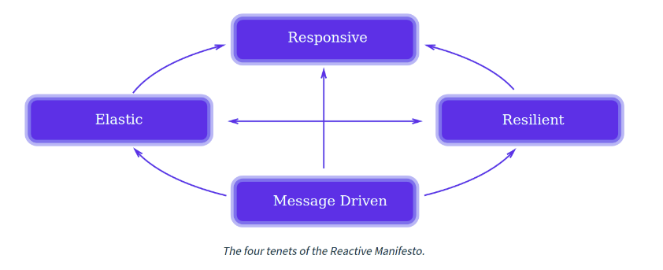

Slide 4
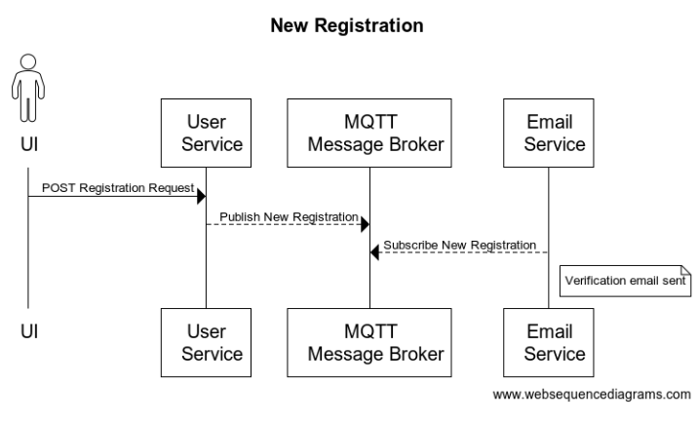
Example 1

Slide 5
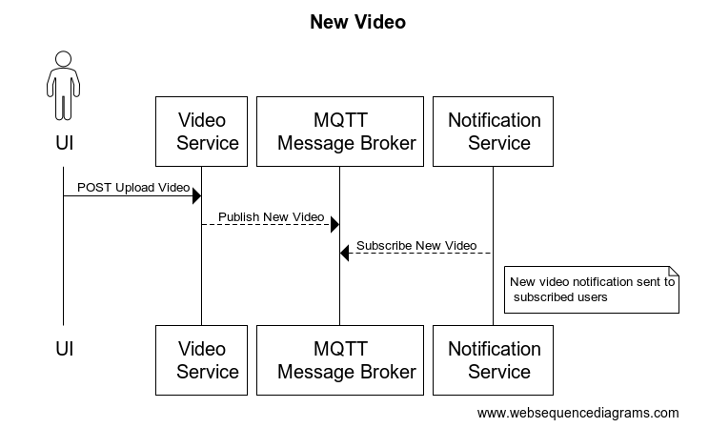
Example 2

Slide 6
Resources
https://en.wikipedia.org/wiki/Message_queue#Standards_and_protocols
https://en.wikipedia.org/wiki/MQTT
https://en.wikipedia.org/wiki/Publish%E2%80%93subscribe_pattern
https://blog.redelastic.com/what-is-reactive-programming-bc9fa7f4a7fc#.qfhx9f9dr
https://mostafa-asg.github.io/post/reactive-systems-vs-reactive-programming/
https://www.reactivemanifesto.org/
https://mosquitto.org/man/mqtt-7.html
https://hub.docker.com/_/eclipse-mosquitto

Slide 7
Mosquitto conf and Docker command
Run container
docker run -it --name mosquitto --network="host" -v mosquitto.conf:<path_to_conf_file> eclipse-mosquitto
mosquitto/config/mosquitto.conf
port 1883
bind_address 127.0.0.1
allow_anonymous true

