Slide 1
Software Testing
Software testing → investigation conducted to provide information about the quality of the software product or service under test (code written to guarantee the quality of production code).
Different terms and approaches

Slide 2
Types
Unit tests
Integration tests
  Component
  Integration
  Sociable
E2E
UI
Exploratory / Manual

Slide 3
Methodologies
TDD – Test Driven Development
BDD – Behavioural Driven Development
DDD - Domain Driven Design

Slide 4
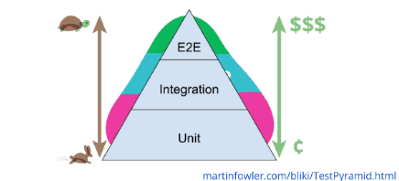
Test Pyramid

Slide 5
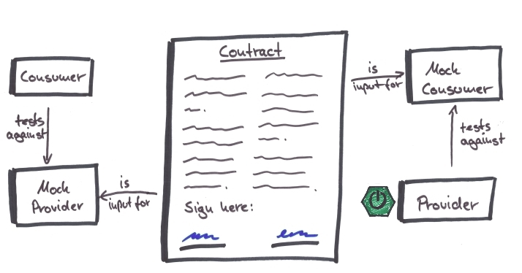
Pact testing

Slide 6
Resources
https://docs.pact.io/
https://github.com/paucls/pact-contract-testing-workshop
https://pactflow.io/how-pact-works/?utm_source=ossdocs&utm_campaign=getting_started#slide-1
https://rhendricksen.medium.com/consumer-driven-contract-testing-with-pact-for-angular-and-spring-boot-9c84caac4040
https://docs.pact.io/pact_broker/docker_images/pactfoundation/
https://github.com/pact-foundation/pact-broker-docker
https://github.com/pact-foundation/pact-broker-docker/blob/master/docker-compose.yml
https://reflectoring.io/consumer-driven-contracts-with-angular-and-pact/

