Slide 1
Landing Page

Slide 2
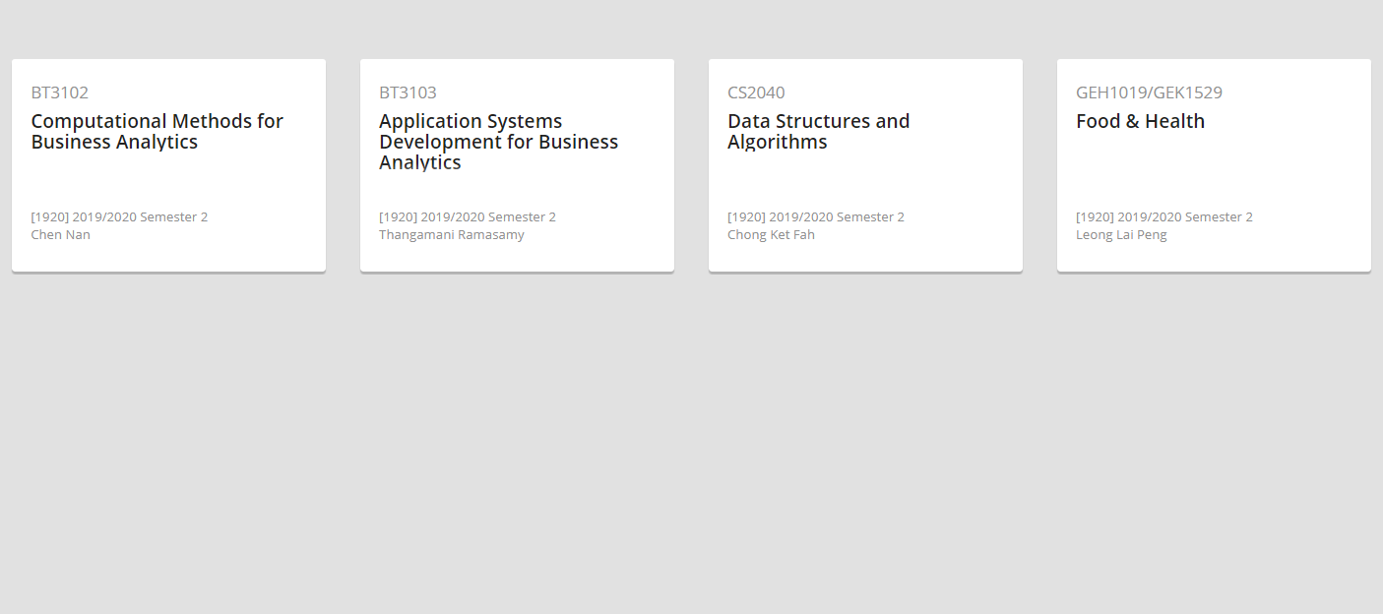
Module 1
Module 2
Module 3
Module 4
Project 1
Due date:
Project 3
Due date:
Project 4
Due date:
Create new project
Project 2
Due date:
Create new project
Create new project
Create new project
Upon clicking any project,
You will go to the main page
Where all other pages are at.
Button to create a new project

Slide 3
Main Page that consists
Of
(sidebar consists of thes, remove projects, teammates &notifications))
Calendar page
Resources page
Gantt Chart Page
Tasks

Slide 4
Calendar Page Specifications

Slide 5
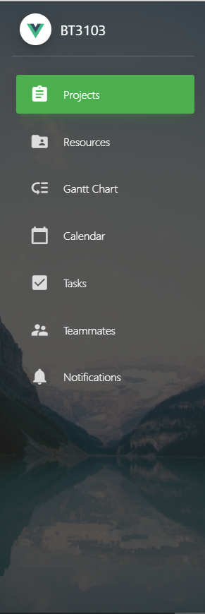
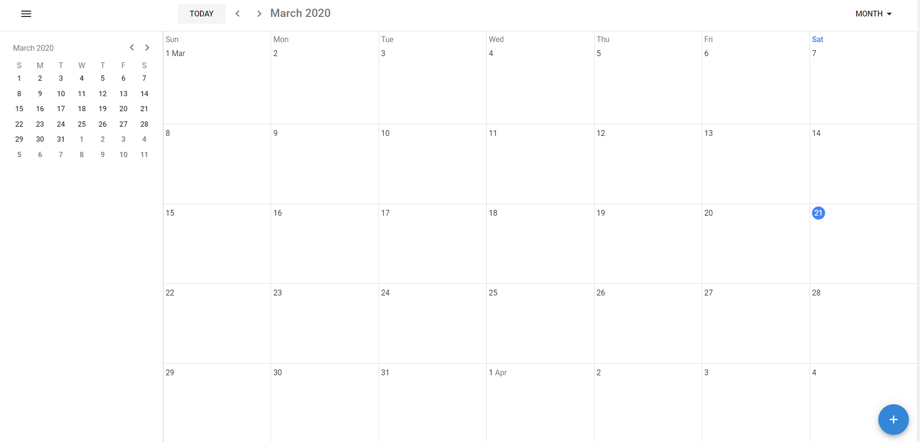
Desired View Upon Clicking ‘Calendar’

Slide 6
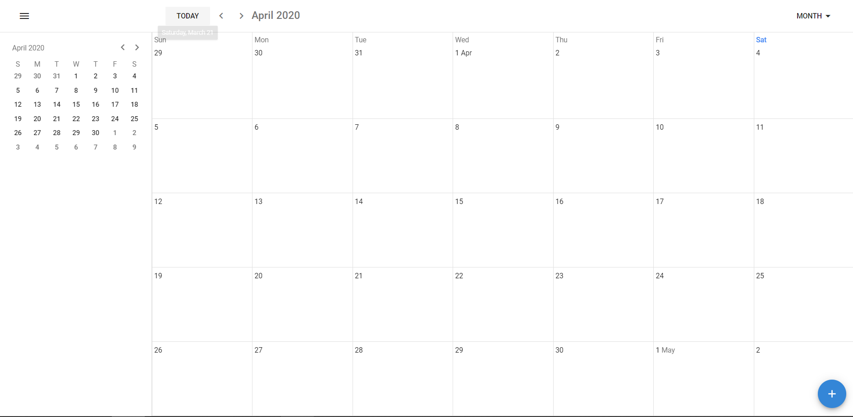
Desired Functionalities
Change
between
Day, Month, Week, Year
Add new event

Slide 7
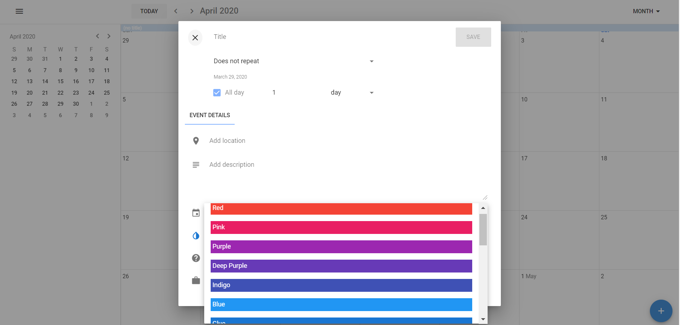
Upon clicking “+” Add new event
Different colours for different team mates
Details

Slide 8
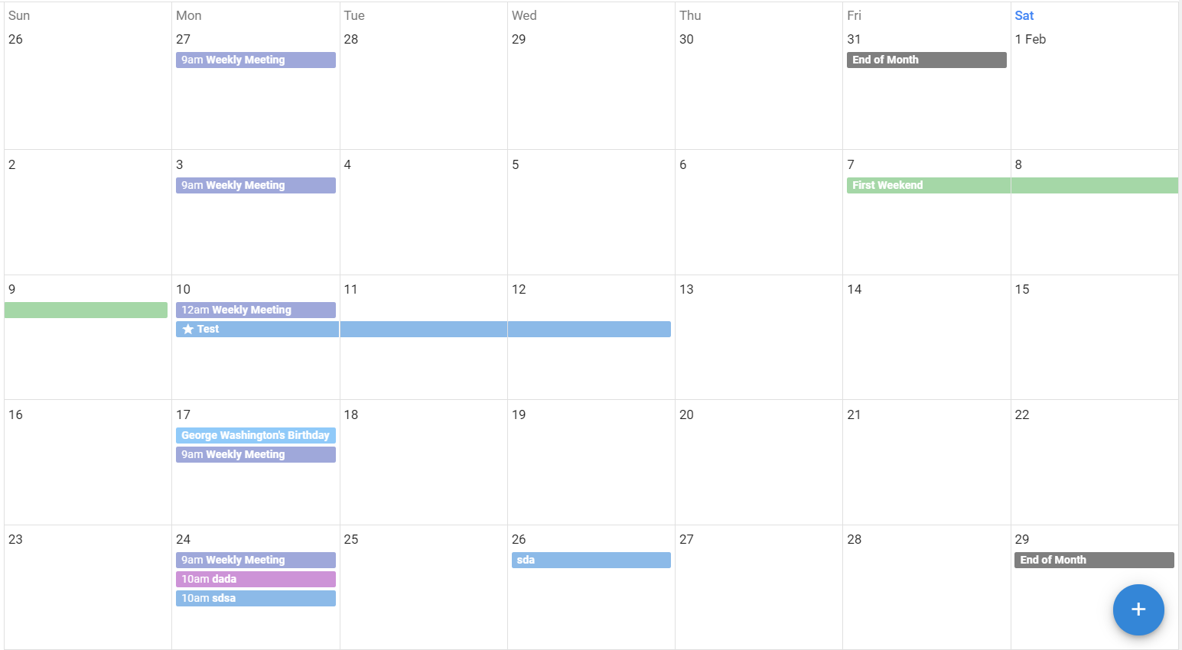
Desired Final Product
Can see when would be good timings to host meetings, different colours = different people

Slide 9
Current Problems
Inability to integrate pre-made package into the final product
Packages derived from
https://github.com/ClickerMonkey/dayspan-vuetify
https://clickermonkey.github.io/dayspan-vuetify/example/ [Example of package use]
Current package is also faulty - unable to display events on the Calendar once an event is “added”
Need to integrate into the backend (firebase) to store information of calendar events so that after refreshing, information is not lost

Slide 10
Task Page
Specifications

Slide 11
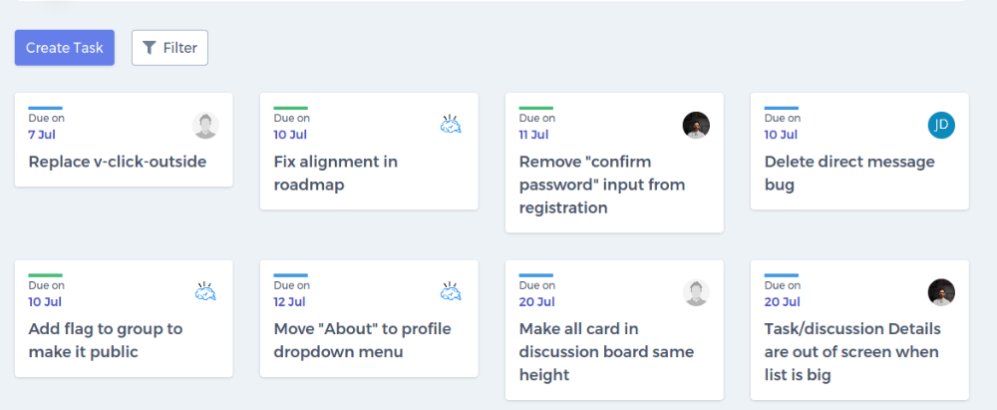
Desired View Upon Clicking ‘Task’
2 buttons. Create tasks & filter tasks (filter tasks by status as seen in next next slide)
Upon clicking on a
Specific task, you can change its details

Slide 12
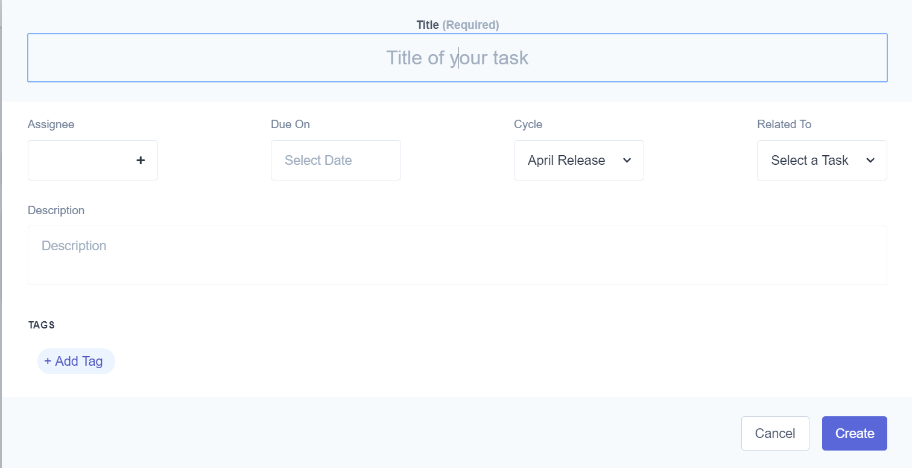
After clicking the “Create Task” button

Slide 13
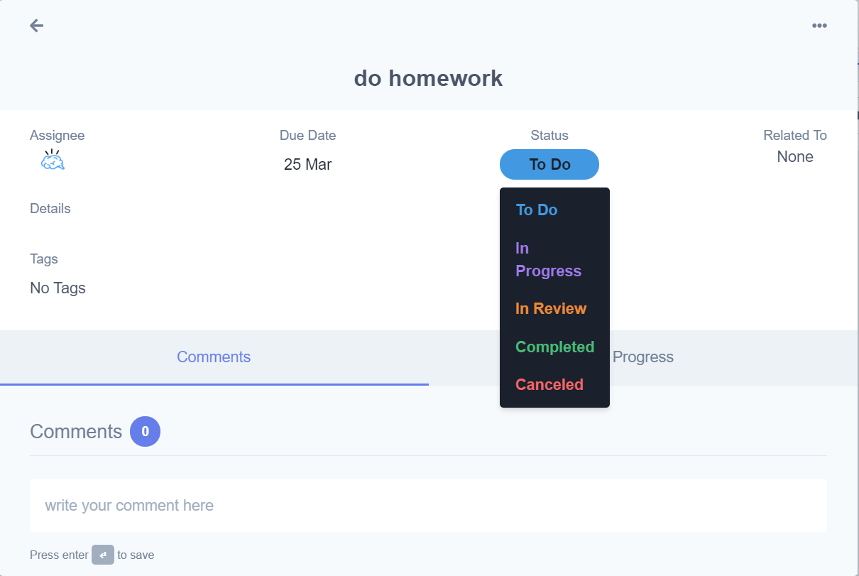
Upon clicking a specific task, you can change
The details like due date/ status and comments

Slide 14
Gantt Chart Page Specifications (already in the existing repo just need some changes)
Using dhtmlxgantt package
Can refer to this link as I would need the same style and functions: https://docs.dhtmlx.com/gantt/samples/05_lightbox/14_jquery_multiselect.html

Slide 15
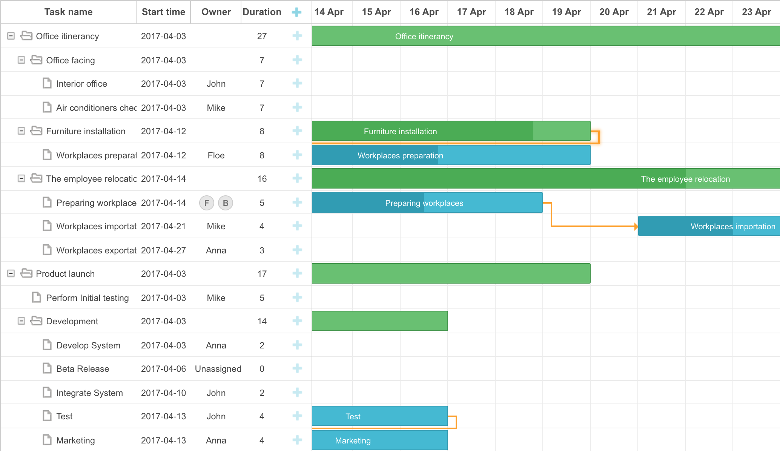

Desired View Upon Clicking ‘Gantt’
Can refer to this link as I would need the same style: https://docs.dhtmlx.com/gantt/samples/05_lightbox/14_jquery_multiselect.html
Different tasks coloured differently:
Red - Urgent
Green - not urgent
Add a red line to track current date

Slide 16

Functionalities
Can press this ‘+’ to add new task
Can press each task to update task’s information
Can link between different tasks
Download as pdf button at the buttom of page
Can drag arrow to update how many % done (progress)

Slide 17
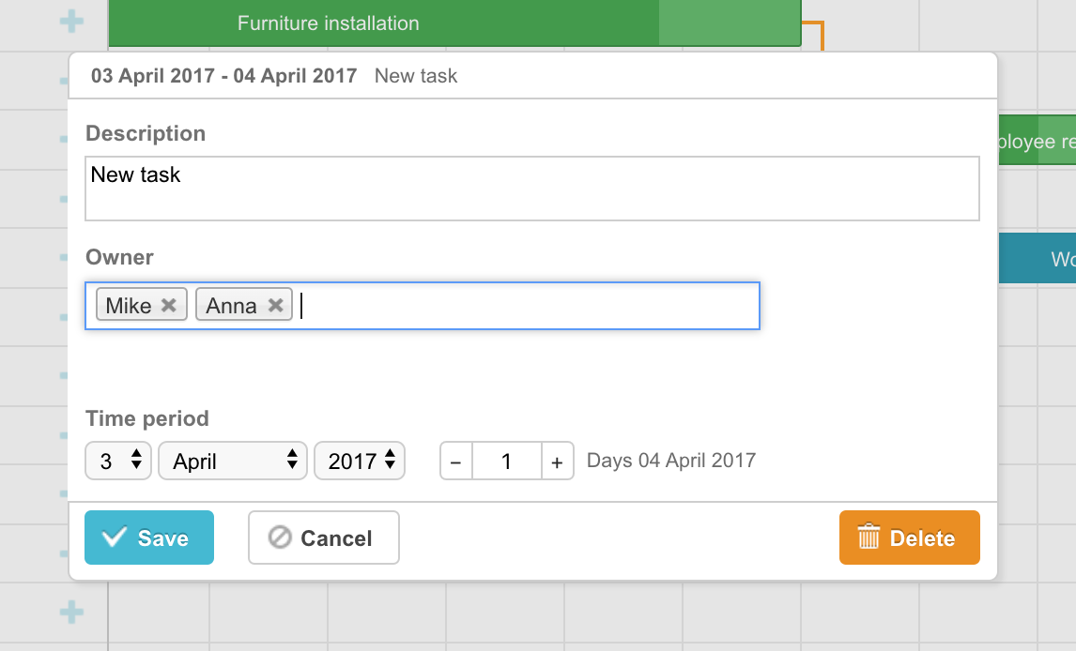
After clicking + or task (press)
Multiselect dropdown to select owner(s)
If possible, add the task to the individual to-do list of the member
Lightbox appears

Slide 18
Resources

Slide 19
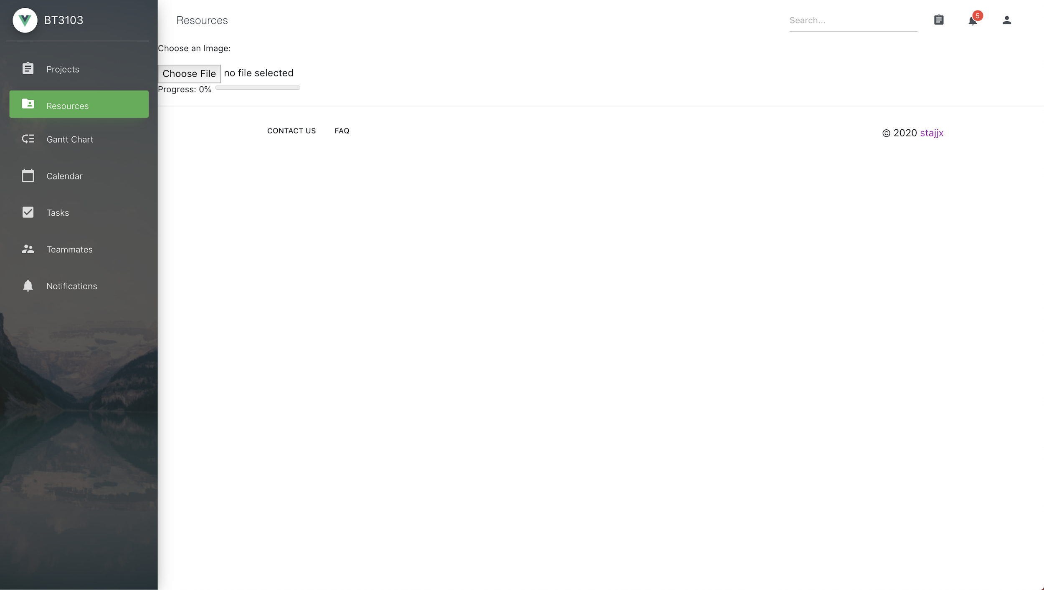
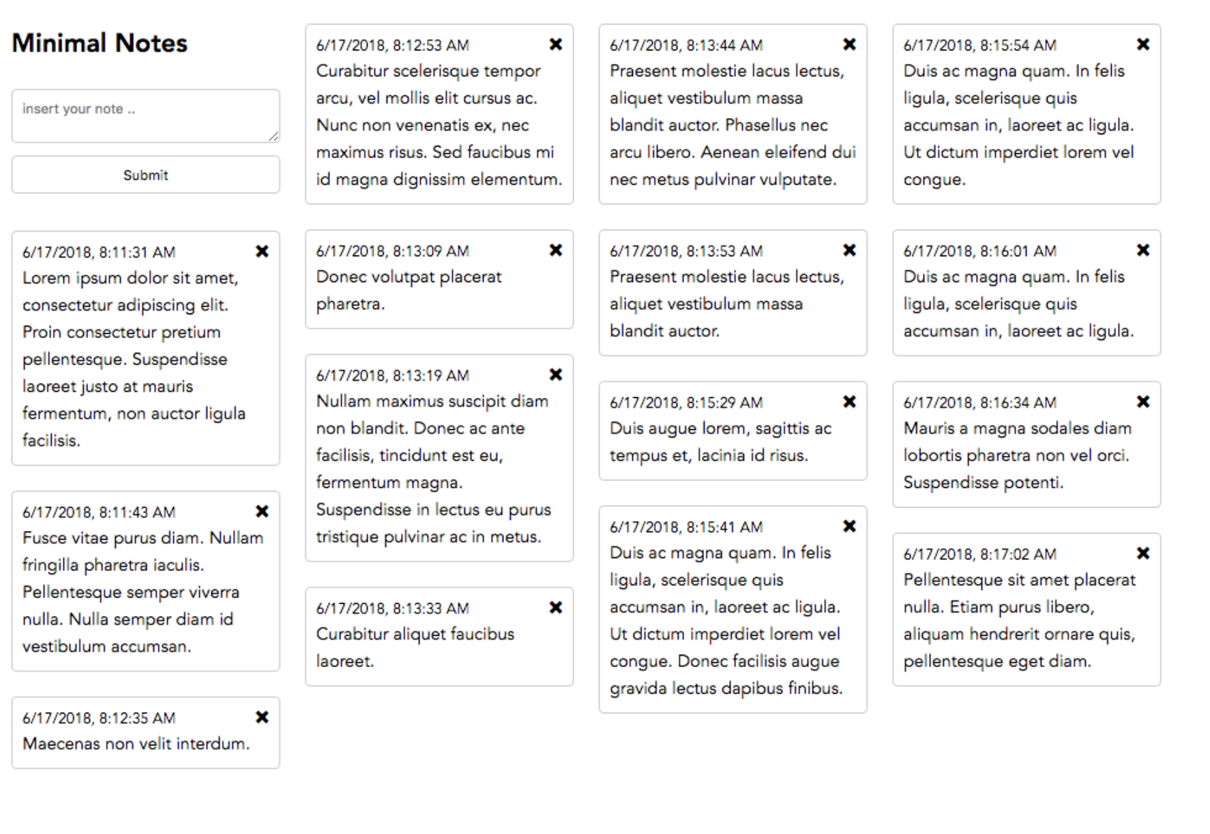
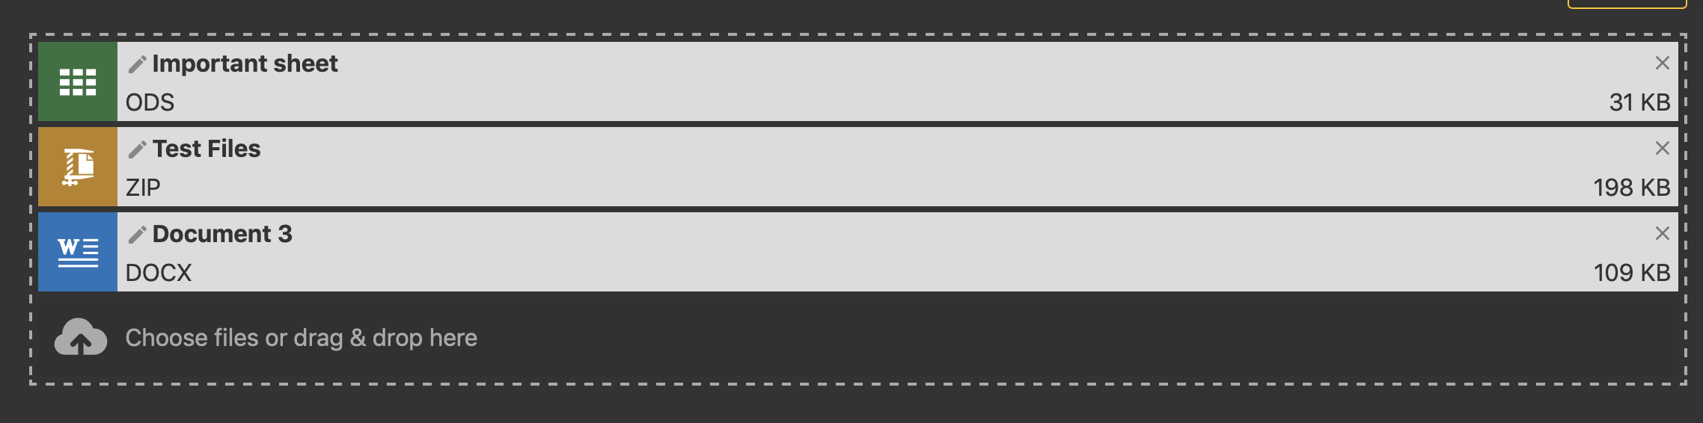
Meeting minutes Sticky notes for personal resource
Drag and drop resources that can be accessed in this page
Able to drop upload any types of files

