Slide 1
Nepal Earthquake Data Analysis (2015–2025)
Insights, Trends & Preparedness Strategies

Slide 2
Nepal is situated in a seismically active region due to the collision of the Indian and Eurasian tectonic plates. This tectonic activity results in frequent earthquakes, with the 2015 Gorkha Earthquake being one of the most significant events in recent history. Understanding the seismic history and tectonic setting of Nepal is crucial for effective disaster preparedness and mitigation.
Contextual Background

Slide 3
Objectives
Visualize and summarize earthquake activity in Nepal (2015–2025)
Highlight regions with frequent seismic events
Provide general recommendation for disaster preparedness.

Slide 4
Dataset Source
Kaggle dataset, cleaned and processed
link:- https://www.kaggle.com/code/sangampaudel530/nepal-earthquake-2015-2025/notebook

Slide 5
Data Cleaning Steps
Removed null rows
Merged Date & Time
Extracted Year & Month
Saved as cleaned_nepal_earthquake.csv

Slide 6
The analysis was conducted using Python, leveraging libraries such as Pandas for data manipulation, Matplotlib and Seaborn for visualization, and Geopandas for geographic plotting. The dataset was cleaned to remove null values, and various visualizations were created to summarize and highlight key insights.
Methodology

Slide 7
Key Findings
Average magnitude is 4.47; most quakes are between 4.0 and 5.0
2015 shows a huge spike (120+ events) due to the Gorkha Earthquake and aftershocks
Bagmati Province is a major earthquake hotspot
No strong correlation between magnitude and surface location (latitude/longitude)
Earthquakes are frequent but mostly mild; big ones are rare but very dangerous

Slide 8
Visual Insights
Histogram of magnitudes
Scatter plot of latitude vs longitude (colored by magnitude)
Heatmap of earthquake count by month & year
Box plots for magnitude by year/month
Seismic Hotspot: Bagmati Province

Slide 9
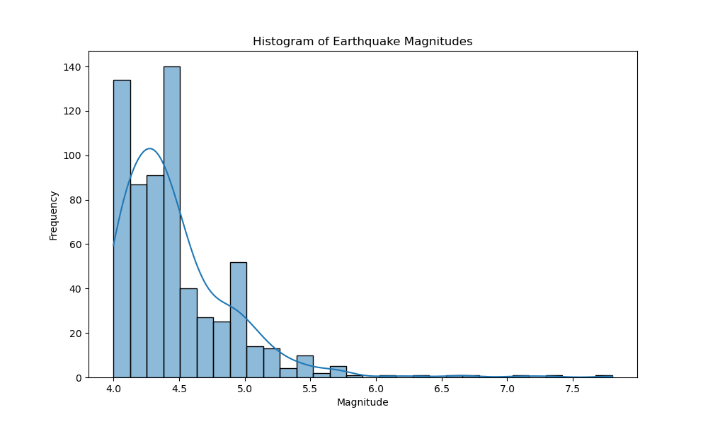
Histogram of Magnitudes

Slide 10
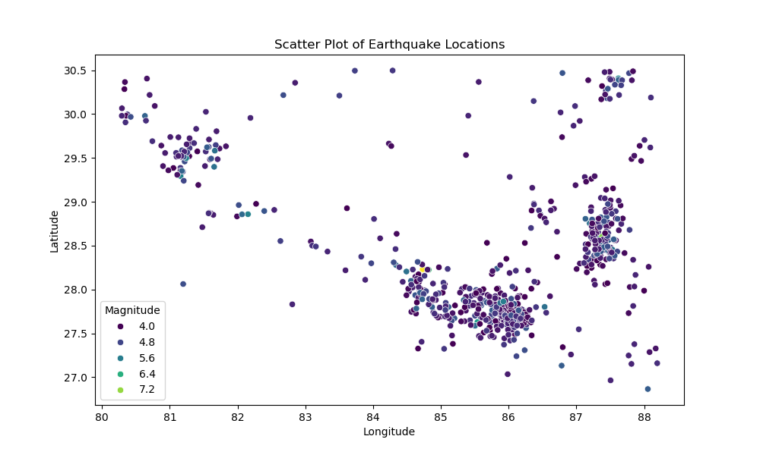
Scatter Plot of Earthquake Locations

Slide 11
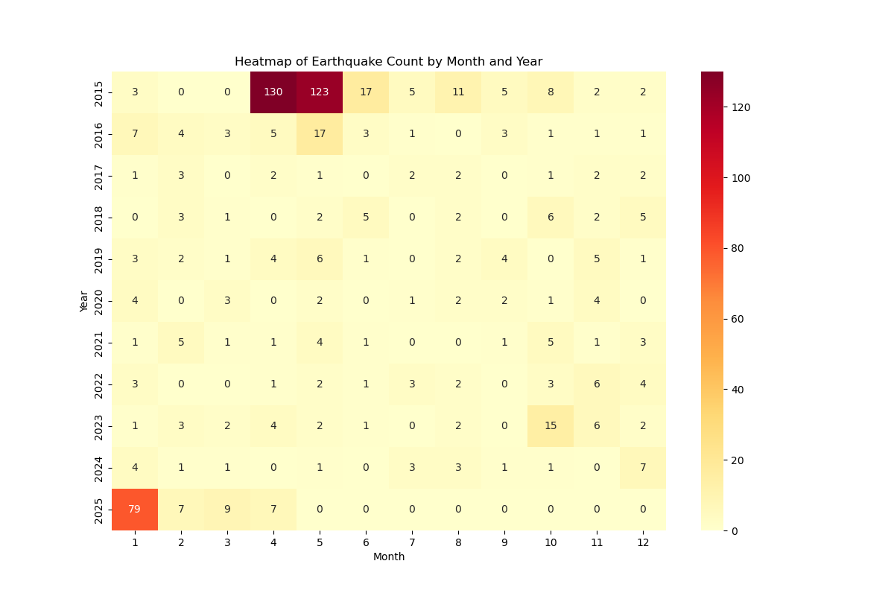
Heatmap of Earthquake Count by Month & Year

Slide 12
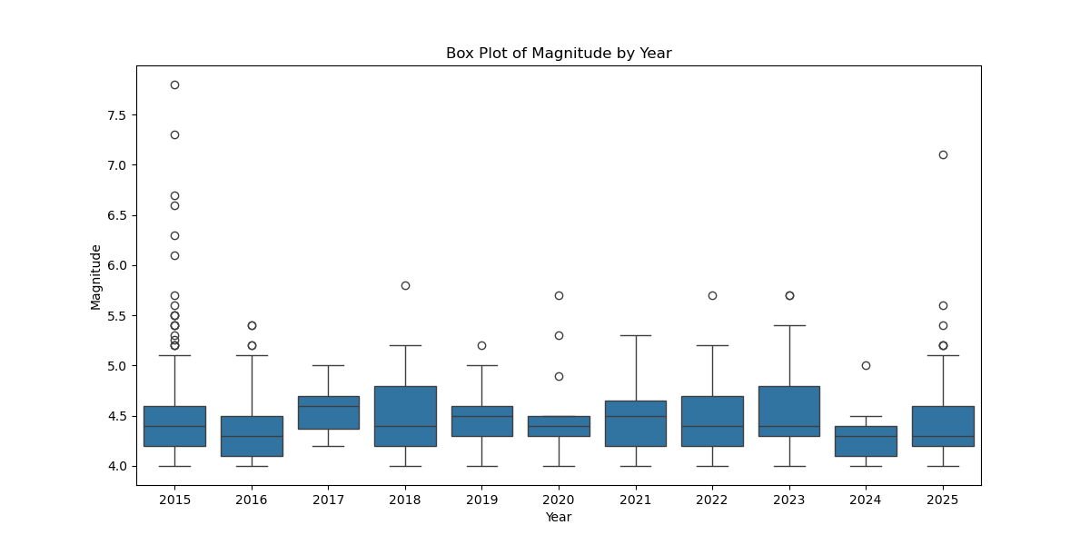
Box Plot of Magnitude by Year

Slide 13
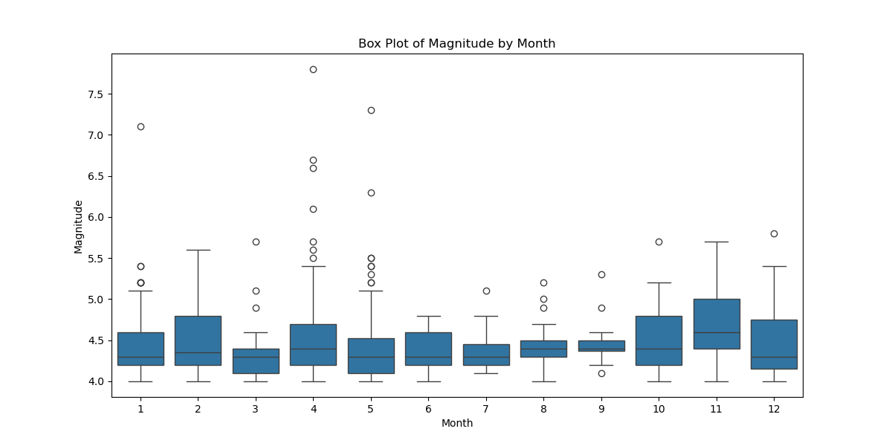
Box Plot of Magnitude by Month

Slide 14
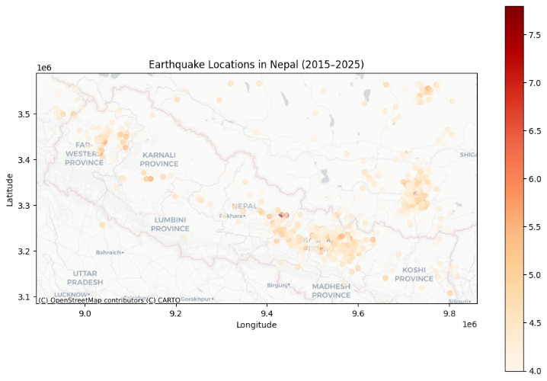
Seismic Hotspot: Bagmati Province

Slide 15
This analysis is based on recorded earthquake data from 2015 to 2025. It does not account for unrecorded events or variations in data collection methods. Additionally, the analysis focuses on surface-level data and does not delve into the depth or subsurface characteristics of the earthquakes.
Limitations or Assumptions

Slide 16
Disaster Preparedness
Install early warning systems
Enforce earthquake-resistant building codes
Run community awareness programs
Train emergency responders (police, army, health)
Build resilient infrastructure (roads, hospitals, towers)
Continue research & monitoring

Slide 17
To mitigate the impact of future earthquakes, it is essential to support local preparedness programs, advocate for resilient infrastructure, and participate in community awareness initiatives. Collaboration between government, organizations, and citizens is key to building a safer and more resilient Nepal.
Call to Action

Slide 18
Conclusion
The 2015 Gorkha earthquake was a major turning point
Preparedness, public education, and proper planning can help reduce future disaster impact
Both government and citizens must work together to stay safe

