Slide 1

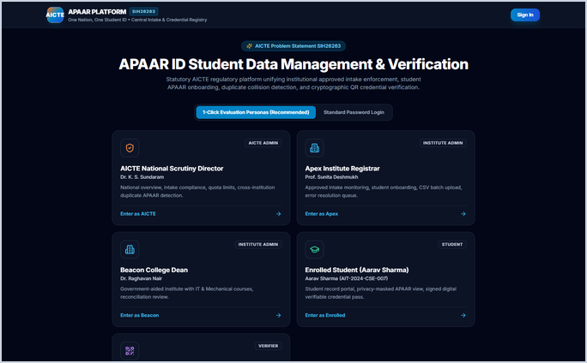
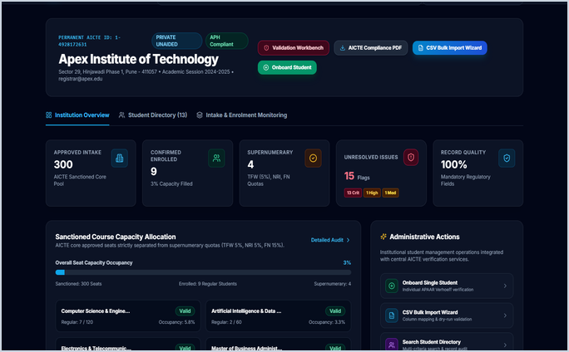
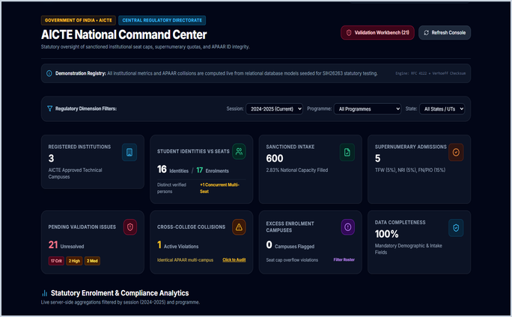
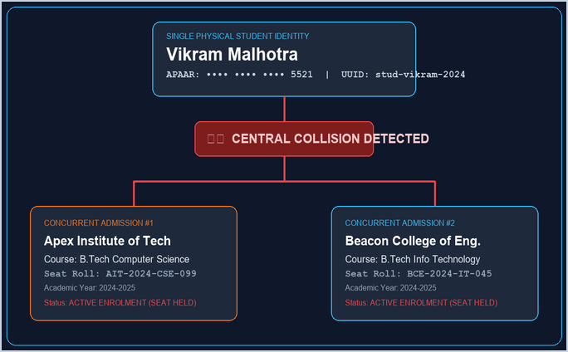
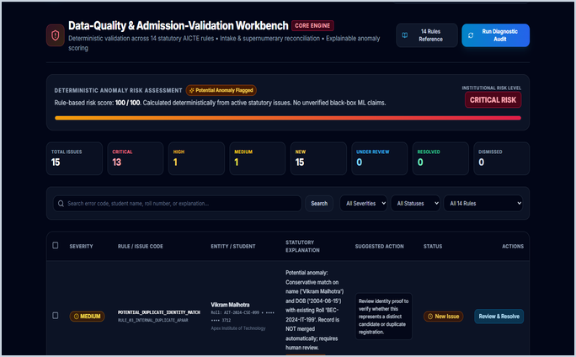

AICTE · SMART INDIA HACKATHON 2026
PS: SIH26263
TRUST EVERY RECORD.
VERIFY EVERY ENROLMENT.
APAAR-Linked Student Data Integrity & Verification Platform
for AICTE-Approved Institutions
Team: Sentinels · Category: Software / Smart Automation · Organisation: AICTE

Slide 2

THE PROBLEM
Student records that can't be trusted.
Institutions across India submit enrolment data through disconnected, manual processes
with no unified validation, no duplicate detection and no real-time oversight.
No Cross-Institution Visibility
Manual Data Collection Gaps
A student can hold active enrolments at multiple institutions simultaneously with no automated detection or flag.
APAAR IDs, programme codes and enrolment details arrive in inconsistent formats across institutions — no field-level validation enforced.
Intake Monitoring Blind Spot
No Authorised Verification Channel
Institutions may exceed approved intake limits without triggering any regulatory alert, distorting official enrolment figures.
Employers and admissions teams have no trusted, privacy-respecting way to verify whether a credential is backed by a valid enrolment record.
No external statistics cited — observations based on domain analysis of the problem statement.

Slide 3
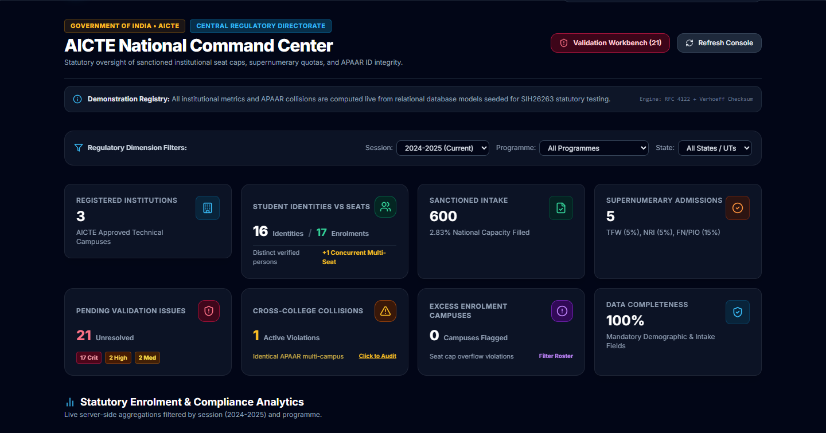
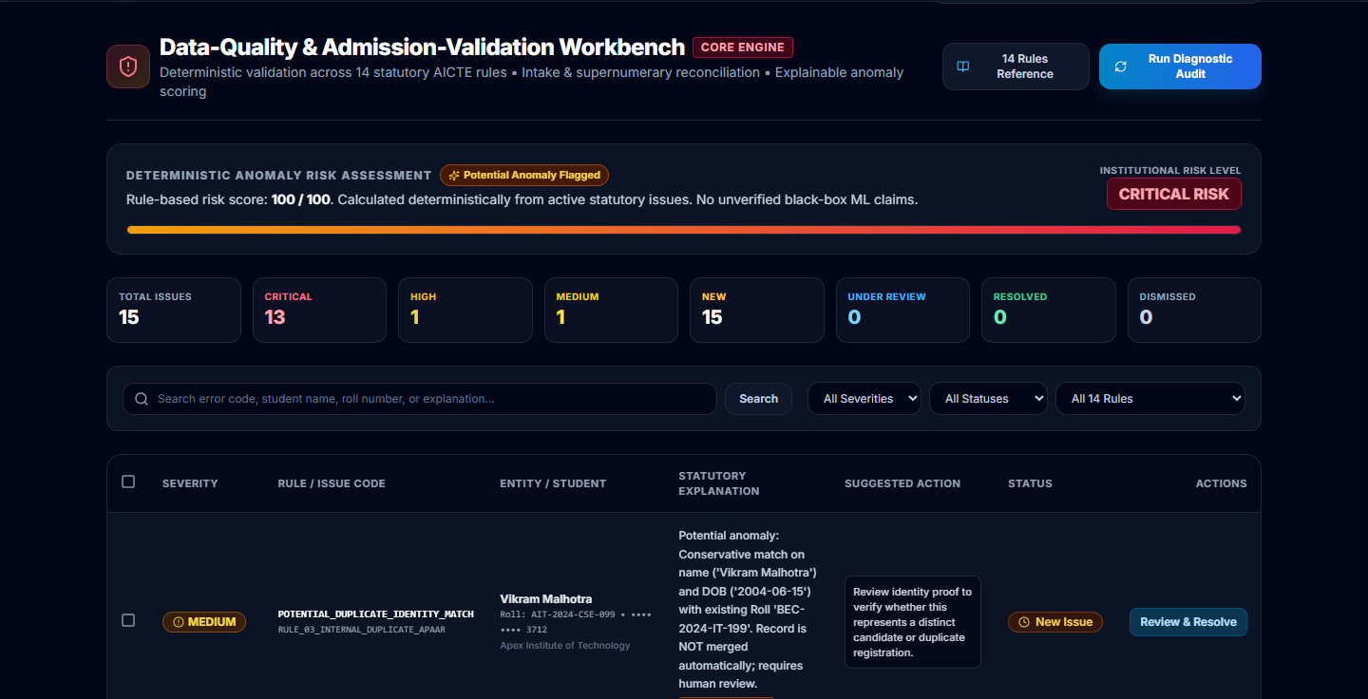

OUR SOLUTION
A Validation-First Enrolment Platform.
01
02
03
04
05
06
Institution
Submission
Server-Side
Validation
Issue Review
& Correction
Central
Registry
AICTE
Analytics
Authorised
Verification
CSV upload
or manual entry
14 deterministic
statutory rules
Flagged rows,
error report
Canonical student
identity store
Intake, duplicates,
compliance
Role-gated QR
credential check
✓ Zero-trust validation
before commit
⬡ Stable UUID per
student identity
⬡ Role-based access
for 5 user types
⚑ Cross-institution
duplicate detection
✓ Signed verifiable
credential pass
AICTE Dashboard
Validation Workbench
Credential Pass

Slide 4
DIFFERENTIATION
Validation-first, not collection-first.
✗ Conventional Record Collection
✓ Our Validation-First Workflow
Identity vs Enrolment
Student identity conflated with enrolment — no distinction between who the student is and what they are enrolled in.
Stable internal UUID separates student identity from enrolment records. Multiple enrolments tracked independently.
Duplicate Detection
No automated cross-institution check. Duplicate enrolments may persist undetected across academic years.
Normalised exact-match detection flags duplicate APAAR IDs within and across institutions before record commit.
Intake Accounting
Manual count of admitted students with no separation of ordinary and supernumerary seats.
Active enrolment count, grouped by institution, programme and year. Supernumerary seats tracked separately.
Access Control
Flat access model — most users can view or edit all records.
Role-based access for 5 roles: AICTE Admin, Institution Admin, Operator, Student Viewer, Authorised Verifier.

Slide 5
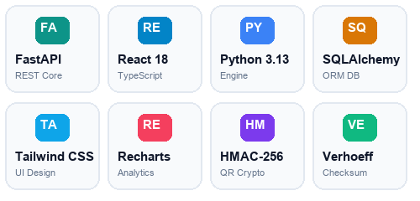
TECHNICAL ARCHITECTURE
Modular, role-aware, audit-logged.
CLIENT TIER
APPLICATION TIER
DATA TIER
■ React 18 + TypeScript
■ FastAPI (Python)
■ SQLAlchemy ORM
▸ JWT authentication + RBAC
▸ SQLite ← PROTOTYPE ONLY
▸ Vite build pipeline
▸ Not for production deployment
■ 5-role adaptive UI
▸ Bcrypt password hashing
▸ Alembic migrations
▸ AICTE Command Centre
■ Validation Engine
▸ 13 normalised tables
▸ 14 deterministic rules
▸ Institution Portal
FUTURE INTEGRATION
▸ NOT ML / not AI
▸ Student Credential Pass
PLANNED — NOT ACTIVE
▸ APAAR Registry API
▸ DigiLocker credential sync
▸ National Academic Depository
▸ Production PostgreSQL
Subject to AICTE authorisation.
■ Credential Signing Service
▸ Validation Workbench
▸ QR-linked verifiable pass
▸ Bulk Upload Wizard
■ Audit Event Logger
▸ No PII in logs

Slide 6
VALIDATION ENGINE
14 deterministic statutory rules. No ML. No guesswork.
Upload
Parse
Validate
Categorise
Review
Commit / Reject
Row
Student ID
Rule
Severity
Finding
Status
1
STU-AIT-0012
—
—
All mandatory fields present. APAAR format valid.
PASS
2
STU-AIT-0017
R-02
CRITICAL
APAAR ID 'APAAR-X-99' does not match configured format pattern.
FLAG
3
STU-BCN-0031
R-03
CRITICAL
APAAR 550011223344 already linked to STU-AIT-0009 in this institution.
FLAG
4
STU-AIT-0024
R-06
CRITICAL
programme_code is missing — required field for enrolment record.
FLAG
5
STU-AIT-0033
R-09
HIGH
Accepting this row would bring CS active enrolment to 122 vs intake 120.
FLAG
⚠ SYNTHETIC DEMONSTRATION DATA — Not sourced from official APAAR registry.
Format validation checks structure only; does not confirm registry authenticity.
Validation Workbench — live application screenshot

Slide 7
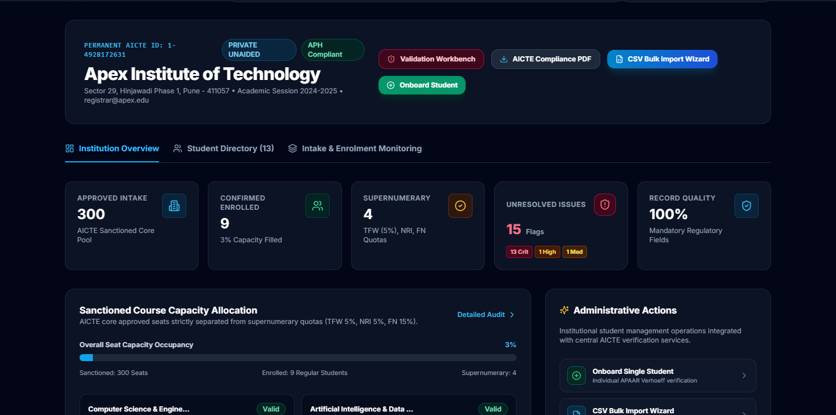
LIVE PRODUCT
From institutional submissions to regulatory intelligence.
AICTE National Command Centre
Institution Intake Dashboard
KPI cards • cross-institution duplicates • intake alerts
Programme gauges • enrolment status • completeness
Demo personas: admin@aicte.gov.in · registrar@apex.edu · verifier@tcs.com · student@apex.edu
14-Rule Validation Workbench
Student Verifiable Credential Pass
Issue codes • severity • row-level error export
Masked APAAR • signed QR • role-gated visibility

Slide 8
SECURITY & IMPACT
Built for trust. Measured against real data.
SECURITY DESIGN
SYSTEM MEASUREMENTS (synthetic demo environment)
Role-Based Access Control
21
Validation issues detected
5 distinct roles. Permissions enforced at API level on every endpoint.
CRITICAL: 17 · HIGH: 2 · MEDIUM: 2
Tenant Isolation
1
Cross-institution collision candidate
All queries scoped to institution. Cross-institution access requires AICTE role.
Vikram Malhotra — concurrent seats at 2 colleges
Masked APAAR Display
44/44
Pytest tests passing
APAAR ID shown as ****-****-3344 to operators. Full value to authorised roles only.
Full backend test suite · 0 failures
Signed Credential + QR
100%
Data completeness (demo data)
Verifiable credential pass with signed metadata. QR links to role-gated verification endpoint.
All required fields populated in synthetic dataset
Audit Event Log
3
Demo institutions loaded
All create, update and delete actions logged with actor, timestamp and change. No PII in log fields.
Apex · Beacon · Zenith — 600 seats approved intake
Bcrypt + JWT
17
Active enrolment records
Passwords hashed with bcrypt. Session tokens signed with configurable secret via environment variable.
16 unique student identities · 1 duplicate enrolment
⚠ Local format check ≠ Registry validation ≠ Official identity verification · QR verification confirms enrolment record integrity, not government identity.

Slide 9
NEXT STEPS & CLOSING
Phase 1
Phase 2
Phase 3
Phase 4
PILOT
POLICY
VALIDATION
INTEGRATION
NATIONAL
ROLLOUT
Deploy with 2–3 AICTE
institutions on controlled
data set
Align statutory rules with
actual AICTE intake
regulations
Official APAAR / DigiLocker
connection — subject to
authorisation
Scale to all AICTE-approved
institutions with production
database
VALIDATE.
MONITOR.
VERIFY.
Building the trust infrastructure for India's higher education enrolment ecosystem.
Team Sentinels
PS: SIH26263 · AICTE · Software / Smart Automation
Live demo — QR verification
All data shown is synthetic. SQLite is prototype-only. APAAR registry integration is planned, not active. Validation engine uses 14 deterministic rules — not ML.

