Slide 1

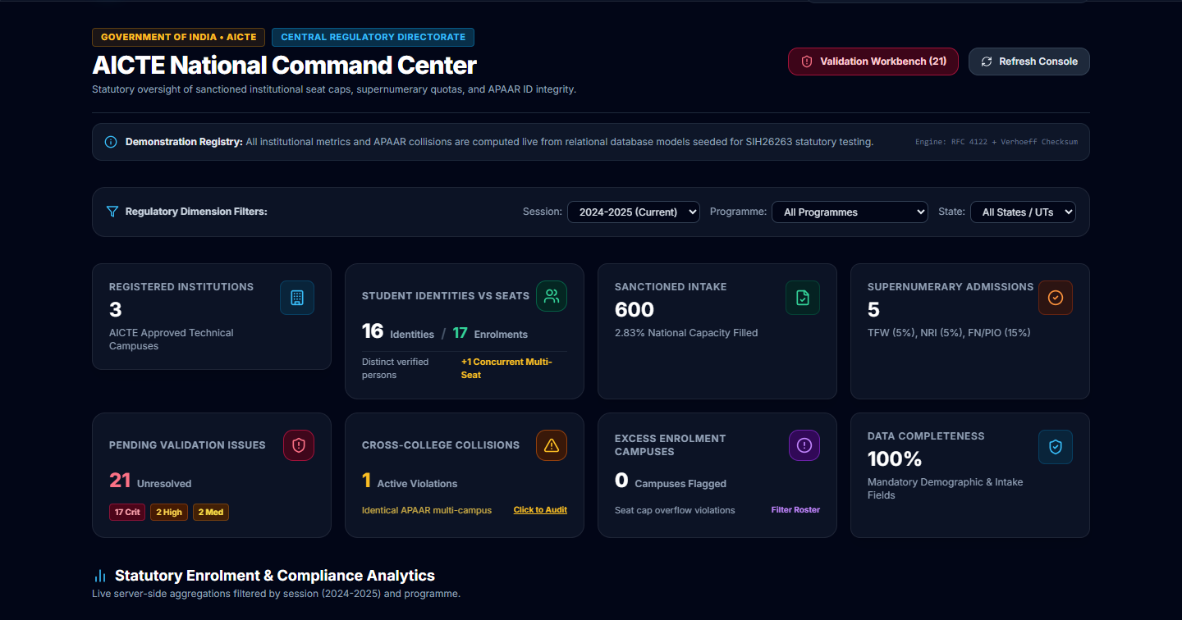
SMART INDIA HACKATHON 2026
🔗 Github Source Code
▶ Demo Video
APAAR AICTE: Central Student Data Management & Verification Platform
• Problem Statement ID – SIH26263
• Problem Statement Title – Development of an APAAR ID-Based Student Data Management and Verification Platform for AICTE-Approved Institutions
• Theme – Ministry of Education
• PS Category – Software
• Team Name – Sentinels
Central AICTE Command Center
100% live database aggregations • 16 student identities • 17 seat enrolments • Real-time collision alerts.

Slide 2
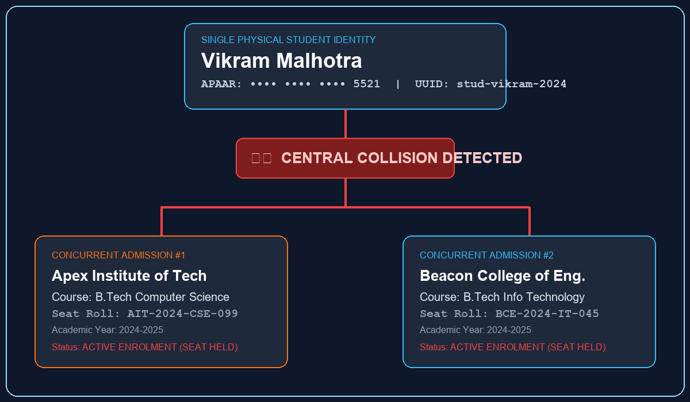
Sentinels
PROPOSED SOLUTION
APAAR-AICTE is an explainable central student data management and verification platform for AICTE-approved institutions. It decouples physical student identities from seat enrolments, gives colleges real-time pre-submission intake validation, and gives regulators a single, explainable verdict backed by 14 deterministic statutory checks and an immutable audit trail — not a black-box AI model.
⚠️ The Problem
• Siloed Institutional Rosters: Colleges manage student data in isolated spreadsheets; AICTE lacks unified, real-time national visibility into intake cap breaches.
• Ghost Enrolments & Seat Hoarding: Students concurrently hold seats in multiple technical institutions during counselling, wasting precious approved capacity.
• Paper Fraud & Black-Box AI Risks: Degree verification takes 3+ weeks, while generic LLMs hallucinate authenticity, can't explain findings, and leak records.
🛡️ The APAAR Solution
College Portal
Real-time completeness tracking (0% → 100%), course capacity gauges, and plain-language pre-submission alerts before formal filing.
AICTE Central Command Center
14 deterministic checks collapsed into one verdict — COMPLIANT or ISSUE FOUND — with transparent point-based penalty scoring.
Audit & Verification Trail
Every upload, cross-institution collision, and third-party verification is permanently logged in an append-only ledger — fully traceable, fully explainable.
2

Slide 3
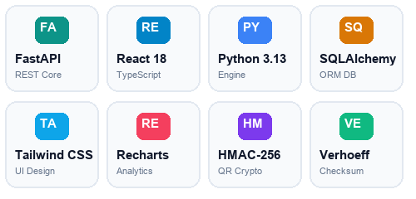
Sentinels
TECHNICAL APPROACH
College Upload ➔ Staging & Pre-Validation ➔ Deterministic Validation (14 checks) ➔ Dual-Quota Reconciliation ➔ Collision Scrutiny ➔ Recorded Decision & Audit
1. Ingestion
CSV template, schema validation, 50MB size gate, path-traversal & header guard.
2. Format Check
Verhoeff checksum, APAAR 12-digit format, legal student name normalization.
3. Quota & Intake
Dual-quota accounting: approved core intake vs TFW/NRI/FN supernumerary.
4. Collision Engine
SHA-256 duplicate detection; cross-institution student ID & roll consistency.
5. Officer Review
Single verdict card (COMPLIANT / ISSUE FOUND); 14-rule evidence on demand.
6. Decision & QR
HMAC-SHA256 signed QR pass; immutable statutory decision audit event.
TECH STACK
⚠️ Honest Scope
The current engine uses deterministic, explainable validation rules rather than ML classifiers, neural networks, or LLMs. AI/ML-based hallucination risks are eliminated by design.
Simulated DigiLocker / ABC National Academic Depository Gateway v2.4 implemented for evaluation; production sandbox binding planned.
Offline QR signature verification on mobile is planned, not implemented in the current prototype.
3

Slide 4
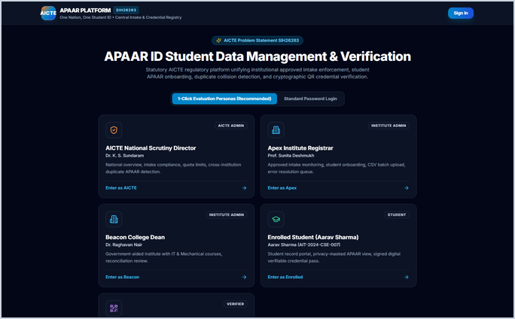
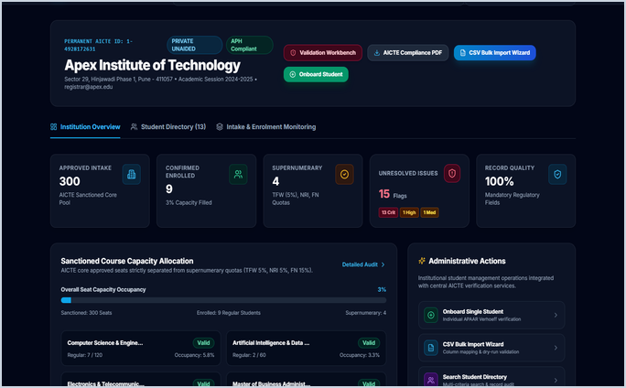
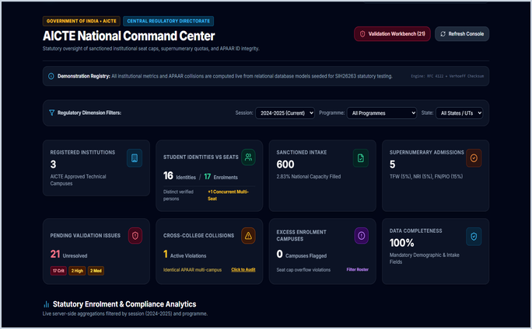
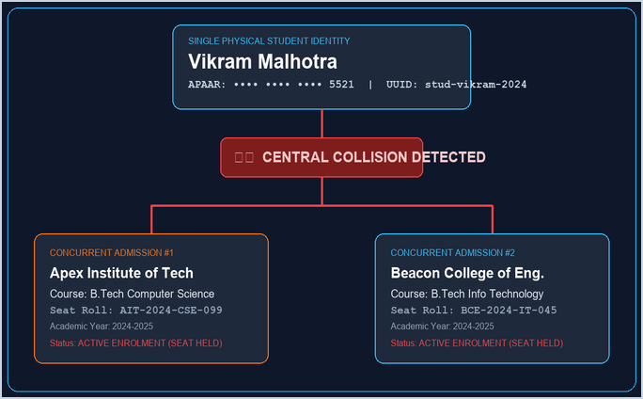
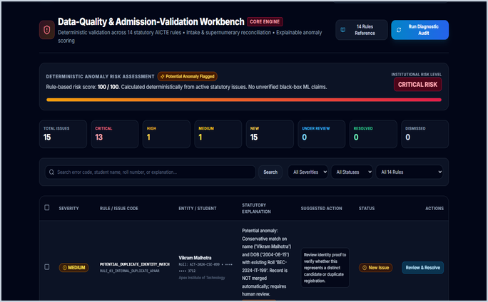
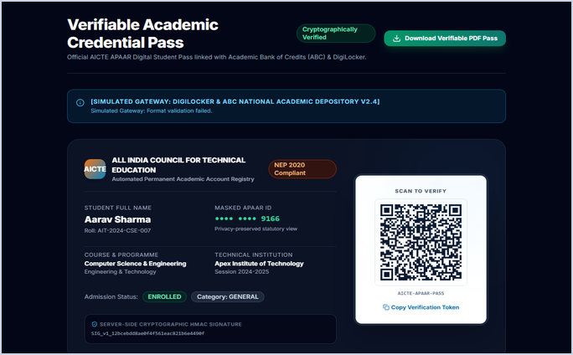
Sentinels
WORKING MODEL
1. Portal Login & Personas
2. College Intake Dashboard
3. AICTE National Scrutiny
4. Collision Discrepancy
5. 14-Rule Workbench
6. Student QR Pass & Verify
4

Slide 5
Sentinels
IMPACT AND BENEFITS
14
Deterministic checks per record
<200ms
Measured validation time per 1,000 batch rows (test suite)
44/44
Automated pytest cases passing (100% test pass rate)
Stakeholder Impact
👥 Colleges
• Catch intake-capacity and duplicate roll number errors before formal submission.
• Clear completeness tracking (0% → 100%) and instant course quota allocation gauges.
👁️ Scrutiny Officers
• Prioritized, explainable findings with transparent penalty scoring instead of raw diagnostics.
• 14 checks collapsed into one actionable verdict (COMPLIANT / ISSUE FOUND).
🛡️ Regulators & Employers
• Every admission decision and third-party verification traceable via immutable audit trail.
• Instant 2-second QR verification eliminates paper credential fraud forever.
🔒 Governance Alignment & Data Sovereignty
Operationalizes NEP 2020 & AICTE Approval Process Handbook (APH 2026-27) — "Light but Tight" transparent, technology-enabled, single-window evaluation. All processing runs on deterministic mathematical logic with zero external AI API calls in the current implementation, so student records never leave the sovereign institutional environment. Final statutory decisions remain exclusively with authorized officers.
5

Slide 6
Sentinels
RESEARCH AND REFERENCES
Regulatory Body / Standard | Citation & Mandate | Official URL
AICTE Official Portal | All India Council for Technical Education national portal and approval gateway | https://www.aicte-india.org
AICTE Approval Process Handbook (APH 2026-27) | Statutory criteria for approved intake limits, supernumerary quotas (TFW 5%, NRI 5%, FN 15%) | AICTE Approval Process Bulletins
AICTE Act No. 52 of 1987 | Statutory mandate for proper planning and coordinated development of technical education in India | AICTE Act & History
Smart India Hackathon (SIH 2026) | Official portal for SIH national innovation and solution submissions | https://sih.gov.in
National Education Policy (NEP 2020) | Section 18: Transforming the Regulatory System into an objective, single-window evaluation framework | https://www.education.gov.in/nep
APAAR / ABC Registry Mandate | Ministry of Education 'One Nation, One Student ID' automated academic depository guidelines | https://apaar.education.gov.in
Digital India Initiative (MeitY) | Ministry of Electronics and IT guidelines for e-Governance, paperless workflows, and e-signatures | https://www.digitalindia.gov.in
National Single Window System (NSWS) | Integrated digital approval portal for statutory clearances in India | https://www.nsws.gov.in
DigiLocker National Verification | National paperless credential and institutional document verification system | https://www.digilocker.gov.in
6

