Slide 1



Activity Kit

Slide 2
Presentation overview
Intro to SustainABLE activity kits
  Sustainability in Science Museums project
  Our SustainABLE programming
Engaging the public in sustainability
  Key concepts
  SustainABLE activities
  Additional resources
Notes:
I’ll be introducing you to the SustainABLE kits and going over some details of our programming.
I’ll also tell you a little bit about what sustainability is, and then go over the hands-on activities included in the kits.

Slide 3
Intro to SustainABLE
Sustainability in Science Museums is a nationwide project led by Arizona State University (ASU)
SustainABLE activity kits are a collaboration of ASU and the National Informal STEM Education Network (NISE Net)

Slide 4
Our programming
Background
Who’s involved
Logistics
Notes:
This slide can be customized to provide information about how your institution will be using the SustainABLE kits:
Incorporating SustainABLE kit activities into ongoing programming
Offering special SustainABLE programming and events

Slide 5
Key concepts
Sustainability means healthy people, communities, and environments, now and in the future.
Sustainability science studies the interaction between people and the planet, and finds innovative and responsible solutions.
Sustainability solutions address today’s biggest challenges to create the future we want.
Everyone has a part to play in creating our future.
Notes:
The SustainABLE activity kits cover four key concepts.
First, what does “sustainability” mean?
Sustainability means healthy people, communities, and environments, now and in the future.
You’ll see that this concept appears in many of the activities. This interaction between humans and our environment is very important. Sustainability is not just about protecting the natural environment—it’s about ensuring a good quality of life for people, too.
Some of the kit activities specifically consider the way society, the environment, and the economy interact. This is sometimes called the “3 Ps”: People, Planet, and Prosperity.

Slide 6
Key concepts
Sustainability means healthy people, communities, and environments, now and in the future.
Sustainability science studies the interaction between people and the planet, and finds innovative and responsible solutions.
Sustainability solutions address today’s biggest challenges to create the future we want.
Everyone has a part to play in creating our future.
Notes:
Second, what is sustainability science?
Sustainability science studies the interaction between people and the planet, and finds innovative and responsible solutions.
Sustainability science is defined by the holistic approach it takes to solving problems. Sustainability scientists can be in any field of science or engineering, and they can use a variety of methods. Often, they use an approach called systems thinking to consider the interrelated, interdependent, and interacting elements of problems.
Some of the kit activities give visitors a chance to explore systems thinking.

Slide 7
Key concepts
Sustainability means healthy people, communities, and environments, now and in the future.
Sustainability science studies the interaction between people and the planet, and finds innovative and responsible solutions.
Sustainability solutions address today’s biggest challenges to create the future we want.
Everyone has a part to play in creating our future.
Notes:
Third, sustainability thinks ahead to the future.
Sustainability solutions address today’s biggest challenges to create the future we want.
Futures thinking recognizes the role that individuals and society play in building our future and reflects on the kind of world we create through our decisions and choices.
Many of the kit activities emphasize the importance of thinking about the future.

Slide 8
Key concepts
Sustainability means healthy people, communities, and environments, now and in the future.
Sustainability science studies the interaction between people and the planet, and finds innovative and responsible solutions.
Sustainability solutions address today’s biggest challenges to create the future we want.
Everyone has a part to play in creating our future.
Notes:
Fourth, sustainability is relevant to all of us:
Everyone has a part to play in creating our future.
Being a change agent involves asking questions and taking actions, as individuals and communities. Each activity in the kit includes an example of ways that different communities can (and have) made sustainable choices. Sustainable solutions will be different for different families and in different places. You can help participants think about the ways they can embrace sustainability—leaving it open to them to decide how they want to act.

Slide 9
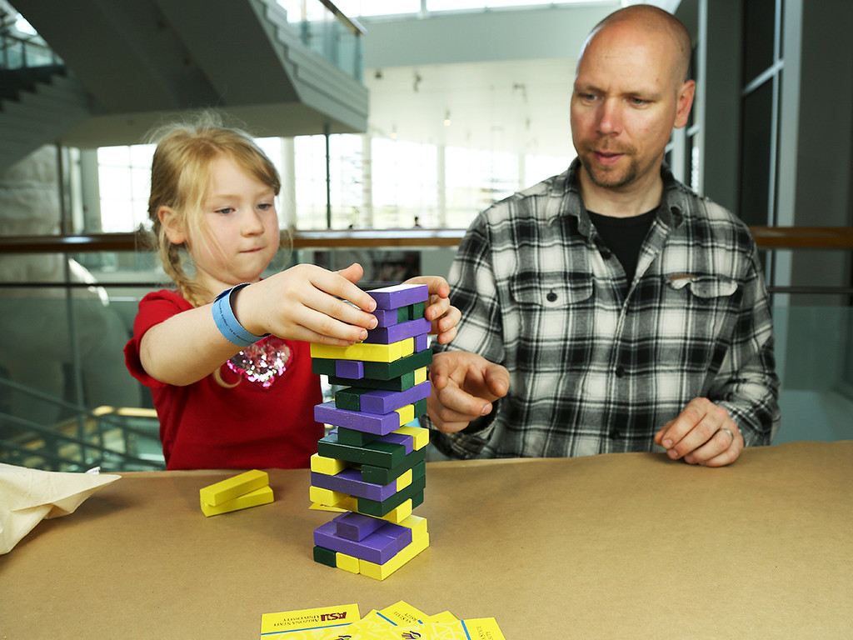
Future Builder
Sustainable communities meet the needs of people, the planet, and the economy.
Notes:
Now let’s take a quick look at the activities included in the SustainABLE kit.
Future Builder is a collaborative game that challenges players to build a pretend sustainable community. They draw cards to discover what to build, and use resource blocks to build a tower that represents their community. They need to build sustainably, or their community will collapse!
The primary learning objectives of this activity is:
Sustainable communities meet the needs of people, the planet, and the economy.

Slide 10

My Community
Sustainable communities meet the needs of people, the planet, and the economy.
Notes:
My Community is a creative activity that challenges participants to think about ways to improve their community and make it more sustainable. They consider different ways that people can improve areas of their communities, then draw a picture that illustrates how they could make their own community more sustainable.
The primary learning objectives of this activity is (again):
Sustainable communities meet the needs of people, the planet, and the economy.

Slide 11
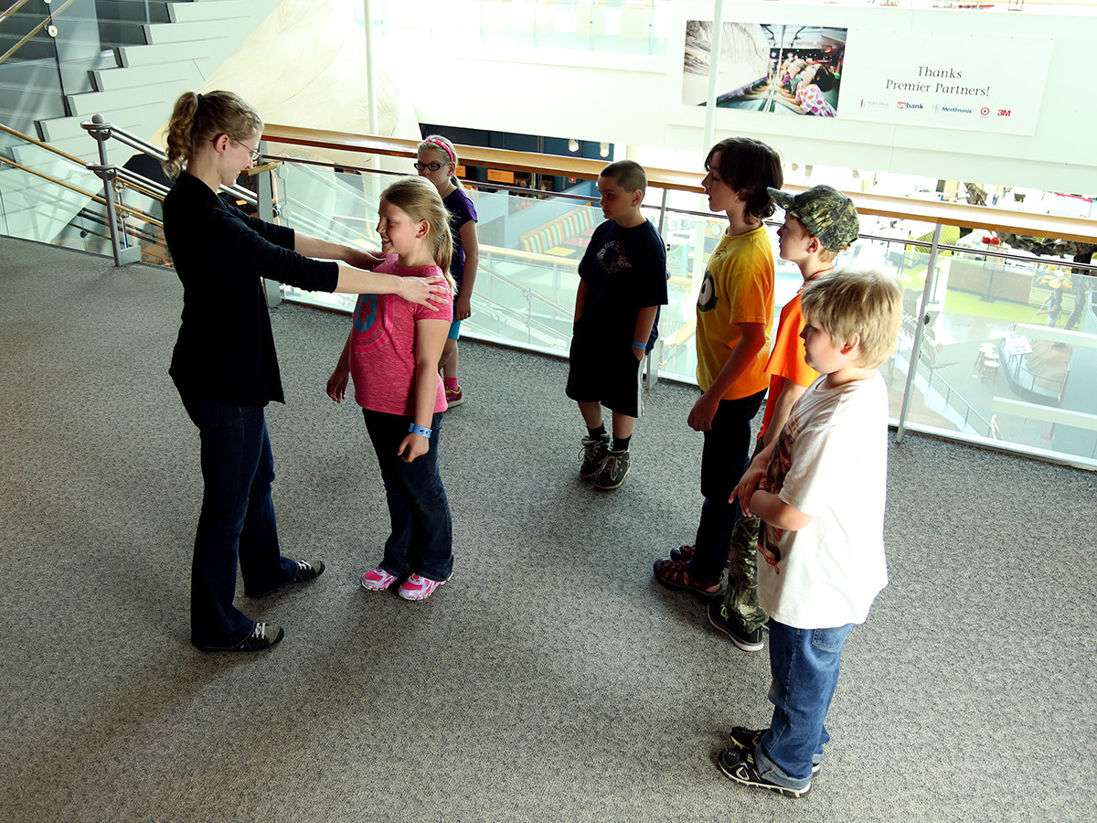
Systems Scramble
Systems thinking helps us understand our complex world and plan for a more sustainable future.
Notes:
Systems Scramble is a whole-body game that allows players to experience how parts in a system interact. They will discover that in a system, things are always changing!
The primary learning objectives of this activity is:
Systems thinking helps us understand our complex world and plan for a more sustainable future.

Slide 12
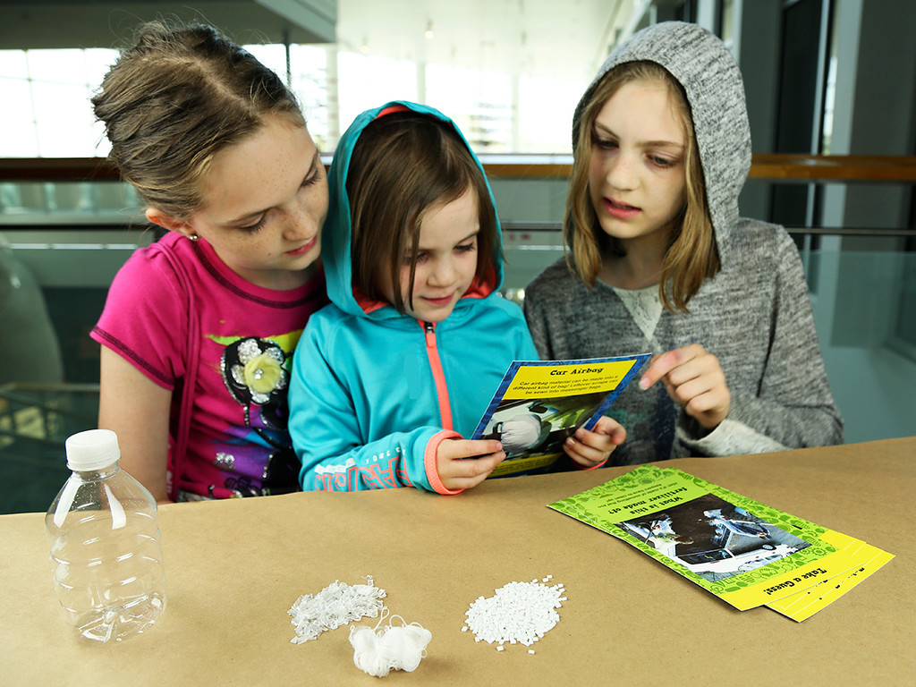
Creative Reinvention
Sustainability solutions address today’s biggest challenges to create the future we want.
Notes:
Creative Reinvention is a game that introduces participants to ways that we can make things more sustainably. They discover how some companies are reusing, recycling, and repurposing materials in creative ways. They also can take away instructions for doing a sustainable craft at home (optional).
The primary learning objectives of this activity is:
Sustainability solutions address today’s biggest challenges to create the future we want.

Slide 13
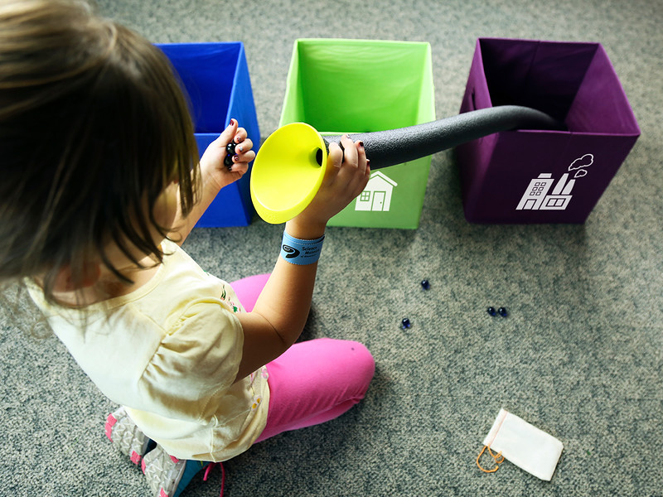
Water Roll
Sustainability solutions address today’s biggest challenges to create the future we want.
Notes:
Water Roll is a collaborative activity that challenges players to work together to share an important limited resource: water. They learn some of the ways we use water today, and consider how we might respond if water became more scarce.
The primary learning objectives of this activity is (again):
Sustainability solutions address today’s biggest challenges to create the future we want.

Slide 14
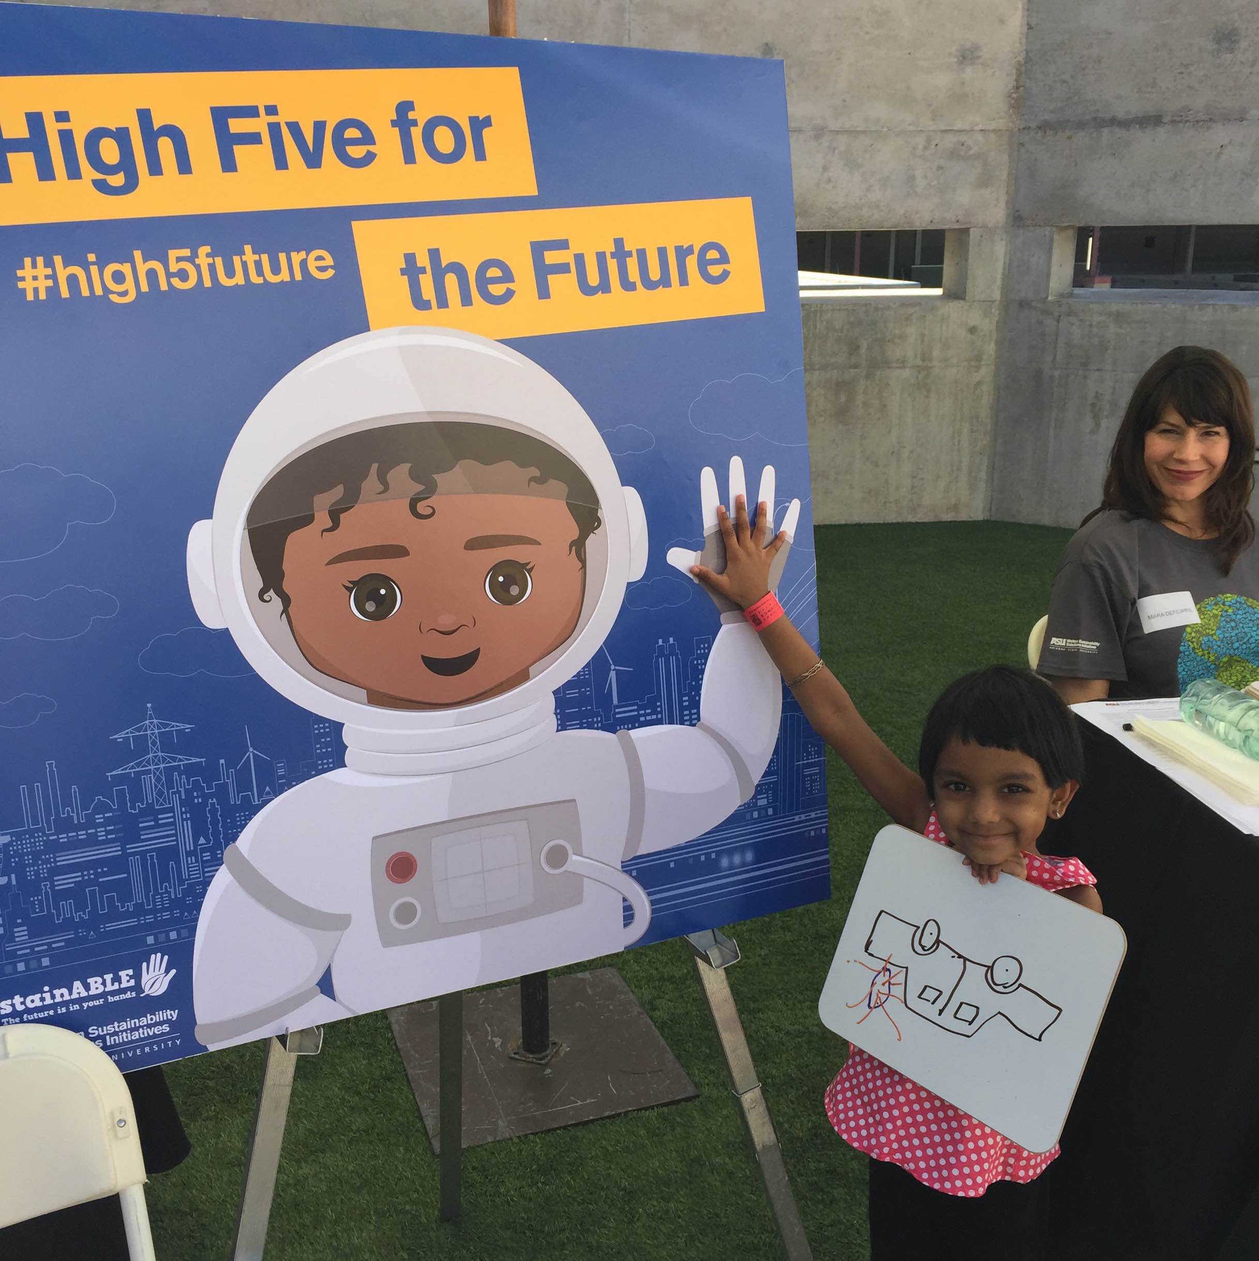
High Five for the Future
We need new sustainability solutions…and we need your help finding them!
Notes:
High Five for the Future gives participants an opportunity to think about things they can do to be a sustainability change agent. They write or draw an idea for a concrete action they can take to help build a more sustainable future.
If they like, they can take a photo of themselves in front of the “High Five” backdrop. They can even give the image of a future kid a high five if they like! This activity provides a photo op as well as a chance for participants to engage in social media, using the #high5future.
The primary learning objectives of this activity is:
We need new sustainability solutions…and we need your help finding them!

Slide 15
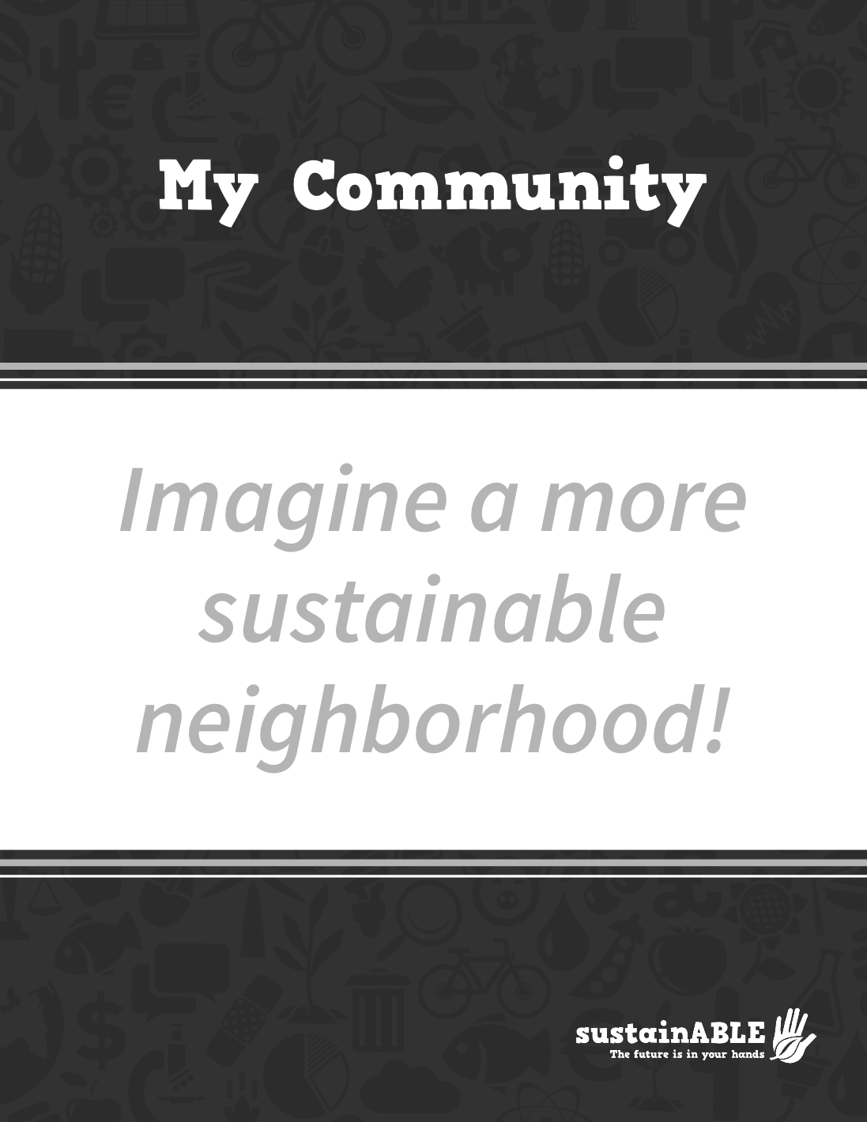
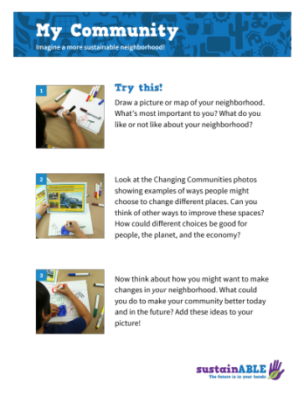
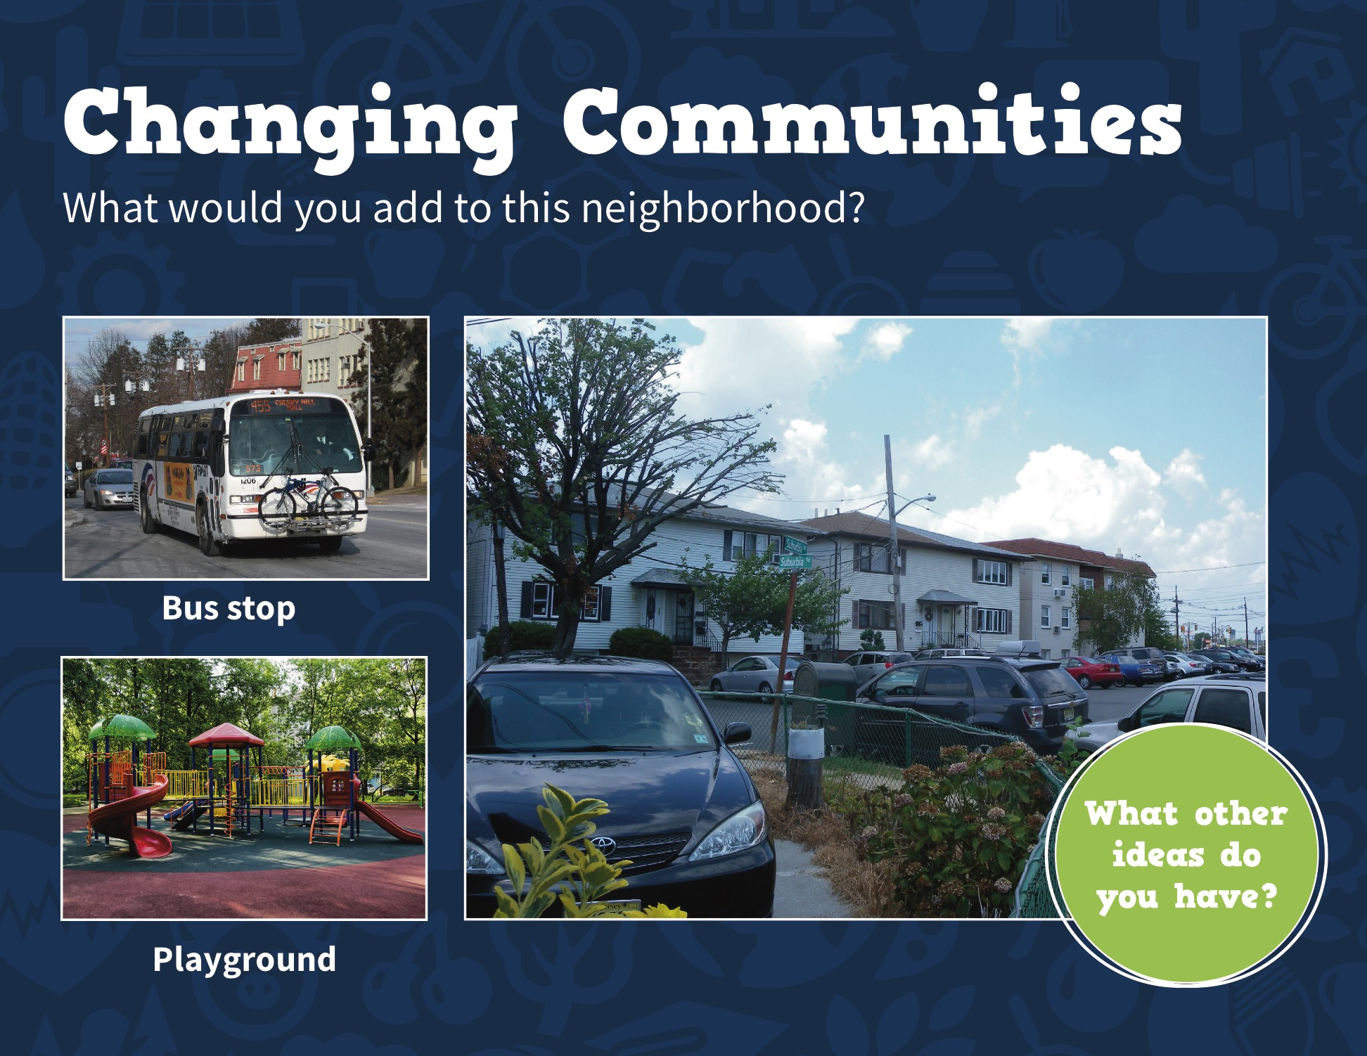
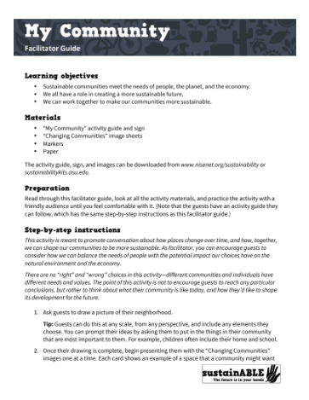
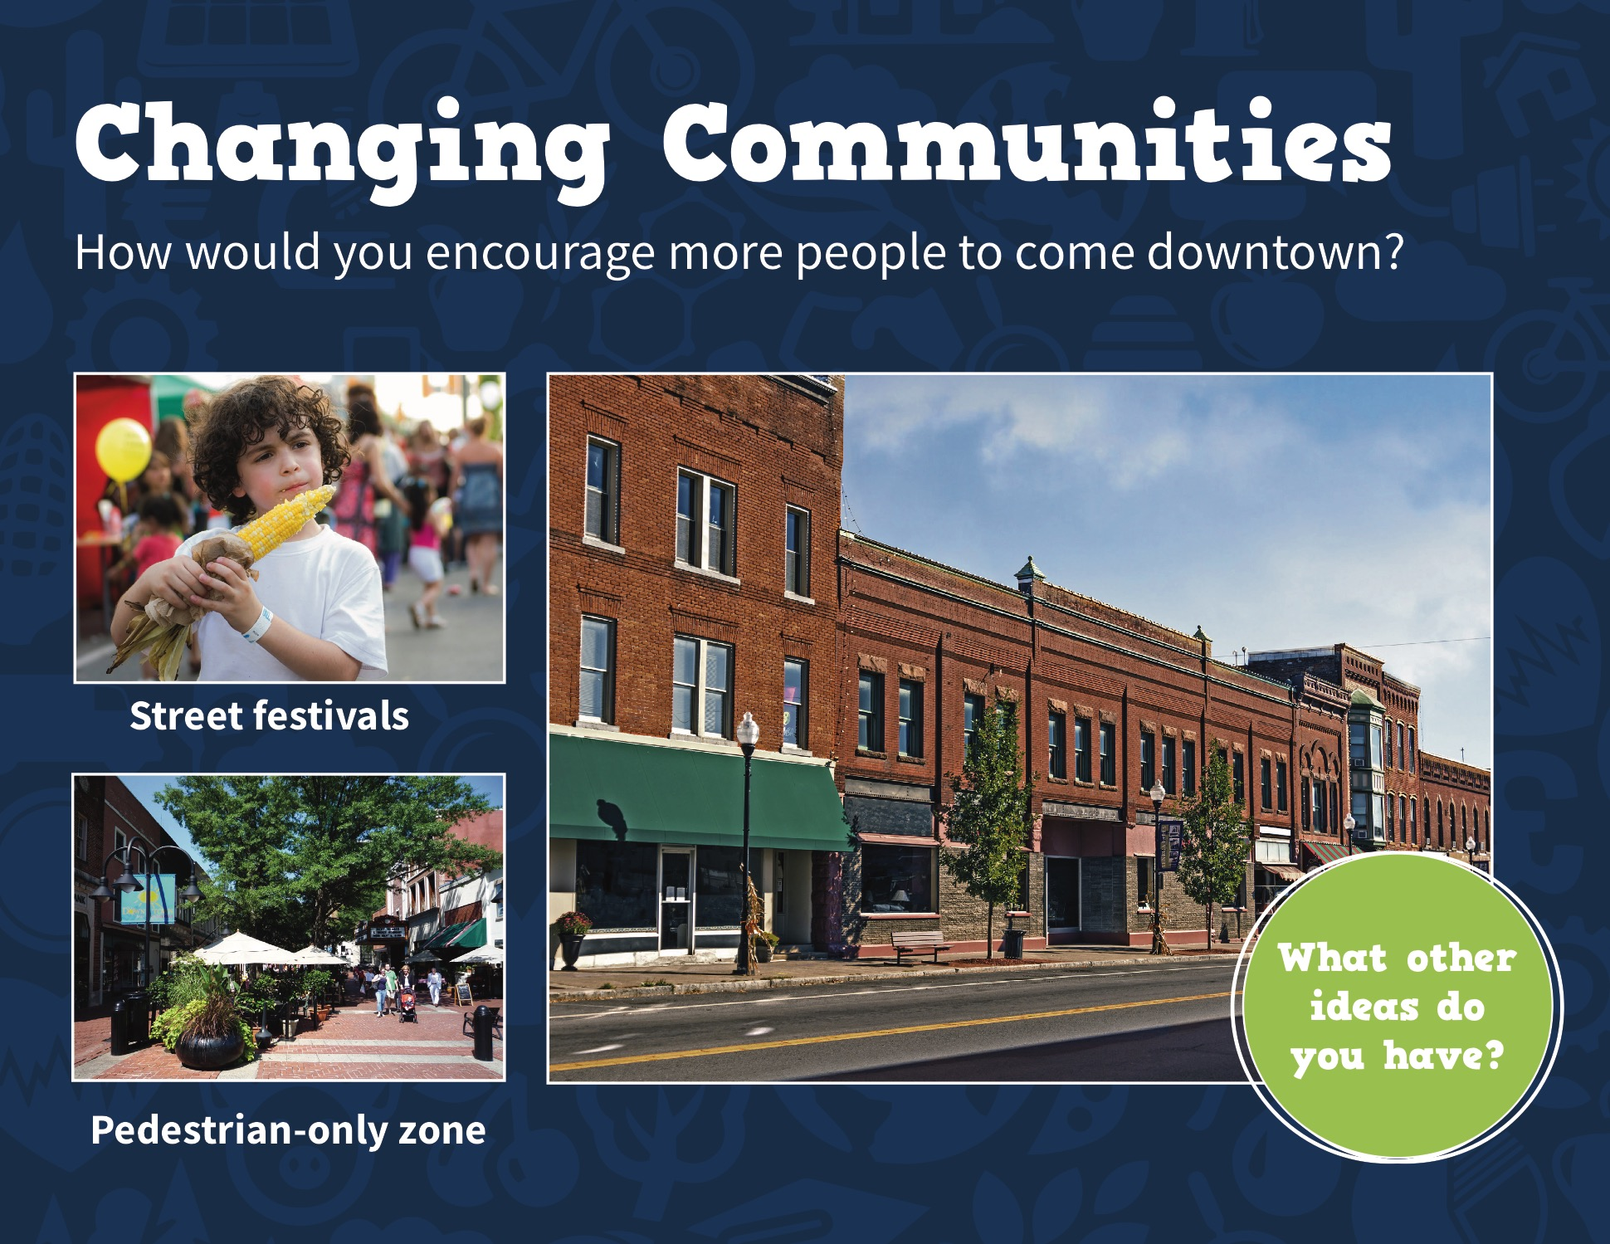
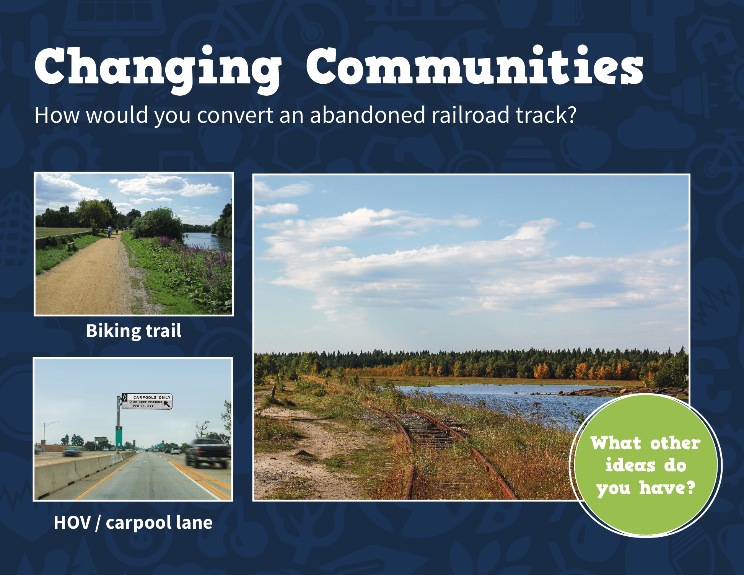
Activity resources
Activity instructions and information
Facilitator information
Materials and supplies
Notes:
The SustainABLE kit includes everything you need for each activity:
Activity guides: Provide instructions and explanations for participants. You can share this with them as you facilitate the activity, so they can see the information and pictures. Some activities also have additional information sheets with images that you can share with participants
Facilitator guides: Provide instructions and information for you, the activity leader. There is also a guide with tips for facilitating hands-on science activities with diverse audiences. You should read these ahead of time.
Materials and supplies: Each box includes everything you need to do the activity with 100 participants. When it’s time to restock, supplies are inexpensive and readily available at discount stores.
In addition to the hands-on activities, the SustainABLE kit also includes posters and other materials to help share sustainability concepts.

Slide 16
Additional resources
For educators:
Sustainability in Science Museums website
NISE Net website
Training videos (Vimeo)
For participants:
Lazy Person’s Guide to Saving the World
Notes:
For educators:
Sustainability in Science Museums website: https://sustainabilitysolutions.asu.edu/sciencemuseums/
NISE Net website: http://nisenet.org/
Training videos (Vimeo): https://vimeopro.com/nisenet/sustainability
For participants:
Lazy Person’s Guide to Saving the World: http://www.un.org/sustainabledevelopment/takeaction/

Slide 17

Sustainability in Science Museums is supported by the Walton Sustainability Solutions Initiatives at Arizona State University (ASU). The SustainABLE activity kits are a collaboration of the Walton Sustainability Solutions Initiatives at ASU, the Center for Engagement and Training in Science & Society (CENTSS) at ASU, Science Museum of Minnesota, and Ithaca Sciencenter. SustainABLE kits are distributed by the National Informal STEM Education Network.
Copyright 2016, Arizona State University. Published under a Creative Commons Attribution-Noncommercial-ShareAlike license: http://creativecommons.org/licenses/by-nc-sa/3.0.

Slide 18
Title
Text
Text
Notes:
You can use this blank, formatted slide to add content to the presentation.

