Slide 1
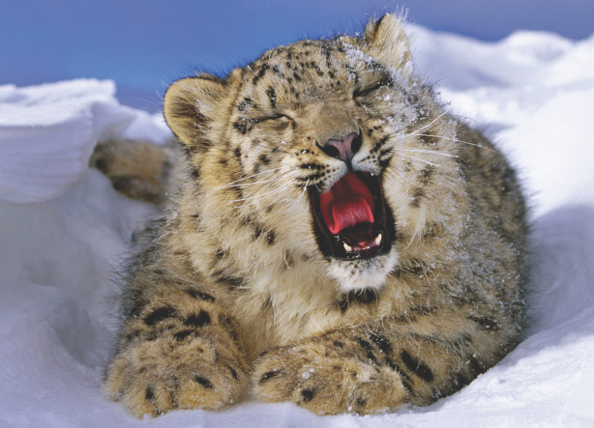

Wildlife and climate change

Slide 2
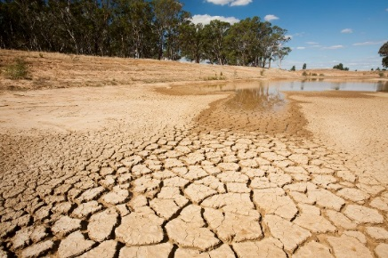
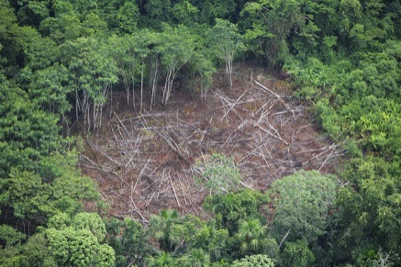
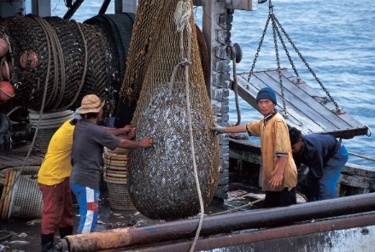
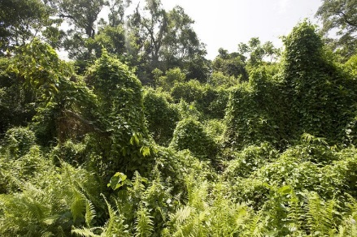
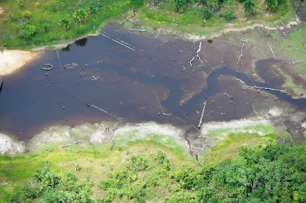
Major threats to biodiversity
Habitat destruction
Overexploitation
Invasive species
Pollution
Climate change
Notes:
The 5 major threats to biodiversity. Climate change is the newest of these, and also exacerbates other threats.

Slide 3
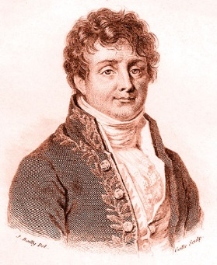
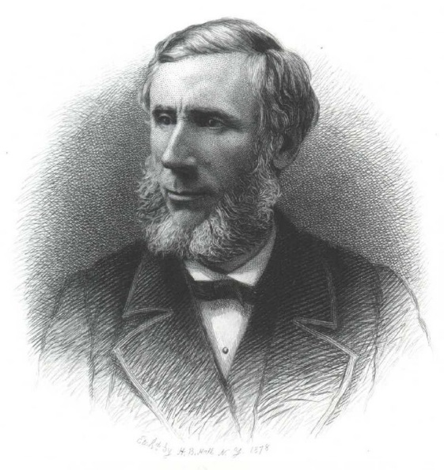
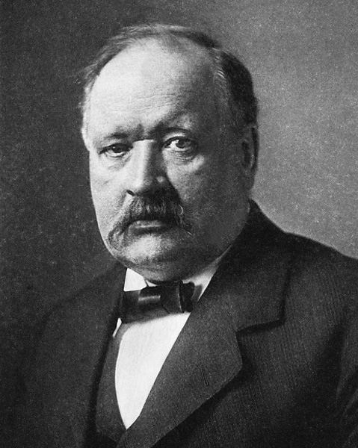
The history of global warming
1824 – Joseph Fourier
Greenhouse effect
1859 - John Tyndall
CO₂ Insulating effect
1896 - Svante Arrhenius
Changes in atmospheric CO₂ lead to surface warming
Notes:
A brief history of global warming, to highlight that this isn’t something new. More than 100 years ago Arrhenius proposed that human-driven greenhouse gas emissions were causing surface warming on earth.

Slide 4
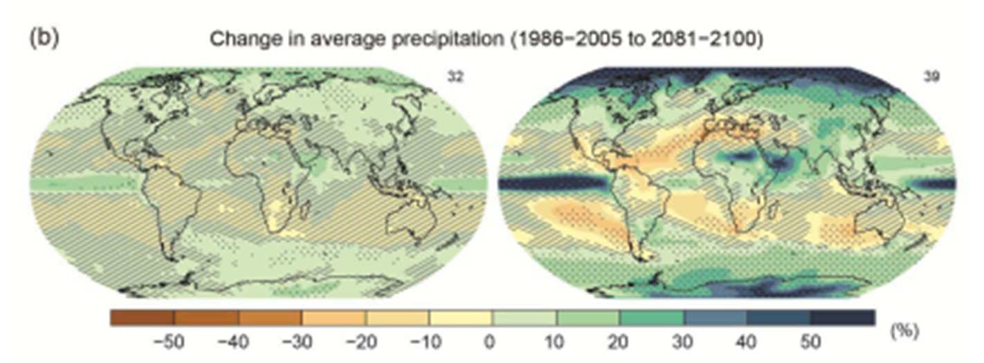
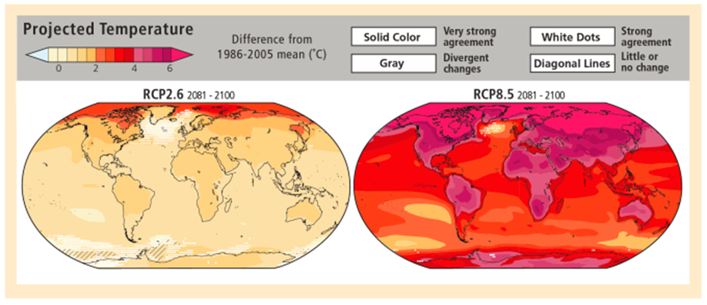
What is climate change? Long term changes in precipitation and temperature…..
Notes:
Most people are used to seeing graphs like this when they think of climate change. On the left, projected precipitation change for the period 2081-2100. On the right, projected temperature change for the period 2081-2100, under 2 different emission scenarios.

Slide 5
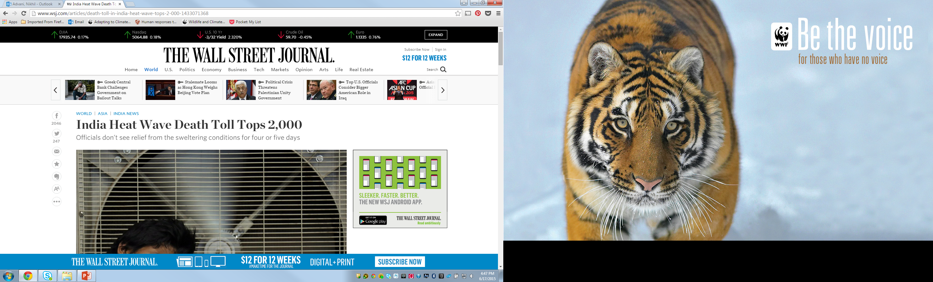
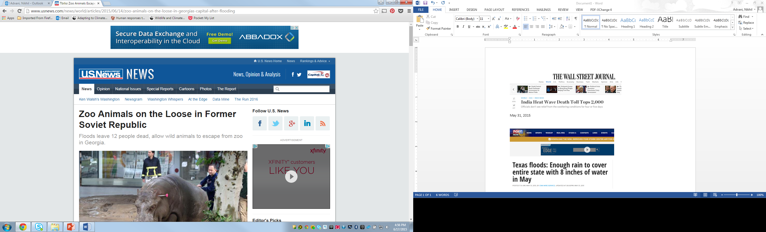
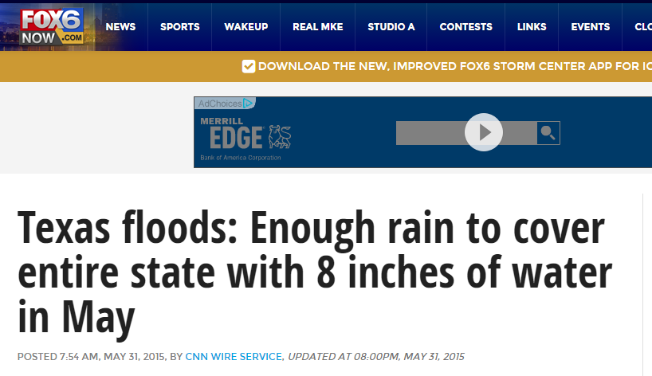
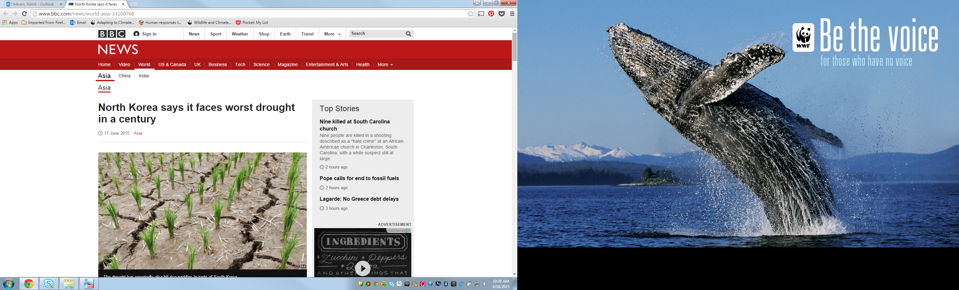
….but also extreme weather events!
June 14, 2015
May 31, 2015
Text
May 31, 2015
June 17, 2015
Notes:
However, climate change is also this! A snapshot of some of the extreme weather events from summer 2015. It is important to highlight that climate change isn’t just the long term changes projected on the previous slide, but also extreme weather events that are already occurring with increased frequency and intensity.

Slide 6
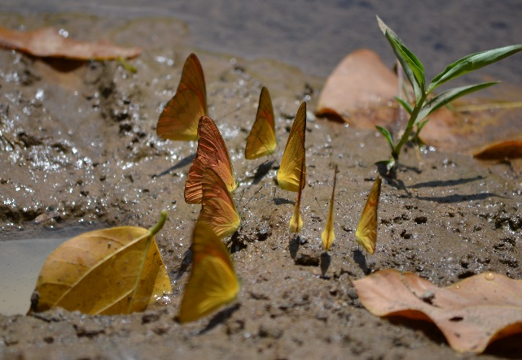
Impacts of climate change on wildlife
Range shifts (altitudinal/poleward)
Notes:
Species have already been documented shifting their range, typically towards the poles and to higher altitudes. This allows them to maintain their climatic envelope. This has been widely documented in butterfly species, unsurprising given that climate is the most important predictor of butterfly species distribution.

Slide 7
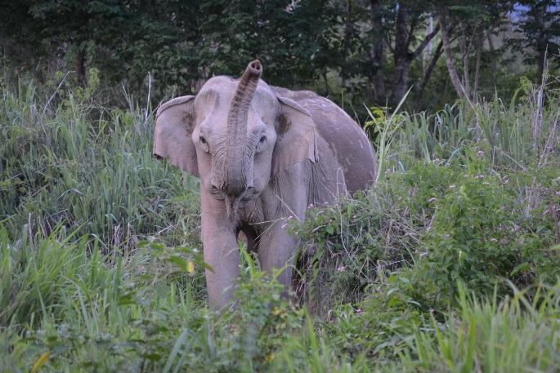
Impacts of climate change on wildlife
Changing food/water availability
Notes:
This is particularly a problem for species with a specialist diet, and those with high freshwater requirements. Elephants for example need up to 300 liters of water a day, just for drinking. As water sources decline, they increasingly come into contact with humans (also in need of water), resulting in human-wildlife conflict.

Slide 8
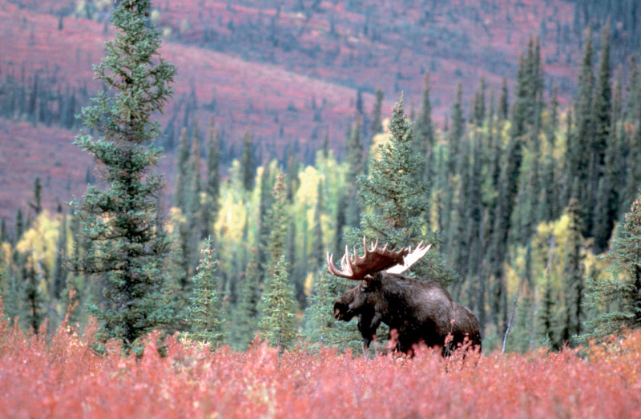
Impacts of climate change on wildlife
Increase in pests and disease
Notes:
In the USA, pine bark beetle infections are on the rise, as are tick infections of Moose. In many cases, we need a period of days below a certain temperature to significantly reduce populations of these pests during the winter, but that is no longer happening, leading to their increased numbers and distribution.

Slide 9
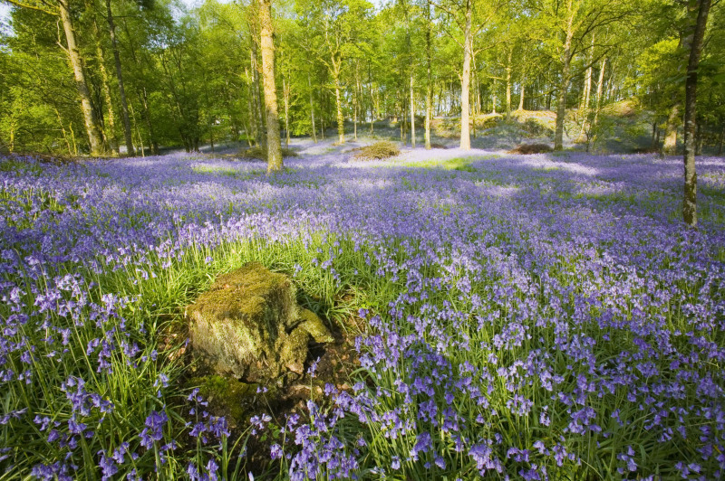
Impacts of climate change on wildlife
Changes in phenology
Notes:
Changes in phenology refers to changes in the timing of life cycle events. In Japan, where they have over a 1000 years of records of the date of first cherry blossom, dates have advanced due to warmer springs. This is a particular problem for species that are heavily dependent on each other, such as pollinators and flowers, which may increasingly become out of sync with each other as one responds to a warmer spring and the other doesn’t.

Slide 10
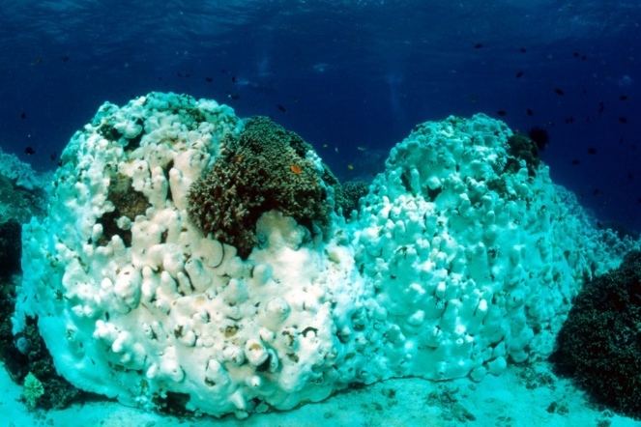
Impacts of climate change on wildlife
Coral bleaching
Notes:
Coral bleaching is occurring due to warmer ocean temperatures. Corals expel the algae (zooxanthellae) living in their tissues causing the coral to turn white. The entire coral garden then becomes devoid of most other marine life.

Slide 11
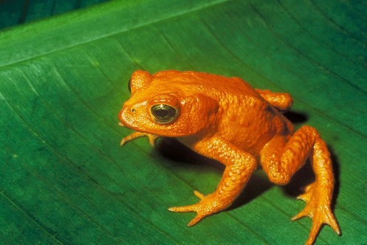
Impacts of climate change on wildlife
Extinction
Notes:
Climate change has been implicated in the extinction of some species, like the golden toad. You would never say that climate change drove the species to extinction, but, climate change is instead a driver of threats. In this case, chytrid fungus infections increased at the high elevations this species was found at, due to warmer temperatures.

Slide 12
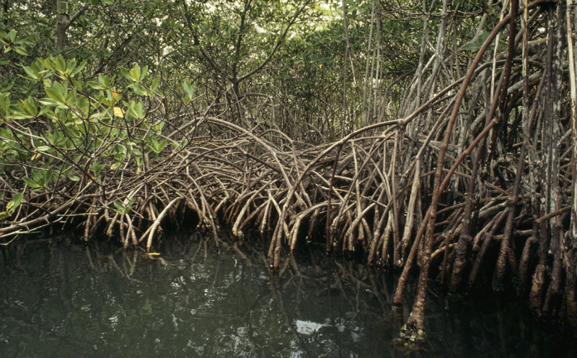
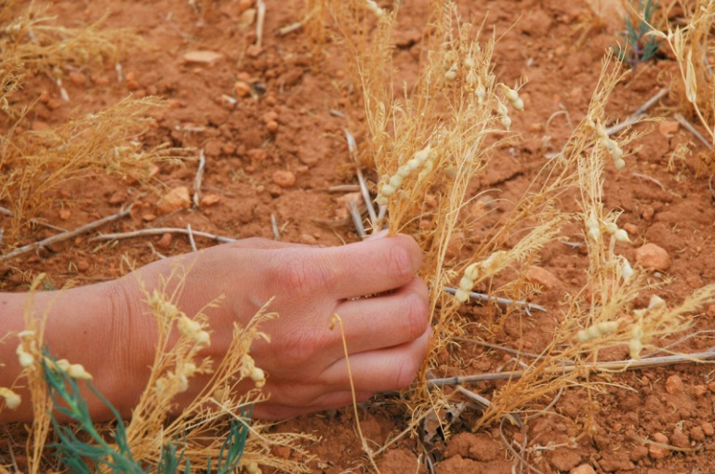
Climate adaptation
Actions to reduce vulnerability to actual and expected changes in climate
Notes:
Definition of climate adaptation.

Slide 13
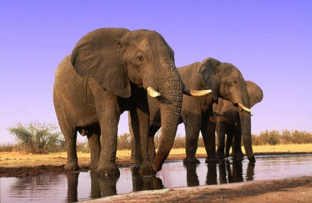
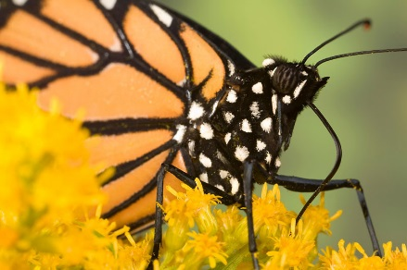
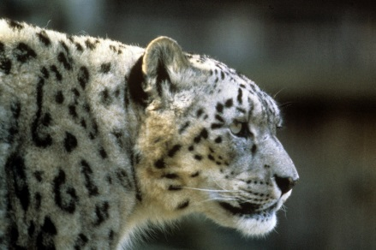
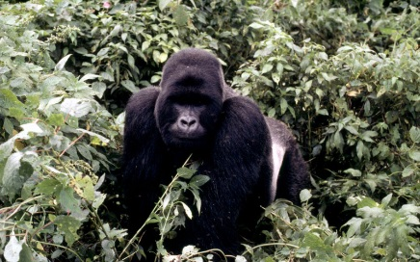
How to assess species vulnerability to climate change?
There are a number of different methods
Many project how the species may shift its range far into the future
WWF has developed a methodology which looks at trait which make a species vulnerable or resilient to changes in climate and weather
Notes:
There are a number of different methods for assessing species vulnerability to climate change. Many have focused on species distribution modelling, which projects how species may shift their range in response to climate change. However, this method has very high uncertainty, and typically projects too far into the future to be useful for conservation planning. Over the last few years, a new method has emerged, looking at traits which make a species vulnerable or resilient to climate change. WWF has adopted and modified this method, and is applying it to WWF priority species.

Slide 14
Trait based assessments
SENSITIVITY: The inability of the species to persist, as is, under changing climatic conditions
ADAPTIVE CAPACITY: The ability of the species to respond to changes in climate
EXPOSURE: The extent of climatic change and variation that the species encounters and is projected to encounter
OTHER THREATS
Notes:
This methodology is divided into 4 categories. The following slides briefly explain the kinds of traits that make a species vulnerable to climate change. For more detailed examples, see the assessment tool.

Slide 15
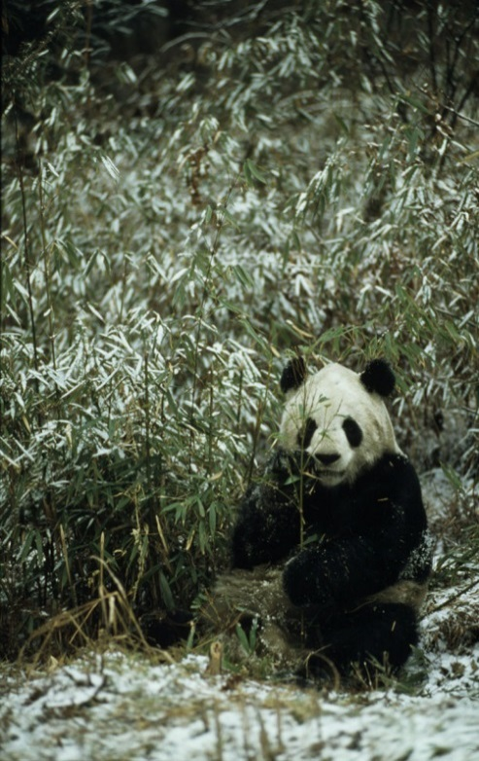
What makes a species vulnerable to climate change?
SENSITIVITY
IUCN Red list status
Geographic range
Population size
Temperature tolerance
Reliance on environmental cues (for reproduction,
migration, hibernation)
Strong interactions with other species
Diet
Abundance of food source
Freshwater requirements
Habitat specialization
Susceptibility to disease
Notes:
The different traits considered under the “sensitivity” category. Species with the following traits would be considered to have a HIGH vulnerability to climate change: Endangered on the IUCN Red list, narrow geographic range, small population size, narrow temperature tolerance, strong dependence on environmental cues for reproduction, migration and hibernation, strong interactions with one or more species (e.g. symbiosis), specialist diet, low abundance of food source, high freshwater requirements, specific habitat requirements, and high susceptibility to disease.

Slide 16
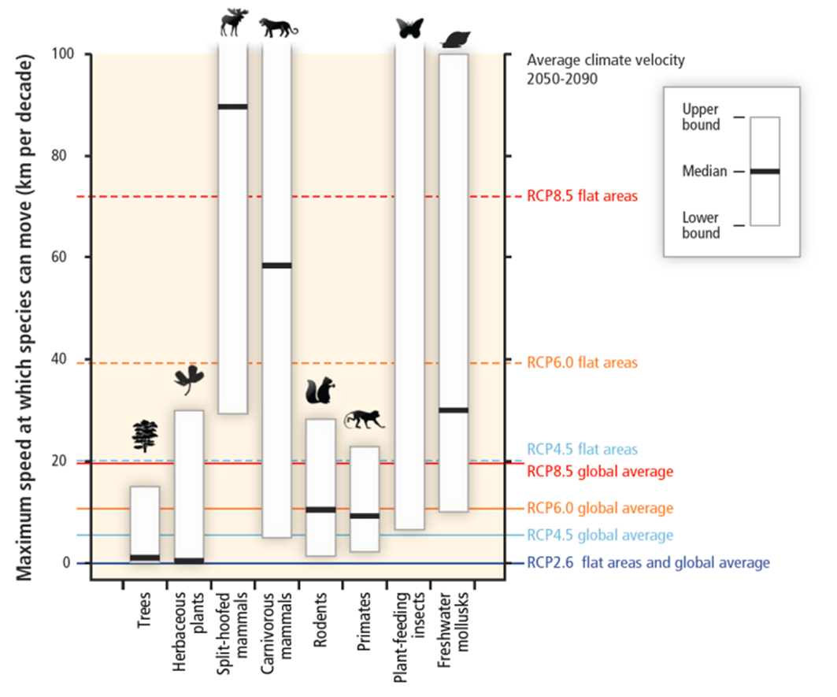
What makes a species vulnerable to climate change?
ADAPTIVE CAPACITY
Dispersal ability
Generation time
Reproductive rate
Genetic variation
Notes:
The different traits considered under the “adaptive capacity” category. These traits look at ability of the species to respond to change, mostly focused on the evolvability of the species. Species with the following traits would be considered to have a HIGH vulnerability to climate change: Limited ability to disperse (both intrinsic (physical ability to move) and extrinsic (barriers to dispersal)), long generation time, low reproductive rate, and low genetic variation within the species.

Slide 17
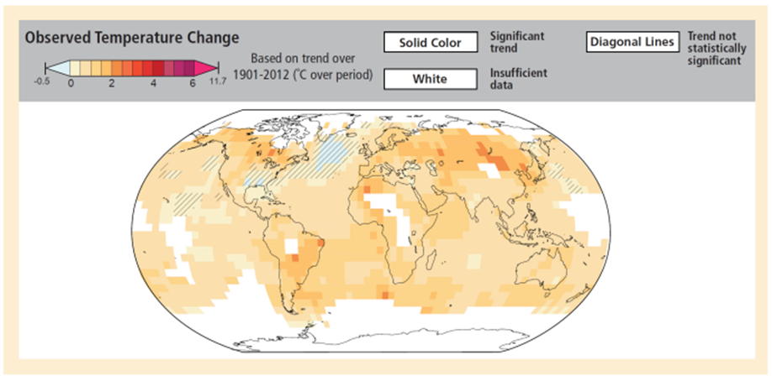
What makes a species vulnerable to climate change?
EXPOSURE
Climate (current, future)
Notes:
Current and future climate are considered under the “exposure” category. Species that are currently exposed to very little climatic variation are considered to have a HIGH vulnerability to climate change, as this might imply that the species cannot tolerate wide variation in climate. Species that are projected to be exposed to large changes in climate have a HIGH vulnerability to climate change. Most species will have high or medium vulnerability in this category.

Slide 18
Pacifici et al. (2015). Assessing species vulnerability to climate change, in Nature climate change
“A glaring oversight in almost all studies is that they only focused on the direct impacts of climate change. Indirect impacts within biological communities, as well as changes in human use of natural resources are going to have substantial, complex, and often multiplicative impacts on species.
Thus, many current assessments are blind to the fact that the interactions between current threats and climate change are likely to be profound. Moreover, the growing human population will itself be increasingly affected by climate change, with human adaptation responses likely to result in substantial and negative impacts on biodiversity. Assessments of future impacts of climate change need to take these factors into account.”
Notes:
Quote from a 2015 publication that highlights how we’ve mostly been focused on the direct impacts of climate change on species, but largely neglected how human responses to climate change might, and already is, impacting species.

Slide 19
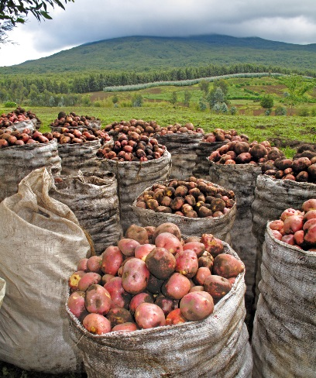
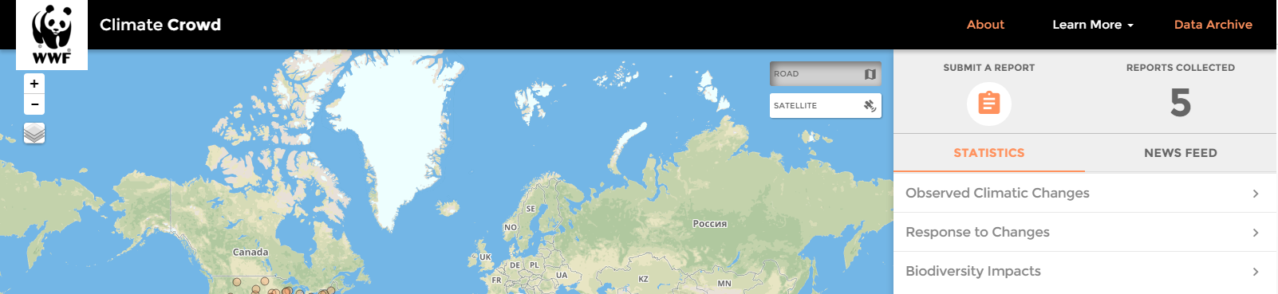
What makes a species vulnerable to climate change?
OTHER THREATS
Such as habitat destruction, poaching, invasive species, pollution, as well as the effects of climate stressors on humans and how this may exacerbate ongoing human impacts on species.
Notes:
This “other threats” category largely includes existing threats to a species that may be exacerbated by climate change, including the human responses to climate change, which is a very significant threat, as discussed on the previous slide. WWF has launched a new initiative, “WWF Climate Crowd”, which will gather such information from all corners of the globe, partnering with organizations like the Peace Corps.

Slide 20
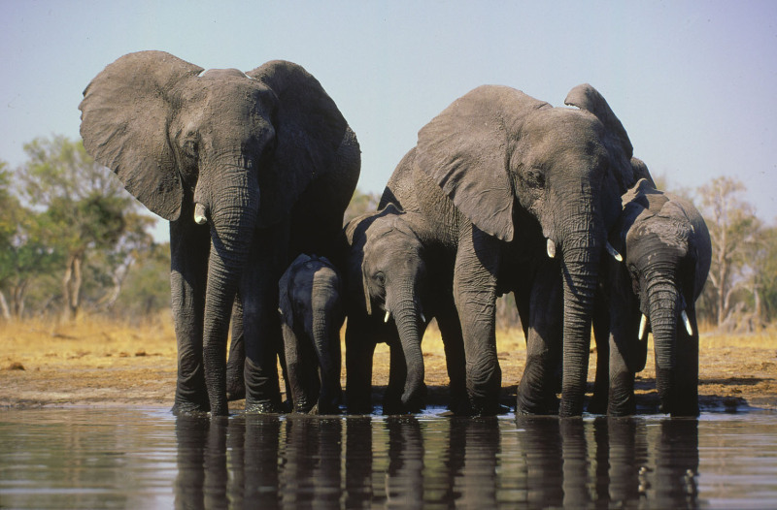
African elephant vulnerability assessment
Key vulnerabilities:
High freshwater requirements
Long generation time
Projected climate change
Other threats
Moderate temperature tolerance
Susceptible to disease
Moderate dispersal ability
Medium reproductive rate
Moderate Genetic variation
Areas of resilience:
Population size
Generalist diet
Abundant food
Habitat generalist
Exposed to variable climates (current)
Notes:
Results of the African elephant climate assessment. For more detail, see the pdf.

Slide 21
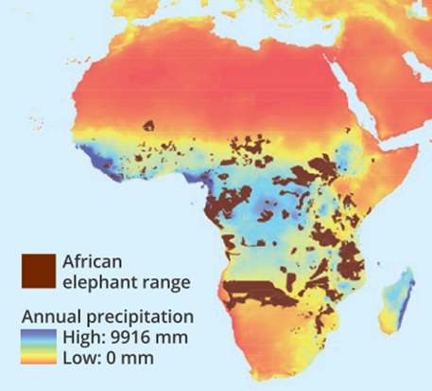
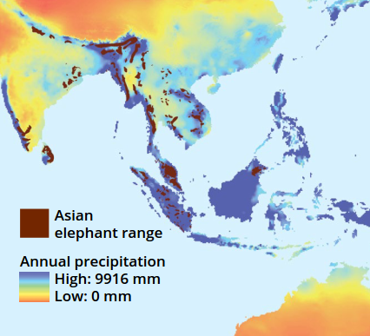
Elephants and water
Notes:
Maps showing the overlap of African/Asian elephant range with annual average rainfall. It highlights how dependent elephants are on water. They need up to 300 litres a day just for drinking.

Slide 22
Climate-adaptive management strategies
Secure fresh water
Monitor disease
Increase monitoring of range shifts, changes in phenology, changes in abundance
Stepping stones, movement corridors, climate refugia
Improve management and restoration of protected areas to facilitate resilience
Reduce pressures from other threats
Notes:
Suggested climate-adaptive management strategies for African elephants. Again, see the climate assessment pdf for more details.

Slide 23
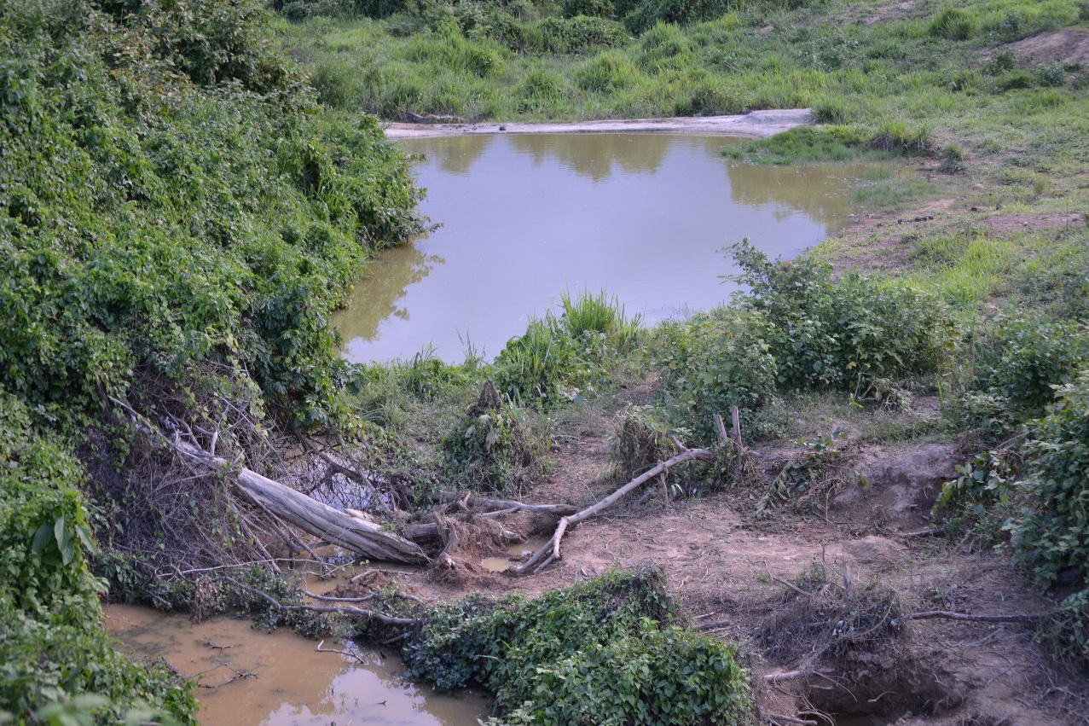
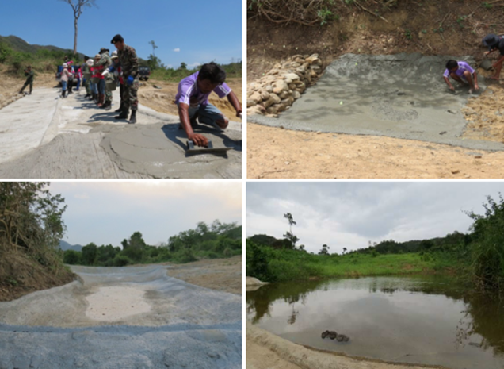
Water provision for elephants in Thailand helps to mitigate human-wildlife conflict
Text
Notes:
An example from Kui Buri national park in Thailand, where WWF is working with park authorities to secure water for wildlife. The picture on the left is a check dam, which accumulates water for up to 2 months in seasonal streams. This keeps elephants in this part of the park, away from the more permanent water source which is near human communities. An effective way to mitigate human-wildlife conflict.

Slide 24
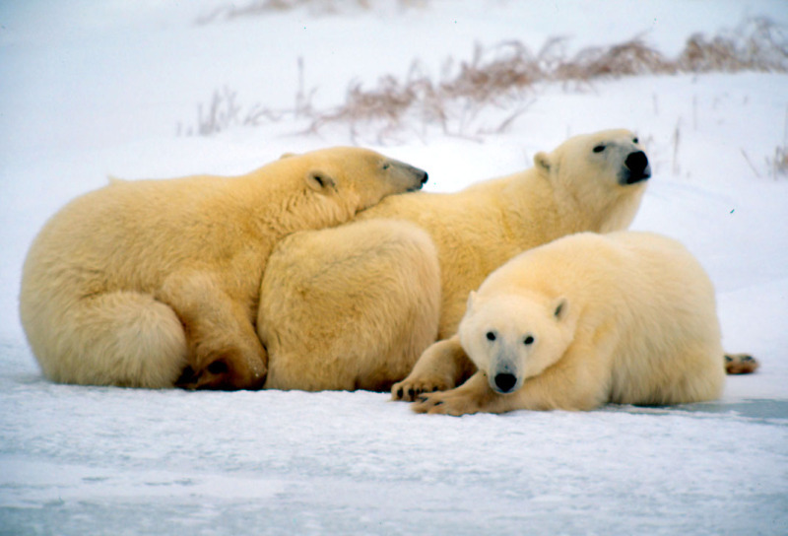
Finding and protecting climate refugia for polar bears in the Arctic
Notes:
WWF is looking for the places in the Arctic where polar bear habitat will remain intact the longest and working to protect that area for polar bears in the future. An example of how being a habitat specialist (in this case on sea ice) can increase your vulnerability to climate change.

Slide 25
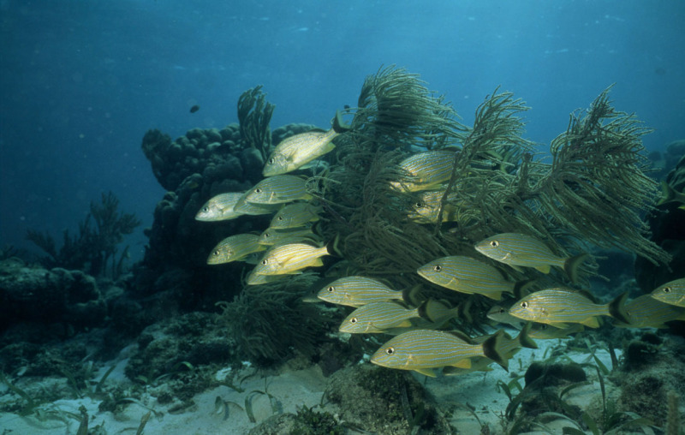

Propagating genetically tolerant coral strains in Belize
Notes:
WWF is working with “Fragments of hope” in Belize to select for corals that are more tolerant of warmer sea temperatures, and use these to propagate future coral gardens. An example of how high genetic diversity within a species could reduce your vulnerability to climate change.

Slide 26
Made possible through the generous support of the General Motors Foundation
http://www.worldwildlife.org/wildlife-and-climate
Also see “WWF Climate Crowd”, our project crowd sourcing human responses to climate change http://www.wwfclimatecrowd.org
and WWF’s online climate courses http://www.wwfadapt.org
Notes:
Please see the website above for different species assessments as well as other learning resources.

Slide 27
Photo Credits
Page 1: © Andy Rouse/WWF;
Page 2: © Global Warming Images/WWF; © Jurgen Freund/WWF; © Simon de Trey-White/WWF-UK; © Brent Stirton/WWF
Page 3: © wikipedia.org
Page 4: © Intergovernmental Panel on Climate Change
Page 6-7: © Nikhil Advani/WWF
Page 8: © Anthony B. Rath/WWF-Canon
Page 9: © Global Warming Images/WWF-Canon
Page 10: © Jurgen Freund/WWF
Page 11: © Wikipedia.org
Page 12: © Juan Pratginestos/WWF-Canon; © Sonia Cervello/WWF-Spain
Page 13: © Martin Harvey/WWF-Canon; © Ingo Arndt/WWF; © Bruce W. Bunting/WWF-US; © Timothy Geer/WWF-Canon
Page 15: © Fritz Polking/WWF
Page 16: © Intergovernmental Panel on Climate Change
Page 17: © Intergovernmental Panel on Climate Change
Page 18: © Andy Rouse/WWF
Page 20: © Martin Harvey-WWF-Canon
Page 21: © Nikhil Advani/WWF
Page 23: © Nikhil Advani/WWF; ©Wayuphong Jitvijak/WWF
Page 24: © Kevin Schafer/WWF-Canon
Page 25: © Anthony B. Rath/WWF-Canon

