Slide 1

St. MOTHER THERESA ENGINEERING COLLEGE
AD DEMAND PREDICTION USING MACHINE LEARNING AND STREAM LIT
GUIDED BY,
Prof. N.RAJESWARI. M.E.,
Assistant Professor/CSE
DONE BY,
MUTHU KRISHNAN.K [953019104024]
PRAKASH.M [953019104028]
SATHISH RUMUGAM.S [953019104036]

Slide 2
INTRODUCTION
In todays world, lot of business are promoted through social media and other platforms
An Ad demand prediction is an powerful web application for the advertisers and marketers.
By combining machine learning and stream lit advertisers can build powerful tools to optimize their advertising campaigns.

Slide 3
ABSTRACT
The aim of this paper is to predict the ad demand for the next rotation.
This work is based on finding suitable data models that helps in achieving high accuracy and generality for demand prediction.
For solving this problem, different Data Mining techniques were evaluated on different data sets.
This work presents a system which use data analytics techniques in performance of ad to predict the demand of the ad.

Slide 4
LITERATURE SURVEY

Slide 5
LITERATURE SURVEY -1
Title :The Advantages of Effective Demand Forecasting
Methodology Used: SARIMA-Seasonal Autoregressive Integrated Moving Average
Along with manufacturing, this also pertains to the setting of the price of the good and what markets should be best suited for the company.
With proper and accurate demand forecasting, it allows for insight into what customers need, which can be forecasted through a variety of means and methods
Drawbacks:
Lack of accuracy.

Slide 6
LITERATURE SURVEY - 2
Title : Deep Learning and Demand Forecasting.
Methodology Used: KNN Algorithm
That's why ML models are adaptive and accurate enough to bring obvious benefits to the business.
While there is no perfect forecasting model, using demand forecasting as a tool can help fashion businesses better prepare for upcoming seasons
Drawbacks:
Unlike traditional methods, demand forecasting using machine learning is more flexible
Since competition is increasing day by day among retailers at the market, companies are focusing more predictive analytics techniques in order to decrease their costs

Slide 7
LITERATURE SURVEY - 3
Title : Evaluating qualitative forecasts
Methodology Used:
The fuzzy-neural network implemented for sales forecasting and demonstrated that this model’s performance is better than traditional neural networks.
This study also discusses the datasets used for Data is the most important part of any BI centric application or model.
The Purposed model acquires data from different sources generated from these sources for forecasting, primary sources of data are sales, inventory, and calendar
Drawbacks:
The Company’s previous systems were excel based for forecasting that is causing trouble in various ways
Non-centralized control.
Poor visibility to stakeholders.

Slide 8
LITERATURE SURVEY - 4
Title : A quantitative assessment of Arctic shipping in 2020
Methodology Used: ANN Artificial Neural Networks
Working with machine learning and deep learning, data collection is the most important task
This study also discusses First, we need to fix that which data will have an impact on prediction.
Drawbacks:
Product data collection is a difficult issue.
The retailer looks for profit; they do not maintain a database.

Slide 9
LITERATURE SURVEY - 5
Title :Benchmarking of Regression Algorithms and Time Series Analysis Techniques for Sales Forecasting:
Methodology Used: Random Forest
The paper proposed They use the timeseries method, three different regression methods, and the SVM method.
Using Deep Learning Approach and Proposed Decision Integration Strategy for Supply Chain
Drawbacks:
Performance by absolute percentage error.
Fuzzy Neural Network accuracy low

Slide 10
OVERVIEW OF LITERATURE SURVEY
TITLE | TECHNIQUES USED | DRAWBACKS
The Advantages of Effective Demand Forecasting | SARIMA-Seasonal Autoregressive Integrated Moving Average | Lack of accuracy.
Deep Learning and Demand Forecasting | K-Nearest Neighbor (as KNN) , Gaussian Nave Bayes , Decision Tree Classifier . | Flexible in Machine learning better then Deep Learning
Evaluating qualitative forecasts | Fuzzy-neural network ANN-model | Non-centralized control. Poor visibility to stakeholders.
A quantitative assessment of Arctic shipping in 2020 | Cross Feature-Based CTR Prediction Artificial neural networks | Product data collection is a difficult issue.
Benchmarking of Regression Algorithms and Time Series Analysis Techniques for Sales Forecasting: | Support Vector Machine (SVM) Fuzzy-neural network | Performance by absolute percentage error

Slide 11
EXISTING SYSTEM
The paper aims at analyzing the demand of the ad by the predicting the demand of the ad at the correct scenario.
Television markets by the knowledge of market demand ad of over 15 local television.
The demand is predicted using the well-known algorithms such as the Partial Least Square (PLS), Autoregressive Integrated Moving Average (ARIMA) and the Artificial Neural Network (ANN). The ad considered for analyzing are advertisement.
The research aims over choosing an appropriate ad for an area selected by the user thus helping the customer to take better and wise decisions.
The prediction which predicts the output is done by analyzing the dataset using supervised machine learning technique such as K nearest neighbor regression algorithm and decision tree learning(ID3).

Slide 12
EXISTING SYSTEM – [Cont…]
Drawbacks of Existing System
The drawbacks of the existing system include
Lack of Accuracy
Flexible in Machine learning better then Deep Learning
Non-centralized control. Poor visibility to stakeholders.
Product data collection is a difficult issue.
Performance by absolute percentage error

Slide 13
PROPOSED SYSTEM
The prediction method will employ 3 machine learning algorithms which are Compare the accuracy of various time series forecasting algorithms such as Naïve bayes, Decision tree and Random Forest in machine learning.
Initialize the dataset containing training data ad demand index
Select all the rows and column 1from dataset to “x” Which is independent variable
Select all of the rows and column 2 from dataset to “y” Which is dependent variable
Fit NB/RF/DT /LSTM to the dataset
Predict the new value
6. Visualize the result and check the accuracy

Slide 14
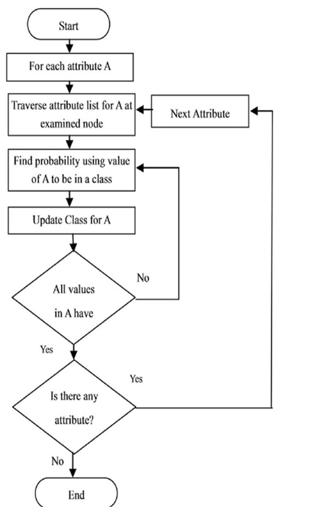
PROPOSED SYSTEM [Cont…]
Algorithm Used: NAÏVE BAYES
Classification Process Using NAÏVE BAYES

Slide 15
PROPOSED SYSTEM [Cont…]
Algorithm Used: NAÏVE BAYES
Classification Process Using NAÏVE BAYES
Data Collection
The data collection method used to obtain the image of batik is by retrieving/downloading via google, or taking data directly.
From this data, samples were taken to be used as training data and test data.
Data Split
The data collected is then divided into two parts, namely test data and training data, each of which has two classification classes, namely normal data classification and abnormal data with a certain percentage.
The test data will be used in the model training process while the training data will be used in the testing process after the model is formed.

Slide 16
PROPOSED SYSTEM [Cont…]
Algorithm Used: NAÏVE BAYES
Classification Process Using NAÏVE BAYES
Pre-Process
P(A|B) is Posterior probability: Probability of hypothesis A on the observed event B.
P(B|A) is Likelihood probability: Probability of the evidence given that the probability of a hypothesis is true.
P(A) is Prior Probability: Probability of hypothesis before observing the evidence.
P(B) is Marginal Probability: Probability of Evidence.

Slide 17
PROPOSED SYSTEM [Cont…]
Algorithm Used: Naïve Bayes
Classification Process Using NB Test
Working of Naïve Bayes' Classifier can be understood with the help of the below example:
Suppose we have a dataset “Advertisement” and corresponding target variable "ad demand”.
So using this dataset we need to decide that whether it had demand or not on a particular ad according to the advertisement.
So to solve this problem, we need to follow the below steps:
Convert the given dataset into frequency tables.
Generate Likelihood table by finding the probabilities of given features.
Now, use Bayes theorem to calculate the posterior probability

Slide 18
PROPOSED SYSTEM [Cont…]
Algorithm Used: Decision-Tree algorithm
Data Pre-processing step
Fitting a Decision-Tree algorithm to the Training set
Predicting the test result
Test accuracy of the result(Creation of Confusion matrix)
Visualizing the test set result.

Slide 19
PROPOSED SYSTEM [Cont…]
Advantages of Proposed System
Accurate Prediction of Demand (Ad).
No Risk about Miss use of data.
Takes much less Time to prediction.
Cost Efficient.

Slide 20
PROPOSED SYSTEM [Cont…]
Existing System vs Proposed System
S.No. | Existing System | Proposed System
1 | Lack of Accuracy | Accurate Prediction of Breast Cancer.
2 | Flexible in Machine learning better then Deep Learning | No Risk about Radiations.
3 | Non-centralized control. Poor visibility to stakeholders | Takes much less Time to detect.
4 | Product data collection is a difficult issue. . | Cost Efficient.
5 | . Performance by absolute percentage error | Easy to detect.

Slide 21
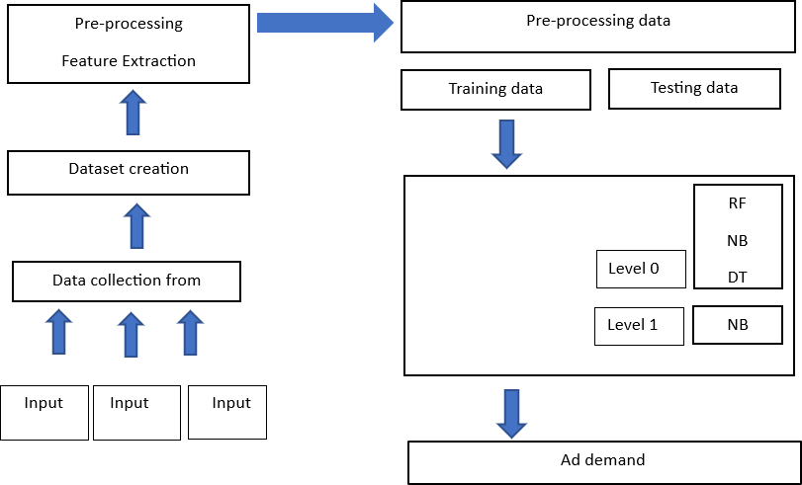
SYSTEM DESIGN

Slide 22
SYSTEM REQUIREMENTS
Hardware Requirements
System : Pentium IV 2.4 GHz.
Hard Disk : 40 GB.
Floppy Drive : 1.44 Mb.
Monitor : 14’ Colour Monitor.
Mouse : Optical Mouse.
Ram : 512 Mb

Slide 23
SYSTEM REQUIREMENTS [Cont…]
Software Requirements
Operating system : Windows 11 Ultimate/8/10/11.
Coding Language : Python 3.7.0
Front-End : Html , Css
Designing : Streamlit Framework
IDE Tool : Anaconda Navigator and Jupyter
Dataset : Advertisement Dataset

Slide 24
MODULES
The list of modules are:
HOME PAGE
DATA COLLECTION
FEATURE EXTRATION
PREDICTION DATA PROCESS
ACCURACY OUTPUT
RESULT

Slide 25
MODULE DESCRIPTION
Module 1 :HOME PAGE
Formatting: The data you have selected may not be in a format that is suitable for you to work The data you have selected may not be in a format that is suitable for you to work
Cleaning: Cleaning data is the removal or fixing of missing data. There may be data instances that are incomplete and do not carry the data you believe you need to address the problem.

Slide 26
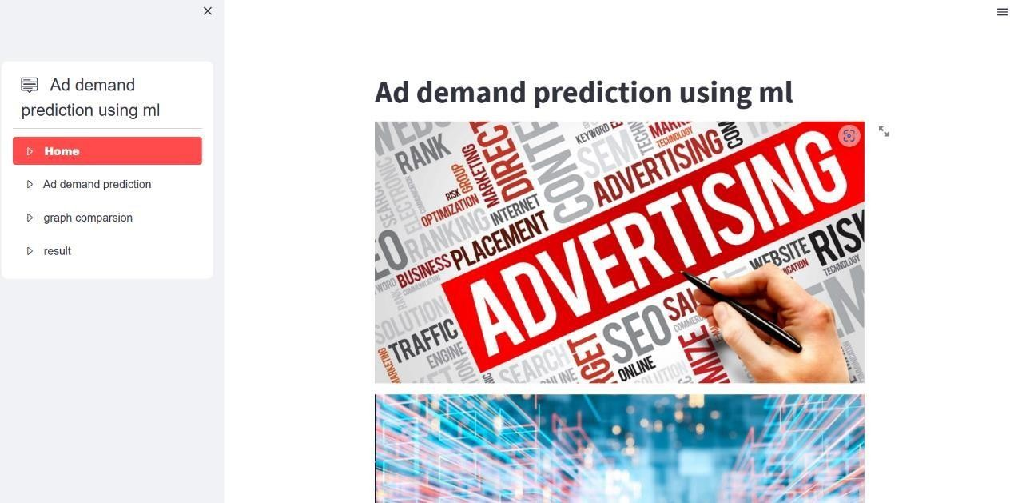
MODULE DESCRIPTION [Cont….]
Module 1 :Home Page – Snapshot

Slide 27
MODULE DESCRIPTION [Cont….]
Module 2 :DATA COLLECTION
Data collection is a process in which information is gathered from many sources which is later used to develop the machine learning models.
The data should be stored in a way that makes sense for problem.
In this step the data set is converted into the understandable format which can be fed into machine learning models.

Slide 28
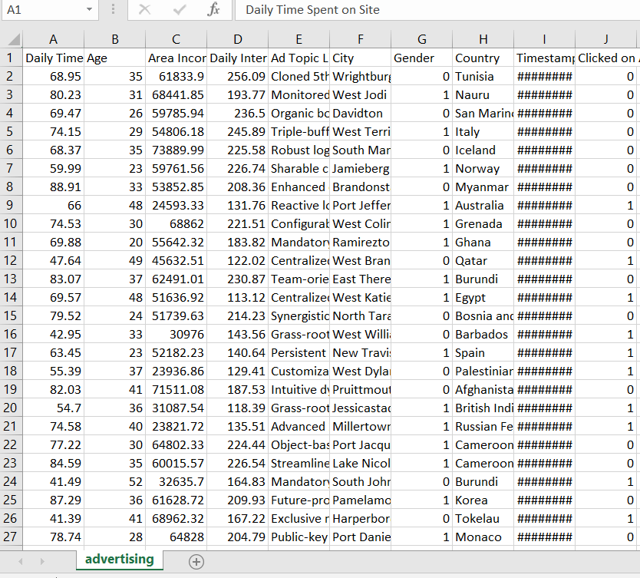
MODULE DESCRIPTION [Cont….]
Module 2 :

Slide 29
MODULE DESCRIPTION [Cont….]
Module 3 :FEATURE EXTRATION
Finally, our models are trained using Classifier algorithm
We use classify module on Natural Language Toolkit library on Python. We use the labelled dataset gathered
The rest of our labelled data will be used to evaluate the models
Some machine learning algorithms were used to classify pre-processed data

Slide 30
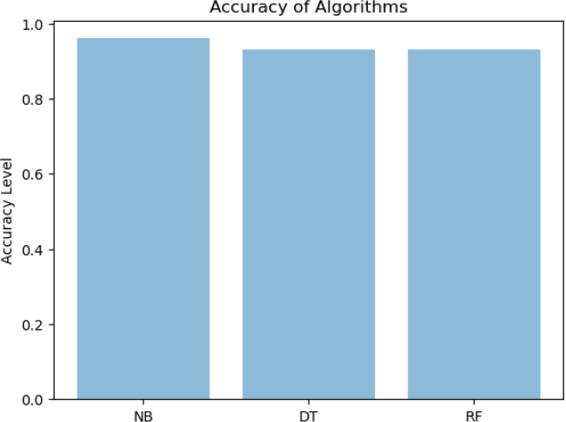
MODULE DESCRIPTION [Cont….]
Module 3 :

Slide 31
MODULE DESCRIPTION [Cont….]
Module 4 : PREDICTION DATA PROCESS
Loading and visualizing data
Creating interactive charts and graphs
Building machine learning models
Deploying and sharing web applications

Slide 32
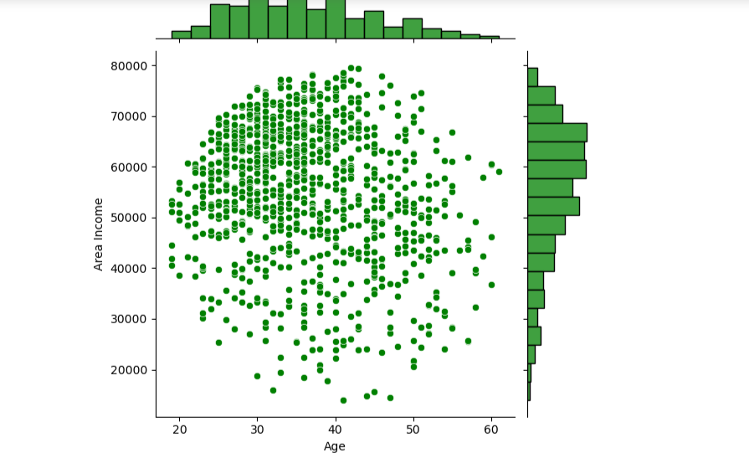
MODULE DESCRIPTION [Cont….]
Module 4 : - Snapshot

Slide 33
SCREENSHOTS

Slide 34
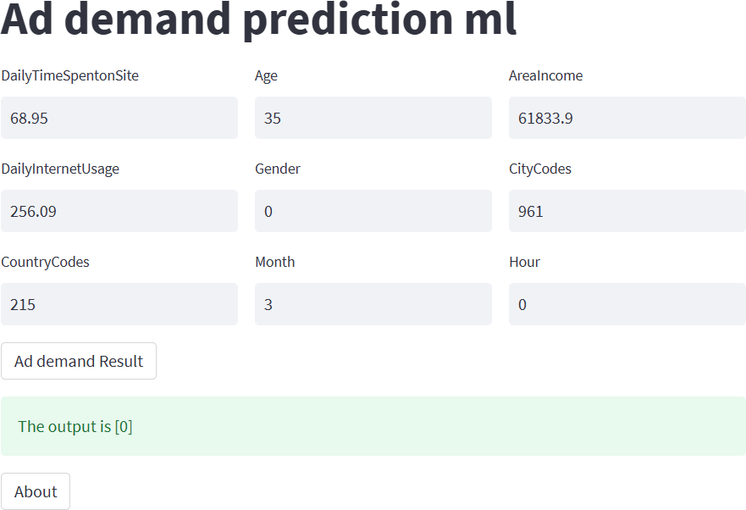
2.Predection Model

Slide 35
CONCLUSION
In this review, we studied different steps to automatically analyze Previously organizations do these calculations manually or some irrational techniques
This automated analysis assists for enterprises the importance of demand forecast doubles as the day passes.
The algorithms developed for automated analysis and evaluation it also increases executive support, cooperation, and transparency significantly
High forecast accuracy helps in formulating established market strategy, stock turn over increase, decrease in supply chain cost

Slide 36
FUTURE ENHANCEMENT
Future researchers may also focus on extracting significant features In this system, the demand forecasting enhances the operational productivity reduces the losses and wastages
Additionally, researchers can focus on feature selection methods to eliminate non-significant features, leading to better performance.
In this application, we proposed a system which exactly shows you how . The scope of demand forecasting depends upon the operated area of the firm

Slide 37
REFERENCES
S. J., J. Kim, and J. Kim. 2022. The bifold triadic relationships framework: A theoretical primer for advertising research in the metaverse. Journal of Advertising 51, no. 5: 592–607. [Taylor & Francis Online], [Google Scholar]
L.Levy, A. Eden, A. S. Won, B. MacIntyre, and K. Johnsen. 2021. IEEEVR2020: Exploring the first steps toward standalone virtual conferences. Frontiers in Virtual Reality 2, no. 648575: 1–15. [Google Scholar]
De Pelsmacker, P. 2021. What is wrong with advertising research and how can we fix it? International Journal of Advertising 40, no. 5: 835–48. [Taylor & Francis Online], [Web of Science ®], [Google Scholar]
M. Geuens, and P. Anckaert. 2002. Media context and advertising effectiveness: The role of context appreciation and context/ad similarity. Journal of Advertising 31, no. 2: 49–61. [Taylor & Francis Online], [Web of Science ®], [Google Scholar]
Kim, J., T. Shinaprayoon, and S. J. Ahn. 2022. Virtual tours encourage tntentions to travel and willingness to pay via spatial presence, enjoyment, and destination image. Journal of Current Issues & Research in Advertising 43, no. 1: 90–105. [Taylor & Francis Online], [Web of Science ®], [Google Scholar]

Slide 38
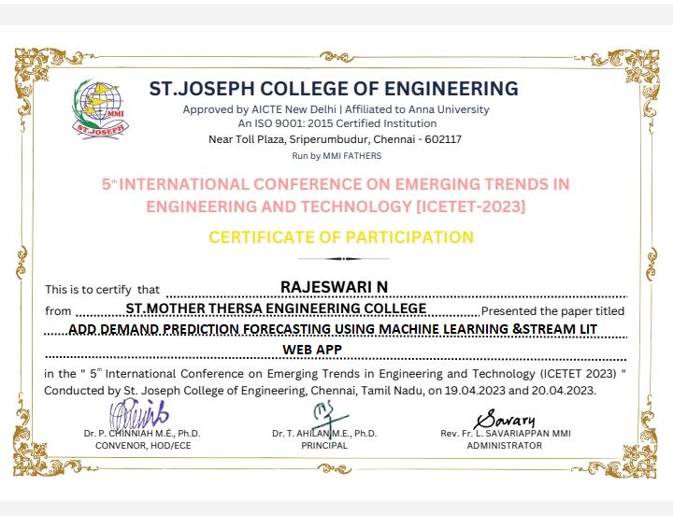
PUBLICATION DETAILS

Slide 39

PUBLICATION DETAILS

Slide 40
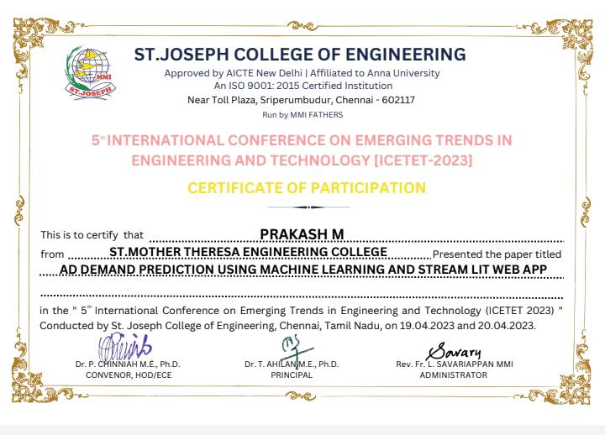
PUBLICATION DETAILS

Slide 41
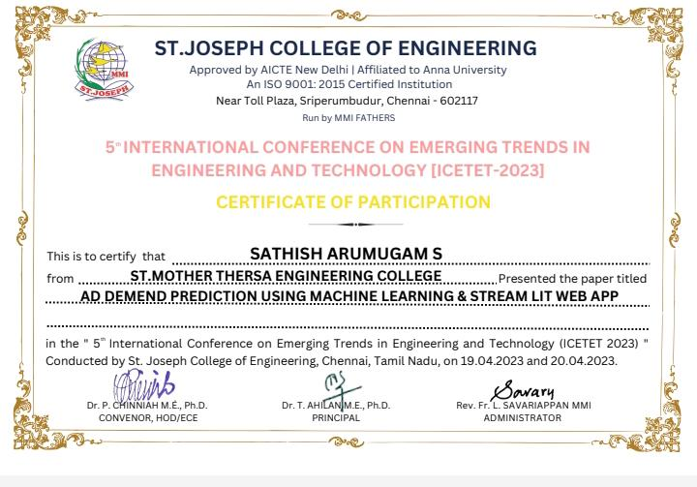
PUBLICATION DETAILS

Slide 42


