Slide 1

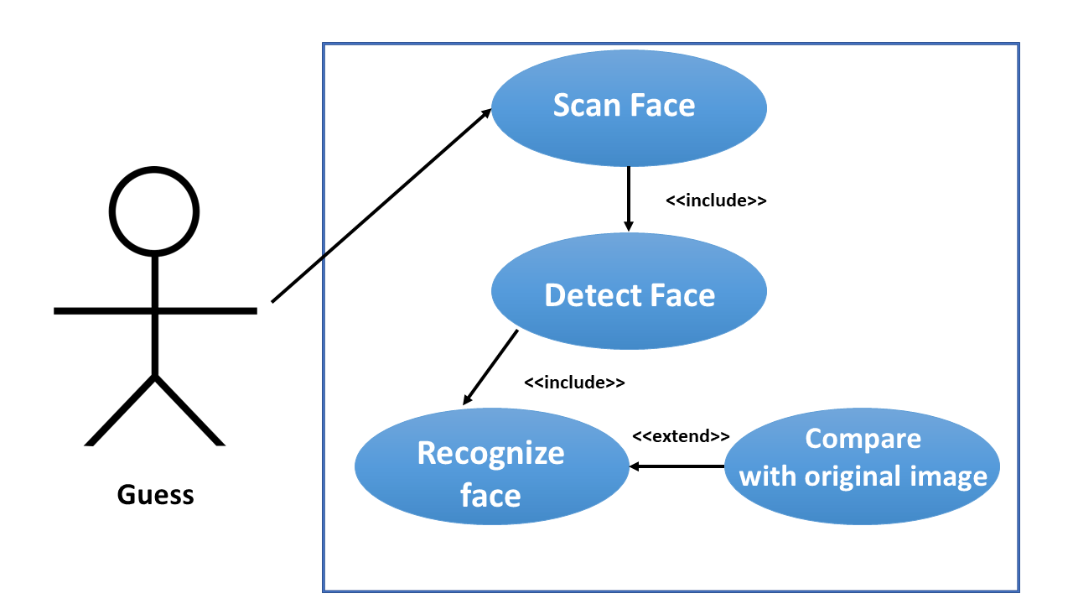

Slide 2







Principle
Detection
Scaning

Slide 3











k
Libraries
b
l
ace ecognition

Slide 4

-Reduce cost
-Can apply for other jobs
- Security

