Slide 1
I-Cha Chanom
Budsadee Chaopatiphan
6052100320 IT

Slide 2
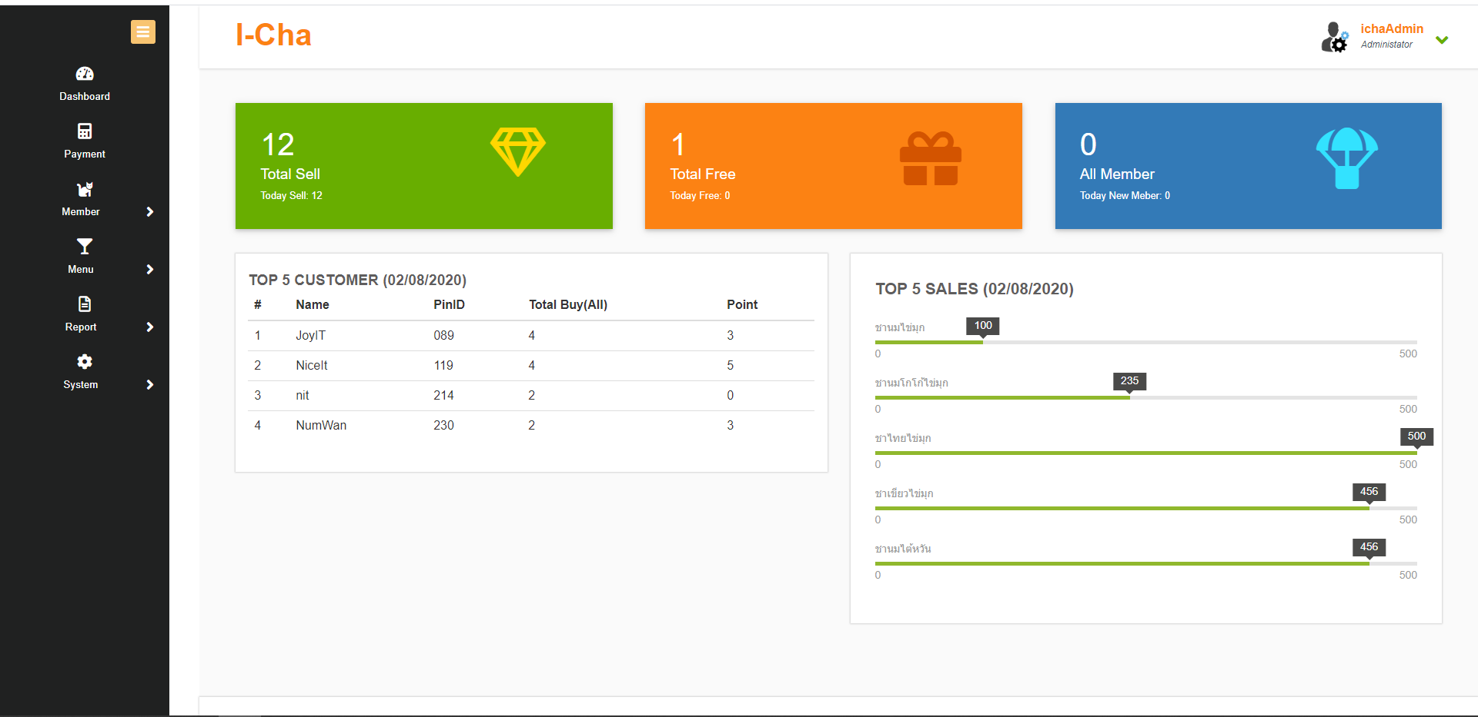
Dashboard

Slide 3
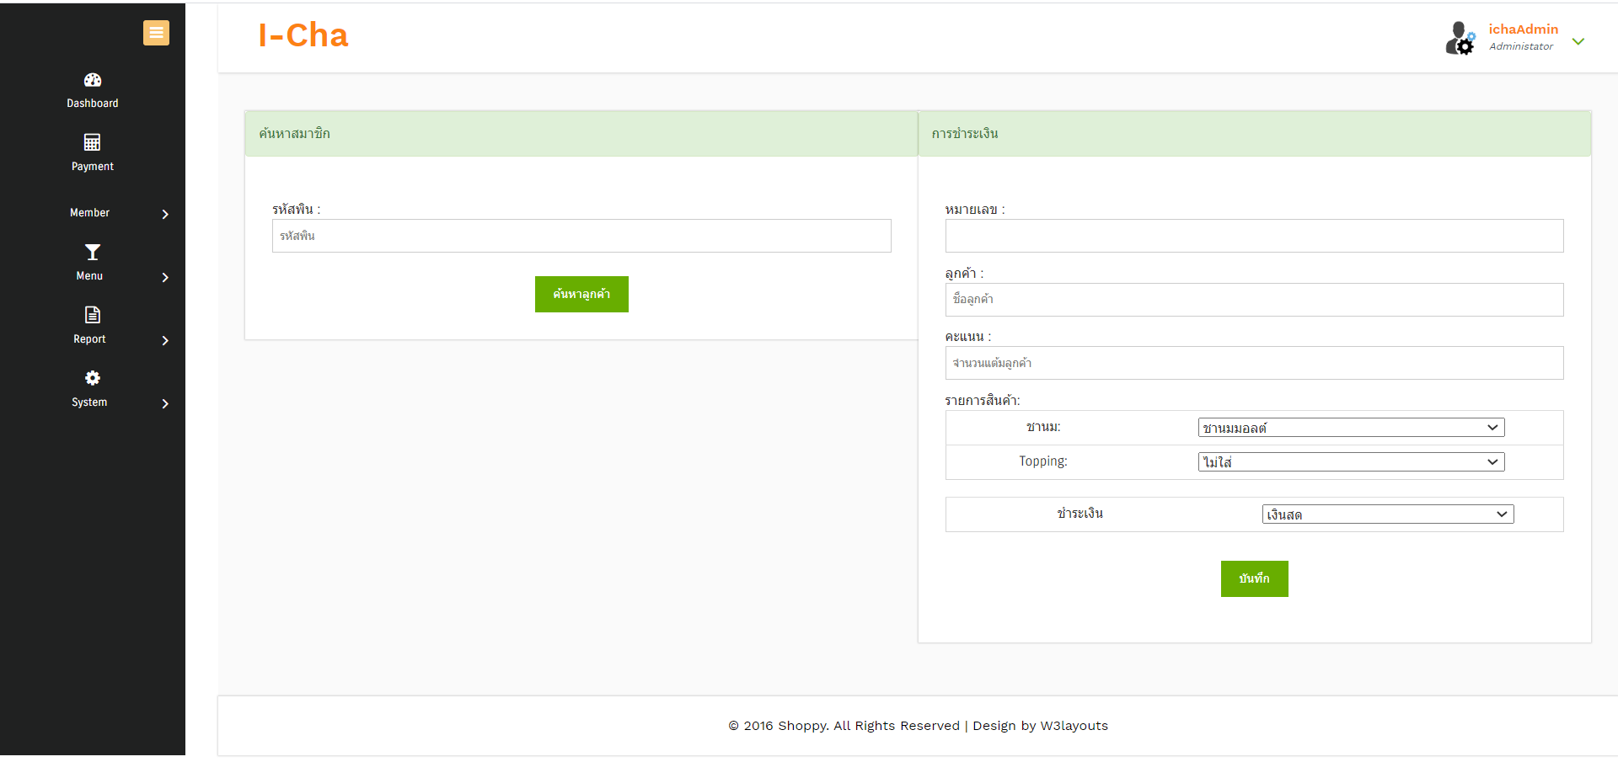
Payment

Slide 4
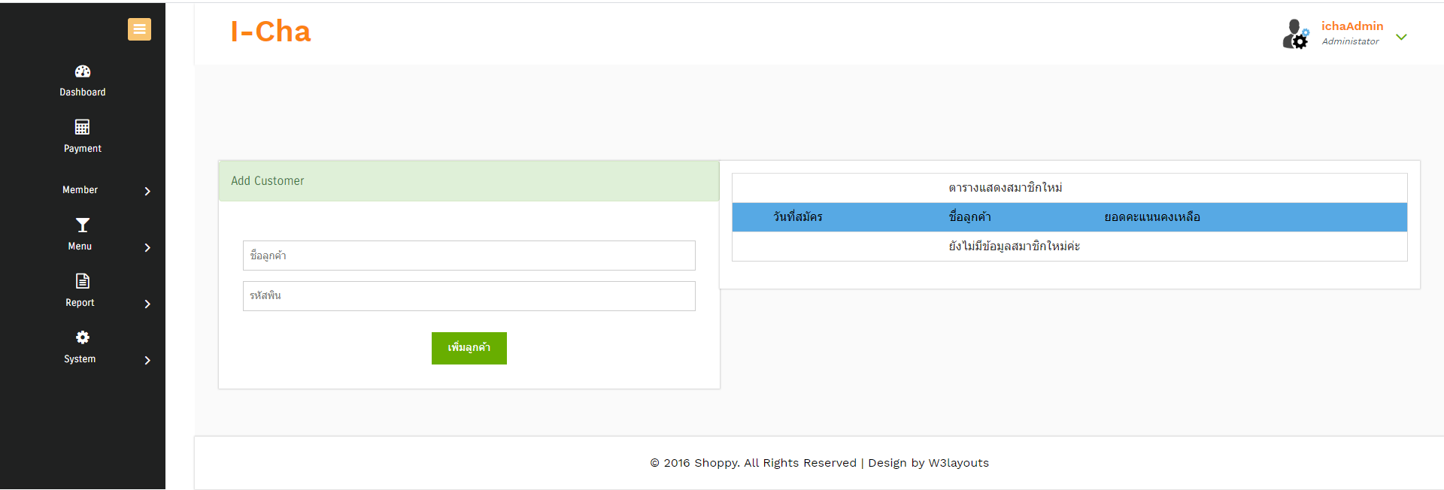
Add Customer

Slide 5
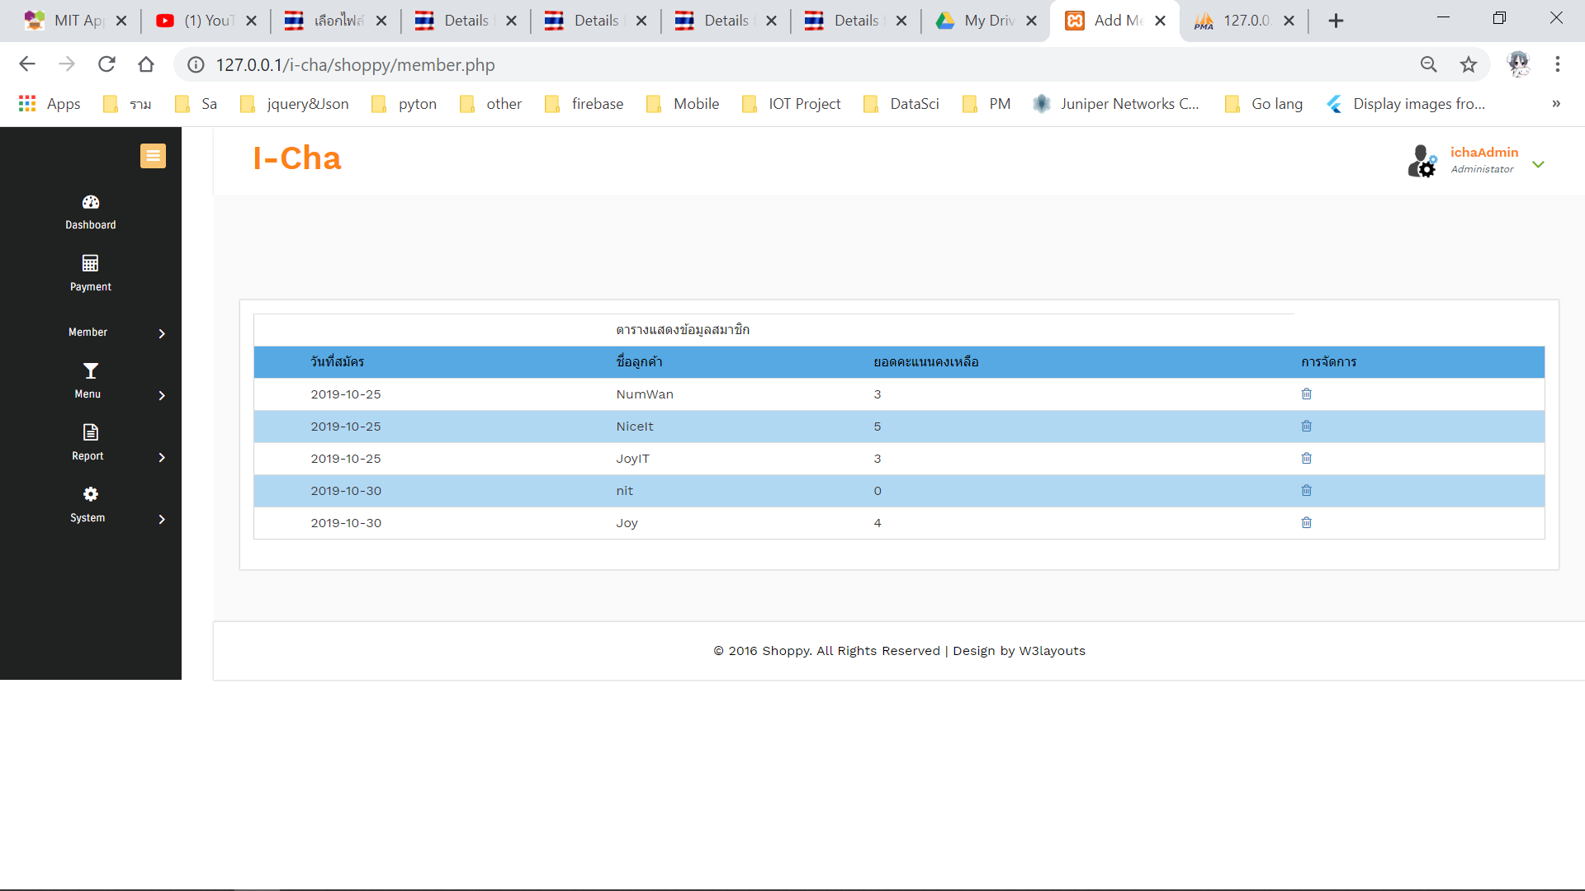
Member

Slide 6
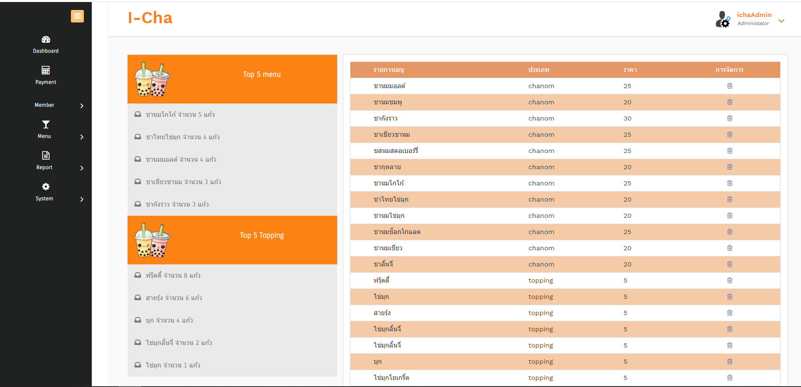
Menu

Slide 7
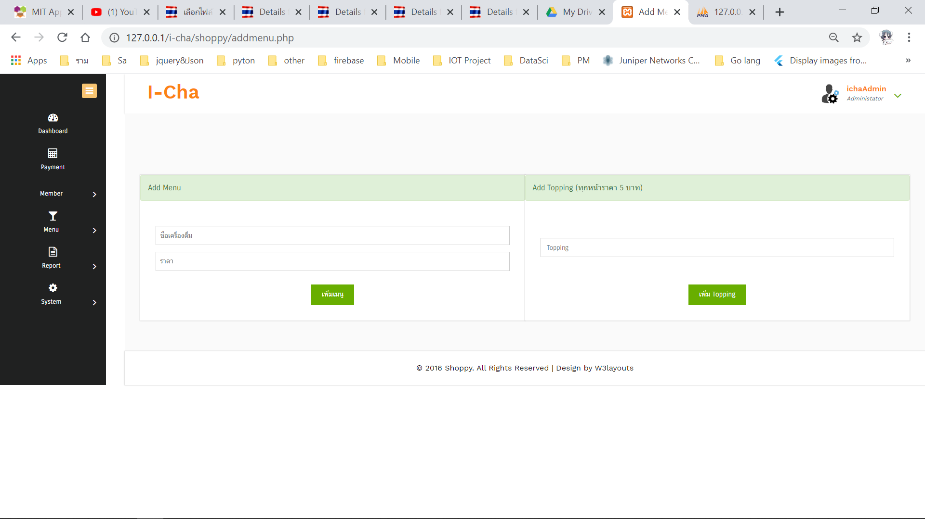
Add Menu

Slide 8
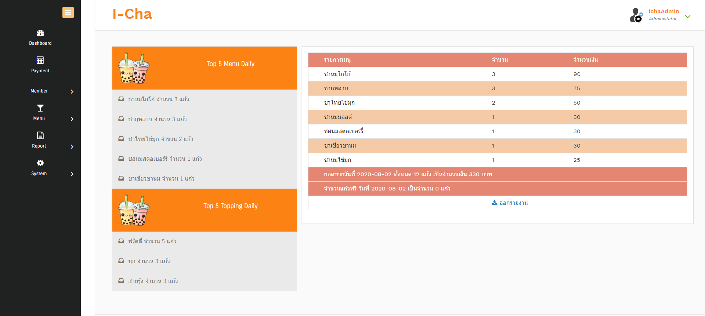
Report : Daily

Slide 9
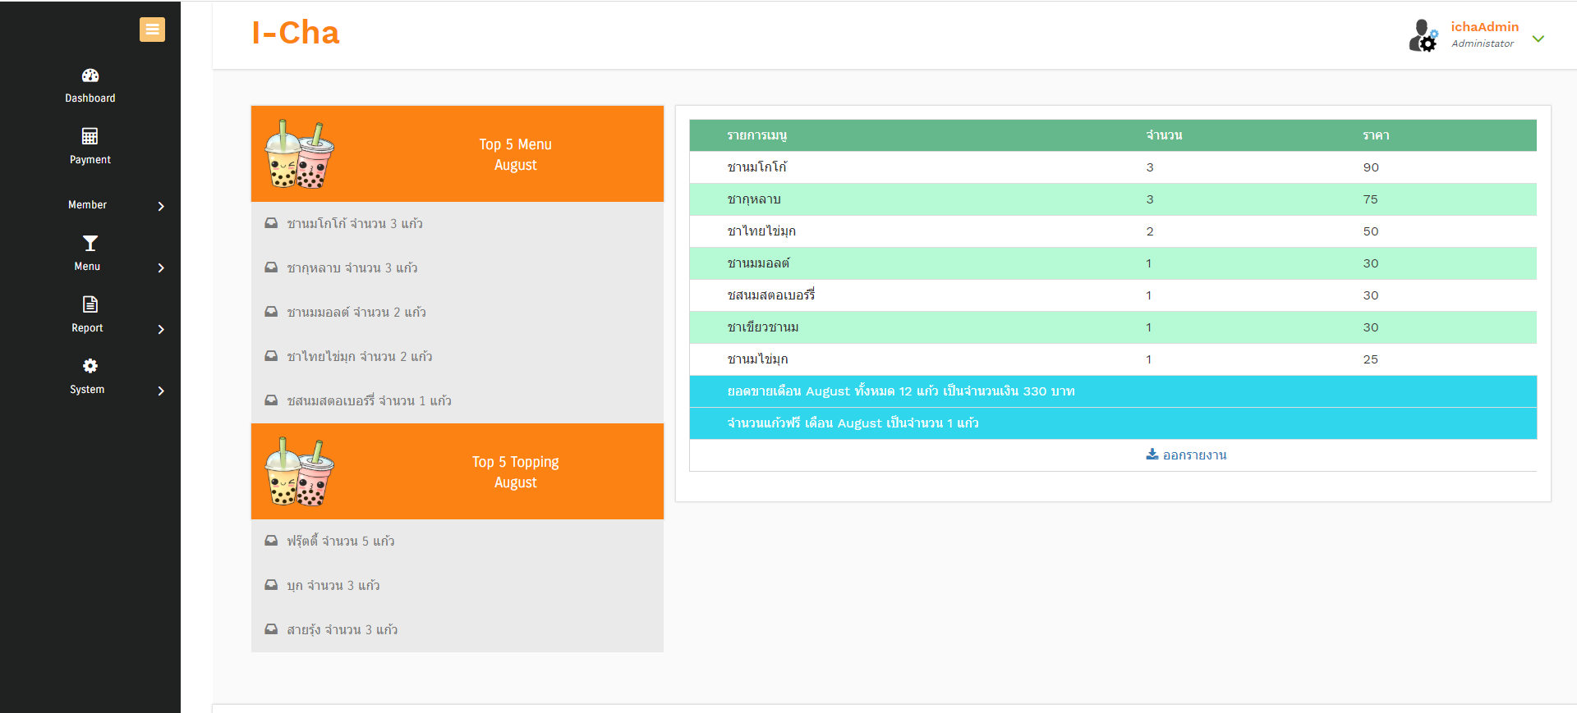
Report : Monthly

