Slide 1

Team 241
Hugo KESTELOOT
Yvan HU
Mathys BRONNEC
Jules DEPANCHON
Ryan LALEG
Aurélie THEAY

Slide 2
Summary
I- Introduction and Analysis of the Subject
1- State of the Art
2- Scope of the Subject and Potential Developments
3- Challenges
4- Study of Risks that Could Compromise the Project's Success
II- Work Organization
1- Task Allocation
2- Team Management and Communication
3- Project Communication and Management
4- Allocated Resources (Time, Expertise, Materials)
5- Definition of Deliverables
III- Work Accomplished Since the Beginning of the Project
1- Progress (Project History up to Today)
2- Quantification of Hours Spent on Tasks
3- Initial Results Achieved

Slide 3
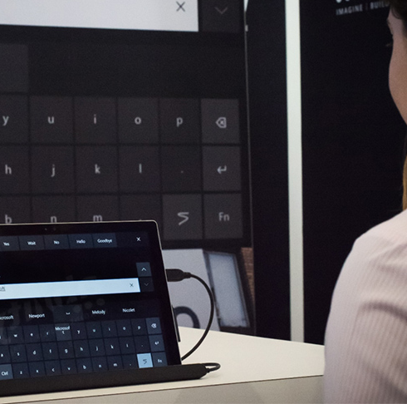
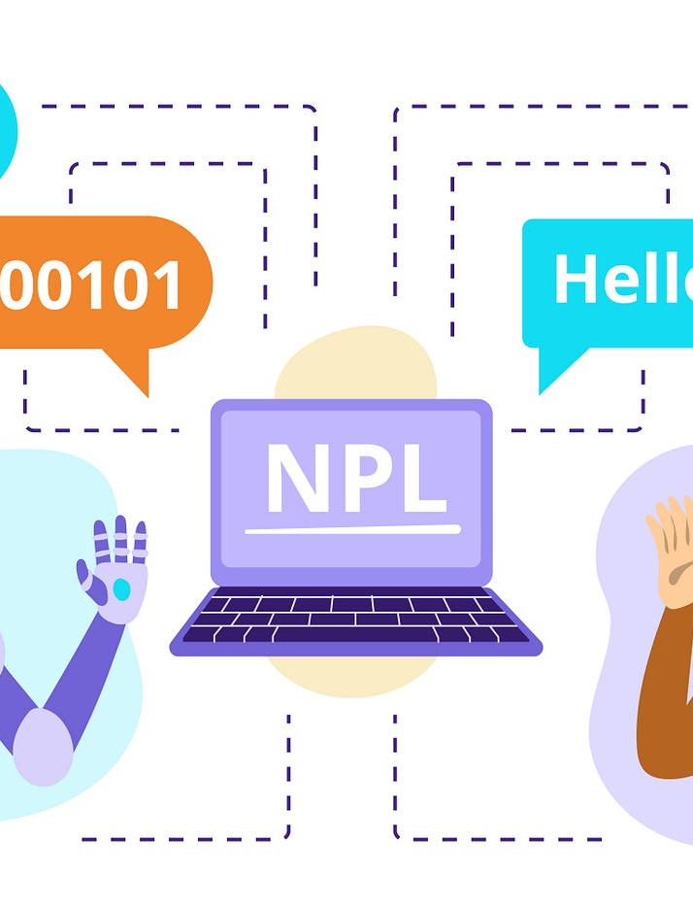
I-PRESENTATION AND ANALYSIS OF THE SUBJECT
Conception of a generative AI for helping people with Locked-in syndrome to communicate

Slide 4
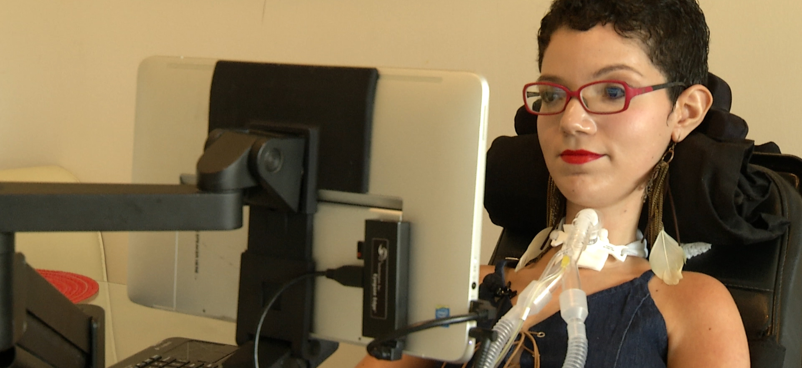

State-of-the-art
Eye gaze communication: One of the most commonly used means of communication for locked-in individuals is the use of eye trackers.
Blinking communication: Some locked-in individuals may be capable of voluntarily controlling their eye movements, including blinking.
Body movement communication: Locked-in individuals may be capable of controlling certain limited body movements
Project did not succed in the past years and we hope chatgpt 3.5 can make it happen.

Slide 5
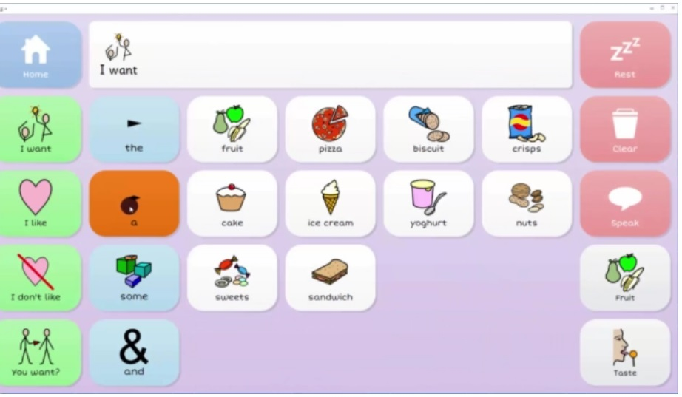
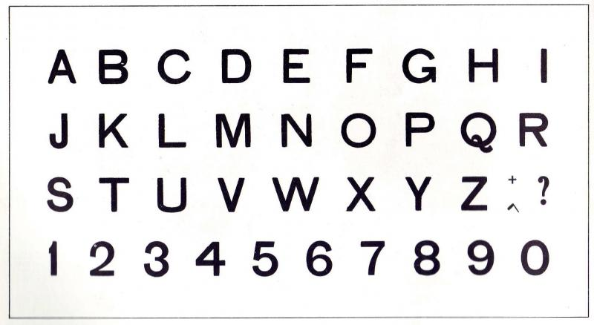
OUR MEETING WITH ALIS
Alphabet used for communication
The grid : software used by people with locked-in syndrome

Slide 6
The scope of the subject and potential developments:
Advanced technology integration: Continued advancements in technology can lead to the development of more sophisticated and seamless communication systems.
Expanding communication modalities: While the current focus is primarily on body movements, there is potential for exploring additional communication modalities.
Personalization and customization: Recognizing that each locked-in individual may have unique capabilities and preferences, there is a need for personalized and customizable communication solutions.

Slide 7

Challenges and Risks of the Project
Challenges :
Speech recognition
An intuitive system
Implementing a conversation history
RISKS :
OpenAI API outage
A time risk
A budget risk
Not meeting expectations

Slide 8

II- Work Organization

Slide 9
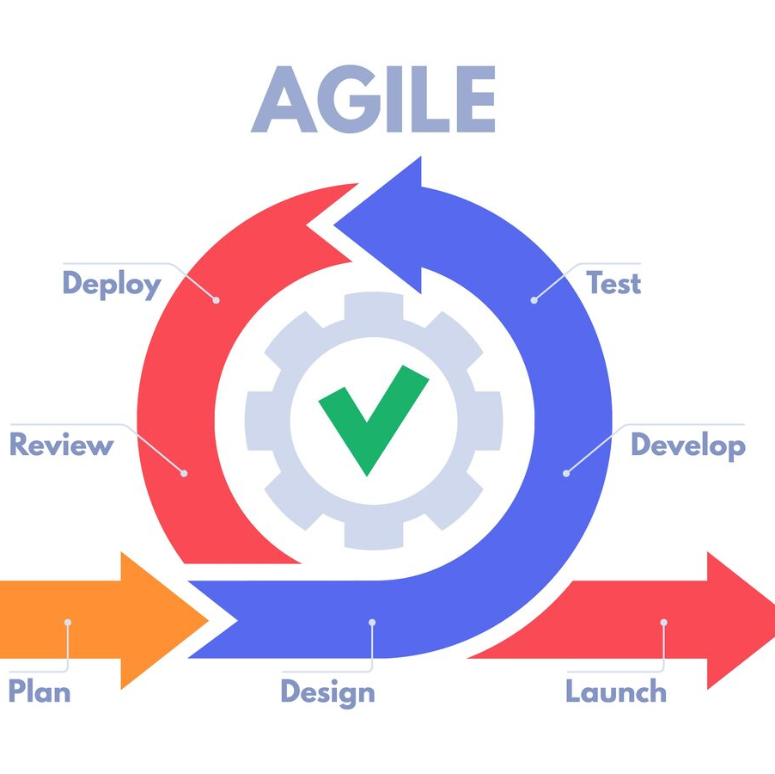
ORGANISATION OF THE WORK
Our team :
4 DIA & 2 SB
Individual research and pool
Appointment with ALIS
Scrum method
1 meeting/week
Teams and Whatsapp group
The partner :
Philippe Trotin, Matthieu Parfus, ALIS
3rd year
Git Hub

Slide 10
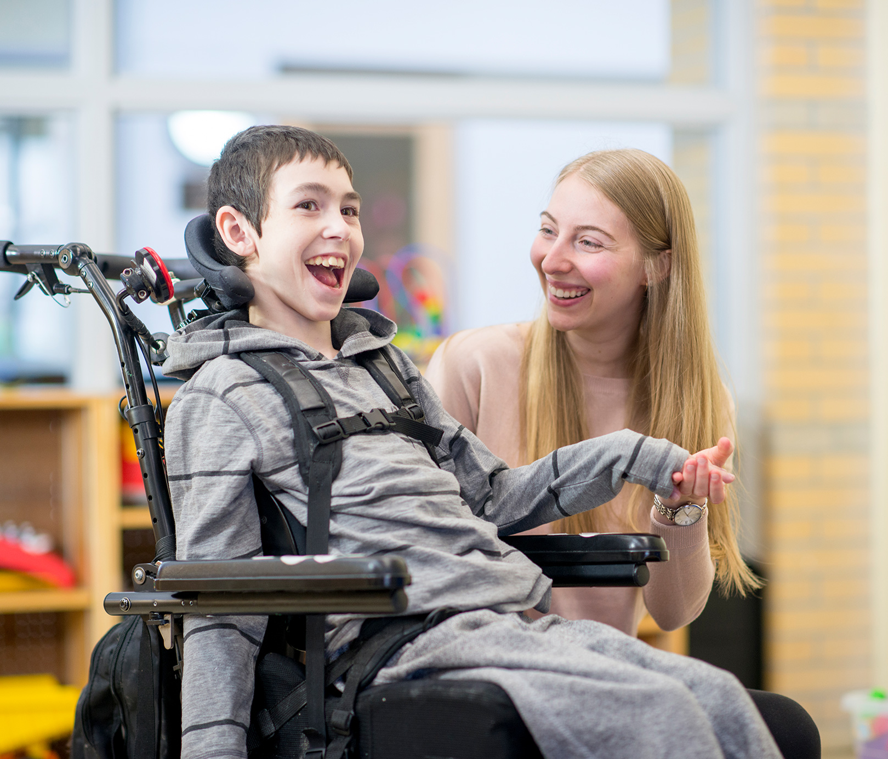
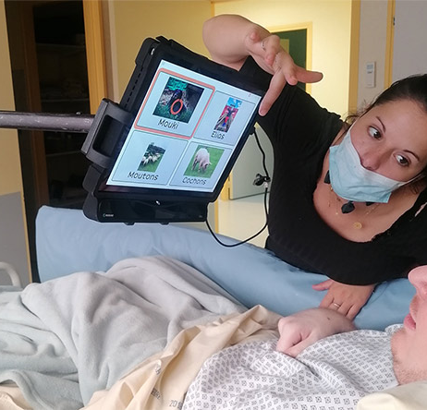
Expected Deliverables
For the deliverables, we aim to achieve the following:
Deliver a completed prototype.
Demonstrate that significant advancements in AI have made it possible to create a more natural and intuitive communication method for individuals with Locked-In Syndrome (LIS).
Proof of Concept (POC) showcasing the effectiveness and potential impact of the developed solution.

Slide 11

III- Work Accomplished Since the Beginning of the Project

Slide 12
PROJECT PROGRESS
Usable LLM
GPT-3.5
GPT-4
LLaMA
Bard
Strict criteria
Precision
Context
Dependencies
Implementation costs
Technology
Vector database
Innovation
Multiple LLM
Simple Data Storage
Solutions
Simple tech testing
Research for greater technical knowledge
MVP creation to check relevance

Slide 13
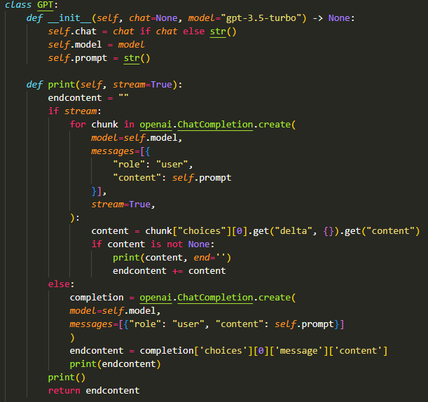
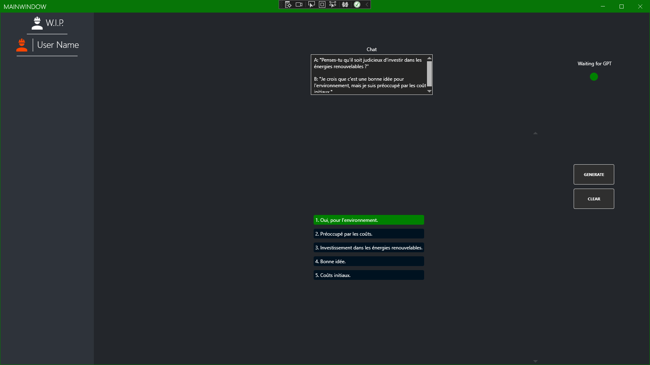
PROJECT STATE
Python testing ground:
The MMVP:
Perfect to test out prompt design and related tech
The minimum, minimum viable product that will help us see the advancement and experiment the human machine interface

