Slide 1
Software Testing
Monika Nyakone Hegedus-Lukacs
Systems Analyst at NI
2025-03-11

Slide 2

Agenda
Introduction to Software Testing
Test Levels
Test Types
Test Techniques
Test Management
Test Automation
Conclusion

Slide 3
Introduction to Software Testing
What is Software Testing?
Epic Fails in Software Testing
Knight Capital Group trading glitch (2012): A software error caused Knight Capital's trading system to execute numerous unintended stock trades, resulting in a loss of $440 million and nearly leading to the firm's bankruptcy.
Delta Air Lines computer outage (2016): A critical power control module failure led to a massive system outage, causing the cancellation of approximately 2,000 flights over three days and highlighting vulnerabilities in the airline's IT infrastructure.
Washington Department of Corrections (DoC) software glitch (2002): More than 3,200 US prisoners have been released early due to a software bug.
Mars Climate Orbiter (1999): When NASA Lost a Spacecraft Due to a Metric Math Mistake (unit conversion error, cost 125M USD)
CrowdStrike software update failure (2024): A faulty update to CrowdStrike's Falcon Sensor software caused widespread system crashes, affecting 8.5 million Windows-based computers globally and disrupting services across airlines, banks, and hospitals.
Definition: the process of evaluating and verifying that a software or application meets the requirements.
Why is Software Testing important?
Ensures software quality
Increases customer satisfaction
Defects can be identified early
Reduces the cost of fixing issues

Slide 4
Test Levels
Component Testing *
Component Integration Testing
System Testing
Acceptance Testing
System Integration Testing
* aka Unit Testing

Slide 5
Test Types
Functional Testing – testing WHAT the application does
Non-functional Testing – testing HOW the application is working
Performance
Compatibility
Usability
Reliability
Security
Maintainability
Portability
Safety
Black Box Testing – specification-based, focusing on requirements, testing without knowledge of internal code structure
White Box Testing – structure-based, testing with knowledge of internal code structure (e.g. code, architecture, workflows, data flows)
+ Confirmation Testing – testing if a bug has been fixed (i.e. re-testing)
+ Regression Testing – testing if the already working functions are still working after a change has been implemented

Slide 6
Test Techniques
Black Box Testing
Equivalence Partitioning
Boundary Value Analysis
Decision Table Testing
State Transition Testing
White Box Testing
Statement Testing
Branch Testing
Experience-based Testing
Error Guessing
Exploratory Testing

Slide 7
Test Techniques – Equivalence Partitioning
„Equivalence Partitioning (EP) divides data into partitions (known as equivalence partitions) based on the expectation that all the elements of a given partition are to be processed in the same way by the test object.” *
Black Box test technique
Valid partition vs invalid partitions
1 test case per partition
Partitions cannot overlap (and cannot be empty)
Test coverage: not satisfactory on its own
e.g. user age validation
Partition 1 | Partition 2 | Partition 3
0 1 2 3 4 5 6 7 8 9 10 11 12 13 14 15 16 17 | 18 19 20 21 22 23 24 25 | 26 27 28 29 30 31 32 33 34 35 36 37 38 39 40 …
invalid | valid | invalid
* ISTQB

Slide 8
Test Techniques – Boundary Value Analysis
”Boundary Value Analysis (BVA) is a test technique based on exercising the boundaries of equivalence partitions.” *
Black Box test technique
BVA can only be used for ordered partitions
Boundary values = the mininum and maximum values of a partition
2-value BVA vs 3-value BVA
Test coverage: 100% can be achieved with 3-value BVA
e.g. user age validation
Partition 1 | Partition 2 | Partition 3
0 1 2 3 4 5 6 7 8 9 10 11 12 13 14 15 16 17 | 18 19 20 21 22 23 24 25 | 26 27 28 29 30 31 32 33 34 35 36 37 38 39 40 …
invalid | valid | invalid
* ISTQB

Slide 9
Test Techniques – Decision Table Testing
„Decision tables are used for testing the implementation of requirements that specify how different
combinations of conditions result in different outcomes.” *
Black Box test technique
When creating decision tables, the conditions and the resulting actions of the system are defined.
Useful for complex logic
it provides a systematic approach to identify all the combinations of conditions
Test coverage: 100% can be achieved
e.g. user login
Conditions | Test Case 1 | Test Case 2 | Test Case 3 | Test Case 4
UserID entered | TRUE | TRUE | TRUE | TRUE
UserID correct | TRUE | TRUE | TRUE | FALSE
Password entered | TRUE | TRUE | FALSE | n/a
Password correct | TRUE | FALSE | n/a | n/a
Actions
Welcome page displayed | TRUE | FALSE | FALSE | FALSE
Error message displayed | n/a | TRUE | TRUE | TRUE
* ISTQB

Slide 10
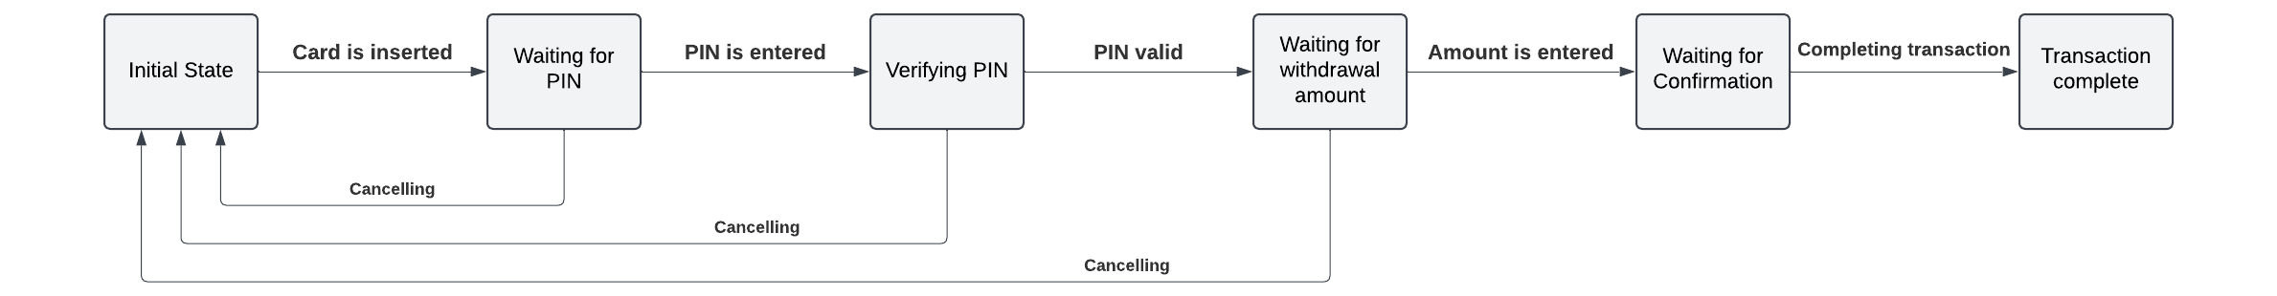
Test Techniques – State Transition Testing
„A state diagram models the behaviour of a system by showing its possible states and valid state
transitions.” *
Black Box test technique
Test coverage:
all states coverage (coverage items: states)
valid transitions coverage (coverage items: single valid transitions)
all transitions coverage (coverage items: all valid&invalid transitions)
e.g. ATM machine
* ISTQB

Slide 11
Test Techniques – Statement Testing
„In statement testing, the coverage items are executable statements. The aim is to design test cases that exercise statements in the code until an acceptable level of coverage is achieved.” *
e.g. online shopping cart
def add_to_cart(cart, item, quantity):
if quantity > 0:
if item in inventory:
cart[item] = cart.get(item, 0) + quantity
inventory[item] -= quantity
return "Item added to cart"
else:
return "Item not in inventory"
else:
return "Invalid quantity"
Test cases:
Input: cart = {}, item = "laptop", quantity = 1
Expected Output: "Item added to cart"
Input: cart = {}, item = "phone", quantity = 1
Expected Output: "Item not in inventory"
Input: cart = {}, item = "laptop", quantity = -1
Expected Output: "Invalid quantity"
White Box test technique
coverage items: statements
Test coverage: may not be satisfactory on its own
* ISTQB

Slide 12
Test Techniques – Branch Testing
„A branch is a transfer of control between two nodes in the control flow graph, which shows the possible sequences in which source code statements are executed in the test object. ” *
e.g. user login
def login(username, password):
if username == "" or password == "":
return "Username or password cannot be empty"
elif username == "admin" and password == "admin123":
return "Login successful"
else:
return "Invalid username or password"
Test cases:
Input: username = "", password = "password"
Expected Output: "Username or password cannot be empty"
Input: username = "user", password = ""
Expected Output: "Username or password cannot be empty"
Input: username = "admin", password = "admin123"
Expected Output: "Login successful"
Input: username = "user", password = "wrongpassword"
Expected Output: "Invalid username or password"
White Box test technique
coverage items: branches
Test coverage: may not be satisfactory on its own
* ISTQB

Slide 13
Test Techniques – Error Guessing
„Error guessing is a test technique used to anticipate the occurrence of errors, defects, and failures, based on the tester’s knowledge. ” *
Experience-based test technique
Errors may be related to:
input (e.g., valid value not accepted, missing parameters)
output (e.g., wrong format, wrong result)
logic (e.g., missing cases, wrong operator)
computation (e.g., incorrect operand, wrong computation)
interfaces (e.g., parameter mismatch, incompatible types)
data (e.g., incorrect initialization, wrong type)
* ISTQB

Slide 14
Test Techniques – Exploratory Testing
„In exploratory testing, tests are simultaneously designed, executed, and evaluated while the tester learns about the test object. The testing is used to learn more about the test object, to explore it more deeply with focused tests, and to create tests for untested areas.” *
Experience-based test technique
requires domain knowledge from tester
* ISTQB

Slide 15
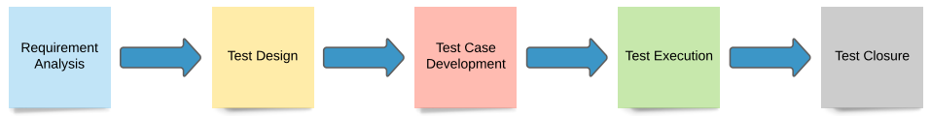
Test Management
Test Management is the process of planning, executing, and monitoring the testing activities and resources to ensure software quality.
Defect management (bugs)
Configuration management (e.g. test environments)
Risk management (risk level = probability x impact)
Monitoring (e.g. dashboard)
Reporting (metrics)
Tools: Jira, AzDo

Slide 16
Test Automation
”Test automation, which includes automated test execution and test reporting, is one or more of the following activities:
Using purpose-built software tools to control and set up test suites for test execution
Executing tests in an automated way
Comparing actual results to expected results” *
Advantages
Increased efficiency (by reducing time required for test execution)
Increased test coverage
Improved consistency (less subject to human errors)
Increased overall quality
Quicker feedback on SW quality
Tools
Selenium, UFT, Tricentis (Tosca), Jenkins
Demo
* ISTQB

Slide 17
Conclusion
Key takeaways – name 1 thing you’ve learnt today ☺
Best Practices in Software Testing
Early Testing – Start testing as early as possible in the development lifecycle
Continuous Testing – Integrate testing into the CI/CD pipeline
Curiosity ☺
Career Opportunities: Quality Analyst, Test Analyst, Test Engineer, Automation Tester, Test Manager
Resources: ISTQB (International Software Testing Qualifications Board)

Slide 18
Thank you for your attention!

Slide 19
Resources
Email address: monika.hegedus-lukacs@emerson.com
ISTQB: https://www.istqb.org/
ISTQB certifications: https://www.istqb.org/certifications/
ISTQB Foundation v4: https://www.istqb.org/certifications/certified-tester-foundation-level-ctfl-v4-0/
Unit testing in python: https://docs.python.org/3/library/unittest.html, https://docs.pytest.org/en/stable/

Slide 20

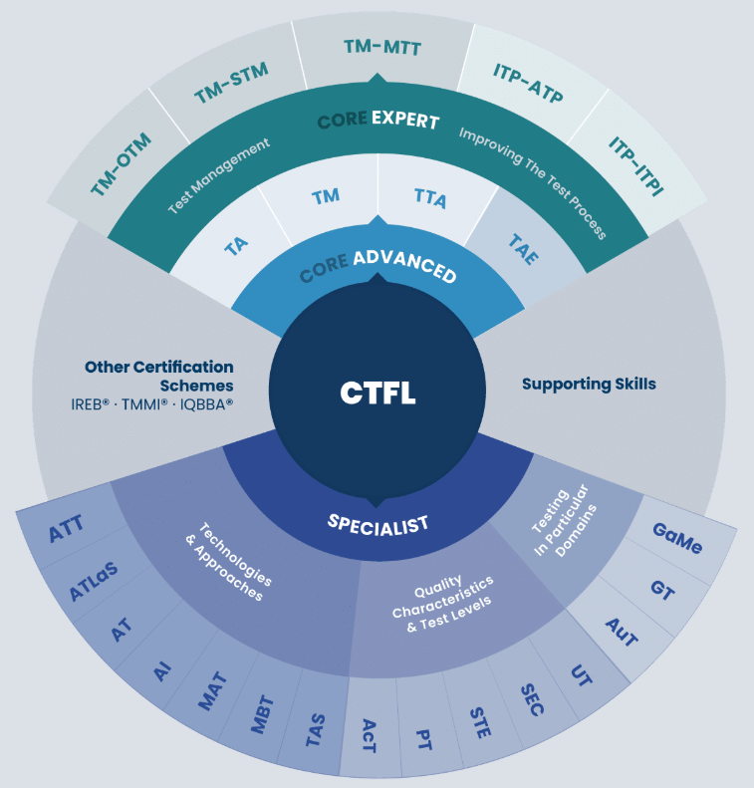
ISQTB Certifications
https://www.istqb.org/certifications/

Slide 21
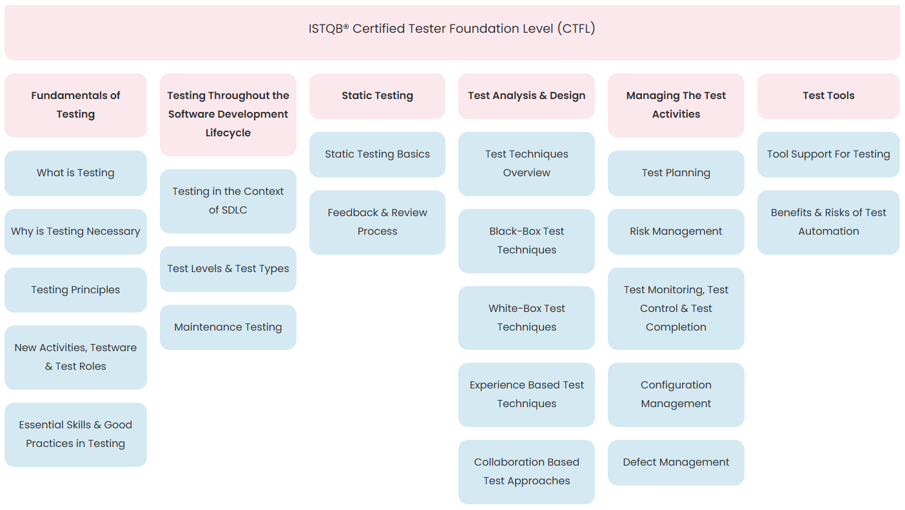
ISQTB Certified Tester Foundation Level (CTFL)
ISTQB Certified Tester Foundation Level (CTFL) v4.0

Slide 22
Test Techniques – Tasks
Task 1: Decision Table Testing
Scenario: You have a PL/SQL function that calculates discounts based on customer type and purchase amount.
Task: Create a decision table for the following conditions:
Customer Type: Regular, Premium
Purchase Amount: < $100, $100 - $500, > $500
Task 2: Equivalence Partitioning
Scenario: You have a PL/SQL procedure that validates user input for age (must be between 18 and 65).
Task: Identify the equivalence partitions and write test cases for valid and invalid age inputs.
Task 3: Boundary Value Analysis
Scenario: You have a PL/SQL function that processes orders if the order quantity is between 1 and 1000.
Task: Identify the boundary values and write test cases for these boundary conditions.
Task 4: State Transition Testing
Scenario: You have a PL/SQL procedure that manages user account states (Active, Suspended, Closed).
Task: Draw a state transition diagram and write test cases for transitions between these states.
Task 5: Error Guessing
Scenario: You have a PL/SQL function that calculates the total price of items in a shopping cart.
Task: Based on your experience, list potential errors that could occur and write test cases to catch these errors.
TASK
crypto exchange
trading volume | commission fee (default: 2%)
above 100 USD | 1.5%
above 1000 USD | 1.0%
above 10000 USD | 0.5%
above 100000 USD | 0%

