Slide 1


Team 1
Phase 2 Presentation

Slide 2
Overview
- Core Functionality
- Front-end Design
- Home/ Login
- New User/ Registration
- Dashboard
- Future Improvements
Database Design
- Core Tables
- Back-end Design
- Timeline
- Conclusion

Slide 3
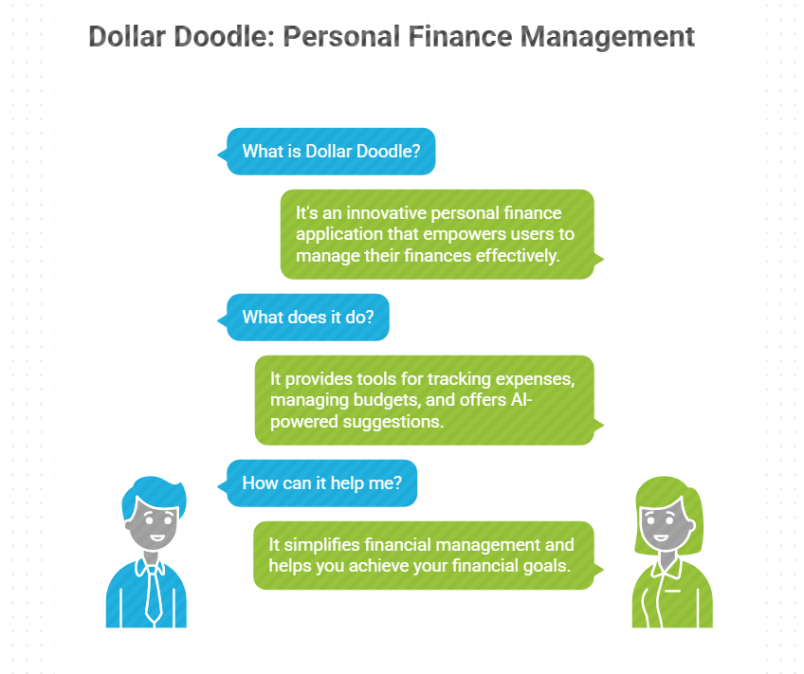
Core Functionality

Slide 4

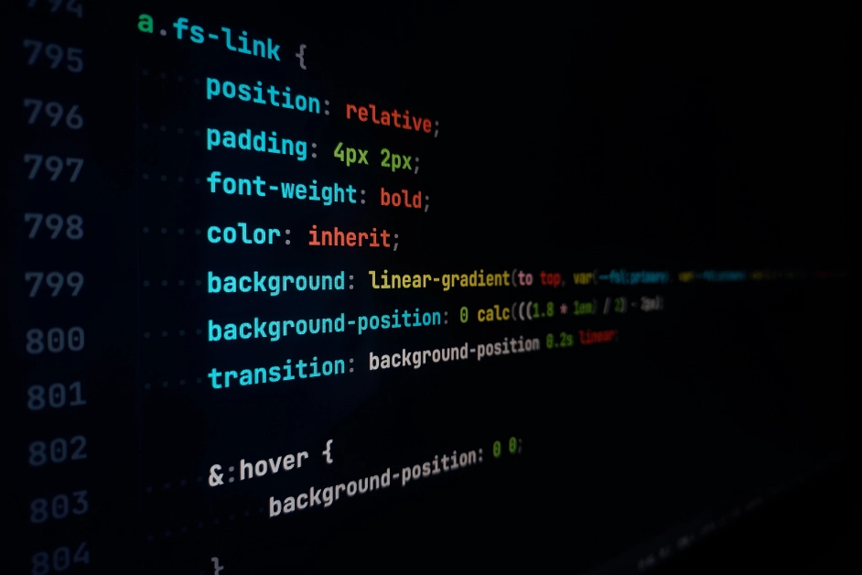



Front-end Design
The front-end was implemented using HTML, CSS, and JavaScript.
It also incorporates the Google OAuth login API.

Slide 5
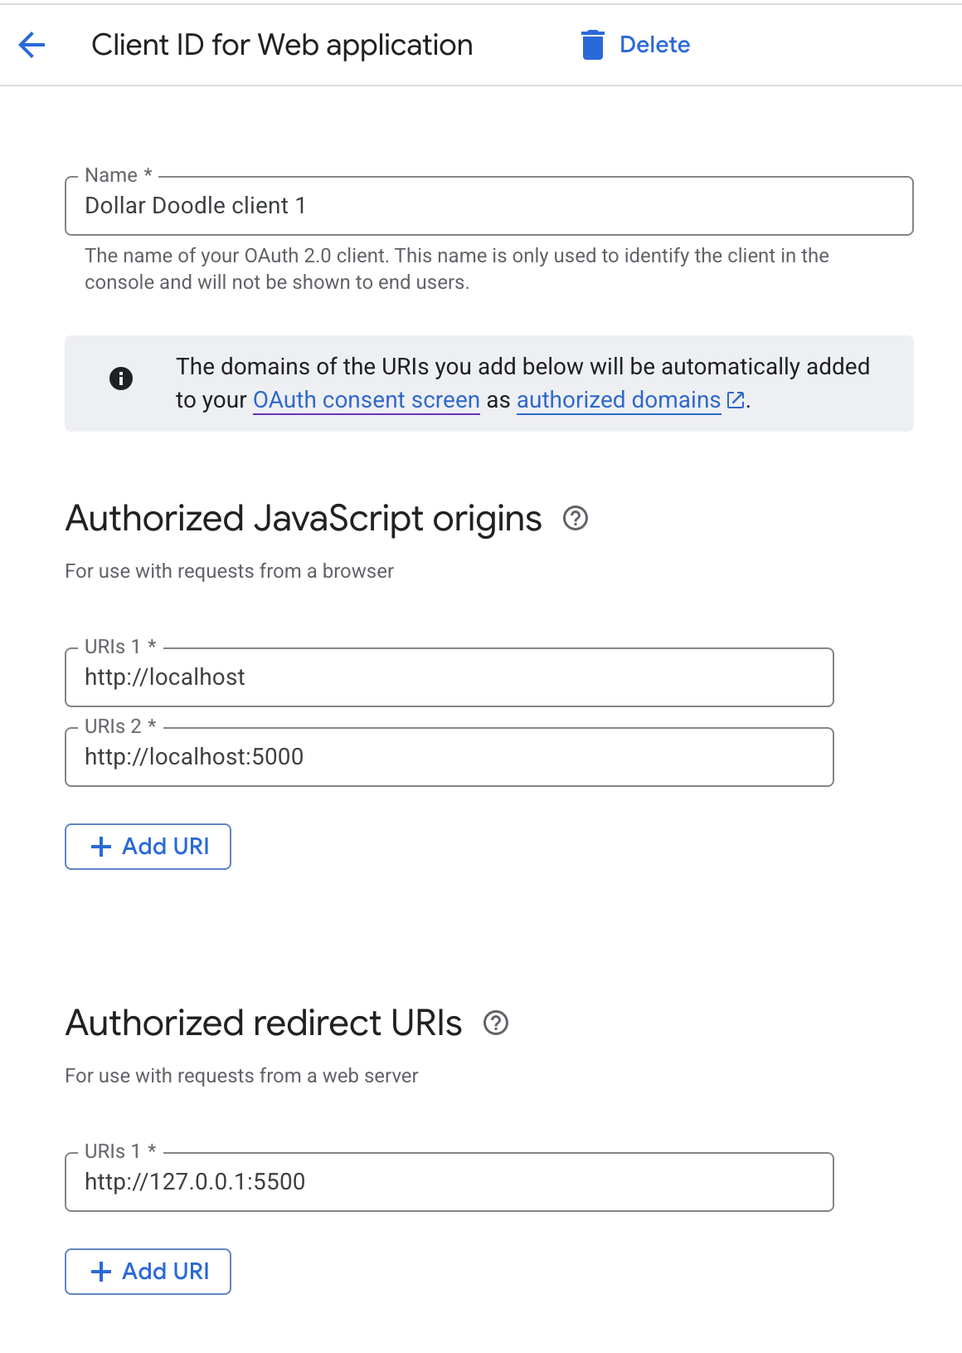
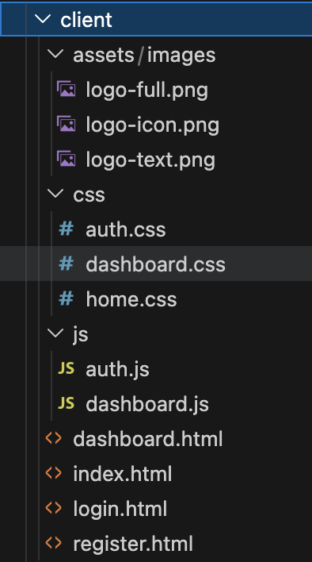
Front-end Design (cont.)
Google OAuth 2.0 Setup
Front-end File Structure

Slide 6
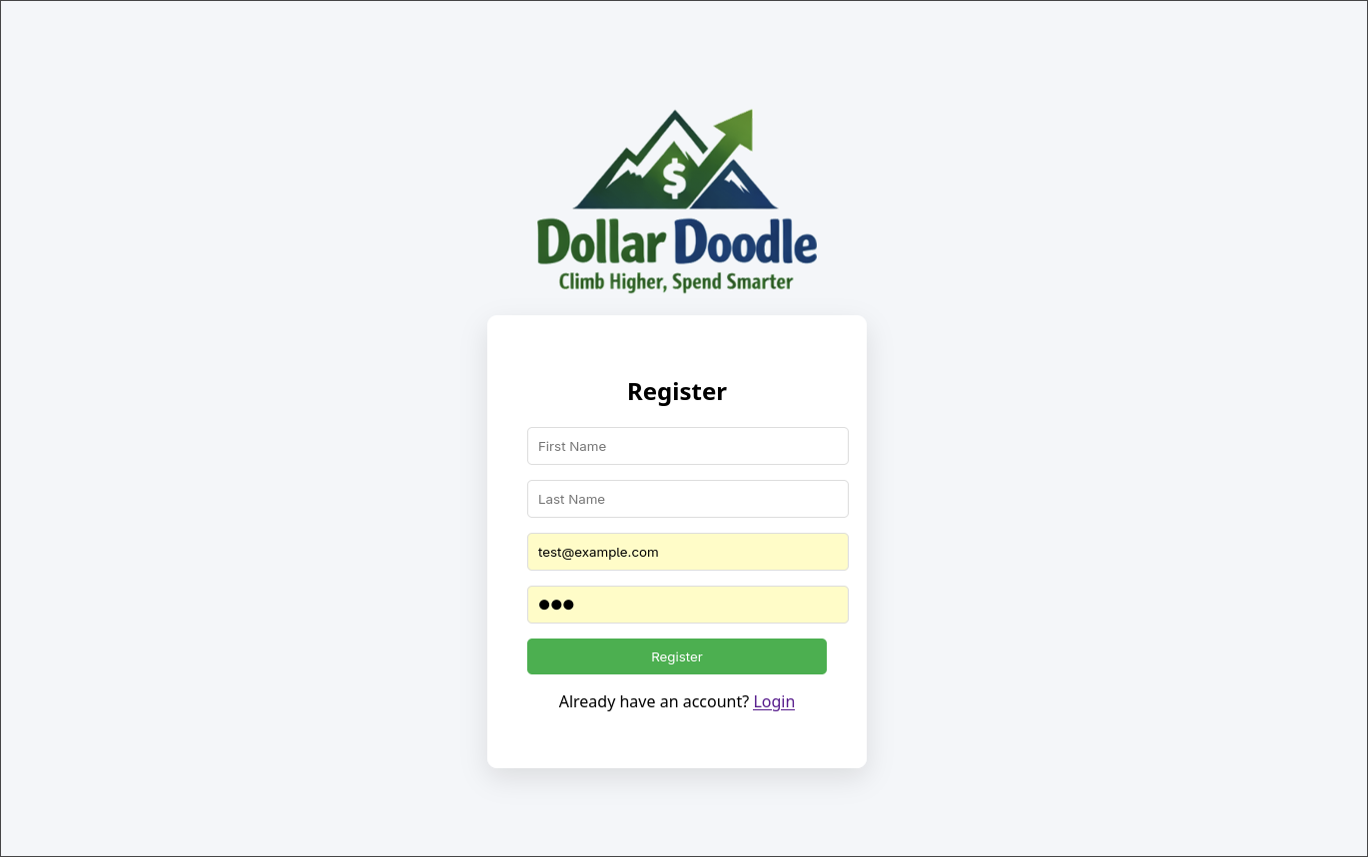
New User/ Registration Screen

Slide 7
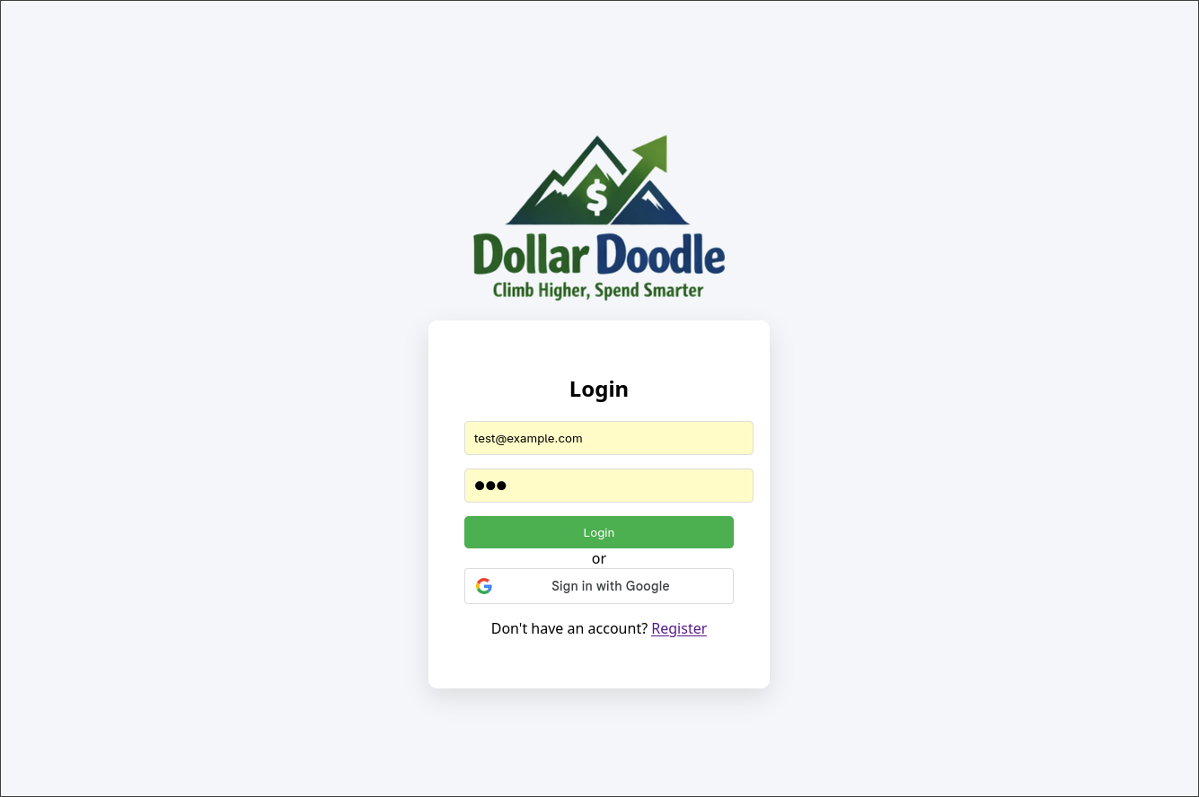
Home/Login Screen

Slide 8
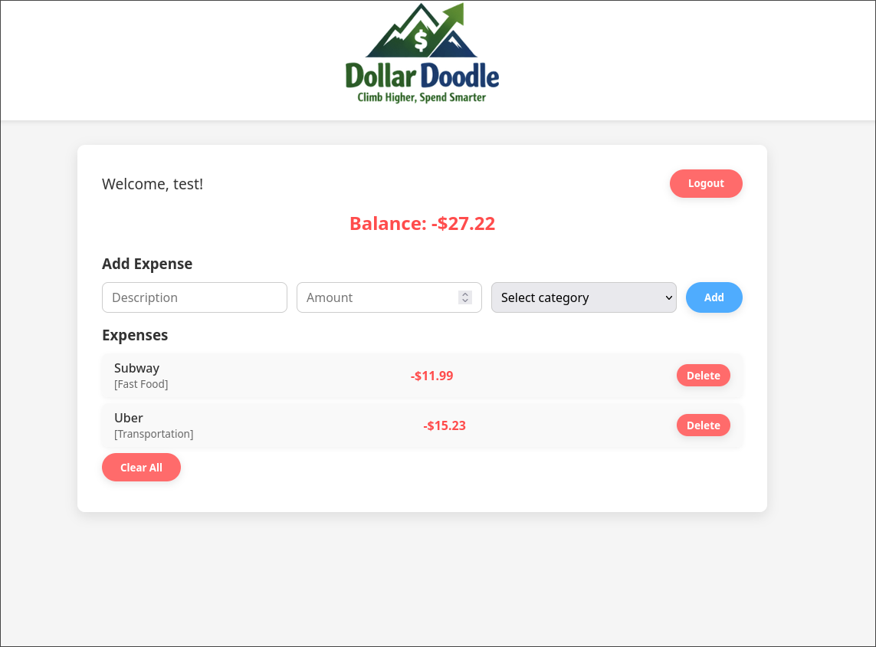
Dashboard

Slide 9
Future Improvements
Sidebar
In the future we want to have a sidebar on the dashboard which will show various menus that we plan to add, such as receipt scanning, budget suggestions, and settings.
Dark Theme/Accessibility Features
We would like to make the Dollar Doodle web app more accessible by creating a dark theme that synchronizes with the time of day, and that users with vision impairments can select to best navigate the app.

Slide 10
Back-end Design
The Back-end was implemented using MYSQL, DBEaver, and Node.js.
We will implement the veryfi api in the future as well.
Notes:
eva

Slide 11
Database Design
A relational MySQL database designed to power a smart expense
tracking application with 8 interconnected tables.
Database: MySQL.
Tables: 8.
Relationships: One-to-Many.
Indexes: 15+ for performance.
Constraints: Data validation rules.
This database is the foundation that makes Dollar Doodle
fast, reliable, and ready to help users save money!
Notes:
eva

Slide 12
Parent Tables Main Entities:
Users - Central table storing user profiles, authentication (email/Google), and account status.
Categories - Predefined expense categories like Food & Dining, Transportation, Entertainment with budget percentages.
Expenses - Tracks all user transactions with amounts, dates, and receipt images.
Income - Manages various income sources (Salary, Freelance, Investments) with recurring options.
Notes:
Eva

Slide 13
Child Tables
Budget Suggestions – Provides personalized financial advice
Receipts – Stores proof of expenses/receipts with image URLs
User Feedback – System collects bug reports and suggestions
Recurring Income – Tracking for regular payments
Notes:
eva

Slide 14
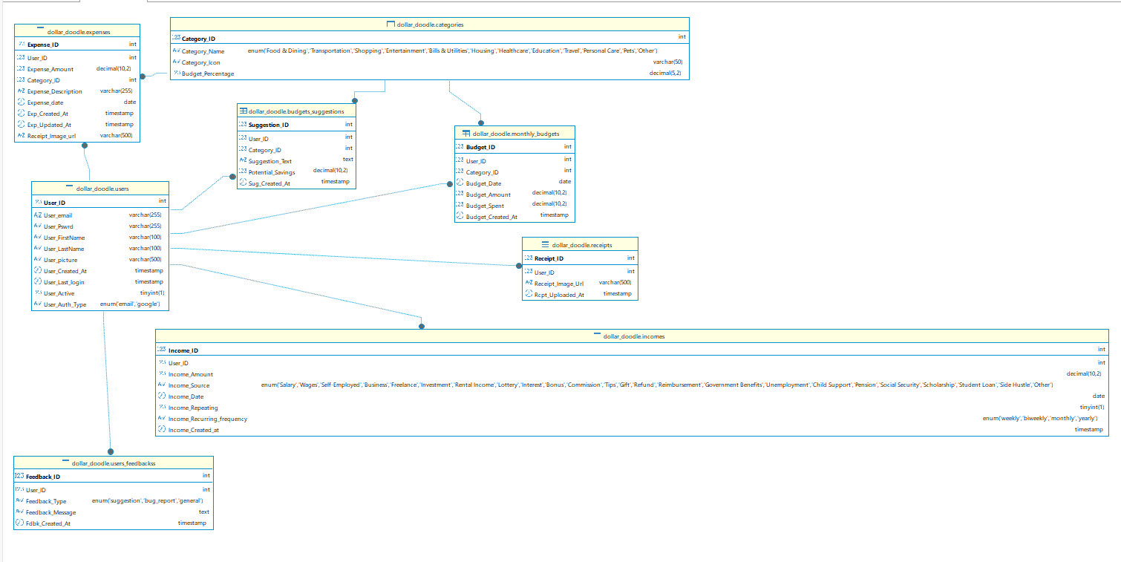
Back-end Design
Notes:
Roma :
Users -
Categories -
Expenses -
Income -
Budget Suggestions
Receipts –

Slide 15
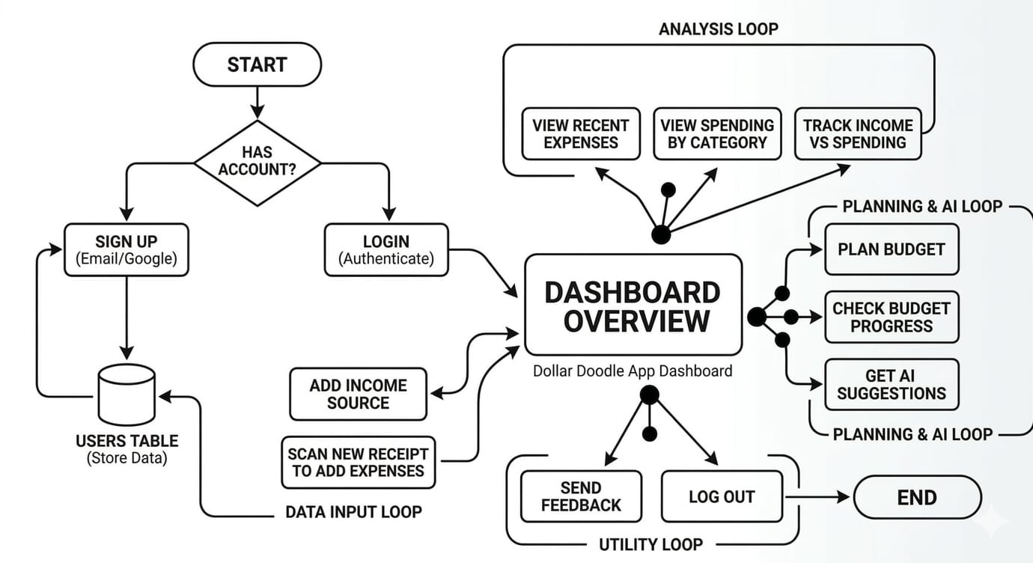
Notes:
Roma : This flowchart shows how a user moves through our Dollar Doodle app - from logging in to tracking their finances.
First, the user starts on our start page. If they already have an account, they log in - that's where our database authenticates them by checking their email and password in the Users table
Once logged in, they see their Dashboard Overview - a snapshot of their current balance, recent expenses, and budget status. This pulls data from multiple tables we designed.
From here, users can do two things:
Add Income Source - They can add salary, freelance income, etc. This data goes directly into our Incomes table.
Scan Receipt to Add Expenses - They can photograph a receipt, and our app extracts the data to create a new expense record in our Expenses table.
then we have loops:
Data Input Loop - Users continuously add new income and expenses.
Utility Loop - The app constantly updates their budget calculations and shows spending insights.
So in simple terms: User logs in → Sees dashboard → Adds transactions → Database updates → Dashboard refreshes.

Slide 16
Timeline

Slide 17
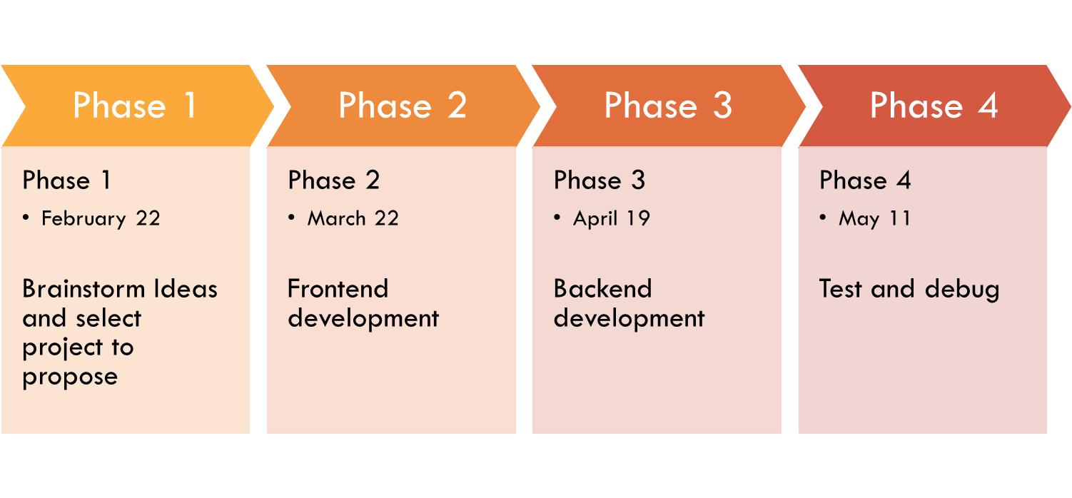
Timeline

Slide 18
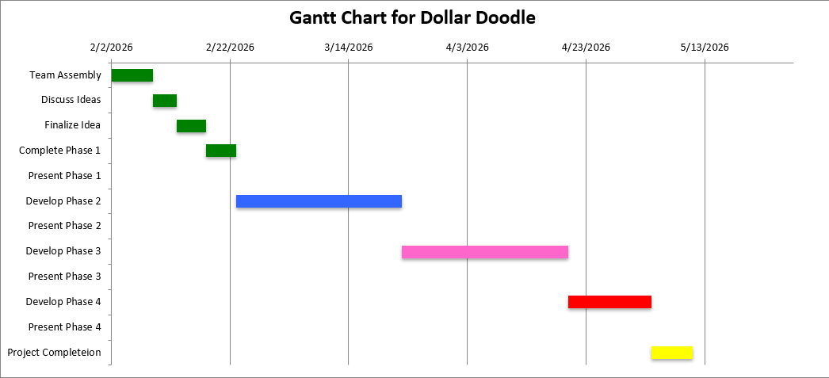

Slide 19
Conclusion
Dollar doodle is more than just a personal finance app; it is a comprehensive tool designed to help users take control of their financial lives.
With its user-friendly interface, powerful features, and ai-driven insights, Dollar Doodle makes managing finances accessible and efficient.
Whether you are looking to track your spending, set budgets, or receive personalized saving tips, Dollar Doodle is your go-to solution for achieving financial wellness.

Slide 20
Team Responsibilities
Alex Hildreth
Project Manager
Nick Schott
Daniel Austin
Front End Development
Roumaysae Jerari
Eva Buesse
Back End Design
Contact Us: dollardoodledev@gmail.com

