Slide 1
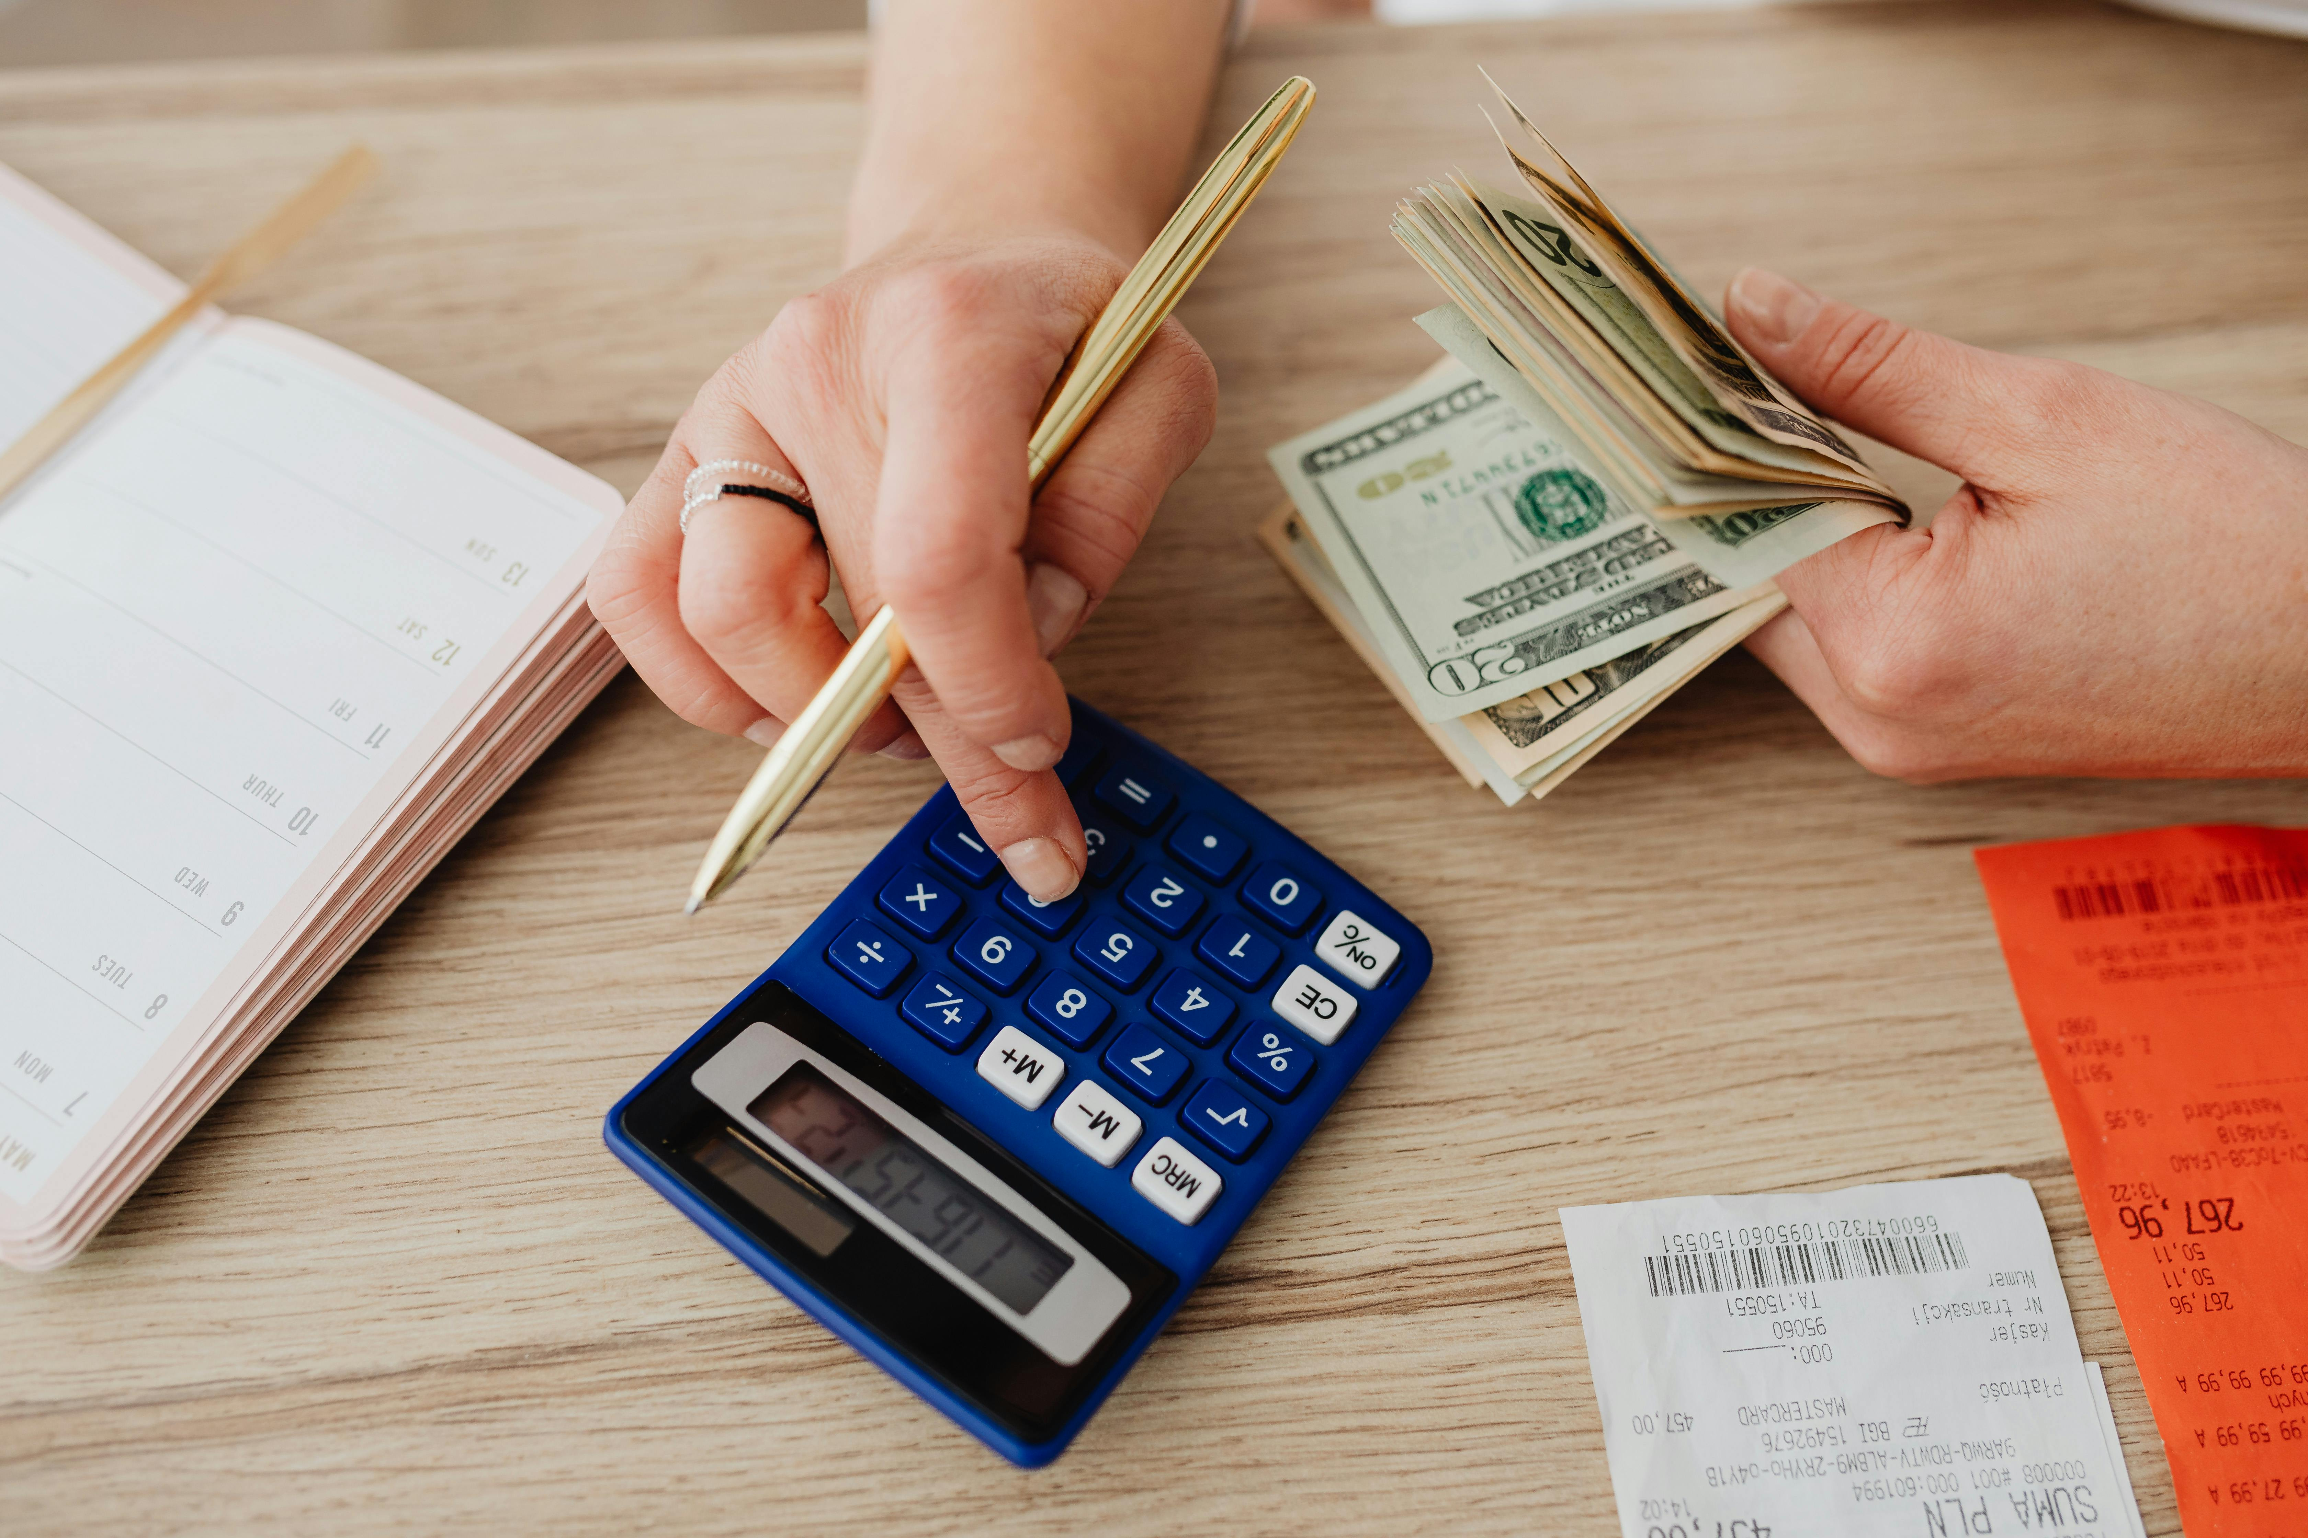
Dollar Doodle
Climb Higher, Spend Smarter
Phase 1
Notes:
Title slide

Slide 2
Team Members
Project Manager
Alex Hildreth
Developers
Roumaysae Jerari
Nick Schott
Eva Buesse
Daniel Austin
Notes:
Alex

Slide 3
Project Ideas
The Universal moment of frustration was the spark for our Idea : The personal struggle with money management.
Too many people overspend simply because they aren't paying attention.
We set out to build a tracker that is simple, practical, and effortless to use.
Notes:
Alex

Slide 4
Problem Statement
Personal Spending is often a blind spot.
No clear picture of daily spending
Transactions are spread across Apps, Cards, and Cash.
Existing tools are too complicated to use daily.
Notes:
Eva

Slide 5
Project Proposal
A web-based App to track spendings and build better habits.
Log expenses by category effortlessly.
View clear summaries of your spending habits to reveal patterns.
Notes:
Eva

Slide 6
System Components
Front End (User Interface)
Back End (Server & APIs)
Database
GitHub Repository
Notes:
Daniel

Slide 7

Module Breakdown
Front End: Dashboard, Add Expense, Transactions, Scan Receipts, View Graphs, Smart Suggestions.
Back End: Authentication, Expense Processing.
Database: Users & Expenses Tables.
Notes:
Daniel

Slide 8
Technology Used
JavaScript (Front End & Back End)
Node.js & Express
MySQL
GitHub for collaboration
Notes:
Roma

Slide 9
Statement of Work
Develop front-end UI
Implement backend APIs
Design database schema
Maintain GitHub repository
Notes:
Roma

Slide 10
Planned Future Work
Budget alerts
More Charts and analytics
Mobile optimization
Data export features
Notes:
Nick

Slide 11
Timeline
Phase 1
Phase 1
February 22
Brainstorm Ideas and select project to propose
Phase 2
Phase 2
March 22
Frontend development
Phase 3
Phase 3
April 19
Backend development
Phase 4
Phase 4
May 11
Test and debug
Notes:
Nick

Slide 12
Team Responsibilities
Alex Hildreth
Project Manager
Roumaysae Jerari
Eva Buesse
Database Design
Nick Schott
Daniel Austin
Front End Development
Notes:
Alex

Slide 13
Dollar Doodle
Climb Higher, Spend Smarter
Notes:
Alex

