Slide 1


KYRGYZSTAN DISEASE ANALYSIS
Math Foundations for Data Science
Bufatima Nk

Slide 2

INTRODUCTION
Objective: The goal is to analyze disease trends in Kyrgyzstan using a dataset of reported cases.
Dataset Overview: The dataset contains information on reported disease cases in Kyrgyzstan.
Data Preparation: The dataset was cleaned to ensure accuracy.

Slide 3

PROBABILITY AND STATISTICS
Descriptive statistics and Probability were used to understand the distribution of disease cases.
Graphs like histograms and boxplots were used to visualize disease data patterns.
Yearly trends were analyzed to visualize changes in disease occurrences over time

Slide 4
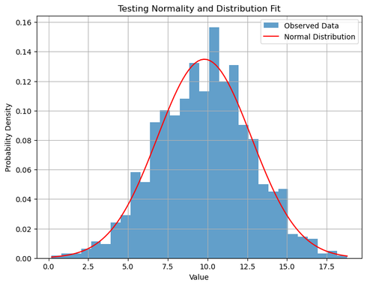
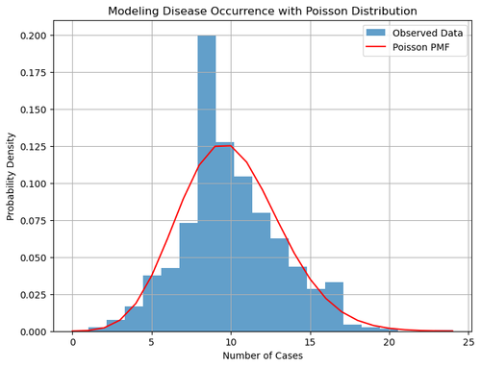
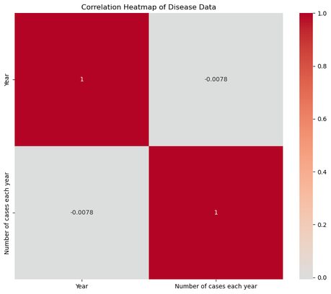

VISUALIZATIONS
Normal Distribution
Poisson distribution
Correlation matrix

Slide 5

CLUSTERING
K-Means clustering WAS applied to group diseases based on their reported patterns, aiming to identify distinct disease clusters.
Clustering revealed meaningful groups of diseases with similar trends, providing valuable insights into prevalent health issues.
Inertia and silhouette scores were used to assess the quality of clustering and the separation between disease clusters.

Slide 6
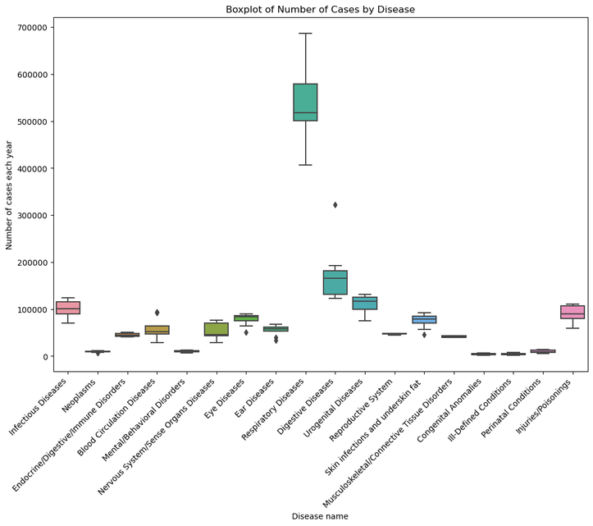
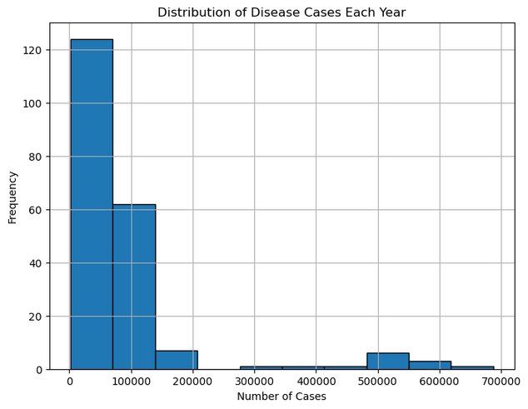
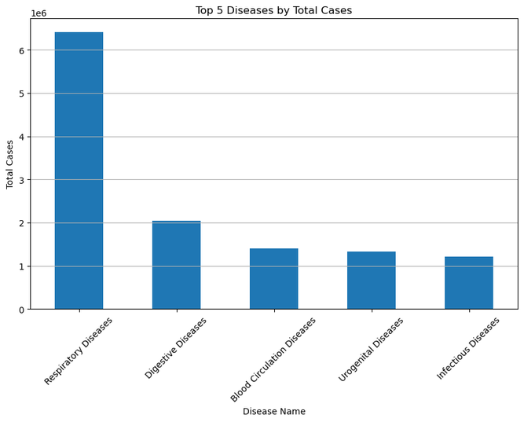
VISUALIZATIONS

Slide 7

DASHBOARD DEVELOPMENT
To make findings accessible, an interactive dashboard was developed using Dash.
The dashboard allows users to explore disease clusters and trends visually, enhancing the understanding of complex health data.

Slide 8

CONCLUSION
Different disease groups and changing trends over time were discovered.
Future work may involve utilizing additional data or predicting disease outbreaks.
The findings may contribute to addressing health challenges in Kyrgyzstan.

Slide 9

ARE THERE ANY QUESTIONS?
End of the presentation

