Slide 1


Traffic Matrix Prediction based on Bidirectional Recurrent Neural Network and Long Short-Term Memory
Van An Le † Phi Le Nguyen† Yusheng Ji†‡
† Department of Informatics, SOKENDAI (The Graduate University for Advanced Studies)
‡National Institute of Informatics, Tokyo, Japan

Slide 2
AGENDA
Introduction
Related works
Problem description
Proposed approach
Evaluation
Conclusion and future work

Slide 3
AGENDA
Introduction
Related works
Problem description
Proposed approach
Evaluation
Conclusion and future work

Slide 4
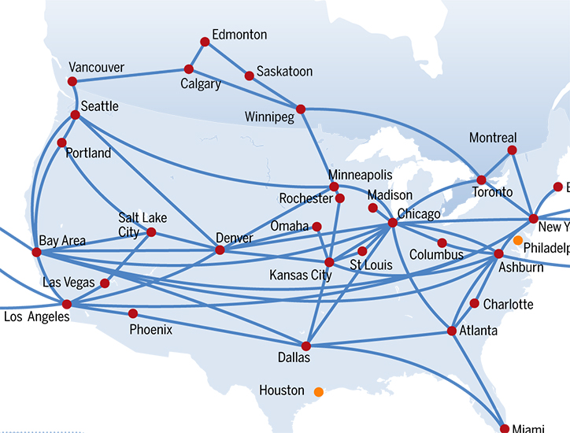

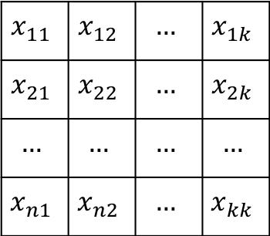

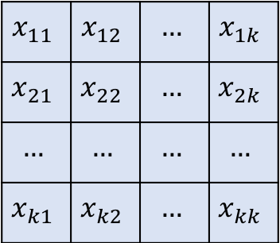
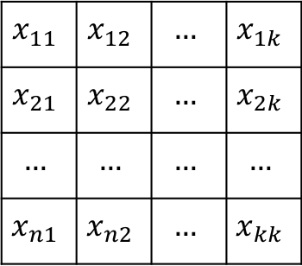

Introduction
TRAFFIC MATRIX: an abstract representation of the traffic volume between set of origins and destinations pairs. [1]
$$0$$
$$x_{11}$$ | $$x_{12}$$ | $$…$$ | $$x_{1k}$$
$$x_{21}$$ | $$x_{22}$$ | $$…$$ | $$x_{2k}$$
$$…$$ | $$…$$ | $$…$$ | $$…$$
$$x_{n1}$$ | $$x_{n2}$$ | $$…$$ | $$x_{kk}$$
$$t−1$$
$$x_{11}$$ | $$x_{12}$$ | $$…$$ | $$x_{1k}$$
$$x_{21}$$ | $$x_{22}$$ | $$…$$ | $$x_{2k}$$
$$…$$ | $$…$$ | $$…$$ | $$…$$
$$x_{n1}$$ | $$x_{n2}$$ | $$…$$ | $$x_{kk}$$
$$t$$
$$x_{11}$$ | $$x_{12}$$ | $$…$$ | $$x_{1k}$$
$$x_{21}$$ | $$x_{22}$$ | $$…$$ | $$x_{2k}$$
$$…$$ | $$…$$ | $$…$$ | $$…$$
$$x_{k1}$$ | $$x_{k2}$$ | $$…$$ | $$x_{kk}$$
Traffic matrix of backbone network at time t
Source: ubiquity.acm.org
Notes:
Given a backbone network likes in this figure which consists k nodes. A traffic matrix is a k-by-k matrix where each element represents for the traffic volume between the origin and destination at on particular time. The traffic matrix contains a lot of information which can tell us about the network situation.

Slide 5
Introduction
Traffic Matrix
Network Optimization
Anomaly Detection
Protocol Design
...
Playing an important roles in wide range of network management applications. [1]
Measuring all the traffic network is impractical due to the monitoring resources constraints.
QoS provisioning
Notes:
Therefore, it plays an important roles in wide range of network management tasks such as QoS provisioning …
However, we know that with the explosion in the network today, to measure all the traffic is impractical due to the monitoring resources constraints.

Slide 6
Related works
 | Network tomography
 | Traffic interpolation using Compressive Sensing and Matrix Completion
 | Traffic prediction using Deep Learning
ASA journal
Estimating traffic from link count and routing information [2].
Infocom
SDN-based traffic aggregation and measurement paradigm [4].
1996
2009
2014
2015
Sigcomm:
Spatial-temporal Compressive sensing approach [3].
Infocom
Adaptive sampling for traffic completion [5].
Notes:
Due to the important of TM, many researchers have invested in how to obtain the traffic matrix. These researches can be divided into 3 main approaches. Network tomography based. Traffic interpolation using compress sensing and traffic prediction using deep learning approach.
In 1996, network tomography has been introduced in which we can estimate the traffic based on link count and routing information. However, the network tomography suffers problem then the number of traffic flows are far more larger than the number of links can be monitored.
In the traffic interpolation problem, the authors try to recovery the traffic matrix based on the compress sensing and matrix completion techniques where they assume that the traffic matrix is a sparse matrix which means almost element is equal to zero. This approach is efficient in recover the traffic matrix under the high missing rate. However, it is useful in the traffic analysis not for traffic engineering or QoS planning when we need to predict the future traffic.

Slide 7
Related works
 | Network tomography
 | Traffic interpolation using Compressive Sensing and Matrix Completion
 | Traffic prediction using Deep Learning
Infocom
Traffic recovery under dynamic condition using tensor completion [8].
IEEE Access
Traffic prediction using recurrent convolutional network in Data center [9].
Infocom
Traffic interpolation using tensor completion [6].
2016
2017
JNCA:
Traffic Matrix estimation based on deep learning and probabilistic model [7].
Infocom
Spatial temporal modelling and prediction in Cellular network using Deep Learning [10].
Notes:
In recent years, Deep Learning has been applied in many application domains. In traffic prediction problem, deep learning has been used for modeling and predicting the traffic load in cellular network also in data center and achieved good results. However, the condition in cellular network or data center is different to the backbone network. For example, in the cellular network, the network operator can control all the traffic that pass through the base stations which mean that after estimate the future traffic, the traffic data can be collected to become the input for the next prediction.

Slide 8
Related works
Network Tomography
Inferring traffic based on link count and routing information.
Under-constrained problem (# of flows >> # of link monitored) .
Traffic interpolation using Compressive Sensing and Matrix Completion.
Recovering the missing traffic .
For traffic analysis.
Traffic prediction based Deep Learning approach
Cellular Network and Data center.
Backbone network?
Notes:
In 1996, network tomography has been introduced in which we can estimate the traffic based on link count and routing information. However, the network tomography suffers problem then the number of traffic flows are far more larger than the number of links can be monitored.
In the traffic interpolation problem, the authors try to recovery the traffic matrix based on the compress sensing and matrix completion techniques where they assume that the traffic matrix is a sparse matrix which means almost element is equal to zero. This approach is efficient in recover the traffic matrix under the high missing rate. However, it is useful in the traffic analysis not for traffic engineering or QoS planning when we need to predict the future traffic.
In recent years, Deep Learning has been applied in many application domains. In traffic prediction problem, deep learning has been used for modeling and predicting the traffic load in cellular network also in data center and achieved good results. However, the condition in cellular network or data center is different to the backbone network. For example, in the cellular network, the network operator can control all the traffic that pass through the base stations which mean that after estimate the future traffic, the traffic data can be collected to become the input for the next prediction.

Slide 9
AGENDA
Introduction
Related works
Problem description
Proposed approach
Evaluation
Conclusion and future work
Notes:
Next, I will present about the motivations and problem description.

Slide 10

Motivation
Predicting traffic matrix is required for:
QoS provisioning.
Capacity planning.
Smart routing.
…
Source: www.ayalpbilisim.com
Notes:
Back to the case of backbone network, even thought thank to the Software defined network architecture, we can perform a comprehensive management and network control. In the SDN-based network, a flow can be monitored at any time and at any flow level. However, with the explosion in the traffic, monitoring all the traffic still remains as the impractical task. The solution is that we can only take a partial monitoring and then predict the rest.

Slide 11












Motivation
$$y_{t}=f(x_{t−1, } x_{t−2}, …, x_{t−l })$$
$$y_{t+1}=f(x_{t, } x_{t−1}, …, x_{t−l+1 })$$
$$x_{t−l}$$ | … | $$x_{t−2}$$ | $$x_{t−1}$$
$$y_{t}$$
$$x_{t−l+1}$$ | … | $$x_{t−1}$$ | $$x_{t}$$
$$y_{t+1}$$
$$…$$ | $$x_{t−1}$$ | $$x_{t}$$ | $$x_{t+1}$$
$$y_{t+2}$$
Solution for backbone network?
High computational task.
Increasing network overhead.
Notes:
Back to the case of backbone network, even thought thank to the Software defined network architecture, we can perform a comprehensive management and network control. In the SDN-based network, a flow can be monitored at any time and at any flow level. However, with the explosion in the traffic, monitoring all the traffic still remains as the impractical task. The solution is that we can only take a partial monitoring and then predict the rest.

Slide 12

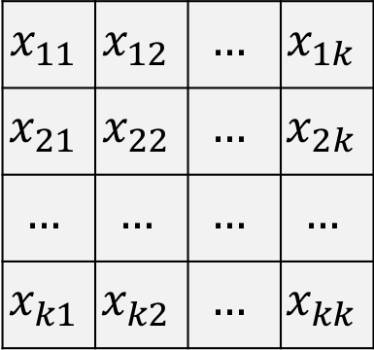

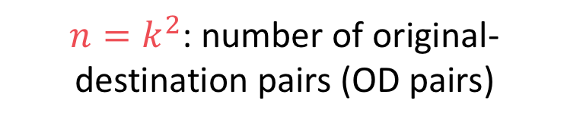
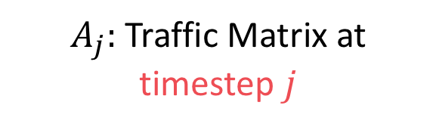



Problem description
$$x_{j−2}^{1}$$ | $$x_{j−2}^{2}$$ | $$…$$ | $$x_{j−2}^{n−1}$$ | $$x_{j−2}^{n}$$
$$x_{11}$$ | $$x_{12}$$ | $$…$$ | $$x_{1k}$$
$$x_{21}$$ | $$x_{22}$$ | $$…$$ | $$x_{2k}$$
$$…$$ | $$…$$ | $$…$$ | $$…$$
$$x_{k1}$$ | $$x_{k2}$$ | $$…$$ | $$x_{kk}$$
$$x_{j−1}^{1}$$ | $$x_{j−1}^{2}$$ | $$…$$ | $$x_{j−1}^{n−1}$$ | $$x_{j−1}^{n}$$
Flattening
$$x_{j}^{1}$$ | $$x_{j}^{2}$$ | $$…$$ | $$x_{j}^{n−1}$$ | $$x_{j}^{n}$$
$$x_{j+1}^{1}$$ | $$x_{j+1}^{2}$$ | $$…$$ | $$x_{j+1}^{n−1}$$ | $$x_{j+1}^{n}$$
$A_{j}:$Traffic Matrix at timestep $j$
Traffic Vector
$n=k^{2}$: number of original-destination pairs (OD pairs)
$k$: number of nodes
Notes:
Suppose that the k-by-k matrix here is the traffic matrix at timestep j, where k is the number of nodes in the network. After flattening this matrix, we got the vector of n dimension and if we stack all the vector of other timesteps, (like this) we will get the traffic matrix over timestep, each column is the traffic load of an origin-destination pair.

Slide 13




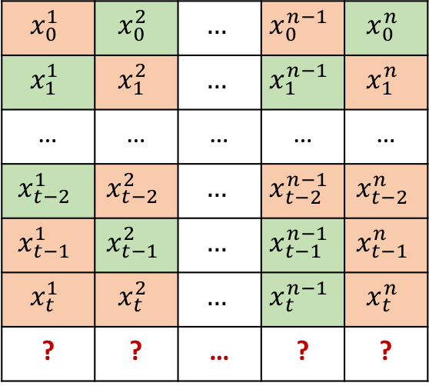










Problem description
Origin-Destination flows
$$0$$
$$x_{0}^{1}$$ | $$x_{0}^{2}$$ | $$…$$ | $$x_{0}^{n−1}$$ | $$x_{0}^{n}$$
$$x_{1}^{1}$$ | $$x_{1}^{2}$$ | $$…$$ | $$x_{1}^{n−1}$$ | $$x_{1}^{n}$$
… | … | … | … | …
$$x_{t−2}^{1}$$ | $$x_{t−2}^{2}$$ | $$…$$ | $$x_{t−2}^{n−1}$$ | $$x_{t−2}^{n}$$
$$x_{t−1}^{1}$$ | $$x_{t−1}^{2}$$ | $$…$$ | $$x_{t−1}^{n−1}$$ | $$x_{t−1}^{n}$$
$$x_{t}^{1}$$ | $$x_{t}^{2}$$ | $$…$$ | $$x_{t}^{n−1}$$ | $$x_{t}^{n}$$
? | ? | … | ? | ?
Timestep
$$1$$
Prediction model
$$t−2$$
Time window
$$t−1$$
$$t$$
$$x_{t+1}^{1}$$
$$x_{t+1}^{n}$$
$$t+1$$
$$x_{t+1}^{1}$$
$$x_{t+1}^{2}$$
$$x_{t+1}^{n−1}$$
$$x_{t+1}^{n}$$
$$t+2$$
Traffic matrix over timesteps
 | Predicted data
 | Measured data
Notes:
As I mention above, we only can measure a part of traffic at each timestep, so that, in this traffic matrix, suppose that the green element is the one we obtain by measuring and the red is the one we got after using prediction algorithm. To predict the future traffic load for each flow, we first define a time frame consist of several historical traffic data. And then, we predict the future traffic using these historical data.
We repeat the same process for other flows. After that, we slide the time frame to predict the next timestep.
We can see that, the input sequence contains both the correct data (the green elements) and the incorrect data which is the results of the previous predictions.
Therefore, we define a new problem in traffic prediction called semi-recursive traffic prediction.

Slide 14
Semi-recursive traffic prediction
Predicting the future traffic volume when both correct data and previous predicted data are used as input.
Notes:
Therefore, in our case, we defined the semi-recursive traffic prediction when the input sequence consists of both correct and incorrect data.
In the formula, l is the length of the time frame or the number of historical data. The traffic load of flow I at timestep j equal either the measured traffic o(ij) or the predicted value depend on the measurement policy m(ij).

Slide 15
















Time Series Prediction strategies
Direct prediction
Recursive prediction
$$y_{t}=f(x_{t−1, } x_{t−2}, …, x_{t−m })$$
$$y_{t}=f(x_{t−1, } x_{t−2}, …, x_{t−m })$$
$$y_{t+1}=f(x_{t, } x_{t−1}, …, x_{t−m+1 })$$
$$y_{t+1}=f(y_{t, } x_{t−1}, …, x_{t−m+1 })$$
$$x_{t−m}$$ | … | $$x_{t−2}$$ | $$x_{t−1}$$
$$y_{t}$$
$$x_{t−m}$$ | … | $$x_{t−2}$$ | $$x_{t−1}$$
$$y_{t}$$
$$x_{t−m+1}$$ | … | $$x_{t−1}$$ | $$x_{t}$$
$$y_{t+1}$$
$$x_{t−m+1}$$ | … | $$x_{t−1}$$ | $$y_{t}$$
$$y_{t+1}$$
$$…$$ | $$x_{t−1}$$ | $$x_{t}$$ | $$x_{t+1}$$
$$y_{t+2}$$
$$…$$ | $$x_{t−1}$$ | $$y_{t}$$ | $$y_{t+1}$$
$$y_{t+2}$$
Correct Data
Previous Predicted Data
Notes:
First we will take a look about the different between two time series prediction strategies. Direct prediction and recursive prediction.
In direct prediction, we predict the future value based on the precise input while in recursive prediction, the predicted value continuously become the input for the next prediction round.
The big difference here is with the correct input, direct prediction can achieve high accuracy than the recursive prediction.

Slide 16
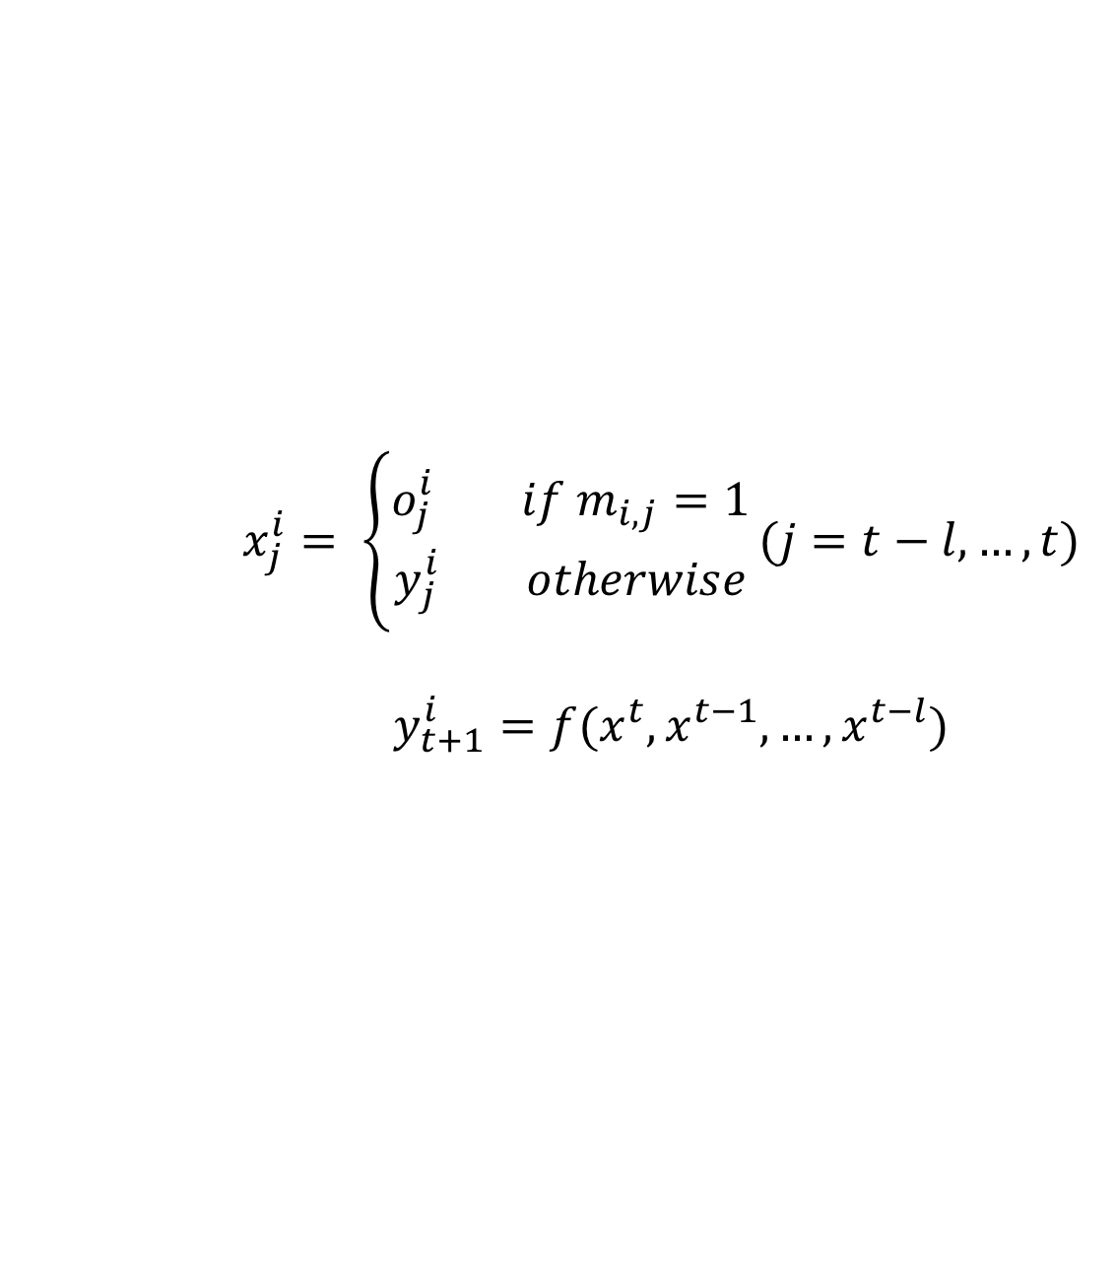
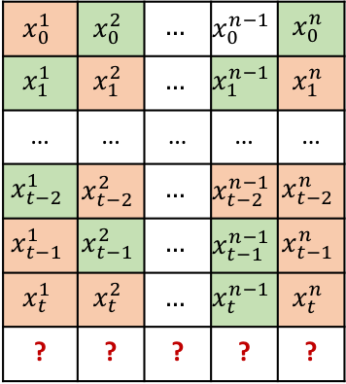
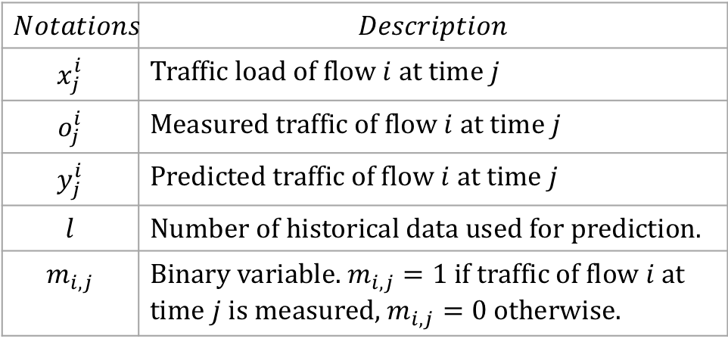
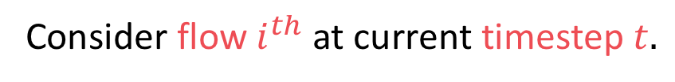
Semi-recursive prediction
Consider flow $i^{th}$ at current timestep $t.$
Origin-Destination flows
$x_{j}^{i}= \left\{\begin{aligned}o_{j}^{i} if m_{i,j}=1 \\ y_{j}^{i} otherwise\end{aligned}\right.(j=t−l,…,t)$
$$y_{t+1}^{i}=f(x^{t}, x^{t−1}, …, x^{t−l})$$
$$x_{0}^{1}$$ | $$x_{0}^{2}$$ | $$…$$ | $$x_{0}^{n−1}$$ | $$x_{0}^{n}$$
$$x_{1}^{1}$$ | $$x_{1}^{2}$$ | $$…$$ | $$x_{1}^{n−1}$$ | $$x_{1}^{n}$$
… | … | … | … | …
$$x_{t−2}^{1}$$ | $$x_{t−2}^{2}$$ | $$…$$ | $$x_{t−2}^{n−1}$$ | $$x_{t−2}^{n}$$
$$x_{t−1}^{1}$$ | $$x_{t−1}^{2}$$ | $$…$$ | $$x_{t−1}^{n−1}$$ | $$x_{t−1}^{n}$$
$$x_{t}^{1}$$ | $$x_{t}^{2}$$ | $$…$$ | $$x_{t}^{n−1}$$ | $$x_{t}^{n}$$
? | ? | ? | ? | ?
$$Notations$$ | $$Description$$
$$x_{j}^{i}$$ | Traffic load of flow $i$ at time $j$
$$o_{j}^{i}$$ | Measured traffic of flow $i$ at time $j$
$$y_{j}^{i}$$ | Predicted traffic of flow $i$ at time $j$
$$l$$ | Number of historical data used for prediction.
$$m_{i,j}$$ | Binary variable. $m_{i,j}=1$ if traffic of flow $i$ at time $j$ is measured, $m_{i,j}=0$ otherwise.
 | Predicted data
 | Measured data
Notes:
Therefore, in our case, we defined the semi-recursive traffic prediction when the input sequence consists of both correct and incorrect data.
In the formula, l is the length of the time frame or the number of historical data. The traffic load of flow I at timestep j equal either the measured traffic o(ij) or the predicted value depend on the measurement policy m(ij).

Slide 17
Challenges and Goals
Accumulative error.
Direct Prediction
Semi-recursive Prediction
Alleviating the accumulative error.
Correcting the imprecise input data.
Notes:
To solve the semi-recursive prediction problem, we face two main challenges. The first one is the accumulative error in the prediction results.
We conduced an experiment which can show the challenge of the semi-recursive prediction. The direct prediction show the good performance in capture the trend and predicting.
The blue stars indicate the measured points.
We can see that, between the consecutive measurement traffic, the error of the prediction result become larger over time since the error will be accumulated.

Slide 18
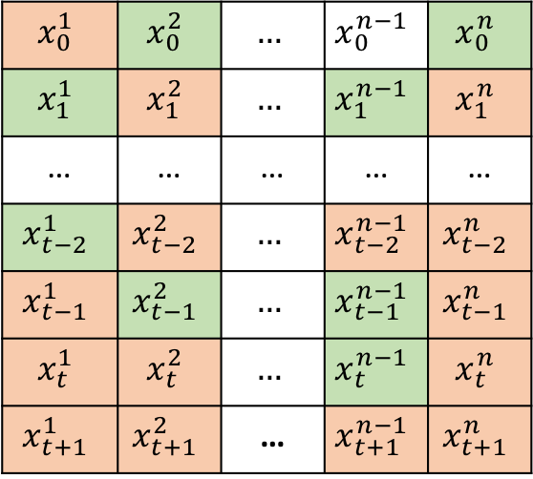




Challenges and Goals
 | Predicted data
 | Measured data
Determining the monitored flow set.
$$0$$
$$x_{0}^{1}$$ | $$x_{0}^{2}$$ | $$…$$ | $$x_{0}^{n−1}$$ | $$x_{0}^{n}$$
$$x_{1}^{1}$$ | $$x_{1}^{2}$$ | $$…$$ | $$x_{1}^{n−1}$$ | $$x_{1}^{n}$$
… | … | … | … | …
$$x_{t−2}^{1}$$ | $$x_{t−2}^{2}$$ | $$…$$ | $$x_{t−2}^{n−1}$$ | $$x_{t−2}^{n}$$
$$x_{t−1}^{1}$$ | $$x_{t−1}^{2}$$ | $$…$$ | $$x_{t−1}^{n−1}$$ | $$x_{t−1}^{n}$$
$$x_{t}^{1}$$ | $$x_{t}^{2}$$ | $$…$$ | $$x_{t}^{n−1}$$ | $$x_{t}^{n}$$
$$x_{t+1}^{1}$$ | $$x_{t+1}^{2}$$ | … | $$x_{t+1}^{n−1}$$ | $$x_{t+1}^{n}$$
$$1$$
$$t−2$$
$$t−1$$
$$t$$
$$t+1$$
Designing a scheme for selecting which flows will be monitored in the next timestep.
Notes:
After predicting the traffic of all the flow in the network, we need to select which flows we will monitored for obtained the correct data.
Because what we want is to reduce the traffic monitoring overhead, therefore we want to measure a small number of flows at each timestep.
So that, we need a scheme for selecting the monitored flows.

Slide 19
AGENDA
Introduction
Related works
Problem description
Proposed approach
Evaluation
Conclusion and future work

Slide 20

Recurrent Neural Network (RNN) and Long Short-Term Memory (LSTM)
Source: machinelearning-blog.com
Notes:
First for the prediction model, we use the RNN-LSTM for predicting the future traffic network. RNN is a well known model in processing the time series data and has been applied in many application domain such as NLP.
We also use the LSTM unit instead of the standard RNN unit in order to well capture the LRD in the traffic network. The figure shows the basic model of RNN. X0 to xt is the input sequence and the output of each step is fed back to the model and become the input for the next step.

Slide 21
















Traffic prediction using Recurrent Neural Network
$$x_{i}^{t−l}$$
…
$$x_{i}^{t−2}$$
$$x_{i}^{t−1}$$
$$x_{i}^{t}$$
$$y_{i}^{t+1}$$
$$l$$
$$y_{i}^{t−l+1}$$
…
$$y_{i}^{t}$$
$$y_{i}^{t+1}$$
LSTM
…
LSTM
LSTM
…
$$x_{i}^{t−l}$$
$$x_{i}^{t−1}$$
$$x_{i}^{t}$$
 | Previous Predicted data.
 | Measured data.
LSTM | LSTM unit.
 | Predicted future traffic volume.
 | Intermediate output.
$$x_{i}^{t−1}$$
$$y_{i}^{t+1}$$
$$x_{i}^{t}$$
$$y_{i}^{t}$$
Notes:
Suppose that we use l historical traffic data as input. The RNN will take the input step by step as following: …
In the end, we get the predicted traffic at time t+1.
Normally, when using RNN for the regression problem, people do not care about the intermediate output.
However, in our case, these output play an important roles in correcting the imprecise input.
I will go to the detail of how we can leverage the intermediate output for correcting the input data in the next few slides.

Slide 22














Forward and backward networks
$$x_{i}^{t−l}$$
…
$$x_{i}^{t−2}$$
$$x_{i}^{t−1}$$
$$x_{i}^{t}$$
$$y_{i}^{t+1}$$
$$y_{i}^{t−l−1}$$
…
$$y_{i}^{t−2}$$
$$y_{i}^{t−1}$$
$$y_{i}^{t−l+1}$$
…
$$y_{i}^{t}$$
$$y_{i}^{t+1}$$
LSTM
…
LSTM
LSTM
LSTM
…
LSTM
LSTM
$$x_{i}^{t−l}$$
$$1$$
…
$$x_{i}^{t−1}$$
$$0$$
$$x_{i}^{t}$$
$$1$$
Notes:
The intuition of our approach is we observe that if in the input sequence contains mode correct data, we will get better prediction results.
Therefore, the main idea of our approach is to leverage the correct data in the input sequence.
Motivated by the bidirectional recurrent neural network, we add an extra network to the model. This network is also fed by the same input but in the reverse order.

Slide 23


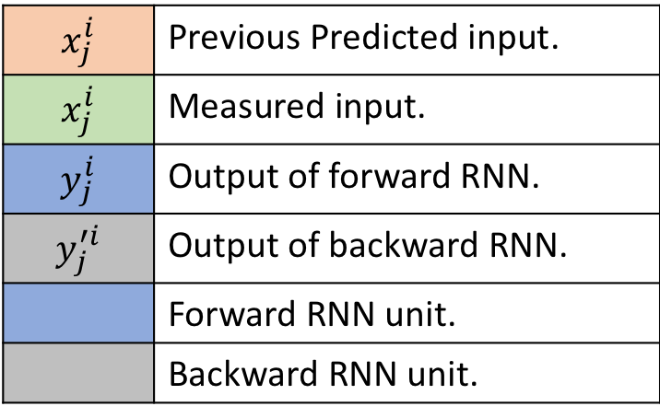














Correcting RNN input
$$x_{j}^{i}$$ | Previous Predicted input.
$$x_{j}^{i}$$ | Measured input.
$$y_{j}^{i}$$ | Output of forward RNN.
$$y_{j}^{′i}$$ | Output of backward RNN.
 | Forward RNN unit.
 | Backward RNN unit.
$$y_{3}^{i}$$
$$y_{3}^{′i}$$
$$x_{1}^{i}$$
$$1$$
$$x_{2}^{i}$$
$$0$$
$$x_{3}^{i}$$
$$0$$
$$x_{4}^{i}$$
$$0$$
$$x_{5}^{i}$$
$$0$$
$$x_{6}^{i}$$
$$1$$
$$x_{7 }^{i}$$
$$1$$
$$x_{8}^{i}$$
$$0$$
Notes:
This is the example of how we correct the input data. Consider the input x_3 which is the imprecise data. The y_3 is the output of forward network and the y’_3 is the output of backward network.
It is clearly that we get y’_3 based on the information of x_4 to x_8 which contains 3 correct data while the input for y_3 contains only 1 correct data. Therefore, we can use y_3 and y’_3 for update the x_3.

Slide 24
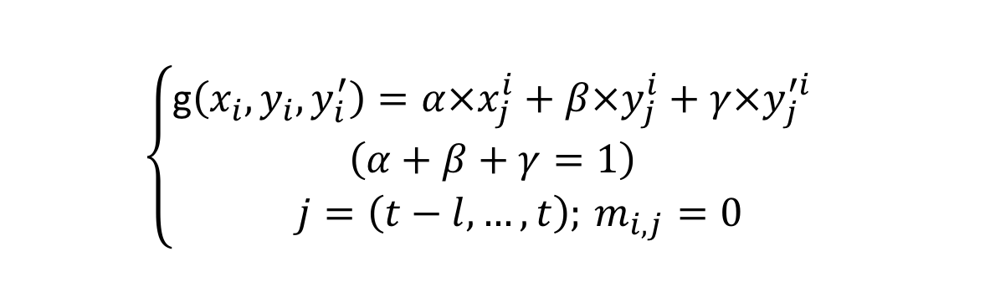





Confidence factors
$$y_{j}^{i}$$
$$y_{j}^{′i}$$
g$(.)$
$$x_{j}^{i}$$
$$x_{j}^{i}$$
$$\left\{\begin{aligned}\begin{aligned}\text{g}\left(x_{i}, y_{i}, y_{i}^{′}\right)=α×x_{j}^{i}+β×y_{j}^{i}+γ×y_{j}^{′i} \\ \left(α+β+γ=1\right)\end{aligned} \\ j=\left(t−l, …,t\right);{ m}_{i,j} =0\end{aligned}\right.$$
Notes:
The updating bases on this formula where alpha, beta, and gamma are the confidence factor represent to how accurate the y_3, y’_3 and x_3 are.

Slide 25












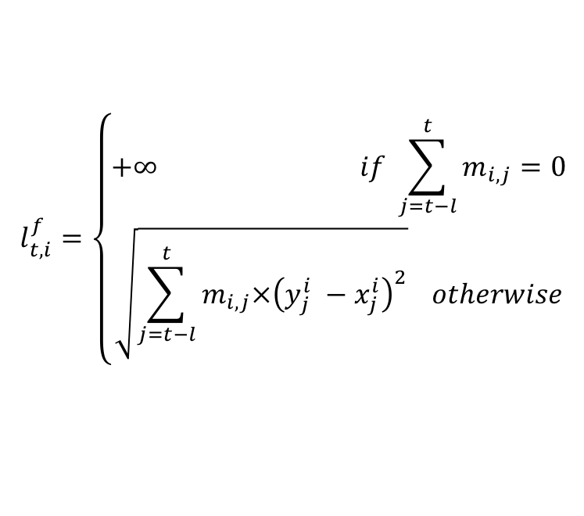









Forward loss and backward loss
$$y_{2}^{i}$$
$$y_{3}^{i}$$
$$y_{4}^{i}$$
$$y_{5}^{i}$$
$$y_{6}^{i}$$
$$y_{7}^{i}$$
$$y_{8}^{i}$$
$$y_{9}^{i}$$
$$x_{1}^{i}$$
$$1$$
$$x_{2}^{i}$$
$$0$$
$$x_{3}^{i}$$
$$0$$
$$x_{4}^{i}$$
$$1$$
$$x_{5}^{i}$$
$$0$$
$$x_{6}^{i}$$
$$1$$
$$x_{7}^{i}$$
$$1$$
$$x_{8}^{i}$$
$$0$$
$$l_{t,i}^{f}=\left\{\begin{aligned}+∞ if \sum_{j=t−l}^{t}{m_{i,j}=0} \\ \sqrt{\sum_{j=t−l}^{t}{m_{i,j}×{\left(y_{j}^{i} −x_{j}^{i}\right)}^{2}}} otherwise\end{aligned}\right.$$
Notes:
To explain how we choose the confidence factors, we first defined the forward and backward loss. The forward and backward loss determine how good the forward and backward network are in predicting traffic.
For example, the forward loss is calculated as follow.
We only consider the correct input and calculate the loss based on the formula here.

Slide 26




















Forward loss and backward loss
$$y_{0}^{′i}$$
$$y_{1}^{′i}$$
$$y_{2}^{′i}$$
$$y_{3}^{′i}$$
$$y_{4}^{′i}$$
$$y_{5}^{′i}$$
$$y_{6}^{′i}$$
$$y_{7}^{′i}$$
$$x_{1}^{i}$$
$$1$$
$$x_{2}^{i}$$
$$0$$
$$x_{3}^{i}$$
$$0$$
$$x_{4}^{i}$$
$$1$$
$$x_{5}^{i}$$
$$0$$
$$x_{6}^{i}$$
$$1$$
$$x_{7}^{i}$$
$$1$$
$$x_{8}^{i}$$
$$0$$
$$l_{t,i}^{b}=\left\{\begin{aligned}+∞ if \sum_{j=t−l}^{t}{m_{i,j}=0} \\ \sqrt{\sum_{j=t−l}^{t}{m_{i,j}×{\left(y_{i}^{′j} −x_{i}^{j}\right)}^{2}}} otherwise\end{aligned}\right.$$
Notes:
The backward loss can also be calculated as the same.

Slide 27


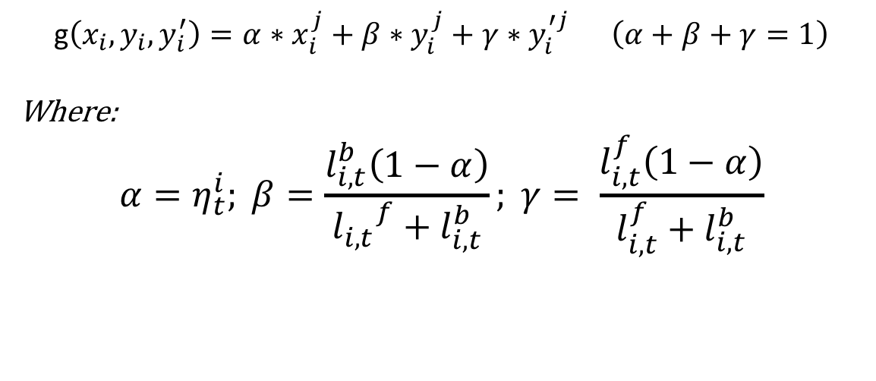





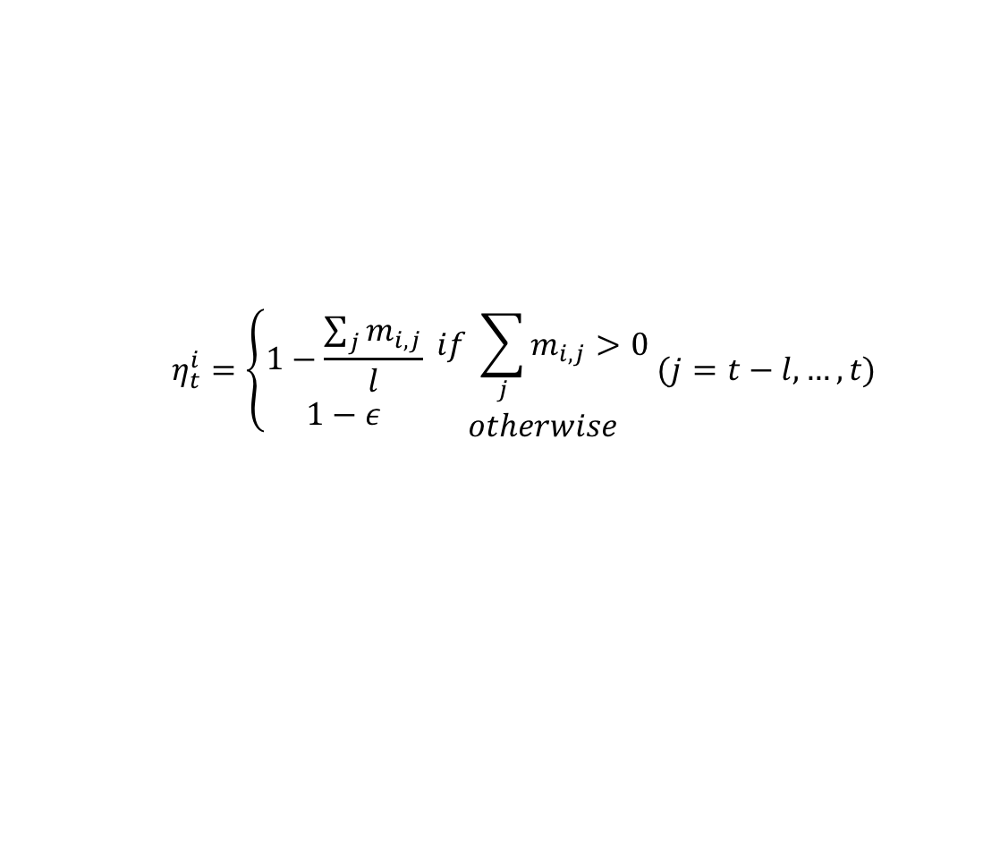


Correcting RNN input
$$\text{g}\left(x_{i}, y_{i}, y_{i}^{′}\right)=α∗x_{i}^{j}+β∗y_{i}^{j}+γ∗y_{i}^{′j} \left(α+β+γ=1\right)$$
Where:
$$α=η_{t}^{i}; β=\frac{l_{i,t}^{b}\left(1−α\right)}{{l_{i,t}}^{f}+l_{i,t}^{b}}; γ= \frac{l_{i,t}^{f}\left(1−α\right)}{l_{i,t}^{f}+l_{i,t}^{b}}$$
$$x_{i}^{t−l}$$
…
$$x_{i}^{t−2}$$
$$x_{i}^{t−1}$$
$$x_{i}^{t}$$
The predicted data ratio:
$$m_{i,j}$$
$$1$$
…
$$0$$
$$0$$
$$1$$
$$η_{t}^{i}=\left\{\begin{aligned}1−\frac{\sum_{j}{m_{i,j}}}{l} \\ 1−ε\end{aligned} \begin{aligned}if \sum_{j}{m_{i,j}}>0 \\ otherwise\end{aligned} (j=t−l,…,t)\right.$$
$$l$$
Notes:
we determine the confidence factors based on the forward loss and the backward loss while the confident of the current input (alpha) is the measurement rate of the input sequence.
So we have solve the problem of accumulative error by correcting the input data before feeding it in to the model.
Then in the next few slide, I present the scheme where we used to address the second challenge.

Slide 28
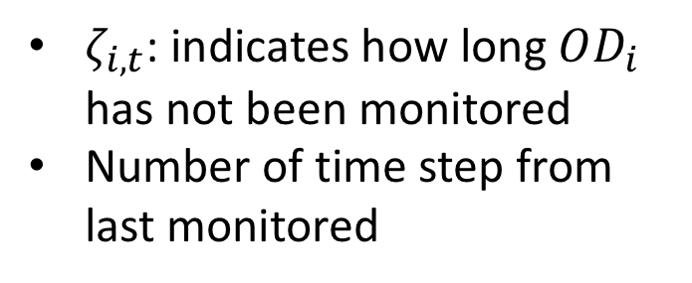
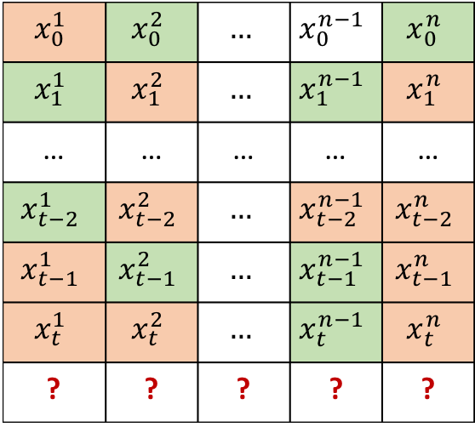
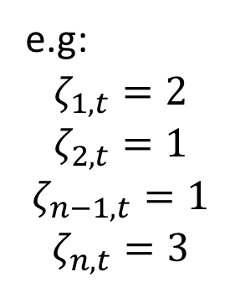
The Consecutive Missing Measurement
Original-Destination pairs
$$x_{0}^{1}$$ | $$x_{0}^{2}$$ | $$…$$ | $$x_{0}^{n−1}$$ | $$x_{0}^{n}$$
$$x_{1}^{1}$$ | $$x_{1}^{2}$$ | $$…$$ | $$x_{1}^{n−1}$$ | $$x_{1}^{n}$$
… | … | … | … | …
$$x_{t−2}^{1}$$ | $$x_{t−2}^{2}$$ | $$…$$ | $$x_{t−2}^{n−1}$$ | $$x_{t−2}^{n}$$
$$x_{t−1}^{1}$$ | $$x_{t−1}^{2}$$ | $$…$$ | $$x_{t−1}^{n−1}$$ | $$x_{t−1}^{n}$$
$$x_{t}^{1}$$ | $$x_{t}^{2}$$ | $$…$$ | $$x_{t}^{n−1}$$ | $$x_{t}^{n}$$
? | ? | ? | ? | ?
$ζ_{i,t}$: indicates how long $OD_{i}$ has not been monitored
Number of time step from last monitored
Time
e.g:
$$ζ_{1,t}=2$$
$$ζ_{2,t}=1$$
$$ζ_{n−1,t}=1$$
$$ζ_{n,t}=3$$
 | Predicted data
 | Measured data
Notes:
The second challenge is how we determine which flows need to be measured in the next timestep.
We know that if we let a flow starvation, the error will accumulated. Therefore, we defined a new loss called consecutive loss in which indicates how long a flow has not been monitored. It is the timesteps from when the flow was last monitored still the current timestep t.
Example….

Slide 29
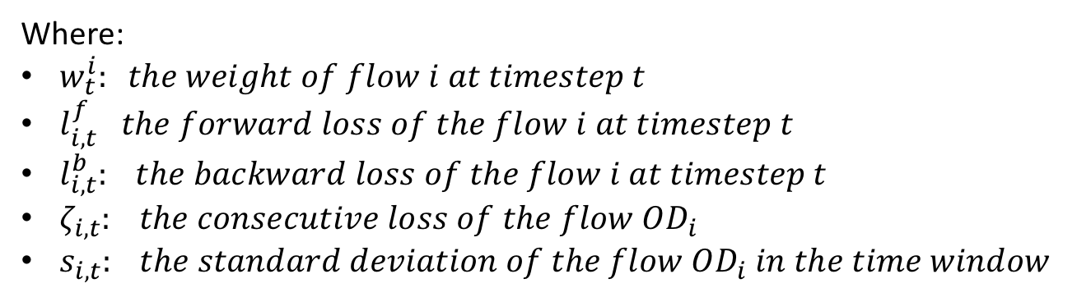
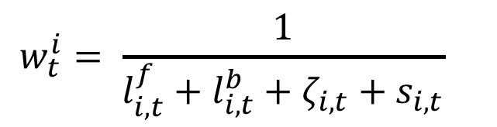
Determining monitored flows
Calculate “weight” after each timestep.
Select the flows which have lower weight.
$$w_{t}^{i}= \frac{1}{l_{i,t}^{f}+l_{i,t}^{b}+ζ_{i,t}+s_{i,t}}$$
Where:
$w_{t}^{i}: the weight of flow i at timestep t$
$l_{i,t}^{f} the forward loss of the flow i at timestep t$
$l_{i,t}^{b}: the backward loss of the flow i at timestep t$
$ζ_{i,t}: the consecutive loss of the flow OD_{i}$
$s_{i,t}: the standard deviation of the flow OD_{i} in the time window$
Notes:
Then for each flow, we defined a weight wit which indicates the priority of flows in being chosen to be monitored. The flow is designed to be inversely proportional with the Consecutive Missing Measurement, forward backward loss and the standard deviation of this flow in the time frame.
After that, the flows with lower weights will be chosen.

Slide 30
AGENDA
Introduction
Related works
Problem description
Proposed approach
Evaluation
Conclusion and future work

Slide 31
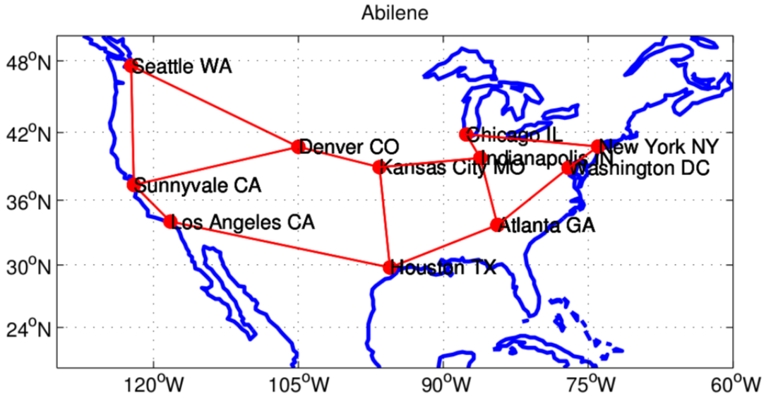
Abilene dataset
Measurement period: from 2004-03-01 to 2004-09-10
168 days
Measurement interval: 5 minutes
288 timestamps per day
Number of nodes: 12
Number of OD flows: 144
Number of traffic data: 288*168*144 = 6967296
Training-Testing-Validation ratio: 60% - 20% - 20%.
Notes:
In our experiment, we use the Abilene dataset which contains the real traffic matrix. There are total 144 flows in the network and they were measured in 168 days.

Slide 32
Experiment setup
Hardware
CPU | Intel(R) Core(TM) i7-6800K CPU@3.40GGHz
GPU | GeForce GTX 1080Ti
RAM | 32G
RNN – Configuration
Hidden units | 100
Layers | 1
Input dimension | 26
Dropout | 0.2
Training Epoch | 100
Notes:
Here is our experiment setup.

Slide 33
Scenarios
Experiment 1:
Flow Monitoring rate: 30%.
Experiment 2:
Flow Monitoring rate: 30%
Consecutive loss. All data of 4 hours (from 10a.m everyday) are loss.
Notes:
Here is our experiment setup.

Slide 34
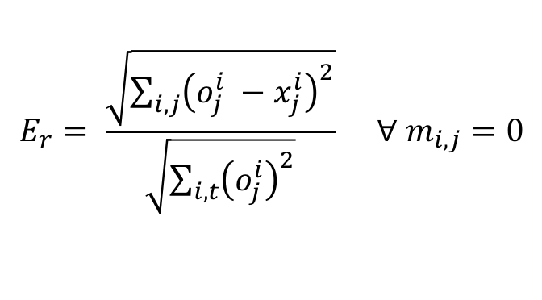


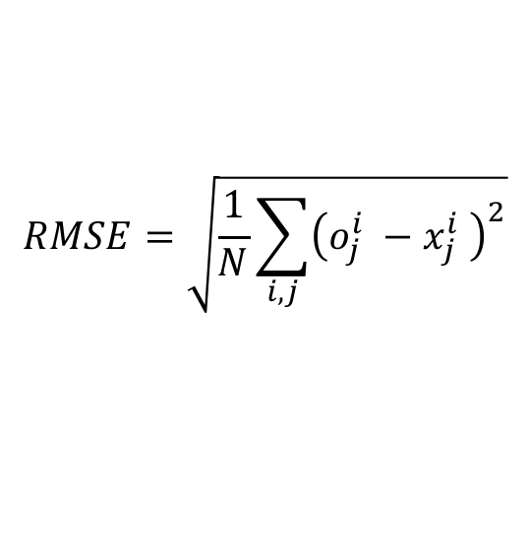
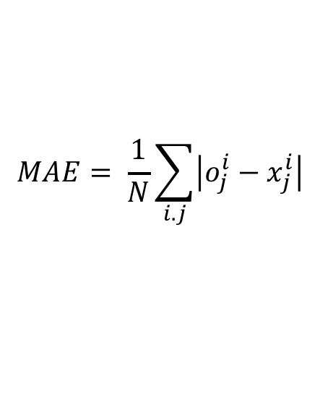
Metrics
$$E_{r}= \frac{\sqrt{\sum_{i,j}{{\left(o_{j}^{i} −x_{j}^{i}\right)}^{2}}}}{\sqrt{\sum_{i,t}{{\left(o_{j}^{i}\right)}^{2}}}} ∀ m_{i,j}=0$$
Error ratio
Mean absolute errors
Root mean squared errors
$$MAE= \frac{1}{N}\sum_{i.j}{\left|o_{j}^{i}−x_{j}^{i}\right|}$$
$$RMSE=\sqrt{\frac{1}{N}\sum_{i,j}{{\left(o_{j}^{i} −x_{j}^{i} \right)}^{2}}}$$
$$j=0,…,N$$
$(N$ is the size of the testing set)
Notes:
To evaluate the performance, we use 3 metrics.
First is the error ratio,
MAE is the average absolute errors
RMSE: presents sample standard deviation of the differences between
We conducted two experiments. In the first one, at each timestep, we measure 30% flows of the network flows. In the second one, we let consecutive measurements over 4 hours all loss from 10 am in everyday and then calculate the errors of each model.

Slide 35
Flow prediction result
TRAFFIC PREDICTION OF A RANDOM FLOW
Notes:
The results of the first experiment are plotted in Fig. 6 and 7. Fig.6 compares the traffic volume predicted by our algorithm and the actual values of a flow chosen randomly. As shown, our algorithm can capture the traffic trend smoothly. Specifically, the largest gap between the predicted values and the actual value is .... Recalling the results shown in Figure 2a, it can be seen that our input data correction algorithm has improved the performance significantly.

Slide 36
Performance comparison
32.7%
48.3%
62.9%
ARIMA: Autoregressive Integrated Moving Average
Notes:
Figure shows the performance comparison among ARIMA, standard RNN and our proposed approach in terms of 𝐸𝑟𝑟𝑜𝑟 𝑅𝑎𝑡𝑖𝑜 , 𝑀𝐴𝐸 and 𝑅𝑀𝑆𝐸 . We can see that our approach outperforms ARIMA and the standard RNN model in terms of all the metrics. Specifically, the proposed approach results in the 𝐸𝑟𝑟𝑜𝑟 𝑅𝑎𝑡𝑖𝑜 that is less than 48.3% that of the standard RNN. The MAE and 𝑅𝑀𝑆𝐸 of the proposed approach are less than 24.2% and 62.9% that of the standard RNN, respectively. Furthermore, comparing with the ARIMA, our approach achieves the 𝐸𝑟𝑟𝑜𝑟𝑅𝑎𝑡𝑖𝑜, 𝑀𝐴𝐸 and 𝑅𝑀𝑆𝐸 that are less than 59.5%, 90,9% and 71.5% of ARIMA.

Slide 37
Traffic prediction under consecutive loss
Data of 4 hours (from 10a.m every day) are all loss
Notes:
The results of the second experiment are presented in Fig.8. As shown, while ARIMA is affected significantly by the consecutive loss (i.e., increasing more than 105, 9 and 106 times in term of 𝐸𝑟𝑟𝑜𝑟 𝑅𝑎𝑡𝑖𝑜 , 𝑀𝐴𝐸 and 𝑅𝑀𝑆𝐸 , respectively, compared to the results of the first experiment), our proposed approach and standard RNN are not. Our proposed approach shows the superiority in dealing with the imprecise as the 𝐸𝑟𝑟𝑜𝑟𝑅𝑎𝑡𝑖𝑜 always remains under 0.5 (Fig.8).

Slide 38
Conclusion
Defining the semi-recursive traffic prediction problem.
Solving the semi-recursive traffic prediction problem by:
Applied BRNN for input data correction
Providing scheme for choosing monitored flow set.
Notes:
In this paper, we defined the semi-recursive traffic prediction problem where the future traffic is estimated under the lack of precise historical data. We proposed the novel deep learning model and techniques which leverage the forward and backward Recurrent Neural Network for input data correction and monitored flows determination after each timestep. We conducted preliminary experiments for evaluating our proposed approach. The results demonstrated that the proposed approach can achieve better performance compared with the well-known methods in time series analysis field.

Slide 39
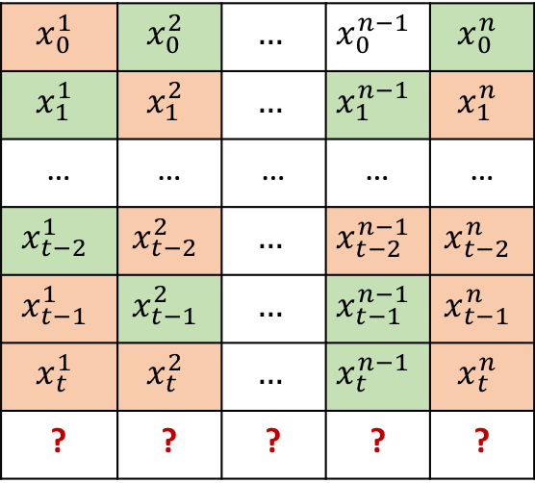
Future work
Design an efficient algorithm for correcting input data and selecting monitored flows.
Examine the relation between the flows in the traffic matrix
Extracting the temporal and spatial feature of the traffic matrices.
$$x_{0}^{1}$$ | $$x_{0}^{2}$$ | $$…$$ | $$x_{0}^{n−1}$$ | $$x_{0}^{n}$$
$$x_{1}^{1}$$ | $$x_{1}^{2}$$ | $$…$$ | $$x_{1}^{n−1}$$ | $$x_{1}^{n}$$
… | … | … | … | …
$$x_{t−2}^{1}$$ | $$x_{t−2}^{2}$$ | $$…$$ | $$x_{t−2}^{n−1}$$ | $$x_{t−2}^{n}$$
$$x_{t−1}^{1}$$ | $$x_{t−1}^{2}$$ | $$…$$ | $$x_{t−1}^{n−1}$$ | $$x_{t−1}^{n}$$
$$x_{t}^{1}$$ | $$x_{t}^{2}$$ | $$…$$ | $$x_{t}^{n−1}$$ | $$x_{t}^{n}$$
? | ? | ? | ? | ?
Notes:
Although our model is good at capturing the long-term dependencies temporal feature and predicting the future traffic even in high missing observation data, we have abandoned the relation between the 𝑂𝐷 flows in the network when treating the flows independently. In the future work, we will examine the relation between the flows in the traffic matrix and capture not only the temporal but also the spatial feature of the traffic matrix.

Slide 40
References
[1] "Recent Advances in Networking", Volume 1, ACM SIGCOMM eBook, August 2013
[2] Vardi, Yehuda. "Network tomography: Estimating source-destination traffic intensities from link data." Journal of the American statistical association 91.433 (1996): 365-377
[3] Zhang, Yin, et al. "Spatial-temporal compressive sensing and internet traffic matrices." ACM SIGCOMM Computer Communication Review. Vol. 39. No. 4. ACM, 2009.
[4] Malboubi, M., Wang, L., Chuah, C. N., & Sharma, P. (2014). Intelligent SDN based traffic (de)Aggregation and Measurement Paradigm (iSTAMP). Proceedings - IEEE INFOCOM, 934–942.
[5] Xie, K., Wang, L., Wang, X., Xie, G., Zhang, G., Xie, D., & Wen, J. (2015). Sequential and adaptive sampling for matrix completion in network monitoring systems. Computer Communications (INFOCOM), 2015 IEEE Conference on, 2443–2451.
[6] Xie, K., Wang, L., Wang, X., Xie, G., Wen, J., & Zhang, G. (2016). Accurate recovery of Internet traffic data: A tensor completion approach. Transaction on Networking, 2016–July, 1–14.
[7] Nie, L., Jiang, D., Guo, L., & Yu, S. (2016). Traffic matrix prediction and estimation based on deep learning in large-scale IP backbone networks. Journal of Network and Computer Applications, 76(October), 16–22.
[8] Xie, Kun, et al. "Accurate recovery of Internet traffic data under dynamic measurements." INFOCOM 2017-IEEE Conference on Computer Communications, IEEE. IEEE, 2017.
[9] Cao, X., Zhong, Y., Zhou, Y., Wang, J., Zhu, C., & Zhang, W. (2017). Interactive temporal recurrent convolution network for traffic prediction in data centers. IEEE Access, 6, 5276–5289.
[10] Wang, J., Tang, J., Xu, Z., Wang, Y., Xue, G., Zhang, X., & Yang, D. (2017). Spatiotemporal modeling and prediction in cellular networks: A big data enabled deep learning approach. IEEE INFOCOM 2017 - IEEE Conference on Computer Communications, 1–9.
[11]

Slide 41
THANK YOU

