Slide 1


Traffic Matrix Prediction based on Bidirectional Recurrent Neural Network and Long Short-Term Memory
Van An Le † Phi Le Nguyen† Yusheng Ji†‡
† Department of Informatics, SOKENDAI (The Graduate University for Advanced Studies)
‡National Institute of Informatics, Tokyo, Japan

Slide 2
AGENDA
Introduction
Related works
Problem description and goal
Proposed approach
Evaluation
Conclusion and future work

Slide 3
AGENDA
Introduction
Related works
Problem description and goal
Proposed approach
Evaluation
Conclusion and future work

Slide 4
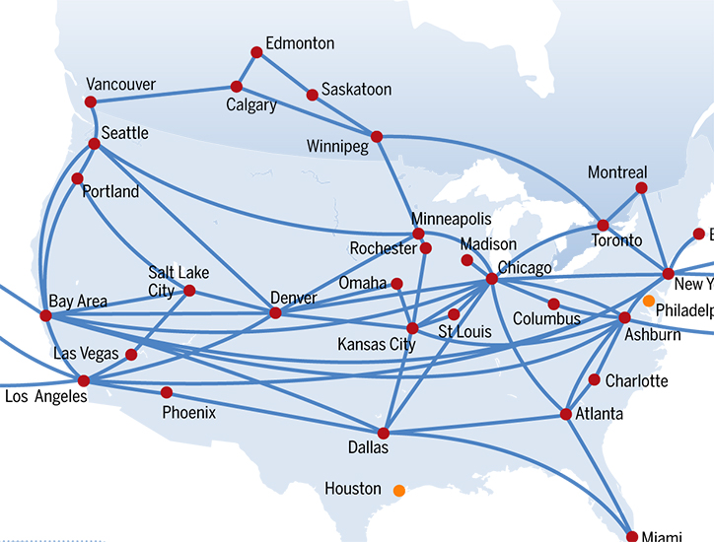
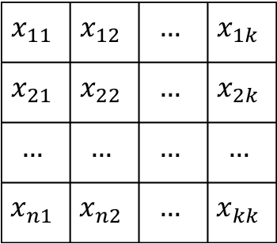




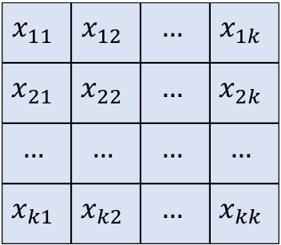
Introduction
TRAFFIC MATRIX: an abstract representation of the traffic volume flowing between set of origins and destinations pairs. [1]
$$x^{1}$$
$$x_{11}$$ | $$x_{12}$$ | $$…$$ | $$x_{1k}$$
$$x_{21}$$ | $$x_{22}$$ | $$…$$ | $$x_{2k}$$
$$…$$ | $$…$$ | $$…$$ | $$…$$
$$x_{n1}$$ | $$x_{n2}$$ | $$…$$ | $$x_{kk}$$
$$x^{t−1}$$
$$x_{11}$$ | $$x_{12}$$ | $$…$$ | $$x_{1k}$$
$$x_{21}$$ | $$x_{22}$$ | $$…$$ | $$x_{2k}$$
$$…$$ | $$…$$ | $$…$$ | $$…$$
$$x_{n1}$$ | $$x_{n2}$$ | $$…$$ | $$x_{kk}$$
$$x^{t}$$
$$x_{11}$$ | $$x_{12}$$ | $$…$$ | $$x_{1k}$$
$$x_{21}$$ | $$x_{22}$$ | $$…$$ | $$x_{2k}$$
$$…$$ | $$…$$ | $$…$$ | $$…$$
$$x_{k1}$$ | $$x_{k2}$$ | $$…$$ | $$x_{kk}$$
Source: ubiquity.acm.org

Slide 5
Introduction
Traffic Matrix
Network Optimization
Anomaly Detection
Protocol Design
...
Traffic matrix plays an important roles in wide range of network management applications/tasks. [1]
Measuring all the traffic network is impractical due to the monitoring resources constraints.
QoS provisioning
Notes:
Không nên để cả câu dài, chỉ viết ý ngắn gọn
Câu thứ 2 để dạng V-ing, thì câu thứ 1 cũng phải để cùng dạng như vậy

Slide 6
Related works
 | Network tomography based approach
 | Traffic interpolation using Compressive Sensing and Matrix Completion
 | Traffic prediction using Deep Learning approach
Network tomography:
Estimating traffic from link data [2].
Infocom
SDN-based traffic aggregation and measurement paradigm [4].
1996
2009
2014
2015
Sigcomm:
Spatial-temporal Compressive sensing approach [3].
Infocom
Adaptive sampling for traffic completion [5].
Notes:
Trong bang tóm tắt góc phải: approach 1 và 3 có chữ approach ở cuối nhưng cái thứ 2 lại không có → nên thống nhất
Trong phần chú thích hình vẽ ở dưới: 4 cái sau đang để format: Tên hội nghị: nội dung bài báo. Nhưng cái thứ nhất thì lại không cùng format đấy.

Slide 7
Related works
 | Network tomography based approach
 | Traffic interpolation using Compressive Sensing and Matrix Completion
 | Traffic prediction using Deep Learning approach
Infocom
Traffic recovery under dynamic condition using tensor completion [8].
IEEE Access
Traffic prediction using recurrent convolutional network in Data center [9].
Infocom
Traffic interpolation using tensor completion [6].
2016
2017
Journals:
Traffic Matrix estimation based on deep learning and probabilistic model [7].
Infocom
Spatial temporal modelling and prediction in Cellular network using Deep Learning [10].

Slide 8
Related works
Network Tomography
Inferring traffic based on link count and routing information
Under-constrained problem (# of flows >> # of link monitored)
Traffic recovery and interpolation.
Recovering the missing traffic
For traffic analysis
Traffic prediction based Deep Learning approach
Cellular Network and Data center.
Backbone network?
Notes:
Tên của các approach đang không đồng nhất với tên ở trong slide 6
Traffic prediction based Deep Learning approach: based hay using ?
Mỗi ý nhỏ thứ nhất em định trình bày gì về các approach: techniques ? Ưu điểm ? Hay là gì ? Chị thấy ở 3 approach, mỗi cái trình bày một kiểu → em nên thống nhất format
Mỗi ý nhỏ thứ 2 của em là shortcoming của mỗi approach. Chị nghĩ là nên ghi rõ là cons: …. . Với cả format của các câu em đang không thống nhất. Ví dụ: ở cái approach thứ 2 em chỉ ghi “For traffic analysis”, ở approach thứ 3 em chỉ ghi “Backbone network? → nhìn những phrase này không hiểu rõ được ý em muốn nói gì ?

Slide 9

Problem description
Monitoring all flows in the network:
High computational cost
Traffic overhead
Impractical
Source: www.ayalpbilisim.com
Partial monitoring and PREDICTION
SDN [11] architecture opens new approaches in comprehensive network monitoring and management.

Slide 10
AGENDA
Introduction
Related works
Problem description
Proposed approach
Evaluation
Conclusion and future work
Notes:
- Trang agenda này phải xuất hiện trước page 9 chứ nhỉ, vì page 9 đã là problem description rồi

Slide 11



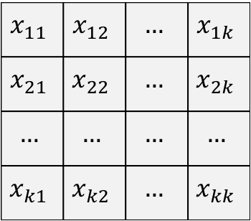



Problem description
$$x_{j−2}^{1}$$ | $$x_{j−2}^{2}$$ | $$…$$ | $$x_{j−2}^{n−1}$$ | $$x_{j−2}^{n}$$
$$x_{11}$$ | $$x_{12}$$ | $$…$$ | $$x_{1k}$$
$$x_{21}$$ | $$x_{22}$$ | $$…$$ | $$x_{2k}$$
$$…$$ | $$…$$ | $$…$$ | $$…$$
$$x_{k1}$$ | $$x_{k2}$$ | $$…$$ | $$x_{kk}$$
$$x_{j−1}^{1}$$ | $$x_{j−1}^{2}$$ | $$…$$ | $$x_{j−1}^{n−1}$$ | $$x_{j−1}^{n}$$
Flattening
$$x_{j}^{1}$$ | $$x_{j}^{2}$$ | $$…$$ | $$x_{j}^{n−1}$$ | $$x_{j}^{n}$$
$$x_{j+1}^{1}$$ | $$x_{j+1}^{2}$$ | $$…$$ | $$x_{j+1}^{n−1}$$ | $$x_{j+1}^{n}$$
$A_{j}:$Traffic Matrix at time $j$
Traffic Vector
$k$: number of nodes
$n=k^{2}$: number of original-destination pairs (OD pairs)

Slide 12

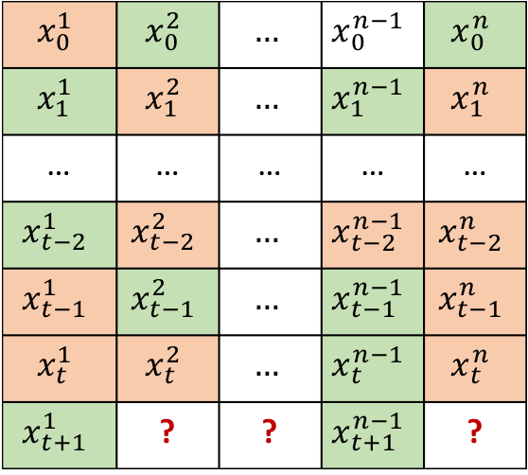
Problem description
Origin-Destination pairs flows
$$x_{0}^{1}$$ | $$x_{0}^{2}$$ | $$…$$ | $$x_{0}^{n−1}$$ | $$x_{0}^{n}$$
$$x_{1}^{1}$$ | $$x_{1}^{2}$$ | $$…$$ | $$x_{1}^{n−1}$$ | $$x_{1}^{n}$$
… | … | … | … | …
$$x_{t−2}^{1}$$ | $$x_{t−2}^{2}$$ | $$…$$ | $$x_{t−2}^{n−1}$$ | $$x_{t−2}^{n}$$
$$x_{t−1}^{1}$$ | $$x_{t−1}^{2}$$ | $$…$$ | $$x_{t−1}^{n−1}$$ | $$x_{t−1}^{n}$$
$$x_{t}^{1}$$ | $$x_{t}^{2}$$ | $$…$$ | $$x_{t}^{n−1}$$ | $$x_{t}^{n}$$
$$x_{t+1}^{1}$$ | ? | ? | $$x_{t+1}^{n−1}$$ | ?
Timestep
Prediction model
Time frame
 | Predicted data
 | Measured data

Slide 13

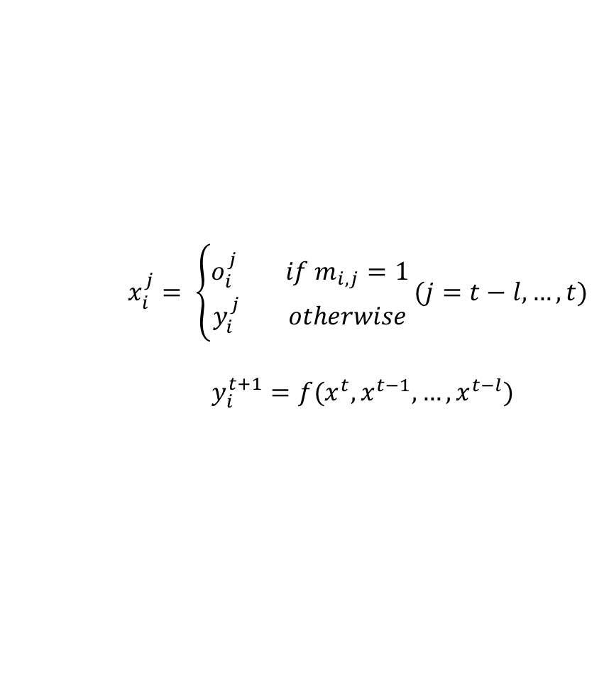
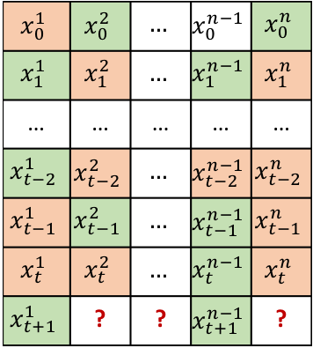
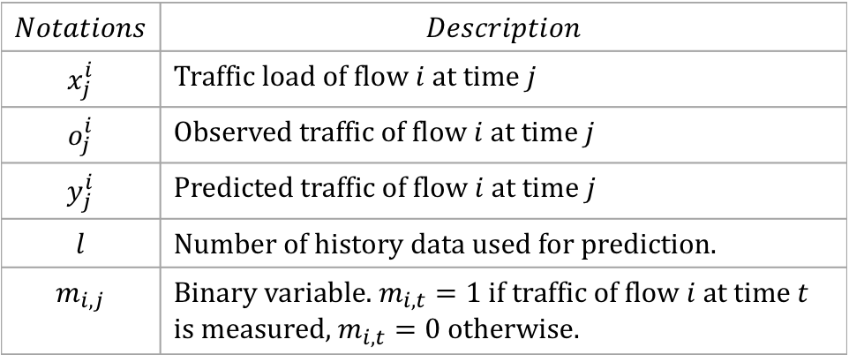
Semi-recursive prediction
Consider current timestep $t.$
Origin-Destination flows
$$x_{0}^{1}$$ | $$x_{0}^{2}$$ | $$…$$ | $$x_{0}^{n−1}$$ | $$x_{0}^{n}$$
$$x_{1}^{1}$$ | $$x_{1}^{2}$$ | $$…$$ | $$x_{1}^{n−1}$$ | $$x_{1}^{n}$$
… | … | … | … | …
$$x_{t−2}^{1}$$ | $$x_{t−2}^{2}$$ | $$…$$ | $$x_{t−2}^{n−1}$$ | $$x_{t−2}^{n}$$
$$x_{t−1}^{1}$$ | $$x_{t−1}^{2}$$ | $$…$$ | $$x_{t−1}^{n−1}$$ | $$x_{t−1}^{n}$$
$$x_{t}^{1}$$ | $$x_{t}^{2}$$ | $$…$$ | $$x_{t}^{n−1}$$ | $$x_{t}^{n}$$
$$x_{t+1}^{1}$$ | ? | ? | $$x_{t+1}^{n−1}$$ | ?
$x_{i}^{j}= \left\{\begin{aligned}o_{i}^{j} if m_{i,j}=1 \\ y_{i}^{j} otherwise\end{aligned}\right.(j=t−l,…,t)$
$$y_{i}^{t+1}=f(x^{t}, x^{t−1}, …, x^{t−l})$$
$$Notations$$ | $$Description$$
$$x_{j}^{i}$$ | Traffic load of flow $i$ at time $j$
$$o_{j}^{i}$$ | Observed traffic of flow $i$ at time $j$
$$y_{j}^{i}$$ | Predicted traffic of flow $i$ at time $j$
$$l$$ | Number of history data used for prediction.
$$m_{i,j}$$ | Binary variable. $m_{i,t}=1$ if traffic of flow $i$ at time $t$ is measured, $m_{i,t}=0$ otherwise.
 | Predicted data
 | Measured data

Slide 14
Challenges and Goals
Accumulative error
Direct Prediction
Semi-recursive Prediction
Alleviating the accumulate errors
Correcting the imprecise input data

Slide 15
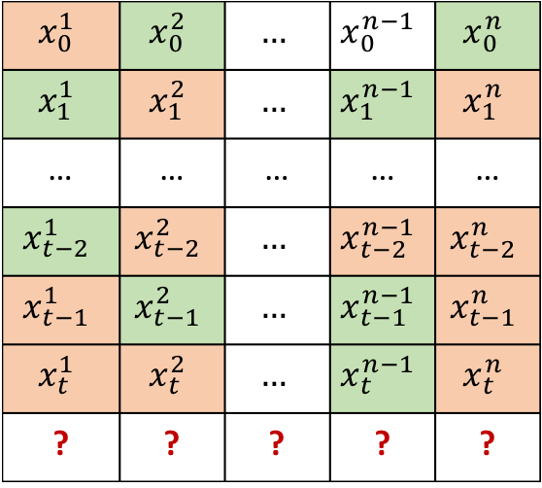
Challenges and Goals
Determining the monitored flow set
$$x_{0}^{1}$$ | $$x_{0}^{2}$$ | $$…$$ | $$x_{0}^{n−1}$$ | $$x_{0}^{n}$$
$$x_{1}^{1}$$ | $$x_{1}^{2}$$ | $$…$$ | $$x_{1}^{n−1}$$ | $$x_{1}^{n}$$
… | … | … | … | …
$$x_{t−2}^{1}$$ | $$x_{t−2}^{2}$$ | $$…$$ | $$x_{t−2}^{n−1}$$ | $$x_{t−2}^{n}$$
$$x_{t−1}^{1}$$ | $$x_{t−1}^{2}$$ | $$…$$ | $$x_{t−1}^{n−1}$$ | $$x_{t−1}^{n}$$
$$x_{t}^{1}$$ | $$x_{t}^{2}$$ | $$…$$ | $$x_{t}^{n−1}$$ | $$x_{t}^{n}$$
? | ? | ? | ? | ?
Designing a scheme for selecting which flow will be monitored in the next timestep.

Slide 16
AGENDA
Introduction
Related works
Problem description
Proposed approach
Evaluation
Conclusion and future work

Slide 17

Recurrent Neural Network and Long Short-Term Memory
Source: machinelearning-blog.com

Slide 18











Traffic prediction using Recurrent Neural Network
$$x_{i}^{t−l}$$
…
$$x_{i}^{t−2}$$
$$x_{i}^{t−1}$$
$$x_{i}^{t}$$
$$y_{i}^{t+1}$$
$$y_{i}^{t−l+1}$$
…
$$y_{i}^{t}$$
$$y_{i}^{t+1}$$
LSTM
…
LSTM
LSTM
…
$$x_{i}^{t−l}$$
$$x_{i}^{t−1}$$
$$x_{i}^{t}$$

Slide 19















Forward and backward networks
$$x_{i}^{t−l}$$
…
$$x_{i}^{t−2}$$
$$x_{i}^{t−1}$$
$$x_{i}^{t}$$
$$y_{i}^{t+1}$$
$$y_{i}^{t−l−1}$$
…
$$y_{i}^{t−2}$$
$$y_{i}^{t−1}$$
$$y_{i}^{t−l+1}$$
…
$$y_{i}^{t}$$
$$y_{i}^{t+1}$$
LSTM
…
LSTM
LSTM
LSTM
…
LSTM
LSTM
$$x_{i}^{t−l}$$
$$1$$
…
$$x_{i}^{t−1}$$
$$0$$
$$x_{i}^{t}$$
$$1$$

Slide 20

















Correcting RNN input
$$x_{j}^{i}$$ | Predicted input
$$x_{j}^{i}$$ | Measured input
$$y_{j}^{i}$$ | Output of forward RNN
$$y_{j}^{′i}$$ | Output of backward RNN
 | Forward RNN unit
 | Backward RNN unit
$$y_{3}^{i}$$
$$y_{3}^{′i}$$
$$x_{1}^{i}$$
$$1$$
$$x_{2}^{i}$$
$$0$$
$$x_{3}^{i}$$
$$0$$
$$x_{4}^{i}$$
$$0$$
$$x_{5}^{i}$$
$$0$$
$$x_{6}^{i}$$
$$1$$
$$x_{7 }^{i}$$
$$1$$
$$x_{8}^{i}$$
$$0$$

Slide 21

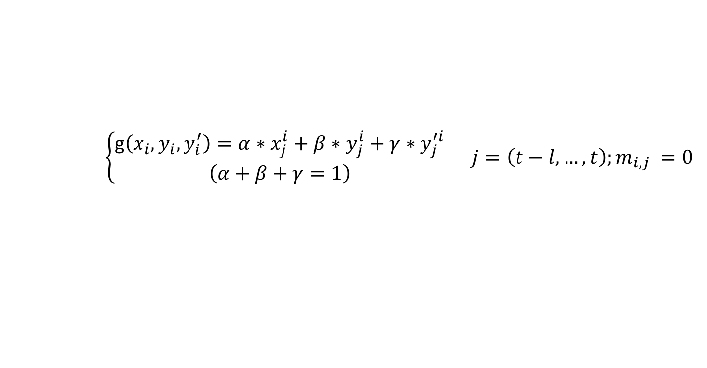




Confidence factors
$$y_{j}^{i}$$
$$y_{j}^{′i}$$
g$(.)$
$$x_{j}^{i}$$
$$x_{j}^{i}$$
$$\left\{\begin{aligned}\text{g}\left(x_{i}, y_{i}, y_{i}^{′}\right)=α∗x_{j}^{i}+β∗y_{j}^{i}+γ∗y_{j}^{′i} \\ \left(α+β+γ=1\right)\end{aligned} j=\left(t−l, …,t\right);m_{i,j} =0\right.$$

Slide 22















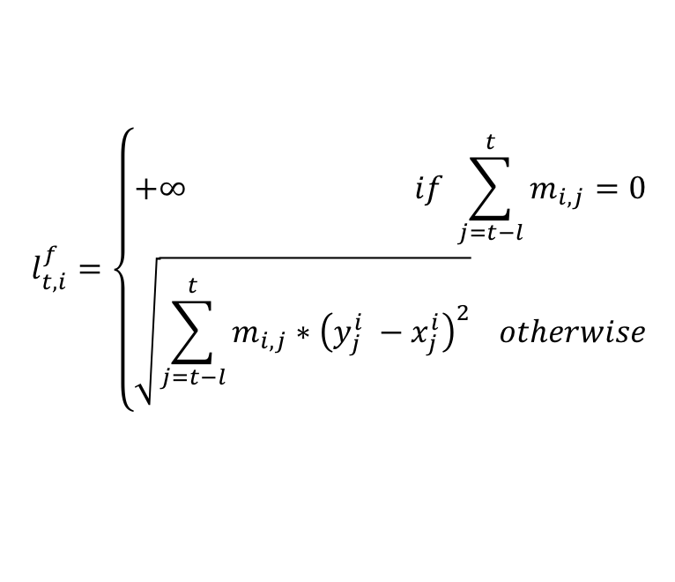






Forward loss and backward loss
$$y_{2}^{i}$$
$$y_{3}^{i}$$
$$y_{4}^{i}$$
$$y_{5}^{i}$$
$$y_{6}^{i}$$
$$y_{7}^{i}$$
$$y_{8}^{i}$$
$$y_{9}^{i}$$
$$x_{1}^{i}$$
$$1$$
$$x_{2}^{i}$$
$$0$$
$$x_{3}^{i}$$
$$0$$
$$x_{4}^{i}$$
$$1$$
$$x_{5}^{i}$$
$$0$$
$$x_{6}^{i}$$
$$1$$
$$x_{7}^{i}$$
$$1$$
$$x_{8}^{i}$$
$$0$$
$$l_{t,i}^{f}=\left\{\begin{aligned}+∞ if \sum_{j=t−l}^{t}{m_{i,j}=0} \\ \sqrt{\sum_{j=t−l}^{t}{m_{i,j}∗{\left(y_{j}^{i} −x_{j}^{i}\right)}^{2}}} otherwise\end{aligned}\right.$$

Slide 23




















Forward loss and backward loss
$$y_{0}^{′i}$$
$$y_{1}^{′i}$$
$$y_{2}^{′i}$$
$$y_{3}^{′i}$$
$$y_{4}^{′i}$$
$$y_{5}^{′i}$$
$$y_{6}^{′i}$$
$$y_{7}^{′i}$$
$$x_{1}^{i}$$
$$1$$
$$x_{2}^{i}$$
$$0$$
$$x_{3}^{i}$$
$$0$$
$$x_{4}^{i}$$
$$1$$
$$x_{5}^{i}$$
$$0$$
$$x_{6}^{i}$$
$$1$$
$$x_{7}^{i}$$
$$1$$
$$x_{8}^{i}$$
$$0$$
$$l_{t,i}^{b}=\left\{\begin{aligned}+∞ if \sum_{j=t−l}^{t}{m_{i}^{j}=0} \\ \sqrt{\sum_{j=t−l}^{t}{m_{i}^{j}{\left(y_{i}^{′j} −x_{i}^{j}\right)}^{2}}} otherwise\end{aligned}\right.$$

Slide 24
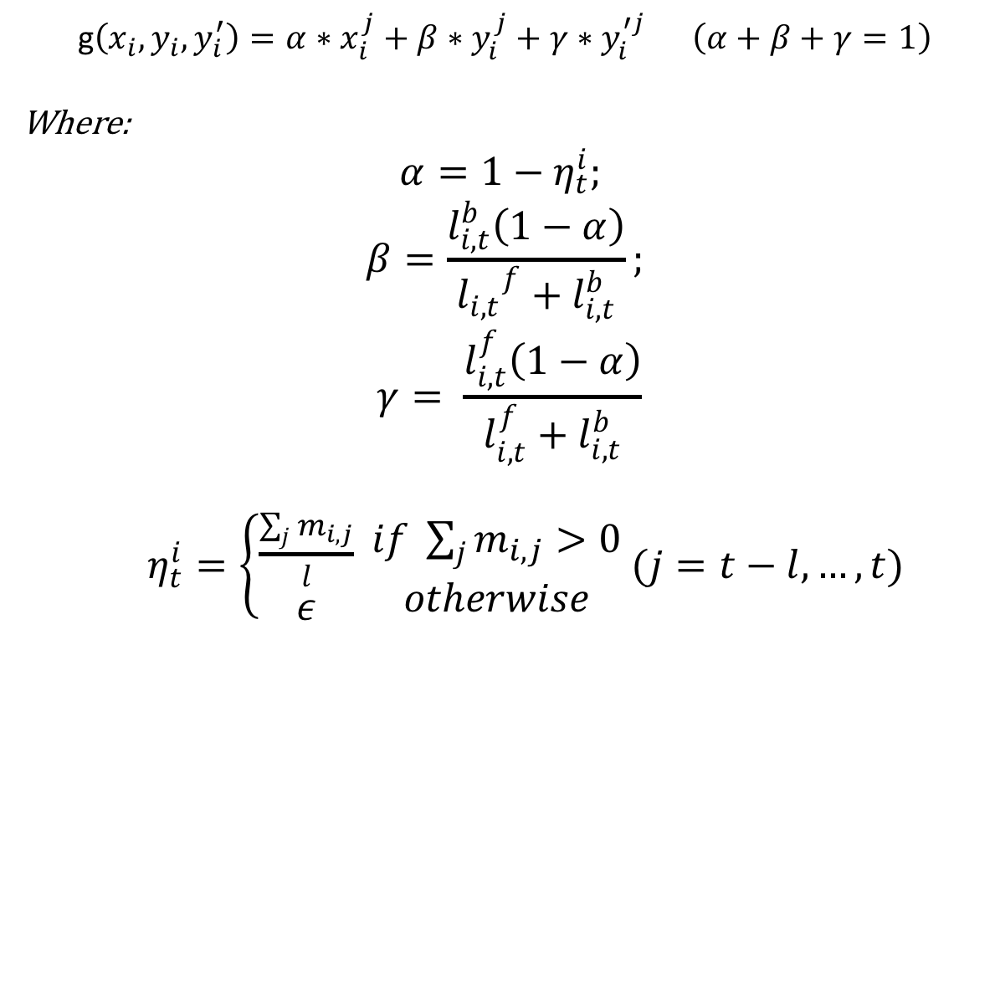
Correcting RNN input
$$\text{g}\left(x_{i}, y_{i}, y_{i}^{′}\right)=α∗x_{i}^{j}+β∗y_{i}^{j}+γ∗y_{i}^{′j} \left(α+β+γ=1\right)$$
Where:
$$α=1−η_{t}^{i};$$
$$β=\frac{l_{i,t}^{b}\left(1−α\right)}{{l_{i,t}}^{f}+l_{i,t}^{b}};$$
$$γ= \frac{l_{i,t}^{f}\left(1−α\right)}{l_{i,t}^{f}+l_{i,t}^{b}}$$
$η_{t}^{i}=\left\{\begin{aligned}\frac{\sum_{j}{m_{i,j}}}{l} \\ ε\end{aligned} \begin{aligned}if \sum_{j}{m_{i,j}}>0 \\ otherwise\end{aligned} (j=t−l,…,t)\right.$

Slide 25
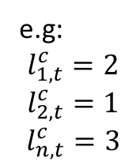
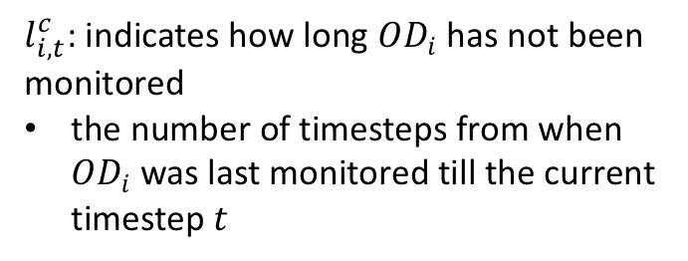
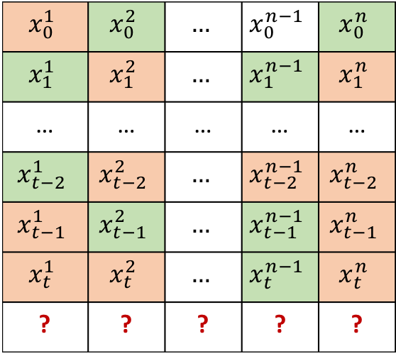
Consecutive loss
Original-Destination pairs
$$x_{0}^{1}$$ | $$x_{0}^{2}$$ | $$…$$ | $$x_{0}^{n−1}$$ | $$x_{0}^{n}$$
$$x_{1}^{1}$$ | $$x_{1}^{2}$$ | $$…$$ | $$x_{1}^{n−1}$$ | $$x_{1}^{n}$$
… | … | … | … | …
$$x_{t−2}^{1}$$ | $$x_{t−2}^{2}$$ | $$…$$ | $$x_{t−2}^{n−1}$$ | $$x_{t−2}^{n}$$
$$x_{t−1}^{1}$$ | $$x_{t−1}^{2}$$ | $$…$$ | $$x_{t−1}^{n−1}$$ | $$x_{t−1}^{n}$$
$$x_{t}^{1}$$ | $$x_{t}^{2}$$ | $$…$$ | $$x_{t}^{n−1}$$ | $$x_{t}^{n}$$
? | ? | ? | ? | ?
$l_{i,t}^{c}$: indicates how long $OD_{i}$ has not been monitored
the number of timesteps from when $OD_{i}$ was last monitored till the current timestep $t$
Time
e.g:
$$l_{1,t}^{c}=2$$
$$l_{2,t}^{c}=1$$
$$l_{n,t}^{c}=3$$
 | Predicted data
 | Measured data

Slide 26
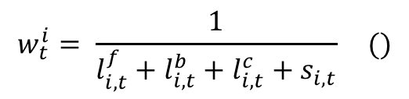
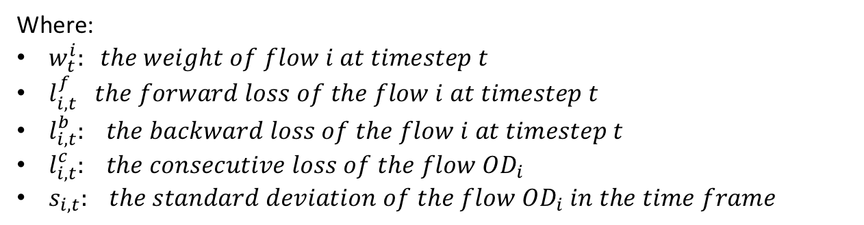
Determining monitored flows
For each $OD_{i}$, we calculate a “weight” $w_{i}$ following the equation () and then choosing the lowest $k$ flows to measure in the next time step.
$$w_{t}^{i}= \frac{1}{l_{i,t}^{f}+l_{i,t}^{b}+l_{i,t}^{c}+s_{i,t}} ()$$
Where:
$w_{t}^{i}: the weight of flow i at timestep t$
$l_{i,t}^{f} the forward loss of the flow i at timestep t$
$l_{i,t}^{b}: the backward loss of the flow i at timestep t$
$l_{i,t}^{c}: the consecutive loss of the flow OD_{i}$
$s_{i,t}: the standard deviation of the flow OD_{i} in the time frame$
Notes:
- Câu “For each $OD_{i}$, we calculate a “weight” $w_{i}$ following the equation () and then choosing the lowest $k$ flows to measure in the next time step.” nên viết lại thành các phrase ngắn

Slide 27
AGENDA
Introduction
Related works
Problem description
Proposed approach
Evaluation
Conclusion and future work

Slide 28
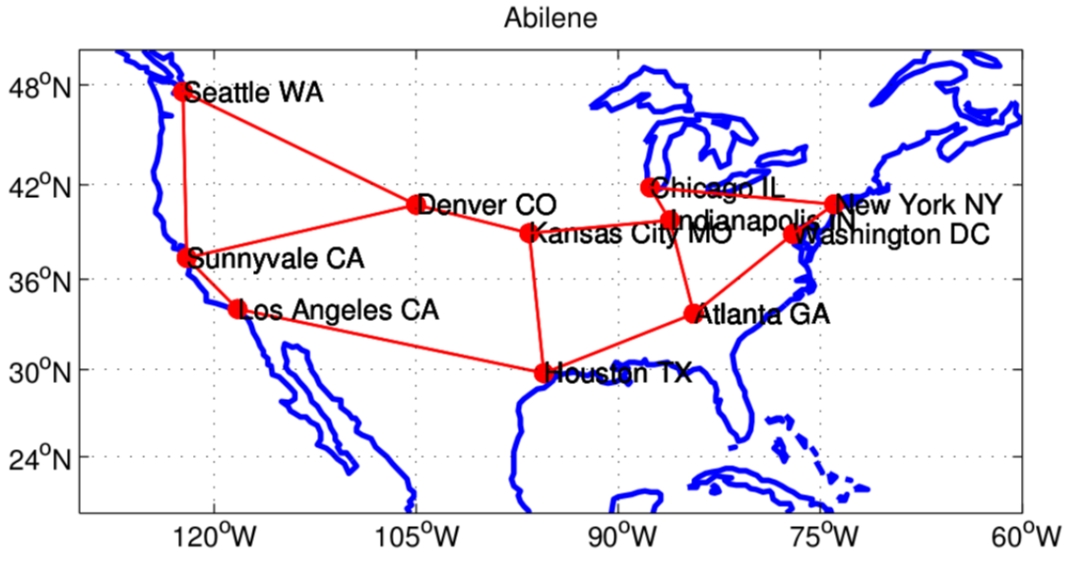
Abilene dataset
Measurement period: from 2004-03-01 to 2004-09-10
168 days
Measurement interval: 5 minutes
288 timestamps per day
Number of nodes: 12
Number of OD flows: 144
Number of traffic data: 288*168*144 = 6967296

Slide 29
Experiment setup
Hardware
CPU | Intel(R) Core(TM) i7-6800K CPU@3.40GGHz
GPU | GeForce GTX 1080Ti
RAM | 32G
RNN – Configuration
Hidden units | 100
Layers | 1
Input dimension | 26
Dropout | 0.2
Training Epoch | 100

Slide 30
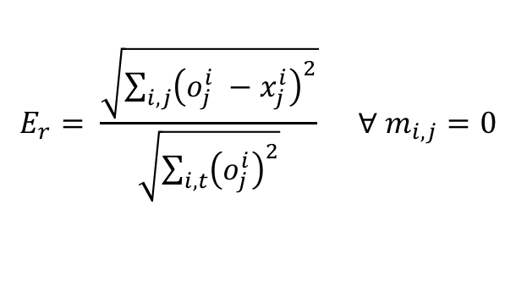


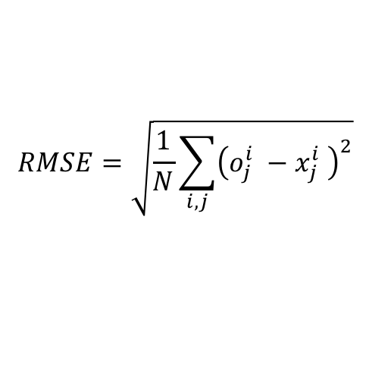
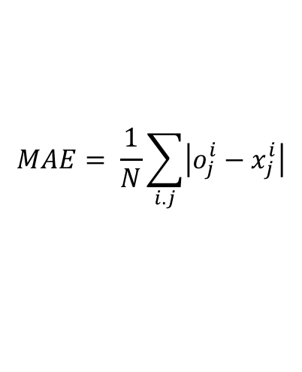
Metrics
Error ratio
Mean absolute errors
Root mean squared errors
$$E_{r}= \frac{\sqrt{\sum_{i,j}{{\left(o_{j}^{i} −x_{j}^{i}\right)}^{2}}}}{\sqrt{\sum_{i,t}{{\left(o_{j}^{i}\right)}^{2}}}} ∀ m_{i,j}=0$$
$$MAE= \frac{1}{N}\sum_{i.j}{\left|o_{j}^{i}−x_{j}^{i}\right|}$$
$$RMSE=\sqrt{\frac{1}{N}\sum_{i,j}{{\left(o_{j}^{i} −x_{j}^{i} \right)}^{2}}}$$
$$j=0,…,N$$
$N$ is the size of the testing set
Notes:
MAE: average absolute errors
RMSE: presents sample standard deviation of the differences between

Slide 31
Flow prediction result
TRAFFIC PREDICTION OF A RANDOM FLOW

Slide 32
Performance comparison
48.3%
32.7%
62.9%

Slide 33
Traffic prediction under consecutive loss
Data of 4 hours (from 10a.m every day) are all loss

Slide 34
Conclusion
In this work, we have:
Defined the semi-recursive traffic prediction problem
Solved the semi-recursive traffic prediction problem by proposing a novel deep learning model and techniques for correcting the input data and monitored flows determination.
Conducted the preliminary experiments for evaluating our proposed approach.
Notes:
“In this work, we have:” → nên bỏ đi
- Câu thứ 2 dài quá, nên viết gọn lại

Slide 35
Future work
Next, we will:
Examine the relation between the flows in the traffic matrix and capture not only the temporal but also the spatial feature of the traffic matrices.
Design an efficient algorithm for correcting input data and selecting monitored flows.
Notes:
- Câu thứ 1 dài quá → nên viết gọn lại

Slide 36
References
[1] "Recent Advances in Networking", Volume 1, ACM SIGCOMM eBook, August 2013
[2] Vardi, Yehuda. "Network tomography: Estimating source-destination traffic intensities from link data." Journal of the American statistical association 91.433 (1996): 365-377
[3] Zhang, Yin, et al. "Spatio-temporal compressive sensing and internet traffic matrices." ACM SIGCOMM Computer Communication Review. Vol. 39. No. 4. ACM, 2009.
[4] Malboubi, M., Wang, L., Chuah, C. N., & Sharma, P. (2014). Intelligent SDN based traffic (de)Aggregation and Measurement Paradigm (iSTAMP). Proceedings - IEEE INFOCOM, 934–942.
[5] Xie, K., Wang, L., Wang, X., Xie, G., Zhang, G., Xie, D., & Wen, J. (2015). Sequential and adaptive sampling for matrix completion in network monitoring systems. Computer Communications (INFOCOM), 2015 IEEE Conference on, 2443–2451.
[6] Xie, K., Wang, L., Wang, X., Xie, G., Wen, J., & Zhang, G. (2016). Accurate recovery of Internet traffic data: A tensor completion approach. Transaction on Networking, 2016–July, 1–14.
[7] Nie, L., Jiang, D., Guo, L., & Yu, S. (2016). Traffic matrix prediction and estimation based on deep learning in large-scale IP backbone networks. Journal of Network and Computer Applications, 76(October), 16–22.
[8] Xie, Kun, et al. "Accurate recovery of Internet traffic data under dynamic measurements." INFOCOM 2017-IEEE Conference on Computer Communications, IEEE. IEEE, 2017.
[9] Cao, X., Zhong, Y., Zhou, Y., Wang, J., Zhu, C., & Zhang, W. (2017). Interactive temporal recurrent convolution network for traffic prediction in data centers. IEEE Access, 6, 5276–5289.
[10] Wang, J., Tang, J., Xu, Z., Wang, Y., Xue, G., Zhang, X., & Yang, D. (2017). Spatiotemporal modeling and prediction in cellular networks: A big data enabled deep learning approach. IEEE INFOCOM 2017 - IEEE Conference on Computer Communications, 1–9.
[11]

Slide 37
THANK YOU

