Slide 1
STORYPLEX
Storyplex — v2
Pre-compiled stories, in-house voices.
A snapshot of the recent architecture refactor.
1 / 25

Slide 2
Headline features in v2
Two things that change the whole shape of the product
NEW
NEW
Pre-compiled story
In-house TTS — Silk Mulberry
• World + all 10 beat dialogues + all 5 endings + every TTS line baked into the cache BEFORE the player starts.
• Runtime is a deterministic DB lookup — <100 ms per page.
• No spinner between choices. No 'characters are responding' delay.
• Our own expressive English voice engine — built in-house.
• WebSocket streaming: PCM arrives as it's synthesized.
• Stable per-character description + per-line emotion delta — consistent identity across every line.
2 / 25

Slide 3
The problem we set out to fix
Why the old runtime felt sluggish
• Old runtime called Gemini Flash on every page advance.
• 2–4 statements per LLM call → 4–6 calls per beat → 5–8 s of wait.
• Choice buttons hid behind a spinner.
• TTS streamed on demand but spun up a fresh WS per line.
“User don’t feel the wait and lag.”
3 / 25

Slide 4
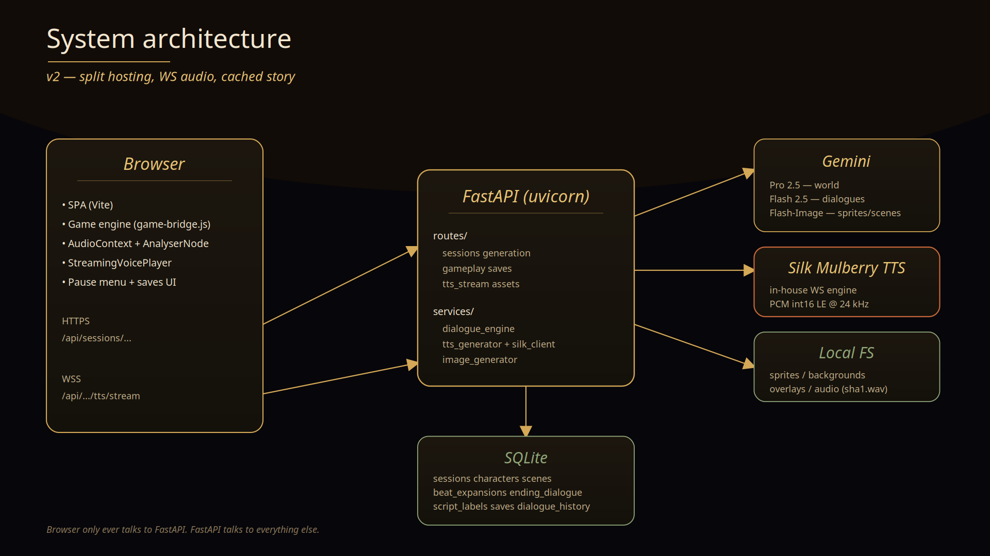
System architecture
Browser ↔ FastAPI ↔ Gemini · Mulberry · SQLite · disk
4 / 25

Slide 5
The shift
What pre-generation covers now
Before
After
Story spine + endings
pre-gen ✓
pre-gen ✓
Per-beat dialogue
live LLM per turn
pre-gen ✓ + cached
Ending dialogue
live LLM at beat 9
pre-gen ✓ + cached
Voice audio
streamed per line
pre-gen ✓ + cached
Per-page advance
1–1.5 s
<100 ms DB lookup
Free-input is the only thing that still calls Gemini at runtime.
5 / 25

Slide 6
Story shape
Spine + branching beats
• 10 beats in a fixed spine.
• 3 pre-baked choices per beat, each tagged (alignmentTag + magnitude).
• 5 candidate endings keyed by tag.
• Choices don’t change beat content; they nudge alignment_state.
• The ending with the highest score fires at beat 9.
Linear in content. Branching in destination.
Most players see the same dialogue. Their choices route them to one of 5 distinct epilogues.
6 / 25

Slide 7
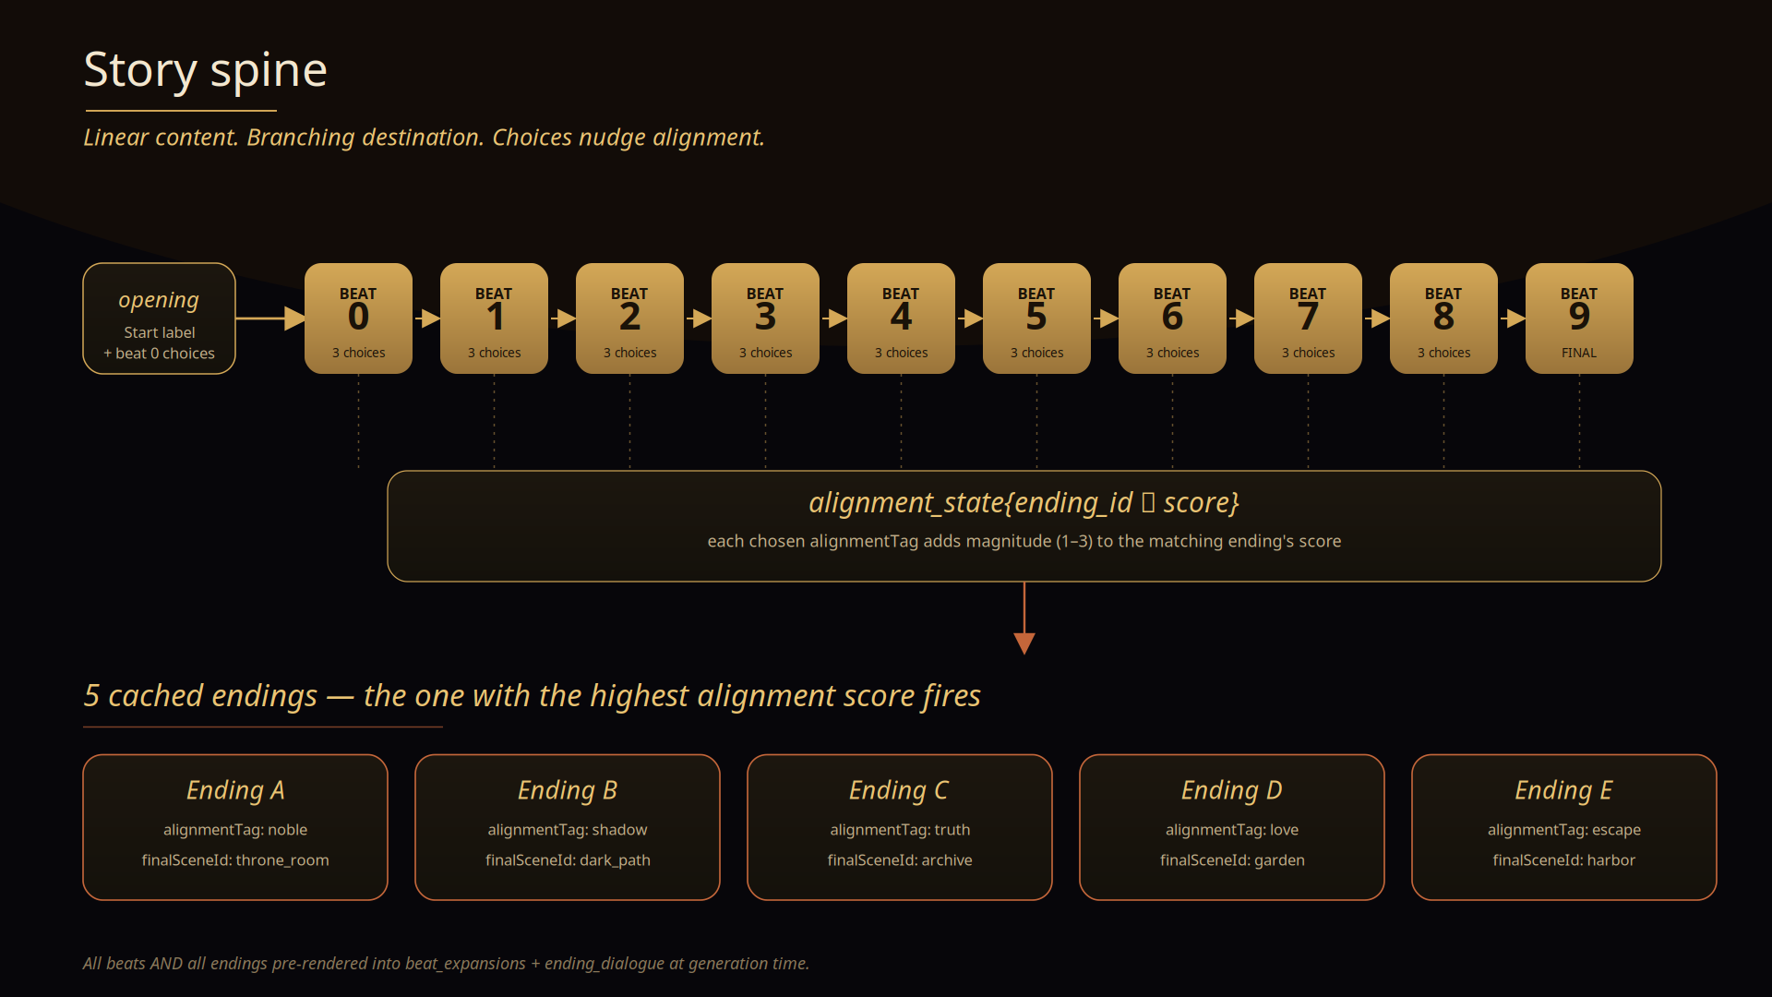
Story spine — at a glance
10 beats, 3 choices each, 5 candidate endings
7 / 25

Slide 8
Spine flow
How beats connect
opening ──► beat 0 ──┬─► beat 1 ──┬─► beat 2 ──► ... ──► beat 9 ──► ending
│ │
choice choice
(3 options, (3 options,
each tagged) each tagged)
alignment_state at beat 9 picks 1 of 5 cached endings.
• Every choice routes to the SAME next beat — only the ending changes.
• _ensure_scene_change + _ensure_cast keep the stage clean across beats.
8 / 25

Slide 9
Generation pipeline
Parallel everywhere
Phase
What runs
⏱
A
World + spine + endings (Pro 2.5)
45 s
B
Character neutrals in parallel
12 s
C
9 emotions × N chars + N scenes pooled
~100 s
D
Overlays ││ 8 beat dialogues (Flash)
~50 s
E
Script + voices + 5 endings
~15 s
F
TTS pre-render of every line (8 workers)
~1.5–2 min
Total: ~3.5–5 min. After that — zero waits during play.
9 / 25

Slide 10
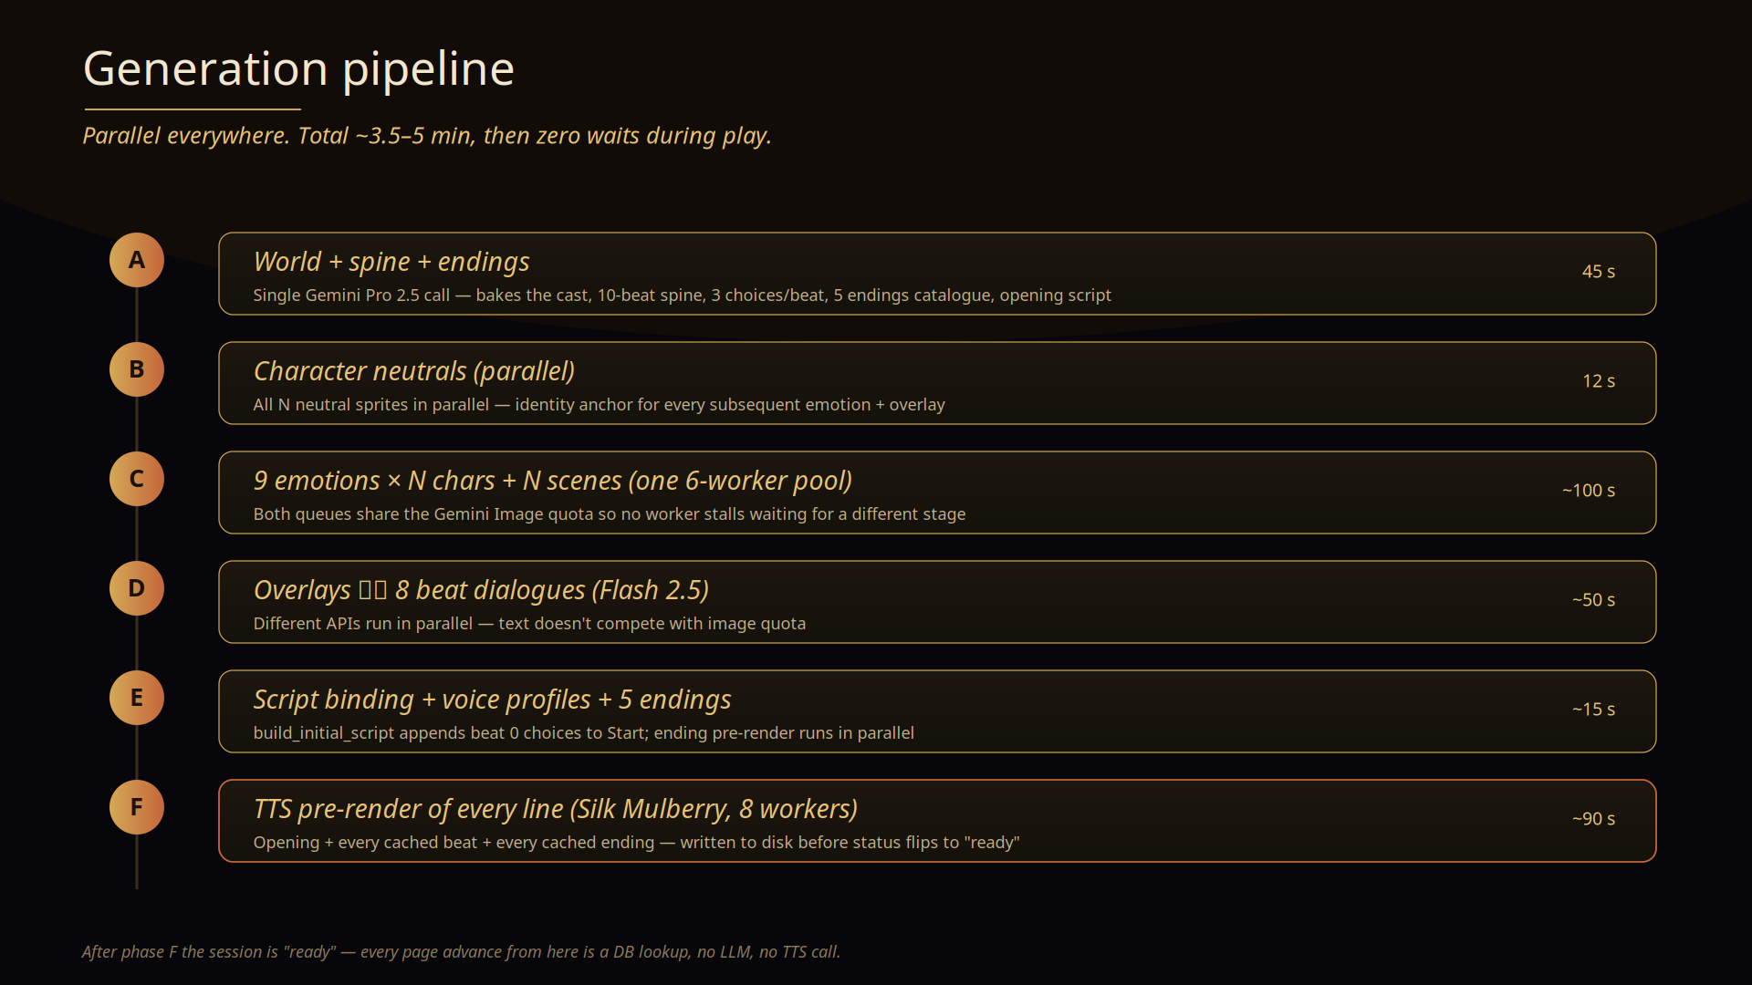
Generation pipeline — visual
6 phases. Most run in parallel.
10 / 25

Slide 11
Caches we write
What lands in the DB + disk
Table
Holds
sessions
spine, endings, alignment, chosen ending, chapter linkage
characters
personality, voice_caption, gender (new)
beat_expansions
ALL 10 beats' statements (pre-rendered)
ending_dialogue
ALL 5 endings' statements (pre-rendered)
script_labels
flat statements per label
saves
Ren'Py-style checkpoints
Plus on-disk: sprites, backgrounds, overlays, <sha1>.wav audio.
11 / 25

Slide 12
Runtime — per page click
What happens in <100 ms
client ──► /choice {alignmentTag, magnitude}
│
▼
process_player_action
│
├── apply alignment to alignment_state[ending_id]
├── target_beat = beat_index + 1
├── LOOKUP beat_expansions ◄─── cache hit
├── _ensure_scene_change(canonical sceneId)
├── _ensure_cast(hide non-cast chars)
└── append beat's pre-baked choices
▼
200 OK in <100 ms
12 / 25

Slide 13
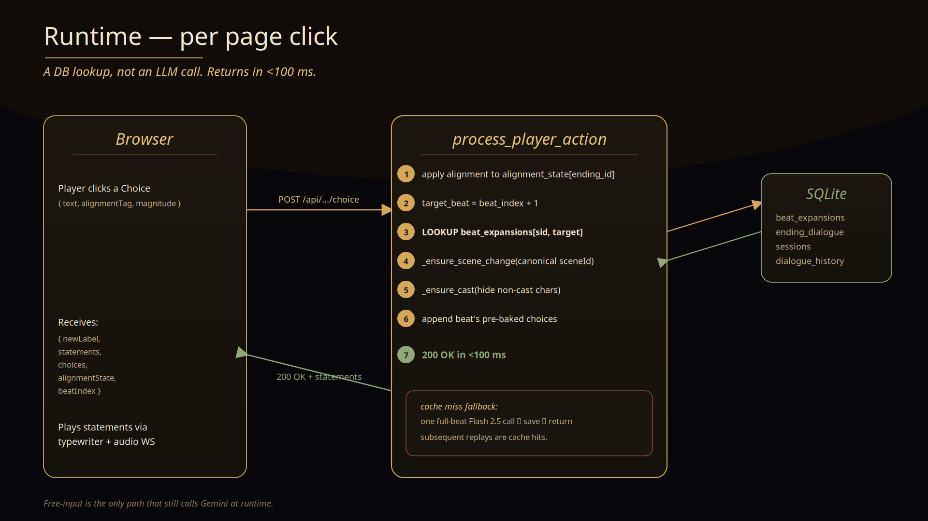
Runtime cache flow
Choice click → DB lookup → 200 OK in <100 ms
13 / 25

Slide 14
TTS — WebSocket all the way
Stream from disk if cached, from Mulberry if not
• Client opens WS to /api/sessions/{sid}/tts/stream.
• Server checks the on-disk WAV cache.
• Cache hit: streams PCM payload in 100 ms chunks.
• Cache miss: opens upstream Mulberry WS, forwards each PCM frame as it arrives, writes WAV at end.
• Client decodes int16 LE @ 24 kHz, schedules each BufferSource on the first chunk.
• AnalyserNode drives amplitude-based lip-sync.
14 / 25

Slide 15
Silk Mulberry — our in-house TTS
Built in-house, streamed over WebSocket, voiced per character
What it is
How a voice is built
• Custom expressive English voice model — built in-house.
• POST /v1/tts/ws-connect mints a one-shot WS session.
• Server forwards each PCM frame to the browser AS IT ARRIVES.
• First-byte latency: <500 ms after the click.
base per-character voice_caption (stable across every line)
+ delta per-line emotion/pacing hint from the expression tag
speaker speaker_1 preset for females; description-driven for males
pitch f0_up_key shifted by age + gender
15 / 25

Slide 16
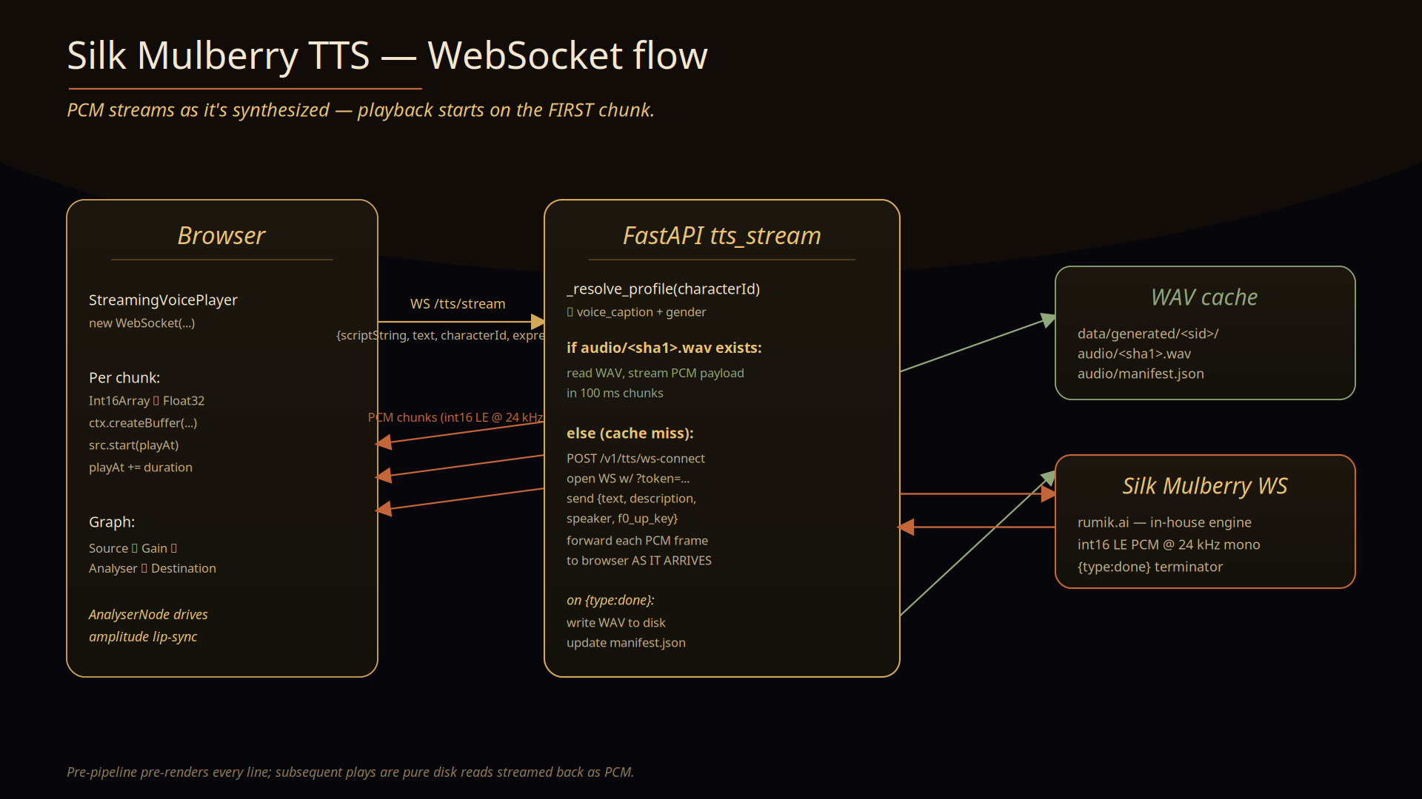
Silk Mulberry — WebSocket flow
Cache-first, live-stream on miss, write WAV on done
16 / 25

Slide 17
Voice profiles
Stable identity + per-line delta
Per-character default — set ONCE from voice_caption:
“A teenage girl with a clear, mid-range voice that is often sharp and clipped, but can soften with vulnerability.”
Per-line delta — only the delivery hint changes:
expression
appended
happy
Speak cheerfully and a bit quickly, with a smile in the voice.
sad
Speak softly and slowly, with a downcast tone.
angry
Speak sharply and with bite, faster paced.
17 / 25

Slide 18
Voice routing
Explicit gender drives the speaker
gender = female speaker_1 preset + age-based pitch
gender = male / neutral description-driven, no preset, deeper pitch
narrator description-driven, f0_up_key = -3
gender is now an EXPLICIT field on every character (set by the world prompt).
Legacy sessions fall back to keyword detection over voice_caption.
18 / 25

Slide 19
Stage guards
Two server-side passes per cache hit
_ensure_scene_change
_ensure_cast
• Replace lead scene_change with the spine's canonical sceneId
• or prepend one if missing
• fixes 'background went black after a choice'
• (LLM hallucinated a sceneId that didn't exist on disk)
• Prepend hide_character for every char NOT in beat.castIds
• Inserted after the scene_change
• stops prior-beat sprites from lingering
• safe to over-hide — client no-ops it
19 / 25

Slide 20
Save / Load / Restart
Ren'Py-style checkpoints
Triggered by Esc key or the ☰ Menu button.
Action
What it does
Save
Snapshot {label, statementIndex, sceneId, beat, alignment, ending, visibleChars} to saves table
Load
Rebuild the scene, mount each char, jump label + index
Restart
Reset alignment + beat. Drop runtime labels. KEEP beat & ending caches so replay is instant.
20 / 25

Slide 21
Continue to next chapter
Spawn a child session linked to the parent
Chapter 1 ────► chosen_ending_id = "noble_sacrifice"
│
▼
Chapter 2 (new session)
parent_session_id ─► Chapter 1
chapter_number = 2
world + cast = inherited
spine + endings = NEW (continues from Ch1's ending)
build_continuation_prompt forces re-use of character ids and picks up after the parent's chosen ending.
21 / 25

Slide 22
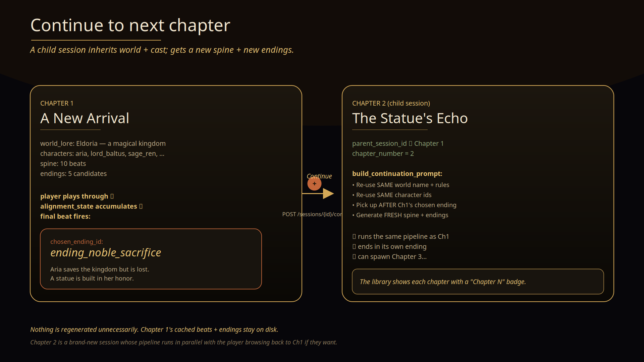
Chapter continuation
Child session inherits world + cast; gets new spine + endings
22 / 25

Slide 23
UI revamp
Cinematic VN — candlelit amber
• Candlelit amber palette — gold accent on near-black.
• Cormorant Garamond display serif + Inter body.
• Film grain + soft vignette overlay.
• Glass-card aesthetic with gold rule dividers.
• Per-view refresh: landing, setup wizard, sessions, loading, pause menu.
• Dialogue box gets a soft gold gradient top edge; choice buttons get a gold left bar on hover.
23 / 25

Slide 24
Deployment plan
Split hosting: Netlify + Render
Layer
Host
Why
Frontend (SPA)
Netlify
static, free, perfect for Vite output
Backend (FastAPI + WS)
Render / Fly / Railway
persistent disk, WS support, long-running
• Netlify Functions can't host the backend: no persistent WS, no persistent disk, hard execution caps.
• Render Starter ($7/mo) with persistent disk handles SQLite + the data/generated/ tree.
• Single-user / dev usage: under $10/mo for hosting. Gemini calls dominate variable cost.
24 / 25

Slide 25
NEXT
What’s next
• Deploy frontend to Netlify.
• Deploy backend to Render with persistent disk.
• Wire env vars + production CORS.
• Smoke-test fresh-session → play → save → continue.
25 / 25

