Slide 1
STORYPLEX
AI-Powered Visual Novel Engine
Create unique visual novels with AI-generated stories, characters, and artwork
HawksLab | 2026

Slide 2
Problem & Solution
THE PROBLEM
OUR SOLUTION
▸ Creating visual novels requires writing, art, and
programming skills — a rare combination
▸ Professional artwork & character sprites are
expensive and time-consuming to produce
▸ Traditional VN engines need extensive manual
scripting with little room for dynamic content
▸ Players experience the same fixed story paths
with no real agency or surprise
▸ AI generates complete stories, characters,
and world lore from a simple user prompt
▸ Character sprites & backgrounds are created
automatically with consistent art styles
▸ Dynamic scripting engine builds interactive
scenes with branching dialogue on the fly
▸ Players can type free-form actions — the AI
adapts the story in real time

Slide 3
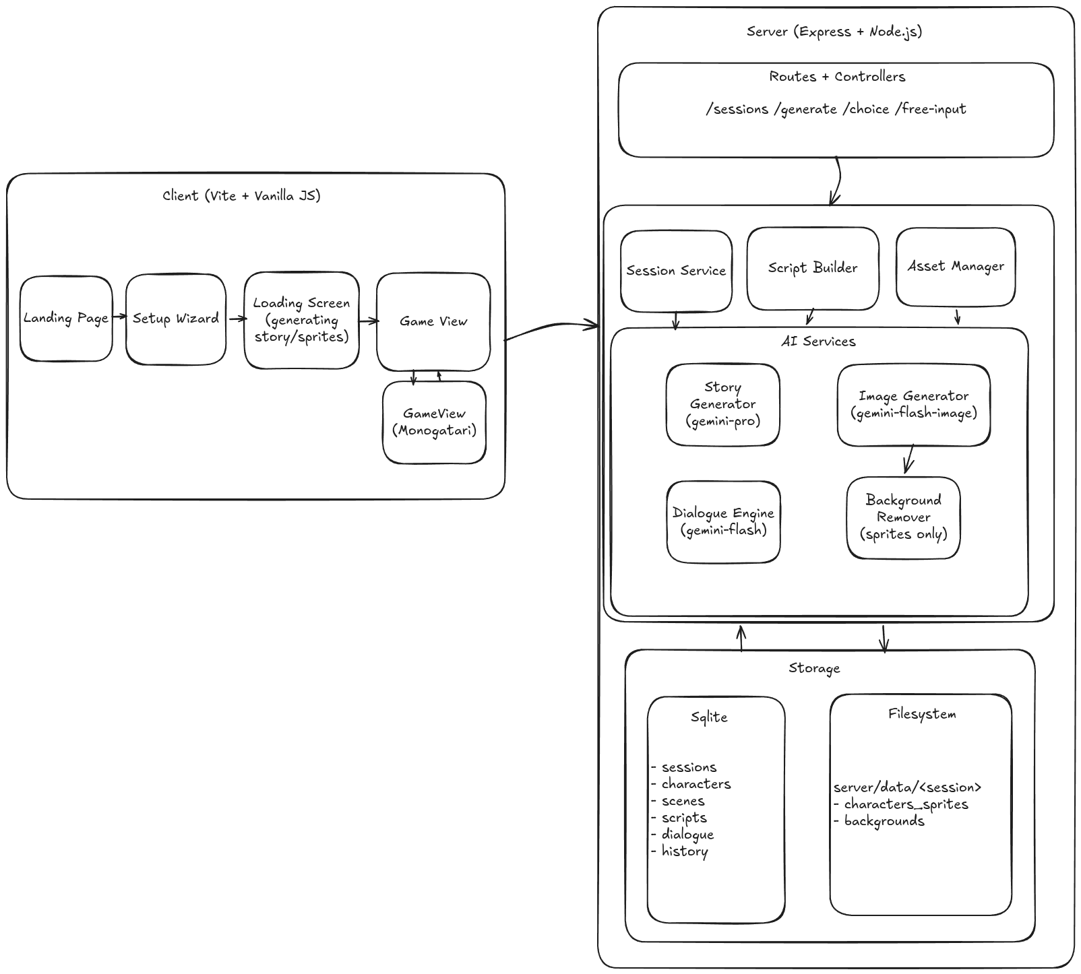

Slide 4
System Architecture
CLIENT (Vite SPA)
SERVER (Express.js)
AI ENGINE (Gemini)
▸ Custom SPA Router
▸ Setup Wizard (7 fields)
▸ Game Bridge Engine
▸ Typewriter Dialogue System
▸ Choice & Free-Input UI
▸ Real-time SSE Progress
▸ Dark Theme Design System
▸ RESTful API Routes
▸ Session Management
▸ Generation Pipeline
▸ Script Builder Service
▸ Asset Manager
▸ Background Remover
▸ SQLite Database (sql.js)
▸ Gemini 2.5 Pro — Story Gen
▸ Gemini 2.5 Flash — Dialogue
▸ Gemini Flash — Image Gen
▸ World Building Prompts
▸ Character Sprite Pipeline
▸ Background Scene Pipeline
▸ Dynamic Choice Generation

Slide 5
Tech Stack
FRONTEND
BACKEND
AI / ML
TOOLING
▸ Vite — Fast build & dev server
▸ Vanilla JS — Custom SPA, no framework
▸ CSS — Dark theme design system
▸ Monogatari for Visual Novel Engine
▸ Node.js — ES Modules runtime
▸ Express.js — RESTful API server
▸ sql.js — SQLite compiled to WASM
▸ Google Gemini 3 Pro — Story generation
▸ Gemini 2.5 Flash — Real-time dialogue
▸ Gemini Flash Image — Sprite & BG gen
▸ Sharp — Image processing & resizing
▸ @imgly/background-removal — Sprite cutout
▸ SSE — Real-time generation progress

Slide 6
Content Generation Pipeline
1
2
3
4
5
▶
▶
▶
▶
Story & World
Character Sprites
Scene Backgrounds
Script Building
Ready to Play
Progress: 5%
Progress: 20-70%
Progress: 70-90%
Progress: 90-92%
Progress: 100%
AI generates world lore, characters, plot arcs, and opening script
10 expressions per char with consistency anchor + background removal
High-res 16:9 backgrounds for each initial scene with detailed prompts
Converts AI output to Monogatari-style DSL with branching labels
Session marked ready Player enters the interactive game view

Slide 7
User Journey & Key Features
USER JOURNEY
KEY FEATURES
▸ Landing Page — Start new story or continue saved sessions
▸ Setup Wizard — Configure genre, art style, setting,
protagonist, tone, and optional story premise
▸ Loading Screen — Watch real-time AI generation progress
via Server-Sent Events (SSE)
▸ Game View — Play the interactive visual novel with
dialogue, choices, and free-form text input
▸ Sessions — Browse, manage, and resume saved games
▸ Dynamic world-building with lore, rules & history
▸ Character sprites — 10 expressions per character
with automatic background removal
▸ Free-form player input — type any action and the
AI adapts the story in real time
▸ New characters & scenes generated dynamically
during gameplay as the story evolves
▸ Multiple art styles: Anime, Cartoon, Realistic, Fiction

Slide 8
API Design
SESSIONS
GENERATION
GAMEPLAY
ASSETS
POST /api/sessions
GET /api/sessions
GET /api/sessions/:id
DELETE /api/sessions/:id
GET /api/sessions/:id/characters
GET /api/sessions/:id/scenes
POST /api/sessions/:id/generate
GET /api/sessions/:id/generate/status
(SSE stream)
POST /api/sessions/:id/choice
POST /api/sessions/:id/free-input
GET /api/sessions/:id/script
GET /api/assets/:sid/backgrounds/:id.png
GET /api/assets/:sid/characters/:id/:expr.png

Slide 9
Database Schema
sessions
characters
scenes
script_labels
dialogue_history
Game session state
Character profiles
Scene definitions
Game scripts
AI conversation log
id, genre, art_style, setting
protagonist_name, personality
tone, premise, status
world_lore, plot_arc (JSON)
id, session_id, name, role
personality, appearance
backstory, speech_style
quirks, color_code
id, session_id, name
description (visual detail)
narrative_context
time_of_day, mood
id, session_id, label_name
statements (JSON array)
Monogatari-style DSL
id, session_id, role
content, timestamp
Indexed for fast lookup

Slide 10
AI Integration
STORY GENERATION
IMAGE GENERATION
RUNTIME DIALOGUE
Gemini 2.5 Pro
Gemini 2.5 Flash Image
Gemini 2.5 Flash
▸ Structured JSON output with
strict schema validation
▸ 3-5 unique characters with
detailed visual descriptions
▸ 5 initial scenes with lighting,
weather & atmosphere details
▸ Opening script with 20-40
statements & choice points
▸ World lore, rules & history
▸ 10 expressions per character:
neutral, happy, sad, angry, etc.
▸ Neutral sprite as consistency
anchor for all other expressions
▸ Automatic background removal
for transparent sprite cutouts
▸ Scene backgrounds at 16:9
with rich visual prompts
▸ Art style adherence across
all generated assets
▸ Full context: character profiles,
world lore & plot arc
▸ Last 40 messages as
conversation history
▸ Structured JSON responses
with next statements & choices
▸ Dynamic character introduction
with on-the-fly sprite generation
▸ Scene transitions & new
background generation

Slide 11
Project Structure
CLIENT
SERVER
client/ src/ main.js Entry point & router setup views/ landing.js Home page setup-wizard.js Story configuration loading.js Generation progress (SSE) game.js Visual novel player sessions.js Session management services/ api.js HTTP + SSE client game-bridge.js Game engine core utils/ router.js Hash-based SPA router styles/ main.css Dark theme design system
server/ src/ index.js Express app setup config.js Environment config db/ database.js sql.js wrapper queries/ Query builders (4 modules) routes/ API endpoint definitions controllers/ Request handlers services/ sessionService Session CRUD scriptBuilder Monogatari DSL builder assetManager File I/O for assets ai/ geminiClient API client wrapper storyGenerator World & story creation dialogueEngine Runtime AI dialogue imageGenerator Sprites & backgrounds prompts/ AI prompt templates (4)

Slide 12
Thank You
Storyplex — Where AI Meets Interactive Storytelling
Questions & Discussion

