Slide 1

IT Project Management Final Presentation
By: Jordan Pangrazzi

Slide 2
Freelance QA Testing Service Business
Initiating
Phase
Many small businesses launch websites without proper testing Common issues: Broken links, Form Errors, Poor mobile responsiveness
These problems create a bad user experience and hurt credibility
My businesses Purpose is to:
Provide affordable, reliable QA testing services
Help businesses launch reliable, user-friendly products by identifying and preventing critical defects before release
Deliver clear, actionable bug reports to improve performance

Slide 3
Objectives
Initiating
Phase
Launch within 6 months
Generate initial revenue & build a client base
Develop real-world QA testing and defect reporting experience in a simulated client environment
Offer: Website app bug testing along with usability & mobile responsiveness testing.
Start-up Goal: Low-cost pricing to attract clients and build referrals
Long-term Goal: Scale into a larger business with more testers

Slide 4
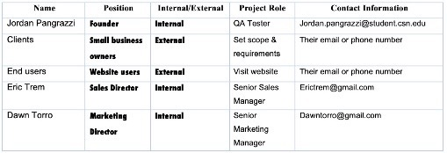
Stakeholders
Initiating
Phase
Founder/QA Lead: Jordan Pangrazzi, contactable via email
Small Business clients are an external stakeholder as these are companies that want their site tested by us.
End Users (customers interacting with client applications) are another external stakeholder as these users will be visiting companies websites and apps so we have to consider their input while testing.
Our marketing and sales directors are internal stakeholders responsible for their respective roles.

Slide 5
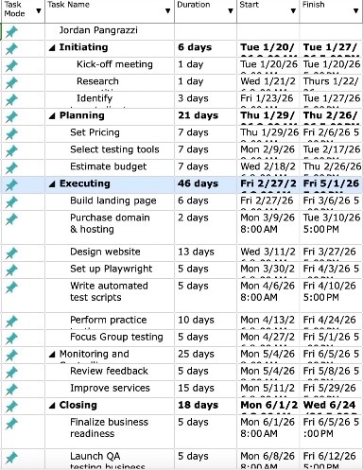
WBS Initiating Phase: Company Kick off meeting, research our testing competition(especially local businesses), and identifying our target demographics clients. Planning Phase: Set pricing, select which testing tools we will use, and budget planning/estimates to ensure we can be profitable. Executing Phase: Build our testing landing page, purchase domain & hosting. Design our company website, Set up Playwright. Write Automated test scripts, Execute QA test cases and validation workflows using Playwright, and focus group testing for practice & feedback. Monitoring & Controlling Phase: Review practice test feedback & then improve services Closing: Finalize business readiness (get as market ready as possible) and then Launch QA testing service! Goal: 6 months process
Planning
Phase

Slide 6
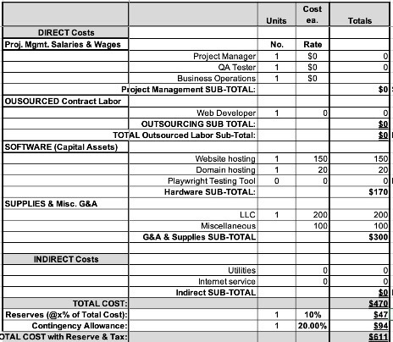
Budget
This is beginning as a Solo Freelance business with no other employees but planning to have a marketing and sales team within 6 months after we launch, and they will be added to this budget plan at that time.
No outsourced labor to keep costs minimal. Will be building my own company webpage. Website and domain hosting will be a paid service through Hostingers platform. Playwright is a free testing tool that we will use.
Internet, utilities, & other indirect costs part of my personal expenses because I will be operating out of my home (no office)
Planning
Phase

Slide 7
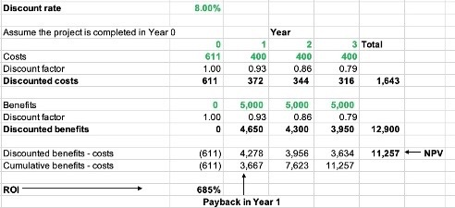
Financial Analysis
Planning
Phase
This business is a low overhead startup since our testing tools are free and it’s a solo operated venture to begin, so there’s a realistic possibility of a 685% ROI year 1. This demonstrates strong potential for early-stage profitability due to low overhead and tool efficiency.

Slide 8
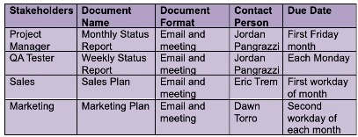
Planning
Phase
As project manager, this communication plan documents how I plan to keep all of our project stakeholders updated on the status of our projects. Our methods will be consistent with an email along with a meeting for all reports and plans.
We will hold a monthly company and project status report meeting on the first Friday of each month to close out the week, a weekly project status report on each Monday to begin the week, a sales plan meeting on the first workday of each month to plan how to generate sales that month, and a marketing meeting on the second workday of each month to discuss marketing strategies.

Slide 9
Milestone Report
Executing
Phase
4 Company Milestones:
Landing page completion & published. When this milestone is hit it means we have an official website that clients can visit and acquire information from.
All testing & reporting tools finalized. When this milestone is hit, we will have all of our resources necessary in order to be able to test companies websites and apps.
Business launched. This milestone is an essential one because it means that all of our planning and preparation came to fruition, and now we can start generating revenue.
Obtained first client. This milestone would mean the most to me because it would indicate that our hard work is paying off and that there’s intrinsic value to this business.

Slide 10
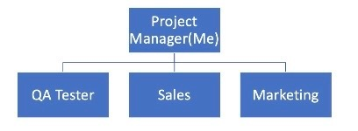
HR Plan
Monitoring
Phase
Above is our team organization chart. While creating it, I identified myself as the project manager. In order to succeed, we will need a QA tester, sales, and marketing team. This structure provides a clear organizational structure for our business.

Slide 11
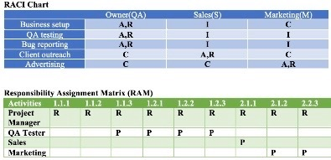
HR Plan
Monitoring
Phase
Our RACI Chart displays the 4 key project roles for our stakeholders. “R” represents who is responsible for doing the task, “A” represents who’s accountable for the task/has authority over it, “C” represents who is consulted and has the information necessary to complete the task, and “I” represents who needs to be informed of task status and results. This helps to allocate work and define project roles and responsibilities.
Our Responsibility Assignment Matrix maps the work of the project, to display who is responsible for performing the work. ”R” represents the responsible party, and “P” represents the party performing the task. This helps to clarify roles that parties have, and prevents discrepancies.

Slide 12
SWOT Risk Analysis
Monitoring
Phase
Strengths
Low startup costs- Only about $600 total.
Full independence & control- because we’re a solo business.
Weaknesses
Limited experience as a new QA business- focus groups will help with this.
Solo operation → limited scalability- no team yet so tough to scale to more clients.
Opportunities
Increasing demand for website QA/testing- Especially as modern technology increases.
Small businesses needing affordable solutions- Instead of small companies spending on large business services we could bridge the gap of affordable quality solutions.
Threats
Competition from established QA companies- Brand visibility and client acquisition strategies will be critical to early success.
Potential difficulty gaining initial clients- Client outreach and trust will be essential.
Risks assessments will be reviewed monthly- to ensure that we’re keeping our risks low.

Slide 13
Risk Management Plan
Monitoring
Phase
Methodology
Maintain a risk register
Solely Responsible for:
Identifying & documenting risks
Implementing mitigation strategies
Mitigation Strategies
Preventative
Avoid delays & other risks. Keep services simple with a clear scope to prevent delays and unhappy clients.
Contingency
Handle delays with clear client communication. If we find ourselves in a situation where we can’t deliver on time we will communicate upfront and clearly to the client.
Offer discounts or solutions (if need-be) to keep clients satisfied
Budget Risks
Low overhead (Playwright tools)
We will focus our spending on marketing & client acquisition

Slide 14
QA Plan
Monitoring
Phase
Quality Assurance Testing quality will be based off the following QA plan metrics, if we can select Y (Yes) for all of these and N(No) for none of these, we have delivered our services appropriately:
Website/app pages scope tested- Y/N
Broken links, forms, all features tested for bugs - Y/N
Cross-functionality tests were performed - Y/N
Bug report delivered - Y/N

Slide 15
Summary & Lessons Learned
Closing
Phase
Throughout developing this business from beginning to end I have learned the value of being detailed and tackling each stage of the process in order to be ready for launch, especially from the WBS. I also took valuable lessons from the risk management plan as it made me reflect on how many potential issues could occur with a small start-up QA business.

Slide 16
Thank you for your time!
Thank
You
Thank you for watching this presentation!
Stay Blessed!

