Slide 1

Exposure Analytics
Dynamic Initial Margin Impact on Exposure
GMIT
Intra-day Credit Risk Monitoring
New York
Lakshmi Krishnamurthy
v0.75 24 August 2018

Slide 2
Dynamic Initial Margin Impact on Exposure
Abstract
VM and IM Collateralized Positions: This chapter leverages the new framework for collateralized exposure modeling introduced by Andersen, Pykhtin, and Sokol (2017b) to analyze credit risk positions collateralized with both initial and variation margin.
Special attention is paid to the dynamics BCBS-IOSCO uncleared margin rules soon to be mandated for bilateral inter-dealer trading in OTC derivatives markets.
Insufficiency of BCBS IOSCO Rules: While these rules set the initial margin at 99th 2-week percentile level and aim to all but eliminate portfolio close-out risk, this chapter demonstrates that the trade flow effects can result in exposures being reduced significantly less than expected.
Efficient IM Simulation on an MC Path: The analysis is supplemented with several practical schemes for estimating IM on a simulation path, and for improving the speed and the stability of the exposure simulation.
Handling Trade Flow Exposure Spikes: This chapter also briefly discusses potential ways to adjust the margin framework to more effectively deal with exposures arising from trade flow events.

Slide 3
Dynamic Initial Margin Impact on Exposure
Introduction - 1
Collateralization based on Variation Margin: Collateralization has long been a way of mitigating counterparty risk in OTC bilateral trading.
The most common collateral mechanism is variation margin (VM) which aims to keep the threshold gap between portfolio value and posted collateral below a certain, possibly stochastic, threshold.
Imperfect Collateralization under VM Schemes: Even when the thresholds for the VM are set to zero, however, there remains residual exposure to the counterparty default resulting from a sequence of contractual and operational time lags, starting from the last snapshot of the market for which the counterparty would post in full the required VM to the termination date after the counterparty’s default.
The various collateral mechanisms, including the precise definition of the variation margin thresholds, are typically captured in the ISDA Credit Support Annex (CSA) – the portfolio level legal agreement that supplements the ISDA Master Agreement.
MPoR - Margin Period of Risk: The aggregation of these lags results in a time period called the Margin Period of Risk (MPoR) during which the gap between the portfolio value and collateral can widen.
The length of the MPoR is a critical input to any model of collateral exposure.

Slide 4
Dynamic Initial Margin Impact on Exposure
Introduction - 2
IM Supplementing the VM Collateral: Posting of initial margin (IM) to supplement VM provides the dealers with a mechanism to reduce the residual exposure resulting from market risk over MPoR.
While it is often believed that the IM is posted strictly in addition to the VM, many CSAs intermingle the two types of collateral by letting IM affect the threshold computation of VM.
Genesis and Structure of IM: Historically, IM in bilateral trading has been mostly reserved for dealer counterparties deemed as high-risk – e.g., hedge funds – and typically done as a trade level calculation, established in term sheets at the transaction time of each trade.
This type of IM posting is normally deterministic and either stays fixed over the life of a trade or amortizes down according to a pre-specified schedule.
New Basel Rules for IM: In the inter-dealer bilateral OTC world, changes to the long-standing VM and IM collateral practices are now imminent.
BCBS and IOSCO proposed (Basel Committee on Banking Supervision (2013)) and later finalized (Basel Committee on Banking Supervision (2015)) new uncleared margin rules for bilateral trading.

Slide 5
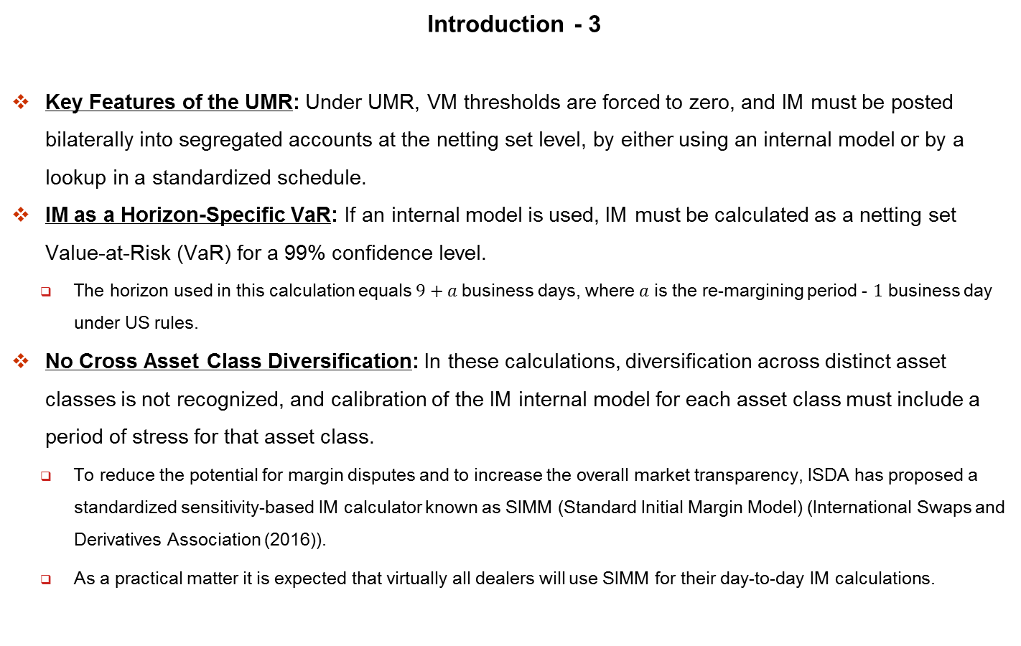
Dynamic Initial Margin Impact on Exposure
Introduction - 3
Key Features of the UMR: Under UMR, VM thresholds are forced to zero, and IM must be posted bilaterally into segregated accounts at the netting set level, by either using an internal model or by a lookup in a standardized schedule.
IM as a Horizon-Specific VaR: If an internal model is used, IM must be calculated as a netting set Value-at-Risk (VaR) for a 99% confidence level.
The horizon used in this calculation equals $9+a$ business days, where $a$ is the re-margining period - $1$ business day under US rules.
No Cross Asset Class Diversification: In these calculations, diversification across distinct asset classes is not recognized, and calibration of the IM internal model for each asset class must include a period of stress for that asset class.
To reduce the potential for margin disputes and to increase the overall market transparency, ISDA has proposed a standardized sensitivity-based IM calculator known as SIMM (Standard Initial Margin Model) (International Swaps and Derivatives Association (2016)).
As a practical matter it is expected that virtually all dealers will use SIMM for their day-to-day IM calculations.

Slide 6
Dynamic Initial Margin Impact on Exposure
Introduction - 4
Dynamic Nature of Initial Margin: Under UMR required levels of IM continuously change as trade cash flows are paid, new trades are booked, or markets move, and dealers regularly need to call for more IM or to return excess IM.
This dynamic aspect of IM requirements makes the modeling of the future exposures a challenge.
Modeling under Dynamics IM and VM: This chapter discusses modeling credit exposure in the presence of dynamic IM and questions the conventional wisdom that IM essentially eliminates counterparty risk.
Leaning on the recent results from Andersen, Pykhtin, and Sokol (2017a), it starts by formulating a general model of exposure in the presence of VM and/or IM.
Simple Case - No Trade Flows: The resulting framework is first applied to the simple case where no trade flows take place within the MPoR.
For processes with Gaussian increments – e.g., an Ito process – a limiting scale factor that converts the IM free expected exposure (EE) to IM-protected EE is derived, for sufficiently small MPoR.

Slide 7
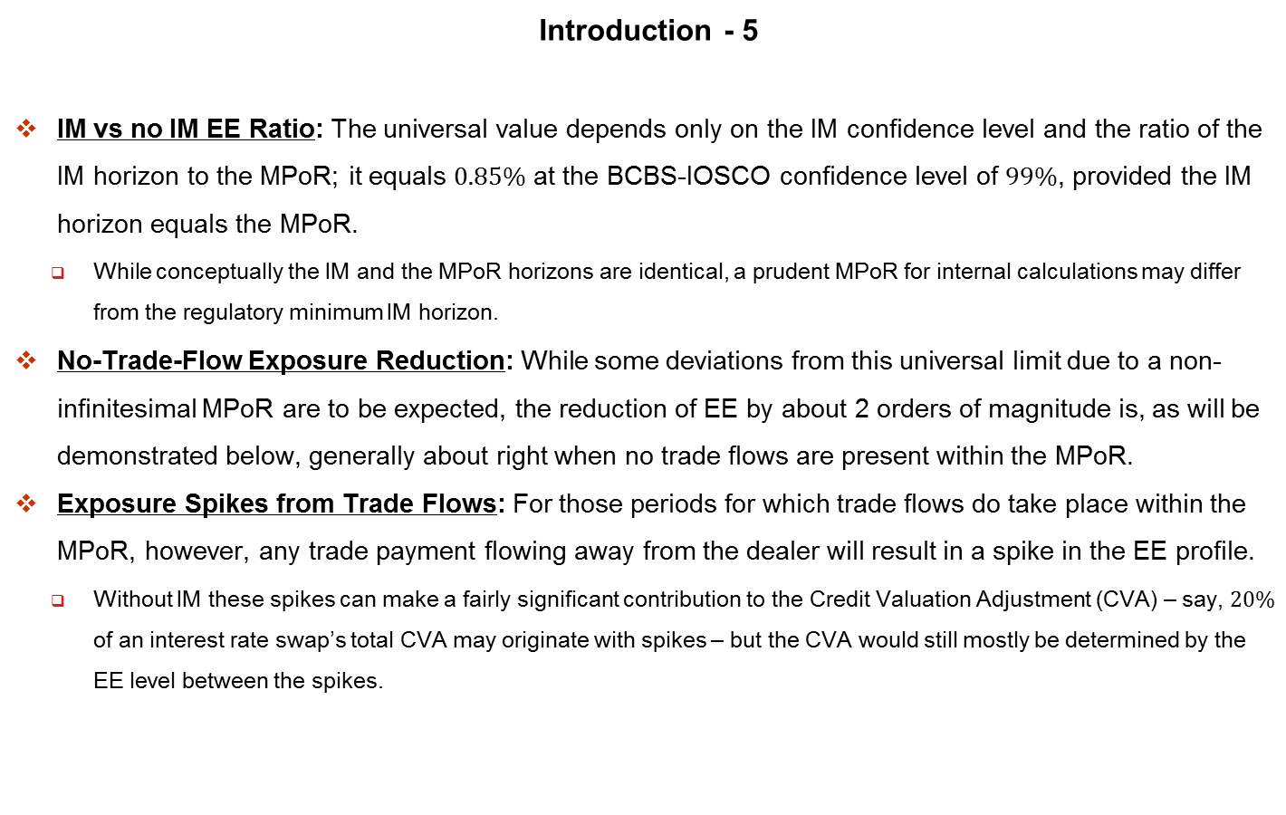
Dynamic Initial Margin Impact on Exposure
Introduction - 5
IM vs no IM EE Ratio: The universal value depends only on the IM confidence level and the ratio of the IM horizon to the MPoR; it equals $0.85\%$ at the BCBS-IOSCO confidence level of $99\%$, provided the IM horizon equals the MPoR.
While conceptually the IM and the MPoR horizons are identical, a prudent MPoR for internal calculations may differ from the regulatory minimum IM horizon.
No-Trade-Flow Exposure Reduction: While some deviations from this universal limit due to a non-infinitesimal MPoR are to be expected, the reduction of EE by about 2 orders of magnitude is, as will be demonstrated below, generally about right when no trade flows are present within the MPoR.
Exposure Spikes from Trade Flows: For those periods for which trade flows do take place within the MPoR, however, any trade payment flowing away from the dealer will result in a spike in the EE profile.
Without IM these spikes can make a fairly significant contribution to the Credit Valuation Adjustment (CVA) – say, $20\%$ of an interest rate swap’s total CVA may originate with spikes – but the CVA would still mostly be determined by the EE level between the spikes.

Slide 8
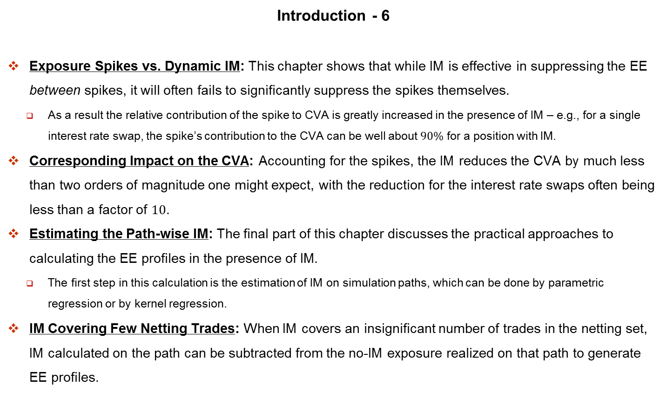
Dynamic Initial Margin Impact on Exposure
Introduction - 6
Exposure Spikes vs. Dynamic IM: This chapter shows that while IM is effective in suppressing the EE between spikes, it will often fails to significantly suppress the spikes themselves.
As a result the relative contribution of the spike to CVA is greatly increased in the presence of IM – e.g., for a single interest rate swap, the spike’s contribution to the CVA can be well about $90\%$ for a position with IM.
Corresponding Impact on the CVA: Accounting for the spikes, the IM reduces the CVA by much less than two orders of magnitude one might expect, with the reduction for the interest rate swaps often being less than a factor of $10$.
Estimating the Path-wise IM: The final part of this chapter discusses the practical approaches to calculating the EE profiles in the presence of IM.
The first step in this calculation is the estimation of IM on simulation paths, which can be done by parametric regression or by kernel regression.
IM Covering Few Netting Trades: When IM covers an insignificant number of trades in the netting set, IM calculated on the path can be subtracted from the no-IM exposure realized on that path to generate EE profiles.

Slide 9
Dynamic Initial Margin Impact on Exposure
Introduction - 7
IM covering most Netting Trades: However, when most trades of the netting set are covered by the IM, this approach can be problematic because of excessive simulation noise and other errors.
An alternative approach that dampens the noise is proposed, and is generally more accurate.
Suggested Alterations to the Exposure Rules: This chapter concludes by summarizing the results and briefly discussing the possible modifications to trade and collateral documentation that would make IM more effective in reducing residual counterparty risk.

Slide 10
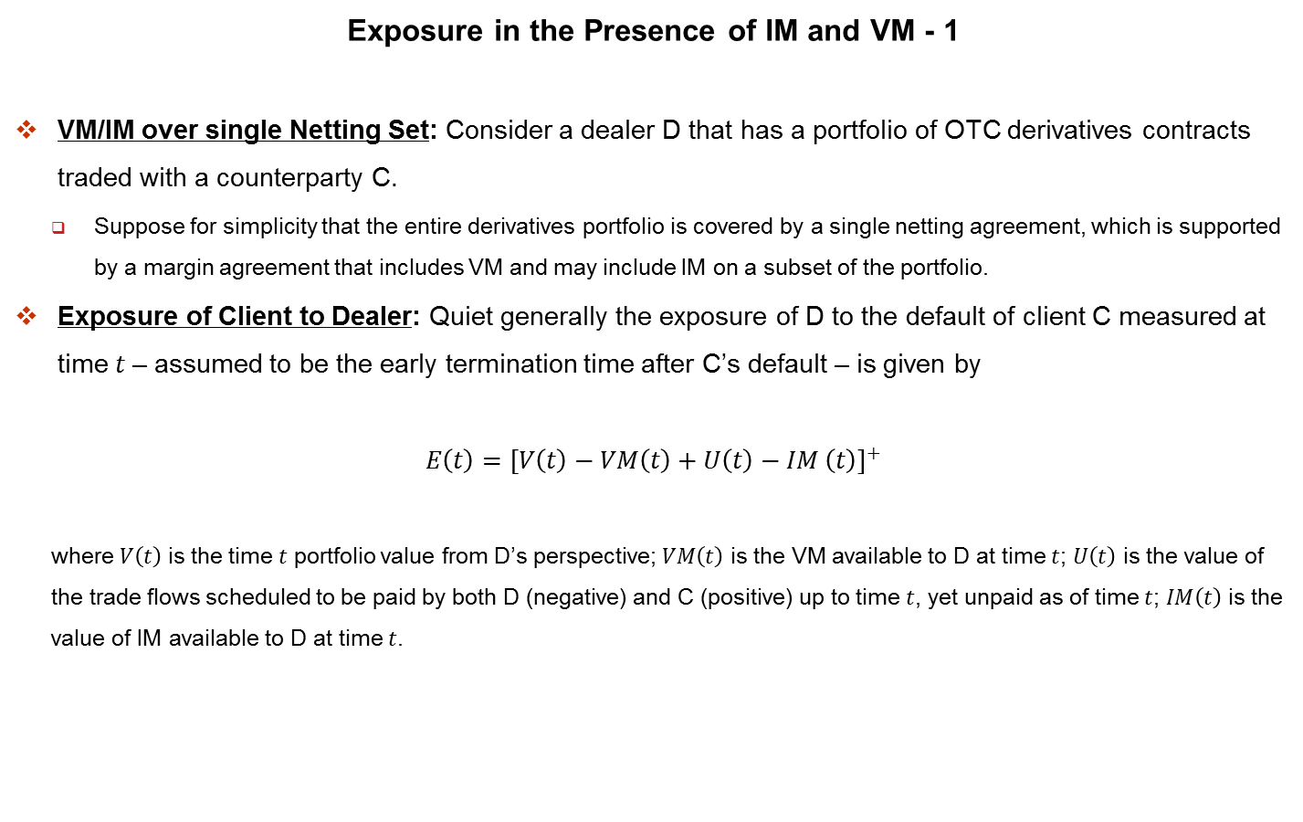
Dynamic Initial Margin Impact on Exposure
Exposure in the Presence of IM and VM - 1
VM/IM over single Netting Set: Consider a dealer D that has a portfolio of OTC derivatives contracts traded with a counterparty C.
Suppose for simplicity that the entire derivatives portfolio is covered by a single netting agreement, which is supported by a margin agreement that includes VM and may include IM on a subset of the portfolio.
Exposure of Client to Dealer: Quiet generally the exposure of D to the default of client C measured at time $t$ – assumed to be the early termination time after C’s default – is given by
$$E\left(t\right)={\left[V\left(t\right)−VM\left(t\right)+U\left(t\right)−IM \left(t\right)\right]}^{+}$$
where $V\left(t\right)$ is the time $t$ portfolio value from D’s perspective; $VM\left(t\right)$ is the VM available to D at time $t$; $U\left(t\right)$ is the value of the trade flows scheduled to be paid by both D (negative) and C (positive) up to time $t$, yet unpaid as of time $t$; $IM\left(t\right)$ is the value of IM available to D at time $t$.

Slide 11
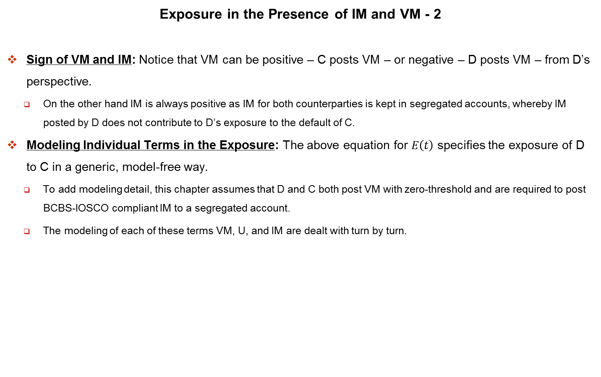
Dynamic Initial Margin Impact on Exposure
Exposure in the Presence of IM and VM - 2
Sign of VM and IM: Notice that VM can be positive – C posts VM – or negative – D posts VM – from D’s perspective.
On the other hand IM is always positive as IM for both counterparties is kept in segregated accounts, whereby IM posted by D does not contribute to D’s exposure to the default of C.
Modeling Individual Terms in the Exposure: The above equation for $E\left(t\right)$ specifies the exposure of D to C in a generic, model-free way.
To add modeling detail, this chapter assumes that D and C both post VM with zero-threshold and are required to post BCBS-IOSCO compliant IM to a segregated account.
The modeling of each of these terms VM, U, and IM are dealt with turn by turn.

Slide 12
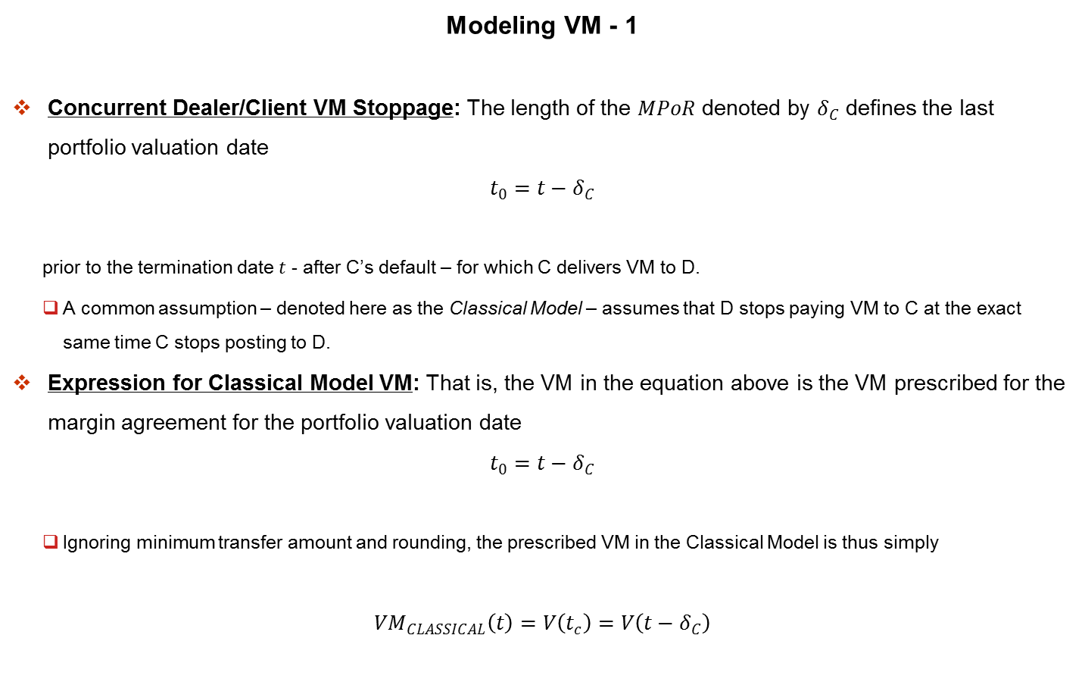
Dynamic Initial Margin Impact on Exposure
Modeling VM - 1
Concurrent Dealer/Client VM Stoppage: The length of the $MPoR$ denoted by $δ_{C}$ defines the last portfolio valuation date
$$t_{0}=t−δ_{C}$$
prior to the termination date $t$ - after C’s default – for which C delivers VM to D.
A common assumption – denoted here as the Classical Model – assumes that D stops paying VM to C at the exact same time C stops posting to D.
Expression for Classical Model VM: That is, the VM in the equation above is the VM prescribed for the margin agreement for the portfolio valuation date
$$t_{0}=t−δ_{C}$$
Ignoring minimum transfer amount and rounding, the prescribed VM in the Classical Model is thus simply
$$VM_{CLASSICAL}\left(t\right)=V\left(t_{c}\right)=V\left(t−δ_{C}\right)$$

Slide 13
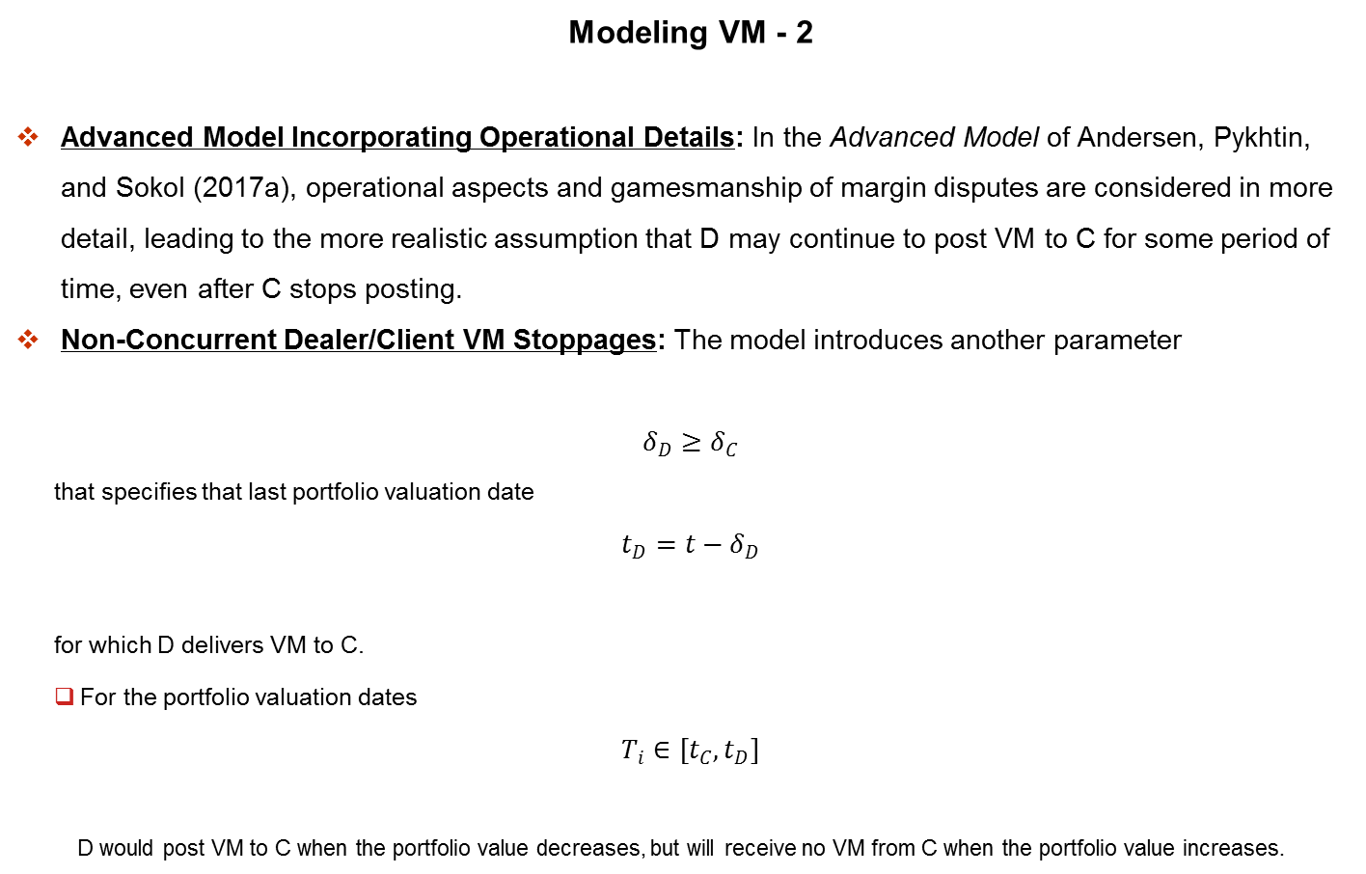
Dynamic Initial Margin Impact on Exposure
Modeling VM - 2
Advanced Model Incorporating Operational Details: In the Advanced Model of Andersen, Pykhtin, and Sokol (2017a), operational aspects and gamesmanship of margin disputes are considered in more detail, leading to the more realistic assumption that D may continue to post VM to C for some period of time, even after C stops posting.
Non-Concurrent Dealer/Client VM Stoppages: The model introduces another parameter
$$δ_{D}≥δ_{C}$$
that specifies that last portfolio valuation date
$$t_{D}=t−δ_{D}$$
for which D delivers VM to C.
For the portfolio valuation dates
$$T_{i}∈\left[t_{C}, t_{D}\right]$$
D would post VM to C when the portfolio value decreases, but will receive no VM from C when the portfolio value increases.

Slide 14

Dynamic Initial Margin Impact on Exposure
Modeling VM - 3
Expression for Advanced Model VM: This results in VM of
$${VM}_{ADVANCED}\left(t\right)=\begin{matrix}min \\ T_{i}∈\left[t_{C}, t_{D}\right]\end{matrix} V\left(T_{i}\right)$$
This equation of course reduces to
$$VM_{CLASSICAL}\left(t\right)=V\left(t_{c}\right)=V\left(t−δ_{C}\right)$$
when one sets
$$δ_{D}=δ_{C}$$

Slide 15
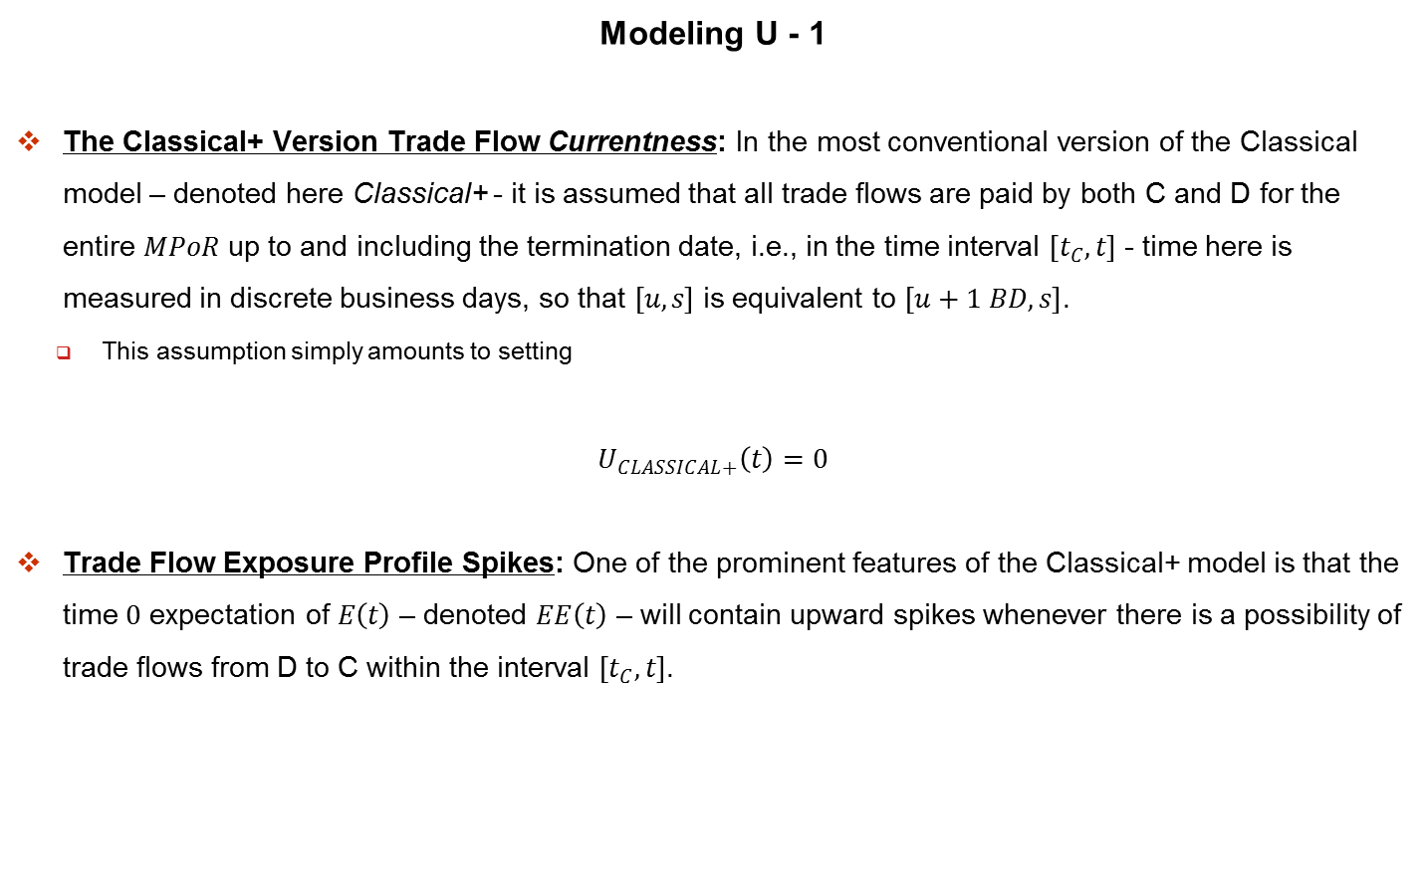
Dynamic Initial Margin Impact on Exposure
Modeling U - 1
The Classical+ Version Trade Flow Currentness: In the most conventional version of the Classical model – denoted here Classical+ - it is assumed that all trade flows are paid by both C and D for the entire $MPoR$ up to and including the termination date, i.e., in the time interval $\left[t_{C}, t\right]$ - time here is measured in discrete business days, so that $\left[u, s\right]$ is equivalent to $\left[u+1 BD, s\right]$.
This assumption simply amounts to setting
$$U_{CLASSICAL+}\left(t\right)=0$$
Trade Flow Exposure Profile Spikes: One of the prominent features of the Classical+ model is that the time $0$ expectation of $E\left(t\right)$ – denoted $EE\left(t\right)$ – will contain upward spikes whenever there is a possibility of trade flows from D to C within the interval $\left[t_{C}, t\right]$.

Slide 16
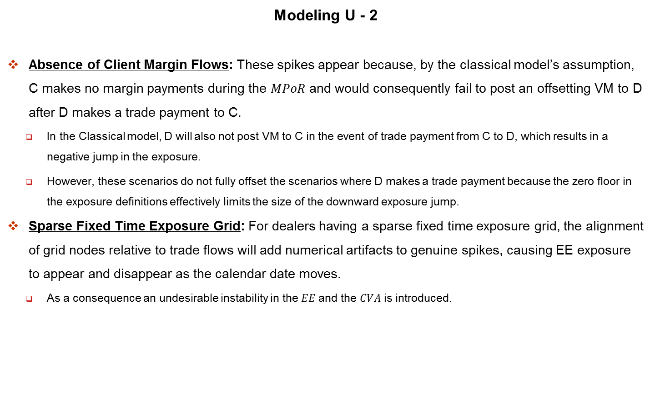
Dynamic Initial Margin Impact on Exposure
Modeling U - 2
Absence of Client Margin Flows: These spikes appear because, by the classical model’s assumption, C makes no margin payments during the $MPoR$ and would consequently fail to post an offsetting VM to D after D makes a trade payment to C.
In the Classical model, D will also not post VM to C in the event of trade payment from C to D, which results in a negative jump in the exposure.
However, these scenarios do not fully offset the scenarios where D makes a trade payment because the zero floor in the exposure definitions effectively limits the size of the downward exposure jump.
Sparse Fixed Time Exposure Grid: For dealers having a sparse fixed time exposure grid, the alignment of grid nodes relative to trade flows will add numerical artifacts to genuine spikes, causing EE exposure to appear and disappear as the calendar date moves.
As a consequence an undesirable instability in the $EE$ and the $CVA$ is introduced.

Slide 17
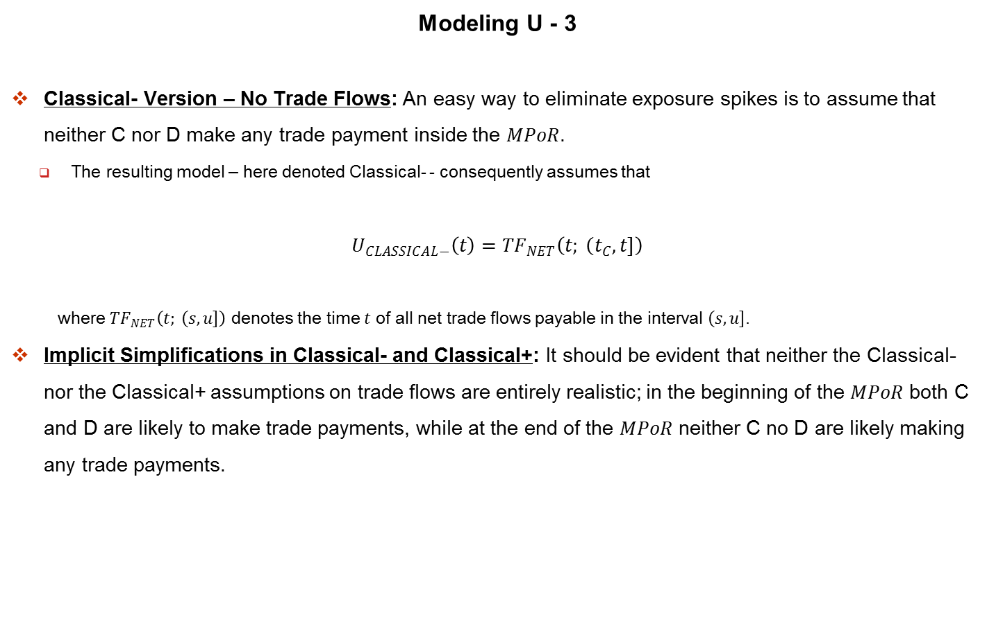
Dynamic Initial Margin Impact on Exposure
Modeling U - 3
Classical- Version – No Trade Flows: An easy way to eliminate exposure spikes is to assume that neither C nor D make any trade payment inside the $MPoR$.
The resulting model – here denoted Classical- - consequently assumes that
$$U_{CLASSICAL−}\left(t\right)={TF}_{NET}\left(t; \left(t_{C}\right., \left.t\right]\right)$$
where ${TF}_{NET}\left(t; \left(s\right., \left.u\right]\right)$ denotes the time $t$ of all net trade flows payable in the interval $\left(s\right., \left.u\right]$.
Implicit Simplifications in Classical- and Classical+: It should be evident that neither the Classical- nor the Classical+ assumptions on trade flows are entirely realistic; in the beginning of the $MPoR$ both C and D are likely to make trade payments, while at the end of the $MPoR$ neither C no D are likely making any trade payments.

Slide 18
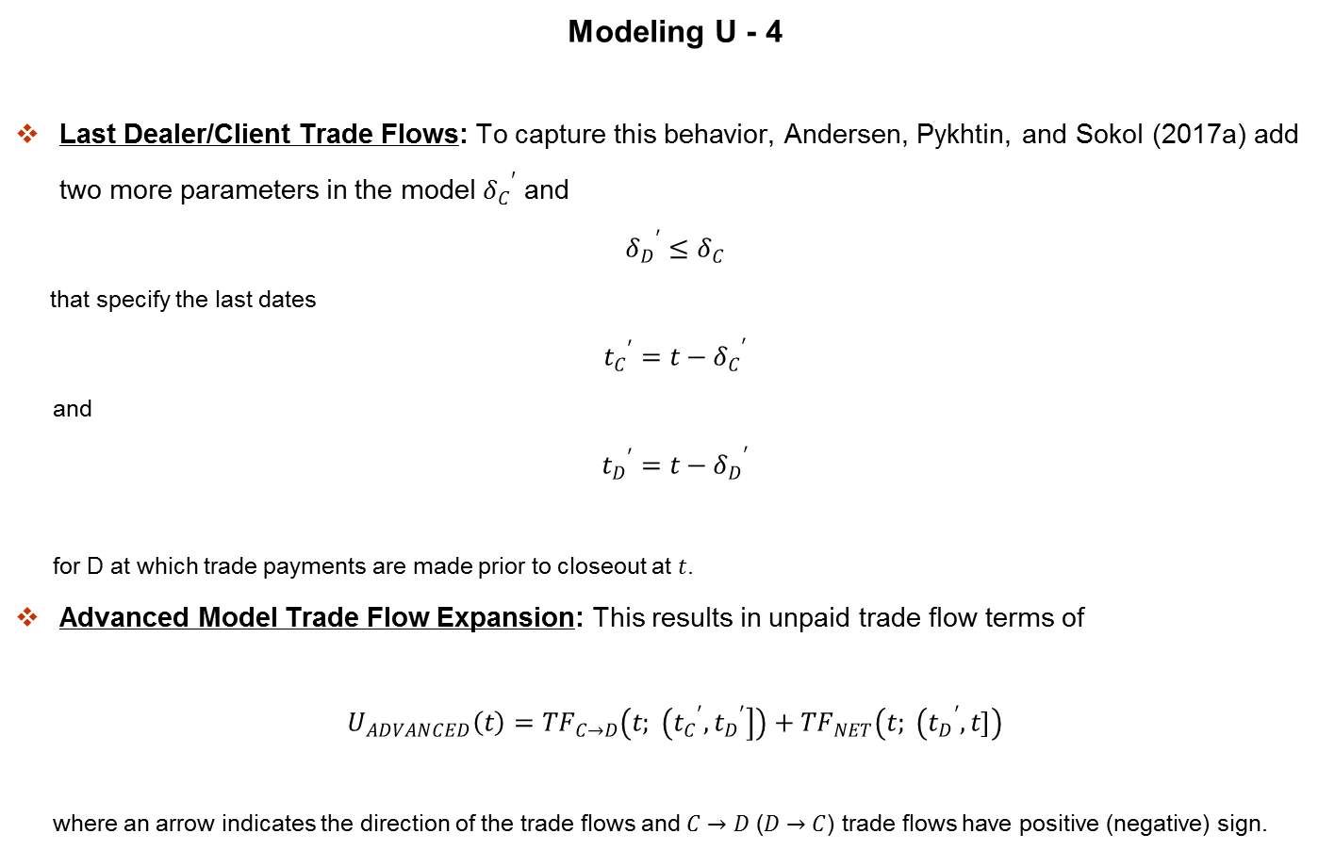
Dynamic Initial Margin Impact on Exposure
Modeling U - 4
Last Dealer/Client Trade Flows: To capture this behavior, Andersen, Pykhtin, and Sokol (2017a) add two more parameters in the model ${δ_{C}}^{′}$ and
$${δ_{D}}^{′}≤δ_{C}$$
that specify the last dates
$${t_{C}}^{′}=t−{δ_{C}}^{′}$$
and
$${t_{D}}^{′}=t−{δ_{D}}^{′}$$
for D at which trade payments are made prior to closeout at $t$.
Advanced Model Trade Flow Expansion: This results in unpaid trade flow terms of
$$U_{ADVANCED}\left(t\right)={TF}_{C→D}\left(t; \left({t_{C}}^{′}\right., \left.{t_{D}}^{′}\right]\right)+{TF}_{NET}\left(t; \left({t_{D}}^{′}\right., \left.t\right]\right)$$
where an arrow indicates the direction of the trade flows and $C→D$ ($D→C$) trade flows have positive (negative) sign.

Slide 19
Dynamic Initial Margin Impact on Exposure
Modeling U - 5
Advanced Model Exposure Profile Structure: The EE profiles obtained with the Advanced Model contain spikes that are typically narrower and have a more complex structure than spikes under the Classical+ model.
Rather than being unwelcome noise, it is argued in Andersen, Pykhtin, and Sokol (2017a) that spikes in EE profiles are important features that represent actual risk.
Approximating the Trade Flow Spikes: To eliminate any numerical instability associated with the spikes an approximation was proposed in Andersen, Pykhtin, and Sokol (2017a) for calculation of the EE on a daily time grid without daily re-evaluation of the portfolio.

Slide 20
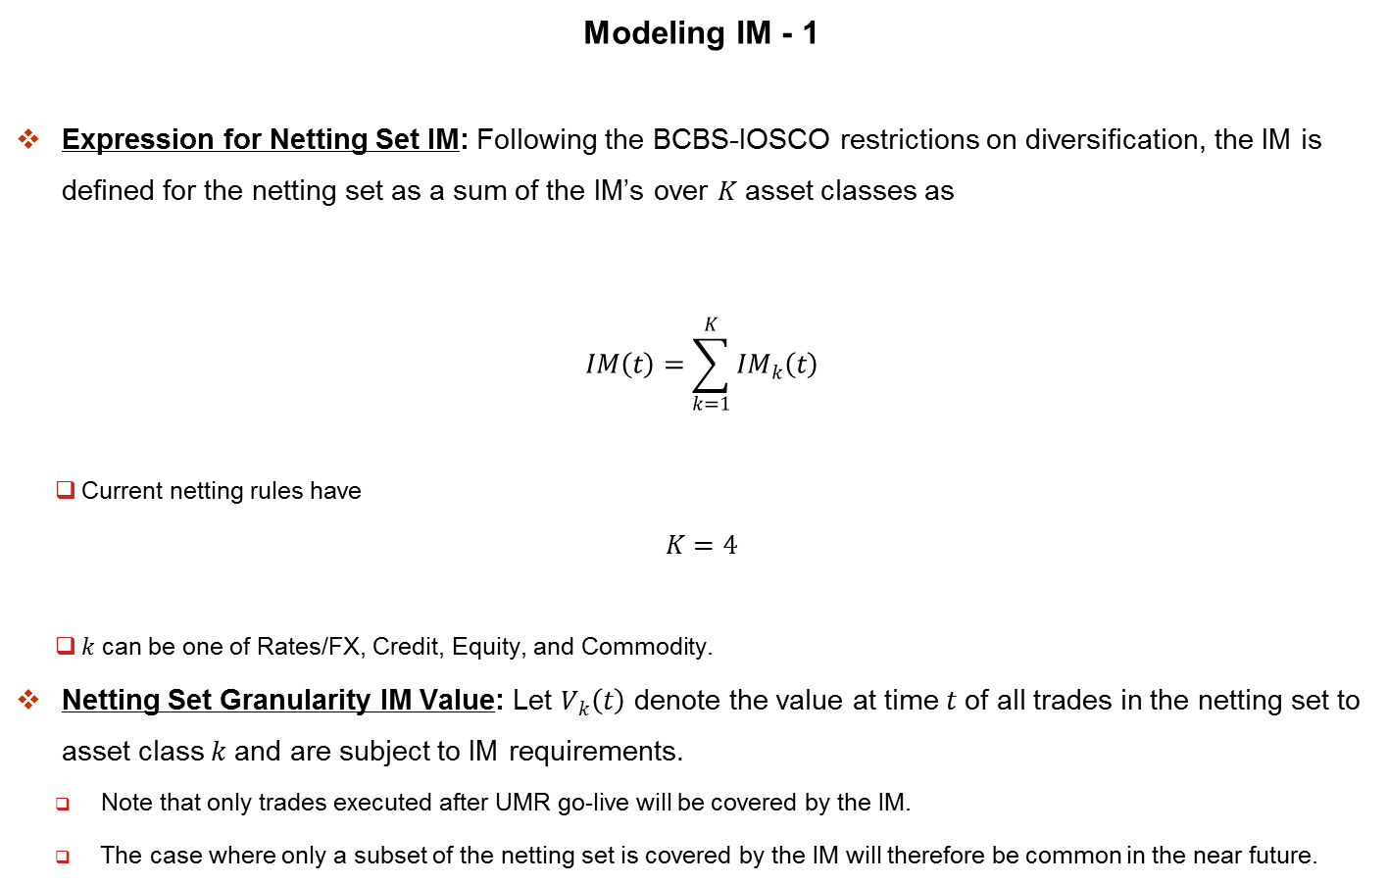
Dynamic Initial Margin Impact on Exposure
Modeling IM - 1
Expression for Netting Set IM: Following the BCBS-IOSCO restrictions on diversification, the IM is defined for the netting set as a sum of the IM’s over $K$ asset classes as
$$IM\left(t\right)=\sum_{k=1}^{K}{{IM}_{k}\left(t\right)}$$
Current netting rules have
$$K=4$$
$k$ can be one of Rates/FX, Credit, Equity, and Commodity.
Netting Set Granularity IM Value: Let $V_{k}\left(t\right)$ denote the value at time $t$ of all trades in the netting set to asset class $k$ and are subject to IM requirements.
Note that only trades executed after UMR go-live will be covered by the IM.
The case where only a subset of the netting set is covered by the IM will therefore be common in the near future.

Slide 21
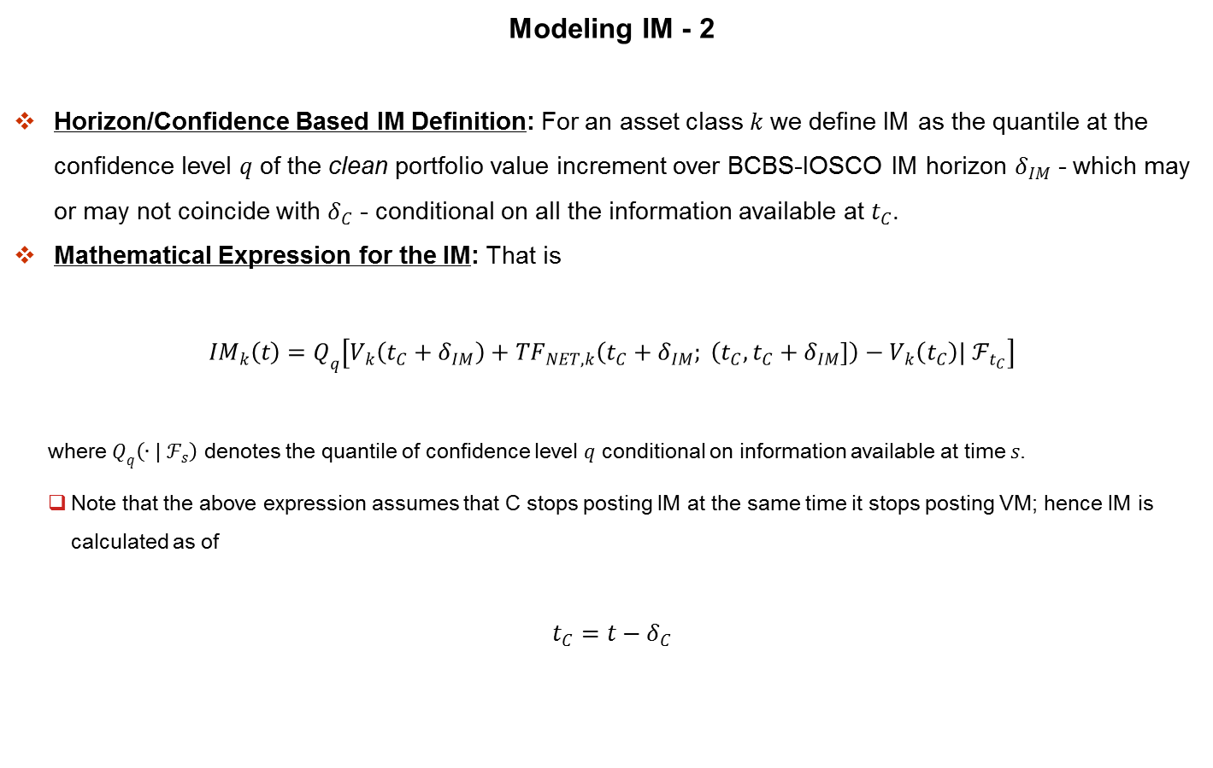
Dynamic Initial Margin Impact on Exposure
Modeling IM - 2
Horizon/Confidence Based IM Definition: For an asset class $k$ we define IM as the quantile at the confidence level $q$ of the clean portfolio value increment over BCBS-IOSCO IM horizon $δ_{IM}$ - which may or may not coincide with $δ_{C}$ - conditional on all the information available at $t_{C}$.
Mathematical Expression for the IM: That is
$${IM}_{k}\left(t\right)=Q_{q}\left[V_{k}\left(t_{C}+δ_{IM}\right)+{TF}_{NET, k}\left(t_{C}+δ_{IM}; \left(t_{C}\right., \left.t_{C}+δ_{IM}\right]\right)−V_{k}\left(t_{C}\right)| ℱ_{t_{C}}\right]$$
where $Q_{q}\left(∙| ℱ_{s}\right)$ denotes the quantile of confidence level $q$ conditional on information available at time $s$.
Note that the above expression assumes that C stops posting IM at the same time it stops posting VM; hence IM is calculated as of
$$t_{C}=t−δ_{C}$$

Slide 22
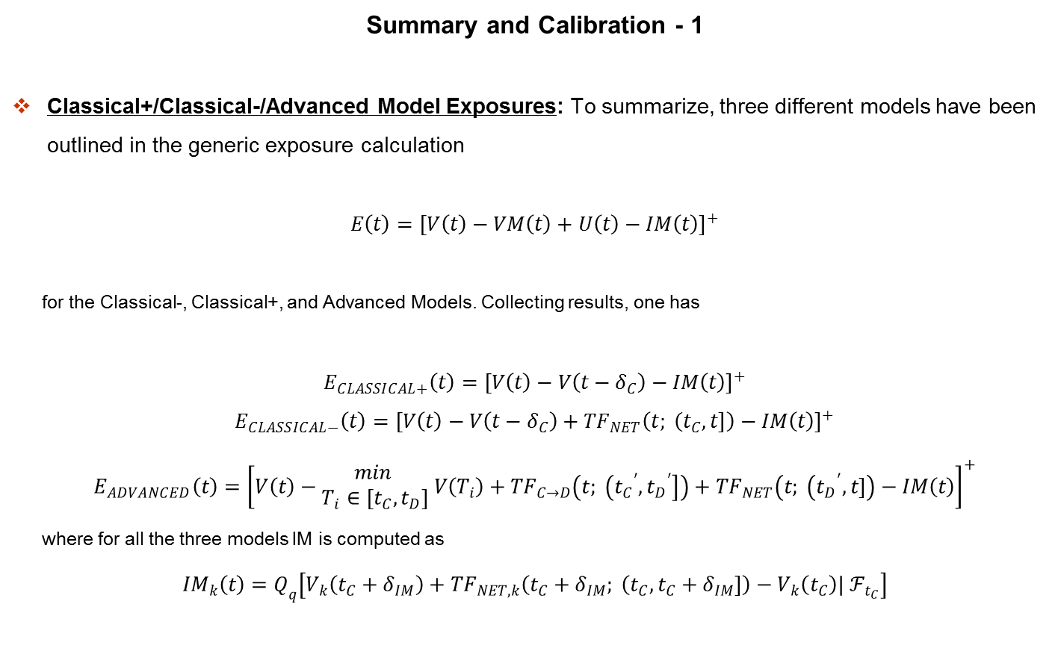
Dynamic Initial Margin Impact on Exposure
Summary and Calibration - 1
Classical+/Classical-/Advanced Model Exposures: To summarize, three different models have been outlined in the generic exposure calculation
$$E\left(t\right)={\left[V\left(t\right)−VM\left(t\right)+U\left(t\right)−IM\left(t\right)\right]}^{+}$$
for the Classical-, Classical+, and Advanced Models. Collecting results, one has
$$E_{CLASSICAL+}\left(t\right)={\left[V\left(t\right)−V\left(t−δ_{C}\right)−IM\left(t\right)\right]}^{+}$$
$$E_{CLASSICAL−}\left(t\right)={\left[V\left(t\right)−V\left(t−δ_{C}\right)+{TF}_{NET}\left(t; \left(t_{C}\right., \left.t\right]\right)−IM\left(t\right)\right]}^{+}$$
$$E_{ADVANCED}\left(t\right)={\left[V\left(t\right)−\begin{matrix}min \\ T_{i}∈\left[t_{C}, t_{D}\right]\end{matrix} V\left(T_{i}\right)+{TF}_{C→D}\left(t; \left({t_{C}}^{′}\right., \left.{t_{D}}^{′}\right]\right)+{TF}_{NET}\left(t; \left({t_{D}}^{′}\right., \left.t\right]\right)−IM\left(t\right)\right]}^{+}$$
where for all the three models IM is computed as
$${IM}_{k}\left(t\right)=Q_{q}\left[V_{k}\left(t_{C}+δ_{IM}\right)+{TF}_{NET, k}\left(t_{C}+δ_{IM}; \left(t_{C}\right., \left.t_{C}+δ_{IM}\right]\right)−V_{k}\left(t_{C}\right)| ℱ_{t_{C}}\right]$$

Slide 23
Dynamic Initial Margin Impact on Exposure
Summary and Calibration - 2
IMA/CSA Dealer/Client Suspension Rights: In practice, the calibration of the time parameters of the Advanced Model should be informed by the dealers’ legal rights and its aggressiveness in pursuing them.
For the former, Andersen, Pykhtin, and Sokol (2017a) contain a full discussion of ISDA Master Agreements.
But note that once a notice of Potential Event of Default (PED) has been served, the suspension rights of ISDA Master Agreement 2 (a) (iii) and its accompanying Credit Support Annex Paragraph 4 (a) allow a bank to suspend all trade-related and collateral-related payments to its counterparty until the PED has been cured.
Risks of Enforcing the Rights: The extent to which the suspension rights are actually exercised in practice, however, depends on the dealer and its operating model, as well as the specifics of each of the PED.
One particular danger in the aggressive and immediate enforcement of the suspension rights is that the original PED might be ruled unjustified.
Should this happen, the dealer can inadvertently commit a breach of contract, which, especially in the presence of the cross-default provisions, can have serious consequences for the dealer.

Slide 24
Dynamic Initial Margin Impact on Exposure
Summary and Calibration - 3
Calibrating the MPoR Lag Parameter: With the four time parameters, the Advanced Model allows for a greater flexibility in modeling its risk tolerance and procedures for exercising its suspension rights.
A dealer may, in fact, calibrate these parameters differently for different counter-parties to reflect its risk management practices towards counterparties of a given type. One may make the time parameters stochastic, e.g., by making the legs a function of the exposure magnitude.
This way one can, say, model the fact that a dealer might tighten its operational controls when the exposures are high.
Prototypical Aggressive vs. Conservative Timelines: Additional discussions can be found in Andersen, Pykhtin, and Sokol (2017a), which also provides some prototypical parameter settings; the Aggressive Calibration (D can always sniff out financial distress in its clients and is swift and aggressive in enforcing its legal rights) and the Conservative Calibration (D is deliberate and cautious in enforcing its rights, and acknowledges potential for operational errors and for rapid, unpredictable deterioration in client credit).
For the numerical results in this chapter, the values of the time parameters are mostly set in between the Aggressive and the Conservative.

Slide 25
Dynamic Initial Margin Impact on Exposure
The Impact of IM: No Trade Flows within the MPoR - 1
No Trade Flow IM EE Impact: This section examines the impact of IM on EE when there are no trade flows within the MPoR.
For simplicity the Classical Model is considered, and the entire netting set is assumed to be covered by the IM and comprised of all trades belonging to the same asset class.
Results for the Advanced Models are similar, as shown in the later sections.

Slide 26
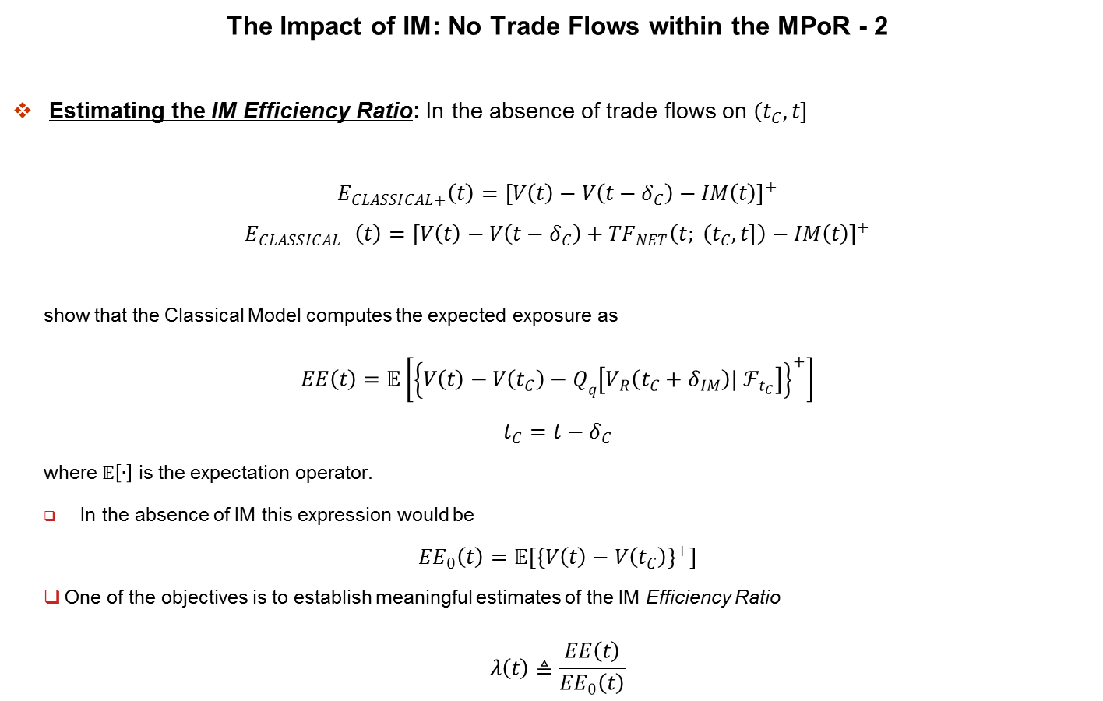
Dynamic Initial Margin Impact on Exposure
The Impact of IM: No Trade Flows within the MPoR - 2
Estimating the IM Efficiency Ratio: In the absence of trade flows on $\left(t_{C}\right., \left.t\right]$
$$E_{CLASSICAL+}\left(t\right)={\left[V\left(t\right)−V\left(t−δ_{C}\right)−IM\left(t\right)\right]}^{+}$$
$$E_{CLASSICAL−}\left(t\right)={\left[V\left(t\right)−V\left(t−δ_{C}\right)+{TF}_{NET}\left(t; \left(t_{C}\right., \left.t\right]\right)−IM\left(t\right)\right]}^{+}$$
show that the Classical Model computes the expected exposure as
$$EE\left(t\right)=𝔼\left[{\left\{V\left(t\right)−V\left(t_{C}\right)−Q_{q}\left[V_{R}\left(t_{C}+δ_{IM}\right)| ℱ_{t_{C}}\right]\right\}}^{+}\right]$$
$$t_{C}=t−δ_{C}$$
where $𝔼\left[∙\right]$ is the expectation operator.
In the absence of IM this expression would be
$${EE}_{0}\left(t\right)=𝔼\left[{\left\{V\left(t\right)−V\left(t_{C}\right)\right\}}^{+}\right]$$
One of the objectives is to establish meaningful estimates of the IM Efficiency Ratio
$$λ\left(t\right)≜\frac{EE\left(t\right)}{{EE}_{0}\left(t\right)}$$

Slide 27
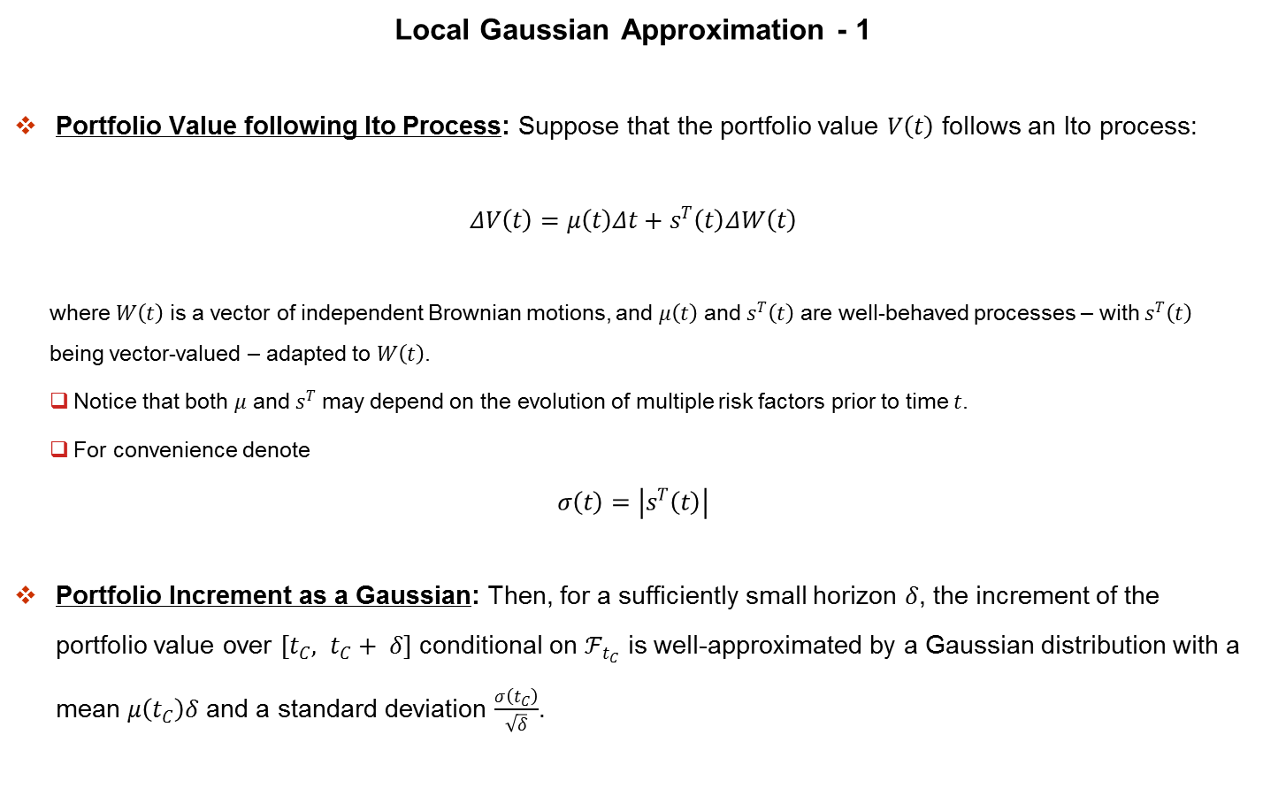
Dynamic Initial Margin Impact on Exposure
Local Gaussian Approximation - 1
Portfolio Value following Ito Process: Suppose that the portfolio value $V\left(t\right)$ follows an Ito process:
$$ΔV\left(t\right)=μ\left(t\right)Δt+s^{T}\left(t\right)ΔW\left(t\right)$$
where $W\left(t\right)$ is a vector of independent Brownian motions, and $μ\left(t\right)$ and $s^{T}\left(t\right)$ are well-behaved processes – with $s^{T}\left(t\right)$ being vector-valued – adapted to $W\left(t\right)$.
Notice that both $μ$ and $s^{T}$ may depend on the evolution of multiple risk factors prior to time $t$.
For convenience denote
$$σ\left(t\right)=\left|s^{T}\left(t\right)\right|$$
Portfolio Increment as a Gaussian: Then, for a sufficiently small horizon $δ$, the increment of the portfolio value over $\left[t_{C}, t_{C}+ δ\right]$ conditional on $ℱ_{t_{C}}$ is well-approximated by a Gaussian distribution with a mean $μ\left(t_{C}\right)δ$ and a standard deviation $\frac{σ\left(t_{C}\right)}{\sqrt{δ}}$.

Slide 28
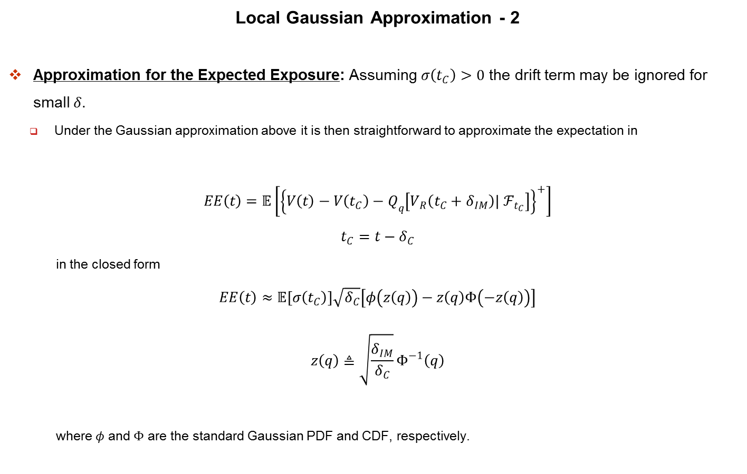
Dynamic Initial Margin Impact on Exposure
Local Gaussian Approximation - 2
Approximation for the Expected Exposure: Assuming $σ\left(t_{C}\right)>0$ the drift term may be ignored for small $δ$.
Under the Gaussian approximation above it is then straightforward to approximate the expectation in
$$EE\left(t\right)=𝔼\left[{\left\{V\left(t\right)−V\left(t_{C}\right)−Q_{q}\left[V_{R}\left(t_{C}+δ_{IM}\right)| ℱ_{t_{C}}\right]\right\}}^{+}\right]$$
$$t_{C}=t−δ_{C}$$
in the closed form
$$EE\left(t\right)≈𝔼\left[σ\left(t_{C}\right)\right]\sqrt{δ_{C}}\left[φ\left(z\left(q\right)\right)−z\left(q\right)Φ\left(−z\left(q\right)\right)\right]$$
$$z\left(q\right)≜\sqrt{\frac{δ_{IM}}{δ_{C}}}Φ^{−1}\left(q\right)$$
where $φ$ and $Φ$ are the standard Gaussian PDF and CDF, respectively.

Slide 29

Dynamic Initial Margin Impact on Exposure
Local Gaussian Approximation - 3
Expression for IM Efficiency Ratio: Similarly
$${EE}_{0}\left(t\right)≈𝔼\left[σ\left(t_{C}\right)\right]\sqrt{δ_{C}}φ\left(0\right)$$
so that $λ$ in
$$λ\left(t\right)≜\frac{EE\left(t\right)}{{EE}_{0}\left(t\right)}$$
is approximated by
$$λ\left(t\right)≈\frac{φ\left(z\left(q\right)\right)−z\left(q\right)Φ\left(−z\left(q\right)\right)}{φ\left(0\right)}$$

Slide 30

Dynamic Initial Margin Impact on Exposure
Local Gaussian Approximation - 4
$λ$ Dependence: $q/MPoR$ Ratio: Interestingly, the multiplier $λ\left(t\right)$ above is independent of $t$ and depends only on two quantities – the confidence level $q$ used for specifying the IM, and the ratio of the IM horizon to the $MPoR$.
It is emphasized that the above expression for $λ\left(t\right)$ was derived under weak conditions; relying on the local normality assumptions for portfolio value increments.
Otherwise, the ratio is model-free; no further assumptions are made on the distribution of the portfolio value or on the dependence of the local volatility on risk factors.
$λ$ Exact under Brownian Motion: The special case for which the above expression for $λ$ becomes exact is when the portfolio process follows a Brownian motion, a case discussed in Gregory (2015).
The point here is that the $λ\left(t\right)$ above constitutes a small-$δ$ limit, and a useful approximation, for a much broader class of processes.
In fact it can be extended to jump-diffusion processes, provided that the portfolio jumps are approximately Gaussian.

