Slide 1

Exposure Analytics
Exposure in the Presence of Margin
GMIT
Intra-day Credit Risk Monitoring
New York
Lakshmi Krishnamurthy
v0.48 20 July 2018

Slide 2
Exposure in the Presence of Margin
Overview
Margin Based Credit Exposure Reduction: Margin agreements as a means of reducing counterparty credit exposure.
Calculating MPoR Collateralized Exposures:
Collateralized Exposure and Margin Period of Risk
Semi-analytical Method for calculating collateralized EE
3. Analysis of Basel Exposure Methods: Analysis of Basel Shortcut method for Effective EPE.

Slide 3
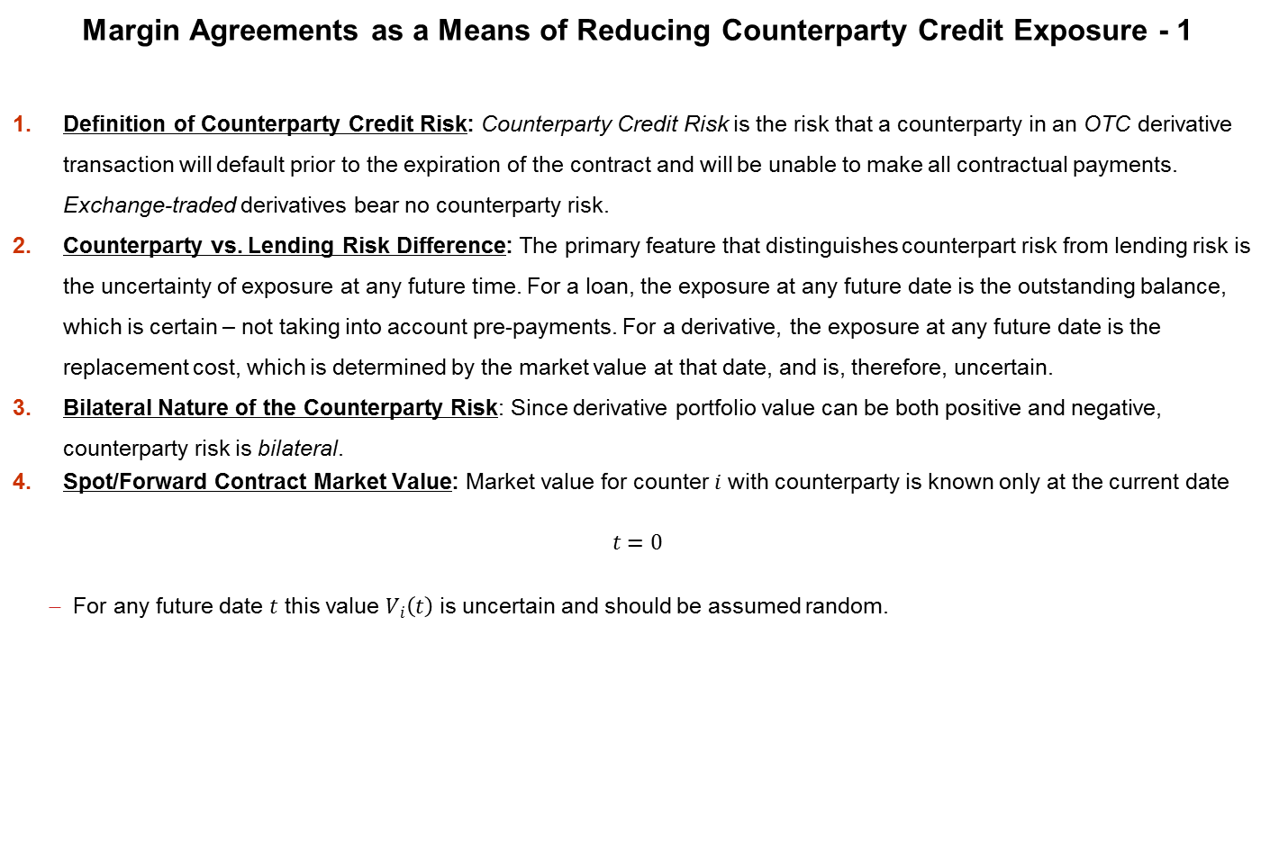
Exposure in the Presence of Margin
Margin Agreements as a Means of Reducing Counterparty Credit Exposure - 1
Definition of Counterparty Credit Risk: Counterparty Credit Risk is the risk that a counterparty in an OTC derivative transaction will default prior to the expiration of the contract and will be unable to make all contractual payments. Exchange-traded derivatives bear no counterparty risk.
Counterparty vs. Lending Risk Difference: The primary feature that distinguishes counterpart risk from lending risk is the uncertainty of exposure at any future time. For a loan, the exposure at any future date is the outstanding balance, which is certain – not taking into account pre-payments. For a derivative, the exposure at any future date is the replacement cost, which is determined by the market value at that date, and is, therefore, uncertain.
Bilateral Nature of the Counterparty Risk: Since derivative portfolio value can be both positive and negative, counterparty risk is bilateral.
Spot/Forward Contract Market Value: Market value for counter $i$ with counterparty is known only at the current date
$$t=0$$
For any future date $t$ this value $V_{i}\left(t\right)$ is uncertain and should be assumed random.

Slide 4
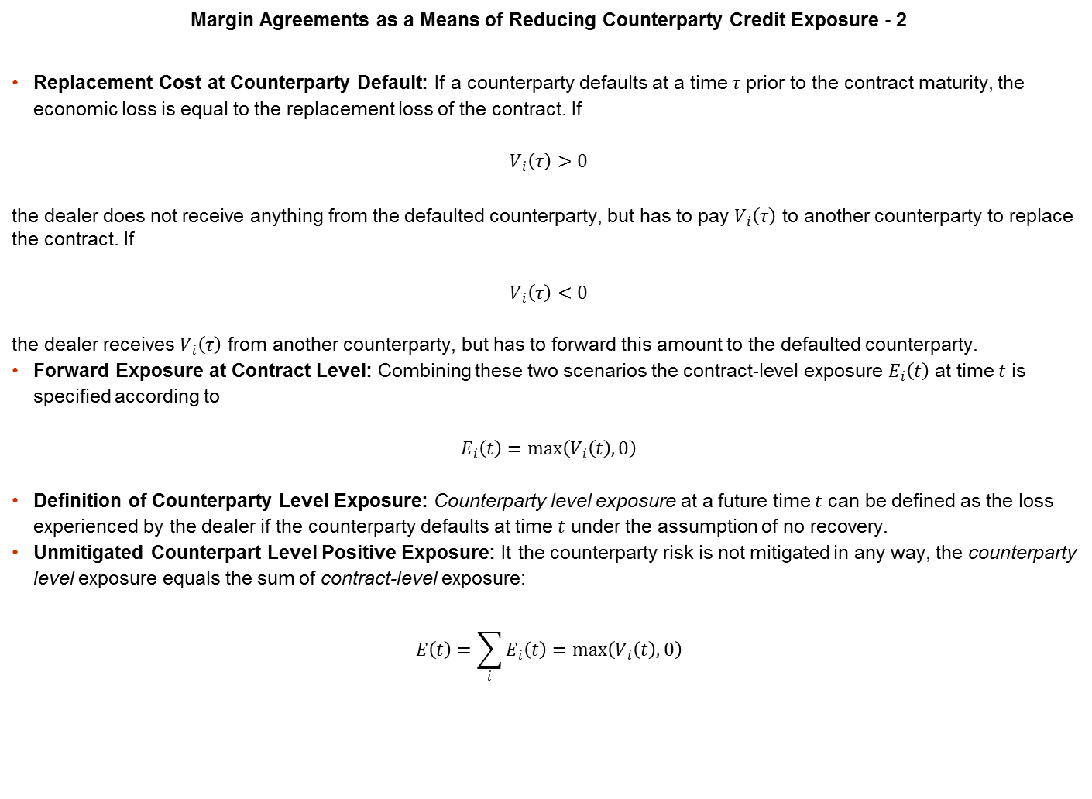
Exposure in the Presence of Margin
Margin Agreements as a Means of Reducing Counterparty Credit Exposure - 2
Replacement Cost at Counterparty Default: If a counterparty defaults at a time $τ$ prior to the contract maturity, the economic loss is equal to the replacement loss of the contract. If
$$V_{i}\left(τ\right)>0$$
the dealer does not receive anything from the defaulted counterparty, but has to pay $V_{i}\left(τ\right)$ to another counterparty to replace the contract. If
$$V_{i}\left(τ\right)<0$$
the dealer receives $V_{i}\left(τ\right)$ from another counterparty, but has to forward this amount to the defaulted counterparty.
Forward Exposure at Contract Level: Combining these two scenarios the contract-level exposure $E_{i}\left(t\right)$ at time $t$ is specified according to
$$E_{i}\left(t\right)=\max\left(V_{i}\left(t\right), 0\right)$$
Definition of Counterparty Level Exposure: Counterparty level exposure at a future time $t$ can be defined as the loss experienced by the dealer if the counterparty defaults at time $t$ under the assumption of no recovery.
Unmitigated Counterpart Level Positive Exposure: It the counterparty risk is not mitigated in any way, the counterparty level exposure equals the sum of contract-level exposure:
$$E\left(t\right)=\sum_{i}{E_{i}\left(t\right)}=\max\left(V_{i}\left(t\right), 0\right)$$

Slide 5
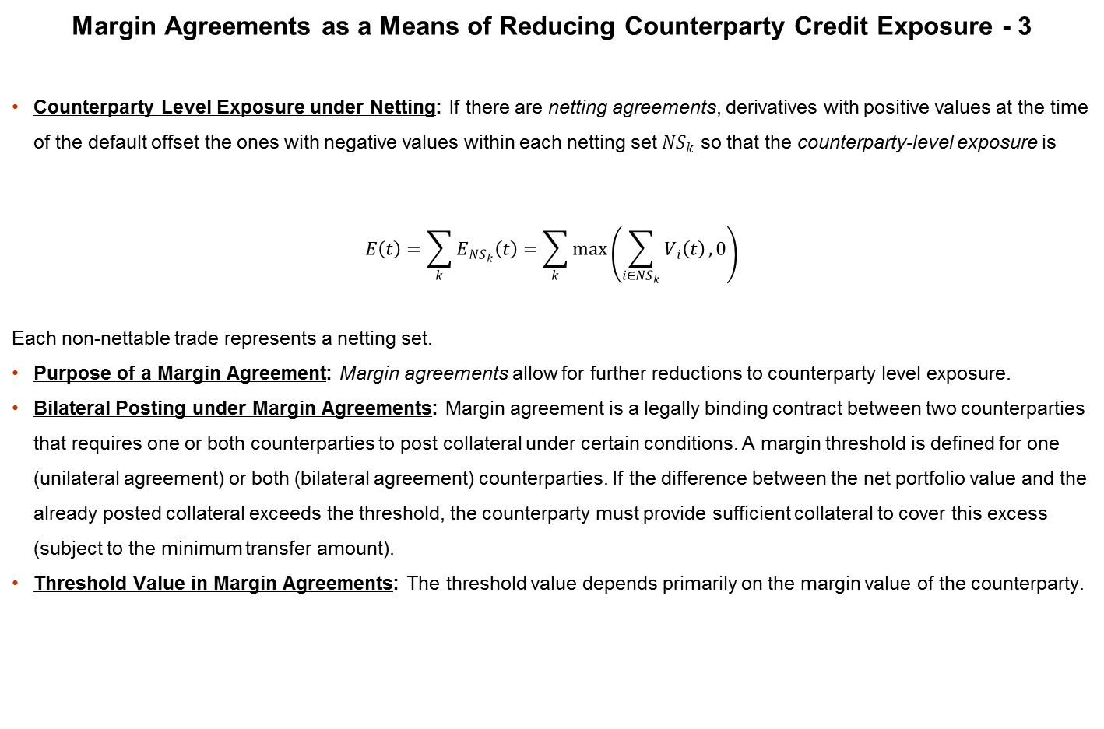
Exposure in the Presence of Margin
Margin Agreements as a Means of Reducing Counterparty Credit Exposure - 3
Counterparty Level Exposure under Netting: If there are netting agreements, derivatives with positive values at the time of the default offset the ones with negative values within each netting set ${NS}_{k}$ so that the counterparty-level exposure is
$$E\left(t\right)=\sum_{k}{E_{{NS}_{k}}\left(t\right)}=\sum_{k}{\max\left(\sum_{i∈{NS}_{k}}{V_{i}\left(t\right)}, 0\right)}$$
Each non-nettable trade represents a netting set.
Purpose of a Margin Agreement: Margin agreements allow for further reductions to counterparty level exposure.
Bilateral Posting under Margin Agreements: Margin agreement is a legally binding contract between two counterparties that requires one or both counterparties to post collateral under certain conditions. A margin threshold is defined for one (unilateral agreement) or both (bilateral agreement) counterparties. If the difference between the net portfolio value and the already posted collateral exceeds the threshold, the counterparty must provide sufficient collateral to cover this excess (subject to the minimum transfer amount).
Threshold Value in Margin Agreements: The threshold value depends primarily on the margin value of the counterparty.

Slide 6
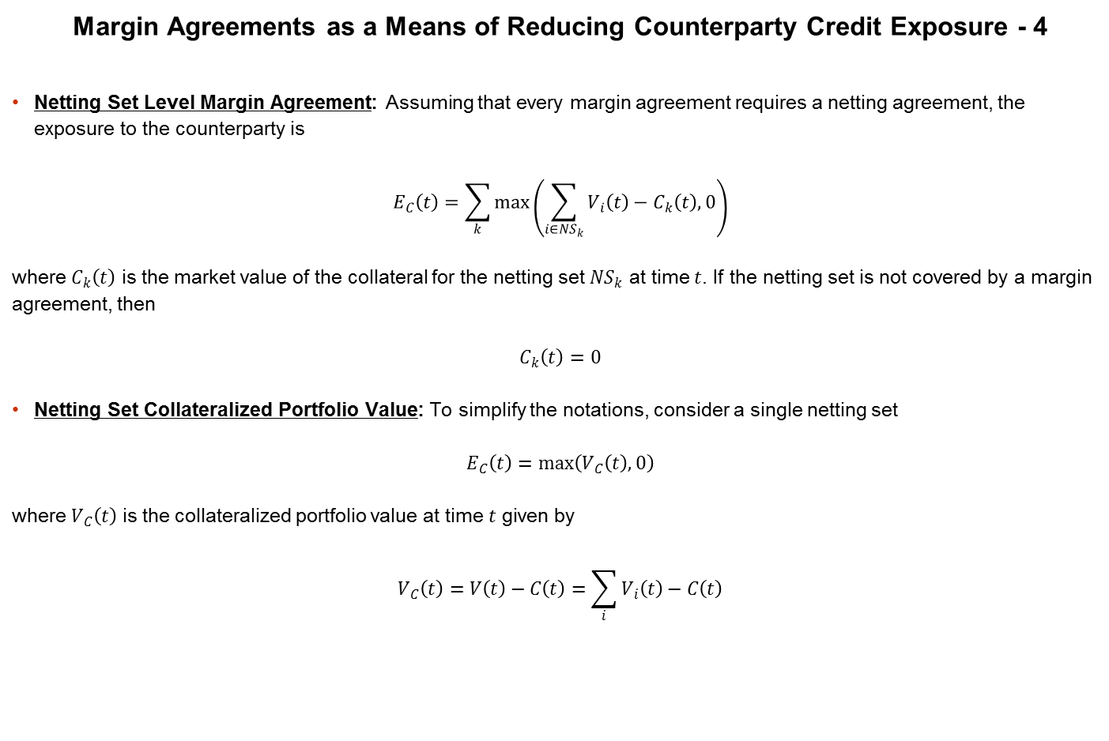
Exposure in the Presence of Margin
Margin Agreements as a Means of Reducing Counterparty Credit Exposure - 4
Netting Set Level Margin Agreement: Assuming that every margin agreement requires a netting agreement, the exposure to the counterparty is
$$E_{C}\left(t\right)=\sum_{k}{\max\left(\sum_{i∈{NS}_{k}}{V_{i}\left(t\right)}−C_{k}\left(t\right), 0\right)}$$
where $C_{k}\left(t\right)$ is the market value of the collateral for the netting set ${NS}_{k}$ at time $t$. If the netting set is not covered by a margin agreement, then
$$C_{k}\left(t\right)=0$$
Netting Set Collateralized Portfolio Value: To simplify the notations, consider a single netting set
$$E_{C}\left(t\right)=\max\left(V_{C}\left(t\right), 0\right)$$
where $V_{C}\left(t\right)$ is the collateralized portfolio value at time $t$ given by
$$V_{C}\left(t\right)=V\left(t\right)−C\left(t\right)=\sum_{i}{V_{i}\left(t\right)}−C\left(t\right)$$

Slide 7
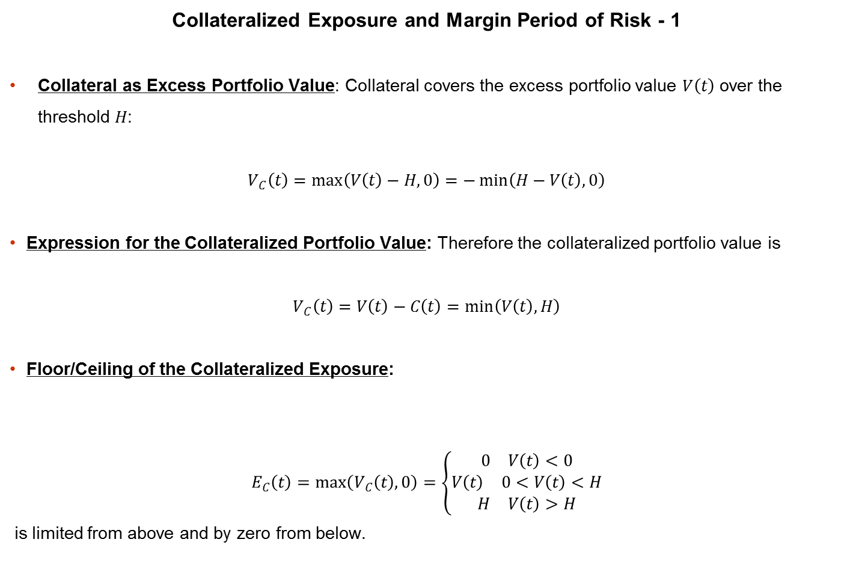
Exposure in the Presence of Margin
Collateralized Exposure and Margin Period of Risk - 1
Collateral as Excess Portfolio Value: Collateral covers the excess portfolio value $V\left(t\right)$ over the threshold $H$:
$$V_{C}\left(t\right)=\max\left(V\left(t\right)−H, 0\right)=−\min\left(H−V\left(t\right), 0\right)$$
Expression for the Collateralized Portfolio Value: Therefore the collateralized portfolio value is
$$V_{C}\left(t\right)=V\left(t\right)−C\left(t\right)=\min\left(V\left(t\right), H\right)$$
Floor/Ceiling of the Collateralized Exposure:
$$E_{C}\left(t\right)=\max\left(V_{C}\left(t\right), 0\right)=\left\{\begin{aligned}\begin{matrix}0 & V\left(t\right)<0\end{matrix} \\ \begin{matrix}V\left(t\right) & 0<V\left(t\right)<H\end{matrix} \\ \begin{matrix}H & V\left(t\right)>H\end{matrix}\end{aligned}\right.$$
is limited from above and by zero from below.

Slide 8
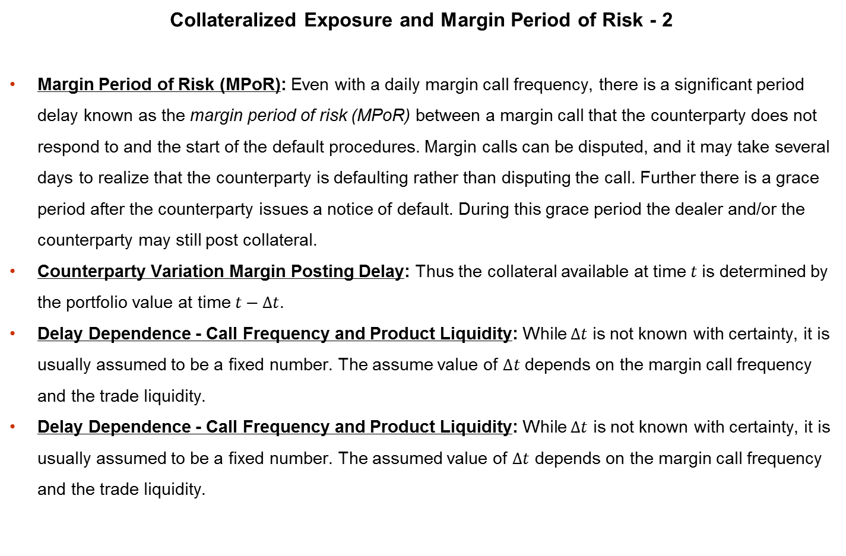
Exposure in the Presence of Margin
Collateralized Exposure and Margin Period of Risk - 2
Margin Period of Risk (MPoR): Even with a daily margin call frequency, there is a significant period delay known as the margin period of risk (MPoR) between a margin call that the counterparty does not respond to and the start of the default procedures. Margin calls can be disputed, and it may take several days to realize that the counterparty is defaulting rather than disputing the call. Further there is a grace period after the counterparty issues a notice of default. During this grace period the dealer and/or the counterparty may still post collateral.
Counterparty Variation Margin Posting Delay: Thus the collateral available at time $t$ is determined by the portfolio value at time $t−∆t$.
Delay Dependence - Call Frequency and Product Liquidity: While $∆t$ is not known with certainty, it is usually assumed to be a fixed number. The assume value of $∆t$ depends on the margin call frequency and the trade liquidity.
Delay Dependence - Call Frequency and Product Liquidity: While $∆t$ is not known with certainty, it is usually assumed to be a fixed number. The assumed value of $∆t$ depends on the margin call frequency and the trade liquidity.

Slide 9
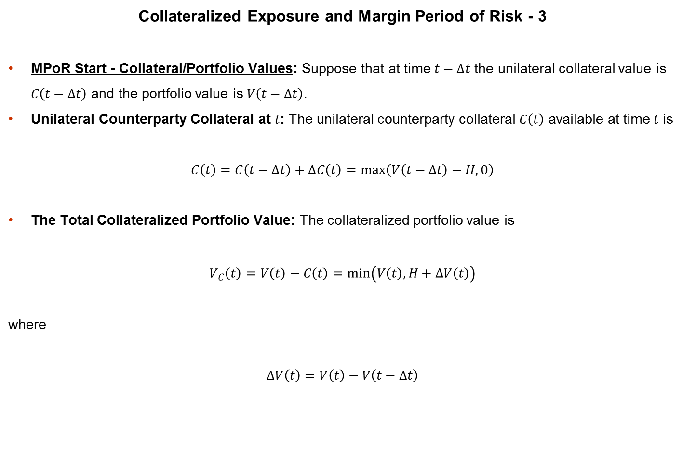
Exposure in the Presence of Margin
Collateralized Exposure and Margin Period of Risk - 3
MPoR Start - Collateral/Portfolio Values: Suppose that at time $t−∆t$ the unilateral collateral value is $C\left(t−∆t\right)$ and the portfolio value is $V\left(t−∆t\right)$.
Unilateral Counterparty Collateral at $t$: The unilateral counterparty collateral $C\left(t\right)$ available at time $t$ is
$$C\left(t\right)=C\left(t−∆t\right)+∆C\left(t\right)=\max\left(V\left(t−∆t\right)−H, 0\right)$$
The Total Collateralized Portfolio Value: The collateralized portfolio value is
$$V_{C}\left(t\right)=V\left(t\right)−C\left(t\right)=\min\left(V\left(t\right), H+∆V\left(t\right)\right)$$
where
$$∆V\left(t\right)=V\left(t\right)−V\left(t−∆t\right)$$

Slide 10

Exposure in the Presence of Margin
Collateralized Exposure and Margin Period of Risk - 4
Monte-Carlo Look-back Points: For each
$$t_{k}>∆t$$
define a lookback point at time $t_{k}−∆t$
Monte Carlo Primary Plus Lookback: The task is to simulate the non-collateralized portfolio value along the path that includes both the primary and the lookback simulation times.

Slide 11
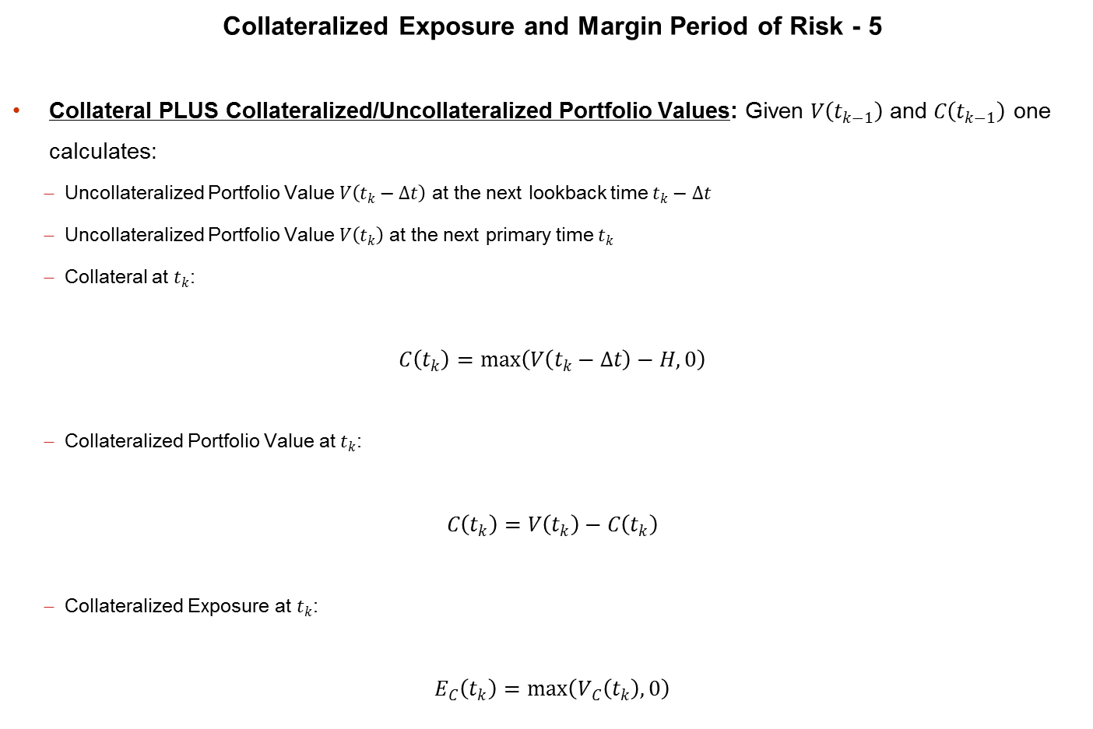
Exposure in the Presence of Margin
Collateralized Exposure and Margin Period of Risk - 5
Collateral PLUS Collateralized/Uncollateralized Portfolio Values: Given $V\left(t_{k−1}\right)$ and $C\left(t_{k−1}\right)$ one calculates:
Uncollateralized Portfolio Value $V\left(t_{k}−∆t\right)$ at the next lookback time $t_{k}−∆t$
Uncollateralized Portfolio Value $V\left(t_{k}\right)$ at the next primary time $t_{k}$
Collateral at $t_{k}$:
$$C\left(t_{k}\right)=\max\left(V\left(t_{k}−∆t\right)−H, 0\right)$$
Collateralized Portfolio Value at $t_{k}$:
$$C\left(t_{k}\right)=V\left(t_{k}\right)−C\left(t_{k}\right)$$
Collateralized Exposure at $t_{k}$:
$$E_{C}\left(t_{k}\right)=\max\left(V_{C}\left(t_{k}\right), 0\right)$$

Slide 12
Exposure in the Presence of Margin
Collateralized Exposure and Margin Period of Risk - 6
Simulating the Collateralized Portfolio Value: Collateralized threshold can go above the threshold due to MPR and MTA.

Slide 13
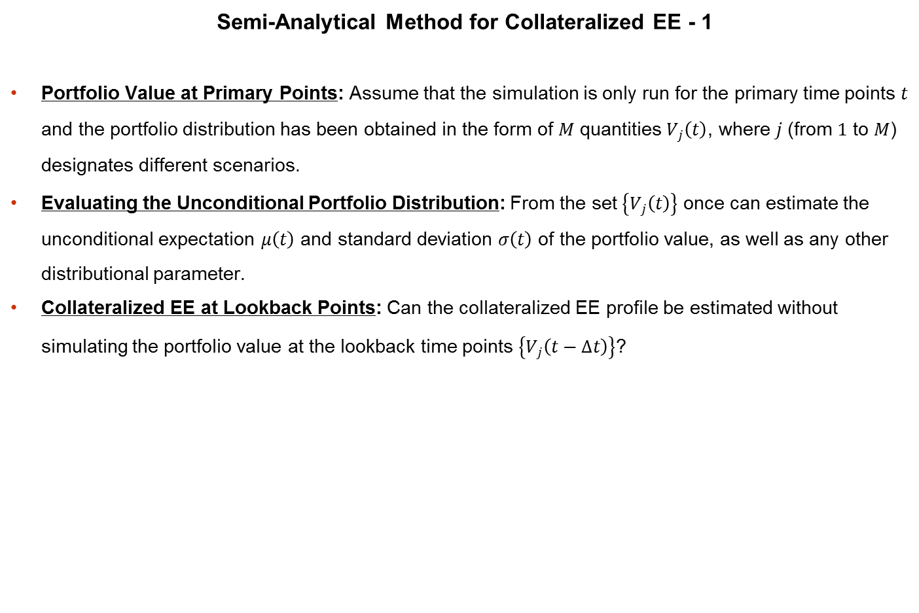
Exposure in the Presence of Margin
Semi-Analytical Method for Collateralized EE - 1
Portfolio Value at Primary Points: Assume that the simulation is only run for the primary time points $t$ and the portfolio distribution has been obtained in the form of $M$ quantities $V_{j}\left(t\right)$, where $j$ (from $1$ to $M$) designates different scenarios.
Evaluating the Unconditional Portfolio Distribution: From the set $\left\{V_{j}\left(t\right)\right\}$ once can estimate the unconditional expectation $μ\left(t\right)$ and standard deviation $σ\left(t\right)$ of the portfolio value, as well as any other distributional parameter.
Collateralized EE at Lookback Points: Can the collateralized EE profile be estimated without simulating the portfolio value at the lookback time points $\left\{V_{j}\left(t−∆t\right)\right\}$?

Slide 14
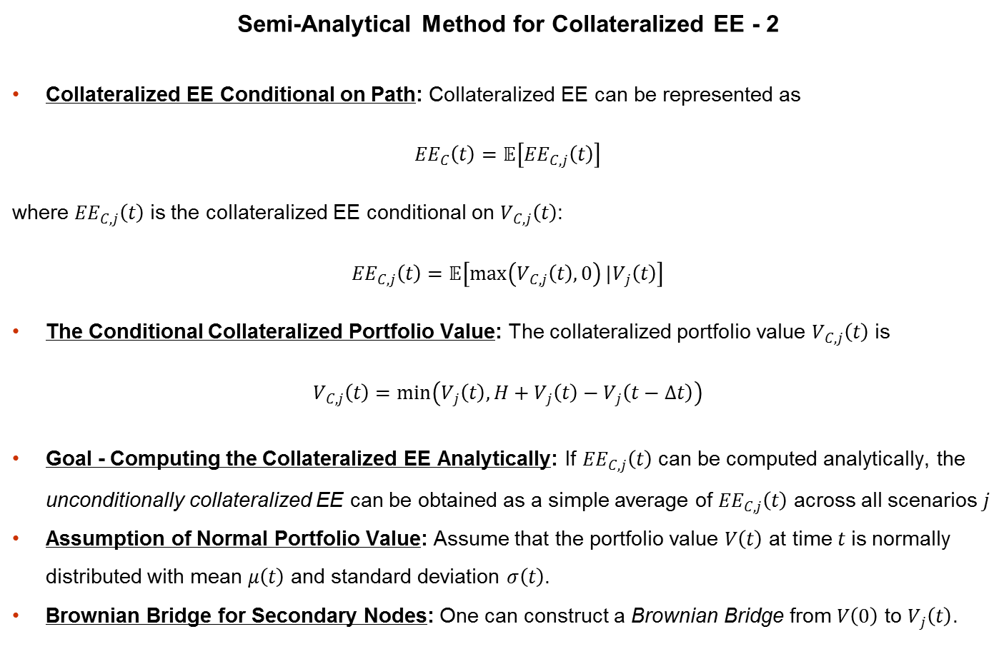
Exposure in the Presence of Margin
Semi-Analytical Method for Collateralized EE - 2
Collateralized EE Conditional on Path: Collateralized EE can be represented as
$${EE}_{C}\left(t\right)=𝔼\left[{EE}_{C, j}\left(t\right)\right]$$
where ${EE}_{C, j}\left(t\right)$ is the collateralized EE conditional on $V_{C, j}\left(t\right)$:
$${EE}_{C, j}\left(t\right)=𝔼\left[\max\left(V_{C, j}\left(t\right), 0\right)|V_{j}\left(t\right)\right]$$
The Conditional Collateralized Portfolio Value: The collateralized portfolio value $V_{C, j}\left(t\right)$ is
$$V_{C, j}\left(t\right)=\min\left(V_{j}\left(t\right), H+V_{j}\left(t\right)−V_{j}\left(t−∆t\right)\right)$$
Goal - Computing the Collateralized EE Analytically: If ${EE}_{C, j}\left(t\right)$ can be computed analytically, the unconditionally collateralized EE can be obtained as a simple average of ${EE}_{C, j}\left(t\right)$ across all scenarios $j$
Assumption of Normal Portfolio Value: Assume that the portfolio value $V\left(t\right)$ at time $t$ is normally distributed with mean $μ\left(t\right)$ and standard deviation $σ\left(t\right)$.
Brownian Bridge for Secondary Nodes: One can construct a Brownian Bridge from $V\left(0\right)$ to $V_{j}\left(t\right)$.

Slide 15
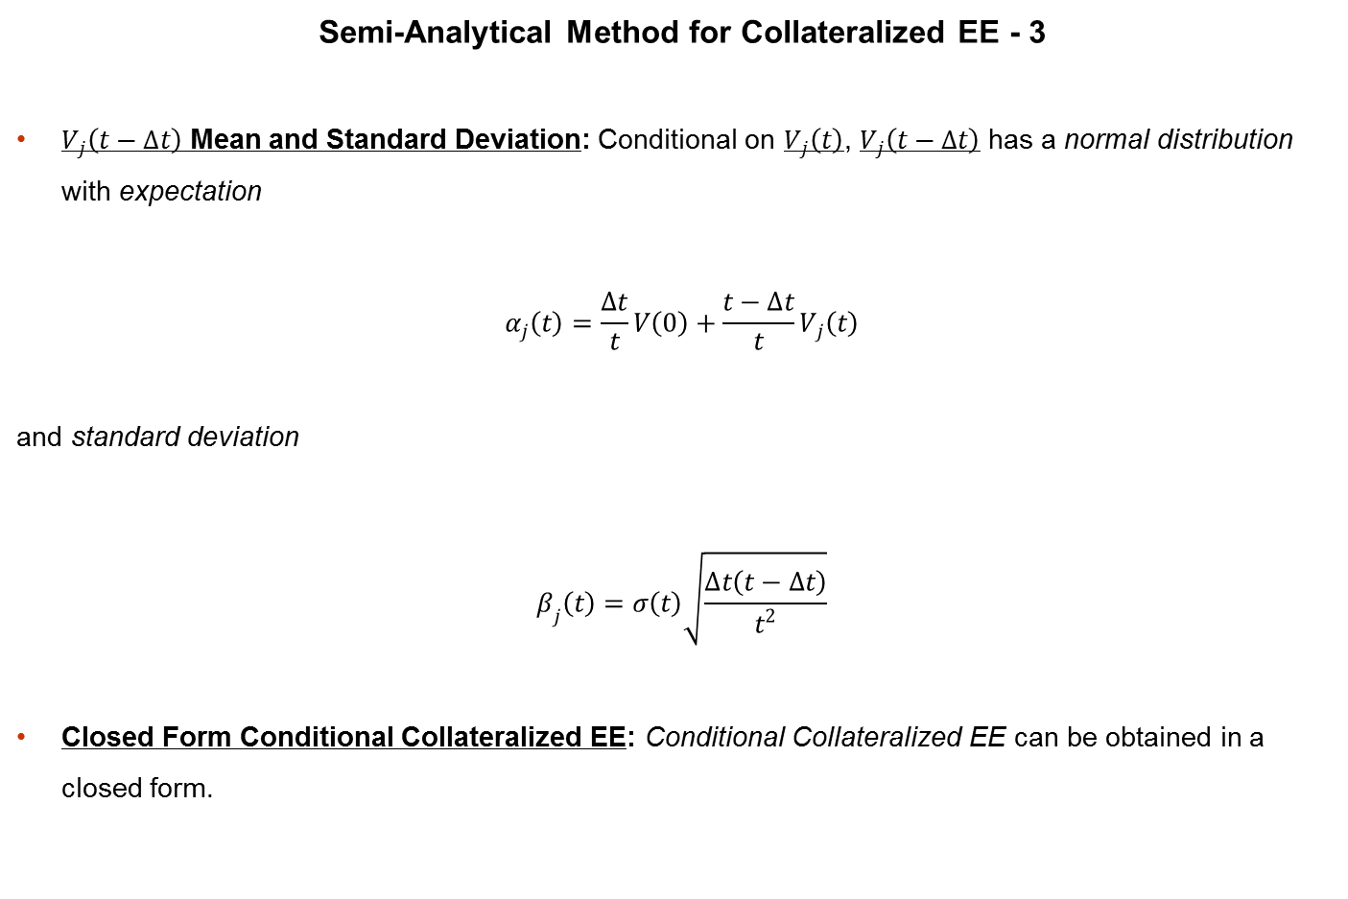
Exposure in the Presence of Margin
Semi-Analytical Method for Collateralized EE - 3
$V_{j}\left(t−∆t\right)$ Mean and Standard Deviation: Conditional on $V_{j}\left(t\right)$, $V_{j}\left(t−∆t\right)$ has a normal distribution with expectation
$$α_{j}\left(t\right)=\frac{∆t}{t}V\left(0\right)+\frac{t−∆t}{t}V_{j}\left(t\right)$$
and standard deviation
$$β_{j}\left(t\right)=σ\left(t\right)\sqrt{\frac{∆t\left(t−∆t\right)}{t^{2}}}$$
Closed Form Conditional Collateralized EE: Conditional Collateralized EE can be obtained in a closed form.

Slide 16
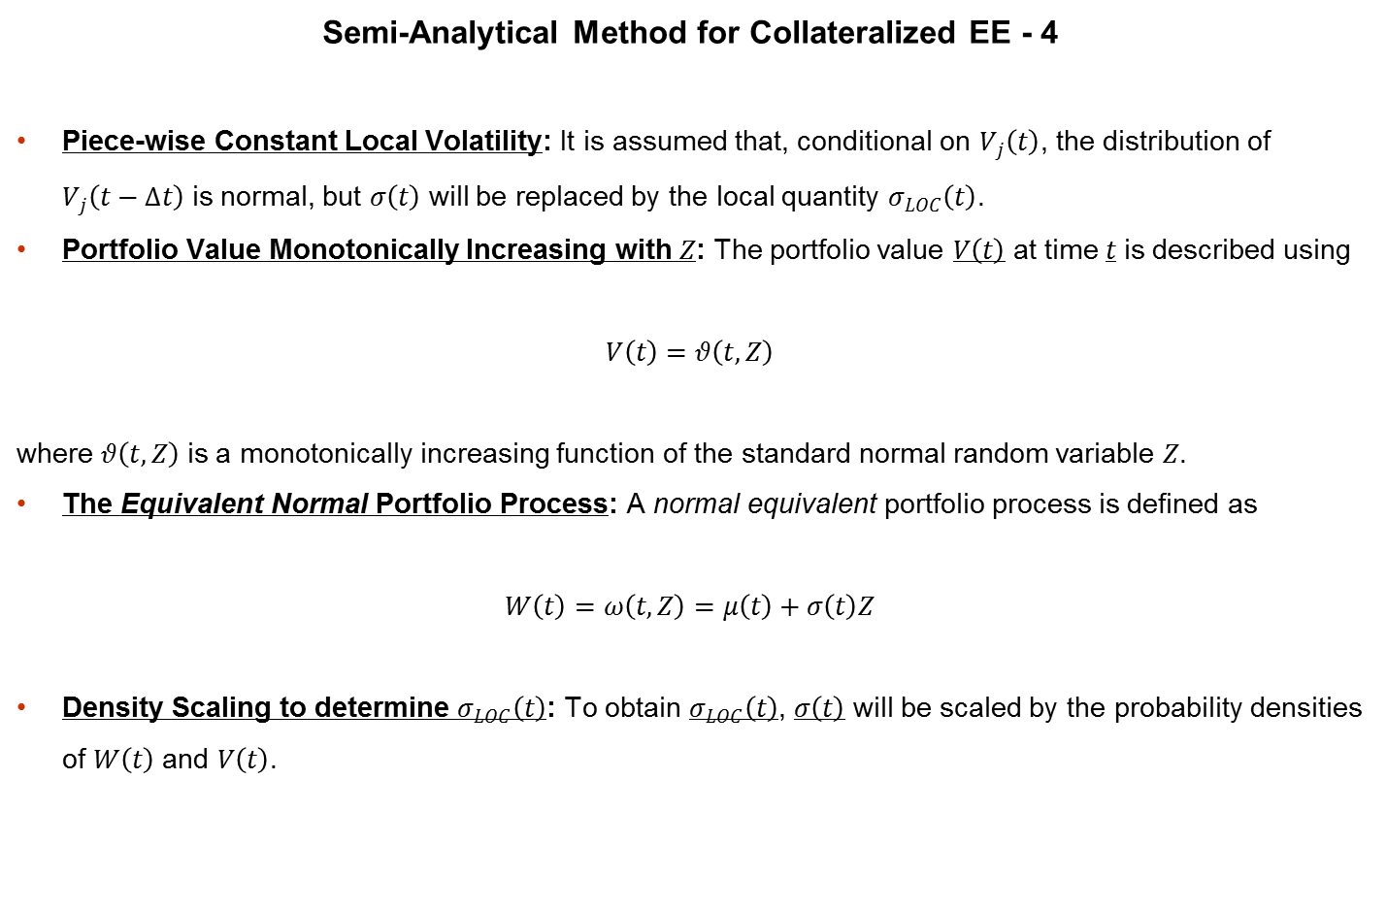
Exposure in the Presence of Margin
Semi-Analytical Method for Collateralized EE - 4
Piece-wise Constant Local Volatility: It is assumed that, conditional on $V_{j}\left(t\right)$, the distribution of $V_{j}\left(t−∆t\right)$ is normal, but $σ\left(t\right)$ will be replaced by the local quantity $σ_{LOC}\left(t\right)$.
Portfolio Value Monotonically Increasing with $Z$: The portfolio value $V\left(t\right)$ at time $t$ is described using
$$V\left(t\right)=θ\left(t, Z\right)$$
where $θ\left(t, Z\right)$ is a monotonically increasing function of the standard normal random variable $Z$.
The Equivalent Normal Portfolio Process: A normal equivalent portfolio process is defined as
$$W\left(t\right)=ω\left(t, Z\right)=μ\left(t\right)+σ\left(t\right)Z$$
Density Scaling to determine $σ_{LOC}\left(t\right)$: To obtain $σ_{LOC}\left(t\right)$, $σ\left(t\right)$ will be scaled by the probability densities of $W\left(t\right)$ and $V\left(t\right)$.

Slide 17
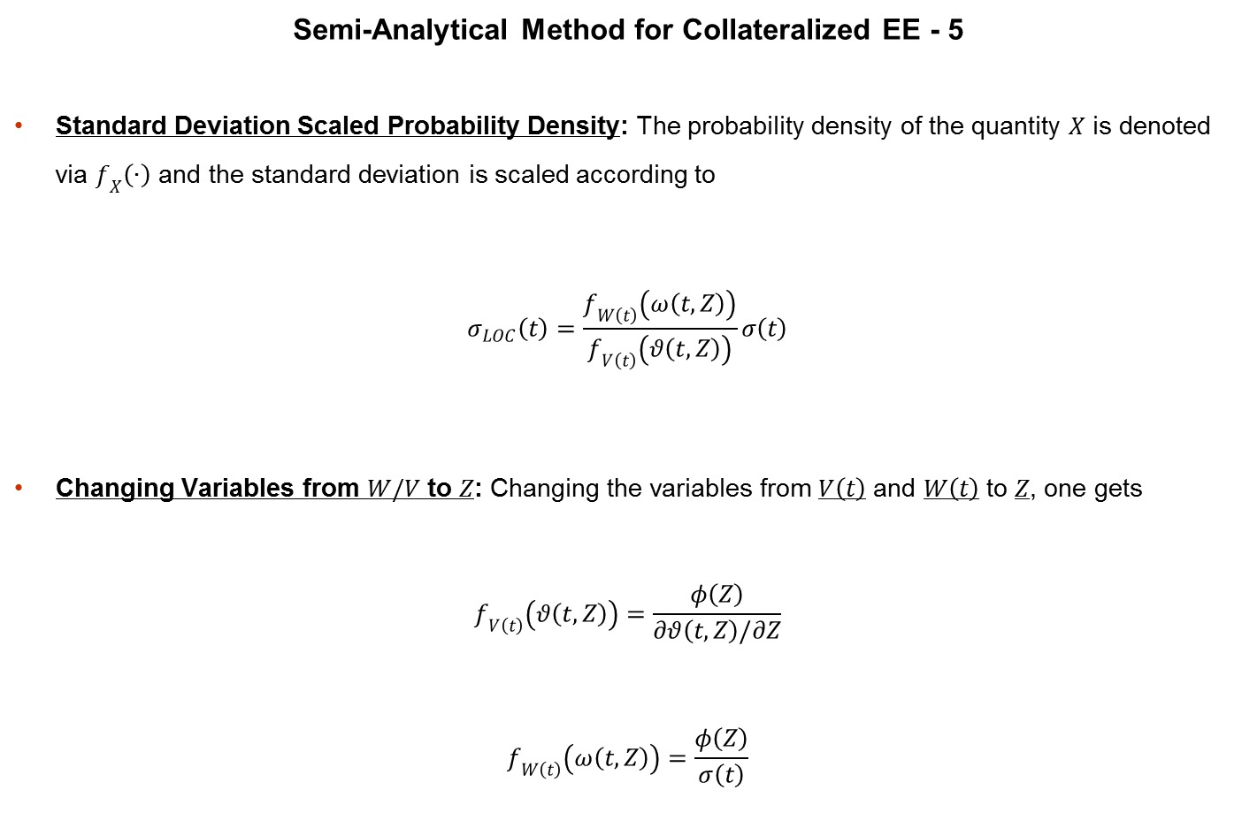
Exposure in the Presence of Margin
Semi-Analytical Method for Collateralized EE - 5
Standard Deviation Scaled Probability Density: The probability density of the quantity $X$ is denoted via $f_{X}\left(∙\right)$ and the standard deviation is scaled according to
$$σ_{LOC}\left(t\right)=\frac{f_{W\left(t\right)}\left(ω\left(t, Z\right)\right)}{f_{V\left(t\right)}\left(θ\left(t, Z\right)\right)}σ\left(t\right)$$
Changing Variables from $W/V$ to $Z$: Changing the variables from $V\left(t\right)$ and $W\left(t\right)$ to $Z$, one gets
$$f_{V\left(t\right)}\left(θ\left(t, Z\right)\right)=\frac{φ\left(Z\right)}{∂θ\left(t, Z\right)/∂Z}$$
$$f_{W\left(t\right)}\left(ω\left(t, Z\right)\right)=\frac{φ\left(Z\right)}{σ\left(t\right)}$$

Slide 18
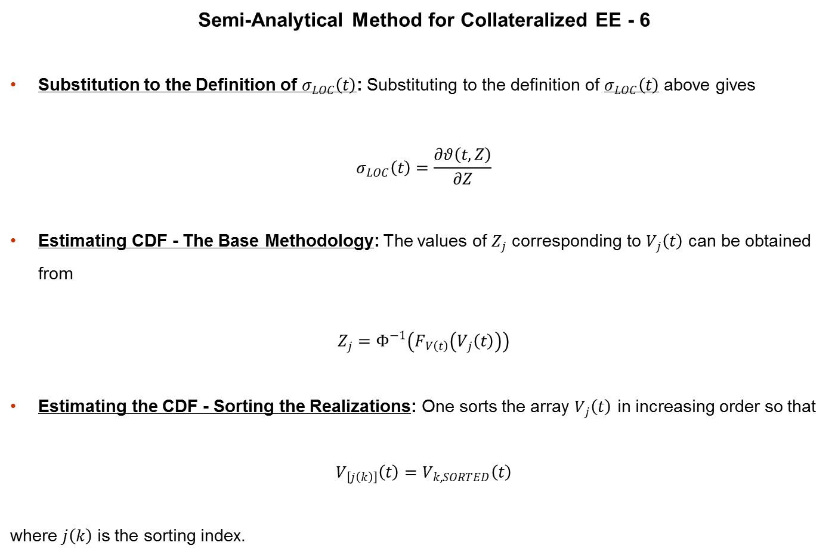
Exposure in the Presence of Margin
Semi-Analytical Method for Collateralized EE - 6
Substitution to the Definition of $σ_{LOC}\left(t\right)$: Substituting to the definition of $σ_{LOC}\left(t\right)$ above gives
$$σ_{LOC}\left(t\right)=\frac{∂θ\left(t, Z\right)}{∂Z}$$
Estimating CDF - The Base Methodology: The values of $Z_{j}$ corresponding to $V_{j}\left(t\right)$ can be obtained from
$$Z_{j}=Φ^{−1}\left(F_{V\left(t\right)}\left(V_{j}\left(t\right)\right)\right)$$
Estimating the CDF - Sorting the Realizations: One sorts the array $V_{j}\left(t\right)$ in increasing order so that
$$V_{\left[j\left(k\right)\right]}\left(t\right)=V_{k, SORTED}\left(t\right)$$
where $j\left(k\right)$ is the sorting index.

Slide 19
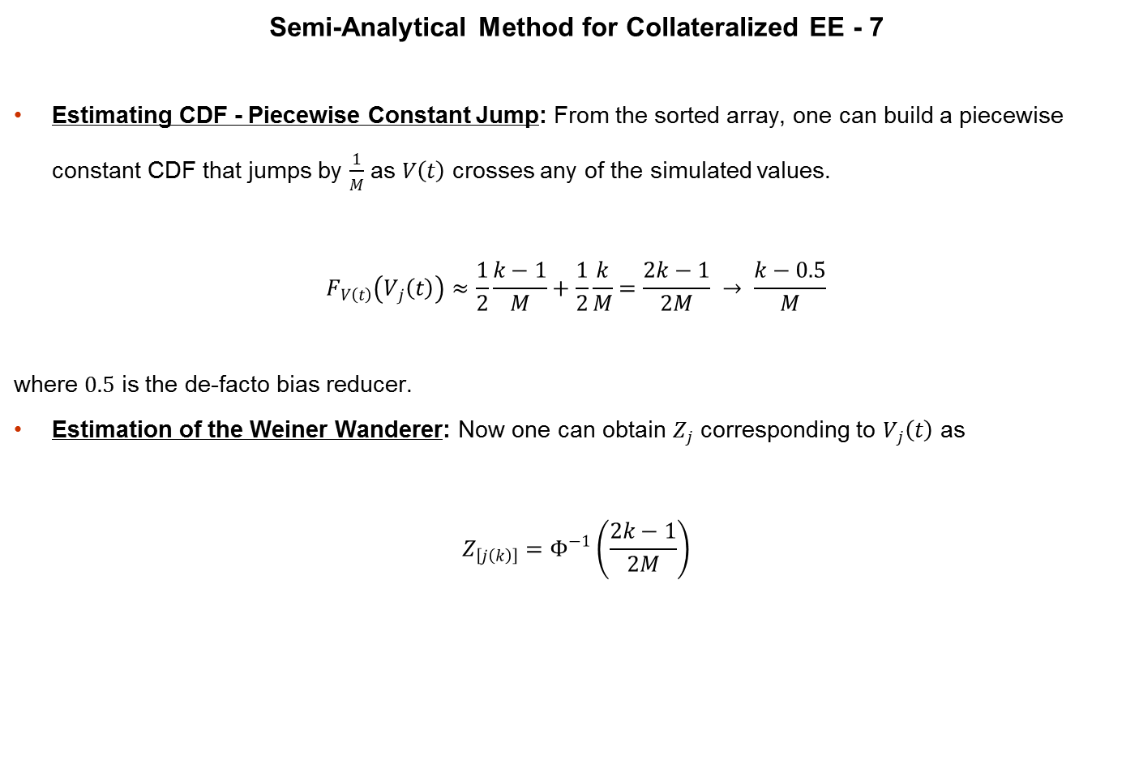
Exposure in the Presence of Margin
Semi-Analytical Method for Collateralized EE - 7
Estimating CDF - Piecewise Constant Jump: From the sorted array, one can build a piecewise constant CDF that jumps by $\frac{1}{M}$ as $V\left(t\right)$ crosses any of the simulated values.
$$F_{V\left(t\right)}\left(V_{j}\left(t\right)\right)≈\frac{1}{2}\frac{k−1}{M}+\frac{1}{2}\frac{k}{M}=\frac{2k−1}{2M} → \frac{k−0.5}{M}$$
where $0.5$ is the de-facto bias reducer.
Estimation of the Weiner Wanderer: Now one can obtain $Z_{j}$ corresponding to $V_{j}\left(t\right)$ as
$$Z_{\left[j\left(k\right)\right]}=Φ^{−1}\left(\frac{2k−1}{2M}\right)$$

Slide 20
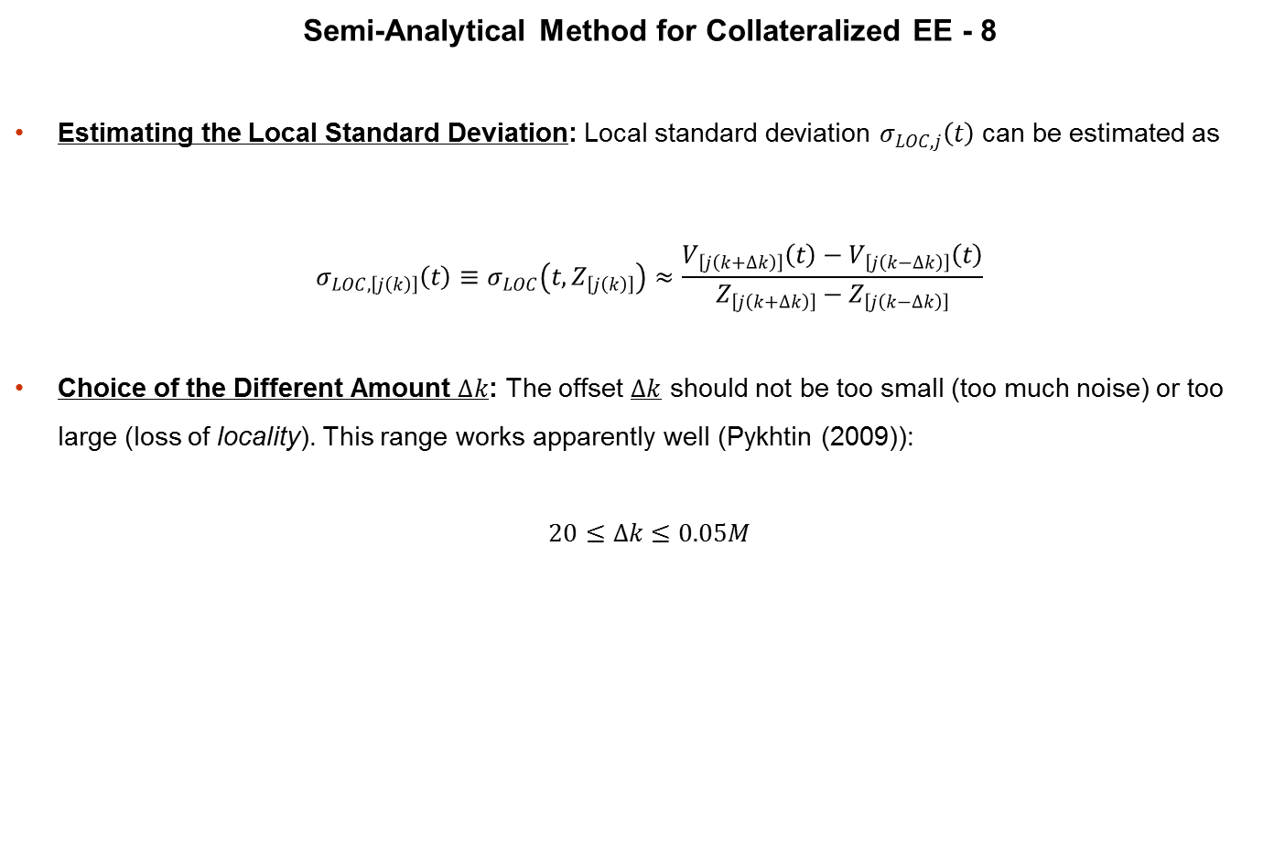
Exposure in the Presence of Margin
Semi-Analytical Method for Collateralized EE - 8
Estimating the Local Standard Deviation: Local standard deviation $σ_{LOC, j}\left(t\right)$ can be estimated as
$$σ_{LOC, \left[j\left(k\right)\right]}\left(t\right)≡σ_{LOC}\left(t, Z_{\left[j\left(k\right)\right]}\right)≈\frac{V_{\left[j\left(k+∆k\right)\right]}\left(t\right)−V_{\left[j\left(k−∆k\right)\right]}\left(t\right)}{Z_{\left[j\left(k+∆k\right)\right]}−Z_{\left[j\left(k−∆k\right)\right]}}$$
Choice of the Different Amount $∆k$: The offset $∆k$ should not be too small (too much noise) or too large (loss of locality). This range works apparently well (Pykhtin (2009)):
$$20≤∆k≤0.05M$$

Slide 21
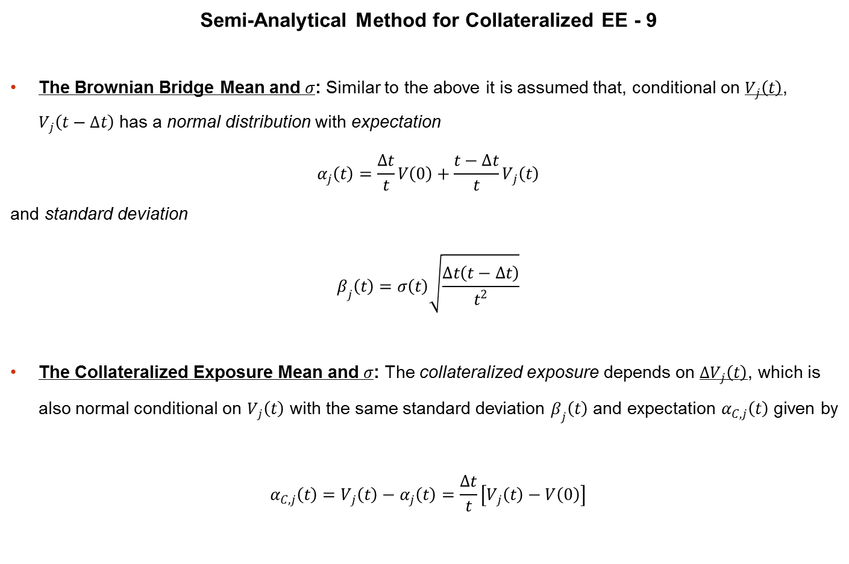
Exposure in the Presence of Margin
Semi-Analytical Method for Collateralized EE - 9
The Brownian Bridge Mean and $σ$: Similar to the above it is assumed that, conditional on $V_{j}\left(t\right)$, $V_{j}\left(t−∆t\right)$ has a normal distribution with expectation
$$α_{j}\left(t\right)=\frac{∆t}{t}V\left(0\right)+\frac{t−∆t}{t}V_{j}\left(t\right)$$
and standard deviation
$$β_{j}\left(t\right)=σ\left(t\right)\sqrt{\frac{∆t\left(t−∆t\right)}{t^{2}}}$$
The Collateralized Exposure Mean and $σ$: The collateralized exposure depends on $∆V_{j}\left(t\right)$, which is also normal conditional on $V_{j}\left(t\right)$ with the same standard deviation $β_{j}\left(t\right)$ and expectation $α_{C, j}\left(t\right)$ given by
$$α_{C, j}\left(t\right)=V_{j}\left(t\right)−α_{j}\left(t\right)=\frac{∆t}{t}\left[V_{j}\left(t\right)−V\left(0\right)\right]$$

Slide 22

Exposure in the Presence of Margin
Semi-Analytical Method for Collateralized EE - 10
Collateralized EE Conditional on $j$: Collateralized EE conditional on scenario $j$ at time $t$ is
$${EE}_{C, j}\left(t\right)=𝔼\left[\max\left(\min\left(V_{j}\left(t\right), H+∆V_{j}\left(t\right)\right), 0\right)|V_{j}\left(t\right)\right]$$
Collateralized EE on Negative Exposure: ${EE}_{C, j}\left(t\right)$ equals zero whenever
$$V_{j}\left(t\right)>0$$
so that
$${EE}_{C, j}\left(t\right)=𝕀_{V_{j}\left(t\right)>0}𝔼\left[\min\left(V_{j}\left(t\right), H+∆V_{j}\left(t\right)\right)|V_{j}\left(t\right)\right]$$

Slide 23

Exposure in the Presence of Margin
Semi-Analytical Method for Collateralized EE - 11
Integral Form for Collateralized EE: Since $∆V_{j}\left(t\right)$ has a normal distribution, one can write
$${EE}_{C, j}\left(t\right)=𝕀_{V_{j}\left(t\right)>0}\int_{−∞}^{+∞}{\min\left(V_{j}\left(t\right), H+α_{C, j}\left(t\right)+β_{j}\left(t\right)Z\right)φ\left(Z\right)dZ}=𝕀_{V_{j}\left(t_{k}\right)>0}\left\{\int_{−d_{2}}^{−d_{1}}{\left[H+α_{C, j}\left(t\right)+β_{j}\left(t\right)Z\right]φ\left(Z\right)dZ}+V_{j}\left(t\right)\int_{−d_{1}}^{+∞}{φ\left(Z\right)dZ}\right\}$$

Slide 24

Exposure in the Presence of Margin
Semi-Analytical Method for Collateralized EE - 12
Conditional Collateralized EE Closed Form: Evaluating the integrals, one obtains
$${EE}_{C, j}\left(t\right)=𝕀_{V_{j}\left(t_{k}\right)>0}\left\{\left[H+α_{C, j}\left(t\right)\right]\left[Φ\left(d_{2}\right)−Φ\left(d_{1}\right)\right]+β_{j}\left(t\right)\left[φ\left(d_{2}\right)−φ\left(d_{1}\right)\right]+V_{j}\left(t\right)Φ\left(d_{1}\right)\right\}$$
where
$$d_{1}=\frac{H+α_{C, j}\left(t\right)−V_{j}\left(t\right)}{β_{j}\left(t\right)}$$
$$d_{2}=\frac{H+α_{C, j}\left(t\right)}{β_{j}\left(t\right)}$$

Slide 25
Exposure in the Presence of Margin
Analysis of Basel “Shortcut” Method for Collateralized Effective EPE - 1
Basel 2 Exposure Capital Requirements: Basel 2 minimal capital requirements for the counterparty risk are determined by wholesale exposure rules with exposure at default obtained from expected exposure profile as follows.

Slide 26

Exposure in the Presence of Margin
Analysis of Basel “Shortcut” Method for Collateralized Effective EPE - 2
Exposure at Default - Basel Variants:
Expected Exposure (EE) – Expected Exposure Profile (EE)
Expected Positive Exposure (EPE) –
$$EPE=\int_{0}^{1 Year}{EE\left(t\right)dt}$$
Effective EE -
$$Effective EE\left(t_{k}\right)=\max\left(EE\left(t_{k}\right), Effective EE\left(t_{k−1}\right)\right)$$
Effective EPE –
$$Effective EPE=\int_{0}^{1 Year}{Effective EE\left(t\right)dt}$$
Exposure at Default (EAD) –
$$EAD=α×Effective EPE$$

Slide 27
Exposure in the Presence of Margin
Analysis of Basel “Shortcut” Method for Collateralized Effective EPE - 3
Incorporating the Margin Agreement: For collateralized counterparties, the netting set level Effective EPE must incorporate the effect of margin agreement.
Effective EPE using Internal Model of Collateral: Collateralized Effective EPE can be calculated using an internal model of collateral.
Basel 2 Simple and Conservative Shortcut: Alternatively dealers can use a simple and conservative approximation to the effective EPE, and sets the effective EPE for a margined counterparty equal to the lesser of:
The Threshold, if positive, under the margin agreement plus an add-on that reflects the potential increase in exposure over the margin period of risk. The add-on is computed as the expected increase in the netting set’s exposure beginning from the current exposure of zero over the margin period of risk.
Effective EPE without a margin agreement.

Slide 28
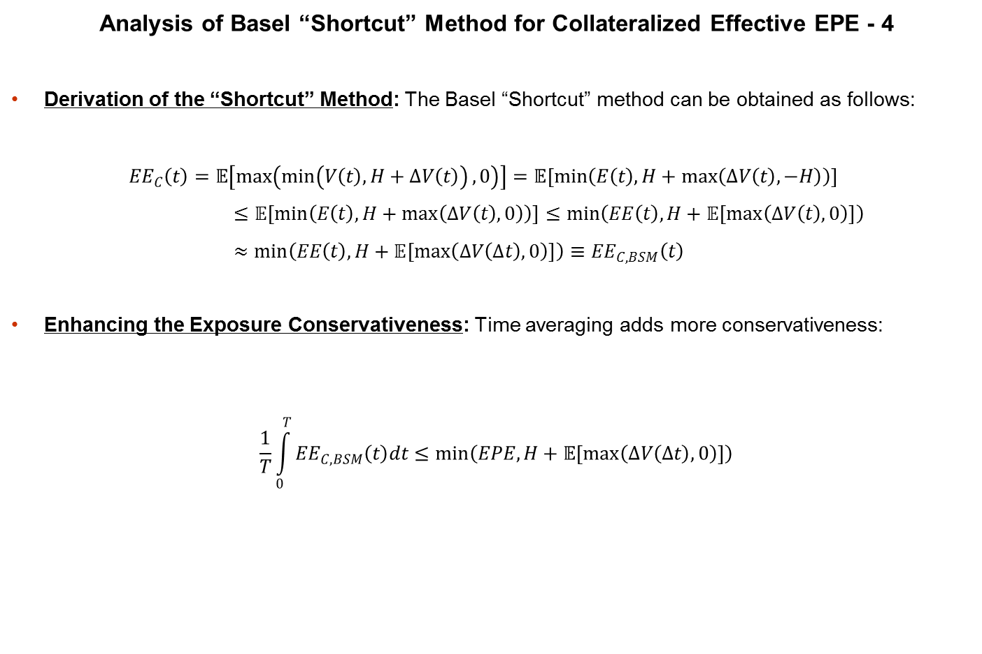
Exposure in the Presence of Margin
Analysis of Basel “Shortcut” Method for Collateralized Effective EPE - 4
Derivation of the “Shortcut” Method: The Basel “Shortcut” method can be obtained as follows:
$${EE}_{C}\left(t\right)=𝔼\left[\max\left(\min\left(V\left(t\right), H+∆V\left(t\right)\right), 0\right)\right]=𝔼\left[\min\left(E\left(t\right), H+\max\left(∆V\left(t\right), −H\right)\right)\right]≤𝔼\left[\min\left(E\left(t\right), H+\max\left(∆V\left(t\right), 0\right)\right)\right]≤\min\left(EE\left(t\right), H+𝔼\left[\max\left(∆V\left(t\right), 0\right)\right]\right)≈\min\left(EE\left(t\right), H+𝔼\left[\max\left(∆V\left(∆t\right), 0\right)\right]\right)≡{EE}_{C, BSM}\left(t\right)$$
Enhancing the Exposure Conservativeness: Time averaging adds more conservativeness:
$$\frac{1}{T}\int_{0}^{T}{{EE}_{C, BSM}\left(t\right)dt}≤\min\left(EPE, H+𝔼\left[\max\left(∆V\left(∆t\right), 0\right)\right]\right)$$

Slide 29
Exposure in the Presence of Margin
Conclusion
Margin Agreements for Risk Mitigation: Margin agreements are important risk mitigation tools that need to be modeled accurately.
Complete MC Doubles Simulation Time: Full Monte Carlo is the most flexible approach, but requires simulating trade values at secondary time points, thus doubling the simulation time.
Semi-Analytical Approach Avoids That: Pykhtin (2009) has presented an accurate semi-analytical approach of calculating the EE that avoids doubling of the simulation time.
Basel 2 Shortcuts are too Conservative: Basel 2 “Shortcut” method for Effective EPE has sound theoretical grounds, but is too conservative.
References
Pykhtin, M. (2009): Modeling Counterparty Credit Exposure in the Presence of Margin Agreements

