Slide 1


Operating System Architecture and Distributed Systems
Dr. Rajkumar Buyya
Redmond Barry Distinguished Professor
Cloud Computing and Distributed Systems (CLOUDS) Laboratory
School of Computing and Information Systems
The University of Melbourne, Australia
http://www.cloudbus.org/652
Some concepts are
drawn from Chapter 7
© Pearson Education
http://www.buyya.com/microkernel/chap2.pdf

Slide 2
Operating System Architecture and Distributed Systems (DS)
Explore the architecture of a kernel suitable for a distributed system.
A key principle of DS is openness and with this in mind, let us examine the major kernel architectures:
  Monolithic kernels
  Layered architecture-based kernels
  Micro-kernels

Slide 3
Open DS and System Software
A open DS should make it possible to:
  Run only that (“specific” component of) system software at each computer that is necessary for its particular role in the system architecture.
    For example, system software needs of laptops and dedicated servers are different and loading redundant modules wastes memory resources.
  Allow the software implementing any particular service to be changed independent of other facilities.
  Allow for alternatives of the same service to be provided, when this is required to suit different users or applications.
  Introduce new services without harming the integrity of existing ones.

Slide 4
Separating Mechanisms and Policies in OS and DS
A Guiding Principle of OS design:
  The separation of fixed resource management “mechanisms“ from resource management “policies”, which vary from application to application and service to service.
  For example, an ideal scheduling system would provide mechanisms that enable a multimedia application such as videoconferencing to meet its real-time demands while coexisting with a non-real-time application such as web browsing.
That is kernel would provide only the most basic mechanisms upon which the general resource management tasks at a node are carried out.
Server modules would be dynamically loaded as required, to implement the required RM policies for the currently running applications.

Slide 5
OS/Kernel Architecture
The two key examples of kernel design approaches are:
  Monolithic
  Microkernel
These two designs differ primarily in the decision as to what functionality belongs in the kernel and what is left to server processes that can be dynamically loaded to run on top of it.
In literature, we find predominantly 3 types of OSs:
  Monolithic OS
  Layered OS
  Microkernel-based OS

Slide 6
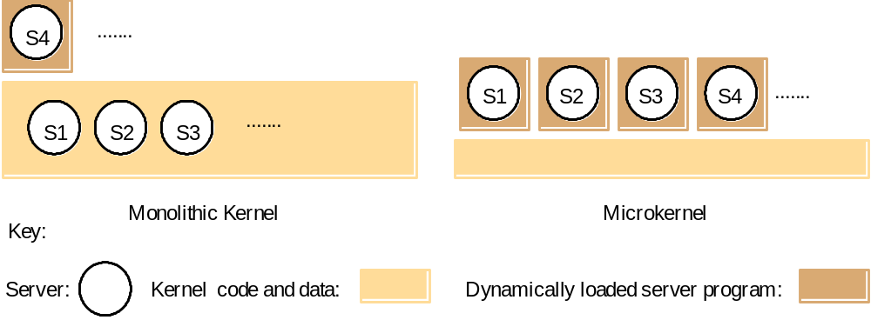
Monolithic kernel and microkernel

Slide 7
Operating System Models
Serve as frameworks that unify capabilities, services and tasks to be performed
Three approaches to building OS....
  Monolithic OS
  Layered OS
  Microkernel based OS
Client server OS
Suitable for distributed systems
Simplicity, flexibility, and high performance are crucial for OS.

Slide 8
Monolithic Operating System
Application
Programs
Application
Programs
User Mode
Kernel Mode
System Services
Hardware
Better application Performance
Difficult to extend
Ex: MS-DOS

Slide 9






Layered OS
Application
Programs
Application
Programs
User Mode
Kernel Mode
System Services
Memory & I/O Device Mgmt
Process Schedule
Hardware
Easier to enhance
Each layer of code access lower level interface
Low-application performance

Slide 10
Traditional OS
Application
Programs
Application
Programs
User Mode
Kernel Mode
OS
Hardware
OS Designer

Slide 11
Disadvantages of Monolithic OS
It is massive:
  It performs all basic OS functions and takes up in the order of megabytes of code and data
It is undifferentiated:
  It is coded in a non-modular way (traditionally) although modern ones are much more layered.
It is intractable:
  Altering any individual software component to adapt it to changing requirements is difficult.

Slide 12
New trend in OS design: Separating mechanisms and policies
Application
Programs
Servers
Application
Programs
User Mode
Kernel Mode
Microkernel
(very basic functions)
Hardware

Slide 13
Micro-kernel / μ-kernel
Compared to monolithic, microkernel design provides only the most basic abstractions,
  address space, threads and local IPC.
All other system services are provided by servers that are dynamically loaded precisely on those computers in the DS that require them.
Clients access these system services using the kernel’s message-based invocation mechanisms.

Slide 14
Microkernel/Client Server OS
Client
Application
OS
Emulators
File
Server
Network
Server
Display
Server
User
Kernel
Microkernel
Send
Reply
Hardware
Tiny OS kernel providing basic primitive (process, memory, IPC)
Traditional services becomes subsystems
OS = Microkernel + User Subsystems
Ex: Mach, QNX, Windows NT!

Slide 15
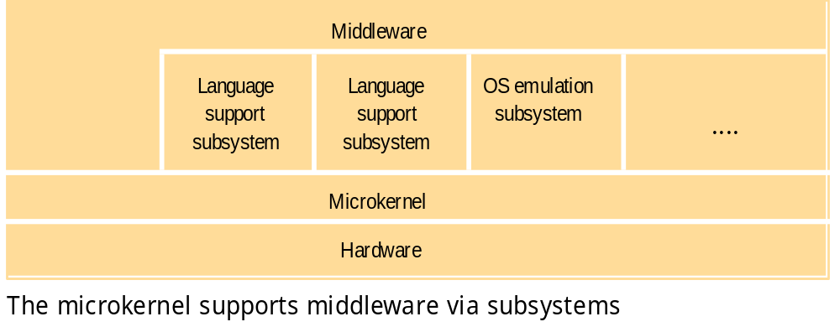
The role of the microkernel (MK)
MK appears as a layer between H/W and a layer of major system components (subsystems). If performance, rather than portability is goal, then middleware may use facilities of MK directly.

Slide 16
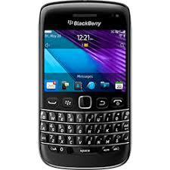
Few Popular Microkernel Systems
MACH, CMU (Carnegie Mellon University)
  supports OS emulators such as Unix and OS/2.
MINIX (modular microkernel by Tanenbaum)
PARAS (C-DAC, India) for PARAM Supercomputers
ChorusOS (Sun, USA) Realtime OS (RTOS)
seL4 (created by NICTA/Data61, Australia)
  Google KateOS for embedded devices (uses seL4)
QNX - Unix-like RTOS (Canada, BlackBerry)
  used in a variety of devices including cars and mobile phones (e.g., BlackBerry).
  Intel x86, MIPS, PowerPC, StrongARM..
Windows NT – original design.

Slide 17
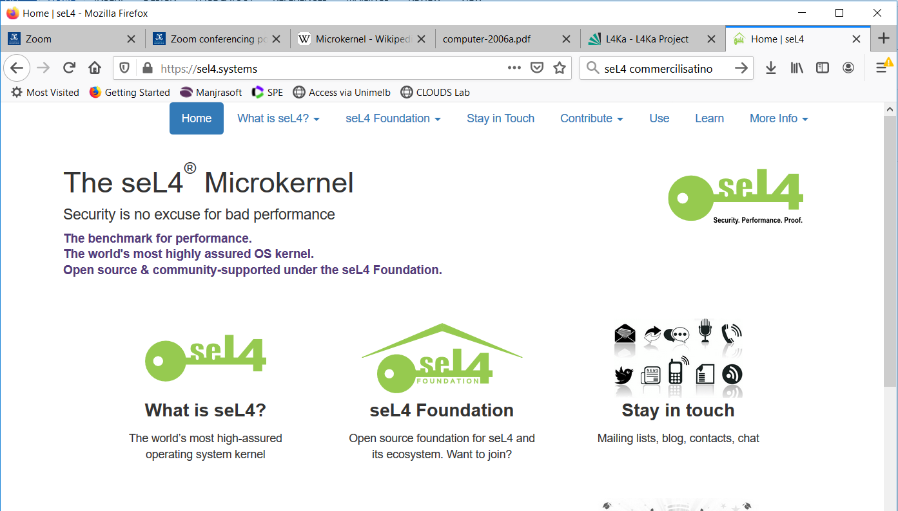

seL4: Made in Australia!

Slide 18
Comparison: Monolithic and
Micro-kernel OS Design
The main advantages of a MK-based OS:
  A relative small kernel is more likely to be free of bugs than one that is larger and complex.
  Extensibility and its ability to enforce modularity behind memory protection boundaries
The advantage of a monolithic OS:
  Relative efficiency with which operations can be invoked is high because even invocation to a separate user-level address space on the same node is more costly.

Slide 19
Hybrid Approaches
Many modern OSs follow hybrid approach in OS structure. E.g., Windows NT.
Pure microkernel OSs such as Chorus & Mach have changed over time to allow servers to be loaded dynamically into the kernel address space or into a user-level address space.
Some OSs (such as SPIN) use event-based model as a mechanism for interaction between modules grafted into the kernel address space.

Slide 20
Summary
OSs provide various types of facilities/services to support middleware for distributed system:
  encapsulation, protection, and concurrent access and management of node resources.
Three types of OS:
  Monolithic OS
  Layered OS
  Microkernel-based OS
New OS designs provide flexibility in terms of separating mechanisms from policies.
Microkernel based systems are flexible
  Quite popular model for OS design for embedded systems
  New Emerging optimized Kernels like nanokernel or picokernel

Slide 21
Additional References
Rajkumar Buyya, The Design of PARAS Microkernel, Centre for Development of Advanced Computing (C-DAC), 1998.
  http://www.buyya.com/microkernel/chap2.pdf
Gernot Heiser, Gerwin Klein, June Andronick, seL4 in Australia: From Research to Real-World Trustworthy Systems, Communications of the ACM, April 2020.
  https://cacm.acm.org/magazines/2020/4/243641-sel4-in-australia/fulltext

