Slide 1


Logo BitLab Avance-Juego
Ronald Choque Sillo
Luis Angel Vertiz Blanco T.
Caleb Adrian Morales Alarcon
Mattias Duarte Aparizio

Slide 2


Adobe Ilustrator

Slide 3
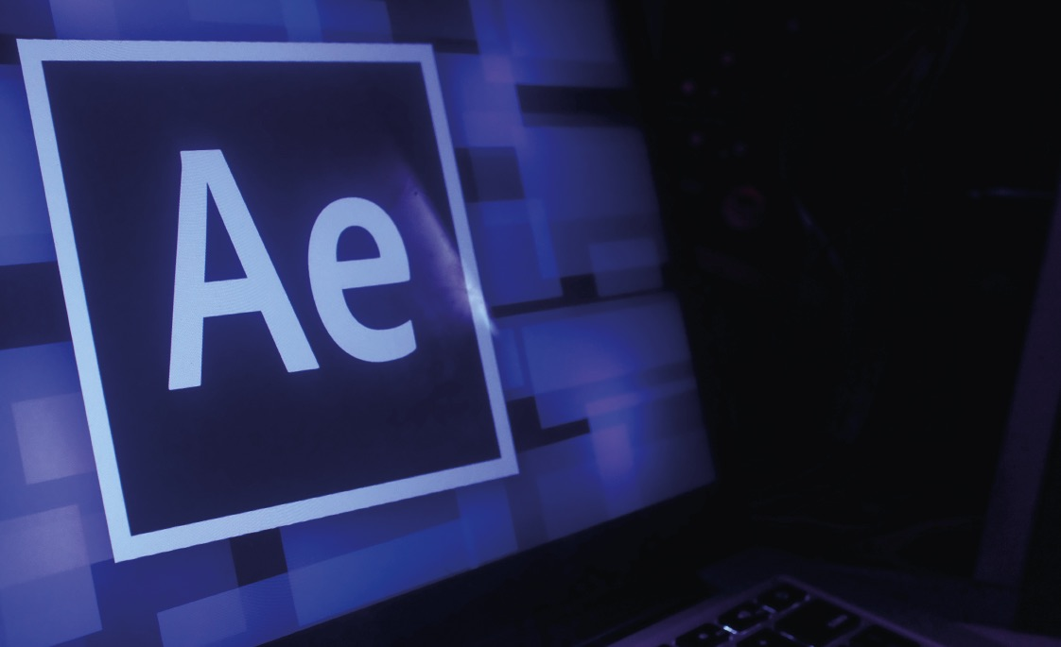
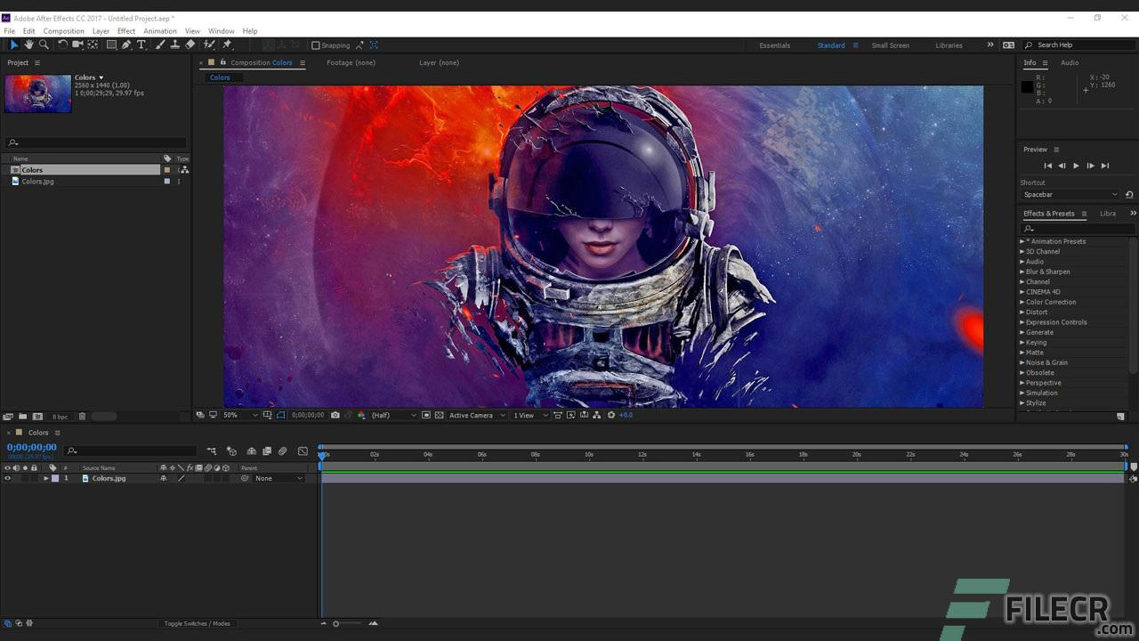
Adobe After Effects

Slide 4
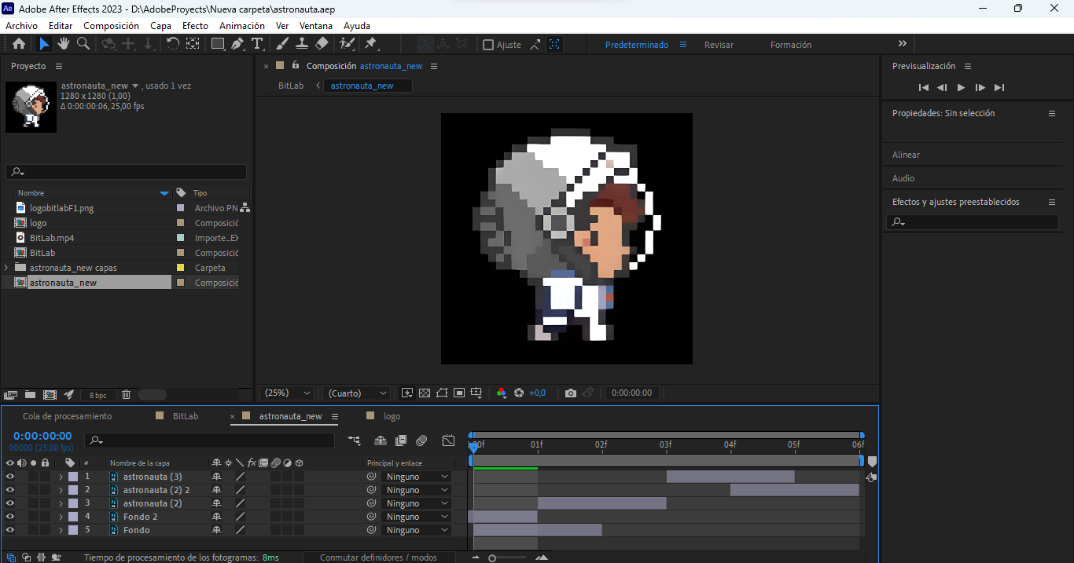

Slide 5


Slide 6
