Slide 1
Unit-4
Software engineering

Slide 2
List of Contents
  Implementation
  Coding Standard and Guidelines
  Review
  Unit Testing
  Verification and
  Validation

Slide 3
  Implementation
During the implementation phase, the software engineer translates the design specifications into source codes in some programming languages.
Implementation is the software development phase that effects the testing and maintenance activities.
the main goal of implementation is to produce quality source codes that can reduce the cost of testing and maintenance .

Slide 4
  Implementation
1) Coding principles
  Information hiding
  Structure programming features
  Maximize Cohesion and Minimize Coupling
  Code Reusability
  KISS(Keep It Simple, Stupid)
  Simplicity, Extensibility, and Effortlessness
  Code Verification
  Code Documentation
  Separation of Concern
  Follow Coding Standards, Guidelines, and Styles

Slide 5
  Implementation
2) Coding Styles
  Use of goto statements
  Use of control constructs
  Define user-defined data types
  Program size
  Information hiding
  Program documentation prologues
  Commenting code
  Use of temporary variables
  Avoid patching bad code

Slide 6
  Implementation
3) Coding Errors
  Compilation Errors
  Logical Errors
  Runtime Errors
4) Coding Standards
  Naming Conventions
  Don’t Be Too Clever
  Code Formatting
  Avoid Deep Nesting
  Error Handling
  Modularization of code

Slide 7
  Implementation
5) Coding Process
  Traditional Coding Process
  Test-Driven Development
6) Coding Verification
  Code review
    Code Walkthrough
    Code inspection
    Pair programming
  Static Analysis
  Testing

Slide 8
  Implementation
7) Code Documentation
  Internal Documentation
  System Documentation
  User Documentation
  Process Documentation
  Daily Documentation

Slide 9
  Coding Standard and Guidelines
Coding is undertaken once the design phase is complete and the design documents have been successfully reviewed.
In the coding phase, every module specified in the design document is coded and unit tested. During unit testing, each module is tested in isolation from other modules. That is, a module is tested independently as and when its coding is complete.

Slide 10
  Coding Standard and Guidelines
After all the modules of a system have been coded and unit tested, the integration and system testing phase is undertaken.
Over the years, the general perception of testing as monkeys typing in random data and trying to crash the system has changed. Now testers are looked upon as masters of specialized concepts, techniques, and tools.

Slide 11
  Coding Standard and Guidelines
CODING:
The input to the coding phase is the design document produced at the end of the design phase.
During the coding phase, different modules identified in the design document are coded according to their respective module specifications.
The objective of the coding phase is to transform the design of a system into code in a high-level language, and then to unit test this code.

Slide 12
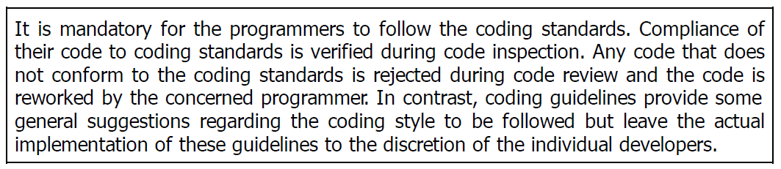
  Coding Standard and Guidelines
The main advantages of adhering to a standard style of coding are the following:
  A coding standard gives a uniform appearance to the codes written by different engineers.
  It facilitates code understanding and code reuse.
  It promotes good programming practices.

Slide 13
  Coding Standard and Guidelines
Representative coding standards
  Rules for limiting the use of globals
    These rules list what types of data can be declared global and what cannot, with a view to limit the data that needs to be defined with global scope.
  Standard headers for different modules
    The header of different modules should have standard format and information for ease of understanding and maintenance.

Slide 14
  Coding Standard and Guidelines
  Standard headers for different modules:
  Name of the module.
  Date on which the module was created.
  Author’s name.
  Modification history.
  Synopsis of the module. This is a small write-up about what the module does.
  Different functions supported in the module, along with their input/output parameters.
  Global variables accessed/modified by the module.

Slide 15
  Coding Standard and Guidelines
Naming conventions for global variables, local variables, and constant identifiers:
A popular naming convention is that variables are named using mixed case lettering.
Global variable names would always start with a capital letter (e.g., Global-Data) and
local variable names start with small letters (e.g., local-Data). Constant names should be formed using capital letters only (e.g., CONSTDATA).

Slide 16
  Coding Standard and Guidelines
Conventions regarding error return values and exception handling mechanisms:
  The way error conditions are reported by different functions in a program should be standard within an organization.
Representative coding guidelines:
Do not use a coding style that is too clever or too difficult to understand:
  Code should be easy to understand. Many inexperienced engineers actually take pride in writing cryptic and incomprehensible code.

Slide 17
  Coding Standard and Guidelines
Avoid obscure side effects:
The side effects of a function call include modifications to the parameters passed by reference, modification of global variables, and I/O operations.
An obscure side effect is one that is not obvious from a casual examination of the code.
Obscure side effects make it difficult to understand a piece of code.

Slide 18
  Coding Standard and Guidelines
Do not use an identifier for multiple purposes:
Programmers often use the same identifier to denote several temporary entities.
Each variable should be given a descriptive name indicating its purpose. This is not possible if an identifier is used for multiple purposes.
Use of a variable for multiple purposes can lead to confusion and make it difficult for somebody trying to read and understand the code.

Slide 19
  Coding Standard and Guidelines
Length of any function should not exceed 10 source lines:
A lengthy function is usually very difficult to understand as it probably has a large number of variables and carries out many different types of computations.
For the same reason, lengthy functions are likely to have disproportionately larger number of bugs.
Do not use GO TO statements:
Use of GO TO statements makes a program unstructured. This makes the program very difficult to understand, debug, and maintain.

Slide 20
  CODE REVIEW
Testing is an effective defect removal mechanism. However, testing is applicable to only executable code.
Review is a very effective technique to remove defects from source code.
review has been acknowledged to be more cost-effective in removing defects as compared to testing.
Code review for a module is undertaken after the module successfully compiles.
code review does not target to design syntax errors in a program, but is designed to detect logical, algorithmic, and programming errors.

Slide 21
  CODE REVIEW
Eliminating an error from code involves three main activities
  testing,
  debugging, and then correcting the errors.
Testing is carried out to detect if the system fails to work satisfactorily for certain types of inputs and under certain circumstances.
debugging is carried out to locate the error that is causing the failure and to remove it.
errors are directly detected, thereby saving the significant effort that would have been required to locate the error.

Slide 22
  CODE REVIEW
The following two types of reviews are carried out on the code of a module:
  Code walkthrough.
  Code inspection.
  Code walkthrough:
  Code walkthrough is an informal code analysis technique.
  In this technique, a module is taken up for review after the module has been coded, successfully compiled, and all syntax errors have been eliminated.
  A few members of the development team are given the code a couple of days before the walkthrough meeting.

Slide 23
  CODE REVIEW
The main objective of code walkthrough is to discover the algorithmic and logical errors in the code.
The team performing code walkthrough should not be either too big or too small. Ideally, it should consist of between three to seven members.
Discussions should focus on discovery of errors and avoid deliberations on how to fix the discovered errors.
In order to foster co-operation and to avoid the feeling among the engineers that they are being watched and evaluated in the code walkthrough meetings, managers should not attend the walkthrough meetings.

Slide 24
  CODE REVIEW
Code Inspection:
During code inspection, the code is examined for the presence of some common programming errors.
This is in contrast to the hand simulation of code execution carried out during code walkthroughs.
The principal aim of code inspection is to check for the presence of some common types of errors that usually creep into code due to programmer mistakes and oversights and to check whether coding standards have been adhered to.

Slide 25
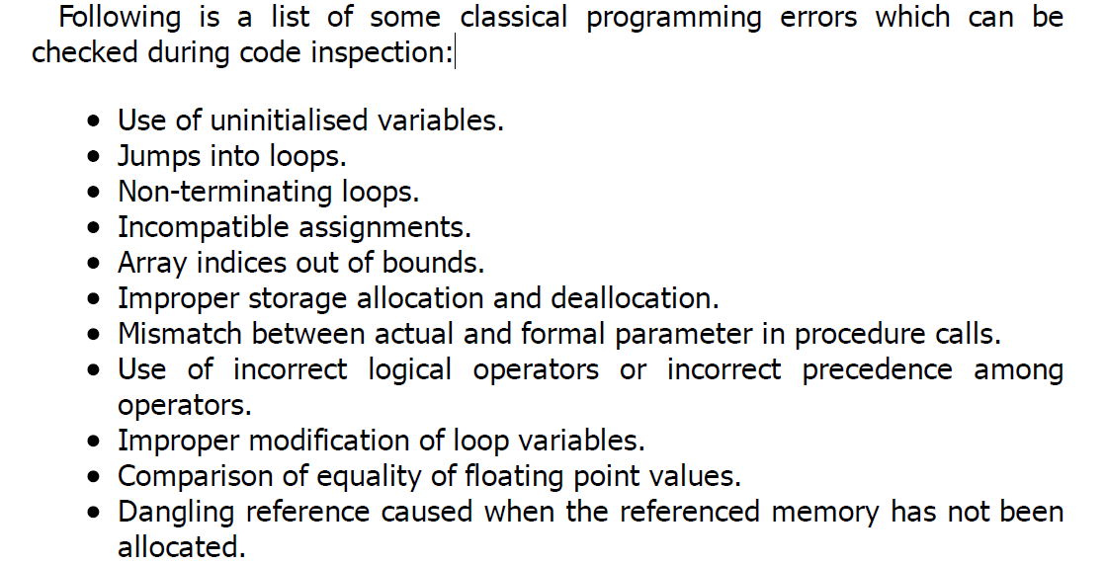
  CODE REVIEW

Slide 26
SOFTWARE DOCUMENTATION
When a software is developed, in addition to the executable files and
The source code, several kinds of documents such as users’ manual, software requirements specification (SRS) document, design document, test document, installation manual, etc., are developed as part of the software engineering process.
All these documents are considered a vital part of any good software development practice. Good documents are helpful in the following ways:

Slide 27
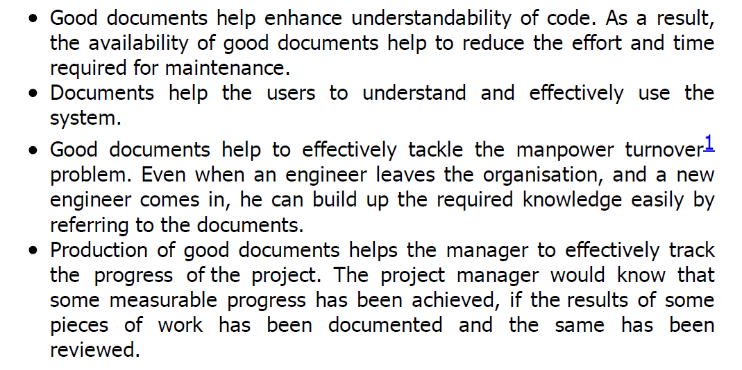
SOFTWARE DOCUMENTATION

Slide 28
SOFTWARE DOCUMENTATION
Different types of software documents can broadly be classified into the following:
Internal documentation:
  These are provided in the source code itself.
External documentation:
  These are the supporting documents such as SRS document, installation document, user manual, design document, and test document.
Careful experiments suggest that out of all types of internal documentation, meaningful variable names is most useful while trying to understand a piece of code.

Slide 29
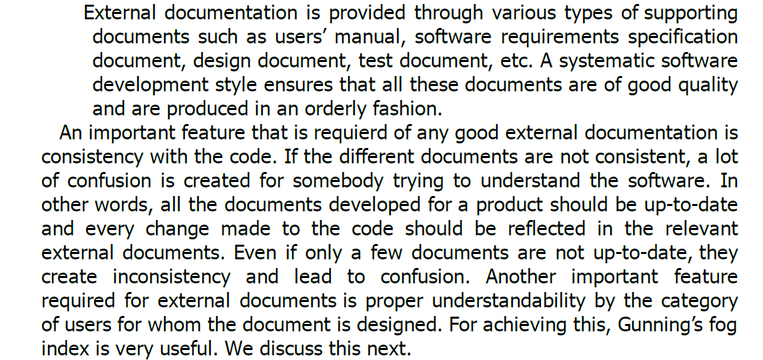
External Documentation

Slide 30
External Documentation
Gunning’s fog index:
  Gunning’s fog index (developed by Robert Gunning in 1952) is a metric that has been designed to measure the readability of a document.
  The computed metric value (fog index) of a document indicates the number of years of formal education that a person should have, in order to be able to comfortably understand that document.

Slide 31
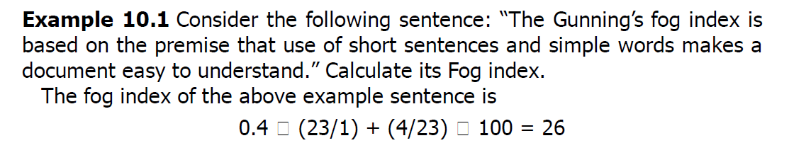
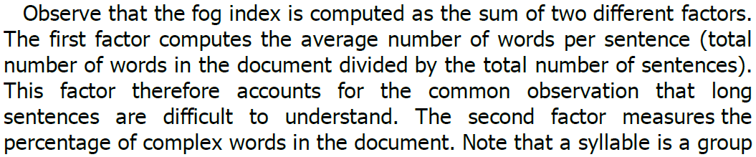
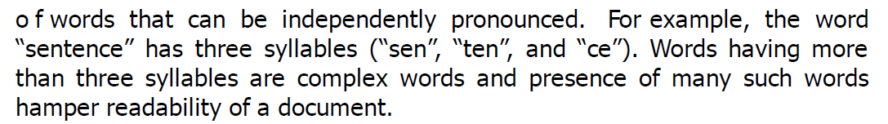
Gunning’s fog index

Slide 32
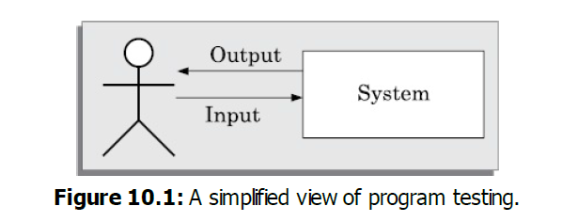
TESTING
The aim of program testing is to help realize identify all defects in a program.
How to test a program?
Testing a program involves executing the program with a set of test inputs and observing if the program behaves as expected.
If the program fails to behave as expected, then the input data and the conditions under which it fails are noted for later debugging and error correction.

Slide 33
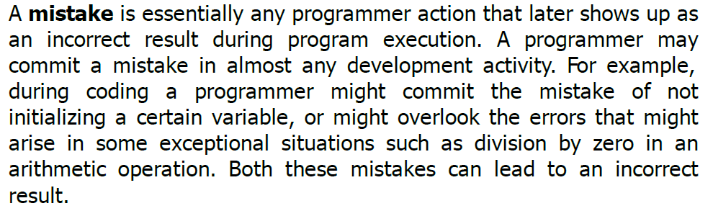
Terminologies
As is true for any specialized domain, the area of software testing has come to be associated with its own set of terminologies.
In the following, a few important terminologies that have been standardized by the IEEE Standard Glossary of Software Engineering Terminology [IEEE90]:

Slide 34
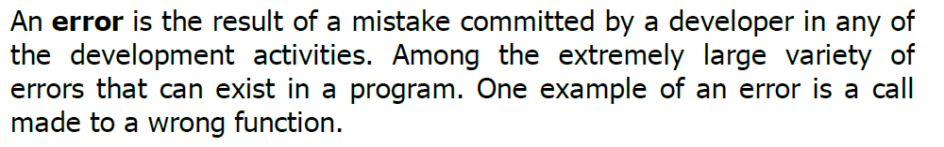
Terminologies
The terms error, fault, bug, and defect are considered to be synonyms in the area of program testing.

Slide 35
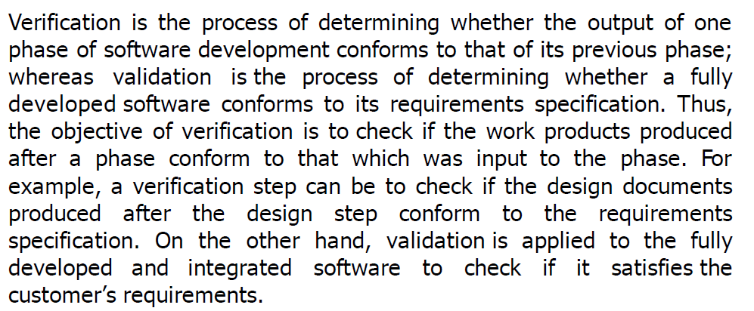
Verification versus validation
The objectives of both verification and validation techniques are very similar since both these techniques are designed to help remove errors in a software.

Slide 36
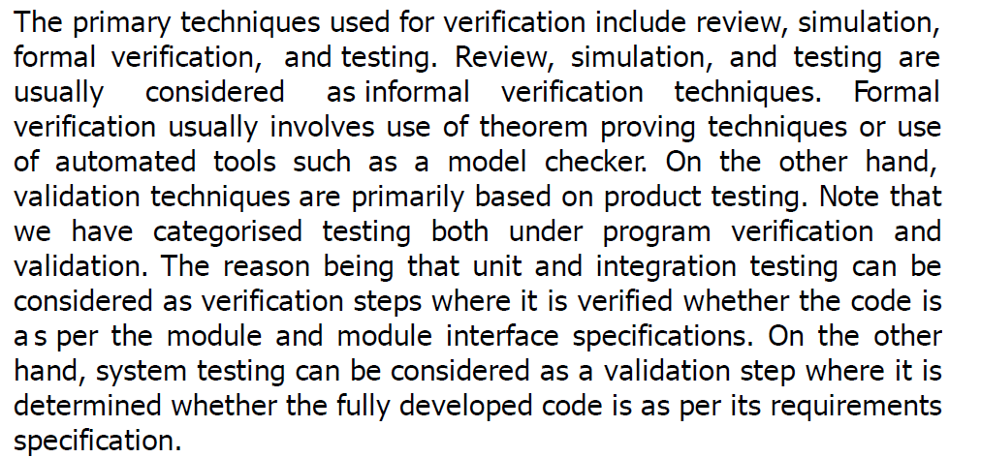
Verification versus validation
Continues…

Slide 37
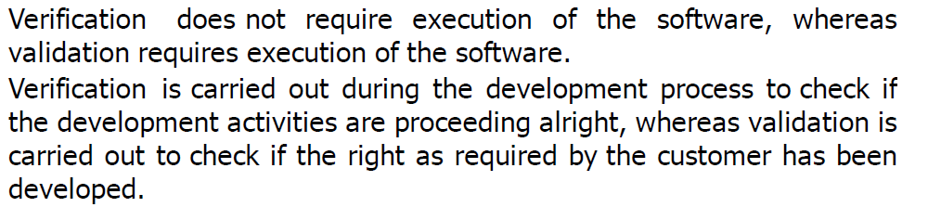
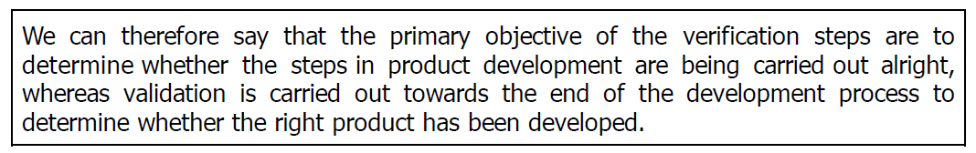
Verification versus validation
Continues…

Slide 38
Verification versus validation
Verification techniques can be viewed as an attempt to achieve phase containment of errors.
Phase containment of errors has been acknowledged to be a cost-effective way to eliminate program bugs, and is an important software engineering principle.
The principle of detecting errors as close to their points of commitment as possible is known as phase containment of errors.
Phase containment of errors can reduce the effort required for correcting bugs.

Slide 39
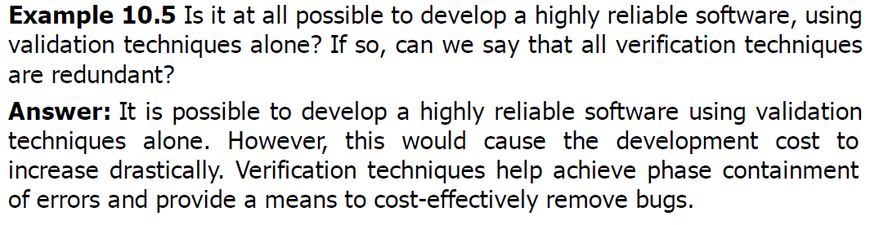
Verification versus validation

Slide 40
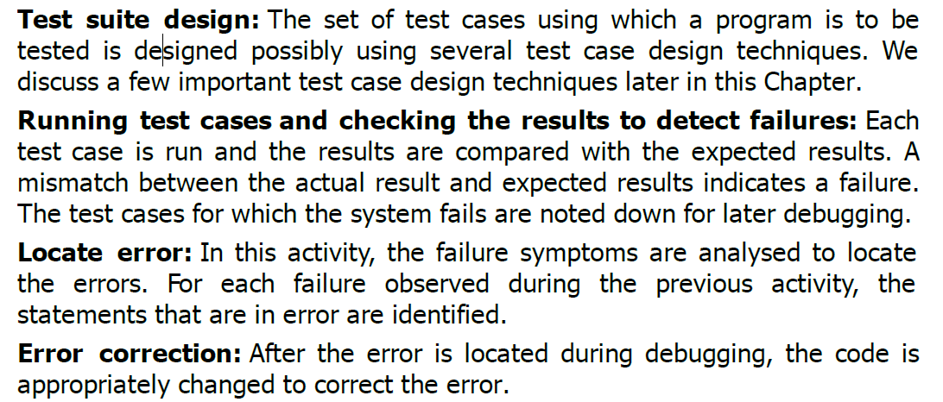
Testing Activities
Testing involves performing the following main activities:

Slide 41
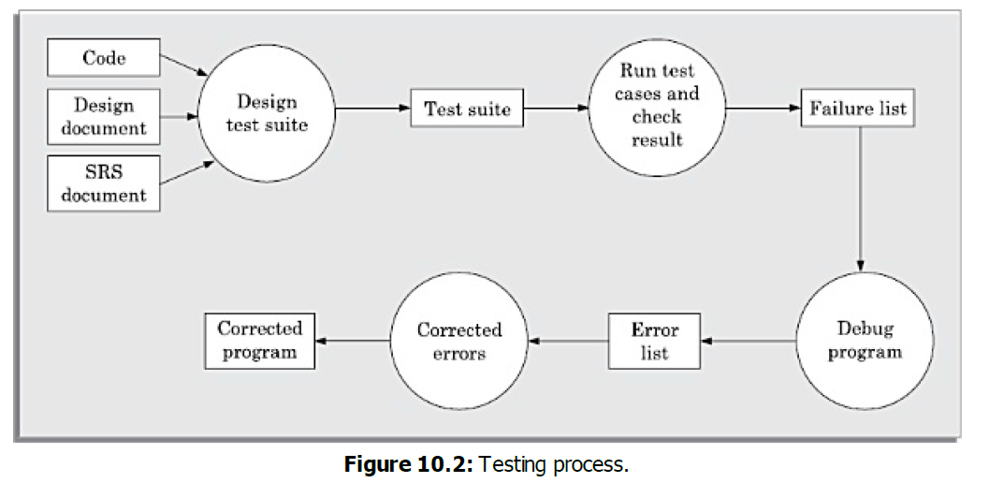
Testing Activities
Testing involves performing the following main activities:

Slide 42
Why Design Test Cases?
When test cases are designed based on random input data, many of the test cases do not contribute to the significance of the test suite, That is, they do not help detect any additional defects not already being detected by other test cases in the suite.
A minimal test suite is a carefully designed set of test cases such that each test case helps detect different errors. This is in contrast to testing using some random input values.

Slide 43
Why Design Test Cases?
There are essentially two main approaches to systematically design test cases:
  Black-box approach
  White-box (or glass-box) approach
Testing in the Large versus Testing in the Small:
  Unit testing
  Integration testing
  System testing
During unit testing, the individual functions (or units) of a program are tested.
Unit testing is referred to as testing in the small, whereas integration and system testing are referred to as testing in the large.

Slide 44
Why Design Test Cases?
After testing all the units individually, the units are slowly integrated and tested after each step of integration (integration testing).
Finally, the fully integrated system is tested (system testing). Integration and system testing are known as testing in the large.
Why test each module (unit) in isolation first, then integrate these modules and test, and again test the integrated set of modules.

Slide 45
UNIT TESTING
Unit testing is undertaken after a module has been coded and reviewed.
This activity is typically undertaken by the coder of the module himself in the coding phase.
Before carrying out unit testing, the unit test cases have to be designed and the test environment for the unit under test has to be developed.
The environment needed to perform unit testing.

Slide 46
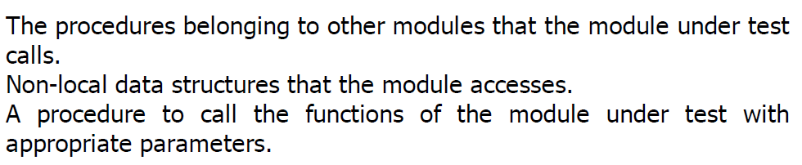
UNIT TESTING
Driver and stub modules:
In order to test a single module, we need a complete environment to provide all relevant code that is necessary for execution of the module.

Slide 47
UNIT TESTING
Stub: The role of stub and driver modules is pictorially shown in Figure 10.3.
A stub procedure is a dummy procedure that has the same I/O parameters as the function called by the unit under test but has a highly simplified behavior.
For example, a stub procedure may produce the expected behavior using a simple table look up mechanism.

Slide 48
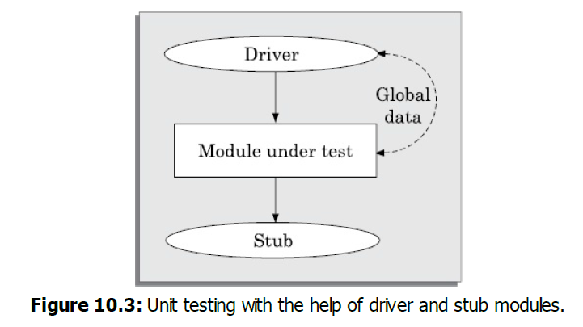
UNIT TESTING
Driver: A driver module should contain the non-local data structures accessed by the module under test. Additionally, it should also have the code to call the different functions of the unit under test with appropriate parameter values for testing.

Slide 49


