Slide 1

Team leader(Bugata Vijay Kumar)
Bourothu Sai Kumar
Bonthu Mahesh Babu
Boyi Bangarraju
Chadaram Maharoop

Slide 2

Part 1: Brand Study,competitor Analysis &
Buyer’s/Audience’s persona
Research Brand: Tata Motors
USP: The USP of Tata Motors is their focus on message execution and image building to associate the brand with positive imagery that impacts consumer perception and long- term reactions
Analyse Brand Tone And Identity:The new brand is based on 3 core attributes that drive all expressions: thoughtful, expressive & stimulating, and bold. We approached the Tata Motors brand as a living brand where motion, sonic and visual are synergetic and of equal importance.

Slide 3
Brand Study(Mission/Values & Usp)
Mission & Values :
To be the most reliable global network for customers and suppliers, that delivers value through products and services. To be a responsible value creator for all our stakeholders.
•
Pioneering : We will be bold and agile, courageously taking on challenges, using deep customer
insight to develop innovative solutions.
Integrity: We will be fair, honest, transparent and ethical in our conduct; everything we do must stand the test of public scrutiny.
Excellence: We will be passionate about achieving the highest standards of quality, always
promoting meritocracy.
Unity: we will invest in our people and partners, enable continuous learning, and build caring and
collaborative relationships based on trust and mutual respect.
•
•
•
➢
Unique Selling Proposition (USP) Analysis :
Tata Motors distinguishes itself through a combination of affordability, innovation, and reliability. With competitively priced vehicles spanning diverse segments, Tata ensures accessibility without compromising on quality. Leveraging advanced technology, Tata integrates innovative features into its vehicles, enhancing safety, comfort, and performance. The company's commitment to durability and reliability is evident in vehicles designed to withstand challenging terrains. Moreover, Tata Motors prioritizes sustainability, offering eco-friendly options such as electric and hybrid models.

Slide 4
Brand study (Brand Tone & KPI)
Brand Tone :
Tata Motors maintains a brand tone that is both authoritative and approachable .It communicates with confidence and expertise, reflecting its status as a key player in the automotive industry while remaining accessible and relatable to its diverse audience. This tone is characterized by clarity, professionalism, and a genuine commitment to customer satisfaction.
key performance indicators (KPIs) for Tata Motors :
Sales Performance: Total vehicle sales volume, revenue from vehicle sales, and market share growth.
Customer Satisfaction: Net Promoter Score (NPS), customer feedback ratings, and customer retention rates.
Brand Perception: Brand awareness, brand favorability, and perception compared to competitors.
Product Quality: Defect rates, warranty claims, and customer complaints related to vehicle quality.
Innovation: Number of patents filed, successful implementation of new technologies, and introduction of
innovative features in vehicles.
Operational Efficiency: Manufacturing efficiency, supply chain performance, and cost per vehicle
produced.
Sustainability Goals: Reduction in carbon emissions, adoption of eco-friendly technologies, and progress towards renewable energy usage.

Slide 5
Buyer/Audience Persona
Buyer Persona: Urban Commuters - Priya
Background: Priya is a 28-year-old marketing professional living in Mumbai, India. She commutes to work daily and occasionally takes weekend trips with friends or family.
Values: Priya values convenience, affordability, and eco-friendliness in her transportation choices.
Needs and Preferences:
Affordability: Priya is conscious of her budget and seeks a vehicle that offers value for money without compromising on quality.
Fuel Efficiency: With the high cost of fuel in urban areas, Priya prefers a vehicle that is fuel-efficient, helping her save on daily commuting expenses.
Modern Features: Priya enjoys technology and looks for modern features such as smartphone connectivity, navigation system, and advanced safety features in her vehicle.
Sustainability: As an environmentally conscious individual, Priya prefers vehicles with low emissions and eco-friendly features, aligning with her values of sustainability.
Example Vehicle: Tata Altroz EV
Goals :
Expanding the charging infrastructure, enhancing the driving range of electric vehicles like the Altroz EV, and shifting consumer perception towards electric vehicle performance.
Challenges:
Charging Infrastructure: Tata Motors collaborates with local authorities and private partners to expand the charging infrastructure network in urban areas like Mumbai, ensuring convenient access to charging stations for Altroz EV owners.
Range Anxiety : Priya's concerns about range anxiety and providing confidence for her daily commuting needs.
Financial Incentives: Tata Motors offers attractive financing options, government subsidies, and incentives for electric vehicle buyers, making the initial investment in the Altroz EV more affordable and appealing to Priya.
Performance Assurance: the Altroz EV's superior performance, smooth driving experience, and advanced features, dispelling Priya's doubts and showcasing the benefits of electric mobility.

Slide 6

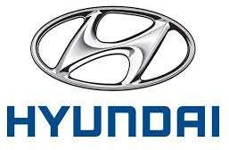

Part-1:Brand Study, Competitor Analysis & Buyer’s/Audience’s Persona
Competitor : 1
Competitor:3
Competitor: 2

Slide 7
Competitor 1 : Volkswagen
USP : Volkswagen claims to have a higher level of quality with respect to price, compared to it's competition. In terms of pricing, Volkswagen has several tactics to give its products a strong competitive advantage in the target market. While the company focus is on product quality, it also tries to offer the consumer an affordable price on every new car.
Online Communication : We provide information about products and innovations, strategic corporate decisions, people, sites and the outlook at Volkswagen – and therefore address high-visibility and opinion-forming target groups like journalists, bloggers, employees, investors, politicians and other disseminators. Transparent communication and open dialogue are especially important to us. That’s because they all have a major impact on Volkswagen’s image as Europe’s biggest car manufacturer.

Slide 8
SWOT
Strengths:
Volkswagen has a high brand presence and recall.
One of the oldest car manufacturers, resulting into increased reach to
masses.
Owner of Audi, Bentley, Bugatti, Lamborghini, Skoda which gives a wide
and large customer base.
Volkswagen also has presence in hybrid cars and motorsports.
Weaknesses:
Intense competition from global car manufacturing companies means
limited market share growth for Volkswagen.
Controversy and fraud about the emissions of the cars caused global
brand image loss.

Slide 9
SWOT
Oppurtunities :
Create long term relationships with non-German car manufacturers
Implementing continuous innovations in cars to stand competition can
boost Volkswagen
Volkswagen can enter different markets by offering cars with features
attractive for the targeted market
Increasing purchasing power of people
Threats:
Innovative features included by competitors can affect market share of Volkswagen
Increasing fuel costs can reduce purchase of cars
Government regulations and policies to protect interest of local car
manufacturers e.g. TATA in India

Slide 10
Competitor 2 : Ford
USP : With Ford's patented design and innovation, especially in their F-Series, their efforts in making their vehicles green and capable of self-driving technology gives them an edge among other brands, not to mention their cutting-edge design and technology.
Online Communication : . When it comes to improving communication, his advice was this: “If there is any great secret of success in life, it lies in the ability to put yourself in the other person’s place and to see things from his point of view – as well as your own.” And on organizational challenges, he offered this
simplification: “There are no big problems, just a lot of little problems.”

Slide 11
SWOT
Strengths:
Ford’s F-Series pickup truck line
Brand reputation combined with the second most loyal customer base
Strong position in China’s automotive market
Geographically diversified revenue streams
Weaknesses:
Weak brand portfolio
Declining market share in the U.S. automotive market
Profitability of smaller vehicle models in its product range
Below average vehicle recall and dependability rates

Slide 12
SWOT
Oppurtunities :
-Future markets for self-driving vehicles.
Significant untapped potential of Chinese and Indian markets.
Improving U.S. economic conditions.
Timing and frequency of new model releases.
Threats:
Increased competition.
Increased government regulations.
Economic and political volatility in international markets.
Rising fuel prices.

Slide 13
Competitor 3 : Hyundai
USP : Hyundai operates the world's largest integrated automobile manufacturing facility in S Korea, which is capable of producing 1.6 million units annually Hyundai STP.
Online Communication : We create synergy through a sense of "togetherness" that is fostered by mutual communication and cooperation within the company and with our business partners.

Slide 14
SWOT
Strengths:
Excellence in vehicle safety and design proven by many awards.
-The 6th highest automotive brand reputation in the world.
Effective research and development (R&D) spending resulting in new innovative cars.
Low cost to drive and durable cars.
Strong presence in China’s market.
Weaknesses:
-Poor brand portfolio, leading to fewer sales.
Low presence in the strongest U.S. vehicle market and no presence in
Japan’s vehicle market.
Declining quality of company’s management.
Product recalls damaging brand reputation.

Slide 15
SWOT
Oppurtunities :
Improving U.S. economy.
Timing and frequency of new model releases.
Low fuel prices opening new markets for Hyundai.
Threats:
Increased competition.
Rising Korean Won exchange rates.
Increasing government regulations may raise the costs.

Slide 16
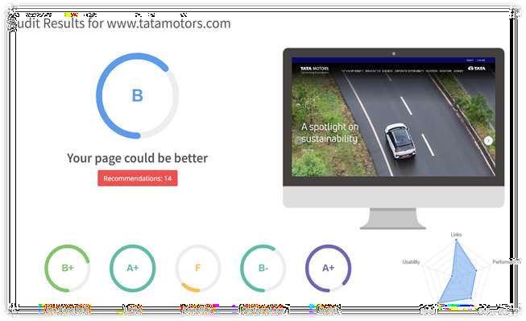
Part 2: SEO & Keyword Research
SEO Audit:
The website has a fair SEO score However it can be improved incertain Aspects such as link building & usability.

Slide 17
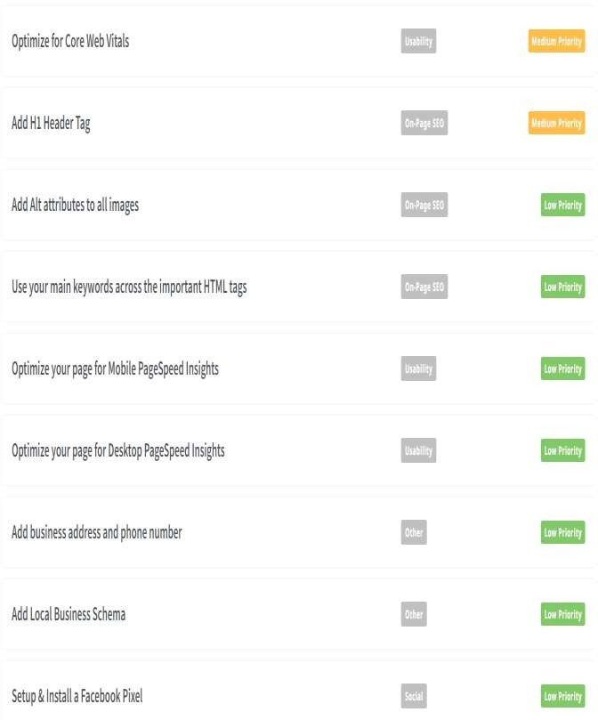
SEO Audit
Here are some points of how the website can improve its SEO.
Optimise for core web
vitals.
Add H1 Header Tag.
Start with off page activites such as link building.

Slide 18
On Page Optimization
Focus Kewords : Tata motors new car , Tata motors all models , Tata motors
share price.
Meta Title :"Driving Tomorrow: Tata Motors' Trailblazing Legacy and Future Innovation.
Meta Description :Tata motors Limited a USD 37 Billion organisation is a leading global automobile manufactuer with a portfollo that covers a wide range of cars.

Slide 19
On Page Optimization (Content Optimization)
Introduction:
In the dynamic world of automotive manufacturing, Tata Motors has carved a niche for itself as a beacon of innovation, sustainability, and excellence.
Innovation in Electric Mobility: Tata Motors' dedication to electric mobility is reshaping the automotive landscape, with groundbreaking vehicles like the Tata Nexon EV leading the charge towards a greener future.
Safety as a Cornerstone: Safety is paramount for Tata Motors, as evidenced by its advanced safety
features and unwavering commitment to protecting drivers, passengers, and pedestrians alike.
Corporate Social Responsibility (CSR) Initiatives: Tata Motors' holistic approach to CSR extends beyond profit margins, focusing on community development, environmental conservation, and skill enhancement programs to create a positive impact on society.
Future-Ready Technologies: Embracing cutting-edge technologies such as artificial intelligence, connected vehicles, and autonomous driving systems, Tata Motors is driving innovation and revolutionizing the automotive landscape for generations to come.
Conclusion:
As Tata Motors continues to pave the way for the future of mobility, its commitment to innovation, safety, corporate social responsibility, and future-ready technologies remains unwavering. With a clear vision and a steadfast dedication to driving positive change, Tata Motors is poised to shape the future of transportation and inspire generations with its pursuit of automotive excellence.

Slide 20
Document the challenges faced during research and analysis phase , as well as the
key insights gained from the keyword research process.
Consumer Preferences: Keyword research provided valuable insights into consumer preferences, search behavior, and trending topics related to Tata Motors' products and services.
Market Demand: By analyzing keyword search volume and trends, key insights were gained
into market demand for Tata Motors' products and services.
Competitive Analysis: Keyword research enabled a comprehensive analysis of competitors'
strategies, including their targeted keywords, search visibility, and content performance.
SEO Strategy Optimization: Insights from keyword research guided the optimization of Tata Motors' SEO strategies, including website content, meta tags, and backlink profiles.

Slide 21
Part-3 Content ideas and Marketing Strategies
Content Idea and Generation & Strategy : Creating a content calendar for the remaining
Month of April by brainstorming content themes, exploring various formats like blog post,
Videos, infographics, podcasts, and interactive quizzes, and scheduling publication dates
Mainly on Facebook & Instagram. And include the strategy, aim and the idea behind only
for the post and story mentioned in the calendar.

Slide 22
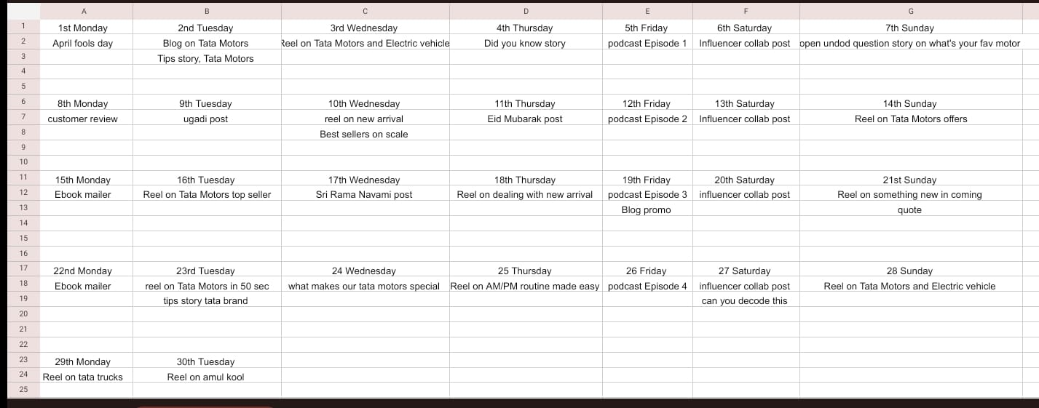
Content Calendar for the month of April
The goal of Tata Motors’s social media marketing plan is to reach out to their target
audience (people who are most likely to buy their cars) and engage with them in a way
that is interesting and informative.
This means creating posts and ads that showcase their cars’ features, benefits, and
unique selling points.
To do this, Tata Motors may use different tactics like creating engaging content,
running contests or promotions, collaborating with influencers or bloggers, and using
targeted advertising to reach specific groups of people.

Slide 23
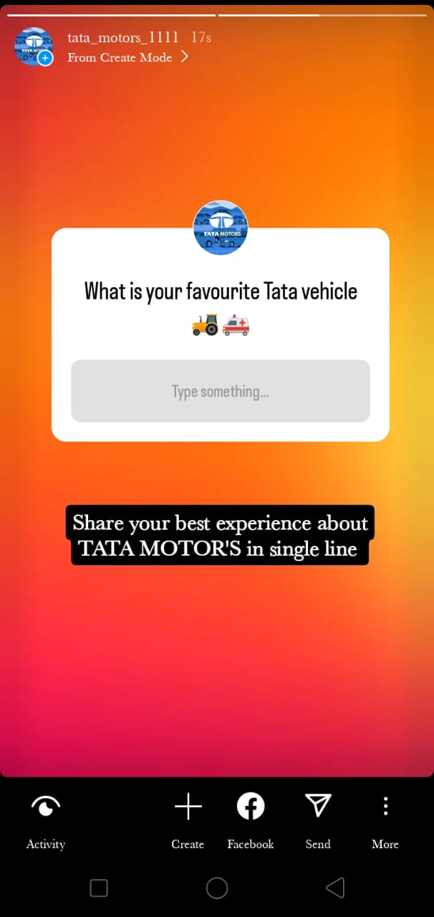
For example, they might create a series of videos showcasing the different features of
their cars and share them on social media to educate potential customers about what
they can expect from their vehicles.
They may also collaborate with popular influencers or bloggers to showcase their cars
and reach a wider audience.
Strategy, Aim and the idea behind this story
The strategy behind this “Q&A” strategy is to educate followers about the importance of
Tata Motors .

Slide 24
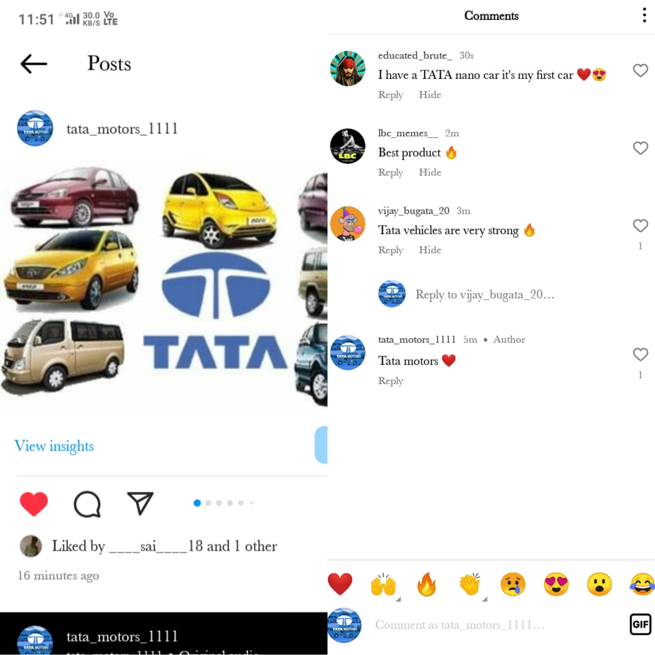
Strategy, Aim and the idea behind this post
Could you provide more context or details About the Tata Motors story or strategy you’re referring To? Knowing a bit more about the Background or theme would help Me provide a more accurate response. The idea is that by having these Engaging stories such as the format It would engage follower and Position the brand as a trusted source of Tata Motors advice.

Slide 25
Part-3: Content Ideas and Marketing strategies
Tata Motors is a company that uses digital marketing strategies to promote its products
and reach new customers. Here are some of the digital marketing strategies they use:
Social Media Marketing: Tata Motors uses social media platforms like Facebook,
Instagram, and Twitter to promote its products and engage with customers.
They share images and videos of their vehicles and also run social media campaigns
to attract new customers.
Search Engine Optimization (SEO): Tata Motors makes sure that its website appears
at the top of search engine results when people search for keywords related to their
products. This is done through various SEO techniques like optimizing website content
and building backlinks.
Pay-Per-Click (PPC) Advertising: Tata Motors uses PPC advertising to target
customers who are searching for information related to their products. They place ads
on search engine result pages and pay only when someone clicks on the ad.
Content Marketing: Tata Motors creates engaging and informative content related to
its products, such as videos, blog posts, and infographics. This helps to build brand
awareness and establish their authority in the industry.

Slide 26
PART 4:Content Creation and Curation Post Creation:
• Select Content Categories: The Amul Model of dairy development is a three tiered structure with the dairy cooperative societies at the village level federated under a milk union at the district level and a federation of members unions at the state level.
• Format 1: Post
• Format 2: Reel post
• Format 3: Festival post

Slide 27
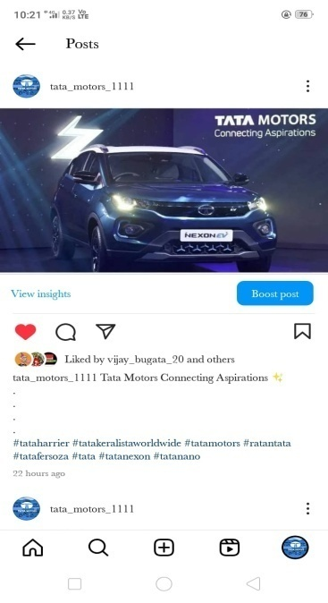
Instagram post :
• Caption : Tata Motors Connecting aspirations
Format 1 : Static Post on Tata Motors
• Link : https://www.instagram.com/p/C6LNE3Rv2pH/?igsh=aTBhdHFqY3B1OWd1
• Post :
• Hashtags: #tataharrier #tatakeralistaworldwide #tatamotors #ratantata #tatafersoza #tata #tatanexon #tatanano

Slide 28
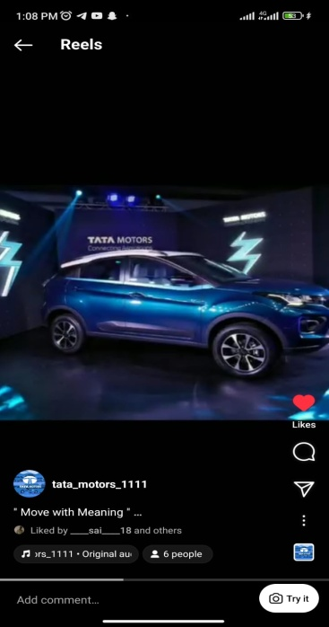
Format 2: Reel post on Tata Motors
• Caption : Move with Meaning
• Link: https://www.instagram.com/reel/C6F8HoRvsqa/?igsh=MTVhN2NjajBhN25veQ==
• Reel Post:
• Hashtages: #ramnavami #tataharrier #tatakeralistaworldwide #tatamotors #ratantata #tatafersoza #tata #tatanexon #tatanano

Slide 29
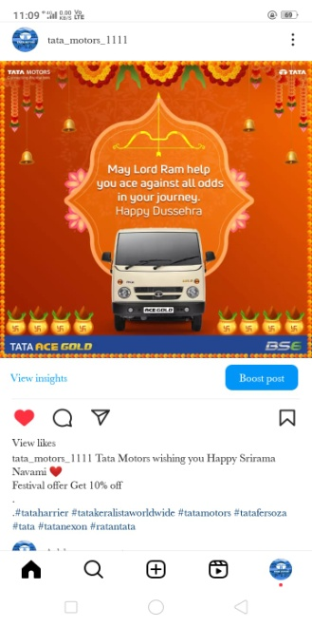
Format 3- Festivals Post on Ramnavami
• Caption : Tata Motors wishing you Happy Srirama Navami
• Link: https://www.instagram.com/p/C6NpVTgvBQ2/?igsh=a2s4ZXkwdGMwYzBs
• Post:
• Hashtags: #ramnavami #tataharrier #tatakeralistaworldwide #tatamotors #ratantata #tatafersoza #tata #tatanexon #tatanano

Slide 30
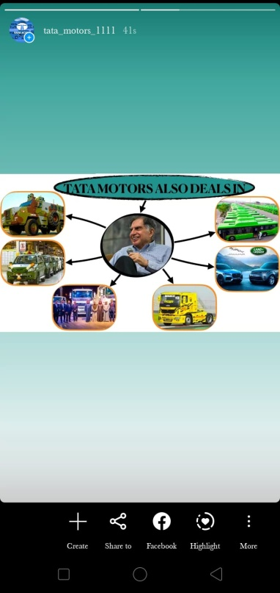
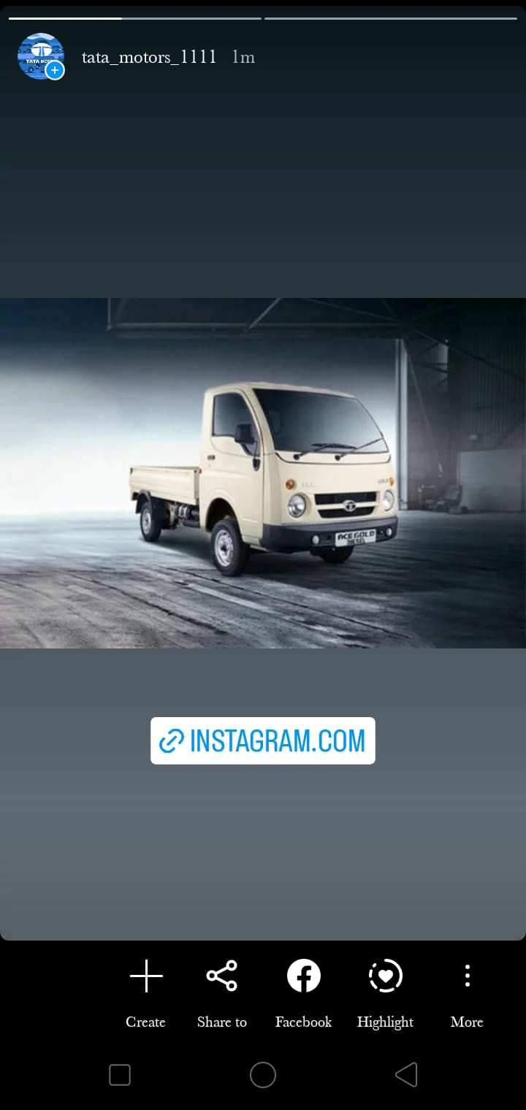
Instagram Story
Screenshots of story :
https://www.instagram.com/stories/tata_motors_1111/3354524607682773411?utm_source=ig_story_item_share&igsh=YTc2c2pqZTVxMGZr

Slide 31
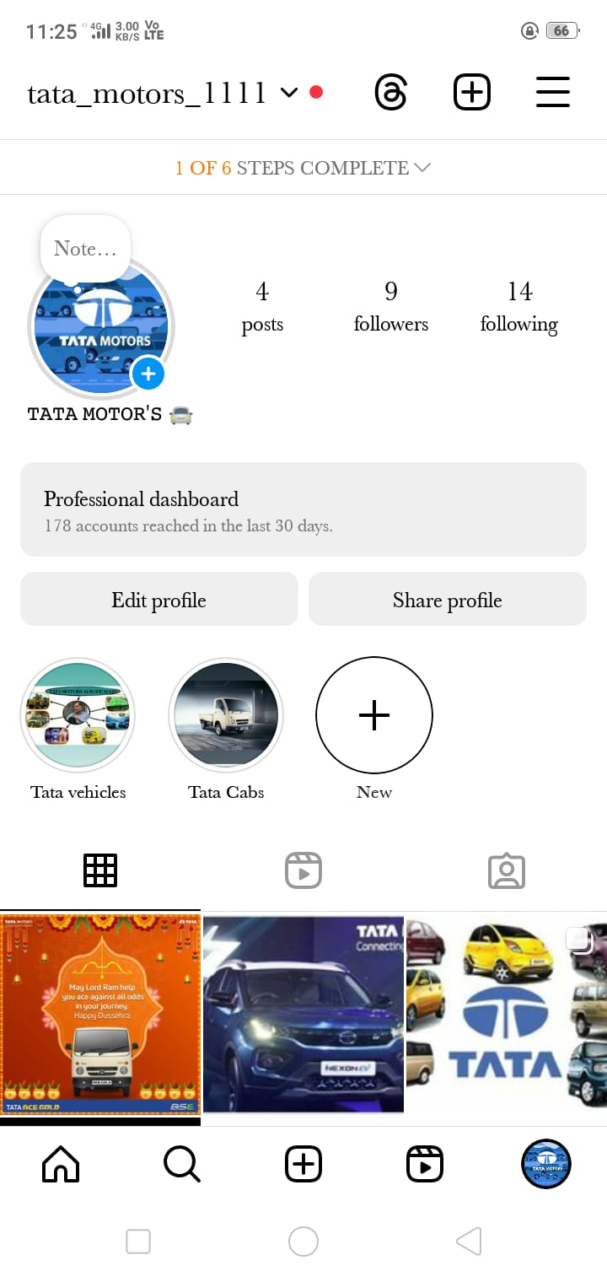
Highlights for Story.
https://www.instagram.com/stories/tata_motors_1111/3354524844954564966?utm_source=ig_story_item_share&igsh=MTdkbWRlemMzenl1cg==

Slide 32
Story Insights – Q&A
Reach is
Impressions is
Like is Etc….
Area for improvement:
• Focus on electrification, connectivity, digital services, metaverse, intelligent enterprise, manufacturing, supply chain and sustainability.
• Some of the recommendations for Tata Motors are exploring mass customization options in the Small Commercial Vehicle (SCV) segment, improving brand reputation and technology appropriation to bring out a world class ultra-HCV segment.

Slide 33
Part 4: Content Creation and Editing
Designs/Video Editing
• Design Tools Familiarization(use canva for creating visually appearing graphics)
• Video Creation: Utilize VN or any video editor of your choice to create videos related to the chosen topic.

Slide 34
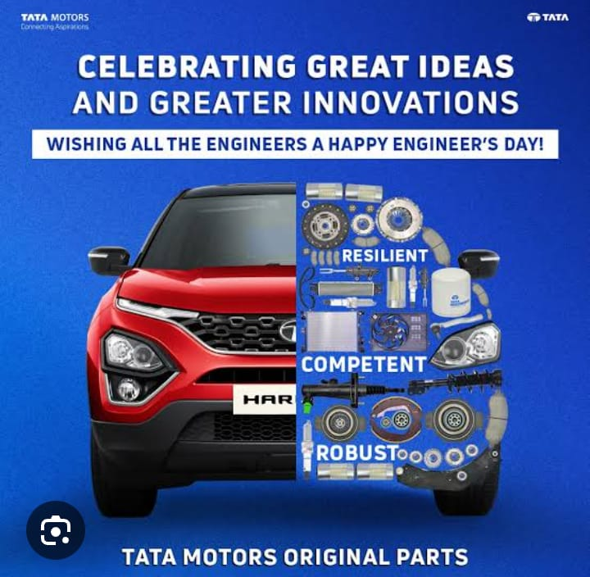
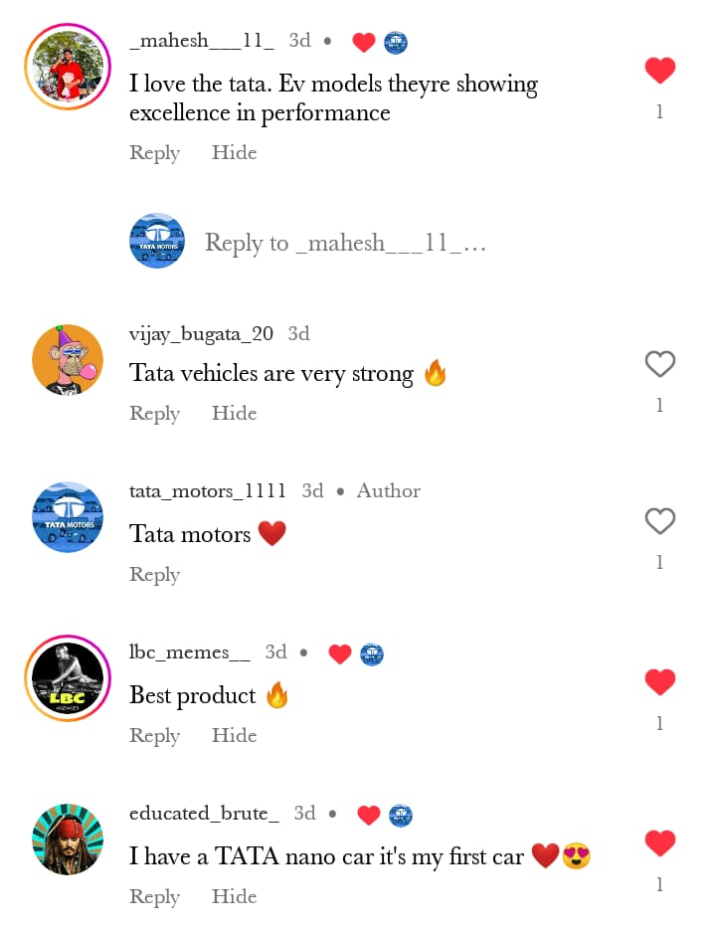
Instagram post :
Caption : Celebrating Great Ideas and Greater Innovations
Hastags: #ramnavami #tataharrier #tatakeralistaworldwide #tatamotors #ratantata #tatafersoza #tata #tatanexon #tatanano
Link: https://www.instagram.com/p/C6NtlkCPk_V/?igsh=MXJudHU1dWg2dmFyOA==

Slide 35
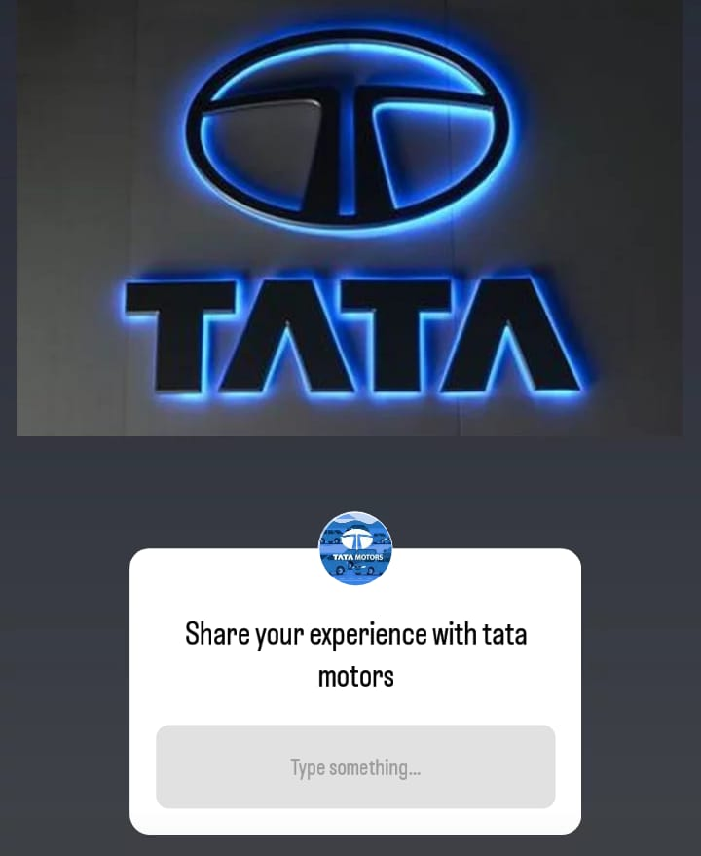
Instagram Story Caption: Share your experience with tata Motors
Hastags: #tatamotors #tata
Link: https://www.instagram.com/stories/tata_motors_1111/3354541923942297266?utm_source=ig_story_item_share&igsh=MTI3aGRyaGwzZmd1MQ==

Slide 36

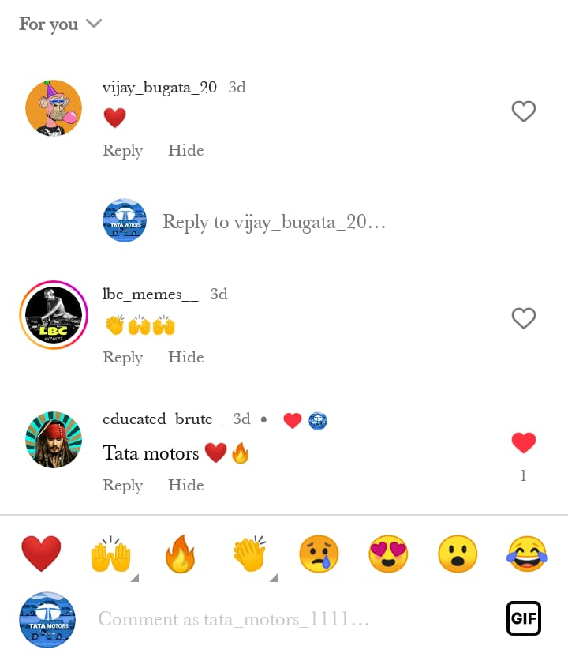
Instagram Story Caption:
Tata Motors ugadi Special Post
Hastags: #ugadi #tatamotors #tata
Link: https://www.instagram.com/stories/tata_motors_1111/3354544395544973427?utm_source=ig_story_item_share&igsh=YXRlbDF6aGx3Z2Nt

Slide 37
THANK YOU
Presented by
B. Vijay kumar
B. Mahesh Babu
B.Sai Kumar
B. Maharoop
Ch. Maharoop

