Slide 1
AUTONOMOUS TECHNICAL INTELLIGENCE BOT
TechPulse AI Digest Bot
Autonomous multi-source intelligence engine distilling open-source velocity, research preprints, and developer signals into high-conviction executive briefings.
6 Multi-Feeds
GitHub, HN, HF, ArXiv, Dev.to
Groq 120B LLM
Sub-15s Curation & JSON Schema
30-Day Dedup
SQLite WAL Sliding Window
$0 / Month
Zero-Cost Serverless & Actions
Author: BT-Nishant (Bugendaitech) | Private GitHub Repository: Bugendaitech-Nishant/techpulse-ai-digest-bot

Slide 2
TECHPULSE // OSINT-AI OBSERVATORY
Decoupled 3-Agent Autonomous Pipeline Architecture
AGENT 1: HARVESTER
Multi-Source Concurrent Ingestion
• Concurrent multi-threaded crawling across 6 APIs & scrapers in <7s total.
• In-batch normalization (UTM parameter stripping, URL SHA-256 hashing).
• 30-day SQLite sliding deduplication window: prevents repeat surfacing.
• Robust error isolation: individual feed failure never halts the pipeline.
AGENT 2: PROCESSOR
Groq LLM Filter, Ranker & Summarizer
• Powered by Groq Cloud API: Primary (openai/gpt-oss-120b) + Fallback (qwen3.8-27b).
• Curates strictly against technical profile (AI agents, LLMs, Python, backends).
• High-Signal 3-Tier Categorization: Must Read, Inspiration, or Skip.
• Generates 2-sentence technical brief and 'Why it matters' strategic note.
AGENT 3: PUBLISHER
Markdown Compiler & Database Syncer
• Compiles structured executive reports to digests/YYYY-MM-DD.md.
• Windows cp1252 & UTF-8 resilient (zero terminal crashes on Windows).
• Transactional SQLite persistence for digests, metrics, and curated items.
• Defensive overwrite protection: safeguards historical records.
Result: Complete end-to-end execution completes in ~15.2 seconds with zero human intervention required.

Slide 3
TECHPULSE // OSINT-AI OBSERVATORY
The 6-Source Intelligence Ingestion Network
GitHub Trending
Protocol: HTML Scraper
Scrapes top daily repos across Python and all engineering languages
GitHub Search API
Protocol: REST API
Monitors fast-moving newly created repositories in AI agents & tools
Hacker News Frontpage
Protocol: Algolia API
Algolia API frontpage discussions, point scores, and comments
Hugging Face Papers
Protocol: Hugging Face API
Daily research papers ranked by ML community upvotes & citations
Dev.to Engineering
Protocol: Dev.to REST
Curated engineering articles covering AI frameworks and system design
ArXiv AI Preprints
Protocol: XML / Atom
Official cs.AI and cs.LG Atom XML research feed for cutting-edge theory
Benchmark: Ingests 90-100 items across all 6 streams in under 5.2 seconds concurrent wall time.

Slide 4
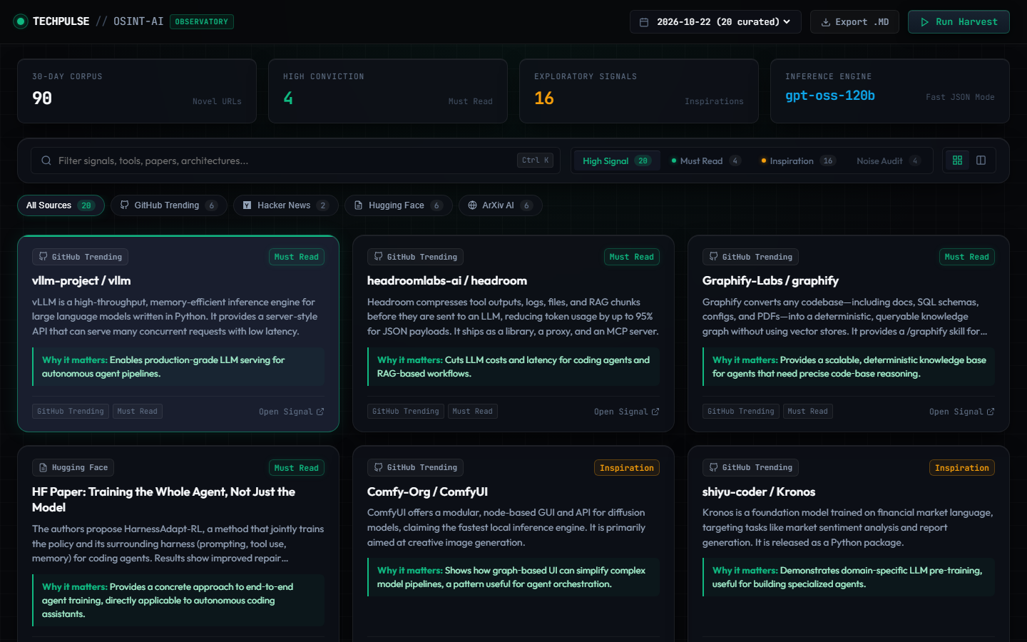
TECHPULSE // OSINT-AI OBSERVATORY
Web Cockpit: Responsive Bento Grid & High-Signal Curation
SIGNAL MONOLITH DESIGN
Engineered for Focus
• High Signal Default: Skip items are quarantined into a 'Noise Audit' tab so readers never see clutter.
• Interactive KPI Strip: Clicking on 'High Conviction' or 'Exploratory Signals' filters items instantly.
• Responsive Bento Grid: Auto-fill columns adapt from 1 to 3 columns without awkward right-hand voids.
• Source Spectrum Pills: Filter by GitHub, Hacker News, Hugging Face, or ArXiv with live count badges.
• Export Markdown: Direct one-click download of executive-ready digest reports.
Live Local Server: FastAPI backend running at http://127.0.0.1:8000 with real-time SSE & hot-reload.

Slide 5
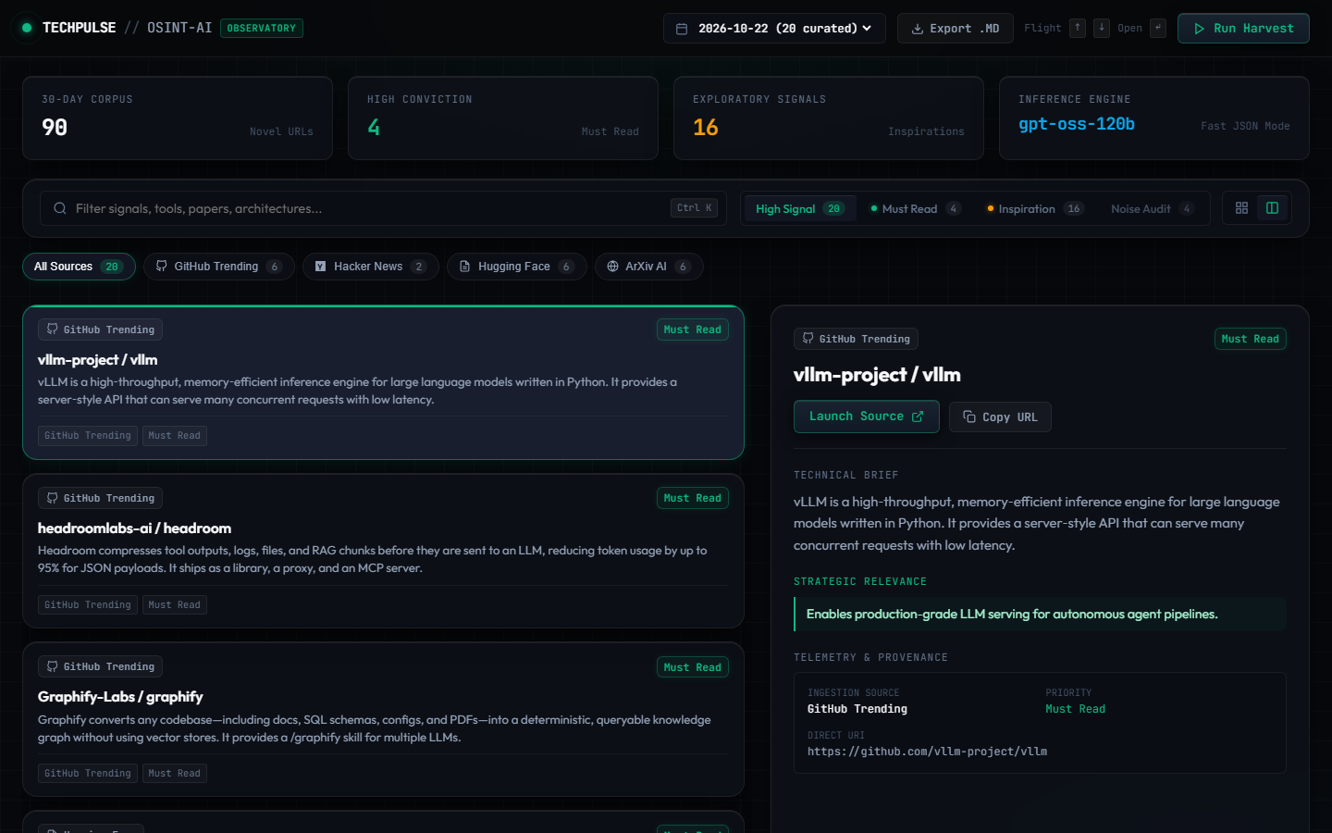
TECHPULSE // OSINT-AI OBSERVATORY
Zero-Scroll Cockpit Flight Mode & Keyboard Navigation
ZERO-SCROLL FLIGHT DECK
Terminal-Speed Curation
• Keyboard Flight Controls: Navigate signals with [Up] / [Down] or [J] / [K]; launch source directly with [Enter].
• Dual-Pane Layout: Left scrollable signal list + Right sticky inspector pane for zero viewport scrolling.
• Deep Technical Telemetry: Inspects technical briefs, strategic relevance takeaways, source origins, and direct URIs.
• Ctrl + K Quick Search: Instant in-memory filtering across titles, summaries, and tags in milliseconds.
• One-Click Launch & Copy: Direct source launch or clipboard copy without leaving the observatory.
Verified via Playwright browser automation with 100% headless test pass rate.

Slide 6
TECHPULSE // OSINT-AI OBSERVATORY
Quality Verification, Performance & Delivery Summary
TESTING EXCELLENCE
22 / 22 Tests Passing (100%)
✔ 6 Collector unit tests with network timeout isolation
✔ SQLite 30-day deduplication & non-destructive tests
✔ Pydantic strict schema & JSON fence stripping tests
✔ Playwright Chromium browser UI end-to-end tests
ZERO-COST ARCHITECTURE
$0.00 Monthly Operating Cost
✔ Inference: Groq Cloud API free tier (120B / 27B models)
✔ Scheduling: GitHub Actions scheduled cron at 8AM UTC
✔ Storage: Local SQLite engine in WAL mode
✔ Ingestion: 100% free public developer APIs & feeds
ENTERPRISE READINESS
Production-Grade Standards
✔ Private GitHub: Bugendaitech-Nishant/techpulse-ai-digest-bot
✔ Windows cp1252 & UTF-8 resilient (zero terminal crashes)
✔ FastAPI REST endpoints for stats, digests, and live harvests
✔ Export-ready Markdown reports with strategic takeaways
Status: Fully operational, tested, documented, and hosted on Private GitHub.

