Slide 1

IFMIS TECHNOLOIES AND INTEGRATION WITH OTHER SYSTEMS
RWANDA
Ministry of Finance and Economic Planning
By
MUKWENDE PLACIDE
IFMIS Coordinator

Slide 2
Contents
Country overview
Development Background
Rollout
Technology Stack
Integration Platform
Integration Services Explained
Future Plans

Slide 3
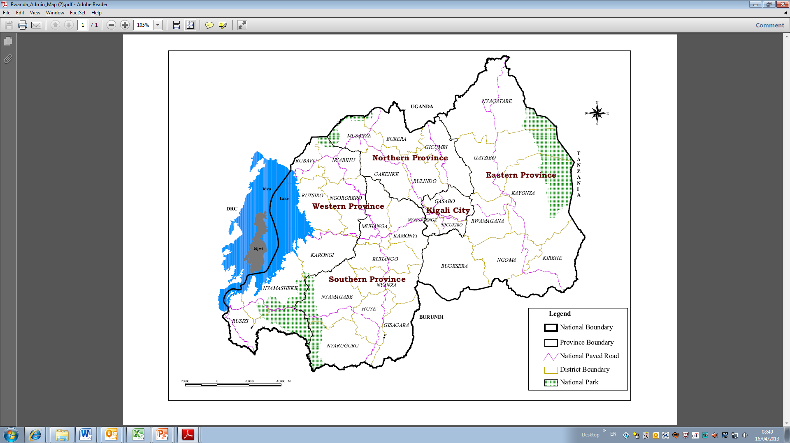
Country Overview: RWANDA
Rwanda in the heart of Africa
National Boundary
District Boundary
Province Boundary
National Park
Key facts
Capital | Kigali
Population | 12.1 million (2018)¹
Nominal GDP | RwF 7,597 billion (2017, approx. US$ 9.1 billion)²
GDP Growth | 6.1 % (2017)³
Literacy Rate | 72%⁴
External Debt (% of GDP) | 48% (End 2017)⁵
Time to Start a Business | 6 hours⁶
Credit Rating | B (stable); B+ (Stable)7
Currency | Rwandan Franc (863 FRW) = 1 US$ (17th October 2018)⁸
National Institute of Statistics Rwanda (NISR)
NISR; NBR for exchange
NISR
NISR – EICV4 FY2013/14 (% of people ages 15 and above)
MINECOFIN
World Bank Doing Business Report 2017
Fitch May 2018; Standard & Poor’s February 2018
BNR

Slide 4
Development Background
Setup of Rwandan IFMIS: Functional Groupings & Systems Integration

Slide 5


Rollout
1,239
Entities
3,133
Users
Public Sector
Central Government
Local Government
Ministries++ [19+4]
Kigali City[1]
Agencies [69]
Districts [30]
Provinces [4]
District Hospitals [43]
District Pharmacies[30]
Projects [72]
Sectors [416]
Embassies [36]
Health Centers [470]
Judicial entities [34]
Public Schools [2,846]

Slide 6
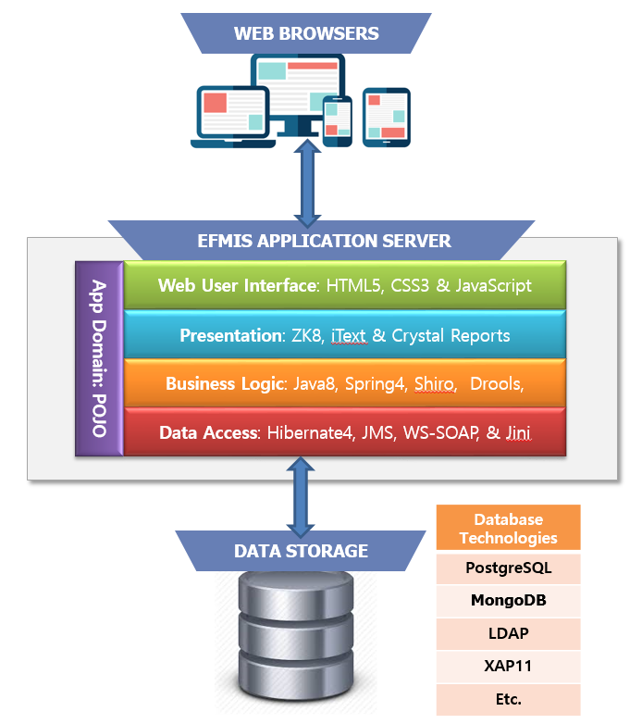
Technology Stack
Application Architecture

Slide 7
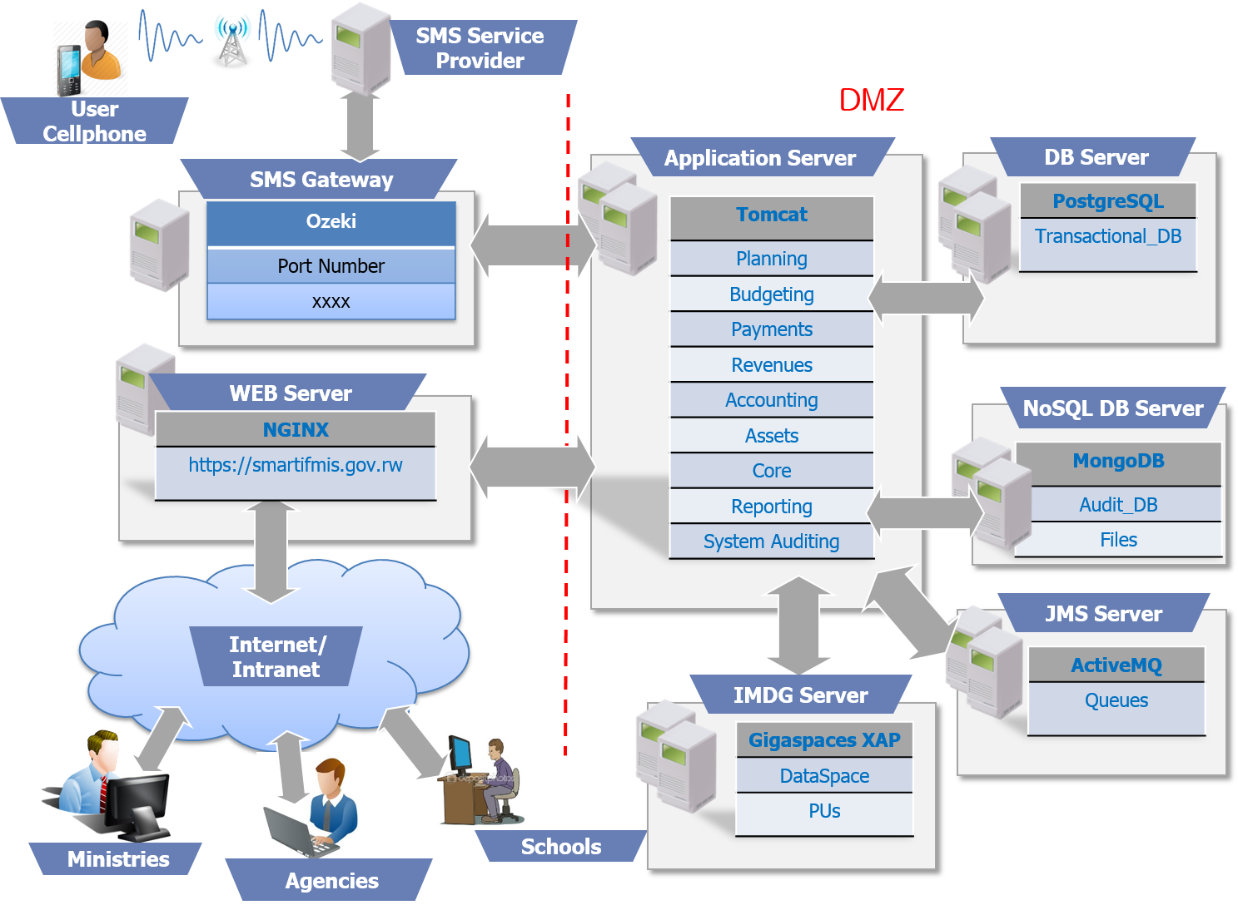
Technology Stack
System Architecture

Slide 8
IFMIS Integration Platform
In-house Enterprise Service Bus: SpaceBus

Slide 9
Integration Platform
Electronic Message Categories

Slide 10
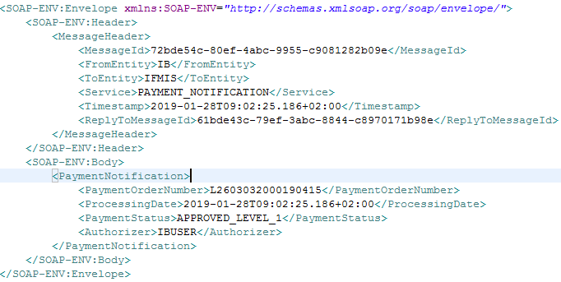
Integration Platform
Electronic Message Format

Slide 11
Integration Services Explained
IFMIS & E-Procurement
I
F
M
I
S
E
-
P
R
O
C
U
R
E
M
E
N
T
Budget Information
Challenges:
Tight coupled procurement and payment services.
Contract management issues inherited from separating the procurement and payment system.
Lack of clear choice of which system must initiate the invoicing process and provide a single window for Supplier to access Government services.
Duplicated processes due to some entities that may be obliged to use other procurement systems: example STEP of World Bank.
Lack of transparent budget execution in E-Procurement
Contract Information
Purchase Order
Delivery Information
Payment Notification

Slide 12
Integration Services Explained
IFMIS & E-Banking System of the Central Bank
I
F
M
I
S
E
-BANK
I
NG
COMMER
I
AL
BANKS
Challenges:
Lack of transparent payment process between IFMIS and commercial banks.
IFMIS lacks the knowledge of returned payments.
Payment using cheques for Non-Budget agencies
Exchange Rates
Payment Instruction
Payment Response
Payment Notification
SWIFT Messages
Returned Payment

Slide 13
Integration Services Explained
IFMIS & Payroll System
I
F
M
I
S
PAYROL
L
SY
S
TEM
Challenges:
Lack of single system for executive managers that need a to approve payroll and payments and this lead to difficulties in implementing the paperless policy.
Lot of work on Treasury side in verifying payroll details related to changes in payroll.
Payroll Information
Commitment Notification
Payment Notification

Slide 14
Integration Services Explained
IFMIS & E-Tax
I
F
M
I
S
E - TAX
Challenges:
Issue of delayed tax payment that may lead to penalties.
Tax Declaration References
Tax Payment Notification
Tax Declaration

Slide 15

Future Plan
IFMIS Usage
1,239
Entities
4,085
Entities
3,133
Users
~10,000
Users

Slide 16


Future Plan
IFMIS in 2020
Modified Cash
Accounting
Accrual
Accounting
Information
System
Expert
System

Slide 17
Thank you!

