Slide 1
Saint Petersburg Electrotechnical University "LETI"
ALGORITHMS FOR OPTIMIZING SIMD-INSTRUCTIONS IN MODERN ARCHITECTURES
Student: Mei Haitao
Scientific advisor: Ph.D., associate prof. A. A. Paznikov

Slide 2
The goal of the GQW
Conduct research and analysis on modern compiler's automatic vectorization algorithms, identify the weaknesses of automatic vectorization, understand the underlying reasons, and implement optimizations.
The relevance of the GQW
It improves computational efficiency in high-performance computing. The study optimizes the performance of automatic vectorization under specific circumstances. It contributes to enabling programmers to achieve high-performance computing.

Slide 3
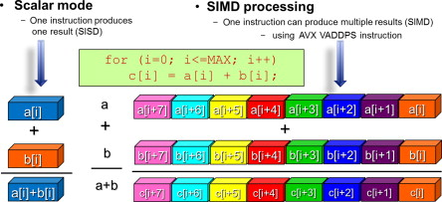
Vectorization Overview
typedef float vec; #define VECLEN 8 void vector_op(vec *a , vec *b, vec * __restrict c) { for (int i=0; i < VECLEN; i++) { c[i] = a[i] * b[i]; } }
vector_op(float*, float*, float*): vmovups ymm0, YMMWORD PTR [rdi] vmulps ymm0, ymm0, YMMWORD PTR [rsi] vmovups YMMWORD PTR [rdx], ymm0 ret
only one command

Slide 4
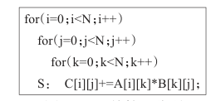
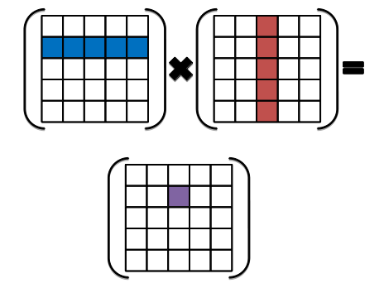
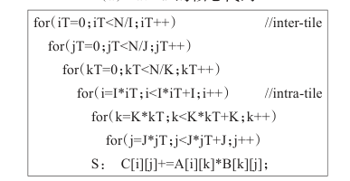
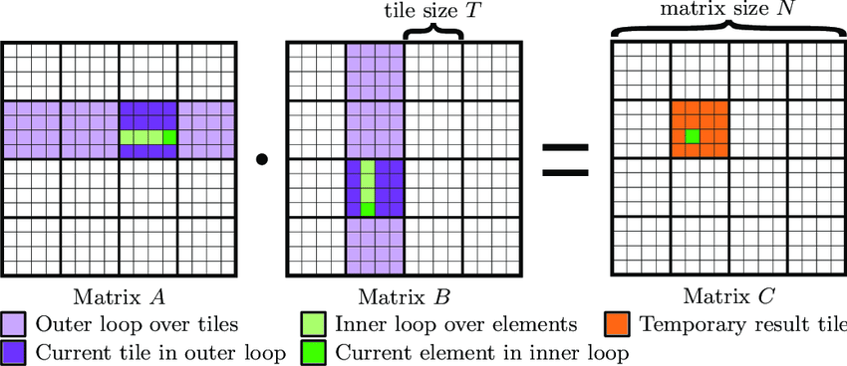
Loop tiling algorithm
matmul core code
tiled-matmal core code

Slide 5
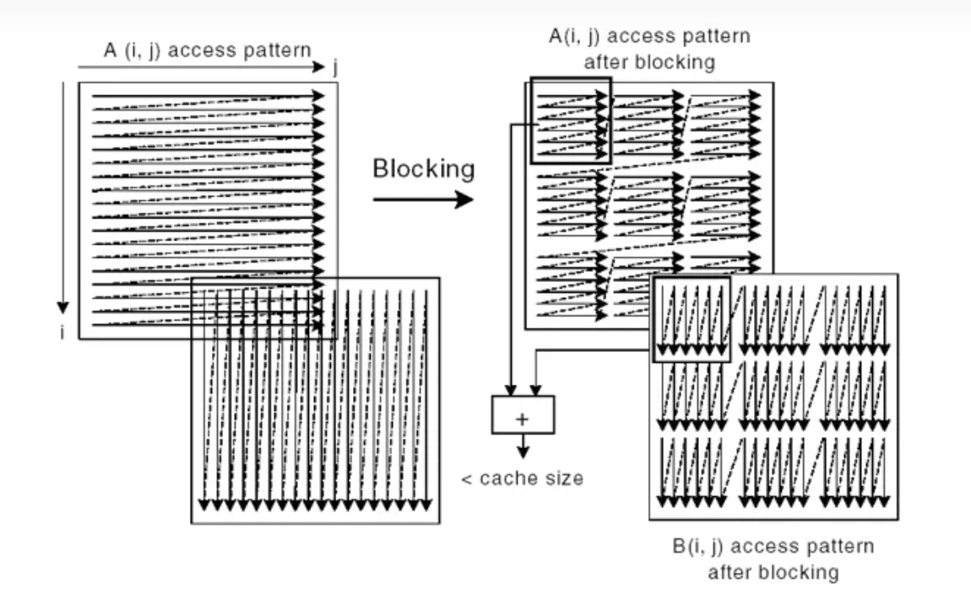
Loop tiling algorithm
Advantages:
Optimizing Vectorization
Enhancing Data Locality
Improving Parallelism
Improving Load Balancing
Issues:
Alignment Issue
Tile size prediction Difficulty
lead to too frequent cache replacement or
underutilization of the cache

Slide 6
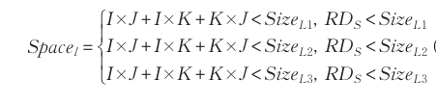

TSS Algorithm Description
Disadvantages of known algorithms:
Only the case where the number of iterations is a multiple of the vector width was tested
Most only consider the impact of cache
Not consider about the gains of vectorization
Advantages of known algorithms:
Very good evaluation of parallelism and locality of loop tiles
Locality
Parallelism
Data should be 70% of each level cache

Slide 7
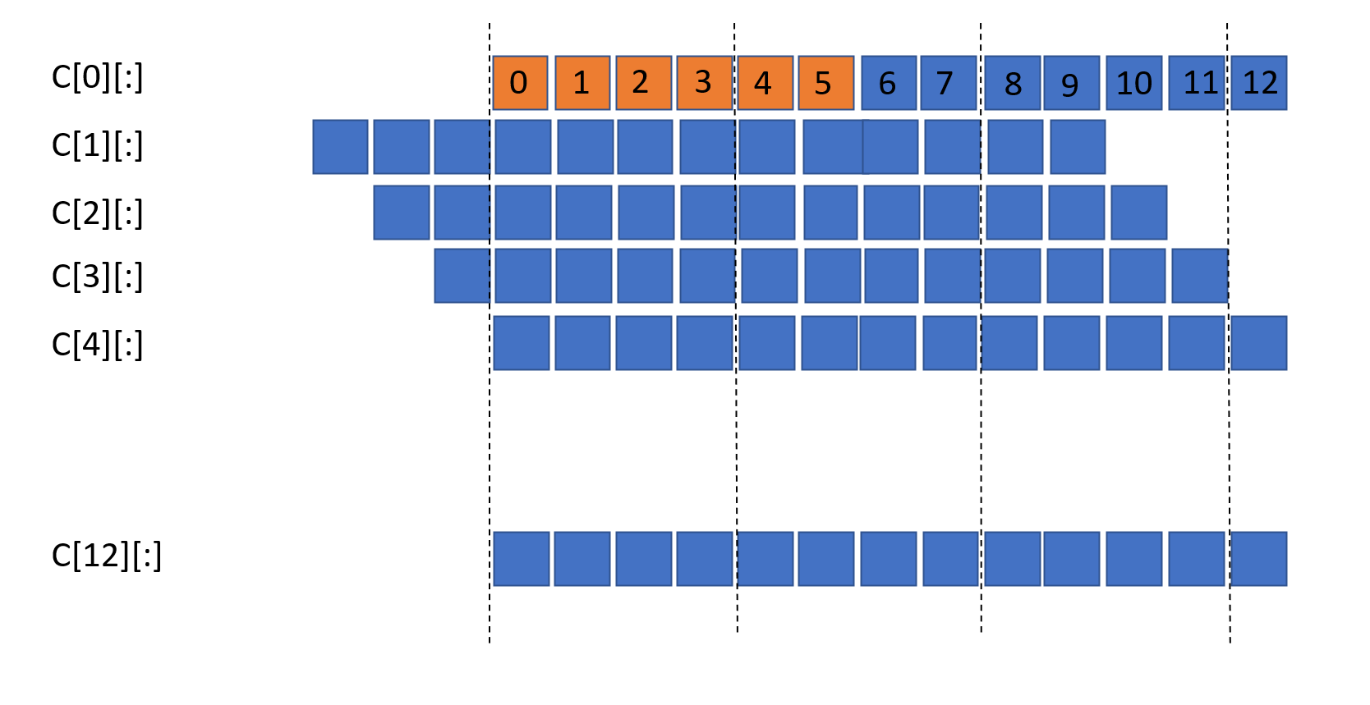
Algorithm Description
Algorithm Focus:
Focus on tile size selection when the number of iterations is not a multiple of the vectorisation
Define 𝑁𝑈𝑀_𝑉𝐸𝐶 as profit. When on part can vectorization, 𝑁𝑈𝑀_VEC +1 , Choose the block size under maximum profit
When the number of iterations is 13 and the block size is 6

Slide 8
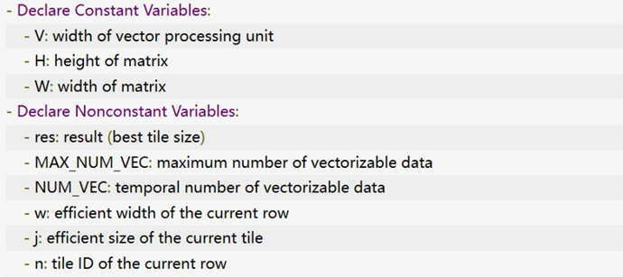
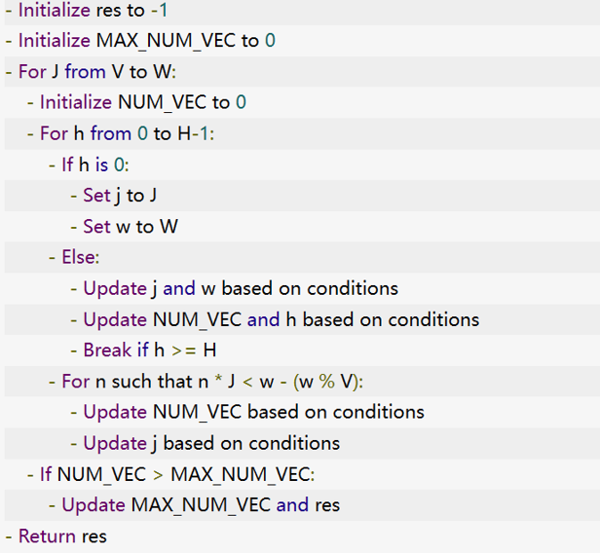
Algorithm Description
The value of J ranges from the vector width V to the array width W, which is the range of possible tile factors.
Check if the current row h is divisible by V to determine whether to give new J and W
Guarantee that J is a multiple of V.

Slide 9
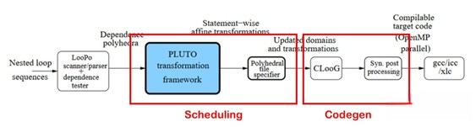
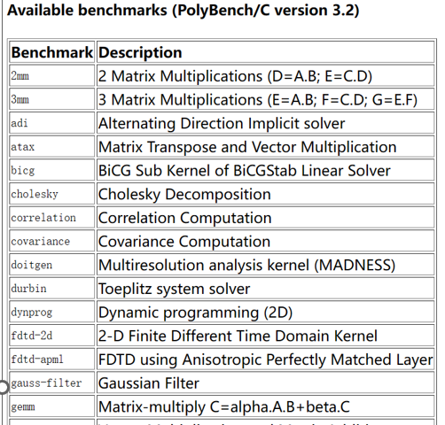
Algorithm hierarchy
Our code
We use the pluto compiler and use the interface exposed by pluto to integrate my algorithm into pluto.
Use clandl and isl to get information to calculate the best size.
The default is to call the stile.sizes file, we change its interface to vec_tile_size() to use our results.
Among the Polybench3.2 test sets, we selected eight test sets that can be vectorized.

Slide 10
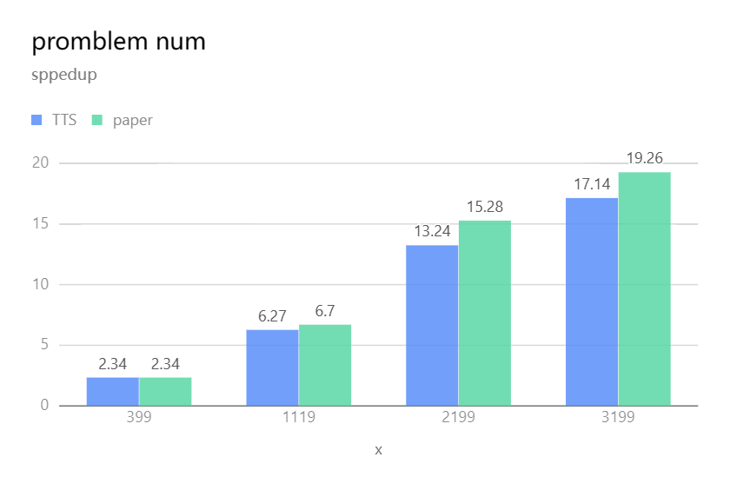
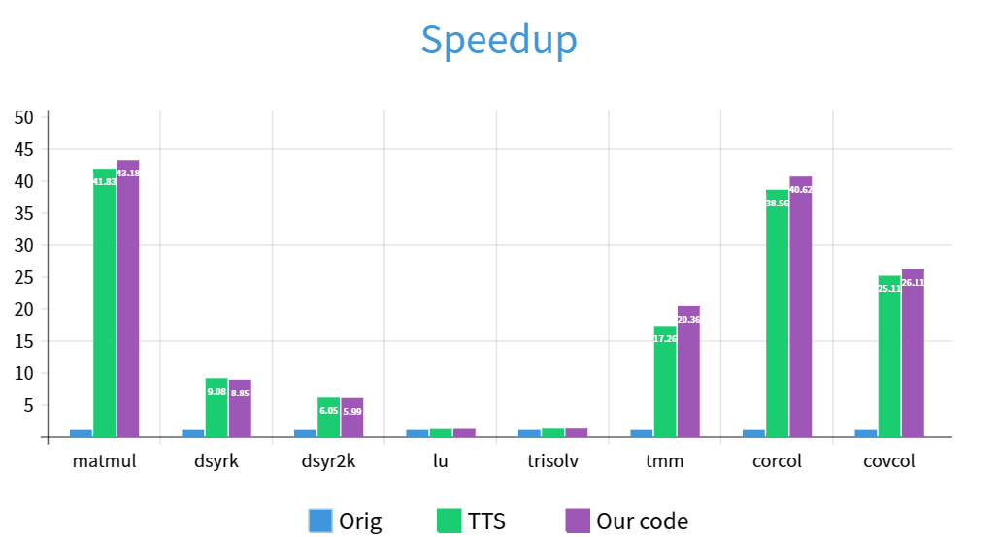
Performance comparison between algorithms at different scales and existing algorithms
The average speedup of the eight programs at different non-vectorization multiple iterations
The performance of the algorithm when the number of iterations is 3199

Slide 11
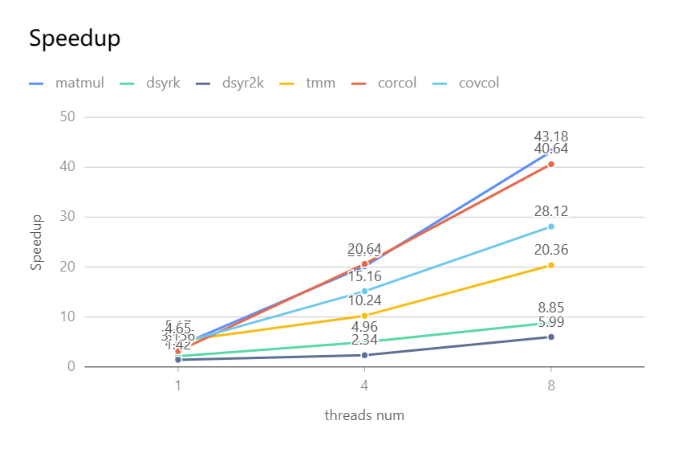
Performance of algorithm under multi-threading
export omp_num_threads=1,4,8
Six of the eight programs are parallelizable with good performance
LU decomposition and Triangular solver are not well parallelized.
Thread num | 1 | 4 | 8
lu | 1.56 | 1.57 | 1.49
trisolv | 1.62 | 1.58 | 1.58
Data competition

Slide 12
Conclusion
We analyze the auto-vectorization features in modern compilers and make optimizations based on existing loop tile schemes. Experimental results show that:
As the size of the problem increases, the advantages of the algorithm become more and more obvious.
Our loop tiling algorithm shows a speedup of about 40 on programs that vectorize well, such as matrix multiplication, and the algorithm works well.
Works well with multiple threads.
However, in the case of vectorized multiples, the proposed algorithm does not show an advantage,
there is still room for improvement in the generality of the algorithm.
Overall, the algorithm proposed in this paper satisfies the basic criteria of the cyclic tile algorithm, namely locality and parallelism, optimizing the performance of vectorization under cyclic tiles. It also provides a reference for tile selection in specific cases.

Slide 13
Acknowledgement
Thank you for listening!
Name: Mei Haitao. Group: 7300
Phone Number: +79210964625
Github: https://github.com/mingshi2333
E-mail: meihaitao0812@gmail.com

