Slide 1
LANDUSE CLASSIFICATION WITH SKLEARN
Buğra Alptekin Sarı
Rukiye Kurt

Slide 2
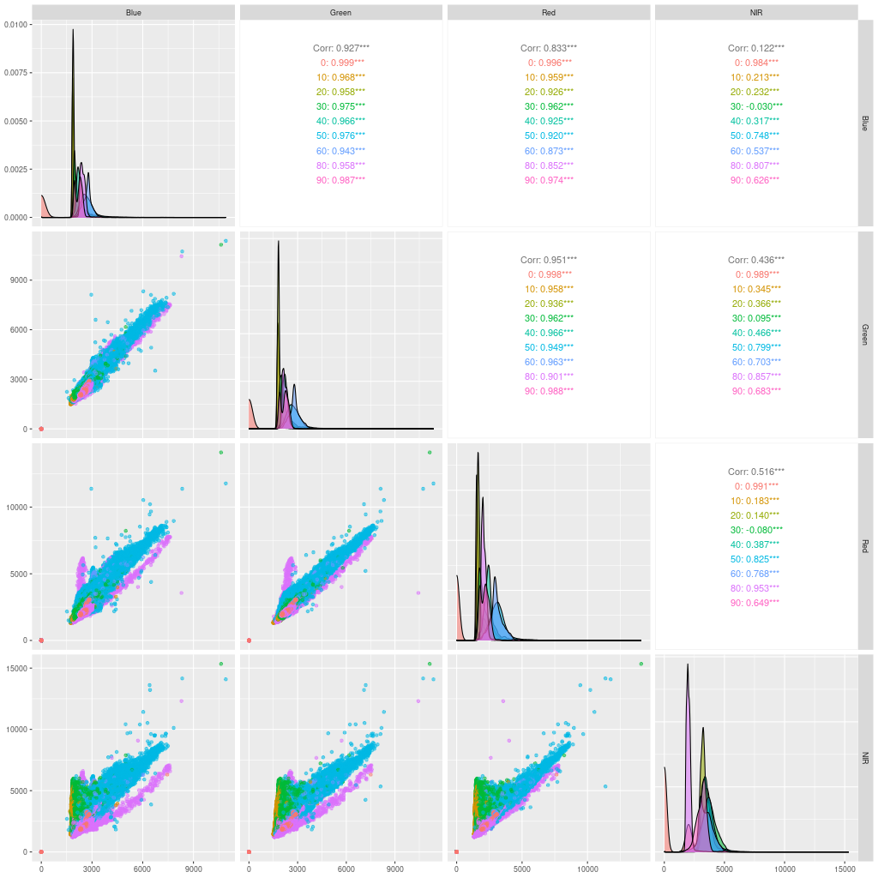
Visualization
Water looks like an easy target
Let’s go for it!

Slide 3
Water vs. All
Right off the bat, we start by using support vector machines.
But there is a problem..
The training is taking an absurd amount of time.
Solution?

Slide 4
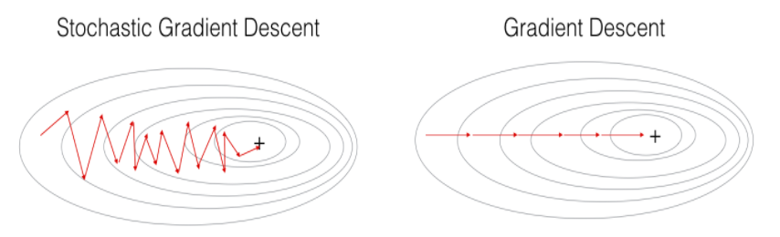
Stochastic Gradient Descent
Commonly used in Neural Networks.
Is an iterative method to find the global minimum.
But most of importantly..
It is fast!

Slide 5
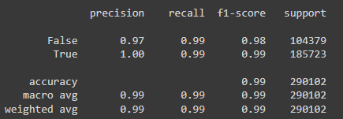
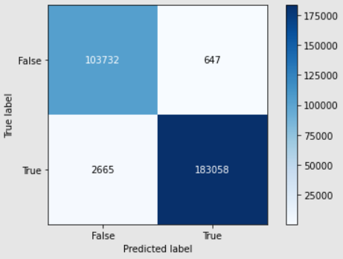
Water vs. All
Training now only takes around 2 minutes.
The resulting accuracies:

Slide 6
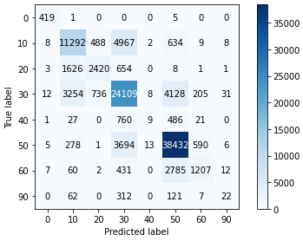
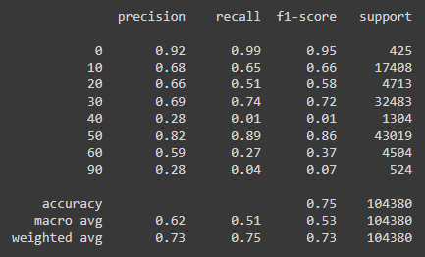
The rest
We classify everything else in one go
With the same classifier we used for water (Namely the SGD Classifier)
The resulting accuracies:

Slide 7
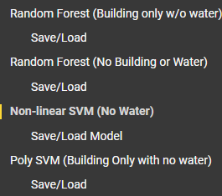
Other Important mentions
Pickles. They will save your life.
It is not by coincidence that everything has a save/load section.

Slide 8

Other Important mentions
Automation and Integration.
Streamlines the whole process of receiving and Sending data.
Improving the overall performance

