Slide 1
A Virtualization-Based Approach to Retrofitting Protection in Commodity Operating Systems

Slide 2
outline
Abstract
Introduction
Design Goals
Multi-Shadowed Cloaking
Overshadow Overview
OS Integration with Cloaking
Adapting System Calls

Slide 3
Abstract
Overshadow offers a last line of defense for application data.
be integrated with existing systems.
used to protect a wide range of unmodiﬁed legacy applications
evaluate this approach is practical

Slide 4
Introduction
Overshadow adds this protection through a novel technique called multi-shadowing which leverages the extra level of indirection offered by memory virtualization in a virtual machine monitor(VMM).

Slide 5
Design Goals
Why Overshadow targets whole-application protection
The threats it attempts to address.

Slide 6
Why Overshadow targets whole-application protection
Ease of Adoption.（可移植性）
Support for Diverse Applications.（兼容性）
Incremental Path to Higher Assurance.（安全性）

Slide 7
The threats it attempts to address.
Threat Model：建立威胁模型的原因很简单，就是找出系统的潜在威胁并建立一个稳固的防守策铬来对抗这些威胁。
Overshadow prevents the guest operating system from reading or modifying application code, data and registers, but makes no attempt to provide availability in the face of a hostile OS

Slide 8
Multi-Shadowed Cloaking
Multi-Shadowed Cloaking
Multi-Shadowing
Memory Cloaking

Slide 9
Multi-Shadowed Cloaking
To support isolation physical memory is virtualized by adding an extra level of address translation.
VM(GVPN-to-GPPN)
VMM (GPPN-to-MPN):maintains a pmap data structure
VMM Also contain GVPN-to-MPN mappings, Since the hardware TLB caches direct GVPN-to-MPN mappings

Slide 10
Multi-Shadowing
Multi-shadowing is a novel mechanism that supports context dependent, one-to-many GPPN-to-MPN mappings.
Conceptually multiple shadow page tables are used to provide different views of guest physical memory to different shadow contexts.

Slide 11
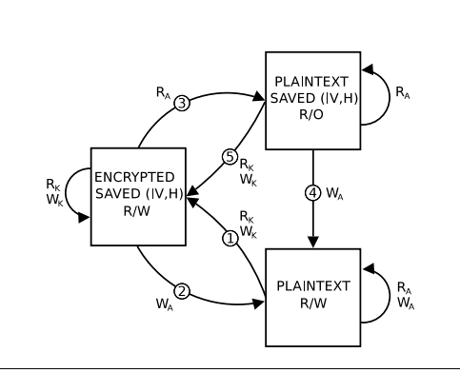
Memory Cloaking
Figure 1:Basic Cloaking Protocol.

Slide 12
Figure 1:Basic Cloaking Protocol.
State transition diagram for maintaining the secrecy and integrity of a single cloaked page. Application reads RA and writes WA manipulate plaintext page contents, while kernel reads RK and writes WK use an encrypted version of the page. A
secure hash H is computed and stored immediately after page encryption, and veriﬁed immediately prior to page decryption.

Slide 13
Figure 1:Basic Cloaking Protocol.
transition 1:encrypts the page, generates an integrity hash, map into the system shadow.
transition 2:veriﬁe its integrity hash, decrypt, map the page into application shadow.
transition 3: the page is mapped read-only and its(IV,H) is retained.
transition 4: the (IV,H) is discarded, and the page protection is changed to read/write.
transition 5:the VMM proceeds as in transition 1

Slide 14
Overshadow Overview
Cloaking is a low-level primitive that protects the privacy and integrity of individual memory pages. Overshadow leverages this basic mechanism to cloak whole applications, cryptographically isolating application resources from the operating system.

Slide 15
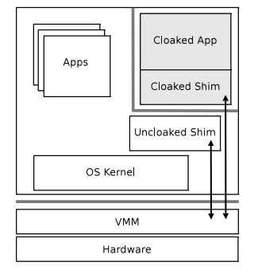
Figure 2. Overshadow Architecture.
Figure 2. Overshadow Architecture.

Slide 16
Figure 2. Overshadow Architecture.
The VMM enforces two virtualization barriers (gray lines). One isolates the guest from the host, and the other cryptographically isolates cloaked applications from the guest OS. The shim cooperates with the VMM to interpose on all control flow between the cloaked application and OS.

Slide 17
Figure 2. Overshadow Architecture.
Overshadow introduces a shim into the address space of the cloaked application, which cooperates with the VMM to mediate all interactions with the OS

Slide 18
OS Integration with Cloaking
From figure 2,we know that through shim The VMM interposes on transitions between the cloaked user-mode application and the guest kernel
How dose the shim work?

Slide 19
Shim Overview
It uses an explicit hypercall interface for interacting with the VMM(a secure
communication mechanism between the guest and the VMM.); It also facilitates extensibility

Slide 20
Shim including
Shim Memory : consist of both cloaked and uncloaked regions, each with its own distinct code, data and stack space
Hypercall Interface : The VMM exports a small hypercall interface to the shim.
Loading Cloaked Applications : a loader program is run with the shim linked into a distinct portion of its address space
Identity Management.

Slide 21
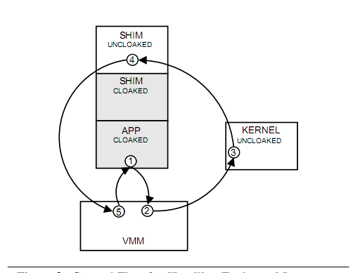
Faults and Interrupts
Figure 3. Control Flow for Handling Faults and Interrupts

Slide 22
Figure 3. Control Flow for Handling Faults and Interrupts
The fault occurs in step 1, and control is transferred to the VMM. In step 2, the VMM saves the contents of all application registers to the CTC(cloaked thread context) in the cloaked shim. The VMM then zeros out
the application’s general-purpose registers,在把权限交给kernel前，修改ip和sp寄存器的值，使它指向the uncloaked shim的地址．

Slide 23
Figure 3. Control Flow for Handling Faults and Interrupts
The kernel handles the fault as usual in step 3, and then returns to the trampoline handler in the uncloaked shim setup in step 2.
In step 4, through the hypercall into the VMM to resume cloaked execution.
In step 5, the VMM restores the registers saved in step 2, and returns control to the faulting instruction in the cloaked application.

Slide 24
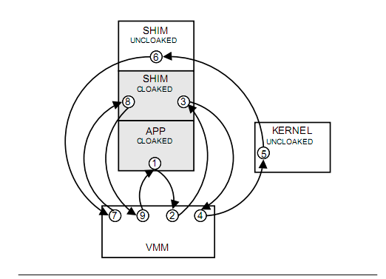
System Call Redirection
Figure 4. Control Flow for Handling System Calls

Slide 25
Figure 4. Control Flow for Handling System Calls
Step1和中断处理时一样.
Step2: The IP is set to an entry point in the cloaked shim corresponding to a system call dispatch handler; similarly, the SP is set to a private stack in the cloaked shim for executing this handler. The VMM then redirects control to the dispatch handler in the cloaked shim.
Step3: the cloaked dispatch handler performs any operations required to proxy the system call on behalf of the application.

Slide 26
Figure 4. Control Flow for Handling System Calls
In step 4:The return IP and SP are modiﬁed to point to addresses in the uncloaked shim. Finally, the VMM transfers control to the kernel.
Step3-to-step9:返回(略)

Slide 27
Managing Protection Metadata
Overshadow introduces OS-neutral abstractions for cloaking both persistent and non-persistent resources, such as ﬁles and private memory regions. For each resource, protection metadata, such as (IV,H) pairs, must be managed to enforce privacy and integrity , ordering, and freshness (to prevent rollback).

Slide 28
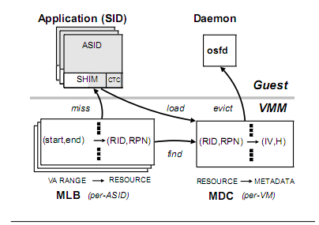
Figure 5. Protection Metadata Management
Figure 5. Protection Metadata Management

Slide 29
Figure 5. Protection Metadata Management
Figure 5 provides an overview of the components involved in metadata protection.
Questions
1. how metadata is stored and mapped to
protected objects?
2. how it is used to enforce protection?

Slide 30
question1
Each cloaked resource is associated with a unique 64-bit resource identiﬁer (RID).
Each RID has a corresponding resource metadata object (RMD)
An RMD is an ordered set of (IV,H) pairs, one per encrypted page, addressed by a 32-bit resource page number (RPN).
When a resource is mapped into memory, its RMD is loaded into the metadata cache (MDC) in the VMM

Slide 31
question1
metadata lookaside buffer(MLB) :is used to map a virtual address to a resource
(start , end) →(RID, RPN):start and end denote the virtual address range into which the resource is mapped; RID denotes the resource being mapped, and RPN denotes the ﬁrst RPN in the mapping.
unique security identiﬁer (SID) that identiﬁes an Over-shadow protection domain.
address space identiﬁer (ASID) that deﬁnes its shadow context.

Slide 32
question2
When a process accesses a cloaked page in its shadow context, its ASID and GVPN are known.
If the page is encrypted, the access will fault into the VMM , since the GVPN is not mapped into the shadow for that ASID .The VMM looks up the faulting address in the MLB, and uses
the resulting (RID, RPN) to index into the MDC and fetch the (IV,H) needed to decrypt

Slide 33
Thank you

