Slide 1

O
OPTIMA PARTNERS
DATA ANALYTICS ASSESSMENT
Video Channel Analysis: Growth, Loyalty, and Strategic Decisions
Analysis Flow
TIME ORIZONT
Q1 → Insight 1 • Q2 → Insight 2 • Q3 → Insight 3
2023 – 2025 Season's

Slide 2
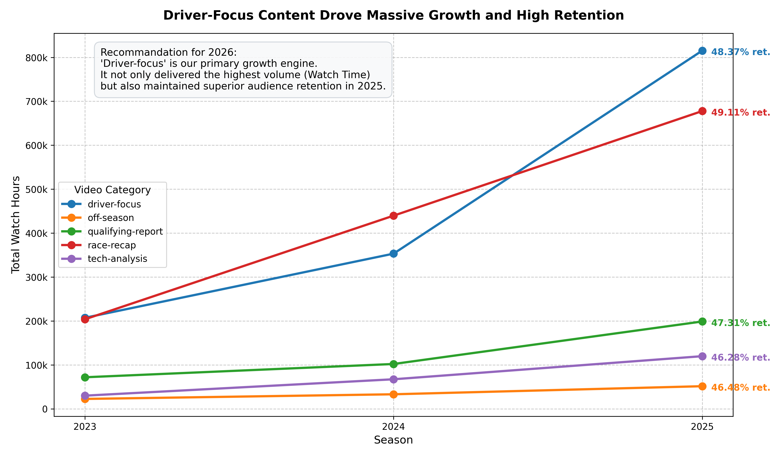
1 / 6

Slide 3
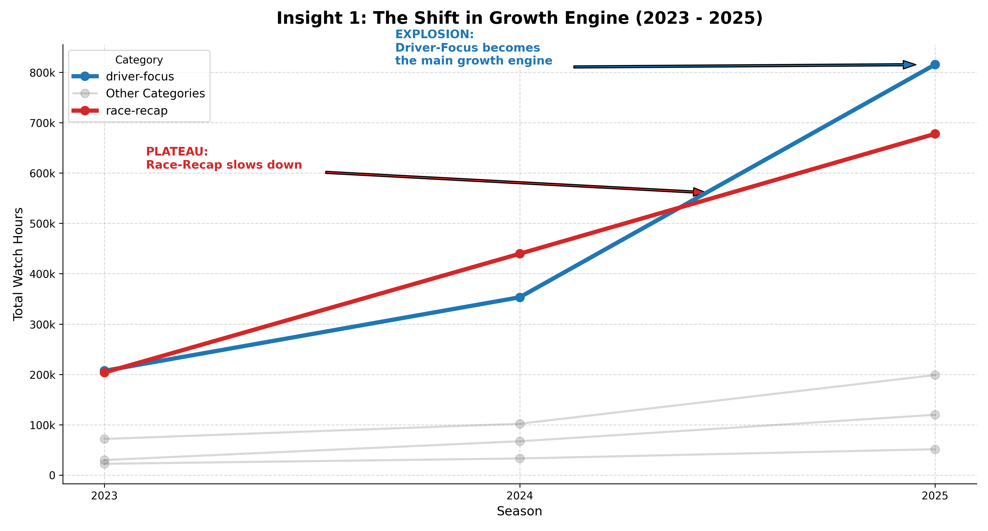
2 / 6

Slide 4
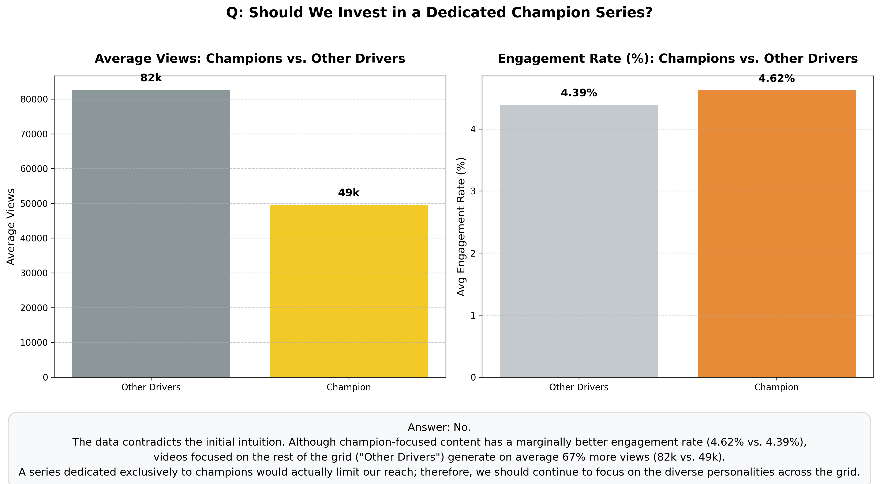
3 / 6

Slide 5
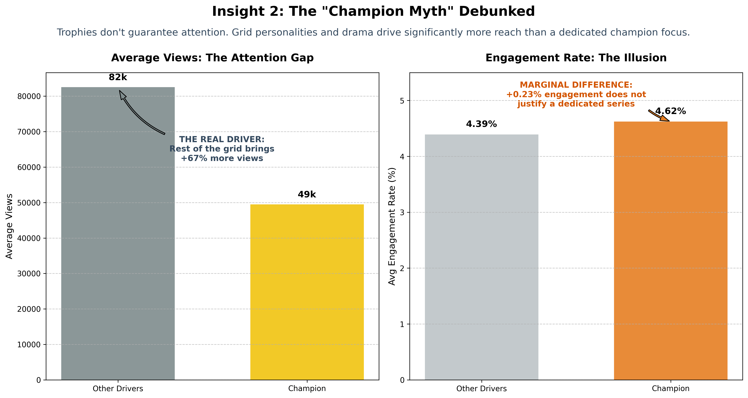
4 / 6

Slide 6
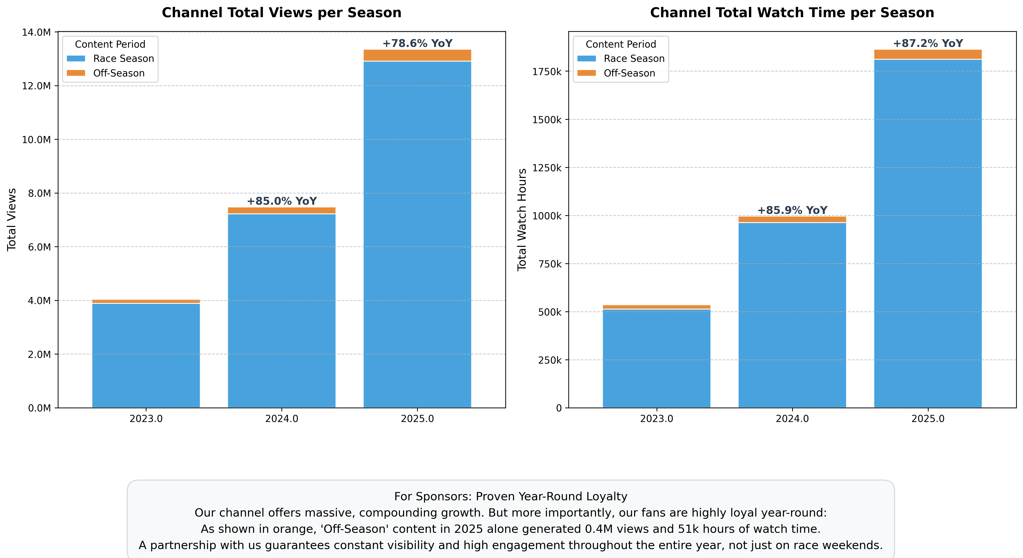
5 / 6

Slide 7
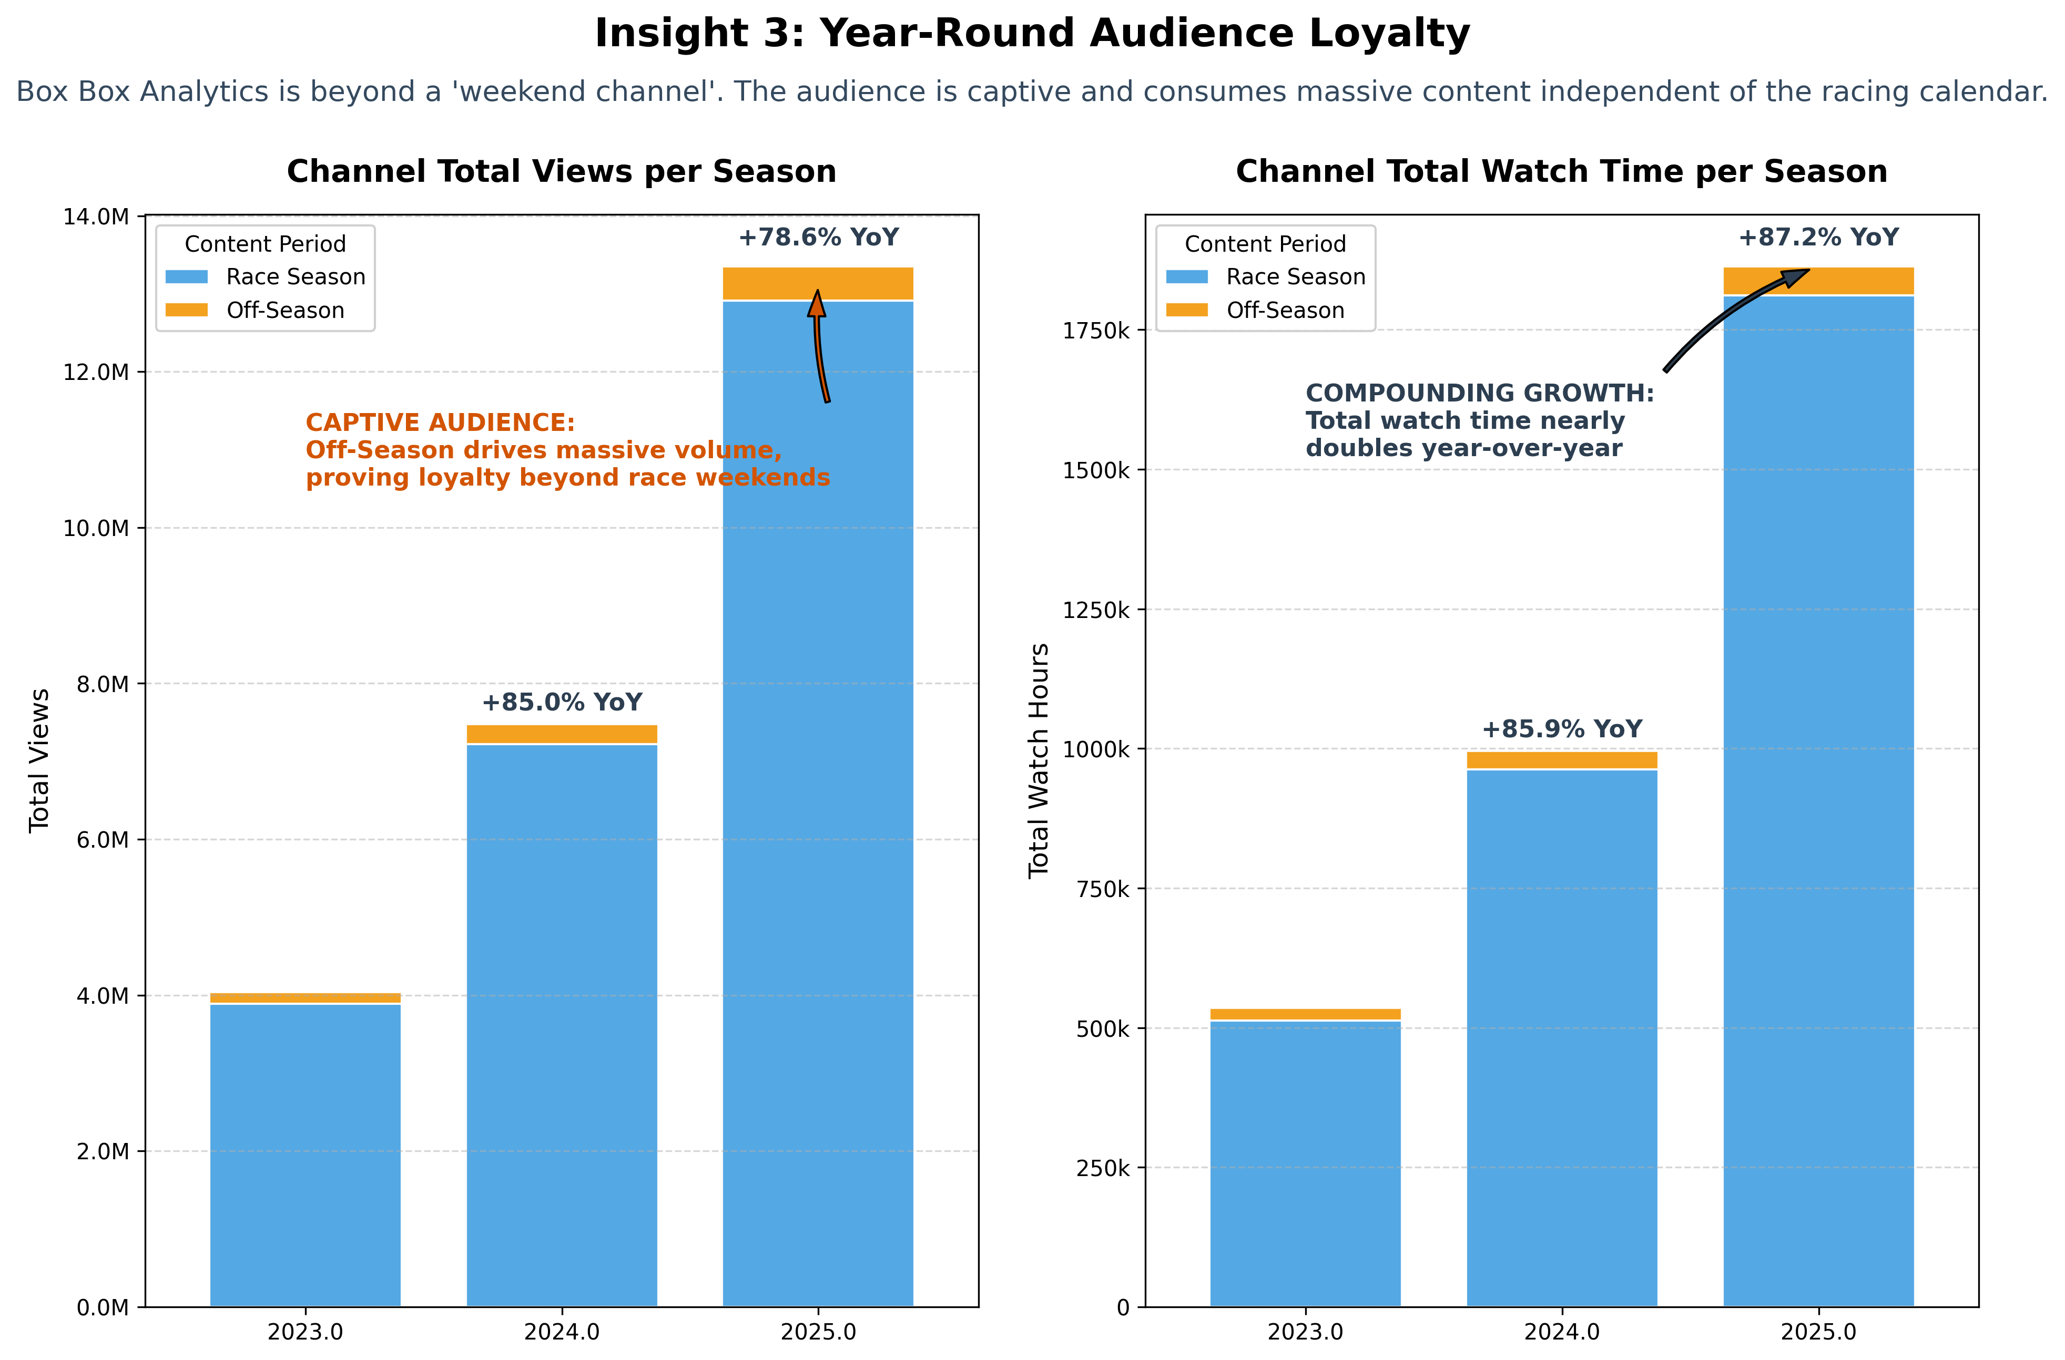
6 / 6

Slide 8
STRATEGIC SYNTHESIS
Recommendations for 2026 Content Strategy
01
02
03
Scale Driver-Focus
Grid Diversity
365 Sponsor Packages
Allocate 60%+ of production budget to profiling high-retention drivers.
Move away from exclusive champion series; prioritize midfield rivalries.
Monetize captive off-season audience at premium engagement rates.
Data-driven decisions confirm the value of scaling beyond on-track results.

Slide 9

O
OPTIMA PARTNERS
Unlocking Value Through Data & AI
Empirical insights translated into high-impact business decisions and measurable growth.
ORGANIZATION
FOCUS AREA
WEBSITE
Optima Partners
Customer & Content Decisioning
optimapartners.co.uk

